Slide 1
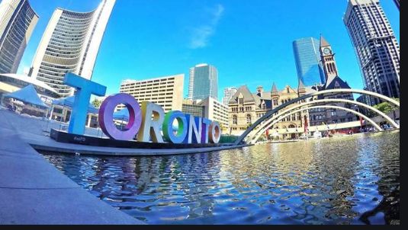
EVALUATING BUSINESS OPPORTUNITIES AROUND UNIVERSITY OF TORONTO-DOWNTOWN CAMPUS
Battle of Neighborhoods –Applied Data Science Capstone

Slide 2
INTRODUCTION
Downtown Toronto has a lot to offer to its residents and travelers all around the world as a city and diverse population Toronto, Ontario, Canada.
The clusters of corporate parks offer a variety of options for leisure spending .
Our target location, University of Toronto – St Georgia campus is at the heart of Downtown Toronto, though separated from the corporate setup.
The project aims at exploring business opportunities in o the surrounding neighborhoods of the campus, mainly focusing overall on recreation and dining, and not particularly on essential services and premium essential services.
Given that a lot of options for recreation and leisure spending exists further downtown, the analysis has to be specific towards the location, limiting it to the immediate vicinity of campus. The opportunities would be compared with those existing in the surrounding neighborhood

Slide 3
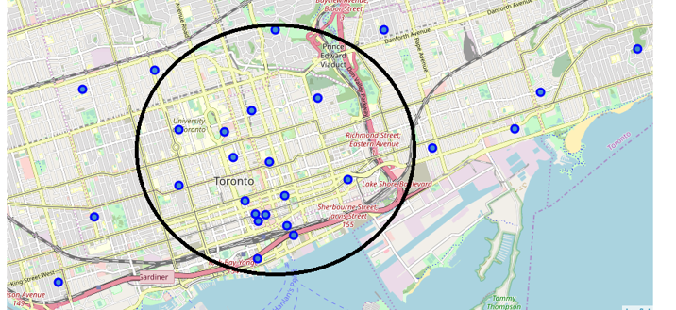
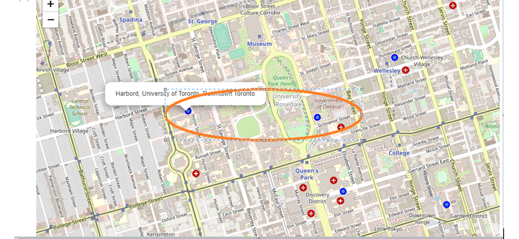
University of Toronto - Location
Our target location, University of Toronto – St Georgia campus is at the heart of Downtown Toronto, though separated from the corporate setup.
Visualizing the data with neighborhood markers on map of Toronto with folium library package, we observe that two immediate neighborhoods exist in the vicinity of campus, i.e Harbord, University of Toronto and Queen’s park as encircled in the map in red, Fig.1.
There are a total of 19 different neighborhoods in Downtown Toronto as shown in Fig 2.

Slide 4
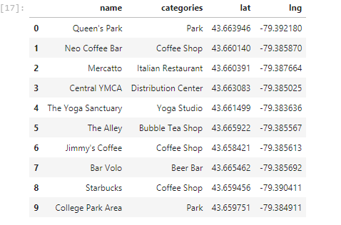
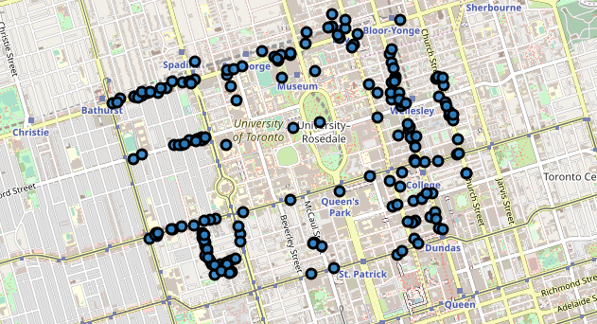
Retrieving and analyzing Top Venues near Campus
A total of 189 different venues with 90 categories are retrieved from Foursquare API database, first 10 rows of which is shown in the table below
The retrieved location of recreational and food outlets around the university campus in the immediate vicinity can be visualized by the following map figure.

Slide 5
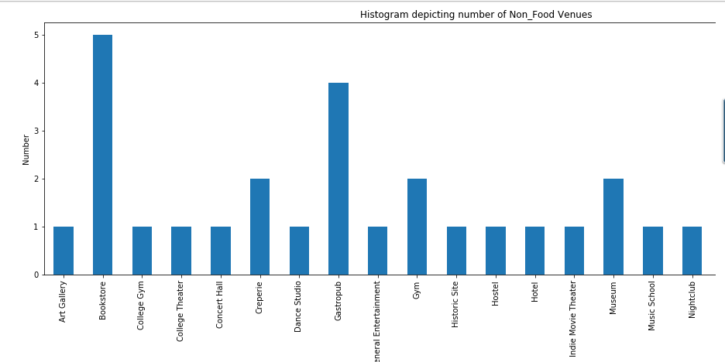
Retrieving and analyzing Top Venues near Campus
In the non food data, we concentrate only upon commercial recreational and shopping outlets, removing essential services and utilities.

Slide 6
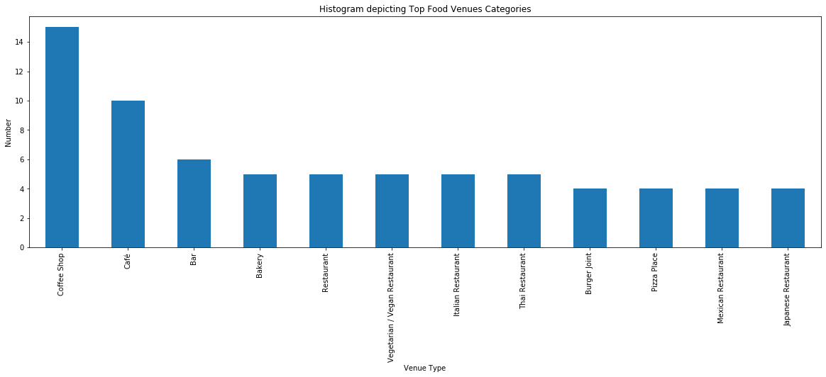
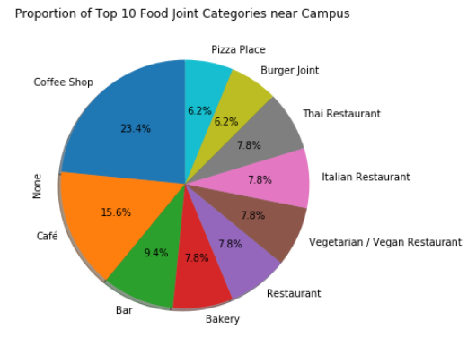
Retrieving and analyzing Top Venues near Campus

Slide 7
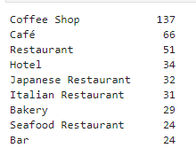
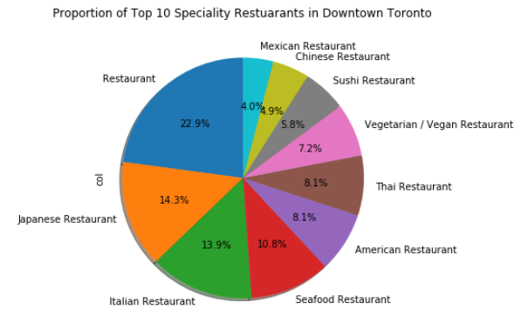
Retrieving Top Venues from around Downtown Toronto –
Next we analyze all the other neighborhoods except Harbord and Queens Park in downtown Toronto. We pull out 208 unique categories of venues, much of which overlap with those found in vicinity of campus.
Given the abundance of Coffee Shops, Bars, Bakeries and general fast food joints we next explore specialty restaurants in vicinity of campus and compare it with those in whole of downtown Toronto.

Slide 8
University of Toronto - Demographics
Some of the publicly released student data by U T for year 2017 is analyzed in this report. Of the 65,051 full-time undergraduate students last year, 55.7 per cent identified as female, 43.7 per cent as male, 22 students as another gender identity, and 341 students’ gender identities remained undisclosed.
Part-time undergraduates were 61 per cent female in 2007. The 2017 data shows a slight majority male student population among part-time undergraduates.
An important observation is that an overwhelming amount of international students at U of T are from China, both graduate and undergraduate students, with other countries making up a small percentage in comparison. With 65.1 per cent of the undergraduate international student enrolment, the 10,463 Chinese international students made up 14.6 per cent of U of T’s total undergraduate population in 2017.
Other significant amount of students are form India making upto 11.4 percent of the student population.

Slide 9
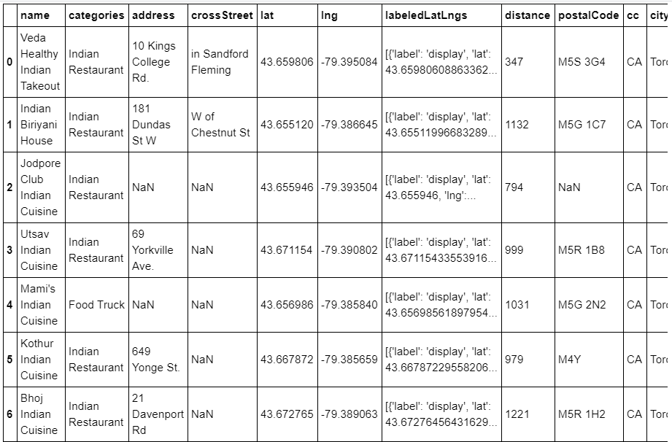
Retrieving Top Indian Restaurants Data from FourSquare -
With search query ‘Indian’ we retrieve top Indian Restaurants from Foursquare API.Following data was received as shown in table.
When searched for ratings of top 3 restaurants, the result was this restaurant hasn’t been rated yet.

Slide 10
DISCUSSION
First analyzing the retrieved location of popular non food outlets around the university campus in the immediate vicinity, we see that there’s a plethora of options for recreation, new skill development and sports and fitness. Relatively fewer number of theaters exist, given the capacity of students of students and University of Toronto.
For popular food venues around campus, there are abundant conventional spots like coffee shops and cafes(23), Bar and pubs(10) and popular fast and convenience food joints of Burger and Pizza(8) along with many bakeries.
Given the diversity of international students in UT, we focus out attention to specialty restaurants. While we can see a number of popular Italian(4) ,Thai(4),Mexican(3) Restaurants, Chinese and Indian restaurants are nowhere to be seen in the entire histogram. There is just one Chinese and Indian Restaurant.
Chinese and Indian students making up for almost a quarter of student population at the UT’s total strength of 62k students, we focus our attention to their specialty restaurants. Thus we explore all neighborhoods in Downtown. As seen in Fig5, Chinese make upto just 5% of top food outlets while Indian is nowhere in picture.
Retrieving top 5 Indian outlets in Downtown Toronto, we observe that even the top outlets don’t have enough footfalls and haven’t been user rated. Biryani is the most popular Indian Cuisine dish and it ought to be more prominent and highlighted in Specialty Restaurant Clusters.

Slide 11
CONCLUSIONS
As discussed above, opening an Indian Restaurant outlet is a feasible business opportunity given the absolute lack of good outlets in Downtown Toronto and with big chunk of International students in UT being from India.
Abundant Indian population would ensure minimum sales requirements and traffic would be fulfilled positively, so it’s a completely safe venture.
Apart from that, with growing craze for Indian cuisine worldwide, the large working population of artists, young professional, aristocrats and beurocrats would love to indulge in authentic Indian cuisine.

