Slide 1
🫁 Respiratory Symptom Diagnosis Portal
Contributors: [Your Name/Team] Course: DBMS Project

Slide 2
🚀 Project Overview
Objective: A robust application to collect patient clinical encounters, respiratory symptoms, and relevant medical history to generate a theoretical disease probability score.
Key Features: - Patient Registration: Capture demographics. - Encounter Processing: Track symptoms, cough characteristics, breath sounds, and environmental exposures. - Diagnostic Engine: Calculates probability score and risk level. - Past Reports Querying: Aggregates stored diagnoses for review.

Slide 3
🏗️ System Architecture
Frontend Interface (UI): Built with Streamlit (Python).
Backend Service: Serves as the middleware (backend_service.py), generating UUIDs, orchestrating data linkage, and running the diagnostic engine logic.
Database: MongoDB (database.py) using pymongo. A NoSQL document-based structure tailored for fast, decoupled medical records.

Slide 4
🗄️ Database Schema & Collections
The data is normalized logically but stored in MongoDB as interconnected collections:
patients
PatientID (Primary Key), Name, DOB, Gender
clinical_encounters
EncounterID (PK), PatientID (FK), EncounterDate, EncounterType
respiratory_symptoms
SymptomID (PK), EncounterID (FK), SymptomType
cough_characteristics
CharacteristicID (PK), EncounterID (FK), CoughType
breath_sounds
SoundID (PK), EncounterID (FK), Location, SoundType, Intensity, Pitch
smoking_histories (Upsert behavior per patient)
HistoryID (PK), PatientID (FK), SmokingStatus, PacksPerDay, YearsSmoked, QuitDate
environmental_exposures (Upsert behavior per patient)
PatientID (PK/FK), ExposureType, Duration, Setting
disease_probability_scores
ScoreID (PK), EncounterID (FK), TargetDisease, ProbabilityScore, RiskLevel, AlgorithmVersion

Slide 5
🔗 Entity Relationship (How Tables Connect)
The database utilizes clear structural links through ID mapping:
1. The Core Anchor: patients Table - Acts as the main anchor for all records. - Primary Key: PatientID
2. The Event Hub: clinical_encounters Table - Links to the Patient. Every time someone visits, a new Encounter is born. - Primary Key: EncounterID - Foreign Key: PatientID (Links back to patients table).
3. Encounter Details: The 1-to-Many Tables - Symptoms, Coughs, and Breath sounds are measured per visit. - They do not map to the patient directly, they map to the specific encounter. - Foreign Key: EncounterID (Links back to clinical_encounters).
4. Patient History: The 1-to-1 Tables - Smoking History & Environmental Exposures are unique to the person, not the visit. - Foreign Key: PatientID (Links back to patients).
5. The Output: disease_probability_scores Table - The diagnostic engine’s result. - Foreign Key: EncounterID (Links back to clinical_encounters).

Slide 6
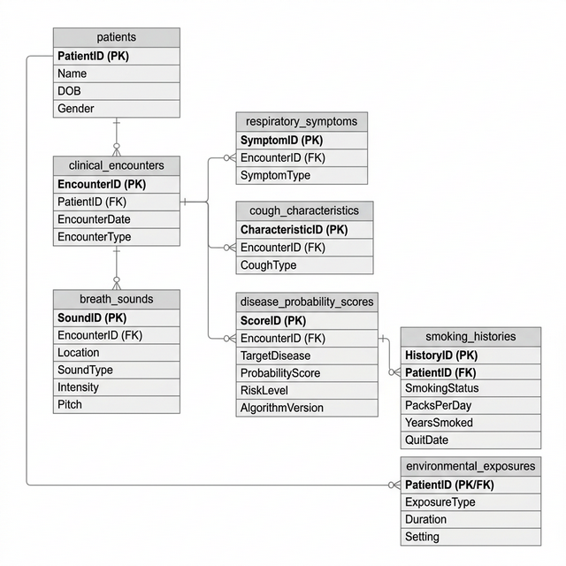
🔄 ER Diagram Summary
Database Entity Relationship Diagram

Slide 7
🔄 Workflow: New Diagnosis
User Input (app.py): User enters details in Streams tabs (Patient Info, Symptoms, Breath Sounds, History).
Data Orchestration (backend_service.py):
Assigns unique UUIDs (PatientID, EncounterID).
Propagates these foreign keys to related dataset dictionaries (e.g., Encounter ID sent to symptom, cough, and breath data).
Database Insertion (database.py):
insert_patient() (Upserts via PatientID to prevent duplication)
insert_encounter(), insert_symptom(), etc.
Updates one-to-one records like smoking history & exposures.
Diagnostic Engine Call: calculate_disease_probability() processes all details.
Result Storage: Engine result is pushed to disease_probability_scores.
UI Update: Probability score and risk levels are dynamically shown to the User.

Slide 8
📊 Workflow: Querying Past Reports
Fetching history relies heavily on MongoDB Aggregation Pipelines.
User Request: Navigates to “Past Reports” page in the UI.
Backend Execution (get_all_reports()):
Hits disease_probability_scores collection.
$lookup against clinical_encounters using EncounterID.
$unwind encounter array to flatten documents.
$lookup against patients using PatientID (found in the unwound encounter).
$unwind patient array.
$project key data elements (Score, Disease, Date, Patient Name).
$sort by date descending.
Display: Converted to a Pandas DataFrame and rendered as a tabular breakdown and Detailed Expanders in Streamlit.

