Slide 1
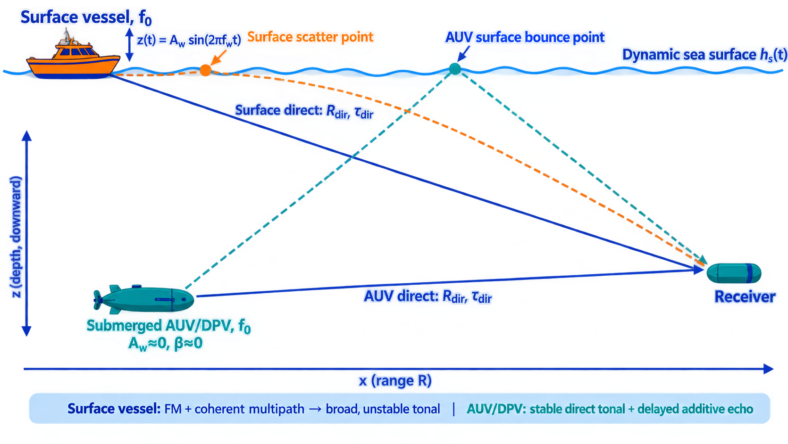

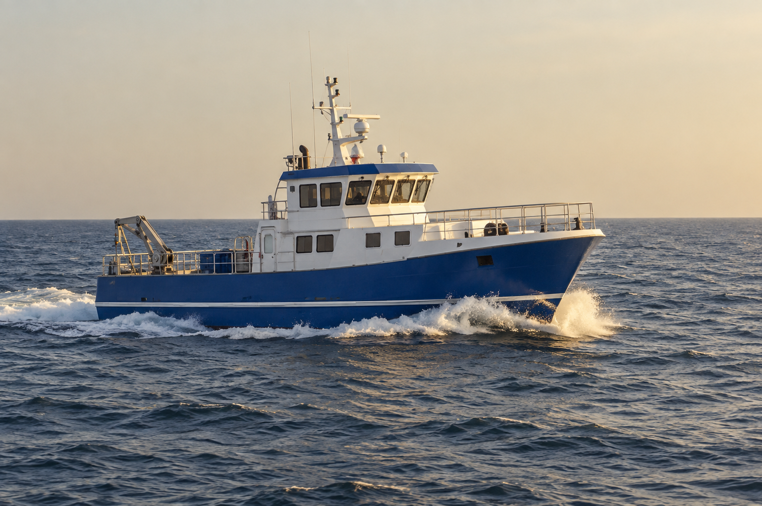
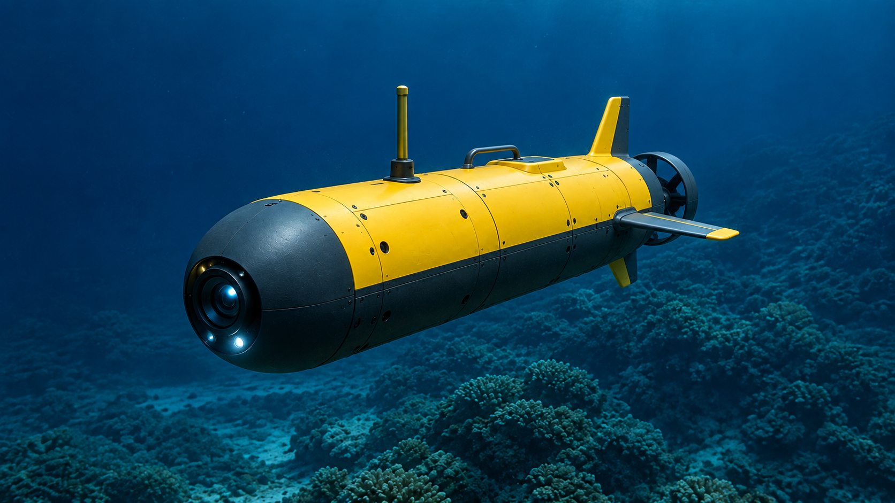
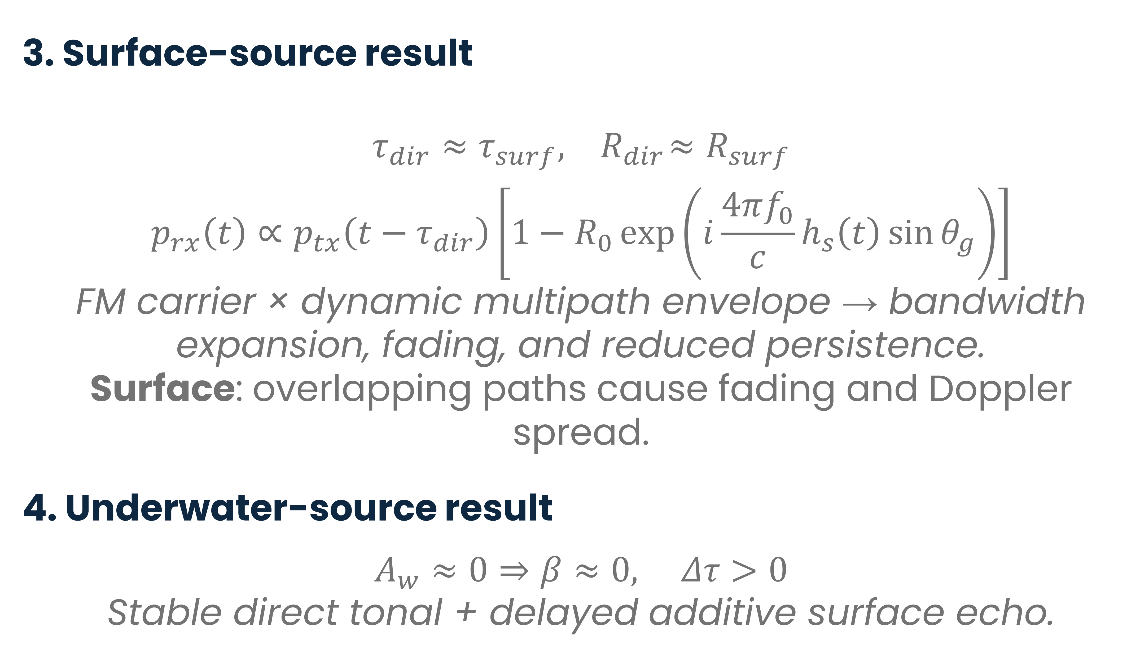
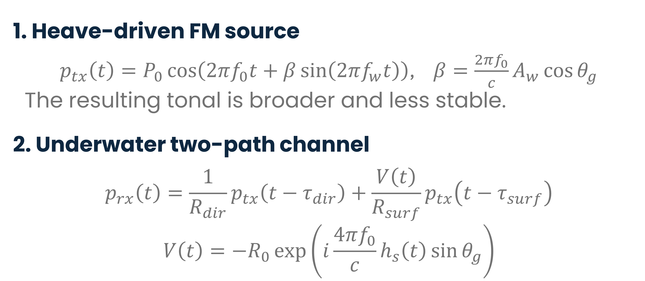
Physics-Informed Machine Learning Vessel Depth Classification
Roy Michael - Department of Marine Technologies, Haifa University
Background
Passive Acoustic Monitoring can distinguish surface and submerged sources using the effect of wave coupling on mechanical tonal.
Physical Model
3. Surface-source result
$$τ_{dir}≈τ_{surf},{ R}_{dir}{≈R}_{surf}$$
$$p_{rx}\left(t\right)∝p_{tx}\left(t−τ_{dir}\right)\left[1−R_{0}\exp\left(i\frac{4πf_{0}}{c}h_{s}\left(t\right){\sin{θ}}_{g}\right)\right]$$
FM carrier × dynamic multipath envelope → bandwidth expansion, fading, and reduced persistence.
Surface: overlapping paths cause fading and Doppler spread.
4. Underwater-source result
$$A_{w}≈0⇒β≈0, Δτ>0$$
Stable direct tonal + delayed additive surface echo.
1. Heave-driven FM source
$p_{tx}\left(t\right)=P_{0}\cos\left(2πf_{0}t+β\sin\left(2πf_{w}t\right)\right)$, $β=\frac{2πf_{0}}{c}A_{w}{\cos{θ}}_{g}$
The resulting tonal is broader and less stable.
2. Underwater two-path channel
$$p_{rx}\left(t\right)=\frac{1}{R_{dir}}p_{tx}\left(t−τ_{dir}\right)+\frac{V\left(t\right)}{R_{surf}}p_{tx}\left(t−τ_{surf}\right)$$
$$V\left(t\right)=−R_{0}\exp\left(i\frac{4πf_{0}}{c}h_{s}\left(t\right){\sin{θ}}_{g}\right)$$
The model predicts broader, less persistent energy for the surface motorboat and narrow, stable tonal bands for submerged DPVs.

Slide 2
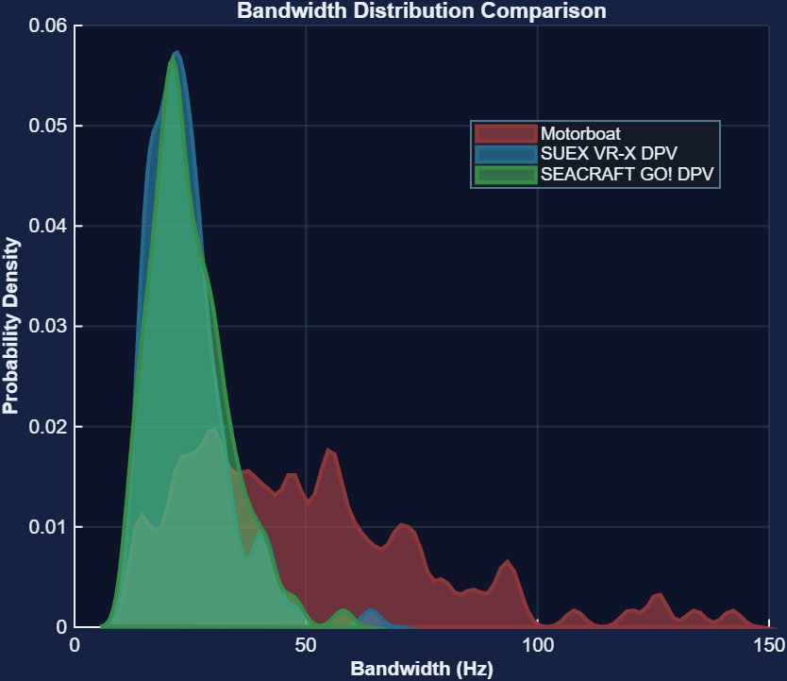
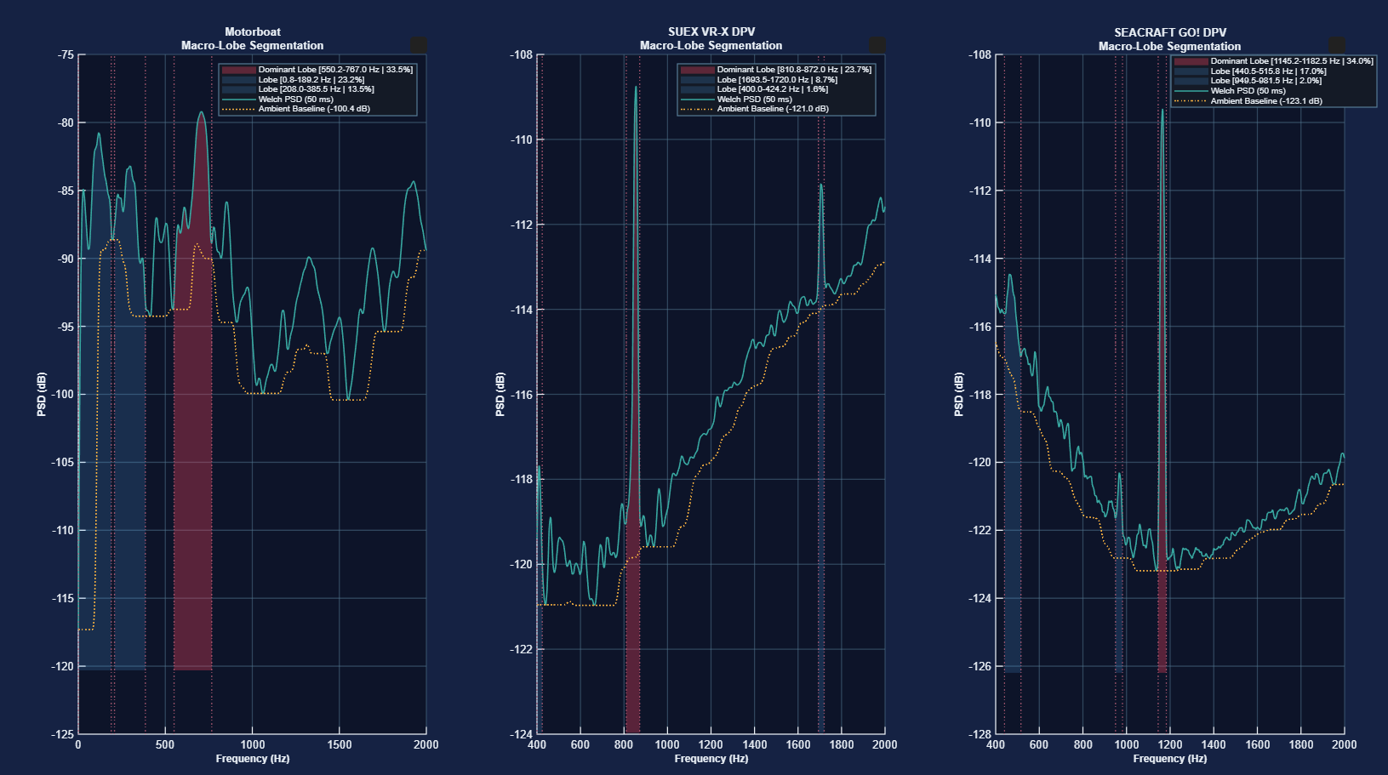
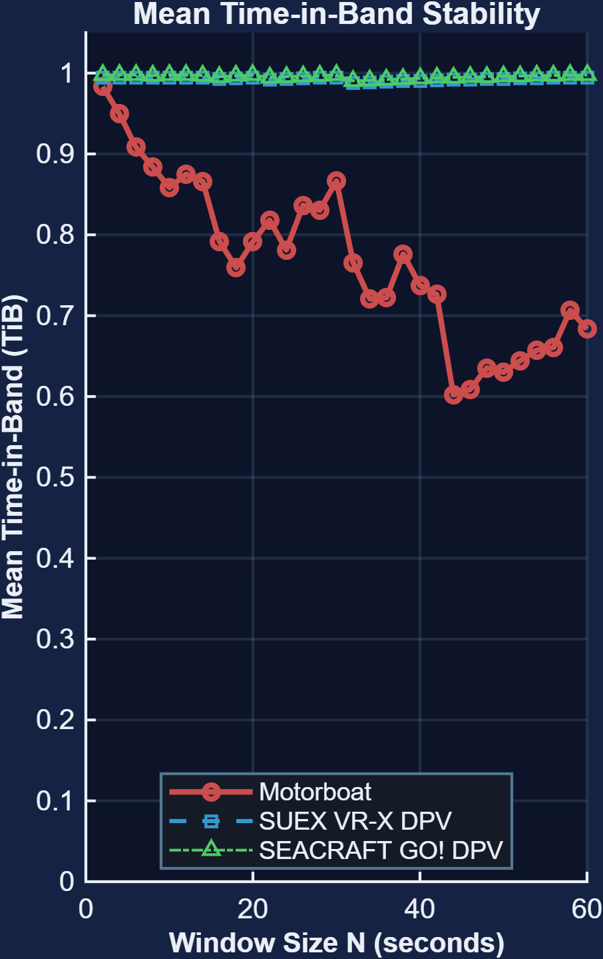
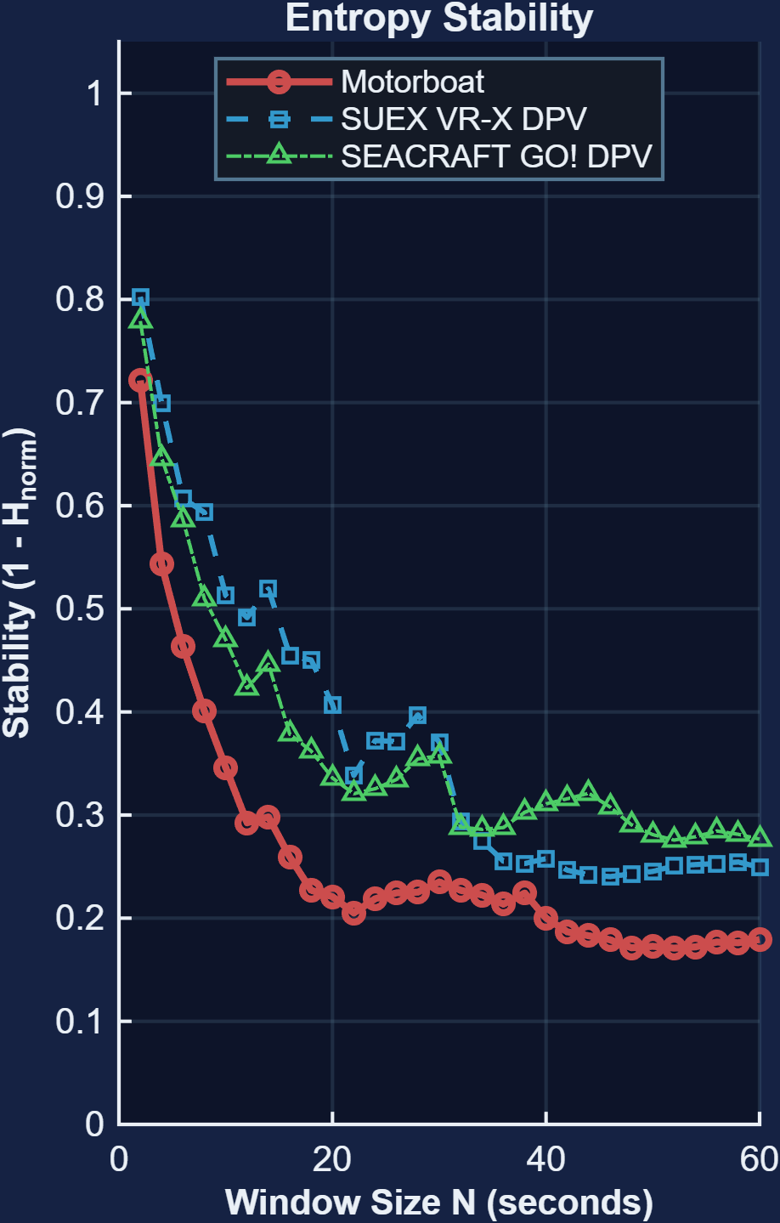
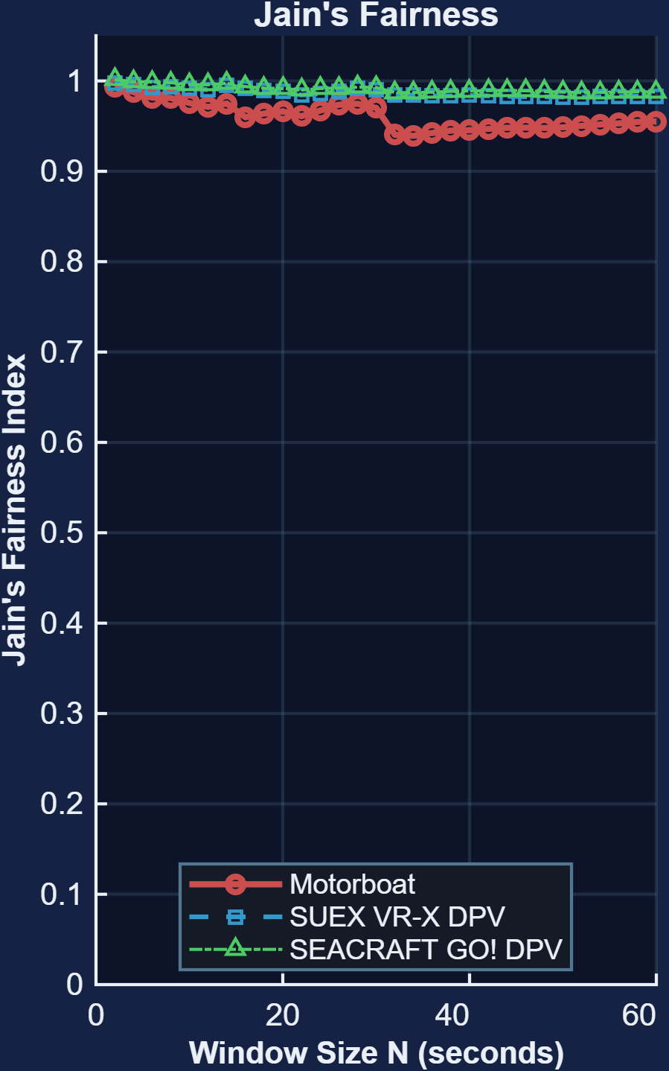
Methodology and Results
Bandwidth Distribution
Methodology
Signal Ingestion
Estimation Matrix
Feature Extraction
Classification
Results
Spectral Fingerprints of Vessel Depth
Dominant spectral peaks
Temporal Stability Separates Depth
Bandwidth separates source depth
Surface motorboat: 136 Hz
Submerged DPVs: 18–26 Hz
Broad spectral distribution vs. narrow tonal bands
Time-in-Band ± 10Hz
Shannon Entropy stability
Jain’s fairness
Submerged DPV tonal bands persist across longer windows; Surface motorboat stability decreases.

Slide 3
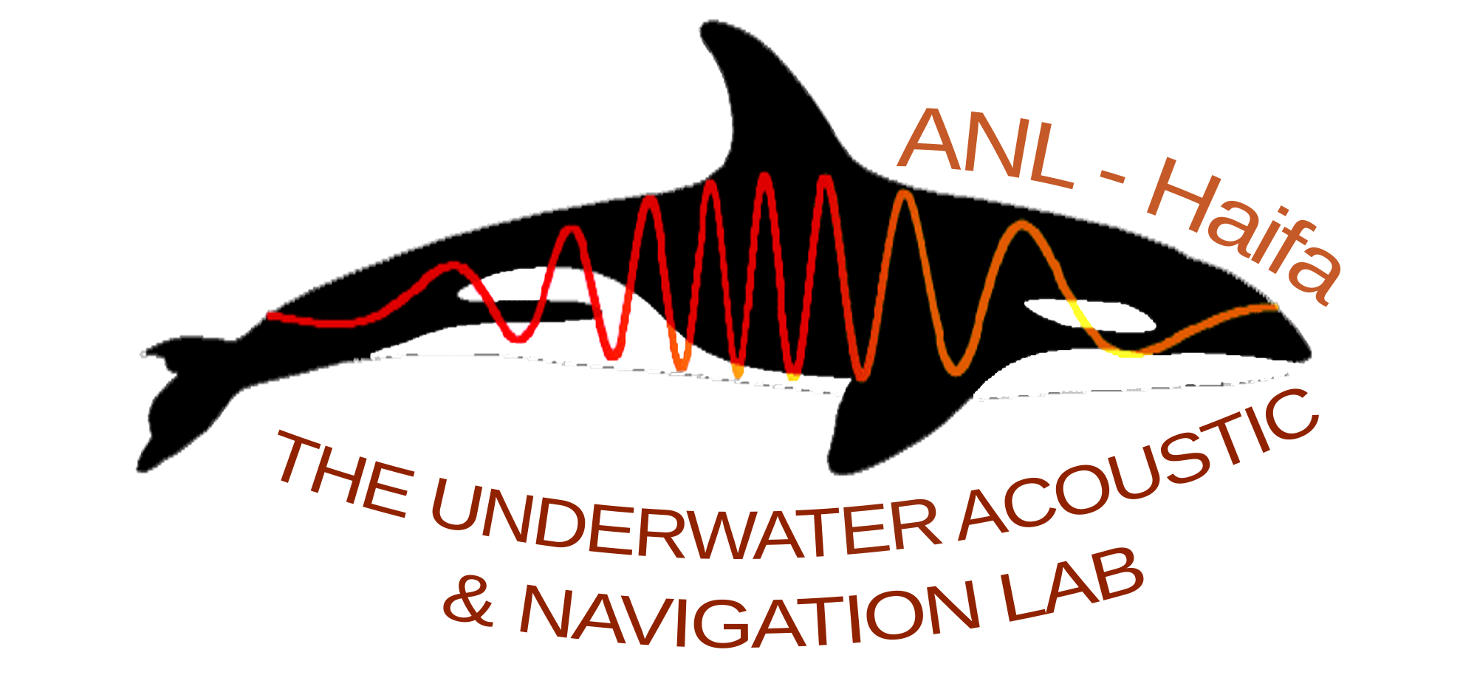

Conclusion and Future Work
Takeaway
Spectral bandwidth and temporal persistence provide complementary, physics-informed cues for distinguishing surface and submerged vessels.
Next steps
Validate across more vessel types, operating conditions, ranges, and environments.
Integrate the features into an ML classifier and real-time detector.
Submerged DPV tonal bands persist across longer windows; Surface motorboat stability decreases.
Authors
Roy Michael - Department of Marine Technologies, Haifa University
Prof. Roee Diamant - Department of Marine Technologies, Haifa University

