Slide 1
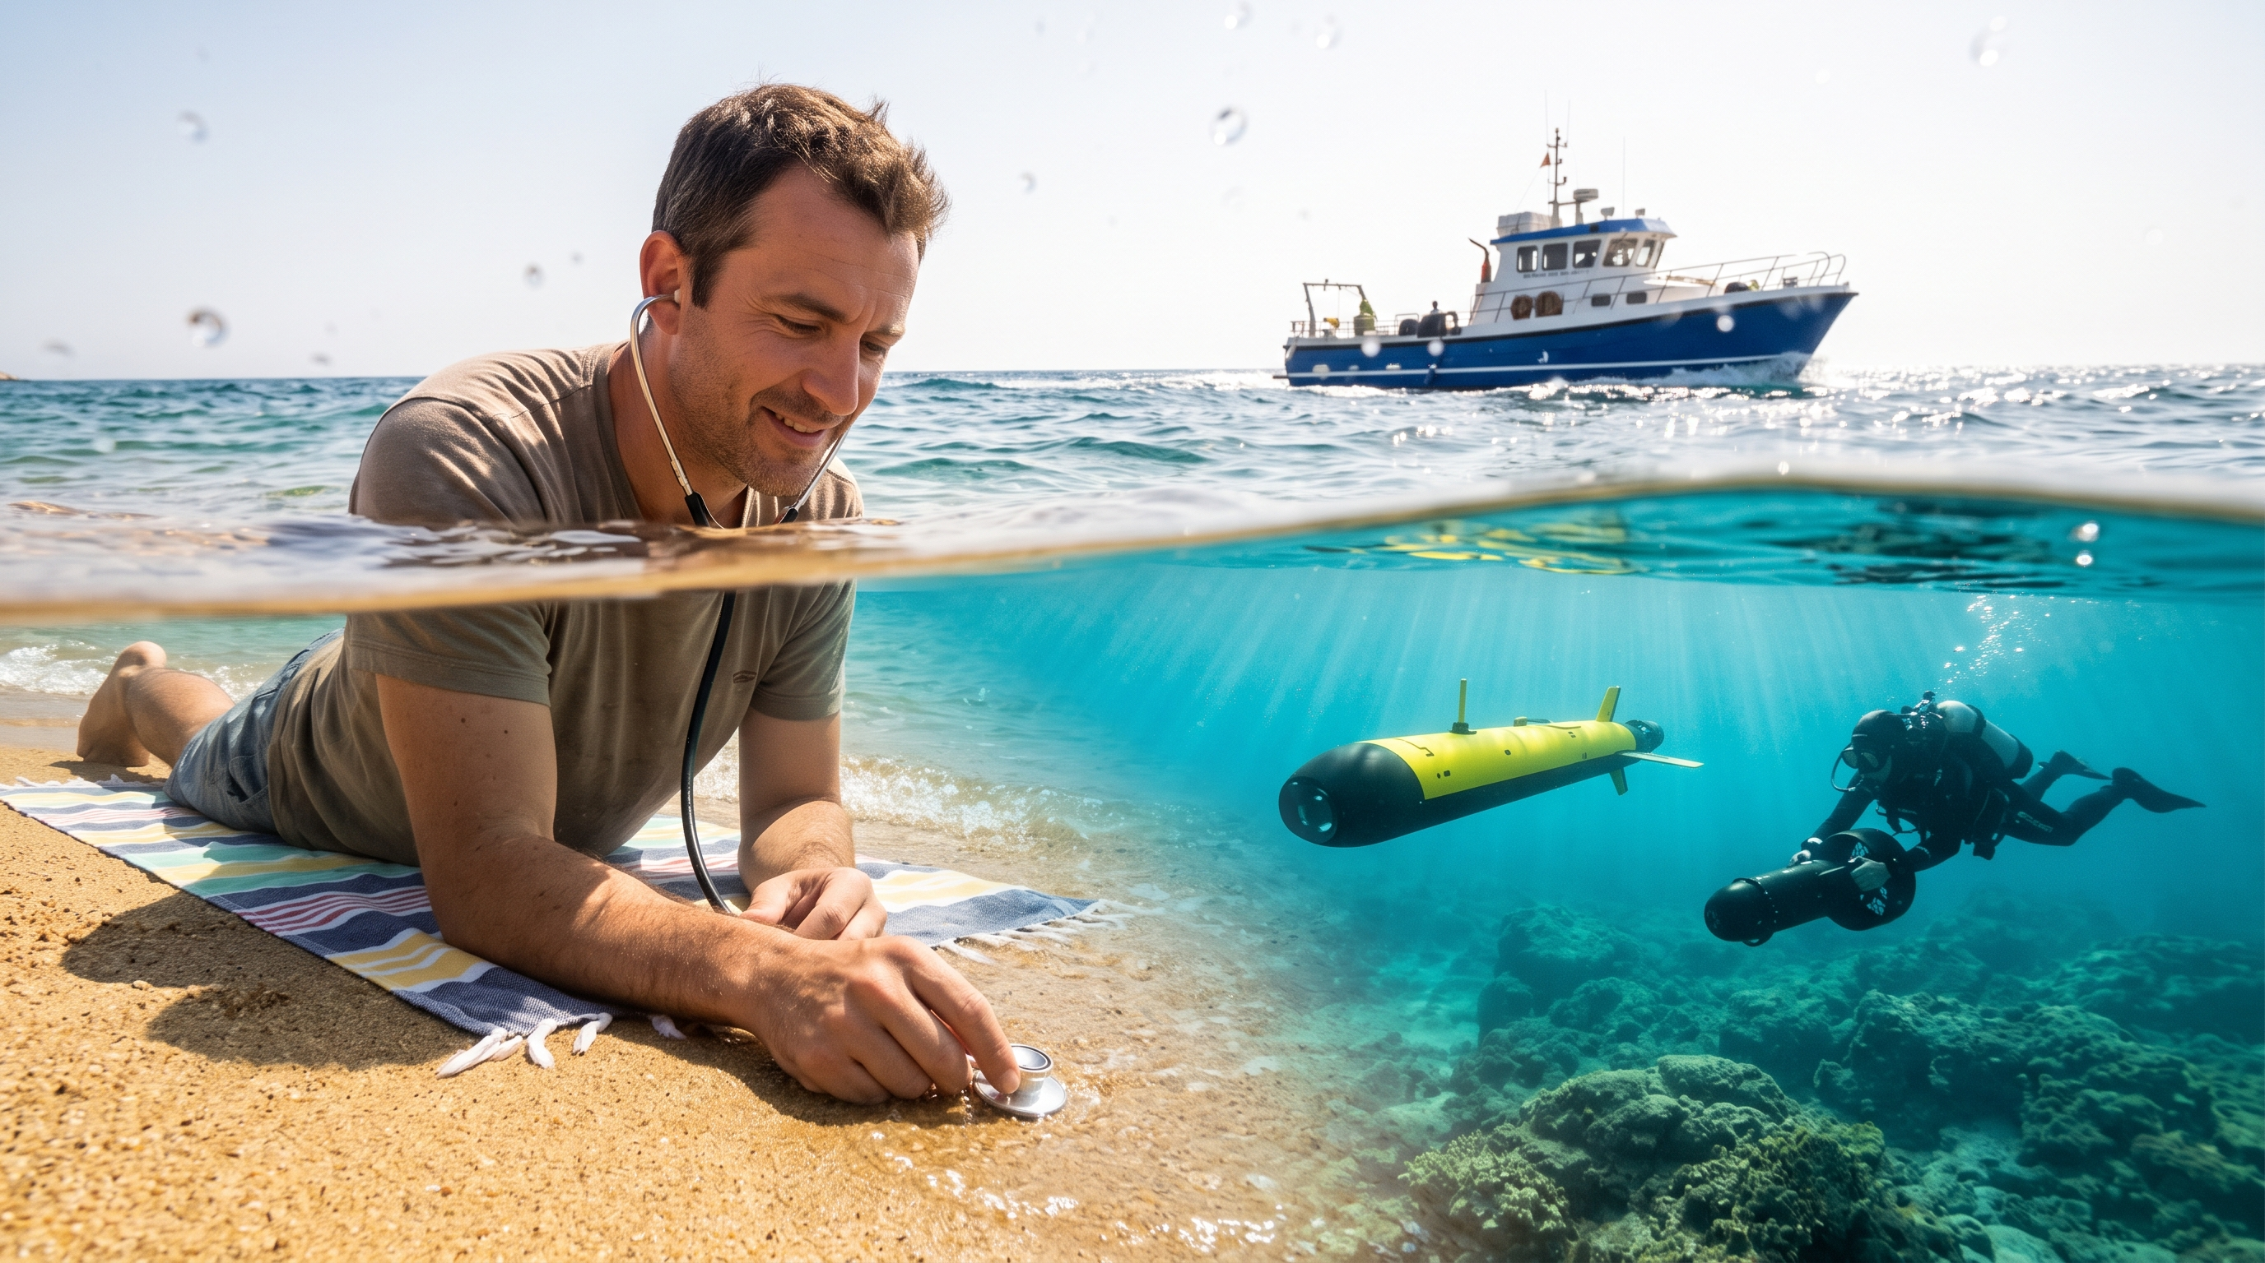
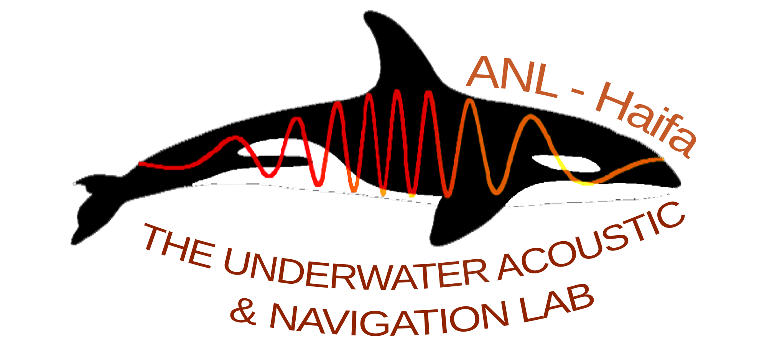

Physics Informed Machine Learning Vessel Depth Classification
The Acoustic Environment: Sound is the primary medium for marine sensing.
The Core Challenge: Distinguishing whether an acoustic source is floating or operating underwater using a passive hydrophone.
The Approach: Leveraging physics-informed machine learning
Roy Michael
Notes:
We’ve all been there: sitting on our private island, throwing a hydrophone in the ocean and listening to the ambient sounds.
When suddenly, you hear a distant noise, and you're not sure if it's your new yacht being delivered or James Bond arriving underwater to challenge your security system.
Hi everyone, my name is Roy and I am from the Haifa University, and I decided to tackle this issue before buying my first island.
Jokes aside, sound is the best way to “see” underwater.
We wanted to know if we can see not only where vessels are but also how deep they are.
We did this using a physics-based model of sound propagation.
And if we do a good job and get clear acoustic features, we can use machine learning model to automate this process.

Slide 2
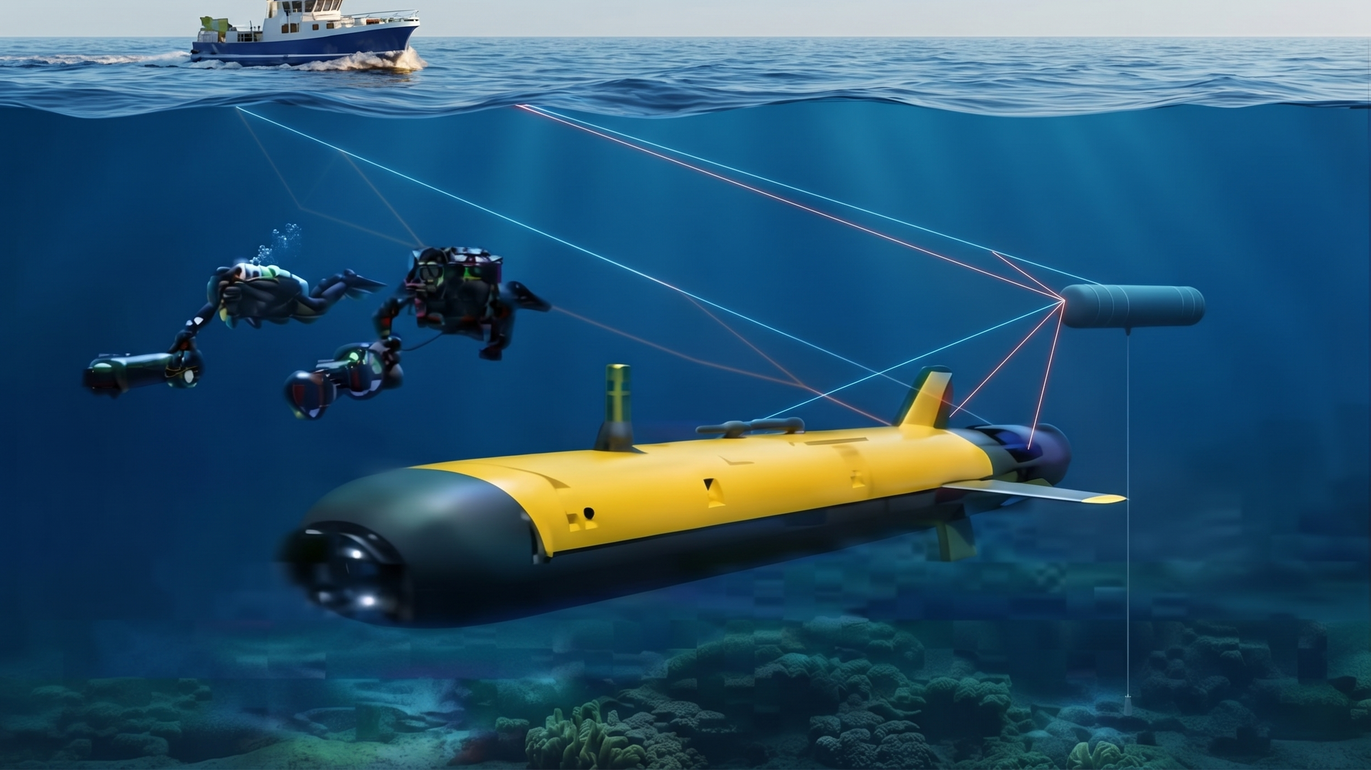
The Physical Model (or Why Waves Make Surface Vessels Sing Off-Key)
Surface Alteration: Surface wave motion alters source frequencies and creates interfering reflections.
Surface Signal Behavior: Broader spectral distributions, Doppler expansion, signal fading, and reduced persistency.
Submerged Signal Behavior: Stable direct tonal band accompanied by a cleaner, delayed surface echo.
Notes:
So, how can we tell vessels apart?
The secret lies in how the ocean surface alters sounds.
Think about it this way:
Sounds from a boat on the water are like riding a roller-coaster, the sound of your screams goes up and down and bounces everywhere.
An underwater vessel is like singing in a professional studio: the sound is pure and steady.

Slide 3
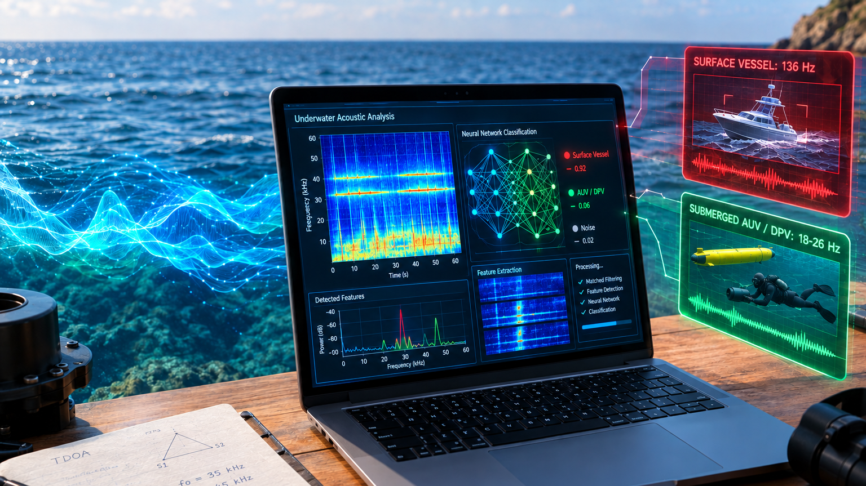
From Raw Sound to Smart AI Classification
Spectral Bandwidth Separation: Surface vessels average 136 Hz in bandwidth, submerged vessels maintain narrow bands of 18–26 Hz.
Temporal Persistence Metrics: Clear differences in persistency measured over varying conditions.
Takeaway & Impact: Robust features were extracted, allowing for real-time ML classification.
Notes:
Well, we took a few boats and underwater scooters and threw them in the water and analyzed the data.
And indeed, we found a difference between the two:
The surface vessels had a broad bandwidth with significant variances.
The underwater vessels showed a narrow bandwidth, maintaining stability in various conditions.
Now that we have clear acoustic features, we can feed them into a machine learning model, to give us a 3D view of ocean traffic.
And I can finally buy my island!
Thank you!

