Slide 1
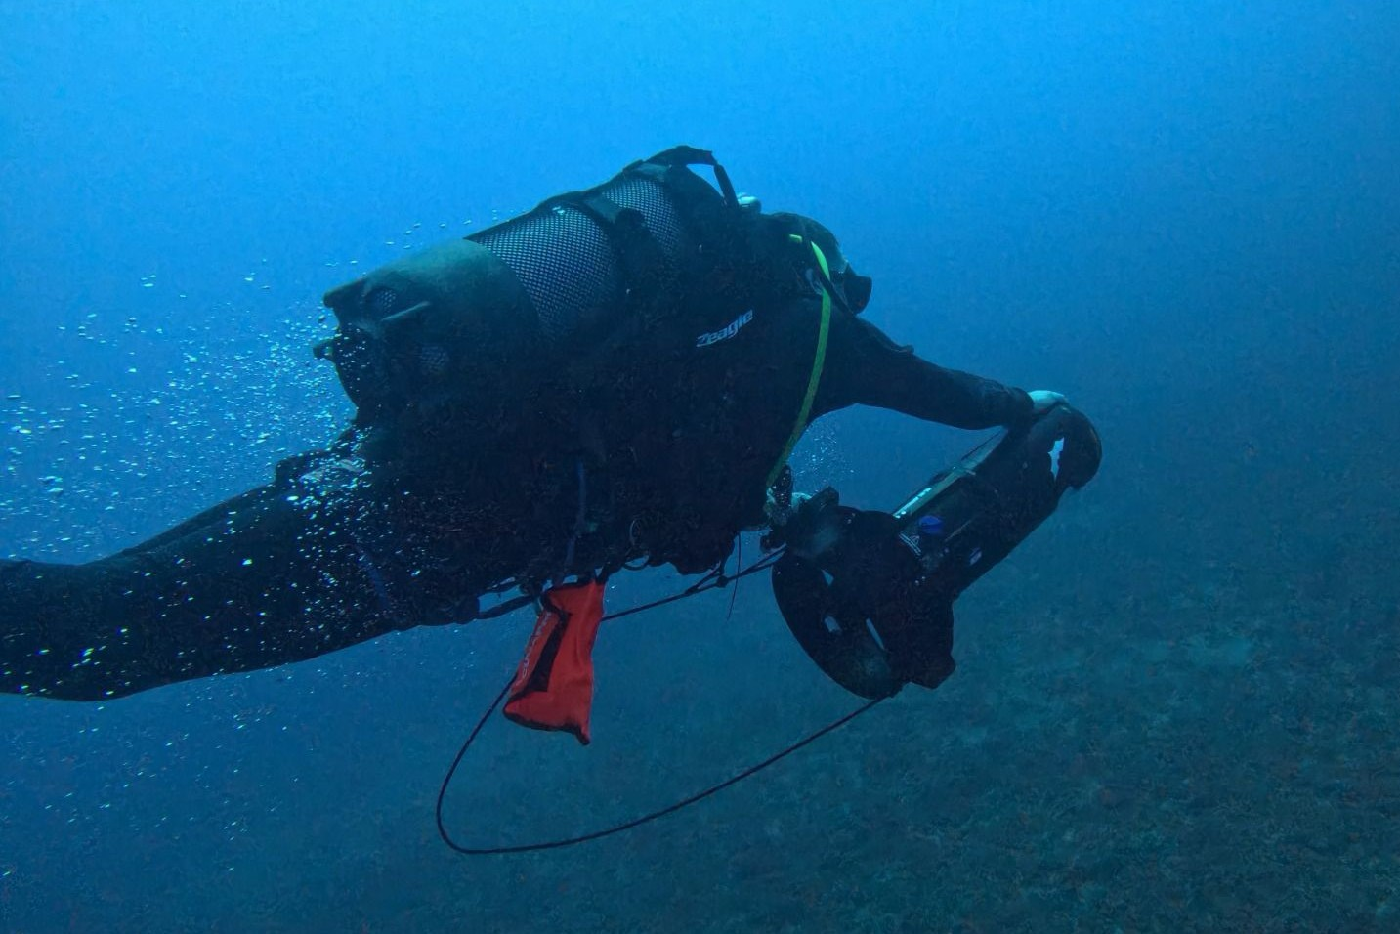
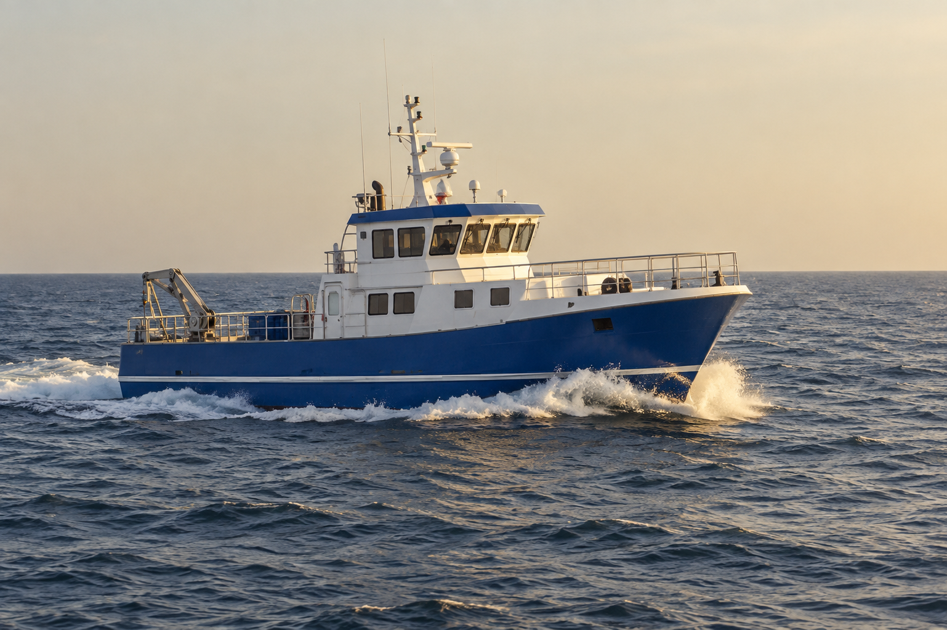
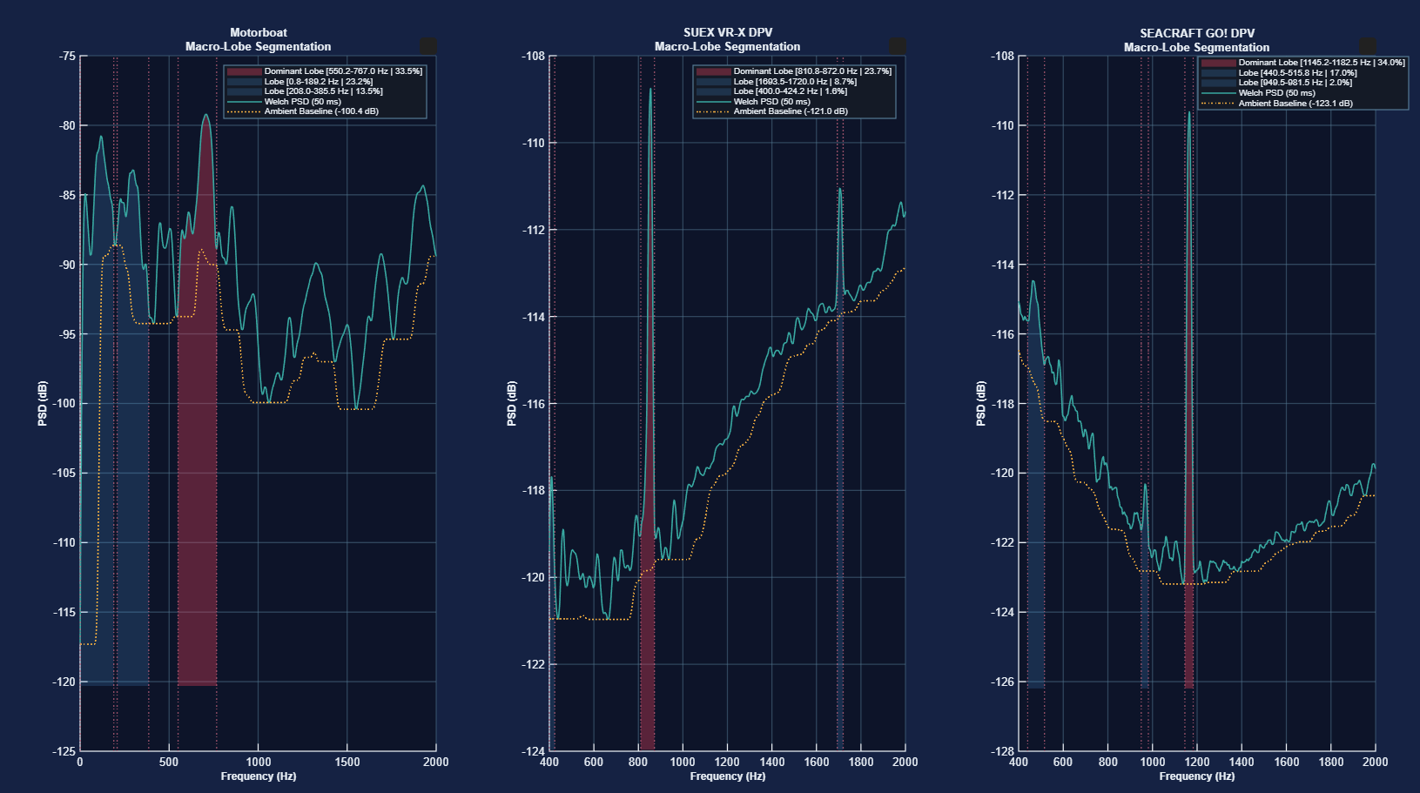
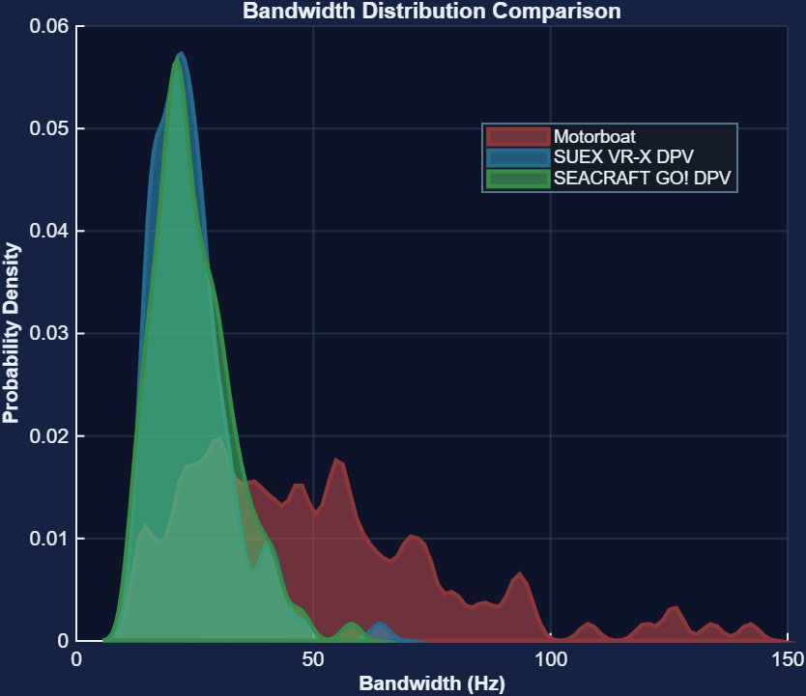
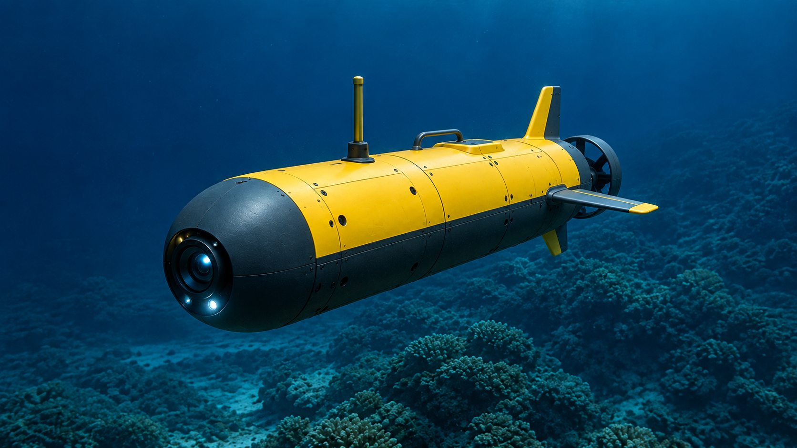
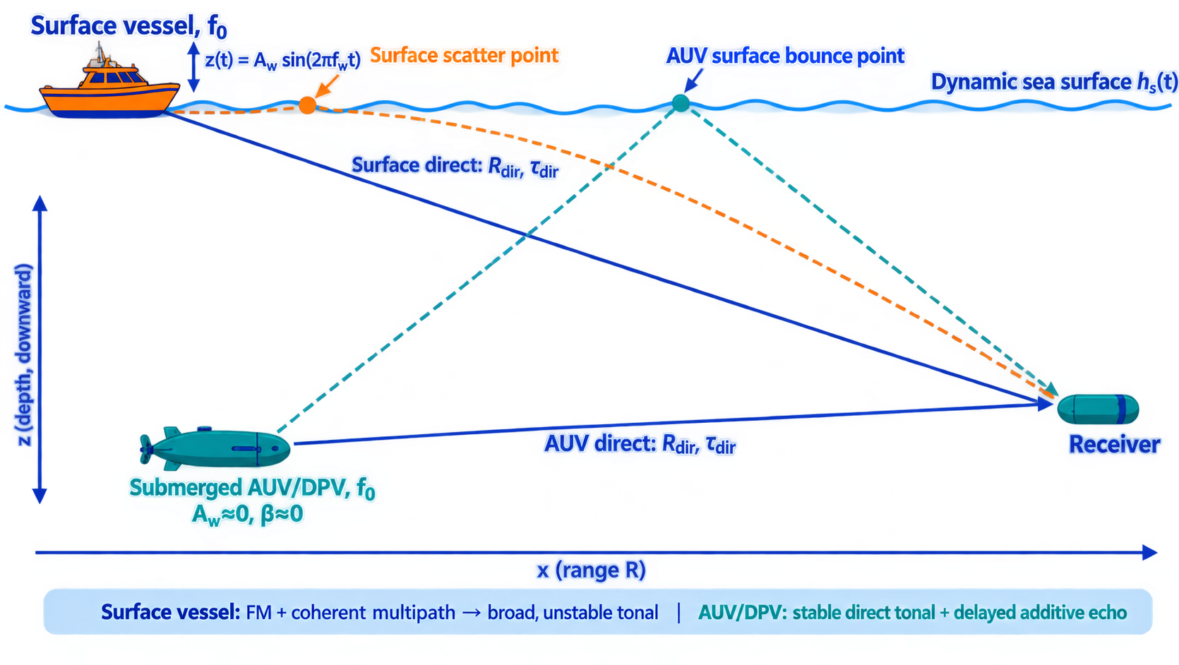
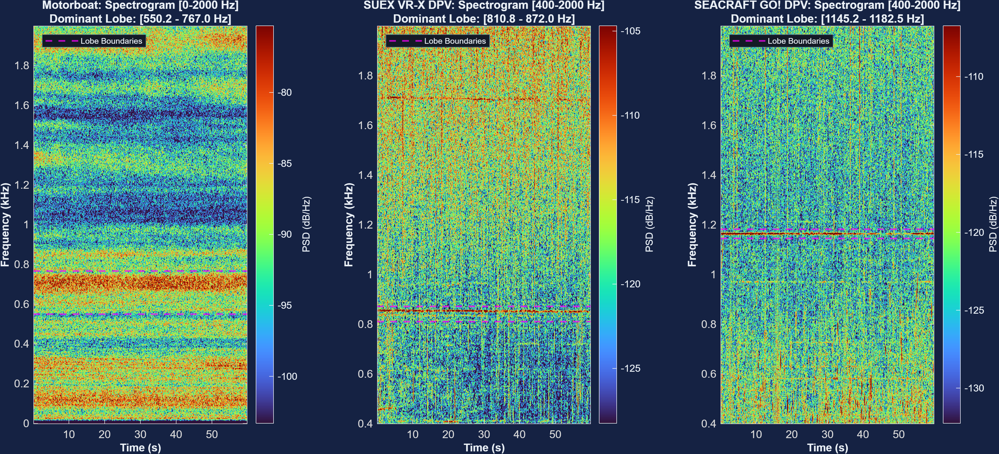
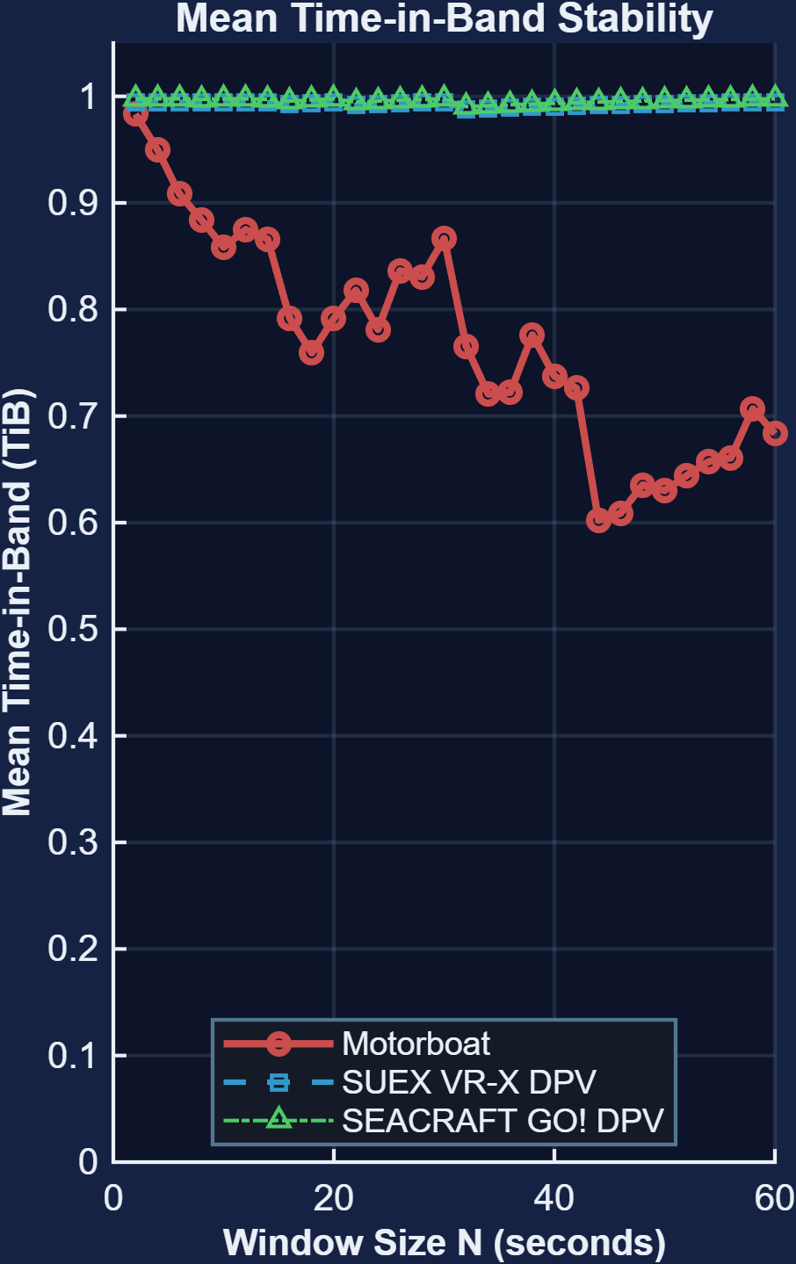
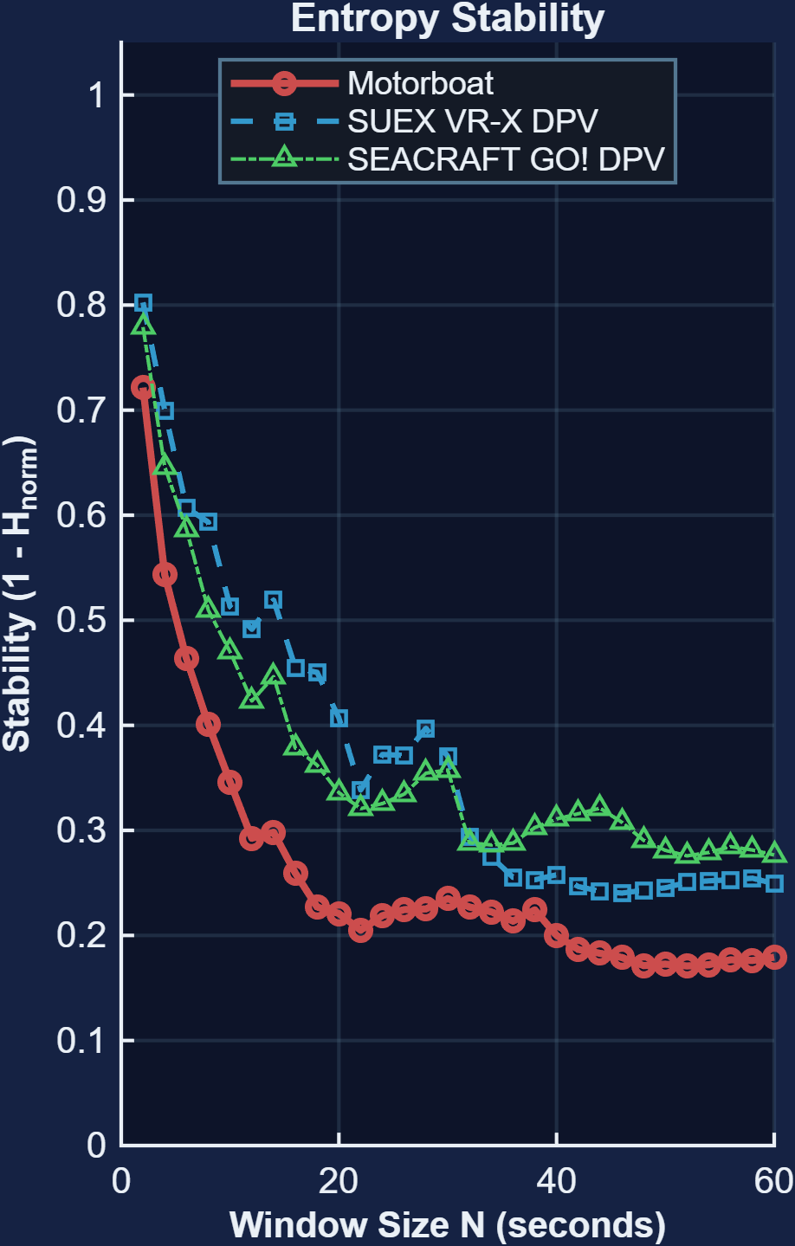
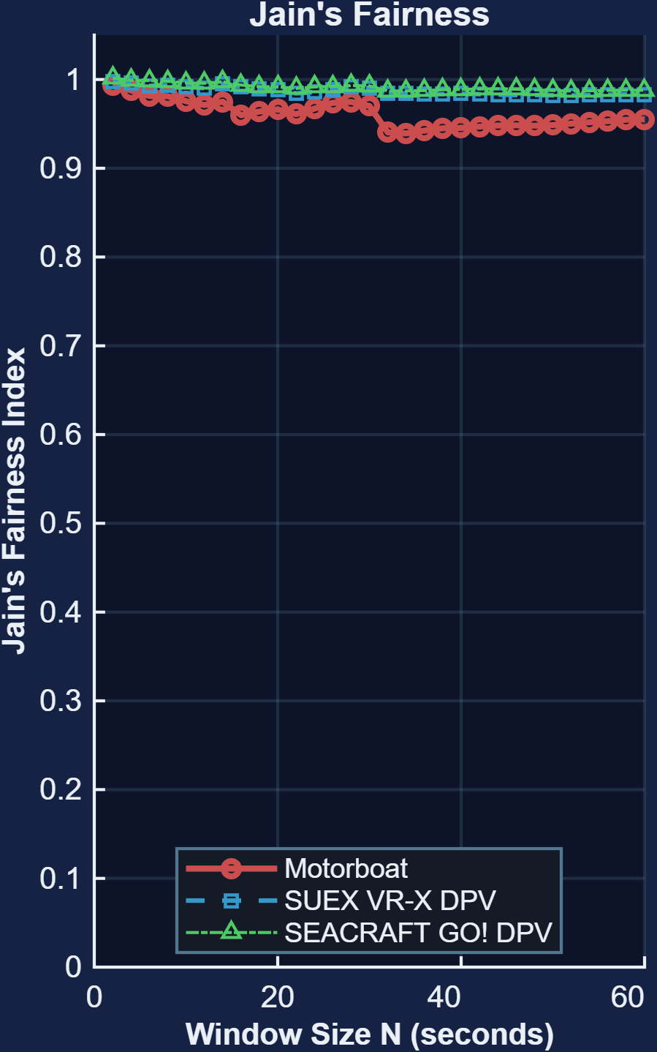


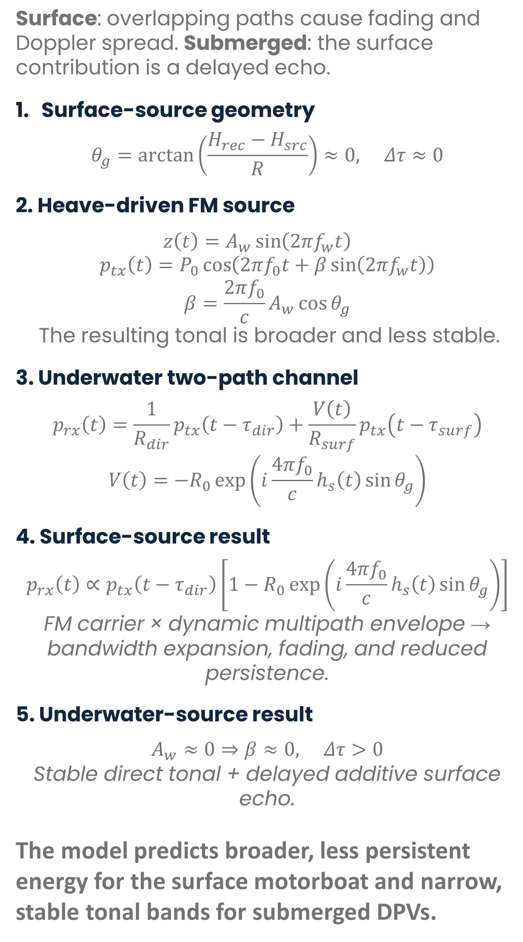
Physics-Informed Machine Learning Vessel Depth Classification
Roy Michael - Department of Marine Technologies, Haifa University
Background
Methodology
Passive Acoustic Monitoring can distinguish surface and submerged sources using the effect of wave coupling on mechanical tonal.
Signal Ingestion
Estimation Matrix
Feature Extraction
Classification
Results
Spectral Fingerprints of Vessel Depth
Dominant spectral peaks
Bandwidth Distribution
Physical Model
Spectrogram Structure
Bandwidth separates source depth
Surface motorboat: 136 Hz
Submerged DPVs: 18–26 Hz
Broad spectral distribution vs. narrow tonal bands
Temporal Stability Separates Depth
Jain’s fairness
Surface: overlapping paths cause fading and Doppler spread. Submerged: the surface contribution is a delayed echo.
Surface-source geometry
$$θ_{g}=\arctan\left(\frac{H_{rec}−H_{src}}{R}\right)≈0, Δτ≈0$$
2. Heave-driven FM source
$$z\left(t\right)=A_{w}\sin\left(2πf_{w}t\right)$$
$$p_{tx}\left(t\right)=P_{0}\cos\left(2πf_{0}t+β\sin\left(2πf_{w}t\right)\right)$$
$$β=\frac{2πf_{0}}{c}A_{w}{\cos{θ}}_{g}$$
The resulting tonal is broader and less stable.
3. Underwater two-path channel
$$p_{rx}\left(t\right)=\frac{1}{R_{dir}}p_{tx}\left(t−τ_{dir}\right)+\frac{V\left(t\right)}{R_{surf}}p_{tx}\left(t−τ_{surf}\right)$$
$$V\left(t\right)=−R_{0}\exp\left(i\frac{4πf_{0}}{c}h_{s}\left(t\right){\sin{θ}}_{g}\right)$$
4. Surface-source result
$$p_{rx}\left(t\right)∝p_{tx}\left(t−τ_{dir}\right)\left[1−R_{0}\exp\left(i\frac{4πf_{0}}{c}h_{s}\left(t\right){\sin{θ}}_{g}\right)\right]$$
FM carrier × dynamic multipath envelope → bandwidth expansion, fading, and reduced persistence.
5. Underwater-source result
$$A_{w}≈0⇒β≈0, Δτ>0$$
Stable direct tonal + delayed additive surface echo.
The model predicts broader, less persistent energy for the surface motorboat and narrow, stable tonal bands for submerged DPVs.
Time-in-Band
Entropy stability
Submerged DPV tonal bands persist across longer windows; Surface motorboat stability decreases.
Conclusion and future work
Acknowledgements
This work was developed within the Department of Marine Technologies, Haifa University, as part of ongoing research on physics-informed passive acoustic sensing.
Takeaway
Spectral bandwidth and temporal persistence provide complementary, physics-informed cues for distinguishing surface and submerged vessels.
Next steps
Validate across more vessel types, operating conditions, ranges, and environments; then integrate the features into an ML classifier and real-time detector.
Authors
Roy Michael - Department of Marine Technologies, Haifa University
Roee Diamant - Department of Marine Technologies, Haifa University
References
[1] M. Stojanovic, IEEE J. Oceanic Engineering, 21(2), 125–136, 1996.
[2] J. C. Preisig, IEEE Communications Magazine, 45(12), 110–117, 2007.
[3] A. B. Carlson, P. B. Crilly, J. C. Rutledge, Communication Systems, 4th ed., McGraw-Hill, 2001.
[4] F. G. Bass, I. M. Fuks, Wave Scattering from Statistically Rough Surfaces, Pergamon, 1979.
[5] W. I. Roderick, PhD dissertation, Yale University, 1979.
[6] L. Vincent and P. Soille, "Watersheds in digital spaces: an efficient algorithm based on immersion simulations," IEEE Transactions on Pattern Analysis and Machine Intelligence, 1991.

