Slide 1
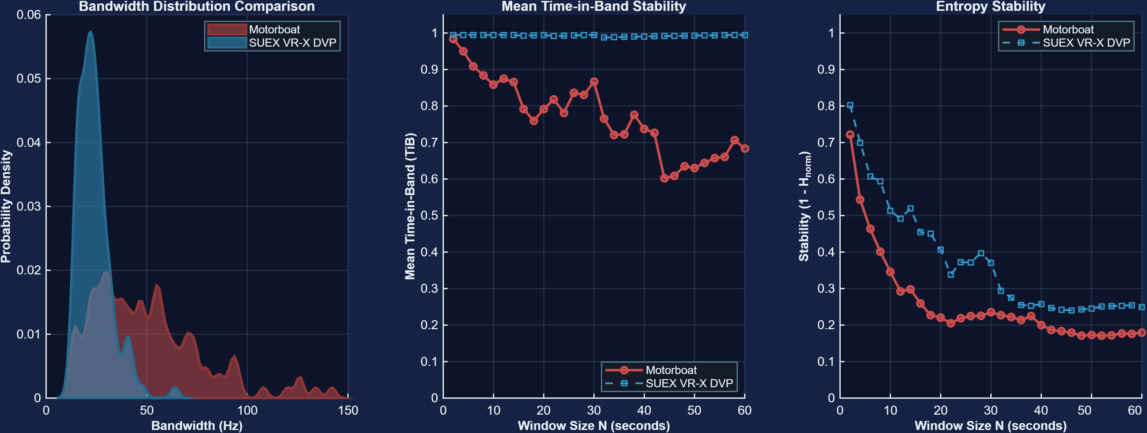
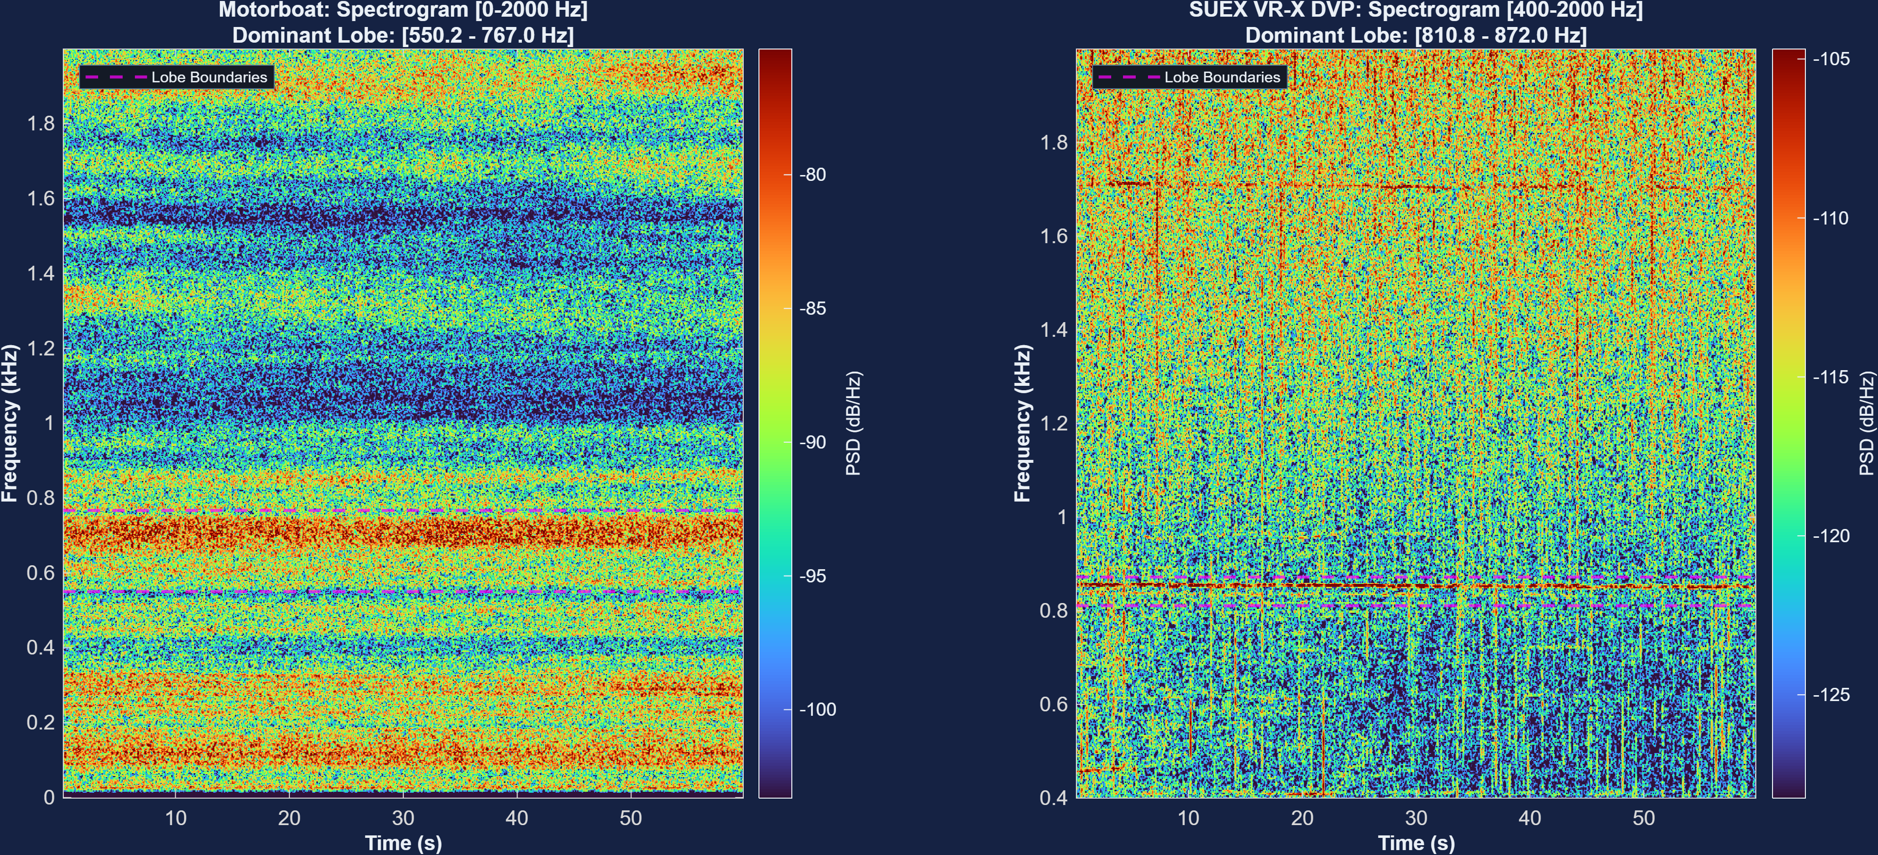
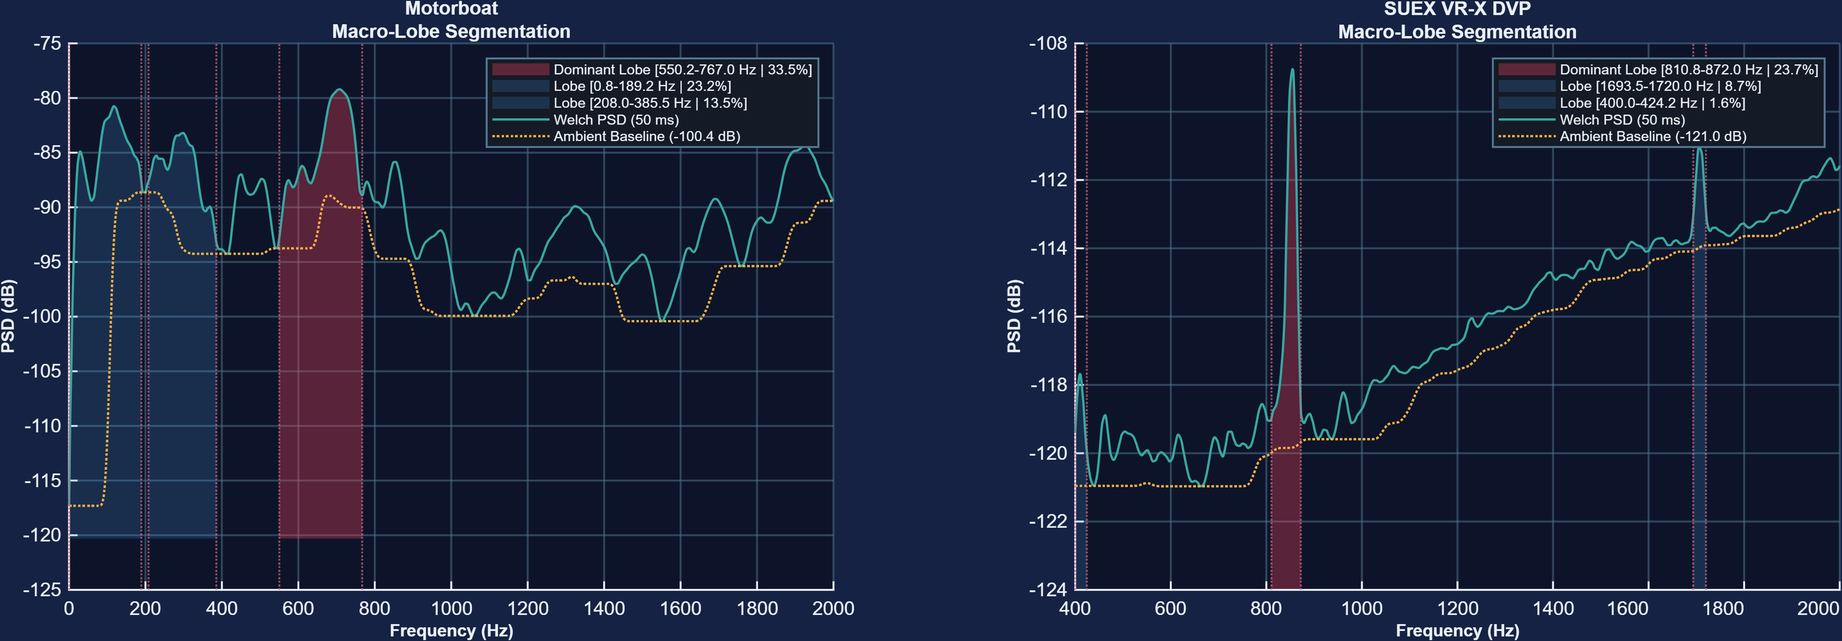



Physics-Informed Machine Learning Vessel Depth Classification
Roy Michael - Department of Marine Technologies, Haifa University
Background
Results
Bandwidth and temporal stability
Passive acoustic monitoring (PAM) can support maritime surveillance and autonomous perception, but depth classification is difficult in shallow water because source motion and a dynamic sea surface spread tonal energy in both time and frequency. Surface craft are mechanically coupled to swell, whereas submerged sources are comparatively decoupled. This work converts those physical differences into interpretable acoustic features for classifying a source as surface or submerged.
Two recordings were compared: one motorboat (surface source) and a submerged DVP recordings. The analysis tests the central physics-informed hypothesis: surface coupling should broaden and destabilize mechanical tonals, whereas a submerged source should preserve narrower and more persistent direct-path components. The spectrogram, bandwidth distribution, Time-in-Band (TiB), entropy-stability, and macro-lobe analyses provide complementary views of this separation.
Bandwidth provides the clearest distributional contrast. The motorboat extends through a long high-bandwidth tail toward ~150 Hz, while both DVP distributions are concentrated mainly in the narrow-band region. TiB reinforces this result: both DVP recordings remain near 0.99 over the tested 2–60 s window sizes, whereas motorboat TiB progressively falls and fluctuates, reaching roughly 0.60–0.70 at longer windows. Entropy stability also differs systematically, indicating different degrees of spectral organization and persistence.
Spectral Structure
The motorboat contains a broad dominant region around 550.2–767.0 Hz together with multiple distributed horizontal components across the 0–2 kHz display. In contrast, the SUEX VR-X DVP is dominated by a much narrower 810.8–872.0 Hz band, and the SEACRAFT GO! DVP shows a concentrated 1145.2–1182.5 Hz tonal. The persistent narrow DVP ridges are consistent with reduced heave-induced frequency spreading for submerged sources.
Methodology
Surface-vessel heave, z(t)=Aw sin(2πfwt), phase-modulates engine tonals, producing Bessel-weighted sidebands and bandwidth expansion. At long range, near-zero grazing geometry causes direct and surface-reflected paths to overlap, adding time-varying fading and Doppler spread. For submerged sources, Aw≈0 collapses the heave-induced sidebands; geometric path separation leaves a sharper direct tonal plus a delayed surface echo. The four-stage pipeline measures these signatures using bandwidth and stability features before the machine-learning decision.
Overall interpretation: the three analyses agree with the proposed propagation model. The surface motorboat is characterized by wider spectral occupancy and decreasing temporal persistence, signatures expected from source heave plus dynamic surface micro-multipath. Both submerged DVP recordings maintain compact dominant bands and near-unity TiB stability despite operating at different tonal frequencies. This suggests that bandwidth expansion and temporal stability are useful complementary, physics-grounded inputs to the final depth classifier. These plots demonstrate feature separation for the available recordings; classification accuracy should be reported only after validation on a larger independent dataset.
Macro-lobe segmentation
The segmentation stage isolates physically meaningful candidate bands before feature extraction. The motorboat dominant lobe spans 550.2–767.0 Hz and accounts for 33.5% of the displayed segmentation measure. The SUEX VR-X dominant lobe is 810.8–872.0 Hz (23.7%), while the SEACRAFT GO! dominant lobe is 1145.2–1182.5 Hz (34.0%). These automatically selected bands focus subsequent bandwidth and stability calculations on source-related tonal structure rather than the full spectrum.
Step 1
Step 2
Step 3
Step 4
▥
▦
∿
✓
SIGNAL
INGESTION
BANDWIDTH
MATRIX
PHYSICS
FEATURES
ML
DECISION
Ingest data
Estimate bandwidth
and frequencies
Extract features
Classify source
depth
Conclusion and future work
Acknowledgements
Authors
The experimental feature trends are consistent with the physics-informed hypothesis. The motorboat exhibits a broader bandwidth distribution and markedly lower Time-in-Band stability as the observation window grows, whereas both submerged DVP recordings remain concentrated at narrow tonal bands with near-unity Time-in-Band stability. Entropy-based stability also separates the recordings, supporting a compact feature space that combines bandwidth expansion, temporal persistence, and spectral organization.
This work was developed within the Department of Marine Technologies, Haifa University, as part of ongoing research on physics-informed passive acoustic sensing.
Roy Michael - Department of Marine Technologies, Haifa University
Roee Diamant - Department of Marine Technologies, Haifa University
Next steps: quantify classification performance across additional sea states, ranges, vessel operating conditions, and independent recordings. Target applications include real-time detection and depth classification of autonomous underwater vehicles (AUVs) and diver propulsion vehicles (DPVs).
References
[1] M. Stojanovic, IEEE J. Oceanic Engineering, 21(2), 125–136, 1996.
[2] J. C. Preisig, IEEE Communications Magazine, 45(12), 110–117, 2007.
[3] A. B. Carlson, P. B. Crilly, J. C. Rutledge, Communication Systems, 4th ed., McGraw-Hill, 2001.
[4] F. G. Bass, I. M. Fuks, Wave Scattering from Statistically Rough Surfaces, Pergamon, 1979.
[5] W. I. Roderick, PhD dissertation, Yale University, 1979.

