Slide 1
FRAUD DETECTION / ML WEEK
Which clients
should we inspect first?
CLIENT
many invoices
↓
one client-level
feature row
Turning 4.48 million invoice rows into a useful, capacity-aware fraud ranking.
Roy + Sean · Electricity & gas fraud challenge
ROY + SEAN · FRAUD DETECTION
01
Notes:
Open with the operational question: a utility team cannot inspect everybody, so we rank who to inspect first.
[Sources]
- Project repository: slides.md and executed notebook outputs.
[/Sources]

Slide 2
CONTEXT
The model must improve a real inspection queue
The stakeholder does not need an automatic verdict; they need a better order of work.
If inspectors can review only a limited number of clients, the useful output is a ranked shortlist.
ALL LABELLED CLIENTS
LABELLED FRAUD
FRAUD PREVALENCE
inspection
queue
135,493
7,566
5.58%
Value means finding more genuine fraud within the team’s fixed capacity — while making false inspections visible.
ROY + SEAN · FRAUD DETECTION
02
Notes:
Frame this as prioritisation, not proof.
[Sources]
- 01_eda.ipynb: labelled client counts and target balance.
[/Sources]

Slide 3
EVALUATION
Accuracy would let the hard part disappear
Fraud is rare, so we evaluate the ranking where the positive class matters.
FRAUD PREVALENCE
DUMMY PR-AUC
PRIMARY METRIC
5.58%
0.056
PR-AUC
Why not accuracy?
Predicting ‘not fraud’ for everybody is about 94% accurate.
That strategy finds zero fraud cases.
Average precision rewards a useful ordering of rare positives.
Precision@k and recall@k translate the score into inspection capacity.
ROY + SEAN · FRAUD DETECTION
03
Notes:
Explain PR-AUC in plain language: of the clients we put near the top, how many are actually fraud, across the ranking.
[Sources]
- 01_eda.ipynb: target balance.
- 02_baseline_model.ipynb: dummy PR-AUC and logistic regression comparison.
[/Sources]

Slide 4
RECOMMENDATION / THE CONCLUSION FIRST
Use the tuned LightGBM
as a ranking aid.
FINAL HOLDOUT PR-AUC
0.2647
FINAL HOLDOUT ROC-AUC
Not an automatic fraud verdict.
0.8354
The evidence behind this decision
Client-level features contain signal beyond the dummy ranking.
Tree models improve the linear baseline, but do not separate fraud perfectly.
Error analysis finds a shared short-history blind spot and regional variation.
Human review and a capacity-based threshold remain necessary.
Next: how the EDA, feature contract, models, and error analysis led here.
ROY + SEAN · FRAUD DETECTION
04
Notes:
Give the conclusion before the technical walk-through, then promise the evidence trail.
[Sources]
- 05_final_model.ipynb: one-time holdout PR-AUC 0.2647 and ROC-AUC 0.8354.
- 04_error_analysis.ipynb: shared blind spot and segment findings.
[/Sources]

Slide 5
EDA
We changed the grain before we changed the model
The target is at client level; invoices are a repeated history.
CLIENT TABLE
INVOICE TABLE
FEATURE TABLE
MODEL SCORE
135,493 rows
1 target / client
→
4,476,749 rows
many / client
→
135,493 rows
15 inputs + target
→
ranked
inspection queue
Invoices were read in chunks; the executed EDA completed aggregation in 16.4 seconds.
The raw tables have no missing cells. 5,333 clients lack a valid meter transition; those derived features are imputed only inside modelling.
ROY + SEAN · FRAUD DETECTION
05
Notes:
The one-to-many relationship is the key modelling constraint. Splitting invoice rows would put the same client in both sets.
[Sources]
- 01_eda.ipynb: client/invoice counts, chunked aggregation, target balance.
[/Sources]

Slide 6
EDA
The feature contract made the history comparable
Twelve engineered numeric features plus three original categorical fields.
FAMILY
FEATURES
WHY IT ENTERS
History
invoice_count · active_days · mean_invoice_gap_days
Exposure and regularity
Consumption
mean_consumption · zero_consumption_rate · elec_share
Typical use across unequal history
Meter
backwards_index_rate · meter_count · mean_monthly_submission_index_delta · backward_submission_rate
Corrections and sequence behaviour
Reconciliation
large_mismatch_count · reconciliation_gap_abs_mean
Meter movement versus billed use
Category / geo
client_catg · disrict · region
Group patterns without fake numeric distance
BASELINE INPUTS
Postponed ≠ deleted: totals, maxima, duplicate counts, raw dates, and possible investigation-leakage fields stay available for later experiments.
15
ROY + SEAN · FRAUD DETECTION
06
Notes:
This is the main EDA design decision: a small, documented contract rather than every available aggregate.
[Sources]
- 01_eda.ipynb: selected feature table and feature-contract decision.
[/Sources]

Slide 7
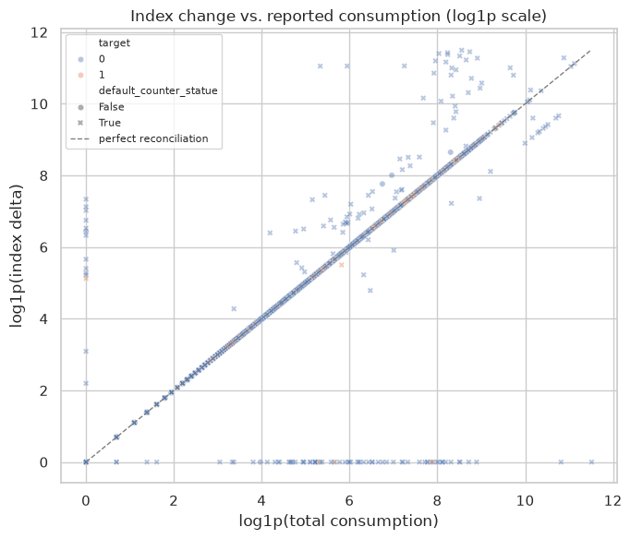
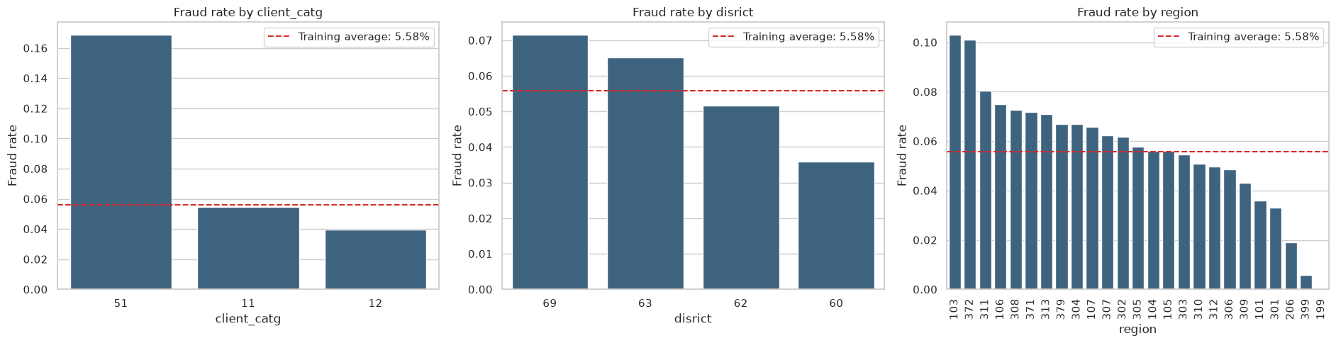
EDA
The strongest patterns also expose the main risks
Associations are useful for feature design, but they are not causal proof.
Category 51: 16.87% fraud
Large mismatch: 8.82% of fraud vs 5.52% of non-fraud
Observation-window bias: fraud rises from 0.94% in the shortest-history group to 9.15% in the longest. Longer histories create more opportunities for a label to appear.
ROY + SEAN · FRAUD DETECTION
07
Notes:
Use these visuals to distinguish a candidate signal from a safe causal interpretation.
[Sources]
- 01_eda.ipynb: categorical fraud-rate charts and meter/consumption reconciliation output.
[/Sources]

Slide 8
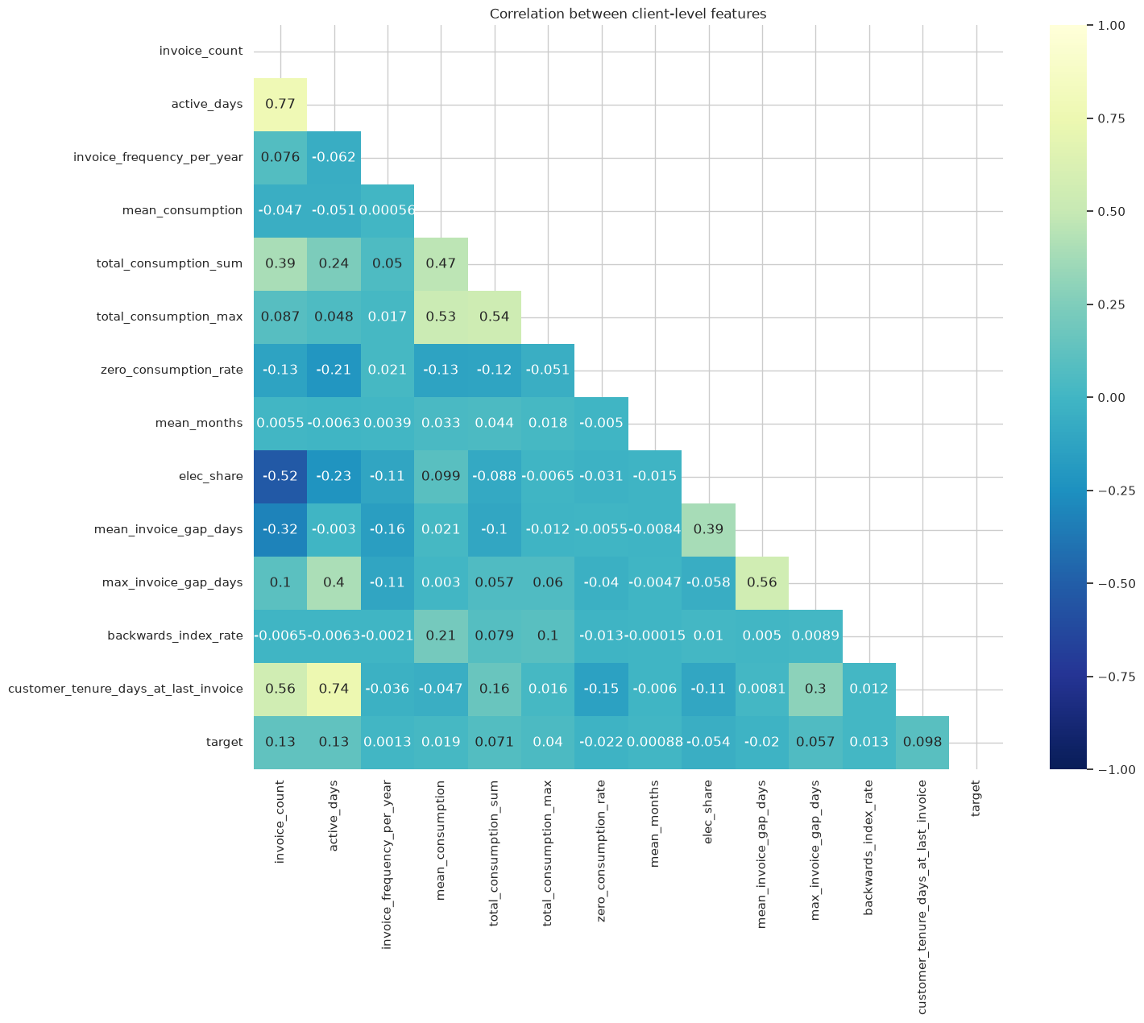
EDA
We kept rows, but made the model inputs explicit
The correlation table informed the discussion; it did not decide feature deletion by itself.
KEEP: all raw invoice rows, including the 11 duplicate-looking rows and backward readings.
KEEP: 15 client inputs — 12 engineered numeric + 3 categorical.
EXCLUDE: IDs, target, raw dates, unreliable tenure, split labels, and possible last-invoice leakage.
POSTPONE: redundant totals, maxima, count duplicates, and invalid months_number features.
No pair exceeded 0.90. Invoice count and active days correlated at 0.77, so we kept both as explicit history signals and tested the risk in error analysis.
ROY + SEAN · FRAUD DETECTION
08
Notes:
Emphasise that correlation alone does not tell us which variable to drop; model performance and explainability complete the decision.
[Sources]
- 01_eda.ipynb: feature correlation heatmap and keep/exclude/postpone decisions.
[/Sources]

Slide 9
WORKFLOW
The notebooks form one reproducible modelling path
Each numbered notebook answers a different question and carries the same feature contract forward.
01
02
03
04
05
EDA
→
Baseline
→
Extensions
→
Errors
→
Final
aggregate
and audit
dummy vs
logistic
six model
families
agreement +
segments
tune + one-time
holdout
Fold-safe preprocessing: numeric median imputation/scaling and categorical handling are fitted inside training folds.
The EDA itself does not fill source-table cells. The final holdout is created in memory and scored once after decisions are frozen.
ROY + SEAN · FRAUD DETECTION
09
Notes:
This is the reproducibility story: the model is not a single cell; it is a sequence of explicit decisions.
[Sources]
- 01_eda.ipynb through 05_final_model.ipynb: notebook sequence and preprocessing decisions.
[/Sources]

Slide 10
BASELINE
The simple model proved that the features contain signal
We started with a dummy reference and regularised logistic regression.
MODEL
5-FOLD PR-AUC
ROC-AUC
ROLE
IMPROVEMENT OVER DUMMY
Dummy classifier
0.056
0.502
reference
0.056 → 0.170
Logistic regression
0.170
0.795
explainable floor
What it means
The feature contract is learnable, not just a class-prior trick.
PR-AUC remains far below 1.0: the classes overlap substantially.
The baseline sets an explainable floor for stronger model families.
ROY + SEAN · FRAUD DETECTION
10
Notes:
The baseline is deliberately modest; its job is to prove the setup and create a fair reference.
[Sources]
- 02_baseline_model.ipynb: five-fold CV dummy and logistic regression results.
[/Sources]

Slide 11
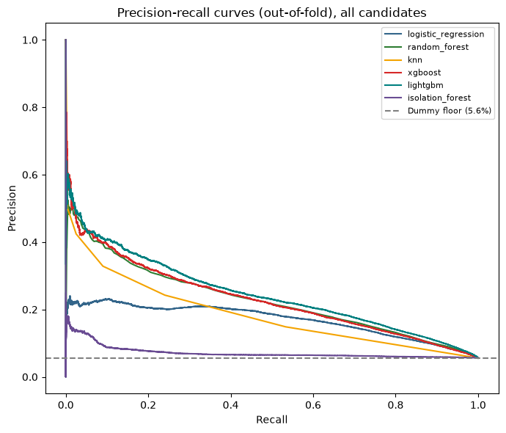
MODEL COMPARISON
Non-linear tree models moved the ranking forward
Same 15 inputs, same five-fold CV, six candidate families.
MODEL
PR-AUC
ROC-AUC
DECISION
LightGBM
0.247
0.831
tune
XGBoost
0.232
0.812
reference
Random Forest
0.227
0.816
reference
Logistic
0.170
0.795
baseline
KNN
0.139
0.687
weaker
Isolation Forest
0.072
0.560
weaker
Decision: tune LightGBM. The gain is evidence for non-linear combinations, not proof that one feature causes fraud.
ROY + SEAN · FRAUD DETECTION
11
Notes:
The model family comparison earns the next experiment; it does not end the analysis.
[Sources]
- 03_model_extension.ipynb: out-of-fold PR curves and comparison table.
[/Sources]

Slide 12
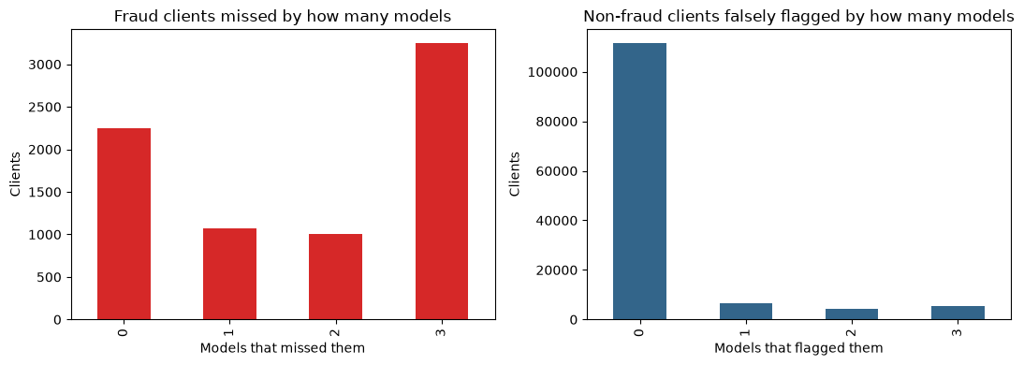
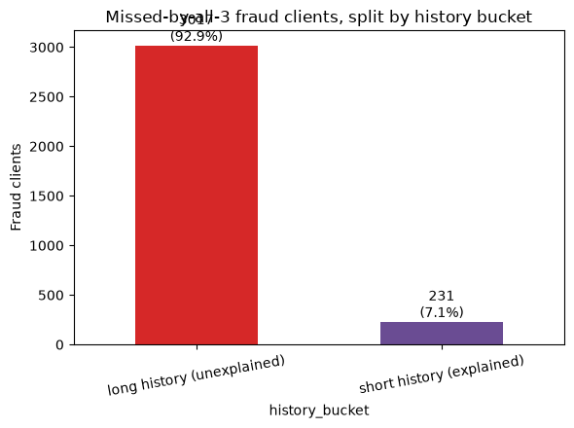
ERROR ANALYSIS
The models share a large blind spot
The question changed from ‘which model wins?’ to ‘which fraud cases do all models miss?’
2,250 caught by all 3
3,248 missed by all three
3,248 fraud clients (42.9%) were missed by all three tree models.
Short-history clients are especially difficult: top-10% recall is only 2.3% for LightGBM.
3,017 long-history fraud clients were still missed — not only a short-history problem.
ROY + SEAN · FRAUD DETECTION
12
Notes:
Explain the bar chart carefully: 0 means all three caught the fraud client; 3 means all three missed it. The shared miss is a feature/data problem as much as a model problem.
[Sources]
- 04_error_analysis.ipynb: model agreement counts and missed-history split.
[/Sources]

Slide 13
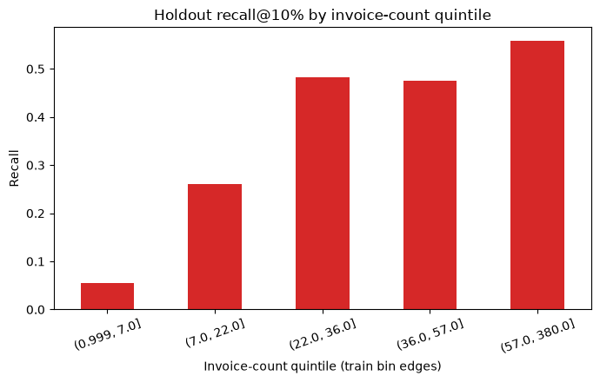
FINAL MODEL
Tuning helped; it did not erase the blind spot
LightGBM with native categorical handling was selected after a small, evidence-gated comparison.
CANDIDATE
DEV CV PR-AUC
DECISION
Untuned LightGBM
0.2379
reference
Tuned, one-hot
0.2470
improved
Tuned, native categorical
0.2506
selected
Tuned + RF ensemble
0.2499
rejected
ONE-TIME HOLDOUT PR-AUC
ONE-TIME HOLDOUT ROC-AUC
0.2647
0.8354
The shortest-history holdout group reaches only 5.6% recall at the same top-10% inspection rule.
0.2514 was the best search CV score; 0.2506 is the post-selection OOF comparison used for the final decision.
ROY + SEAN · FRAUD DETECTION
13
Notes:
The selected model is the best measured candidate, but the holdout segment chart keeps the recommendation honest.
[Sources]
- 05_final_model.ipynb: tuning comparison and one-time holdout results.
[/Sources]

Slide 14
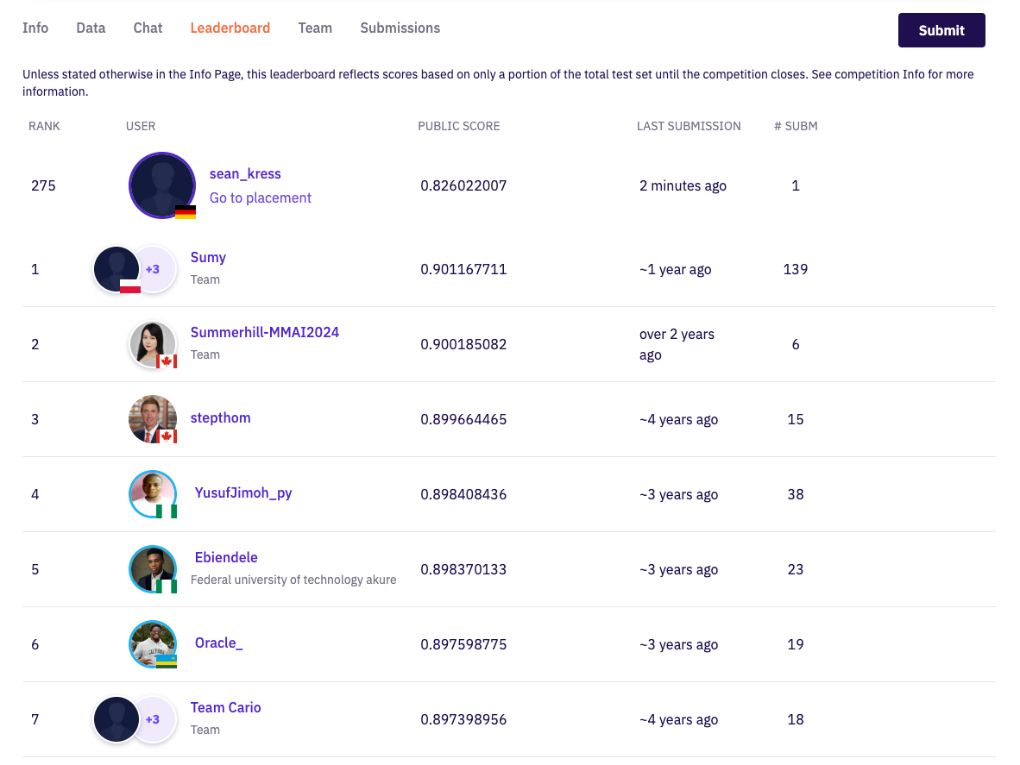
EXTERNAL CHECK
The first submission landed in a credible place
A local model result became a public leaderboard result.
PUBLIC RANK
PUBLIC SCORE
275 / 710
0.8260
Approximately the top 39% of actually rated participants.
One submission at the time of the screenshot.
A positive external check beyond our local CV and holdout numbers.
Kaggle’s public leaderboard is provisional until the competition closes.
Not a winning claim — a credible first result that makes feature quality and temporal validation the next priorities.
ROY + SEAN · FRAUD DETECTION
14
Notes:
Acknowledge the submission as an external check, while being precise that the public leaderboard is provisional and not the same as a final competition result.
[Sources]
- User-provided Kaggle leaderboard screenshot: presentation/assets/kaggle_leaderboard_rank_275.png.
[/Sources]

Slide 15
RECOMMENDATION
Useful ranking, bounded claim
The model is ready for a controlled prioritisation experiment — not an unattended decision.
What we can claim
What we cannot claim
It ranks better than the dummy and logistic baseline.
It does not prove that a client is committing fraud.
It captures useful signal in a one-time holdout check.
It is not equally reliable across regions or history lengths.
It gives inspectors a consistent shortlist to evaluate.
A random split does not prove future-time performance.
Deployment guardrail: choose the inspection capacity first, then set the score threshold and monitor precision/recall by segment.
ROY + SEAN · FRAUD DETECTION
15
Notes:
This is the practical boundary between a model demo and a safe operational experiment.
[Sources]
- 04_error_analysis.ipynb and 05_final_model.ipynb: segment limits and holdout caveats.
[/Sources]

Slide 16
NEXT ITERATION
The next lift is more likely to come from data than tuning
The error analysis tells us where to invest next.
01
Define the operating point
inspection capacity and cost of false positives vs missed fraud
02
Add short-history signal
relative or sequence features that work with only a few invoices
03
Validate semantics
meter identifiers and the reconciliation threshold with experts
04
Test time
as-of cutoff and temporal backtesting
05
Check segments
region, category, history length, and meter availability
Protect the final holdout until the feature contract and threshold are frozen.
ROY + SEAN · FRAUD DETECTION
16
Notes:
Close the analytical story by showing that the next iteration follows directly from observed errors.
[Sources]
- 04_error_analysis.ipynb and 05_final_model.ipynb: next-step recommendations.
[/Sources]

Slide 17
BONUS / ENGINEERING FOR REPRODUCIBILITY
The ML deliverable is
more than a score.
GitHub Actions
PRs and pushes to main execute the EDA and baseline notebooks headlessly.
Parquet workflow
Committed Parquet inputs make large-table reads repeatable and memory-aware.
Saved pipeline
The saved feature and preprocessing contract can be reused consistently for future data.
Explicit contract
The 15 inputs and excluded leakage-prone fields are documented across notebooks.
Reproducibility is part of the model’s credibility.
ROY + SEAN · FRAUD DETECTION
17
Notes:
The bonus is evidence of engineering maturity: the next run should reproduce the table, preprocessing, and evaluation.
[Sources]
- .github/workflows/notebooks.yml: GitHub Actions workflow.
- README.md and scripts/csv_to_parquet.py: reproducibility and data setup.
[/Sources]

