Slide 1
DATA SCIENCE · FRAUD DETECTION
Predicting which electricity and gas clients should be inspected first
Fraud detection as a ranking problem
Roy Grossman
Sean Kress
135,493 clients
4,476,749 invoices
15 features
ML Week 08 Challenge
01

Slide 2
OVERVIEW
Today’s route
From the business problem to a tested recommendation.
01
Problem and value
Business case, metric choice, and evaluation design
03–06
02
Data and EDA
Aggregation, feature contract, patterns, and bias
07–10
03
Modelling
Pipeline, baseline, extensions, errors, and final model
11–17
04
Recommendation
Operating controls and limits
18
05
Discussion and next steps
Questions, roadmap, and engineering work
19–23
ROY + SEAN · FRAUD DETECTION
02

Slide 3
PROBLEM FRAMING
Business case
The useful output is a ranked inspection queue, not a universal yes/no verdict.
Limited inspection capacity
1 · SCORE
One probability per client
A utility cannot investigate all 135,493 clients. The model must concentrate genuine fraud near the top of a finite queue.
2 · RANK
Sort clients by predicted fraud risk
Model output
Stakeholder decision
3 · REVIEW
risk score
inspection cut-off
Inspect only the capacity-limited top slice
4 · LEARN
Return investigation outcomes for monitoring and retraining
ROY + SEAN · FRAUD DETECTION
03

Slide 4
EVALUATION
What does value mean?
Rare-class ranking quality first, operating-point metrics second.
LABELLED CLIENTS
FRAUD CLIENTS
FRAUD PREVALENCE
ALL-NEGATIVE ACCURACY
135,493
7,566
5.58%
94.42%
PRIMARY · PR-AUC
OPERATING POINT · PRECISION@10% / RECALL@10%
Measures whether rare fraud cases are concentrated near the top across the ranking.
Translates the ranking into hit rate and fraud coverage at a fixed inspection capacity.
ROC-AUC remains a secondary ranking diagnostic. Accuracy is not a model-selection metric for this task.
ROY + SEAN · FRAUD DETECTION
04

Slide 5
EVALUATION DESIGN
Our data-science question
Can client and invoice history produce a useful ranking — and where does it fail?
1
2
3
4
Feature table
Out-of-fold comparison
Tune on development
One final holdout
Aggregate invoices to one row per client
Five-fold stratified predictions for model selection
Search only after selecting the model family
Freeze the pipeline, then score once
ROY + SEAN · FRAUD DETECTION
05

Slide 6
DECISION
The conclusion first
Use tuned LightGBM to prioritise investigations — with explicit limits.
FINAL HOLDOUT PR-AUC
FINAL HOLDOUT ROC-AUC
SHORTEST-HISTORY RECALL@10%
0.2647
0.8354
5.6%
LightGBM materially improves the linear baseline on the same 15-input contract.
Native categorical handling edges out one-hot encoding in the tuning comparison.
A LightGBM + Random Forest ensemble is slightly worse and is rejected.
All three top models miss many of the same fraud clients, suggesting that the current features lack useful information for those cases.
Decision boundary: ranking support + human review + segment monitoring
ROY + SEAN · FRAUD DETECTION
06

Slide 7
EDA
EDA: from invoices to one prediction row per client
The modelling grain follows the target grain.
CLIENT_TRAIN
INVOICE_TRAIN
DF_TRAINING
135,493
→
4,476,749
→
135,493 × 17
one target per client
repeated meter and billing rows
key + target + 15 inputs
MEMORY-AWARE AGGREGATION
OBSERVATION-WINDOW BIAS
Invoice Parquet is processed in 250,000-row chunks. The executed aggregation completed in 16.4 seconds.
Fraud rate rises from 0.94% for clients with 1–7 invoices to 9.15% for clients with 58+. The model may learn how much history exists, not only fraud behaviour.
ROY + SEAN · FRAUD DETECTION
07

Slide 8
EDA
EDA: the feature contract we built
Fifteen client inputs, grouped by the question they answer.
OBSERVATION HISTORY
invoice_count · active_days · mean_invoice_gap_days
How much evidence and how regularly?
CONSUMPTION
mean_consumption · zero_consumption_rate · elec_share
What does typical demand look like?
METER SEQUENCE
backwards_index_rate · meter_count · mean_monthly_submission_index_delta · backward_submission_rate
How do ordered readings move?
RECONCILIATION
large_mismatch_count · reconciliation_gap_abs_mean
Do meter movement and billed use agree?
CLIENT CONTEXT
client_catg · disrict · region
Which categorical segment is this?
ROY + SEAN · FRAUD DETECTION
08

Slide 9
EDA
EDA: strong patterns and bias risks
The strongest signals are useful — and each has an interpretation risk.
Observation window
Client category
Reconciliation gap
9.15%
0.94%
9.7× fraud-rate range
Category ≠ cause
Median is zero in both
MODELLING IMPLICATION
No single numeric variable is decisive: the largest target correlations are only 0.128 (active_days) and 0.127 (invoice_count). Combine signals and test non-linear interactions.
ROY + SEAN · FRAUD DETECTION
09

Slide 10
EDA DECISION
EDA conclusion: what changes for modelling?
EDA defined the inputs, the evaluation checks, and the next feature work.
MODEL NOW
CONTROL FOR
INVESTIGATE NEXT
Use 15 client inputs covering history, consumption, meter sequence, reconciliation, category, district, and region.
Report results by history length and geography. Avoid conclusions based on unreliable creation dates.
Build stronger short-history signals and validate meter resets and reconciliation gaps with domain experts.
What EDA changed
The first model uses one explicit 15-input contract rather than every available aggregate.
Unusual readings remain available as possible signals; rows are not deleted without evidence.
ROY + SEAN · FRAUD DETECTION
10

Slide 11
IMPLEMENTATION
Reproducible modelling pipeline
Deterministic feature creation is separated from learned preprocessing and estimation.
RAW PARQUET
→
AGGREGATE
→
CONTRACT
→
PREPROCESS
→
ESTIMATOR
→
RANK
client + invoice
one row / client
15 inputs
fit inside fold
probability score
top-k queue
COMMON COMPARISON PIPELINE
FINAL LIGHTGBM PIPELINE
Numeric: median imputation + scaling. Categories: one-hot encoding with unknown-category handling.
Numeric: median imputation + scaling. Categories: native categorical handling; no dummy columns.
REUSABLE FEATURE CREATION
Applies the same client-feature calculations to future raw data. It does not contain the fitted fraud estimator.
ROY + SEAN · FRAUD DETECTION
11
Notes:
We saved the feature-creation process so the same 15 client features can be recreated from new invoice and client data.
It remembers the calculation steps, such as:
- Counting invoices
- Calculating active days and invoice gaps
- Measuring consumption patterns
- Detecting backward meter readings
- Creating reconciliation features
It does not contain the trained fraud model.

Slide 12
MODEL 1
Baseline model and results
A simple linear classifier proves the feature contract contains signal.
DUMMY PR-AUC
0.056
LOGISTIC PR-AUC
0.170
LOGISTIC ROC-AUC
0.795
Chart: PR-AUC (%)
≈3× PR-AUC lift over prevalence
ROY + SEAN · FRAUD DETECTION
12

Slide 13
MODEL COMPARISON
Model extensions and results
Same inputs and folds, only the model family changes.
WINNER
LightGBM
PR-AUC 0.247
ROC-AUC 0.831
WHY IT WINS
Non-linear splits capture interactions that the linear baseline cannot express.
Tuning budget goes to LightGBM
Chart: PR-AUC (%)
ROY + SEAN · FRAUD DETECTION
13

Slide 14
ERROR ANALYSIS
Error analysis: where the models fail
Model agreement exposes a shared blind spot. Holdout segments show where it persists.
Fraud clients by model agreement
Holdout recall@10% by invoice history
3,248 unanimous misses = 42.9% of all fraud
5.6% recall in Q1 → 55.9% in Q5
INTERPRETATION
Shared misses point to missing information in the feature contract.
ROY + SEAN · FRAUD DETECTION
14

Slide 15
FINAL MODEL
Final tuned model
Tuning produced a modest gain, evidence rejected the ensemble.
FINAL HOLDOUT PR-AUC
0.2647
FINAL HOLDOUT ROC-AUC
0.8354
MODEL DECISION
Keep tuned LightGBM with native categorical handling. Reject the ensemble: 0.2499 is below 0.2506 and adds complexity.
Average precision (%)
ROY + SEAN · FRAUD DETECTION
15

Slide 16
OPERATING POINT
One illustrative example — not a recommendation
A top-10% threshold makes the trade-off concrete; it is not the chosen production capacity.
TOP 10% OF HOLDOUT
ACTUALLY FRAUD
ACTUALLY NOT FRAUD
2,710 of 27,099
clients flagged
702
Caught · 46.4% recall
2,008
False alarms · 74.1% of flags
WHAT THAT MEANS
ACTUALLY FRAUD
ACTUALLY NOT FRAUD
702 fraud caught · 811 missed
811
Missed
23,578
Correctly cleared
2,008 false alarms · 25.9% precision
ILLUSTRATIVE THRESHOLD ONLY
A real cut-off depends on inspection capacity and the cost of false alarms versus missed fraud.
ROY + SEAN · FRAUD DETECTION
16

Slide 17
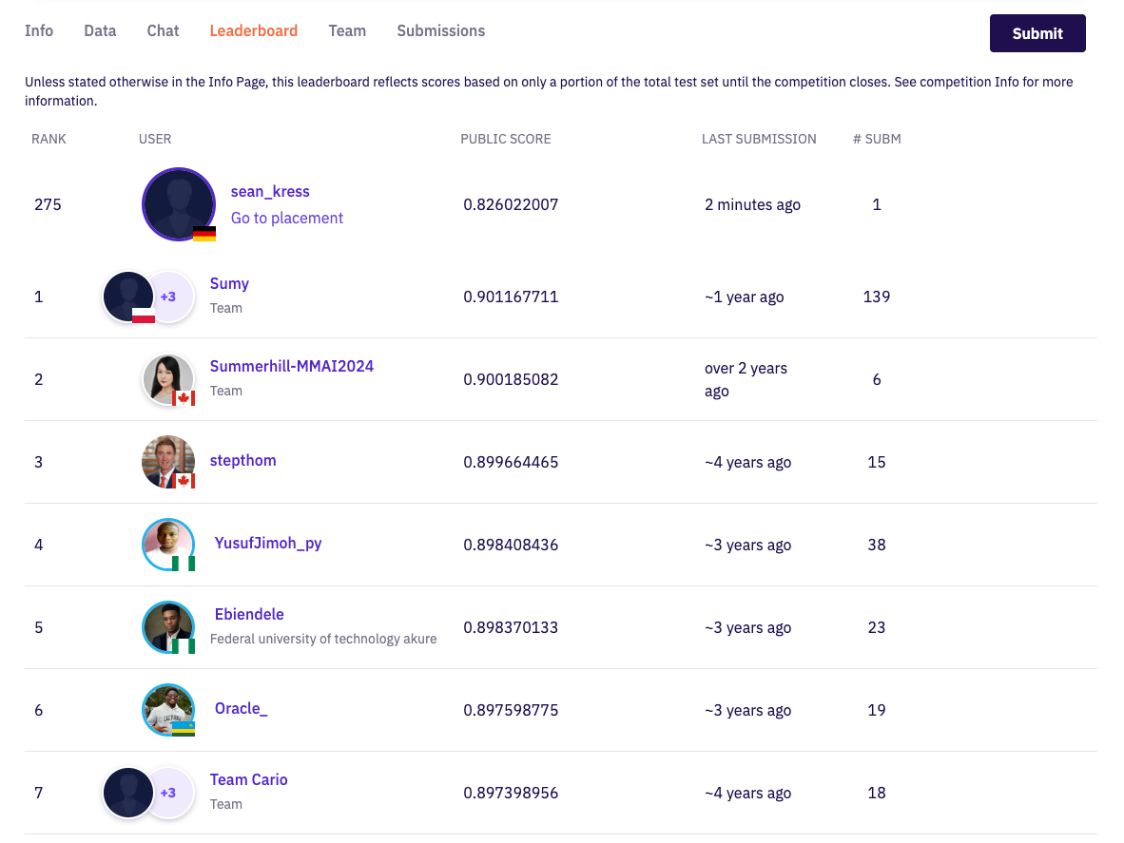
EXTERNAL CHECK
Zindi submission: a credible first result
The public leaderboard supports the ranking quality without replacing local error analysis.
PUBLIC RANK
275 / 710
PUBLIC SCORE
0.826022
SUBMISSIONS
1
Public score ≠ local PR-AUC. The leaderboard is provisional and uses Zindi‘s competition evaluation.
ROY + SEAN · FRAUD DETECTION
17

Slide 18
DECISION
Recommendation
Adopt the ranking workflow only with operating and monitoring controls.
USE
CAPACITY
HUMAN REVIEW
Tuned LightGBM
for inspection prioritisation
Choose the top-k cut-off from available inspections.
Keep an investigator between score and action.
DO NOT USE
SEGMENTS
FEEDBACK
Automatic fraud verdicts
or causal interpretations
Monitor history length, region, district, and category.
Capture inspection outcomes for calibration and retraining.
ACCEPTANCE CONDITION
Define error costs and minimum segment performance before deployment.
ROY + SEAN · FRAUD DETECTION
18

Slide 19
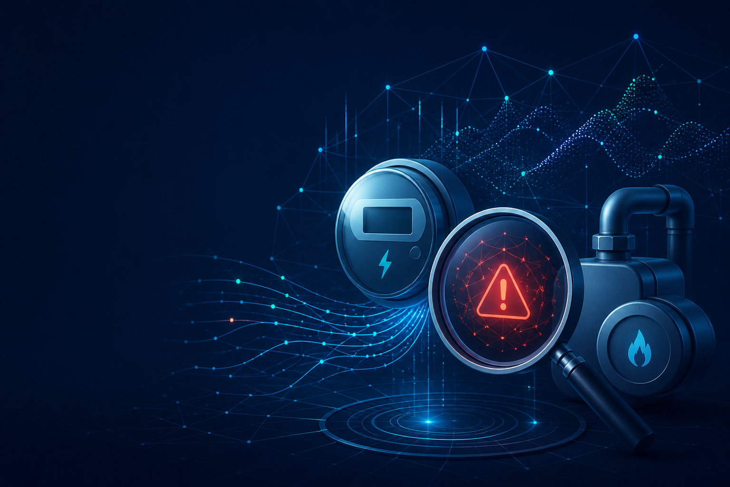
DISCUSSION
Questions?
What would you challenge,
test, or improve next?
ROY + SEAN · FRAUD DETECTION
19

Slide 20

DISCUSSION
Questions?
Data · Features · Models · Limitations
ROY + SEAN · FRAUD DETECTION
20

Slide 21
ENGINEERING
Extra / bonus: reproducibility and CI/CD
The project is a repeatable workflow, not a single successful notebook run.
01–05
PARQUET
15
Lifecycle notebooks
Memory-aware data
Feature contract
EDA → baseline → models → errors → final
Headless conversion + chunked aggregation
Explicit inputs + reusable transformer
UV
DOCKER
CI
Locked environment
Runtime parity
Notebook checks
pyproject.toml + uv.lock
Pinned Jupyter image
EDA + baseline execute on PRs and main
ROY + SEAN · FRAUD DETECTION
23

Slide 22
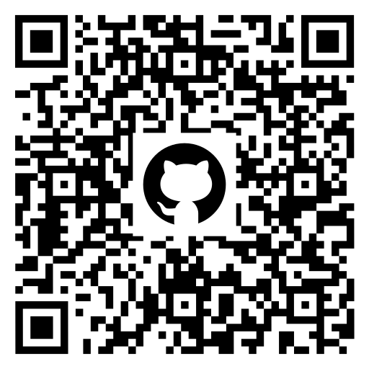
THANK YOU
Thank you
Roy Grossman · Sean Kress
https://github.com/roy-nfisch/ds-fraud-in-electricity-and-gas
Fraud detection in electricity and gas consumption
22

Slide 23
ROADMAP
Next steps
The next iteration should target missing information and validation realism.
01
Temporal validation
02
Short-history features
Train earlier, test later with a defensible fraud-event timestamp.
Ratios, recency, and early-life sequence features.
03
Domain validation
04
Operating point
Confirm meter/consumption gap definitions and thresholds.
Estimate costs, capacity, and probability calibration.
05
Segment robustness
06
Production contract
Define minimum performance and sample-size rules.
Version transformer, schema, model, and monitoring together.
ROY + SEAN · FRAUD DETECTION
21

