Slide 1
Image Segmentation Using Conditional Random
Fields
Salvador, Roy
Panaligan, Daryll
Department of Computer Science
College of Engineering, University of the Philippines Diliman
CS 284 – Mini Project

Slide 2
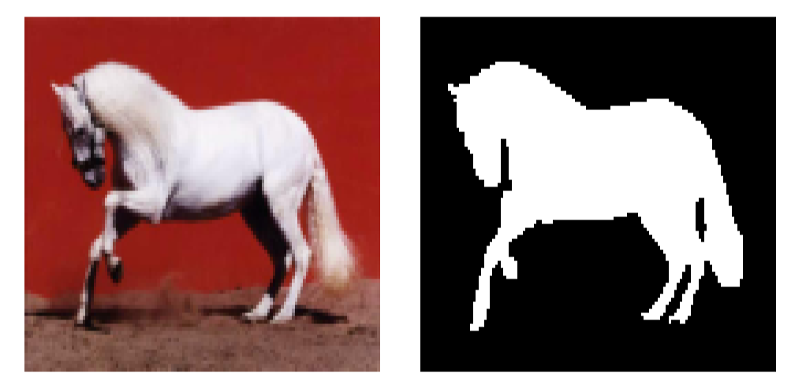
Introduction
Regular inspection of railway systems
Image segmentation
Notes:
computer vision : process of partitioning a digital image into multiple segments
simplify into something that is more meaningful and easier to analyze
Applications such as self-driving cars

Slide 3
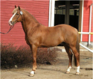
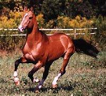
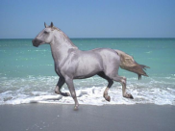
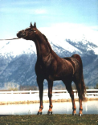
Dataset
Regular inspection of railway systems
Weizmann Horse Dataset
328 side-view color images
High intra-class variability
50:50 training:test split
Manually-segmented versions
Notes:
From the WWW
Variability: Color, texture, different postures, varying backgrounds
Shotton’s version: normalised the images reducing their sizes to
somewhere between 100x100 and 200x200 pixel
Hand-labelled versions

Slide 4
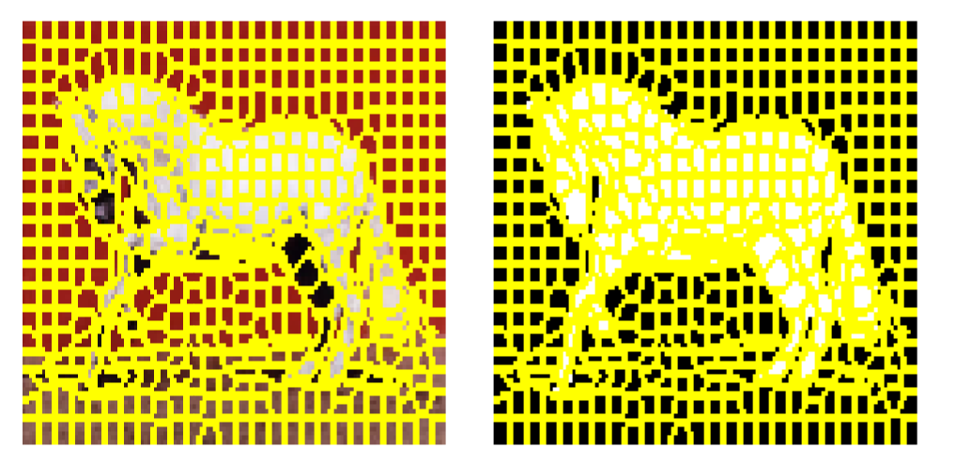
Methodology
Pre-processing
Regular inspection of railway systems
Oversegmentation with superpixels
Notes:
Simple Linear Iterative Clustering (SLIC)
~500 superpixels
Allows easier mapping into CRFs
Superimposed to label image then obtained the average values of the contained pixels
loss of pixelwise accuracy due to the grouping of pixels
resulting accuracy from ground truth is always > 95%

Slide 5
Methodology
Feature Extraction
Regular inspection of railway systems
Unary feature: Superpixel color
RGB red, green, blue
CIE Lab lightness, red-green, blue-yellow
Notes:
average of the intensity values of all the pixels
International Commission on Illumination (CIE)
Chosen for lightness variance

Slide 6
Methodology
Feature Extraction
Regular inspection of railway systems
Unary feature: Histogram
Intensity values of the extracted patch
12 bins per channel
L2-normalized
Notes:
patches centered at the centroids of the vertices are extracted and features are derived from this patch except for
the superpixel color

Slide 7
Methodology
Feature Extraction
Regular inspection of railway systems
Unary feature: CNN features
From convolutional neural network (CNN) model
Notes:
Pre-trained CNN model (CIFAR-10) dataset
Horse as one of the object classes
patch is fed to the model, outputs are used as feature

Slide 8
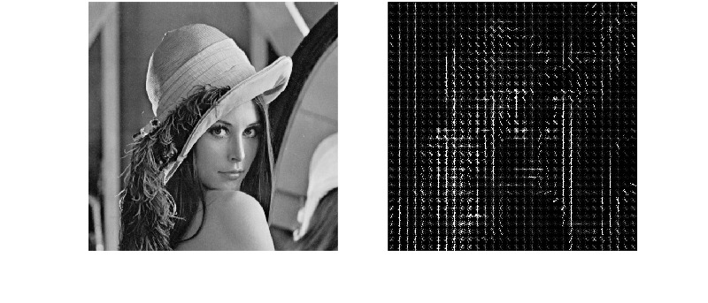
Methodology
Feature Extraction
Regular inspection of railway systems
Unary feature: Histogram of Oriented Gradients (HOG)
Grayscale values of the extracted patch
Occurrences of gradient orientation
Notes:
Image taken from: http://sharky93.github.io/docs/gallery/auto_examples/plot_hog.html

Slide 9
Methodology
Feature Extraction
Regular inspection of railway systems
Pairwise feature: Color difference
RGB Euclidean
CIE Lab CIEDE2000

Slide 10
Methodology
Feature Extraction
Regular inspection of railway systems
Pairwise feature: Histogram difference
Using the Bhattacharyya distance
Notes:
measures the similarity of two discrete or continuous probability distributions

Slide 11
Methodology
Feature Extraction
Regular inspection of railway systems
Pairwise feature: Texture similarity
Local Binary Pattern (LBP) histogram
Kullback-Leibler-Divergence
Notes:
LBP for shape and texture
KLD for similarity of LBP histograms

Slide 12
Methodology
CRF Model
Regular inspection of railway systems
Structured support vector machines (SSVMs)
to learn the coefficients of potentials
Block-Coordinate Frank-Wolfe Optimization inference algorithm
Notes:
LBP for shape and texture
KLD for similarity of LBP histograms
All models have been trained with 1000 iteration

Slide 13
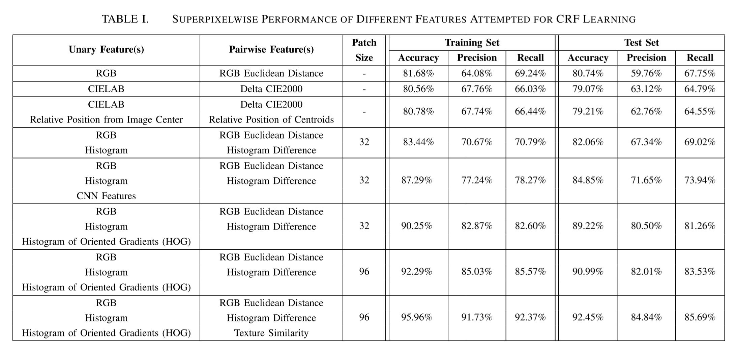
Results
Superpixelwise
Regular inspection of railway systems
Notes:
decided to use HOG over the CNN features as it performed far better, with both precision and recall reaching above 80%. Unfortunately, we were unable to find the preprocessing code used by the pretrained CNN model
Dense computations of histograms = performance hit
no HOG - < 1 second
HOG (32) - 2-5 seconds
HOG (96) - 10 - 20 seconds : unsuitable for real time

Slide 14
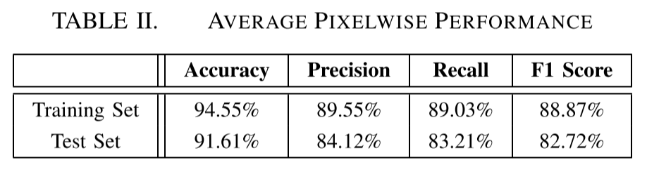
Results
Pixelwise
Regular inspection of railway systems
Regular inspection of railway systems
Regular inspection of railway systems

Slide 15
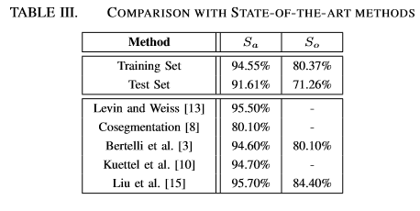
Results
Pixelwise
Regular inspection of railway systems
Regular inspection of railway systems
Regular inspection of railway systems
Notes:
2009 Levin and Wiss – Combination of bottom-up and top-down segmentation
2010 Cosegmentation - simultaneously dividing q images into regions (segments) corresponding to k different classes
2011 Bertelli et al – used kernelized version of structured support vector machines (SSVM) learning
2012 Kuettel et al – used Figure-ground segmentation by transferring window masks
2015 Liu et al – used AlexNet CNN features trained with ImageNet

