Slide 1

Representation of Signal
using Different Encoding Methods.
(Digital Data to Digital Dignal)

Slide 2

Course Name: Data Communication
Course Code: CSE350
SEC: (1).
SPRING-2017.
Instructor:
Maheen Islam
Dept. of CSE ,East West University.
Dhaka, Bangladesh.
Date: 12 April,2017

Slide 3

Submitted by:
Shah Jafor Quaderi
#2014-2-60-075.
Kevin Stephen Biswas
#2014-2-60-091.
Birat Saha
#2014-2-60-086.
Md. Fahim ShahrierRasel
#2014-2-60-088.

Slide 4
overview
What transmitter do
How transmitter convert data to signal
different Encoding methods
How receiver convert signal into data
Signal representation
How we do that

Slide 5
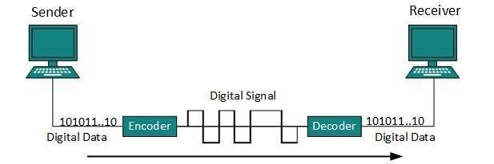


Slide 6
Transmitter device (encoder)
Data → bit
1 char = 8 bit
ewu
→
011001010111011101110101
signal
→
011100110110100101100111011011100110000101101100
→
first
0110011001101001011100100111001101110100

Slide 7
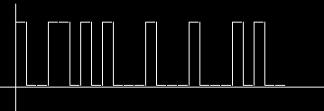
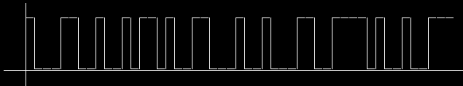
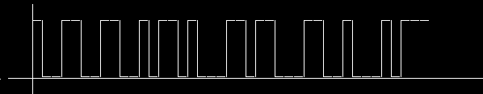
Transmitter program
bit → signal
→
011001010111011101110101
011100110110100101100111011011100110000101101100
0110011001101001011100100111001101110100
NRZ-L encoding

Slide 8
Receiver program (decoder)
Signal → bit
011001010111011101110101
011100110110100101100111011011100110000101101100
NRZ-L encoding

Slide 9
Receiver program
bit → Data
→
ewu
011001010111011101110101
011100110110100101100111011011100110000101101100
→
signal

Slide 10
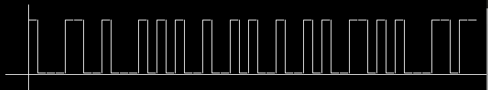
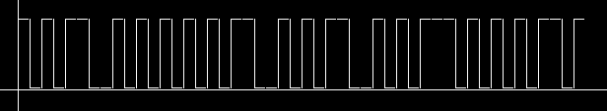
NRZ-L encoding
INPUT : summer
Bit: 011100110111010101101101011011010110010101110010
INPUT : SUMMER
Bit: 010100110101010101001101010011010100010101010010
Diagram

Slide 11
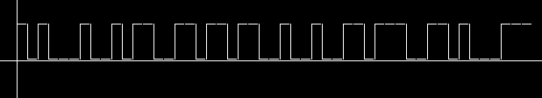
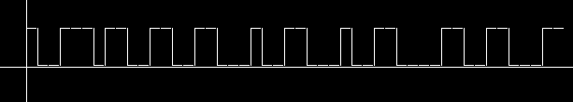
NRZ-I encoding
INPUT : summer
Bit: 011100110111010101101101011011010110010101110010
INPUT : SUMMER
Bit: 010100110101010101001101010011010100010101010010
Diagram

Slide 12
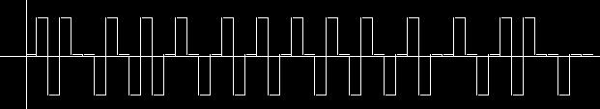
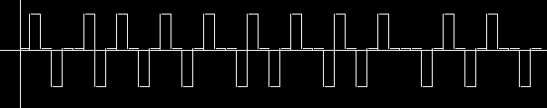
Bipolar AMI encoding
INPUT : summer
Bit: 011100110111010101101101011011010110010101110010
INPUT : SUMMER
Bit: 010100110101010101001101010011010100010101010010

Slide 13


Manchester encoding
INPUT : summer
Bit: 011100110111010101101101011011010110010101110010
INPUT : SUMMER
Bit: 010100110101010101001101010011010100010101010010

Slide 14


Problem and solution
Last bit of data stream repeat once and generate signal.
Transmitted bit : 011100110111010101101101011011010110010101110010
Extra signal

Slide 15



Error detection
Receiver (decoder) convert signal into bit , the additional last bit still here. Now receiver
Convert the bit stream into data text. It take 8 bit at a time to convert into character. The
additional bit will ignored by program cause it can’t found 8 bit in a row, then program detect
there are additional bit and terminate successfully .
01110011 01110101 01101101 01101101 01100101 01110010 0
s
u
m
m
e
r
Received data : summer

Slide 16
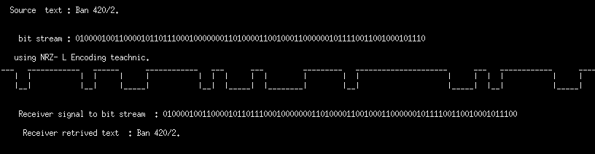
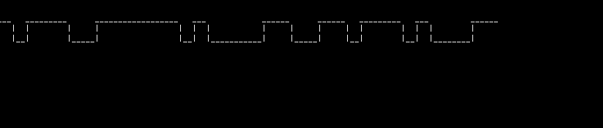
Files and diagrams
Cont..

Slide 17
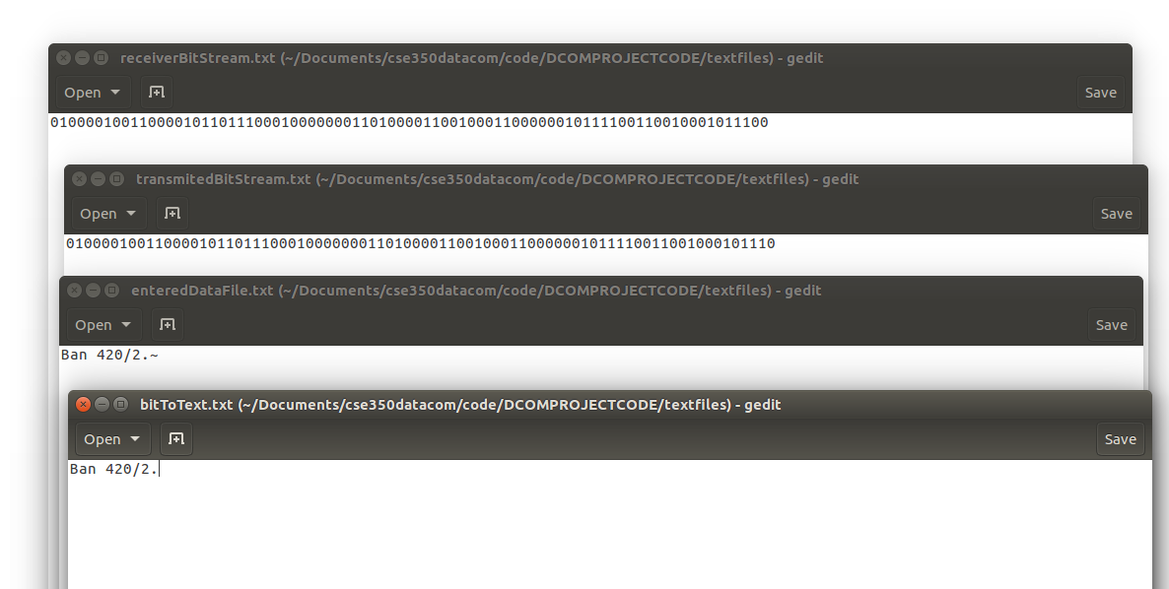
Text files

Slide 18
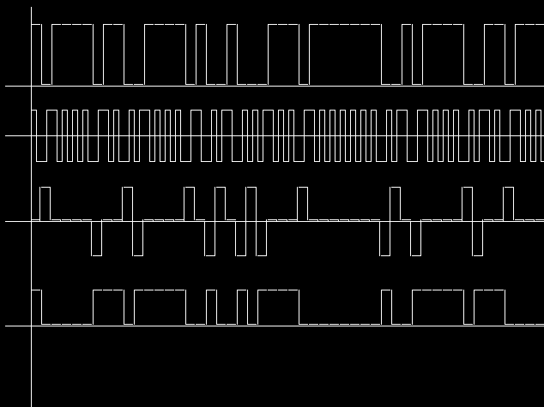
All signal figure
NRZ-L
Manchester
bipolarAMI
NRZ-I
bit : 0111001101110101011011010110110101100

Slide 19



