Slide 1
Tree
Discrete Mathematics
Simanta Kumar Roy (221-35-909)
Sudip Datta (221-35-880)

Slide 2
What is Tree ?
A tree is a connected acyclic graph .
Tree is connected graph having no cycle. And its edges are called Branches.
Not a tree
Tree

Slide 3
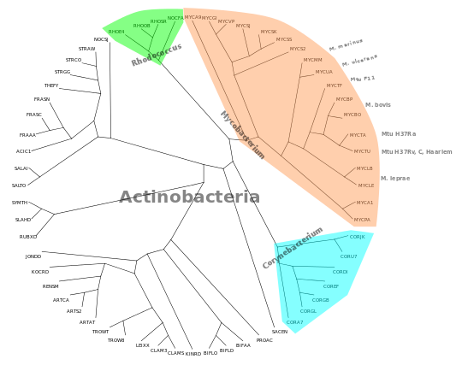
Unrooted Tree And Rooted Tree
Unrooted Tree
Rooted Tree
Root

Slide 4
What is Nodes ?
A tree is a collection of entities called nodes. Nodes are Connected by edges . Each Node contains a value of data , and it may or may not have a child node . The First node of the tree is called the root .
A
Node
B
C
D
E
R
Every Nodes Contains Value

Slide 5
What is Edge ?
An edge connects two nodes to show that there is a relationship between them.
A
Edge
B
C
If we have N nodes , then The number of Edge is N-1
D
E
R

Slide 6
The node which is predecessor of any node is called as parent node
The node which is Descendant of any node is called as child node
Parent
A
A
B
C
B
C
Child
Child
D
E
R

Slide 7
Nodes which belong to same Parent are called as SIBLINGS
A
B
C
Siblings
D
E

Slide 8
Root node, Leaf Nodes And Internal Nodes
Root
A
Root Node: The first node in a Tree is called a root , it is often called the top level node.
Internal Nodes: The node which has at least one child is called as internal node.
Leaf Nodes : The node which does not have a child as node with degree zero is called a leaf node . Leaf node is also called External / Terminal Nodes.
B
C
Internal Nodes
D
E
R
Leaf Nodes

Slide 9
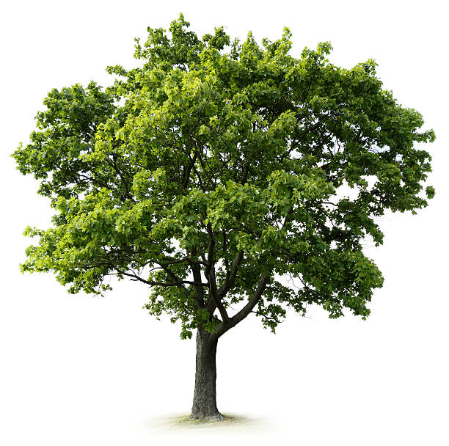
Thank You

