Slide 1
Lab Assignment:
Course Name: Software Development Capstone Project
Course Code: SE133
Teacher Information:
MD. SHOHEL ARMAN
Department of Software Engineering
Daffodil International University

Slide 2
DIU Delta Bot Name: Simanta Kumar roy ID: 221-35-909 section: A

Slide 3
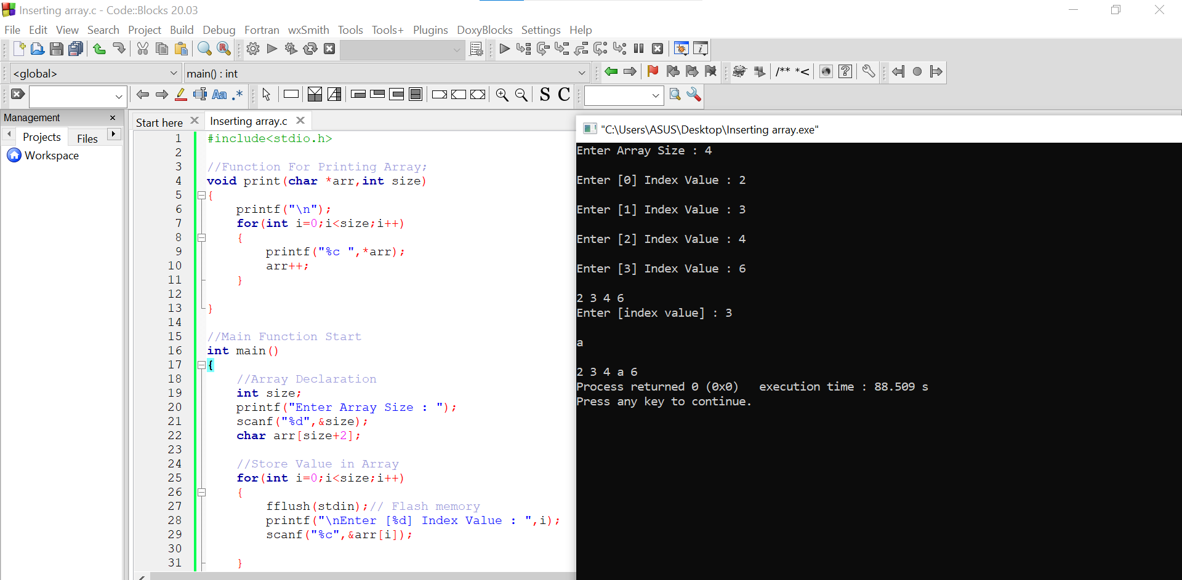
Array Insertion ( part 1)

Slide 4
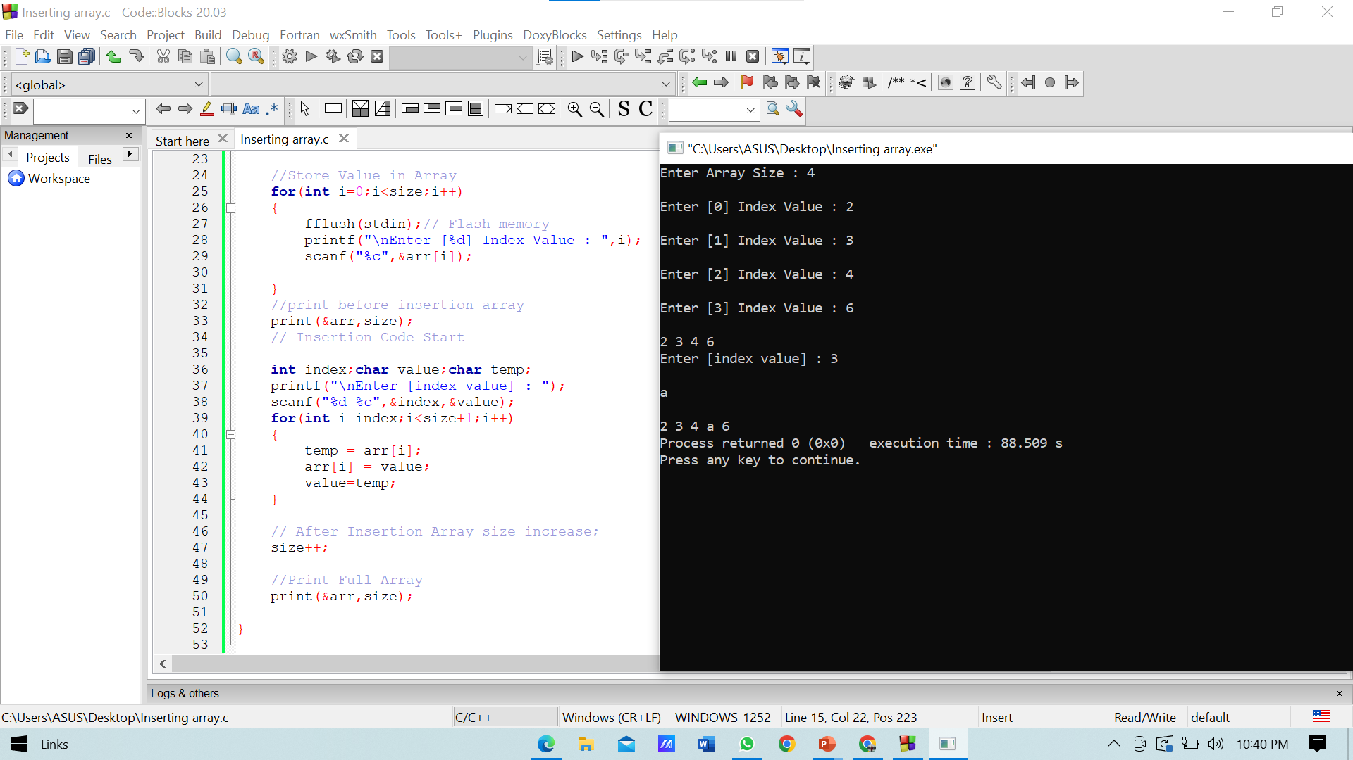
Array Insertion (Part 2)

Slide 5
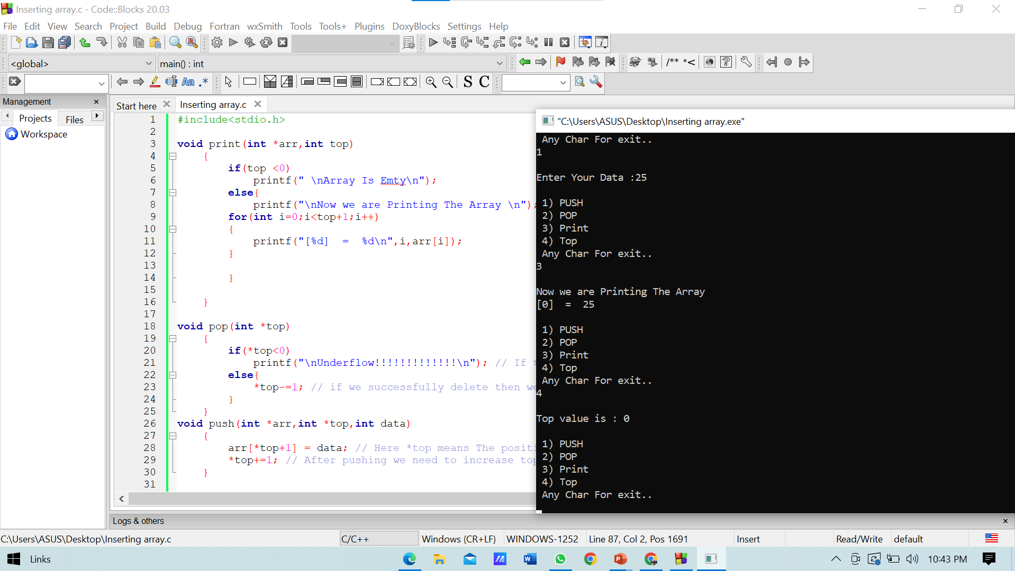
Stack ( Part 1)

Slide 6
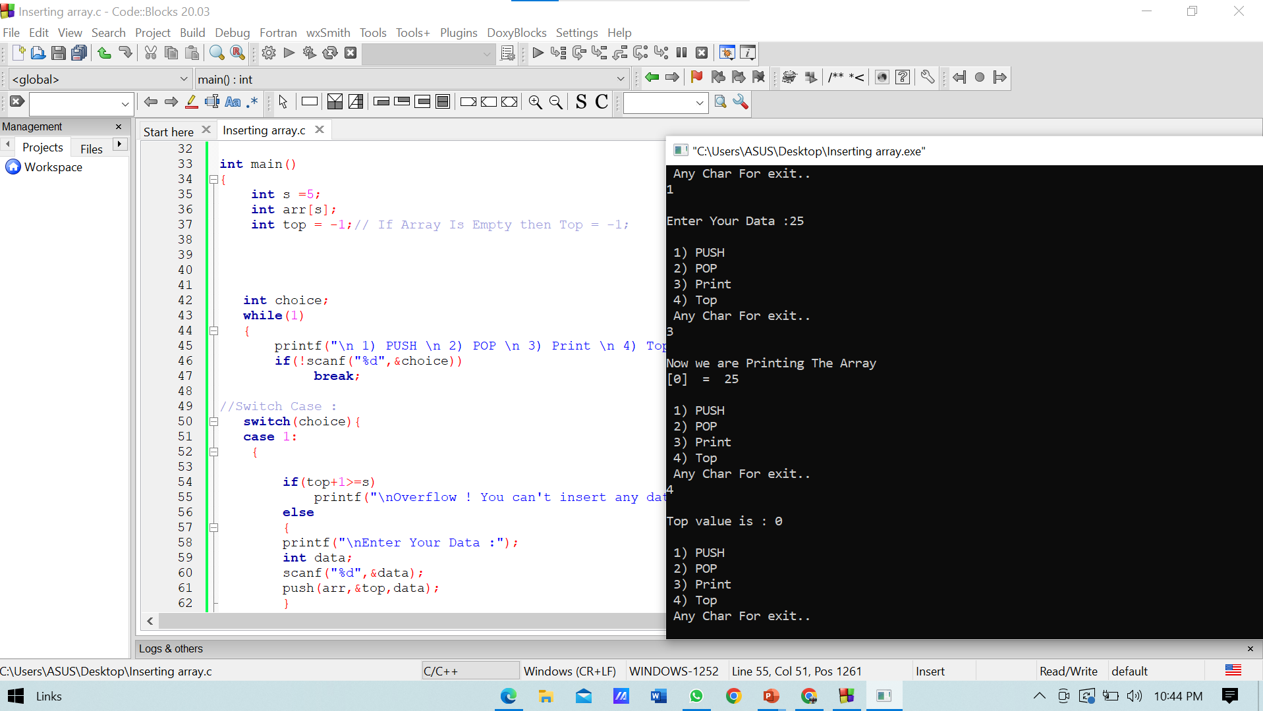
Stack ( Part 2)

Slide 7
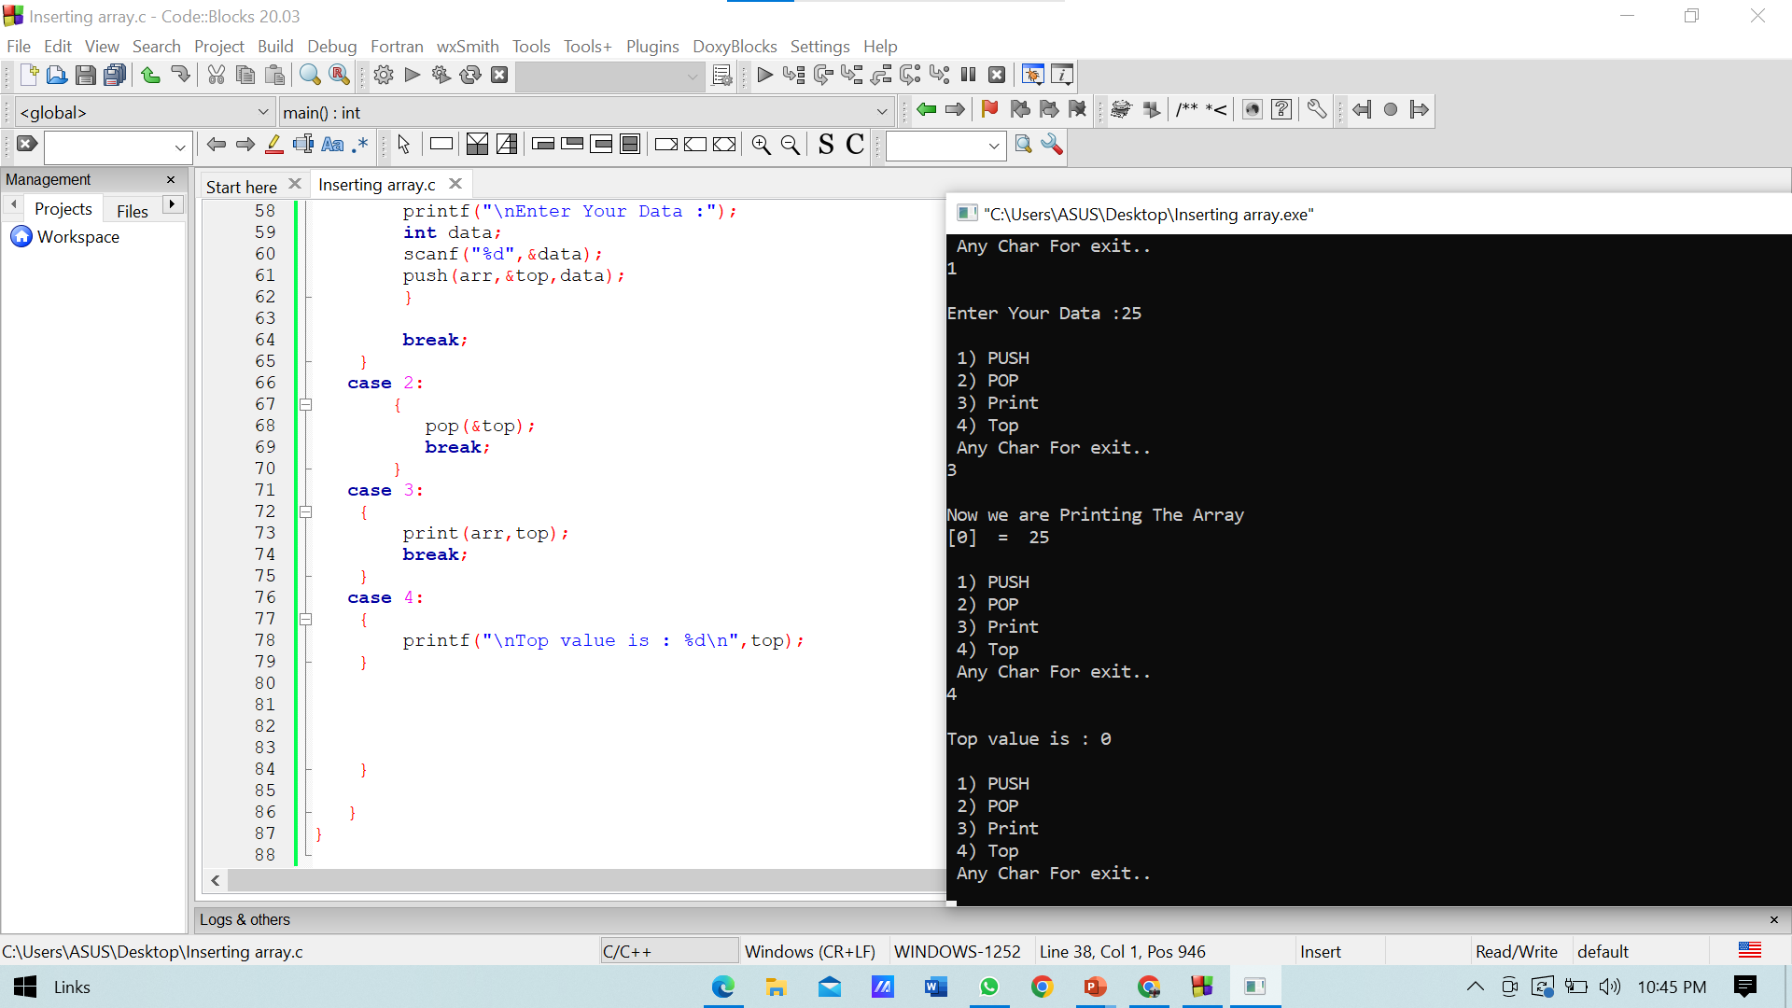
Stack ( part 3)

Slide 8
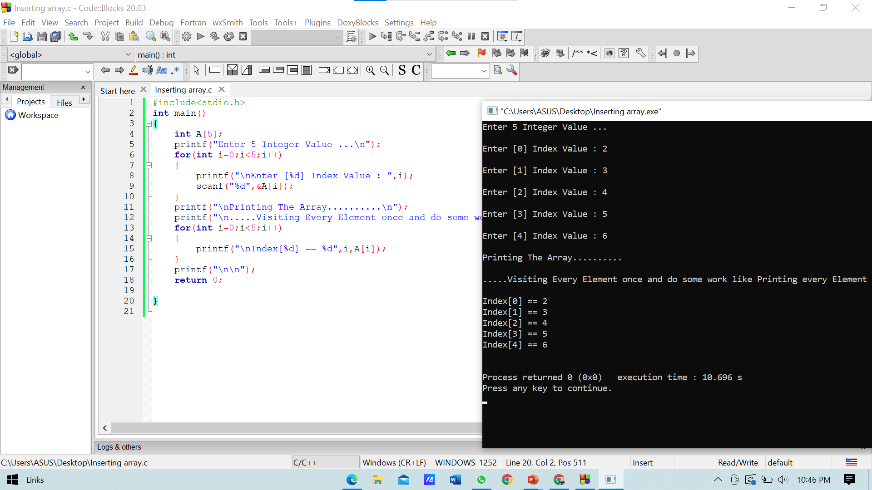
Traversing array

Slide 9
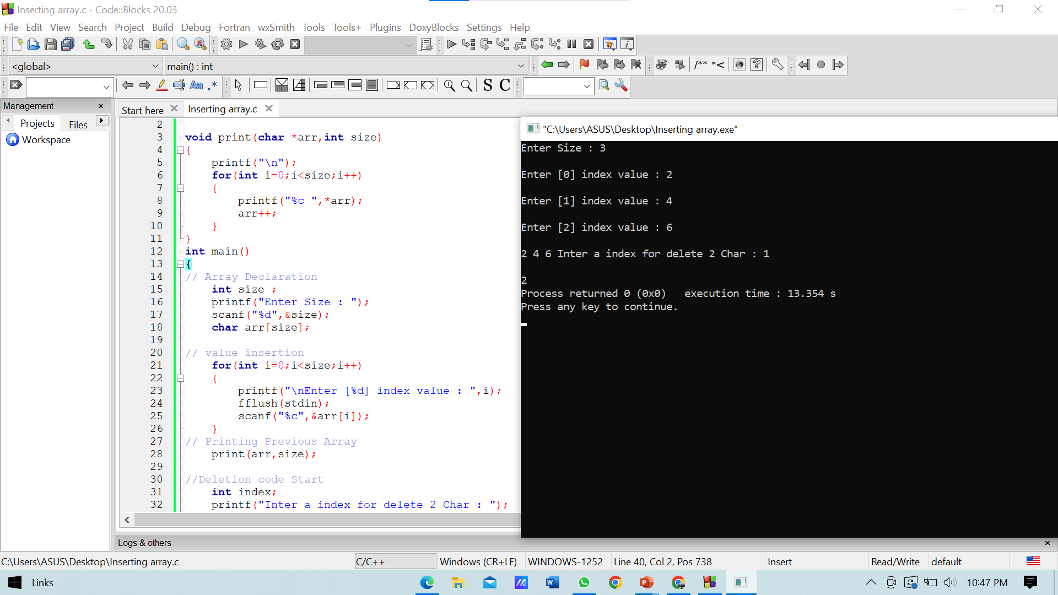
Delete element from array

Slide 10
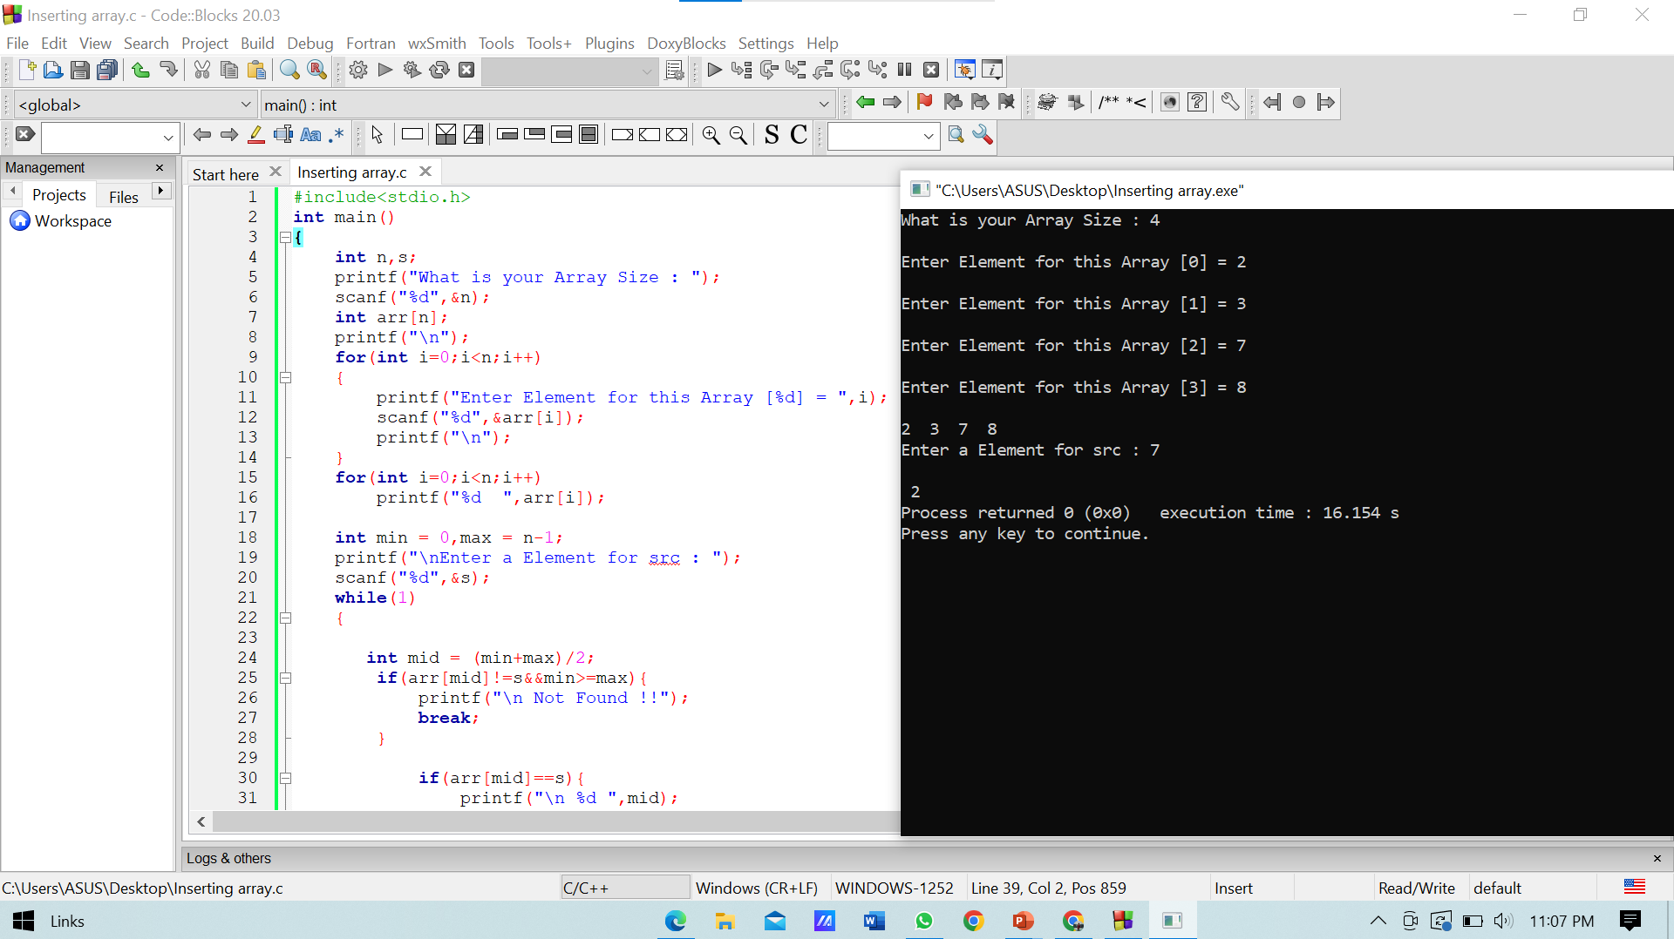
Binary Search ( part 1)

Slide 11
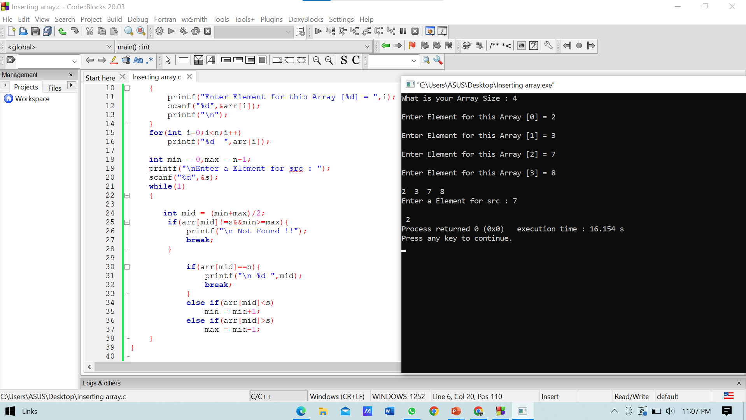
Binary serach ( part 2)

