Slide 1

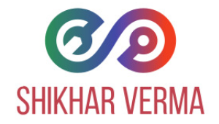
DevOps
DevOps => Development + Operations.
DevOps is the combination of best practices and tools which is designed to increase an organization/company’s ability to deliver applications/projects and services faster than traditional software development processes.
This speed enables organizations to better serve their customers and compete more effectively in the market.
Under a DevOps model, development and operations teams work together across the entire software application life cycle, from development and test through deployment to operations.
What is DevOps and its benefits?

Slide 3
DevOps
Speed
Rapid delivery
Reliability
Improved collaboration
Security
What is DevOps and its benefits?

Slide 4
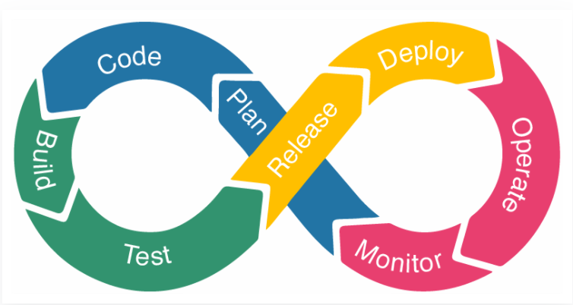
DevOps
The DevOps workflow consists of phases:
Planning the next iteration of the product’s development
Building the code
Testing and deploying to the production environment
Delivering product updates
Monitoring and logging software performance
Gathering customer feedback
DevOps Lifecycle

Slide 5
DevOps
Continuous Development
Continuous Integration
Continuous testing
Continuous monitoring
Continuous feedback
Continuous deployment
Continuous operations
DevOps Lifecycle

Slide 6
DevOps
Continuous Development
The first phase of the DevOps lifecycle is where the planning and software coding takes place.
The planning involves understanding the vision of the project.
Planning doesn’t involve any major tools, but maintaining the code entails the use of a range of tools.
JavaScript, C/C++, Ruby, and Python are prominently used for coding applications in DevOps.
The process of maintaining the code is called Source Code Management (SCM), where version control tools such as GIT, TFS, GitLab, Subversion, and Mercurial, among others, are used.
DevOps Lifecycle

Slide 7
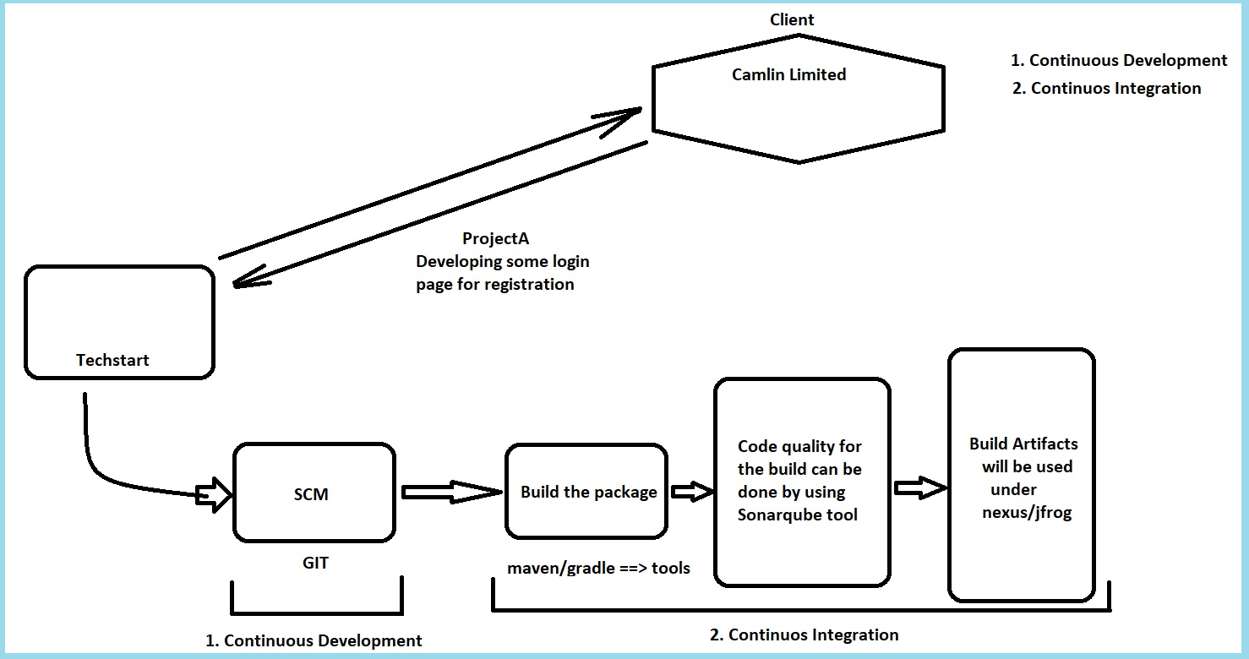

Slide 8
DevOps
Continuous Integration or Code Integration
This stage is the heart of the entire DevOps lifecycle. It is a software development practice in which the developers require to commit changes to the source code more frequently.
The source code gets modified several times and those changes will happen weekly or daily bases.
In this phase, bugs in the source code are detected early on.
Tools Involved in Continuous Integration: Jenkins, Apache Maven, Apache Tomcat, Sonarqube, Nexux/Jfrog, etc.
Jenkins is a popular tool used in this phase. Whenever there is a change in the Git repository, then Jenkins fetches the updated code and prepares a build of that code, which is an executable file in the form of war or jar. Then this build is forwarded to the test server or the production server.
DevOps Lifecycle

Slide 9
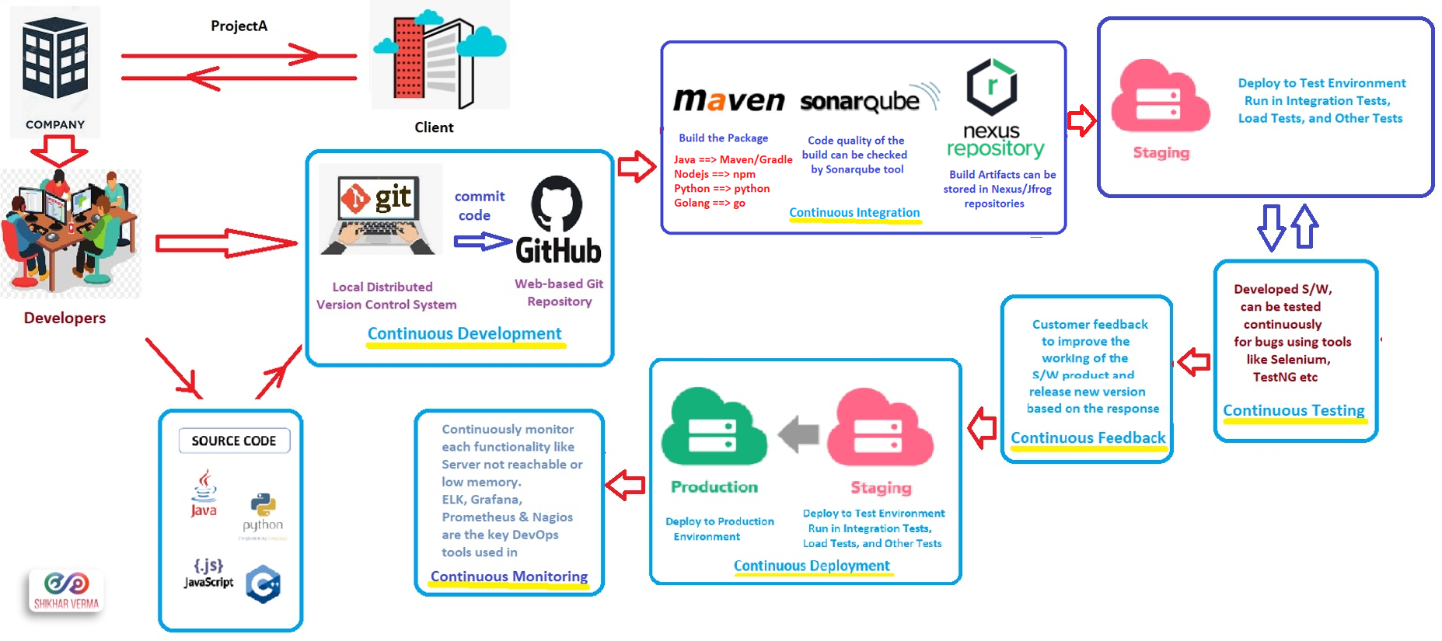
DevOps

Slide 11
DevOps
Continuous Testing
We need some mechanism to run test cases automatically.
Here, the developed software is continuously tested for bugs. A test environment is simulated with the use of Docker containers.
We will run continuous testing which will run against the deployed software using tools like Selenium, TestNG and which will generate a report to analyze the failed test cases easy.
TestNG, Selenium and JUnit are some of the DevOps tools used for automated testing and which runs once the build is deployed and after CD process these tools comes into the picture.
Selenium does the automation testing, and TestNG generates the reports. This entire testing phase can automate with the help of a Continuous Integration tool called Jenkins.
DevOps Lifecycle

Slide 12
DevOps
Continuous Feedback
The application performance is improved consistently by analyzing the final outcome of the product.
The continuous feedback is an important phase of the software application where customer feedback is a big asset to improve the working of the current software product and release new versions quickly based on the response.
DevOps Lifecycle

Slide 14
DevOps
Continuous Deployment
In this phase, the finalized application code is deployed to the production servers.
Conventionally, the phase of continuous deployment takes place before continuous monitoring.
Configuration Management is a key process in this phase, and it carries out the precise deployment of application code on all servers. Code is released to the servers, updates are scheduled for all servers, and these configurations are kept consistent throughout the production process.
Ansible, Puppet, and Chef are some of the effective DevOps tools used for Configuration Management, where they frequently execute the quick and continuous deployment of new code. Docker & Kubernetes are also used in this phase.
DevOps Lifecycle

Slide 15
DevOps
Continuous Monitoring
In this phase, developers record data on the use of application and continuously monitor each functionality. “Server not reachable” or “low memory” are some of the common system errors resolved in this phase.
ELK, Grafana, Prometheus and Nagios are the key DevOps tools used in continuous monitoring.
DevOps Lifecycle

Slide 16
DevOps
Continuous Operations
The last phase of the DevOps lifecycle is the shortest phase and the least complicated one. The purpose of continuous operation is to automate the process of releasing the application and the subsequent updates.
Development cycles in continuous operations are shorter, allowing developers to ongoingly accelerate the time-to-market for the application. Conventionally, the phase of continuous deployment takes place before continuous monitoring.
DevOps Lifecycle

Slide 18
DevOps
Apache Maven is a software project management and comprehension tool and based on the concept of a project object model (POM), maven can manage a project’s build, reporting and documentation from a central piece of information.
For the person building a project, this means that it is only necessary to learn a small set of commands to build any Maven project, and the POM will ensure they get the results they desired.
There are three built-in build lifecycles: default, clean and site.
The default lifecycle handles your project deployment,
The clean lifecycle handles project cleaning,
The site lifecycle handles the creation of your project's web site.
Official Website: https://maven.apache.org/guides/introduction/introduction-to-the-lifecycle.html
Maven Tool

Slide 19
DevOps
There are three types of repositories.
Local ➔ $(HOME)/.m2/repository
Remote/Private ➔ Nexus/Jfrog
Central/Public ➔ Public from maven website
Maven Tool

Slide 21
DevOps
SonarQube is a Code Quality Assurance tool that collects and analyzes source code, and provides reports for the code quality of your project.
Static code analysis for 17 languages
Java, C#, JavaScript, TypeScript, CloudFormation, Terraform, Kotlin, Ruby, Go, Scala, Flex, Python, PHP, HTML, CSS, XML and VB.NET
Detect Bugs & Vulnerabilities
Review Security Hotspots
Track Code Smells & fix your Technical Debt
Code Quality Metrics & History
CI/CD integration
Extensible, with 50+ community plugins
SonarQube

Slide 22
DevOps
Setup PostgreSQL Database for SonarQube

Slide 23
DevOps
Integrate nexus with maven project

Slide 24
DevOps
Integrate gradle with nexus

Slide 26
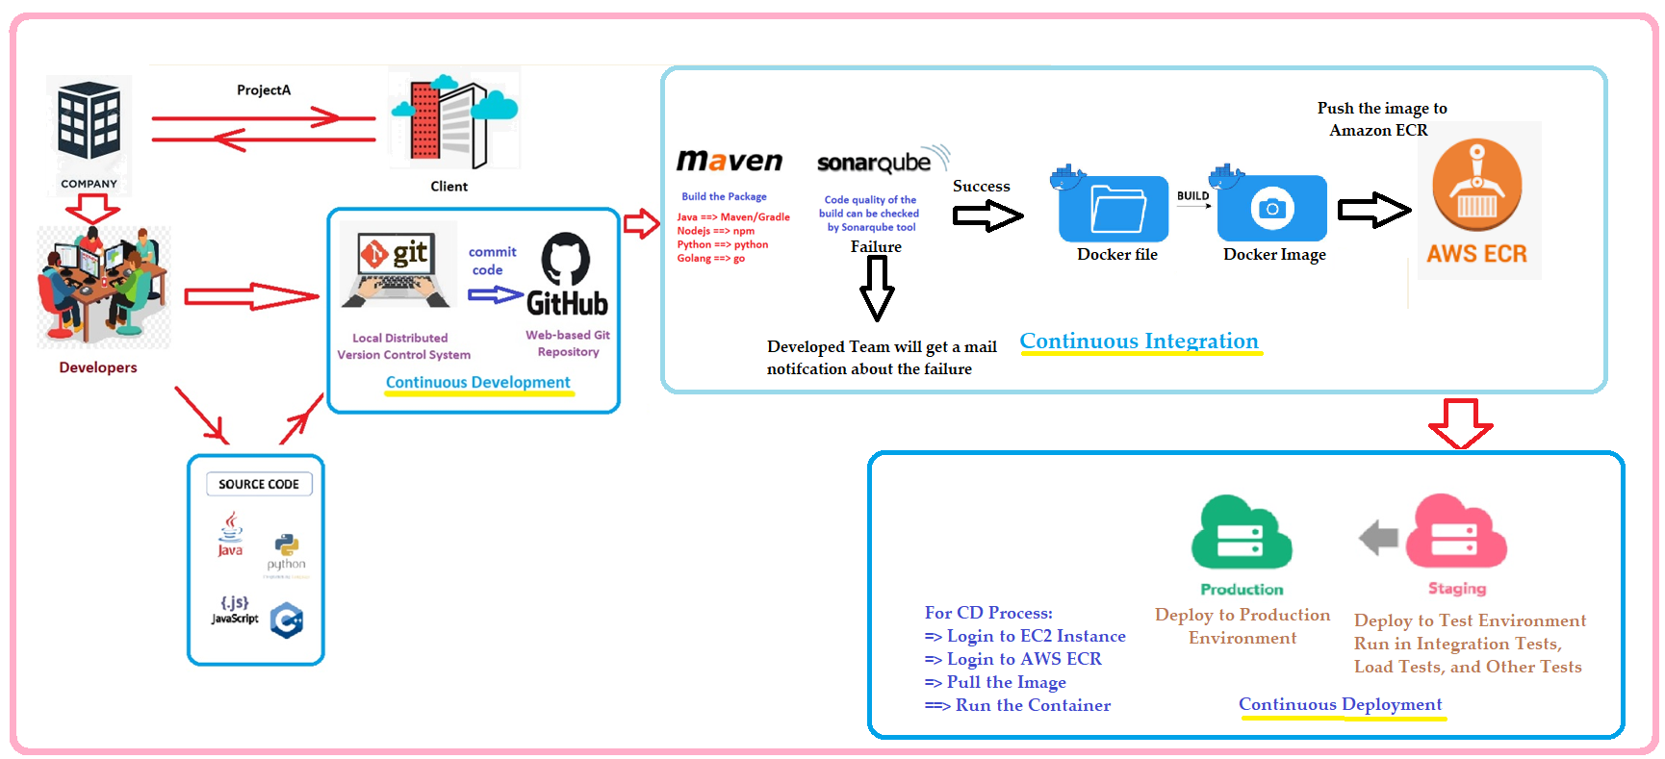

Slide 27
DevOps
Jenkins Pipeline (or simply "Pipeline" with a capital "P") is a suite of plugins which supports implementing and integrating continuous delivery pipelines into Jenkins.
A continuous delivery (CD) pipeline is an automated expression of your process for getting software from version control right through to your users and customers. Every change to your software (committed in source control) goes through a complex process on its way to being released. This process involves building the software in a reliable and repeatable manner, as well as progressing the built software (called a "build") through multiple stages of testing and deployment.
The definition of a Jenkins Pipeline is written into a text file (called a Jenkinsfile) which in turn can be committed to a project’s source control repository.
Jenkins Pipeline

Slide 28
DevOps
Jenkins has two types of pipelines:
Declarative pipeline
Scripted pipeline
Declarative and Scripted Pipelines are constructed fundamentally differently. Declarative Pipeline is a more recent feature of Jenkins Pipeline which:
provides richer syntactical features over Scripted Pipeline syntax, and
is designed to make writing and reading Pipeline code easier.
It break down stages into individual stages that can further have multiple steps in that.
For Scripted pipeline, you need to have knowledge on Apache groovy.
Jenkins Pipeline

Slide 29
DevOps
Jenkins is, fundamentally, an automation engine which supports a number of automation patterns. Pipeline adds a powerful set of automation tools onto Jenkins, supporting use cases that span from simple continuous integration to comprehensive CD pipelines. By modeling a series of related tasks, users can take advantage of the many features of Pipeline:
Code: Pipelines are implemented in code and typically checked into source control, giving teams the ability to edit, review, and iterate upon their delivery pipeline.
Durable: Pipelines can survive both planned and unplanned restarts of the Jenkins controller.
Pausable: Pipelines can optionally stop and wait for human input or approval before continuing the Pipeline run.
Versatile: Pipelines support complex real-world CD requirements, including the ability to fork/join, loop, and perform work in parallel.
Extensible: The Pipeline plugin supports custom extensions to its DSL [1] and multiple options for integration with other plugins.
Why Pipeline

Slide 30
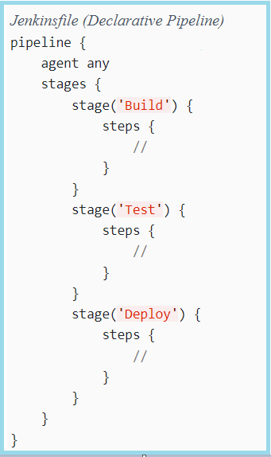
DevOps
Declarative Pipeline fundamentals

