Slide 1
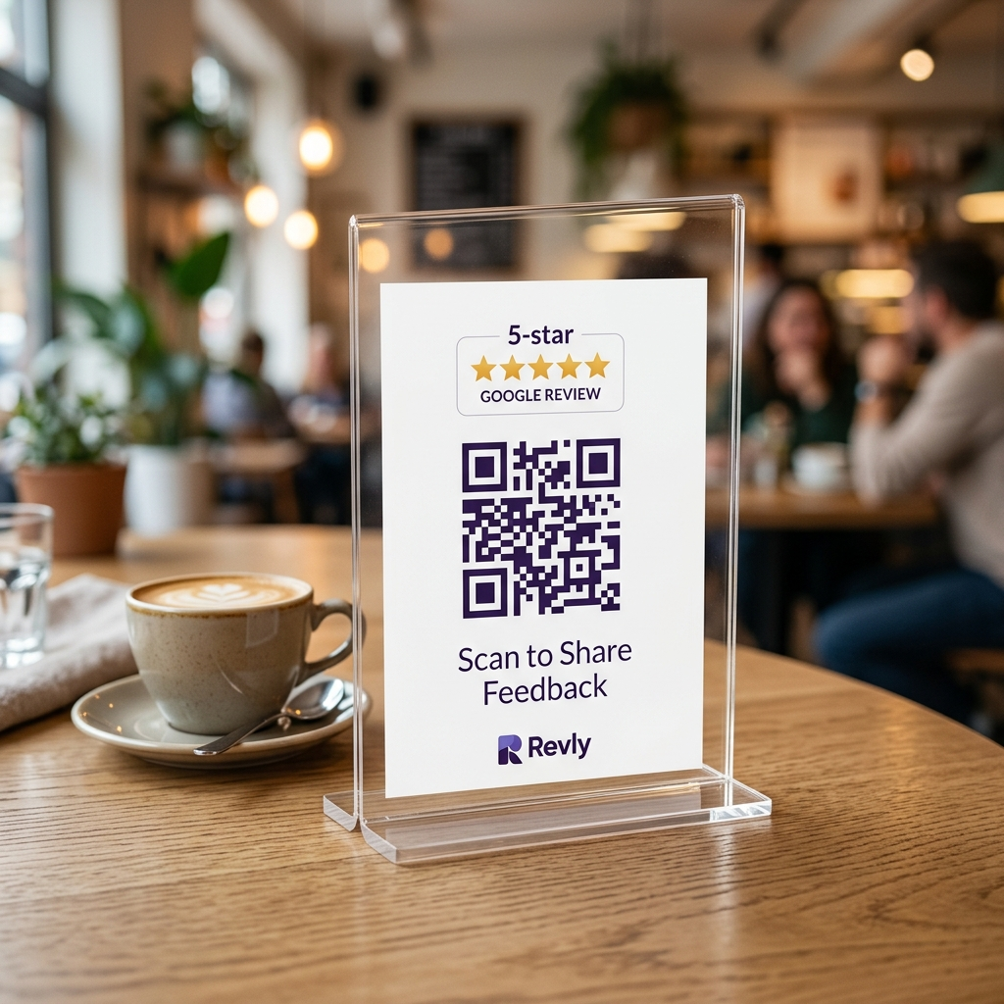
⚡ GOOGLE MAPS GROWTH ENGINE
Turn Every Walk-In
Into a 5-Star
Google Review.
30-second tabletop QR feedback that ranks your local business #1 on Google Maps — automatically.
⏱️ 30 Sec Journey • ⚡ 100% Automated • 📱 Zero App Needed

Slide 2
THE PROBLEM
Great Footfall. Zero Google Visibility.
88%
People search Google Maps before visiting a local shop.
95%
Satisfied walk-in customers leave without writing any review.
Top 3
Only the top 3 spots on Google Maps get 75%+ of customer visits.
2 Words
Average review length ('Nice food'). Zero keywords for Google ranking.

Slide 3
THE SOLUTION
30 Seconds. From Table QR to #1 Google Rank.
STEP 1
0 App Download
Scan tabletop QR stander with mobile camera.
STEP 2
3 Emojis
Customer rates visit; AI drafts keyword-rich review instantly.
STEP 3
1 Tap Post
Review auto-copies & Google Maps opens. Done in 3 seconds.
👥 100% Leads Captured: Customer name & phone number saved automatically.

Slide 4
THE SECRET TO RANKING
Why Keywords Make or Break Your Google Rank
0 Keywords = 0 Ranking
“Nice food, super place.”
• Zero dish or service names
• Zero search keywords
• Google Maps completely ignores it
• Business stays invisible for 'near me' searches
Keywords = Top 3 Rank
“Loved the creamy Alfredo pasta and cold brew! Relaxing seating atmosphere.”
• Keywords Indexed: Alfredo pasta, cold brew, relaxing atmosphere
• Google recognizes your exact offerings
• Ranks #1 when locals search pasta, coffee, or hangout
• 100% human, authentic customer voice

Slide 5
KEY FEATURES
Built for Store Owners. Zero Tech Skills.
Custom Question Bank
Tailored for Cafes, Salons, Clinics, Gyms & Retail. 3 random questions per scan.
Customer Contact CRM
Captures names and phone numbers to identify repeat loyal visitors.
Operational Health Scores
Live ratings for food, staff speed, and cleanliness to catch issues early.
Branded Tabletop Standers
Custom shop colors, logo, and print-ready QR codes for tables and counters.

Slide 6
BUSINESS ROI
Proven Results from Day One
10x
Monthly Google Review Velocity
Turn silent walk-ins into 5-star brand promoters.
#1 Rank
Top 3 Google Maps Placement
Outrank competitors without spending on paid ads.
2,000+
Phone Leads Captured / Month
Own your customer database for festival campaigns.
0 Effort
100% Automated & Staff-Free
Zero manual follow-ups, zero awkward staff begging.
🎯 Every customer who enters your shop is a Google Ranking opportunity.
Revly turns that daily footfall into permanent Google Maps dominance.

