Slide 1
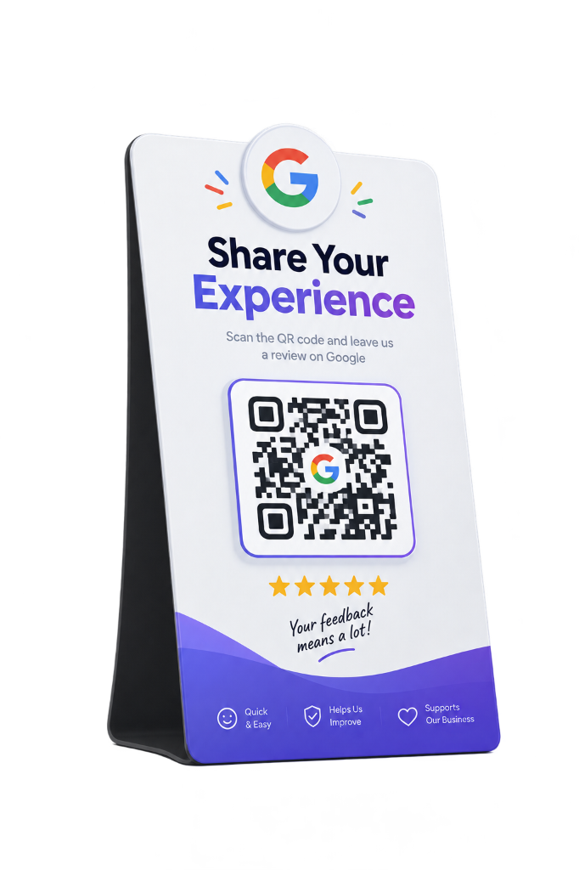
⚡ AI-POWERED LOCAL SEO ENGINE
Turn Every Walk-In
Into a 5-Star
Google Review.
30-second tabletop QR feedback that ranks your local business #1 on Google Maps — completely automated.
⏱️ 30 Sec Journey • ⚡ 100% Automated • 📱 Zero App Needed

Slide 2
THE PROBLEM
Great Footfall. Zero Google Visibility.
88%
Local Search Dominance
People search Google Maps before visiting a local shop or cafe.
95%
The Silent Customer Exit
Satisfied walk-in customers leave without writing any Google review.
Top 3
The Winner's Circle
Only the top 3 spots on Google Maps get 75%+ of customer visits.
2 Words
The Generic Review Trap
Average review length ('Nice food'). Zero keywords for Google ranking.

Slide 3
THE SOLUTION
30 Seconds. From Table QR to #1 Google Rank.
STEP 1
0 App Download
📱 Instant Camera Scan
Customer scans the tabletop stander with their smartphone camera. Loads in under 1 second.
STEP 2
3 Emojis
⚡ Smart Micro-Feedback
Customer rates 2-3 quick aspects. AI weaves ratings + targeted SEO keywords into a genuine draft.
STEP 3
1 Tap Post
⭐ Google Maps Post
Review auto-copies & Google Maps opens. Customer pastes and posts in 3 seconds!
👥 100% Leads Captured: Customer name & phone number saved automatically into your private CRM.

Slide 4
THE LOCAL SEO SECRET
Why Keywords Make or Break Your Google Rank
❌ 0 Keywords = 0 Ranking
“Nice food, super place.”
• Zero dish or service names mentioned
• Zero search keywords for Google's algorithm
• Google Maps completely ignores it
• Business stays invisible for 'near me' searches
✅ Keywords = Top 3 Rank
“Loved the creamy Alfredo pasta and cold brew! Relaxing seating atmosphere.”
• Keywords Indexed: Alfredo pasta, cold brew, relaxing atmosphere
• Google recognizes your exact offerings
• Ranks #1 when locals search pasta, coffee, or hangout
• 100% human, authentic customer voice

Slide 5
KEY FEATURES
Built for Store Owners. Zero Tech Skills Needed.
🎯 Custom Question Bank
Tailored for Cafes, Salons, Clinics, Gyms & Retail. 3 random questions per scan.
👥 Customer Contact CRM
Captures names and mobile numbers to identify repeat loyal visitors automatically.
📊 Operational Health Scores
Live ratings for food, staff speed, and cleanliness to catch issues early.
🏷️ Branded Tabletop Standers
Custom shop colors, logo, and print-ready QR codes for tables and counters.

Slide 6
BUSINESS ROI
Proven Results from Day One
10x
Monthly Google Review Velocity
Turn silent walk-ins into active 5-star brand promoters.
#1 Rank
Top 3 Google Maps Placement
Outrank competitors without spending on paid ads.
2,000+
Phone Leads Captured / Month
Own your customer database for festival campaigns.
0 Effort
100% Automated & Staff-Free
Zero manual follow-ups, zero staff begging.
🎯 Every customer who enters your shop is a Google Ranking opportunity.
Revly turns that daily footfall into permanent Google Maps dominance.

