Slide 1
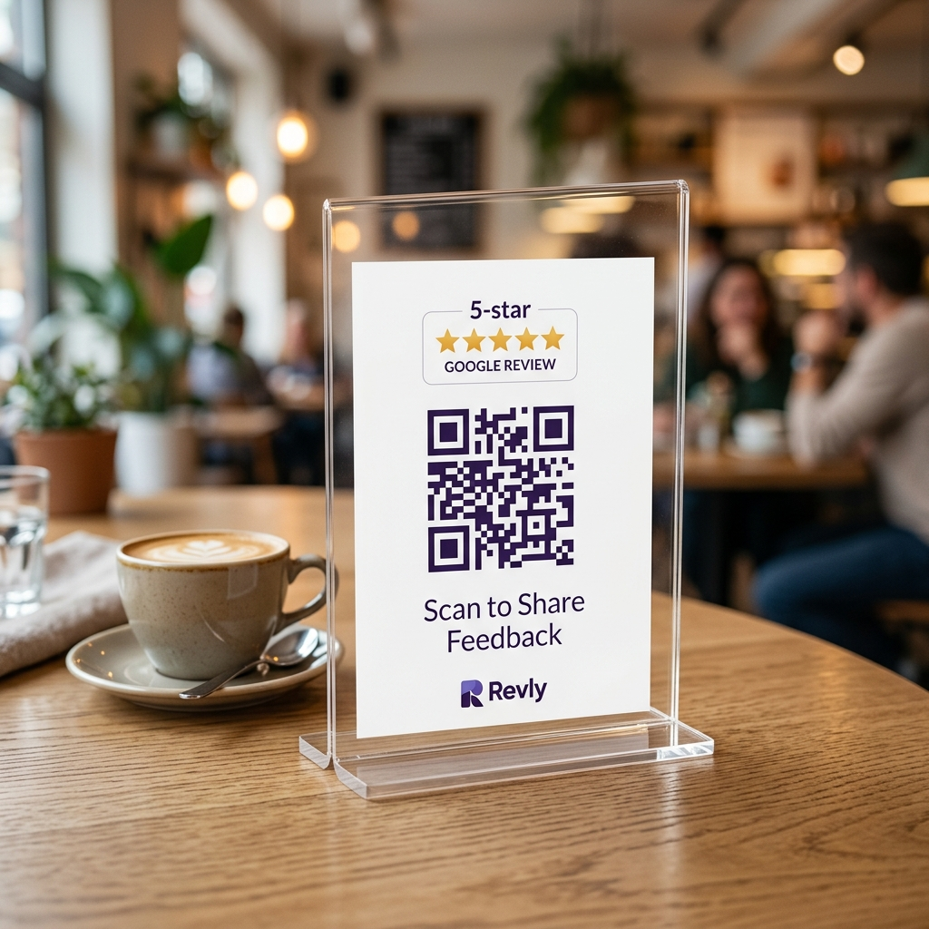
✨ AI-POWERED GOOGLE MAPS ENGINE
Turn Every Walk-In
Into a 5-Star
Google Review.
Revly turns tabletop QR feedback into authentic, keyword-rich Google reviews in 30 seconds — boosting your Google Maps #1 rank automatically.
⏱️ 30 Sec Journey • ⚡ 100% Staff-Free • 📱 Zero App Needed

Slide 2
THE PROBLEM
Why Great Businesses Stay Invisible on Google Maps
1. Hidden on Google Maps
88% of shoppers search on Google before visiting, but competitors with more reviews take the top 3 spots. If you're not in the top 3, you are invisible.
2. The Friction Barrier
95% of happy customers walk out without reviewing. Asking in person is awkward for staff, and customers forget the second they leave the store.
3. The 'Nice & Good' Trap
When customers do post, they write: 'Nice food' or 'Good salon'. These 2 words contain zero keywords. Google's algorithm gives your shop zero ranking credit.
4. Zero Customer Data
Customers pay via cash or UPI and walk away. The owner has no contact number, no visit history, and no way to invite them back for slow days.

Slide 3
THE SOLUTION
The Revly 30-Second Growth Engine
STEP 1
Scan Tabletop QR
Customer scans branded stander with their mobile camera.
• Zero app download
• Instant web load (<1s)
• Zero login barrier
STEP 2
3-Tap Micro-Feedback
Customer rates 2-3 quick emoji questions about their visit.
• AI weaves experience
• Automatically inserts high-value SEO keywords
• 100% human tone
STEP 3
1-Tap Google Post
Customer clicks 'Post to Google'. Review is copied & Maps opens.
• Customer simply pastes
• Submitted in 3 seconds
• Name & mobile saved to CRM
🚀 Result: Customer completes the review effortlessly • Business gains Google SEO ranking power + Verified Customer Lead.

Slide 4
THE LOCAL SEO SECRET
Why Keyword-Rich Reviews Drive #1 Google Rankings
❌ WITHOUT REVLY (Generic Review)
“Nice food, super place.”
• Zero dish names or service mentions
• Zero local area search signals
• Google's algorithm ignores it
• Completely invisible for 'near me' discovery searches
✅ WITH REVLY (AI Keyword-Rich Review)
“Loved the creamy Alfredo pasta and hazelnut cold brew! The seating atmosphere was so relaxing. Top cafe spot in the area.”
• Keywords Indexed: Alfredo pasta, hazelnut cold brew, seating atmosphere
• Signals relevance to Google's ranking algorithm
• Ranks at the Top when locals search for pasta or cold brew
• 100% human, authentic, customer-verified

Slide 5
POWERFUL PLATFORM
Core Features Built for Store Owners
🎯 Custom Question Builder
Configure specific questions for Cafes, Salons, Clinics, Gyms & Retail. 3 random questions served per scan so reviews cover all aspects.
👥 Customer Directory (CRM)
Captures customer names and phone numbers automatically. Identify loyal repeat guests and build an owned SMS/WhatsApp marketing database.
📊 Operational Health Analytics
Track scan counts, review conversion rates, and department ratings (Food Taste, Service Speed, Cleanliness) to fix operational flaws fast.
🏷️ Custom Branded Standers
Customized with your shop's official colors, logo badge, and high-resolution print-ready QR codes for tables, counters, and bill folders.

Slide 6
PROVEN BUSINESS IMPACT
Measurable ROI from Day One
5x – 10x
Monthly Google Review Velocity
Turn silent walk-in visitors into active 5-star brand promoters.
#1 Rank
Top 3 Google Maps Placement
Outrank competitors for high-intent searches without spending on ads.
500–2,000
Verified Phone Leads / Month
Own your customer database instead of relying on third-party aggregators.
100%
Automated & Staff-Free
Zero manual follow-ups, zero awkward staff begging at billing desks.
🎯 Every customer who visits your store is a Google Ranking opportunity.
Revly turns that daily footfall into permanent Google Maps dominance and customer loyalty.

