Slide 1
Name ;p.sai sudharshan reg no ;192110137

Slide 2
E-TOURISM
AIM; to analyse e-commerce application foR e –tourism.
TEST SENARIO;
> Travel Technology or commonly called as tourisM generation technology.
This is very similar to the digital tourism or e-tourism (electronic tourism).
Tourism is the fastest growing industry with a huge potential to generate employment.
E-Tourism is the digitization of all the processes and value chains in the tourism, travel, hospitality and catering.

Slide 3
Functional test cases;
The list of different functions are provided below:
• Management support
• Competition analysis
. Financial planning and control
• Accounting and finance • Marketing research
• Marketing strategy & implementation
. Middle term planning & feedback•
• Operational control management functions

Slide 4
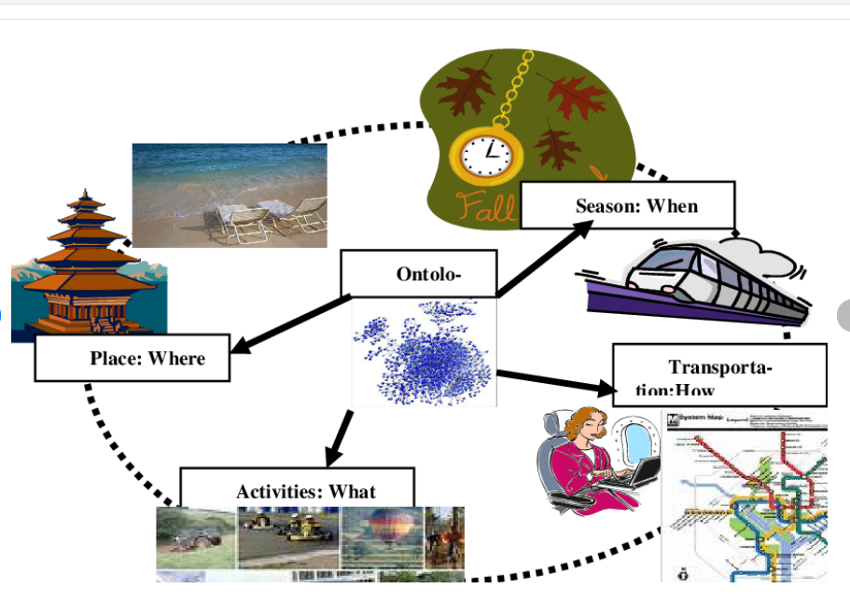
Searching places;

Slide 5
Positive test cases;
The technology in the tourism industry is an important one and has successfully delivered away far-flung locations very close.
Overall the IT application, software, mobile apps, and other technologies have helped in making the tourism industry fast and progressive!
The technology could make smooth routes work currently, humans use innovation to make plans for his or her journey, which makes it gradually nice and simple.
The technology could make smooth routes work currently, humans use innovation to make plans for his or her journey, which makes it gradually nice and simple.

Slide 6
Negative test cases;
The flood of improvement and industrialization has infected our environment.
Let’s take a case wherein the exhaust of machines and motors have an effect on air fine and harm the ozone layer.
Furthermore, technology moreover brings about monetary problems in households considering the maximum of the technology is high priced just like computers.
the visitors who've bodily remote from the sender and growth availability and receptiveness in an organization.

Slide 7
Coclusion;
we can say that tourism is a very productive activity both for the tourist and the government. As they support each other simultaneously. Also, the government should consider improving the conditions of the country as more and more number of tourist visit their county.
Above all, tourism is one of the fastest-growing industry in the world that has changed the scenario of the world.

Slide 8


