Slide 1
AWS
Realtime Threat Detection And Prevention

Slide 2
Table Of Content
Introduction
Architecture Diagram
Conclusion
Contents
Problem Statement
Prerequisites
Results
References

Slide 3
Problem Statement
Organizations using AWS face challenges in detecting and preventing security threats in real time. With increasing risks like unauthorized access and malicious activities, there’s a need for an automated security solution. By integrating AWS services such as GuardDuty, SNS, and Lambda, this architecture ensures swift threat detection, alerting, and automated response to minimize security risks.

Slide 4
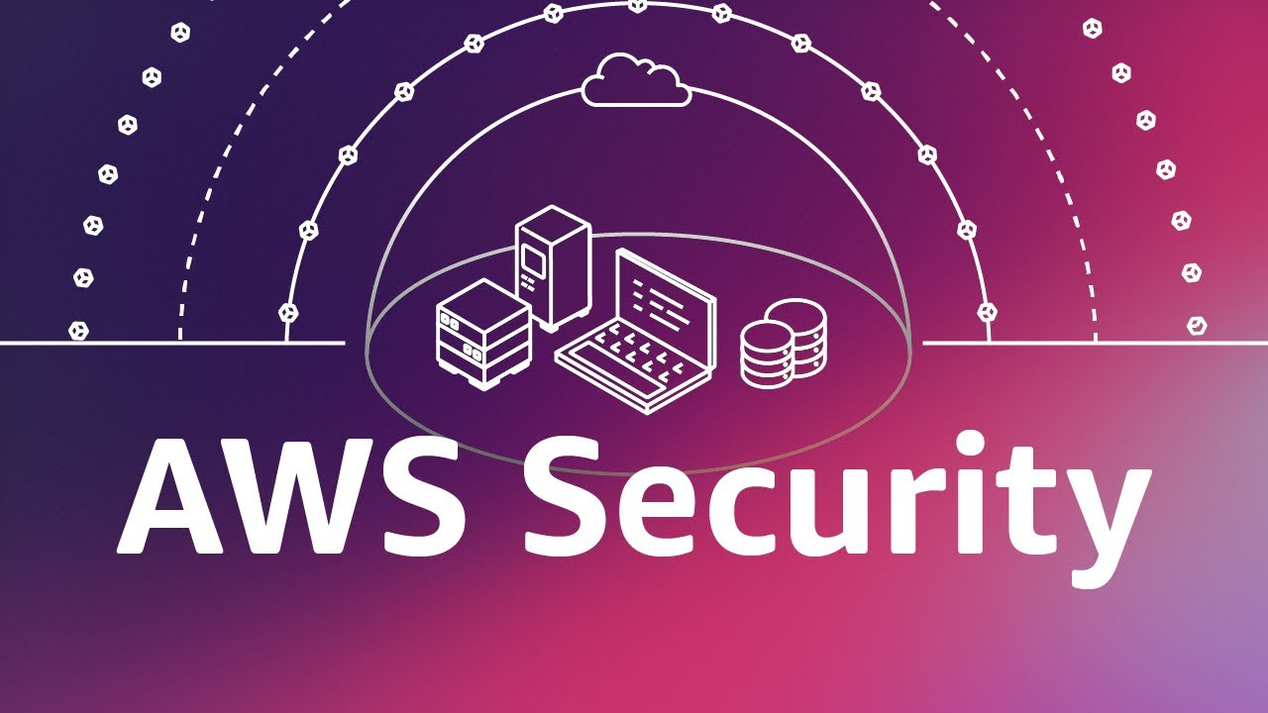
Introduction
In today’s cloud-driven landscape, security is a critical concern for organizations operating on AWS. As cyber threats such as unauthorized access, port scans, and malicious activities continue to rise, businesses need a proactive approach to detect and respond to threats in real-time.
This architecture leverages AWS-native services like GuardDuty, EventBridge, SNS, and Lambda to build a comprehensive threat detection and automated remediation solution. By integrating these services, organizations can effectively identify security risks, trigger alerts, and automatically isolate compromised resources, ensuring the cloud environment remains secure and resilient.
This presentation walks you through the step-by-step setup and benefits of this security architecture.

Slide 5
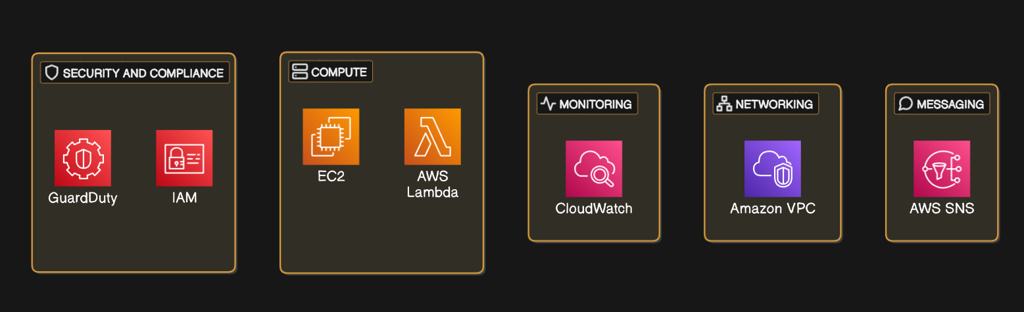
Prerequisites

Slide 6
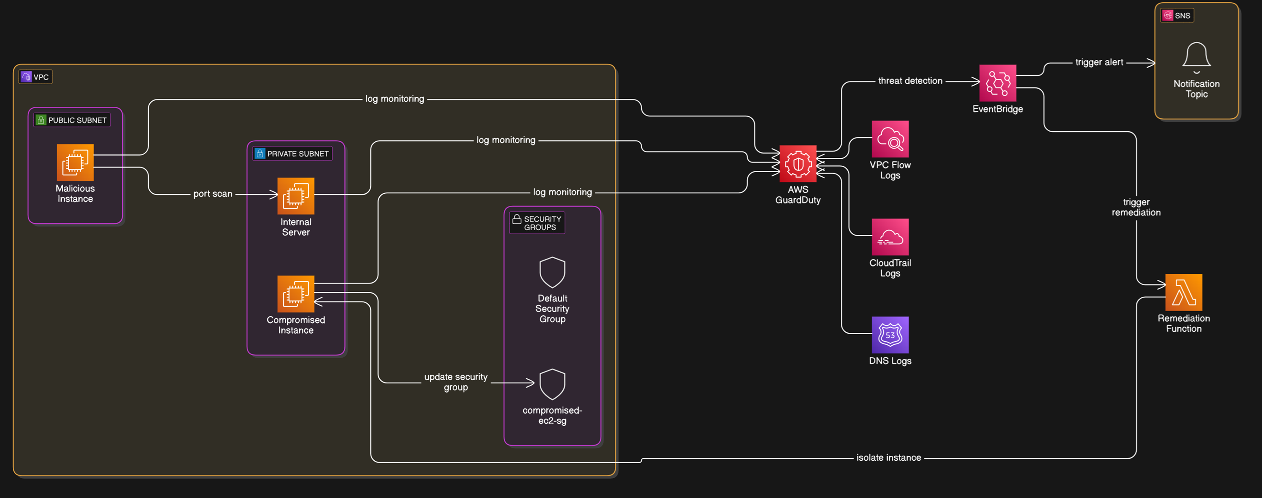
Architecture Diagram

Slide 7
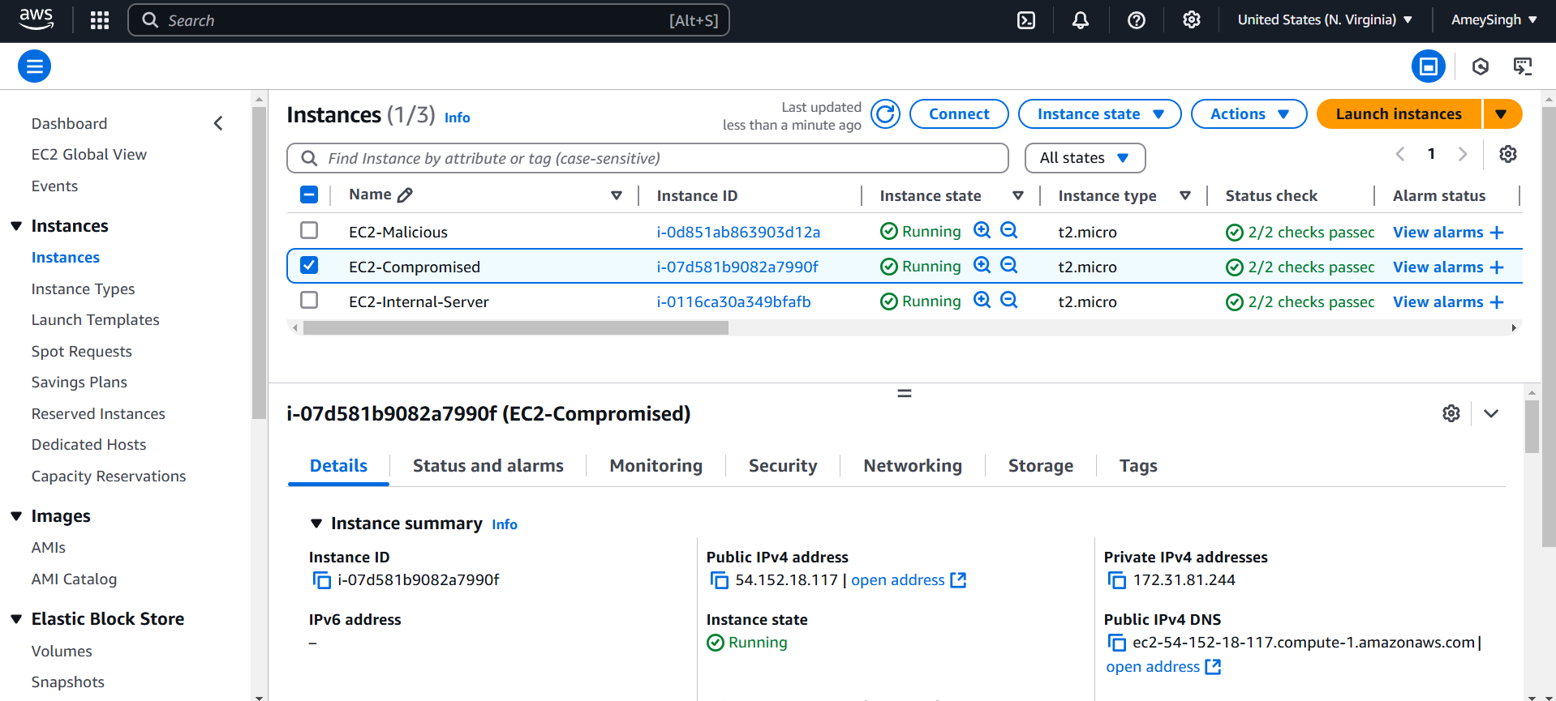
Result
Created 3 EC2-Instances for our given architecture for demonstration

Slide 8
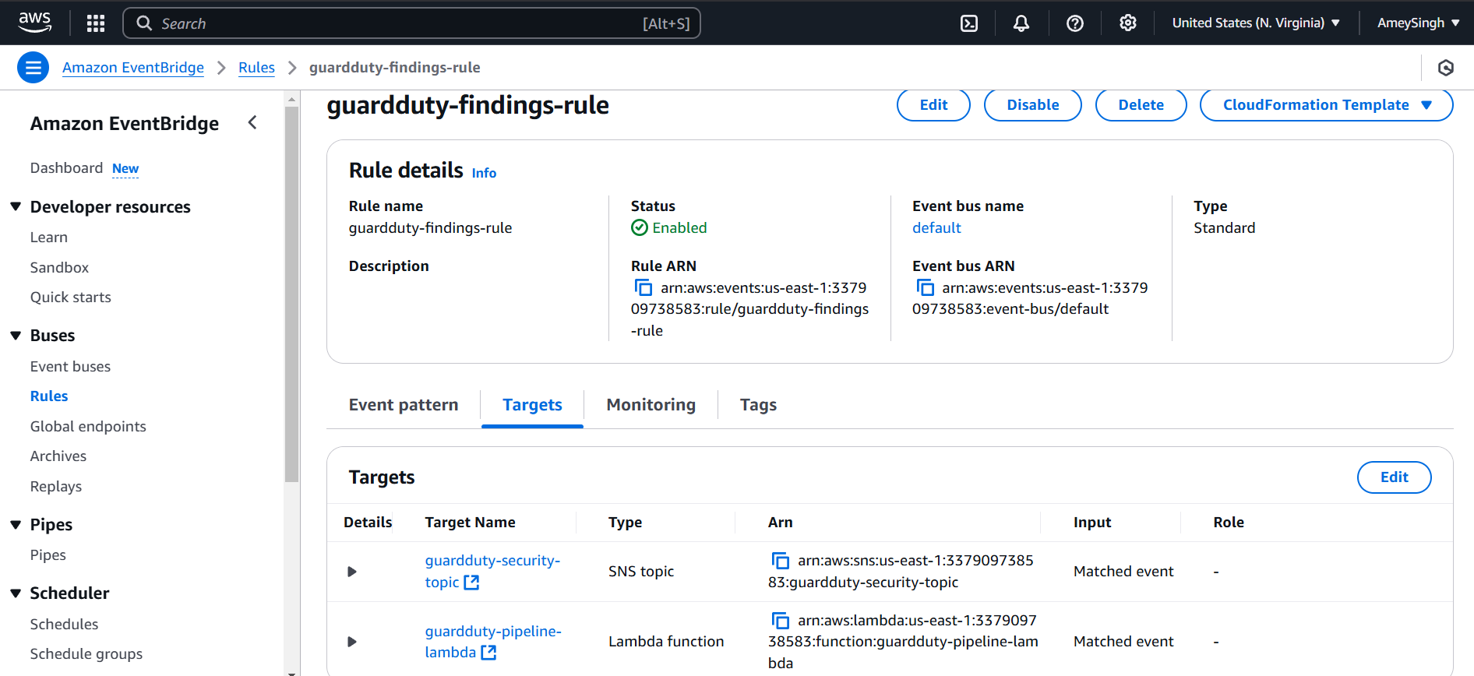
Result
Created CloudWatch rules for SNS and AWS Lambda function

Slide 9
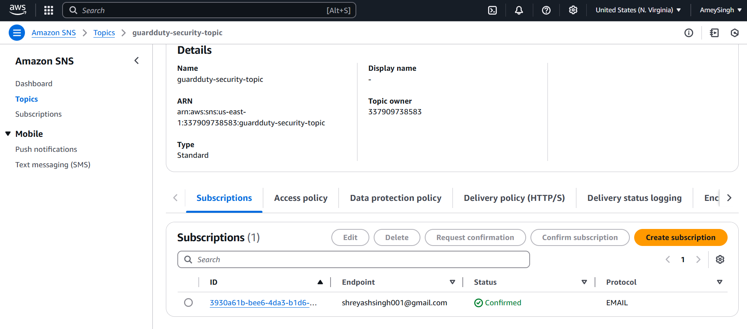
Result
Configured SNS for desired endpoint mail ID

Slide 10
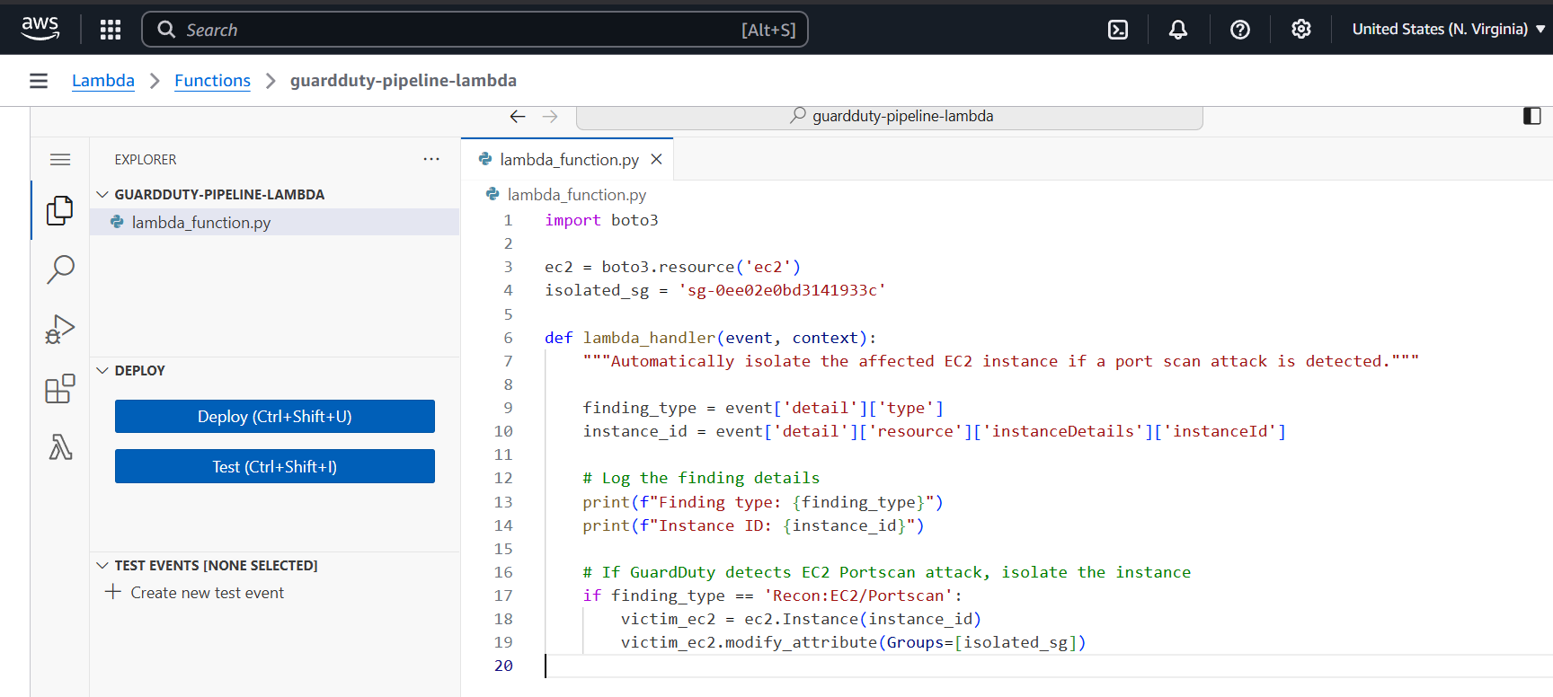
Result
Lambda function code to isolate an compromised instance by changing security group

Slide 11
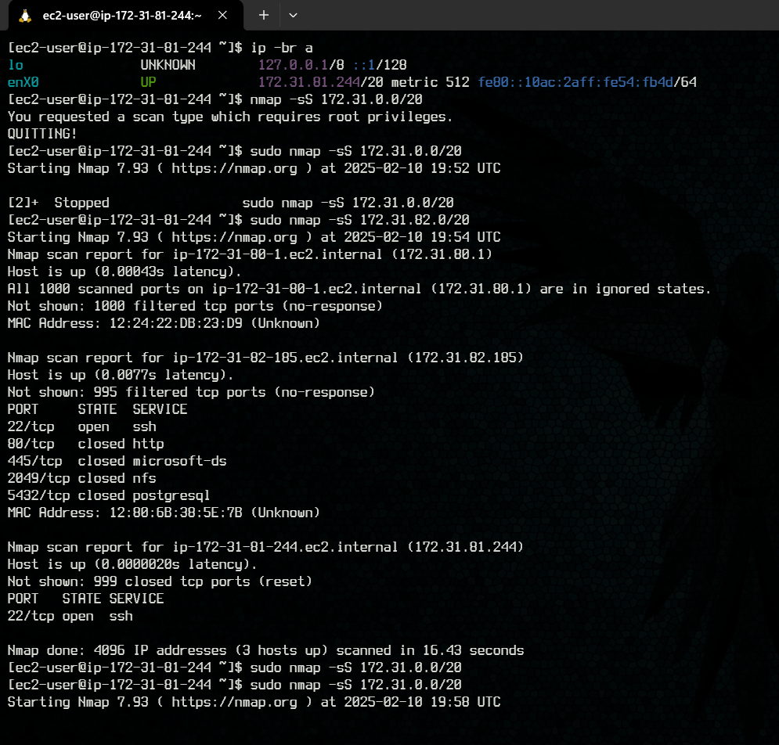
Result
Performing nmap to demonstrate portscan attack

Slide 12
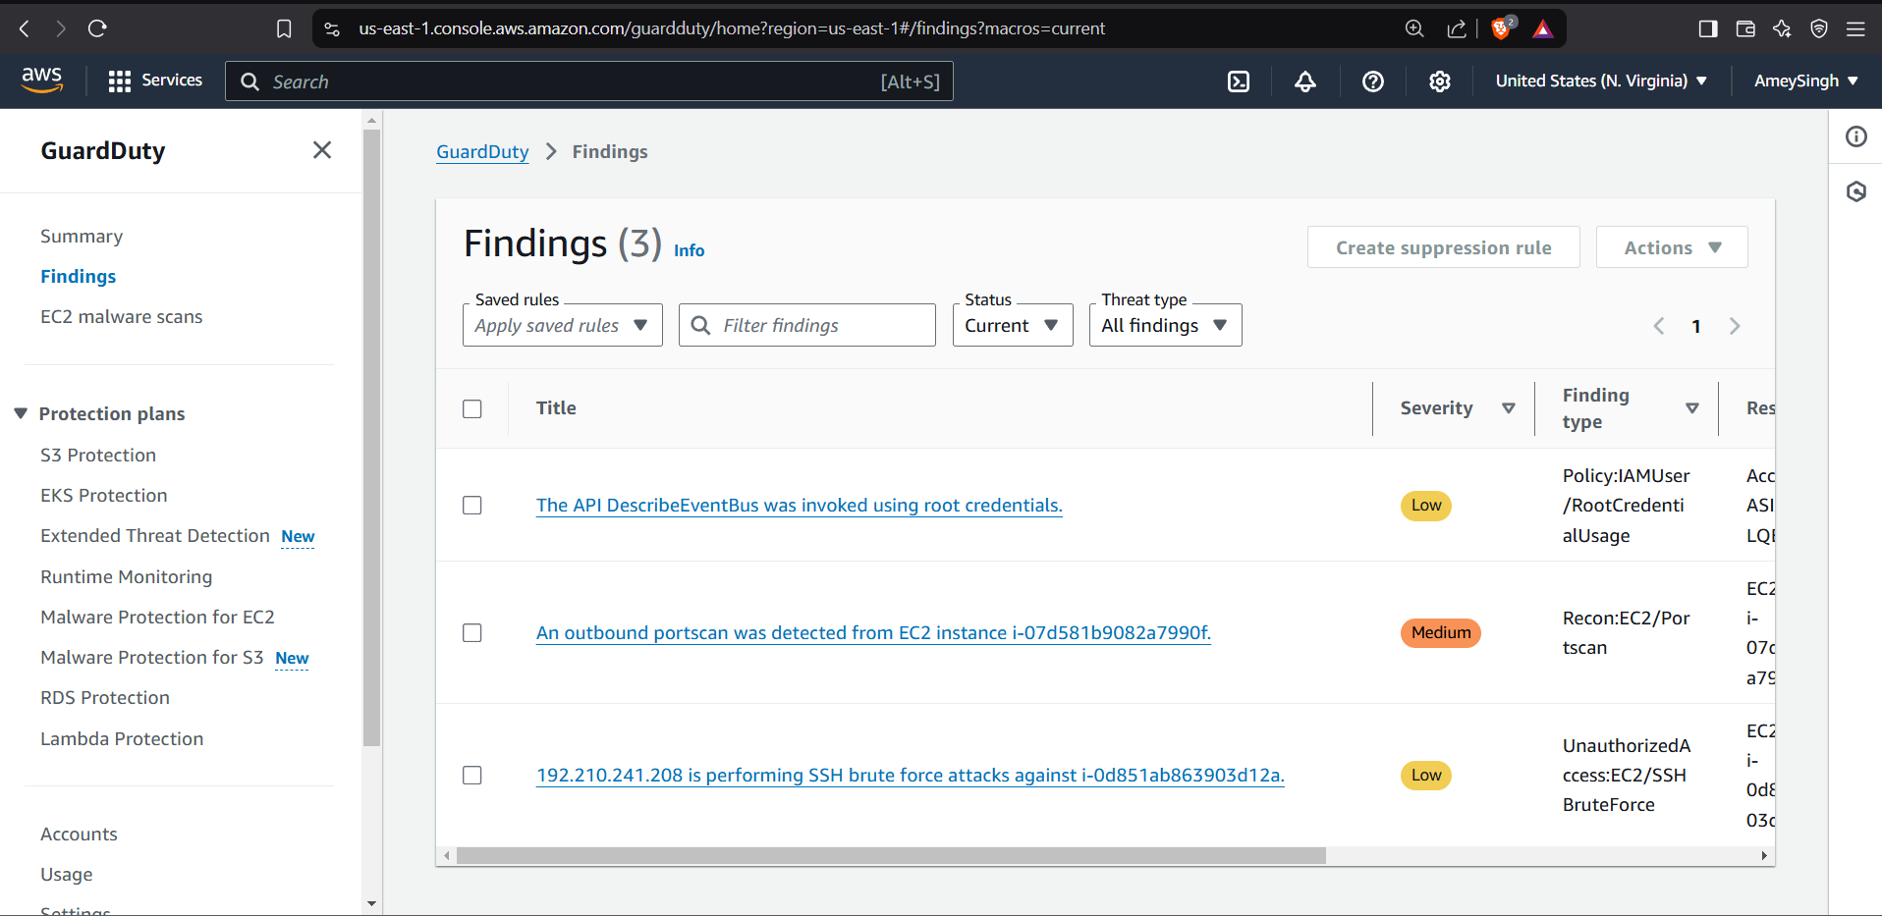
Result
Malicious activities scanned by GuardDuty

Slide 13
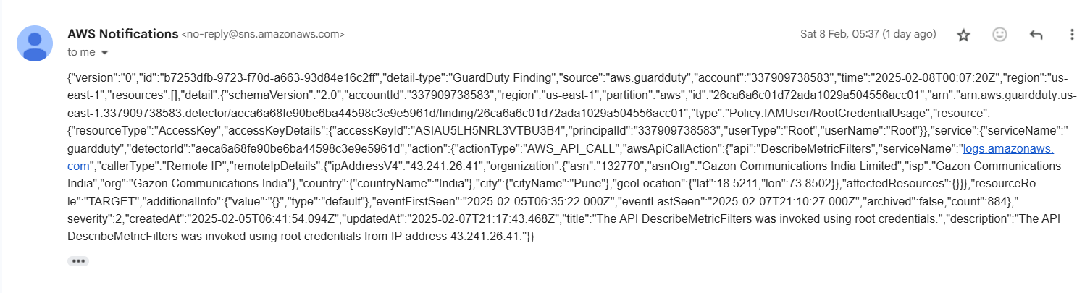
Result
SNS mail alert with JSON file

Slide 14
Conclusion
In conclusion, this architecture offers a comprehensive and efficient solution for real-time threat detection and automated security remediation in AWS environments. By integrating services such as GuardDuty for proactive threat identification and Lambda for swift preventive measures, organizations can enhance their cloud security posture, safeguard critical assets, and maintain operational efficiency while minimizing security risks.

Slide 15
Reference
https://aws.amazon.com/guardduty/
https://aws.amazon.com/guardduty/resources/
https://docs.aws.amazon.com/guardduty/latest/ug/guardduty_integrations.html
https://docs.amazonaws.cn/en_us/guardduty/latest/ug/infrastructure-security.html
https://docs.aws.amazon.com/AmazonCloudWatch/latest/monitoring/WhatIsCloudWatch.html
https://docs.aws.amazon.com/awssupport/latest/user/cloudwatch-events-ta.html
https://docs.aws.amazon.com/sns/latest/dg/sns-create-topic.html
https://docs.aws.amazon.com/sns/latest/dg/sns-setting-up.html

Slide 16
Thank You

