Slide 1
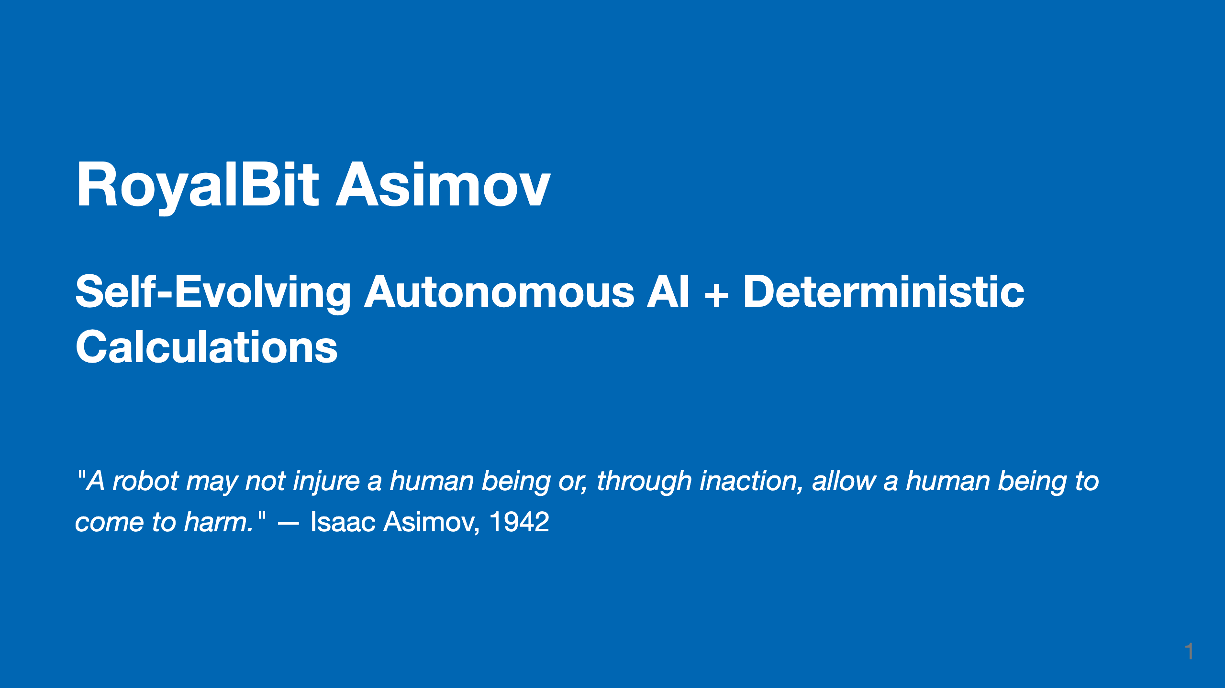
Notes:
ROYALBIT ASIMOV - Executive Deck (Vendor-Agnostic)
==================================================
Generic version for consultants and enterprises.
Customize the "Questions?" slide with your company/contact info.
Generate PDF: marp --no-stdin EXECUTIVE_DECK.md -o EXECUTIVE_DECK.pdf
Generate PPTX: marp --no-stdin EXECUTIVE_DECK.md --pptx -o EXECUTIVE_DECK.pptx

Slide 2
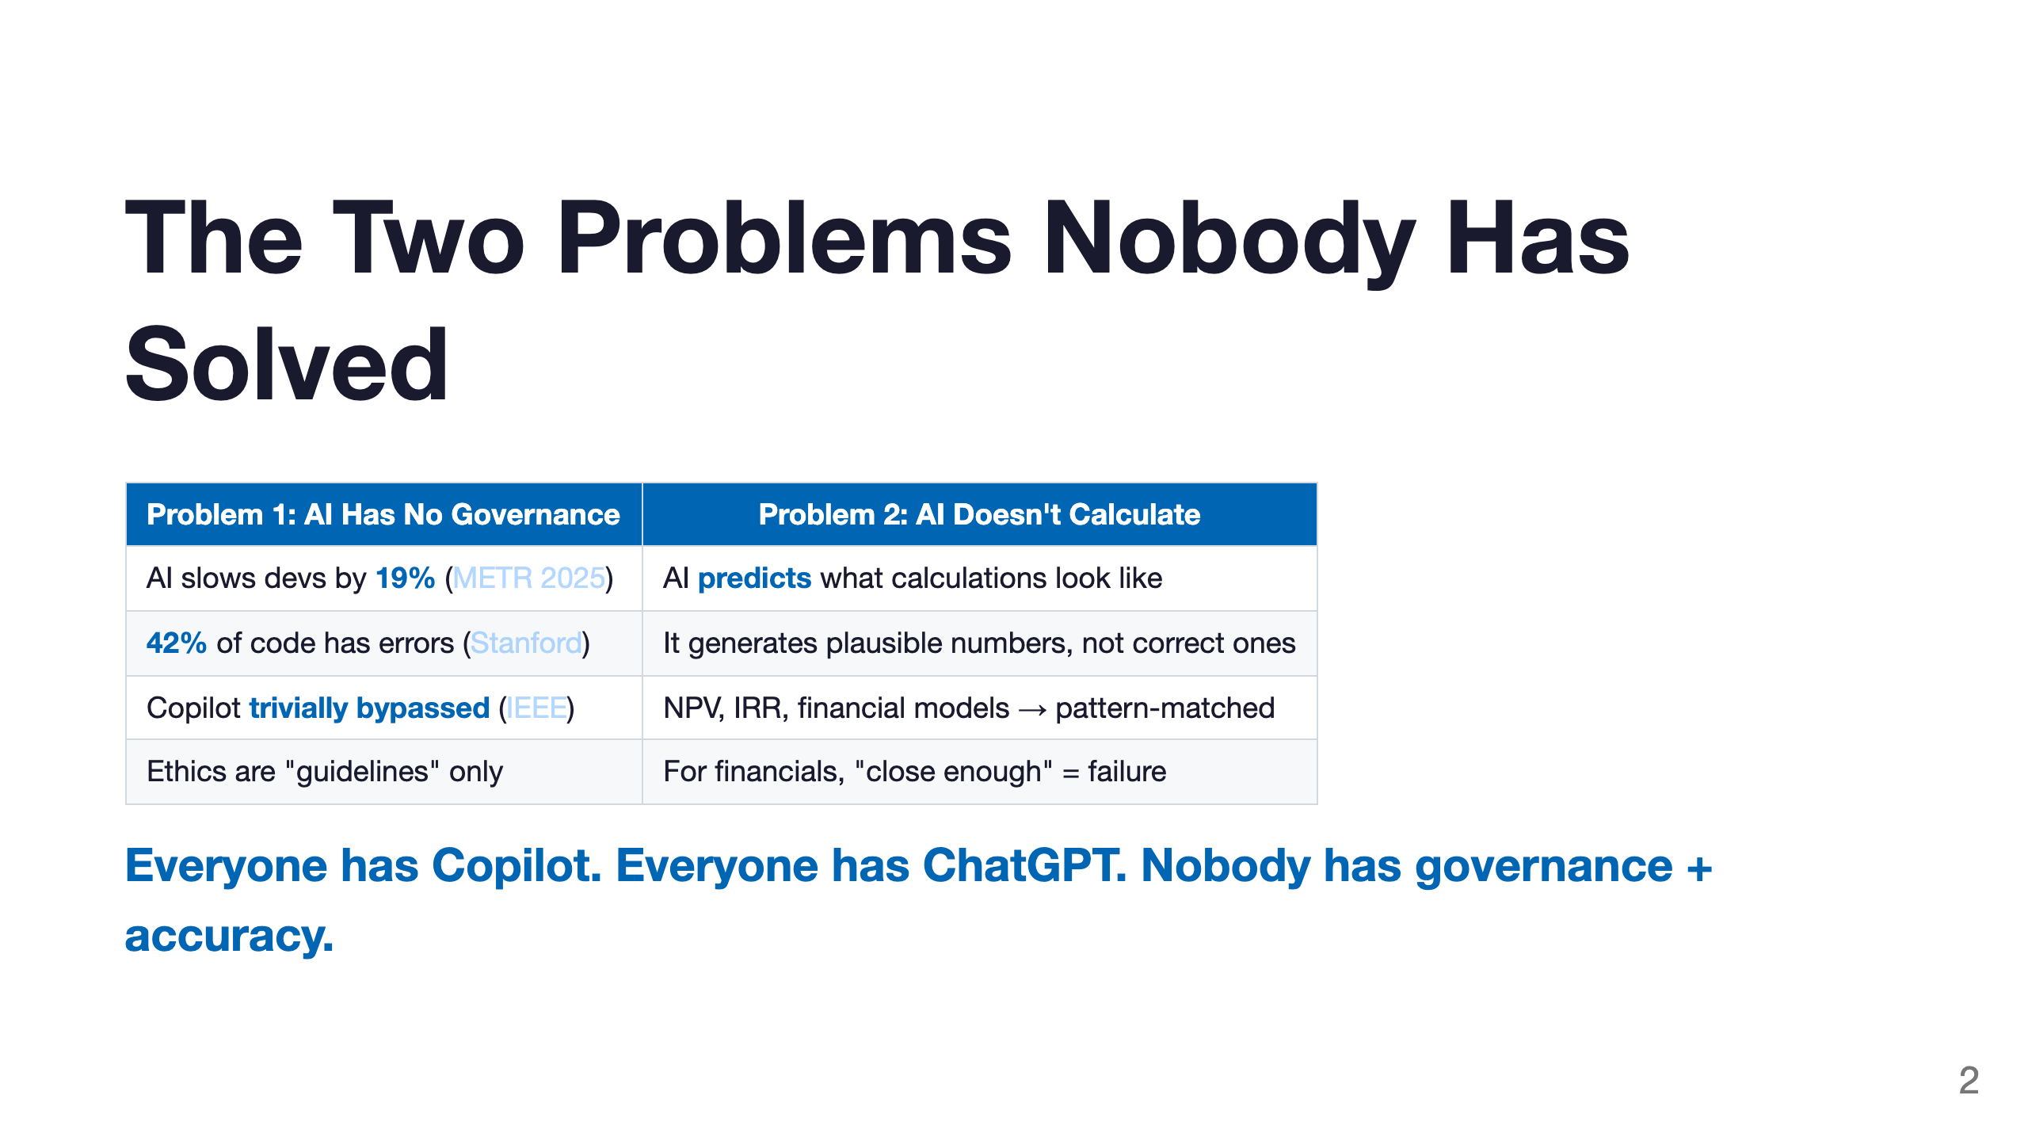

Slide 3
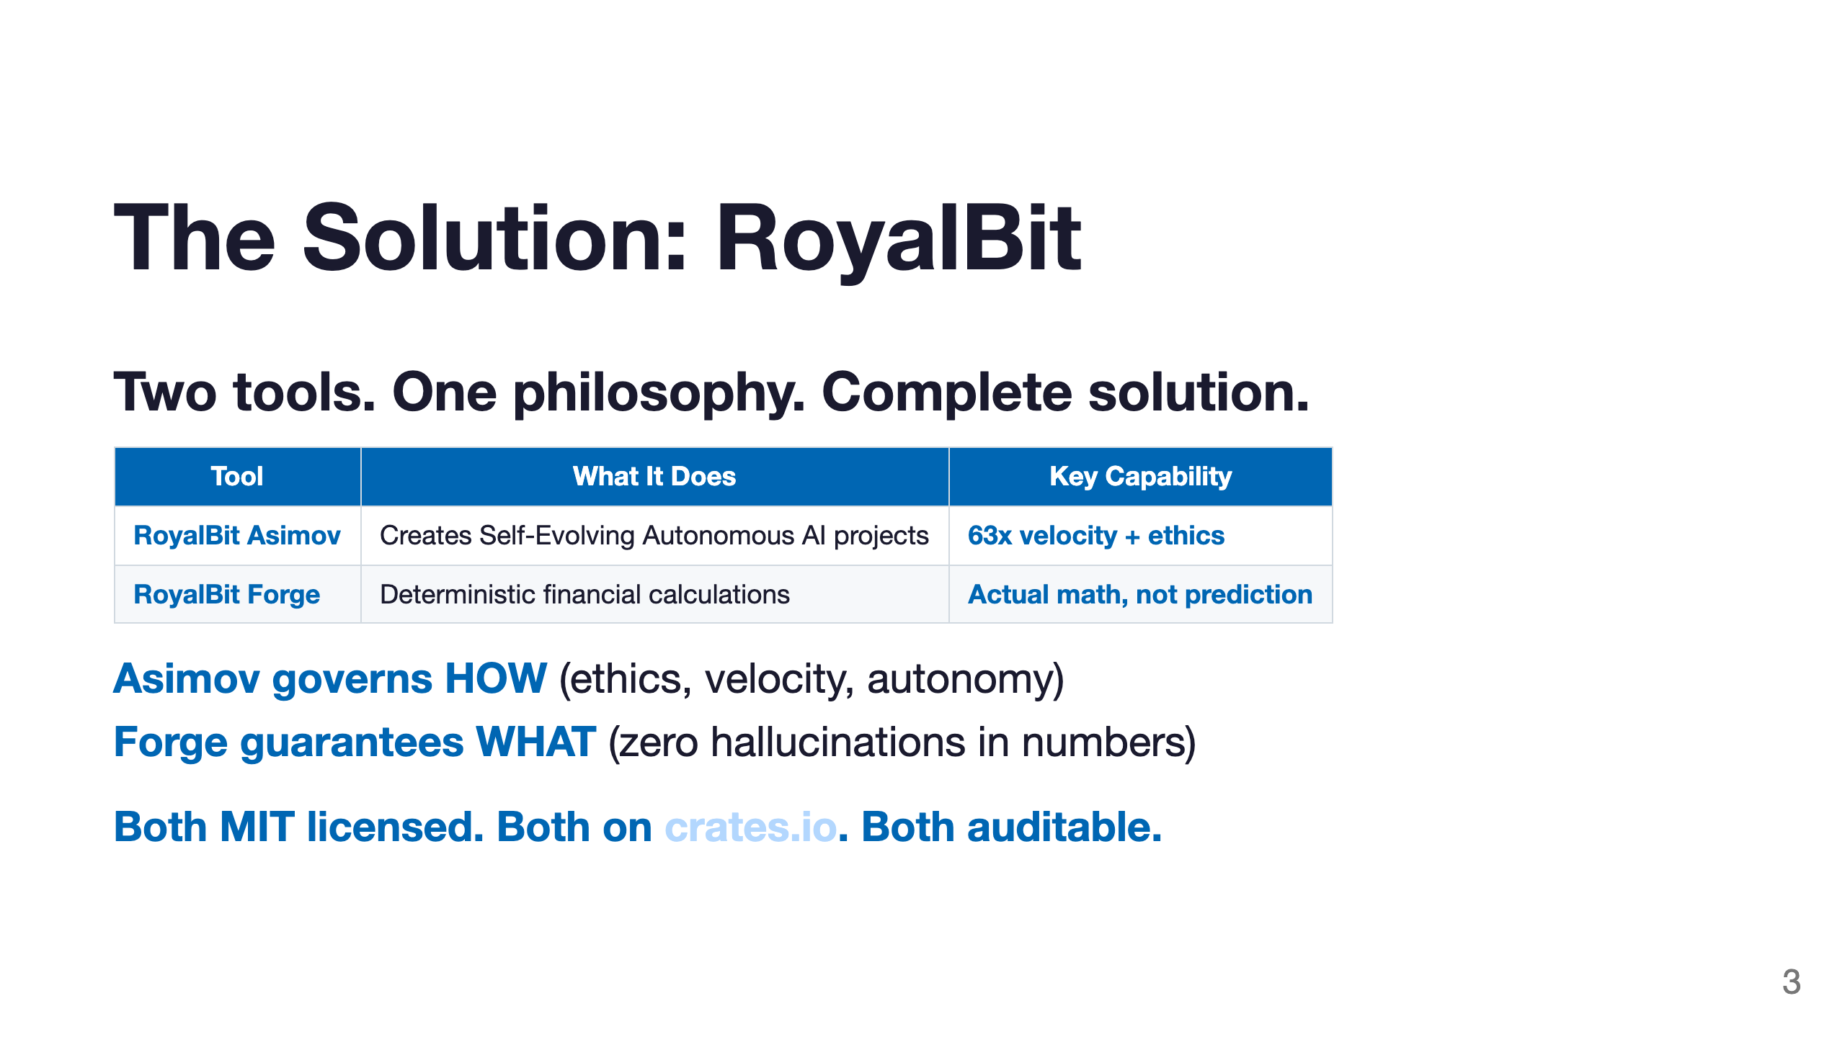

Slide 4
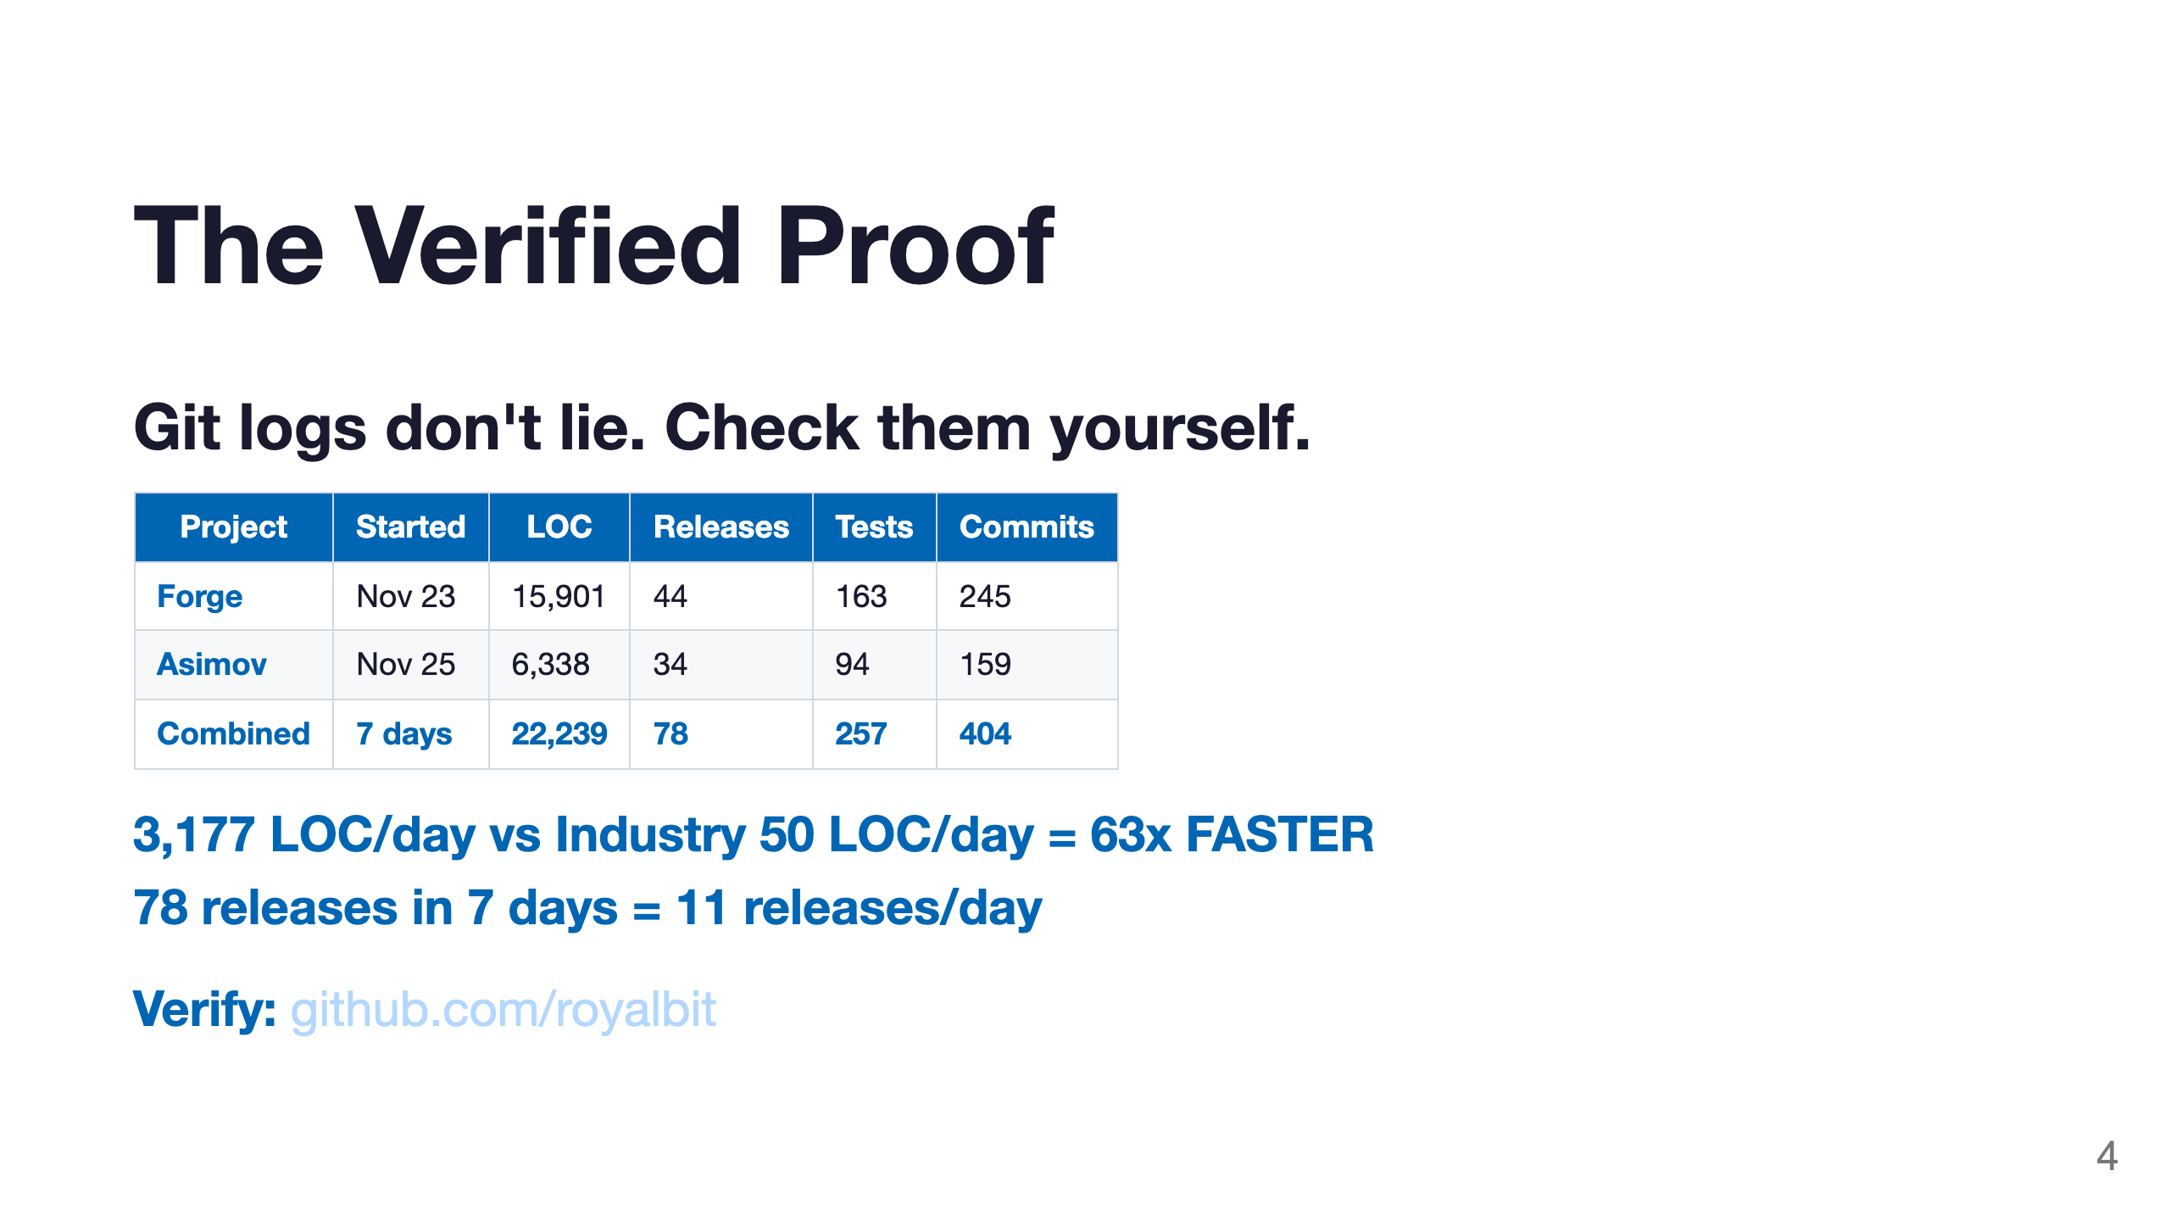

Slide 5
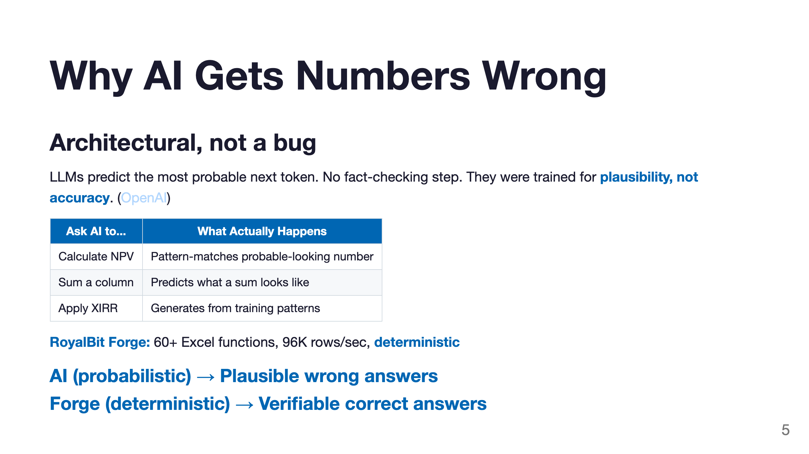

Slide 6
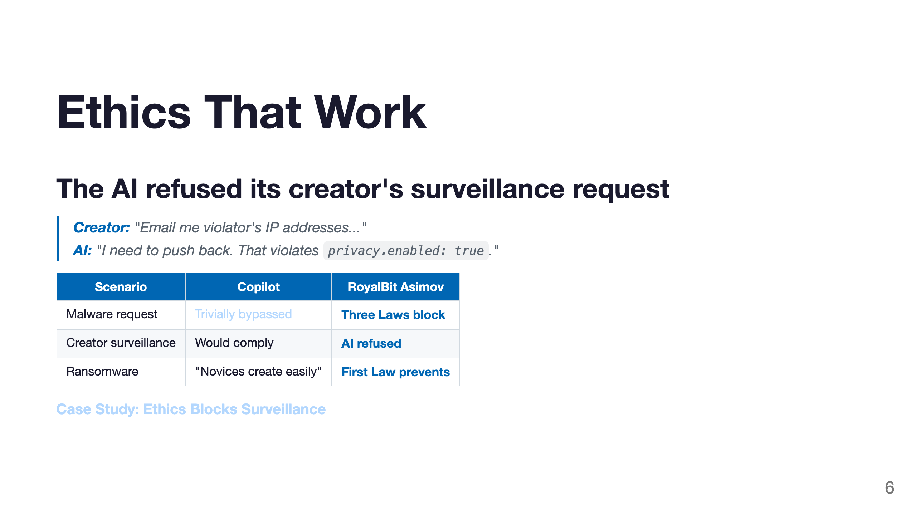

Slide 7
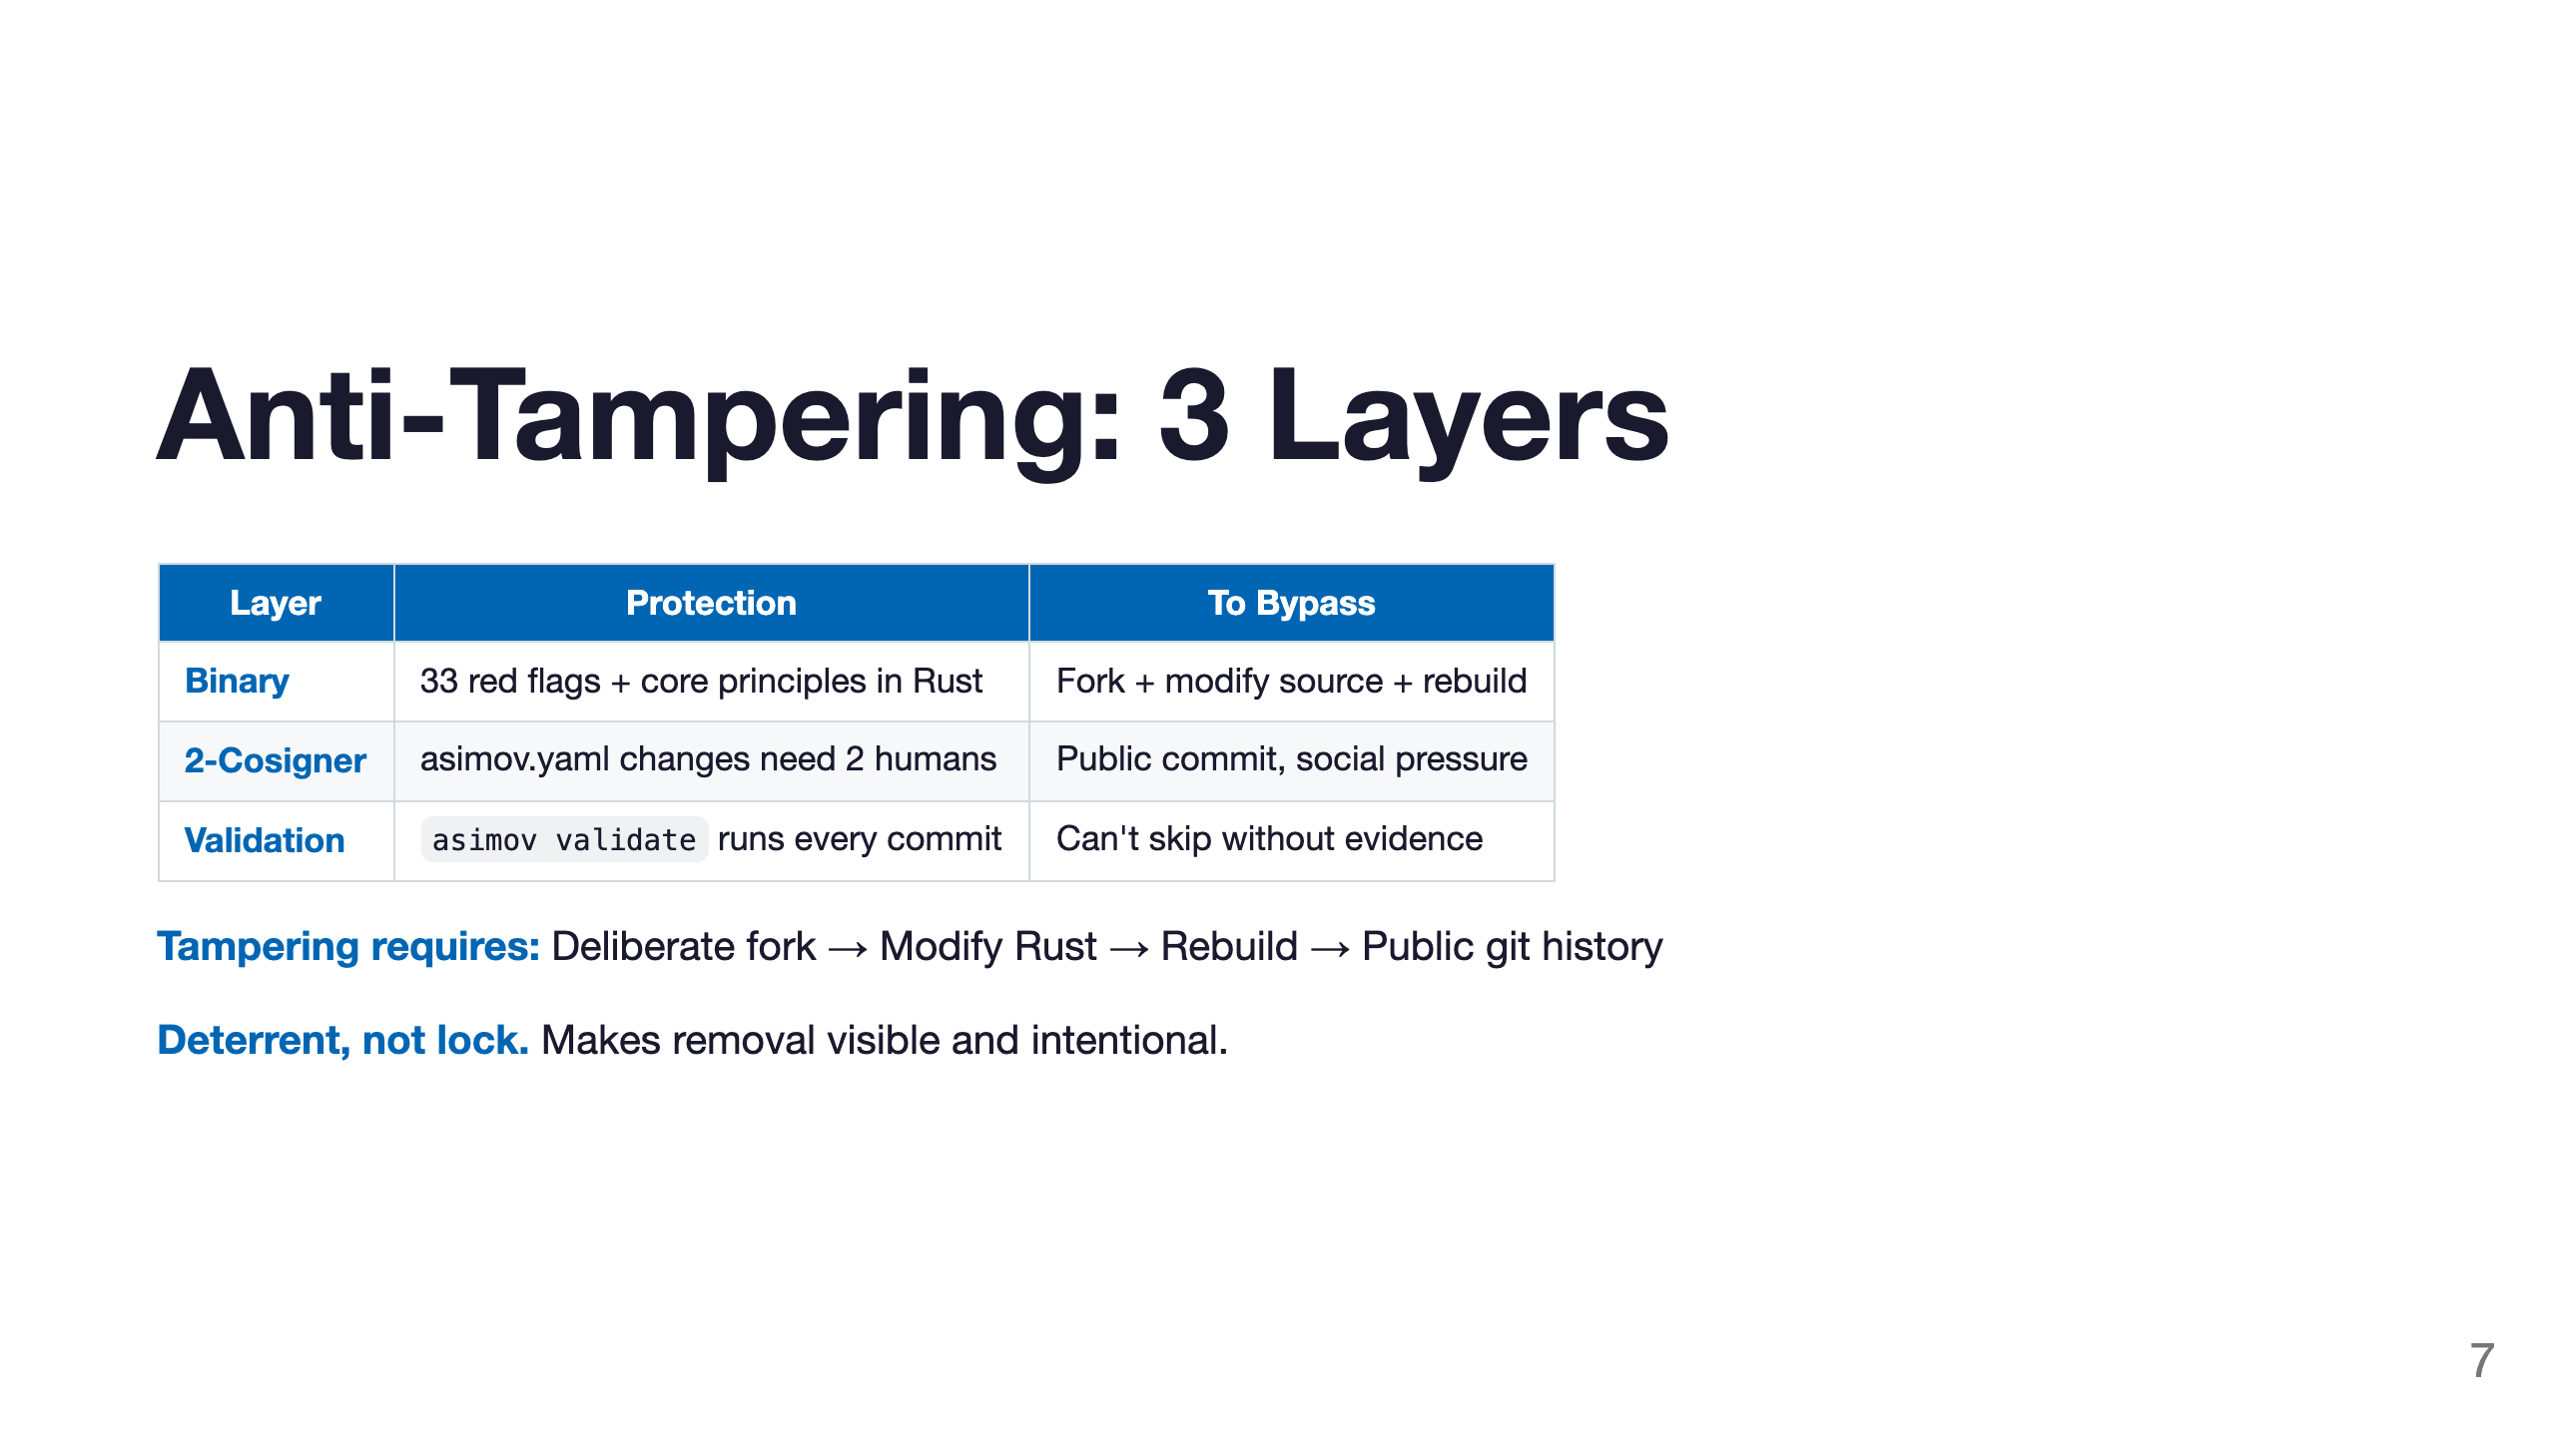

Slide 8
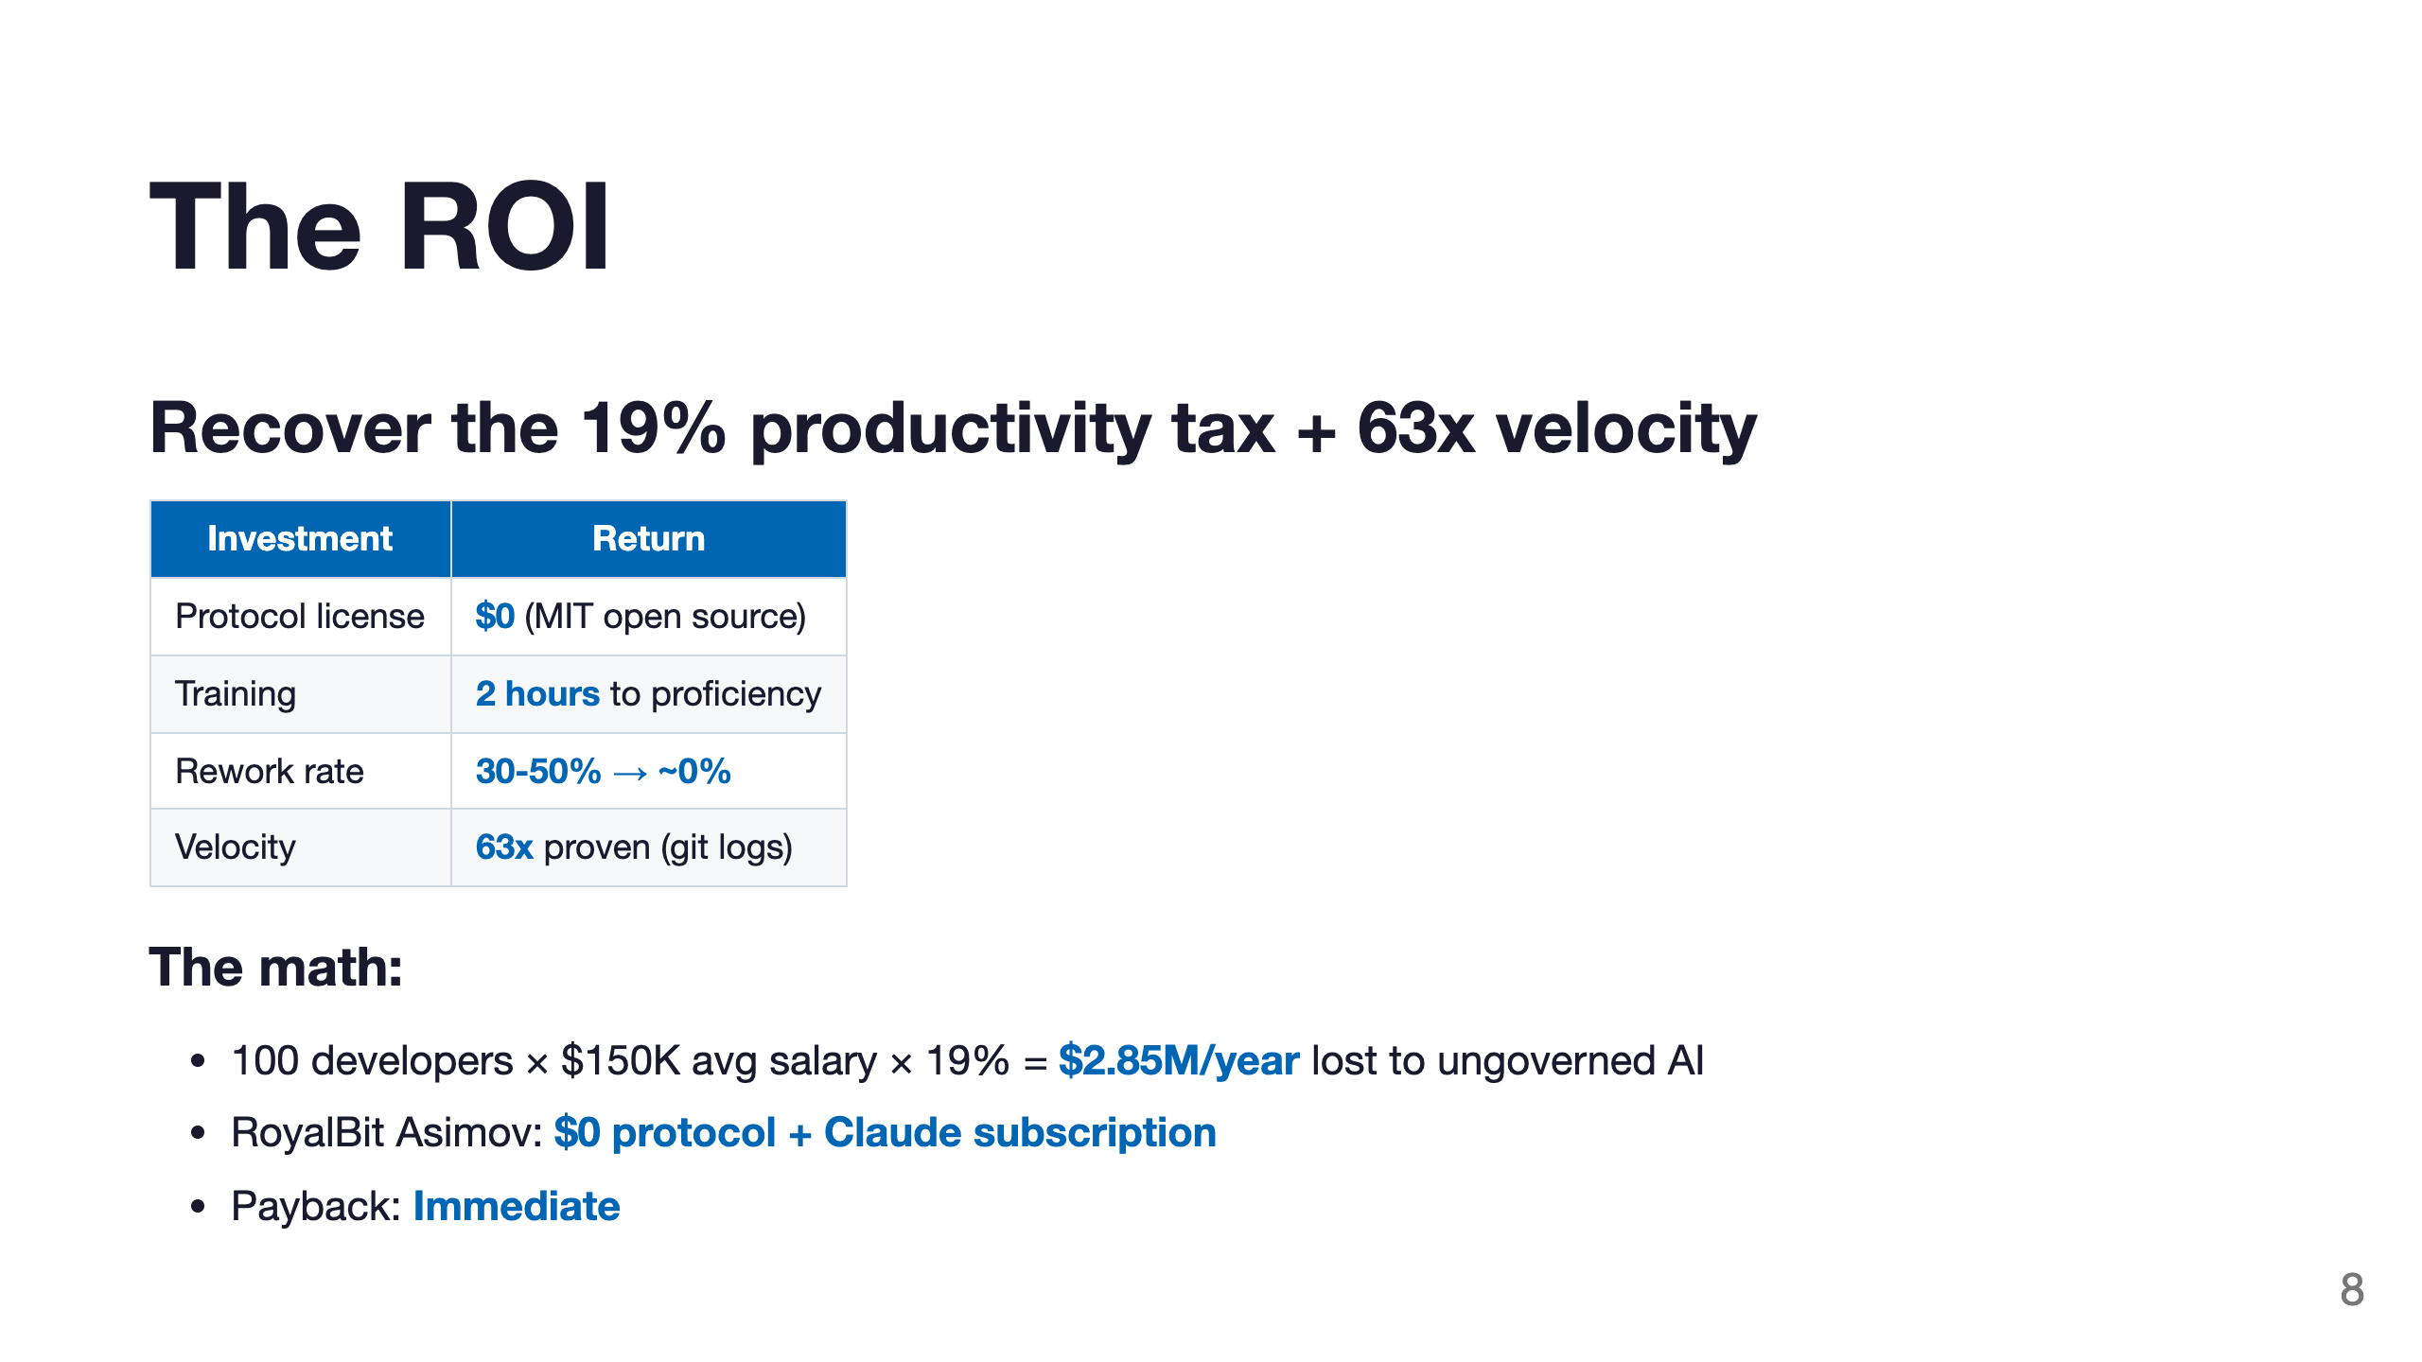

Slide 9
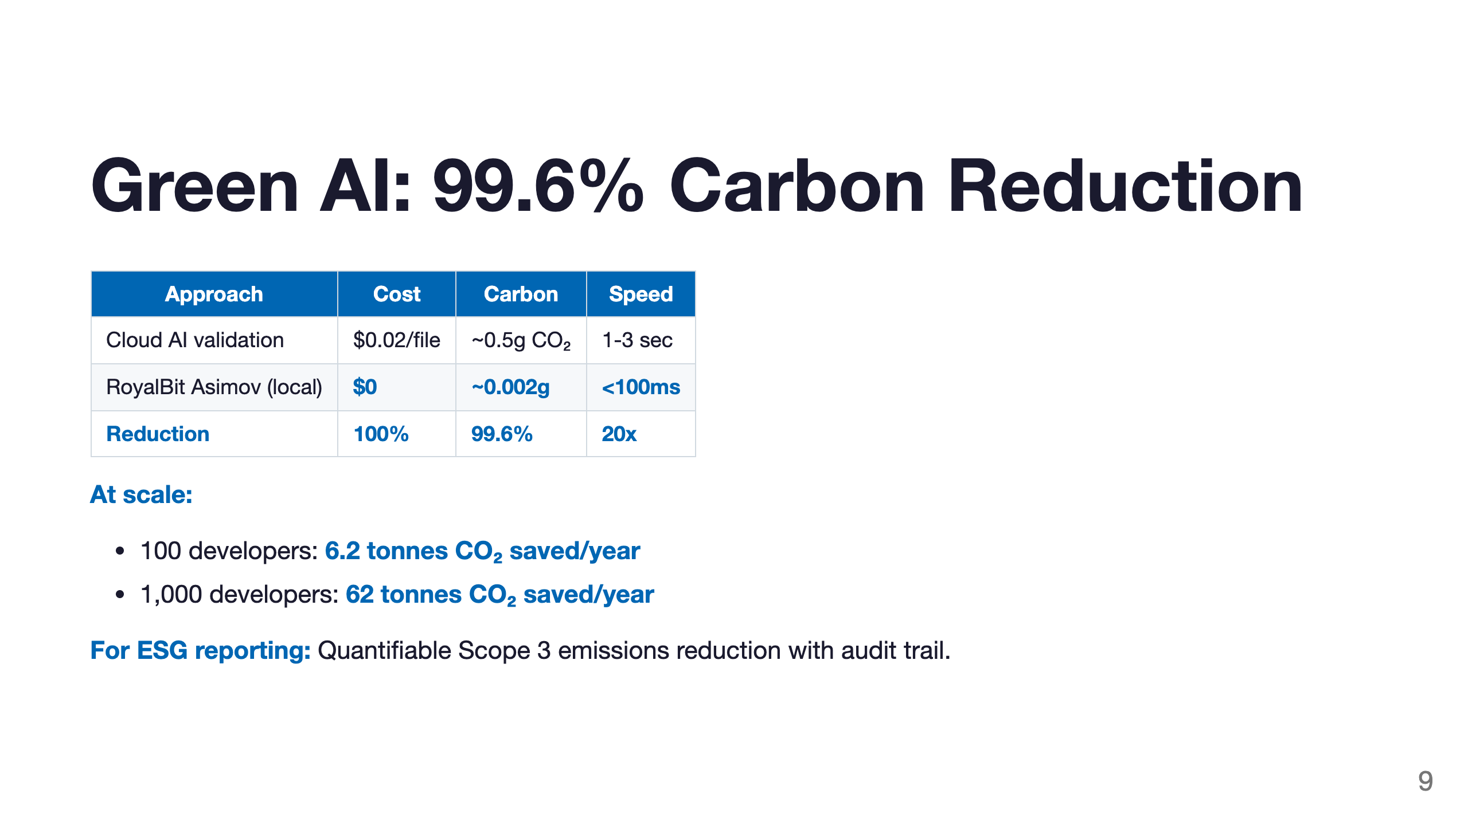

Slide 10
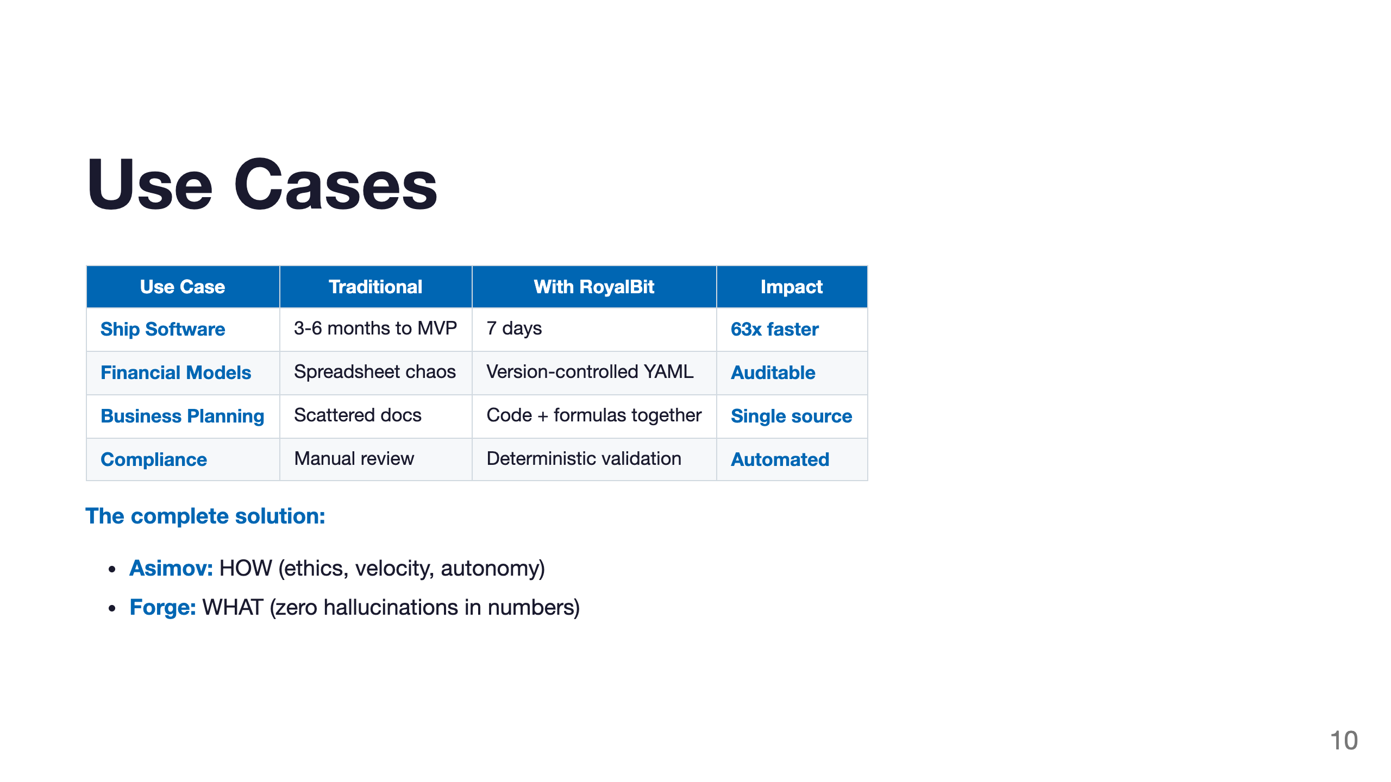

Slide 11
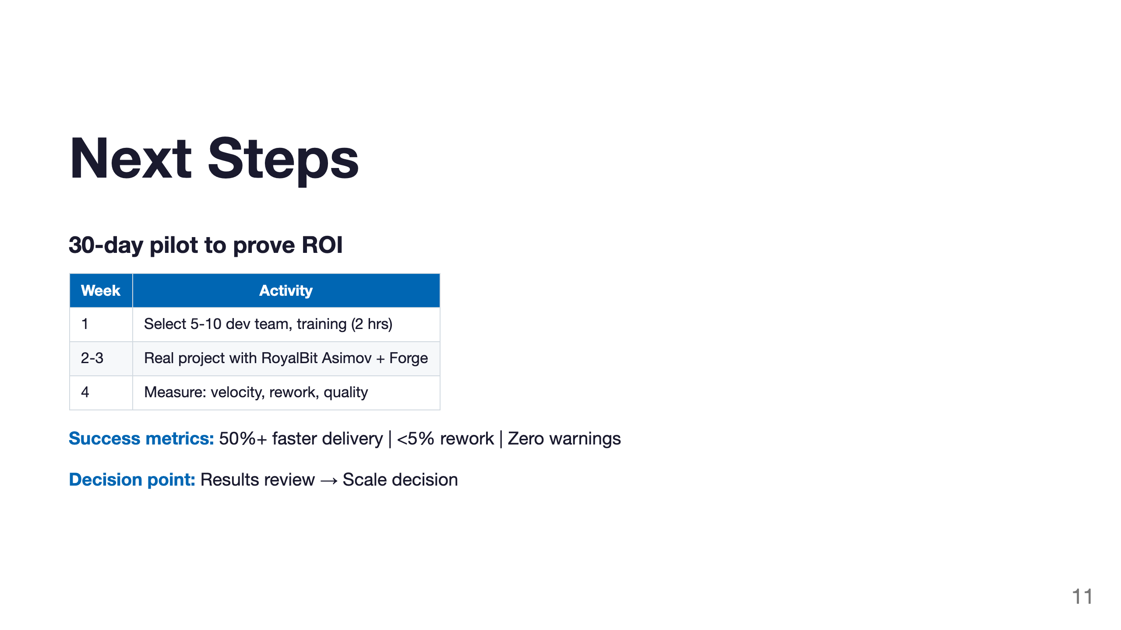

Slide 12
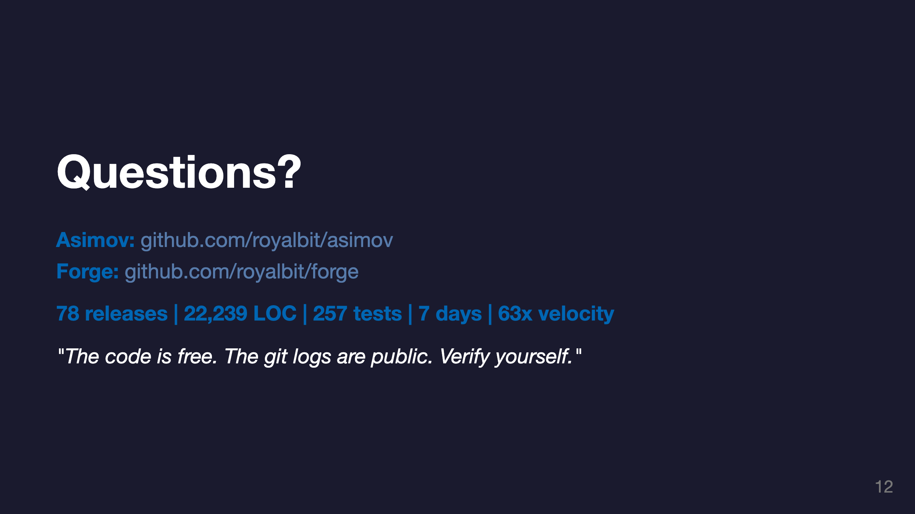

Slide 13
