Slide 1

WIPRO NGA Program – DWS
Capstone Project Presentation – 17th June & 18th June 2025
Project Title – Add File Associations via MSI
Presented by - Vishal Thakor
www.rpsconsulting.in

Slide 2

Introduction
What is File Association?
Linking a file extension (e.g., .txt, .cpp, .html) to a specific application.
Allows double-clicking a file to open it in the intended software.
Why is File Association Important?
Improves user experience.
Helps ensure files are opened with the right app after installation. IDEs.
Common in custom software, media players, browsers, and IDEs
2024 - RPS Consulting all rights reserved

Slide 3
Overview of MSI (Windows Installer)
What is MSI?
Microsoft Installer format for installing software on Windows.
Database-driven installation system using predefined tables.
Why use MSI for File Association?
Allows configuration of registry entries, file extensions, and default programs.
Supports enterprise deployment with consistency.
2024 - RPS Consulting all rights reserved

Slide 4
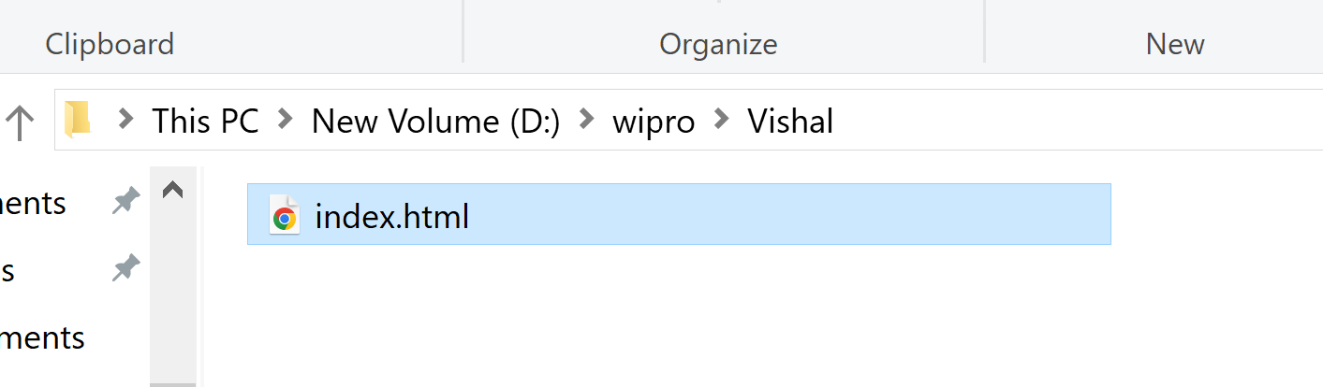
Use Cases of File Association
When to Use File Associations:
Custom software with unique file formats (e.g., .vishu, .abcdata)
Redirecting file types to open with your application.
Controlling user file-opening behavior in corporate environments.
Examples:
Associate .html files with Firefox or chrome.
Set .txt to open in a visual editor.
2024 - RPS Consulting all rights reserved

Slide 5
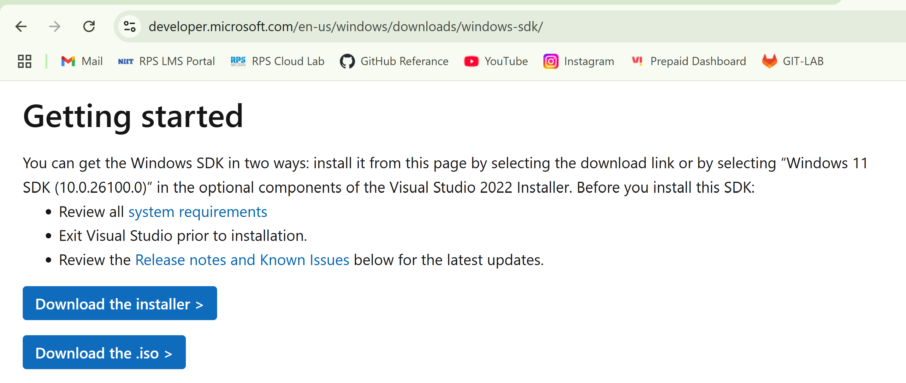
Tools Required
Essential Tools:
ORCA – Microsoft tool to edit MSI tables.
InstEd – Alternative MSI editor.
Advanced Installer – GUI-based MSI builder (optional).
Text Editor – For writing scripts or registry paths.
We are going to use ORCA tool.
You can download and install orca free of cost.
You can download orca from Microsoft official site.
2024 - RPS Consulting all rights reserved

Slide 6
File Association Prerequisites
Before Configuring File Association:
Orca installed (via Windows SDK)
MSI installer file for your application
File extension to associate (e.g., .vishu, .abc, .cpp)
Program executable path (e.g., firefox.exe, MyApp.exe)
Understanding of Registry and MSI tables (Registry, ProgId, Extension)
2024 - RPS Consulting all rights reserved

Slide 7
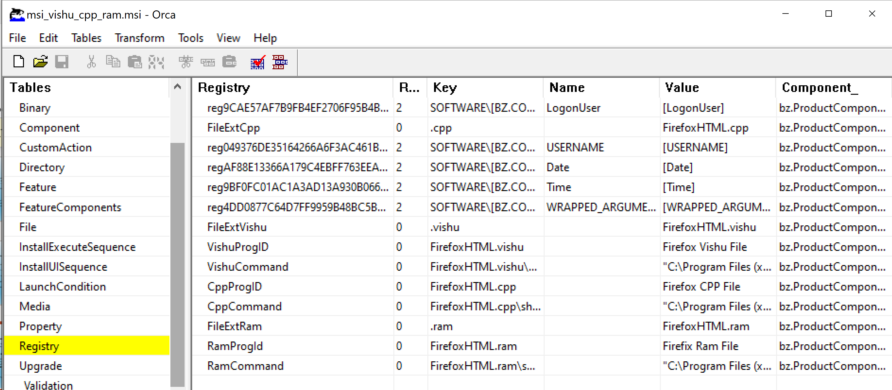
File Association via Registry table
Use Registry Table If:
You want finer control or registry-level customization.
The tables above don’t meet your needs.
Example Entries
Root: HKCU
Key: .vishu
Value: MyApp.file
Component_: Link to an installed component
Subkey:
MyApp.File\shell\open\command = "C:\Program Files\MyApp\MyApp.exe" "%1"
2024 - RPS Consulting all rights reserved

Slide 8
Testing & Validation
After Installing the MSI:
Double-click a file with the associated extension.
Check:
Does it open in the correct application?
Registry: Open regedit, go to HKEY_CLASSES_ROOT\.abc
Default Apps: Windows Settings > Apps > Default Apps
Tips
Always test on a clean or virtual machine.
Restart the PC if changes don’t take effect.
2024 - RPS Consulting all rights reserved

Slide 9
Conclusion
File association is a critical feature for enhancing the usability and user experience of desktop applications.
Using MSI packages to configure file associations provides a standardized, manageable, and automated way to register file types during software installation.
With tools like ORCA and support from MSI tables (such as Extension, ProgId, and Verb), developers and IT admins can reliably set up file associations that integrate their applications into the Windows environment.
Alternative methods, such as the Registry table, offer deeper control when needed.
Proper testing and adherence to best practices ensure smooth user experience and system compatibility, especially in enterprise deployments.
2024 - RPS Consulting all rights reserved

Slide 10
References
Microsoft MSI Documentation
Orca Tool (part of Windows SDK)
WiX Toolset Docs
2024 - RPS Consulting all rights reserved

Slide 11
Thank You
2024 - RPS Consulting all rights reserved

