Slide 1
Insertion sort
void insertion_sort(int a[],int n)
{
int i,key,j;
for(i=1;i<n;i++)
{
  key=a[i];
  j=i-1;
  while(j>0 && key<a[j])
  {
  a[j+1]=a[j];
  j--;
  }
  a[j+1]=key;
  }
  }}

Slide 2
Radix sort
void main()
{ int a[100][100],r=0,c=0,i,n,a[50],temp;
clrscr();
printf(“Size of array: ”);
scanf(“%d”,&n);
printf(“\n”);
for(r=0;r<100;r++)
{ for(c=0;c<100;c++)
a[r][c]=0;
}

Slide 3
for(i=0;i<sz;i++)
{ printf(“Enter element %d: ”,i+1);
scanf(“%d”,&a[i]);
r=b[i]/100;
c=b[i]%100;
a[r][c]=b[i];
}
i=0;
for(r=0;r<100;r++)
for(c=0;c<100;c++)
{
{ if(a[r][c]!=0)
{ printf(“\n\t”);
b[i]=a[r][c];
i++;
}
}
}
}

Slide 4
MERGE SORT

Slide 5
Merging
The key to Merge Sort is merging two sorted lists into one, such that if you have two lists X (x₁≤x₂≤…≤x_{m}) and Y(y₁≤y₂≤…≤y_{n}) the resulting list is Z(z₁≤z₂≤…≤z_{m+n})
Example:
L₁ = { 3 8 9 } L₂ = { 1 5 7 }
merge(L₁, L₂) = { 1 3 5 7 8 9 }

Slide 6
Merging (cont.)
X:
3 | 10 | 23 | 54
Y:
1 | 5 | 25 | 75
Result:

Slide 7
Merging (cont.)
X:
3 | 10 | 23 | 54
Y:
 | 5 | 25 | 75
Result:
1

Slide 8
Merging (cont.)
X:
 | 10 | 23 | 54
Y:
 | 5 | 25 | 75
Result:
1 | 3

Slide 9
Merging (cont.)
X:
 | 10 | 23 | 54
Y:
 |  | 25 | 75
Result:
1 | 3 | 5

Slide 10
Merging (cont.)
X:
 |  | 23 | 54
Y:
 |  | 25 | 75
Result:
1 | 3 | 5 | 10

Slide 11
Merging (cont.)
X:
 |  |  | 54
Y:
 |  | 25 | 75
Result:
1 | 3 | 5 | 10 | 23

Slide 12
Merging (cont.)
X:
 |  |  | 54
Y:
 |  |  | 75
Result:
1 | 3 | 5 | 10 | 23 | 25

Slide 13
Merging (cont.)
X:
Y:
 |  |  | 75
Result:
1 | 3 | 5 | 10 | 23 | 25 | 54

Slide 14
Merging (cont.)
X:
Y:
Result:
1 | 3 | 5 | 10 | 23 | 25 | 54 | 75

Slide 15
Divide And Conquer
Merging a two lists of one element each is the same as sorting them.
Merge sort divides up an unsorted list until the above condition is met and then sorts the divided parts back together in pairs.
Specifically this can be done by recursively dividing the unsorted list in half, merge sorting the right side then the left side and then merging the right and left back together.

Slide 16
Merge Sort Algorithm
Given a list L with a length k:
If k == 1 → the list is sorted
Else:
  Merge Sort the left side (1 thru k/2)
  Merge Sort the right side (k/2+1 thru k)
  Merge the right side with the left side

Slide 17
Merge Sort Example
99 | 6 | 86 | 15 | 58 | 35 | 86 | 4 | 0

Slide 18
Merge Sort Example
99 | 6 | 86 | 15 | 58 | 35 | 86 | 4 | 0
99 | 6 | 86 | 15
58 | 35 | 86 | 4 | 0

Slide 19
Merge Sort Example
99 | 6 | 86 | 15 | 58 | 35 | 86 | 4 | 0
99 | 6 | 86 | 15
58 | 35 | 86 | 4 | 0
99 | 6
86 | 15
58 | 35
86 | 4 | 0

Slide 20
Merge Sort Example
99 | 6 | 86 | 15 | 58 | 35 | 86 | 4 | 0
99 | 6 | 86 | 15
58 | 35 | 86 | 4 | 0
99 | 6
86 | 15
58 | 35
86 | 4 | 0
99
6
86
15
58
35
86
4 | 0

Slide 21
Merge Sort Example
99 | 6 | 86 | 15 | 58 | 35 | 86 | 4 | 0
99 | 6 | 86 | 15
58 | 35 | 86 | 4 | 0
99 | 6
86 | 15
58 | 35
86 | 4 | 0
99
6
86
15
58
35
86
4 | 0
4
0

Slide 22
Merge Sort Example
99
6
86
15
58
35
86
0 | 4
Merge
4
0

Slide 23
Merge Sort Example
6 | 99
15 | 86
35 | 58
0 | 4 | 86
99
6
86
15
58
35
86
0 | 4
Merge

Slide 24
Merge Sort Example
6 | 15 | 86 | 99
0 | 4 | 35 | 58 | 86
6 | 99
15 | 86
35 | 58
0 | 4 | 86
Merge

Slide 25
Merge Sort Example
0 | 4 | 6 | 15 | 35 | 58 | 86 | 86 | 99
6 | 15 | 86 | 99
0 | 4 | 35 | 58 | 86
Merge

Slide 26
Merge Sort Example
0 | 4 | 6 | 15 | 35 | 58 | 86 | 86 | 99

Slide 27
Implementing Merge Sort
There are two basic ways to implement merge sort:
  In Place: Merging is done with only the input array
    Pro: Requires only the space needed to hold the array
    Con: Takes longer to merge because if the next element is in the right side then all of the elements must be moved down.
  Double Storage: Merging is done with a temporary array of the same size as the input array.
    Pro: Faster than In Place since the temp array holds the resulting array until both left and right sides are merged into the temp array, then the temp array is appended over the input array.
    Con: The memory requirement is doubled.

Slide 28
void partition(int a[],int,int);
void merge_sort(int a[],int,int,int);
vnt a[20];
int main()
{
int i,n;;
for(i=0;i<n;i++)
{
printf("\nEnter no:");
scanf("%d",&a[i]);
}
partition(a,0,n-1);
for(i=0;i<n;i++)
{
printf("\n%d",a[i]);
}
}
void partition(int a[],int low,int high)
{
Int mid;
if(low<high)
{
mid=(low+high)/2;
partition(a,low,mid);
partition(a,mid+1,high);
merge_sort(a,low,mid,high);
}
}

Slide 29
void merge_sort(int a[],int low,int mid,int high)
{
  int i,m,k,l,temp[30];
  l=low;
  i=low;
  m=mid+1;
  while((l<=mid) && (m<=high))
  {
    if(a[l]<=a[m]) {
      temp[i]=a[l];
      l++; }
      else {
      temp[i]=a[m];
      m++; }
      i++;
}

Slide 30
if(l>mid) {
  for(k=m;k<=high;k++) {
    temp[i]=a[k];
    i++; } }
else {
      for(k=l;k<=mid;k++) {
        temp[i]=arr[k];
        i++; }
}
for(k=low;k<=high;k++)
{
a[k]=temp[k];
}
}

Slide 31
Merge Sort Analysis
The Double Memory Merge Sort runs O (N log N) for all cases, because of its Divide and Conquer approach.
T(N) = 2T(N/2) + N = O(N logN)

Slide 32
QUICK SORT

Slide 33
Quick-Sort
To understand quick-sort, let’s look at a high-level description of the algorithm
1) Divide : If the sequence S has 2 or more elements, select an element x from S to be your pivot. Any arbitrary element, like the last, will do. Remove all the elements of S and divide them into 3 sequences:
  L, holds S’s elements less than x
  E, holds S’s elements equal to x
  G, holds S’s elements greater than x
2) Recurse: Recursively sort L and G
3) Conquer: Finally, to put elements back into S in order, first inserts the elements of L, then those of E, and those of G.
Here are some pretty diagrams....

Slide 34
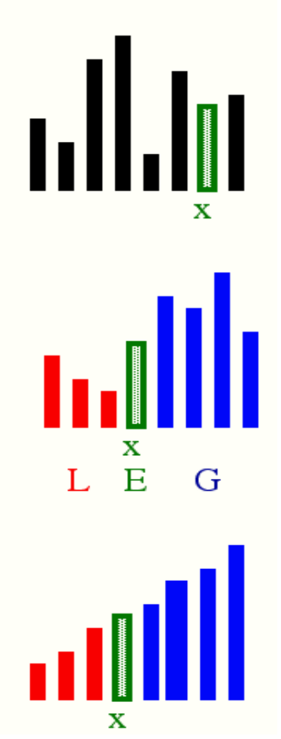
Idea of Quick Sort
1) Select: pick an element
2) Divide: rearrange elements so that x goes to its final position E
3) Recurse and Conquer: recursively sort

Slide 35
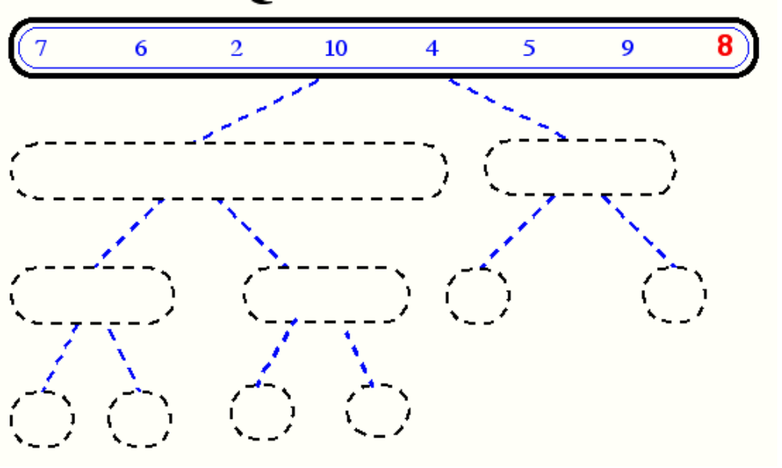
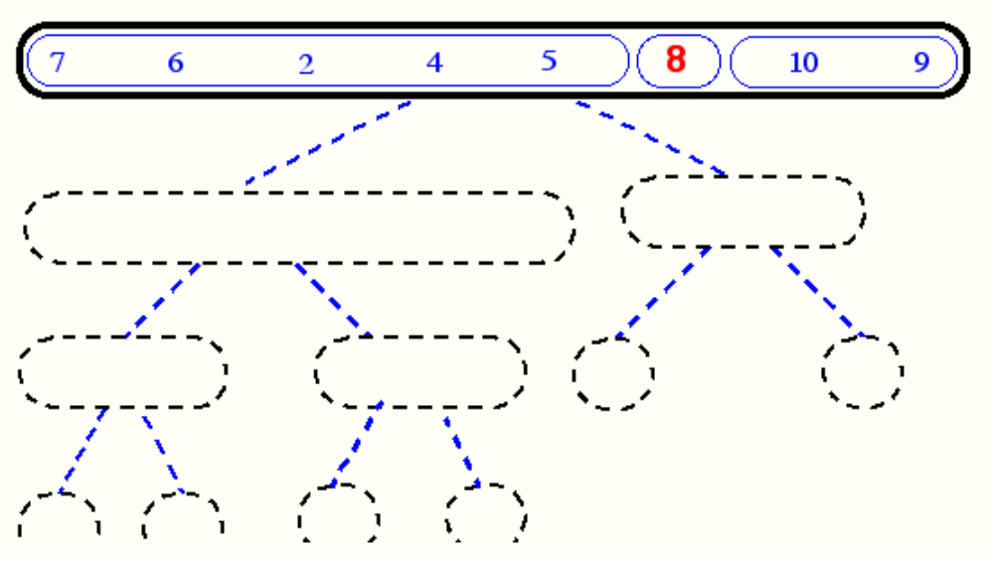
Quick-Sort Tree

Slide 36
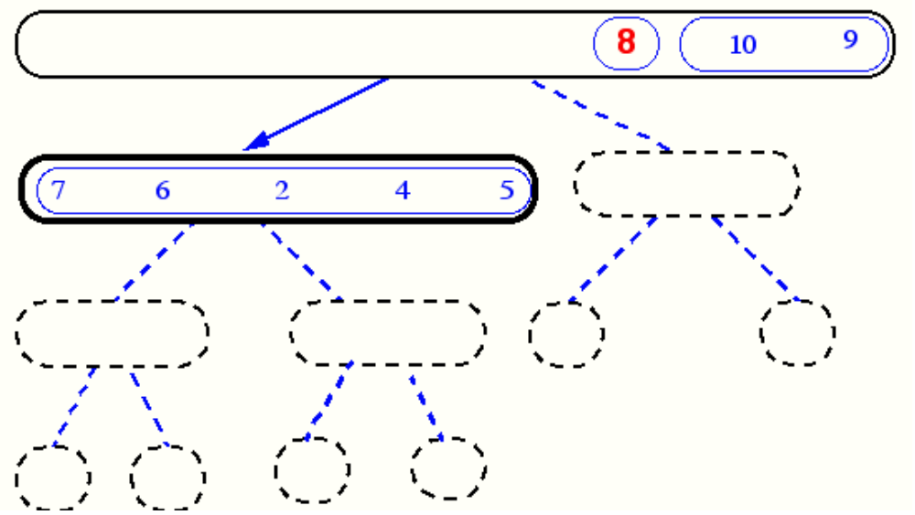
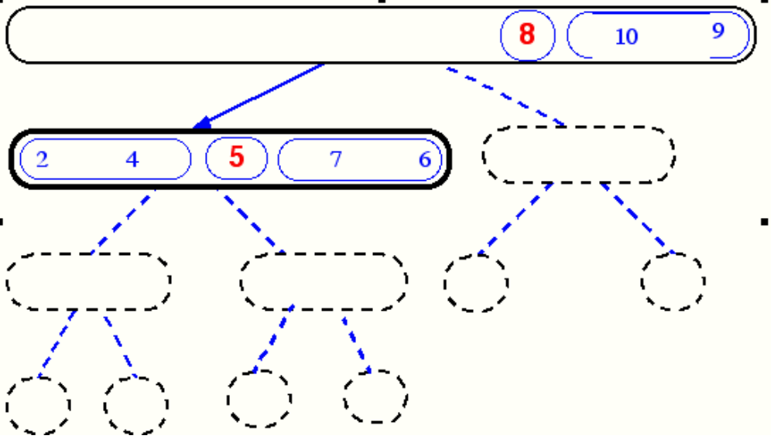
Quick-Sort Tree

Slide 37
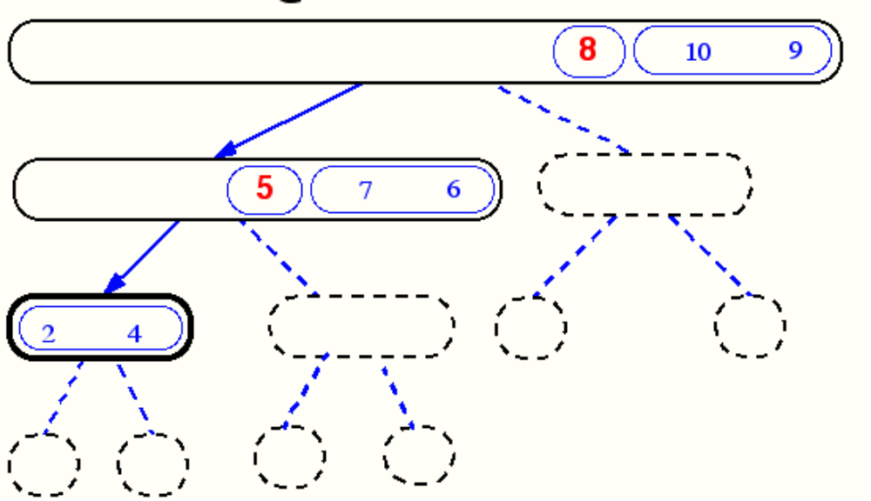
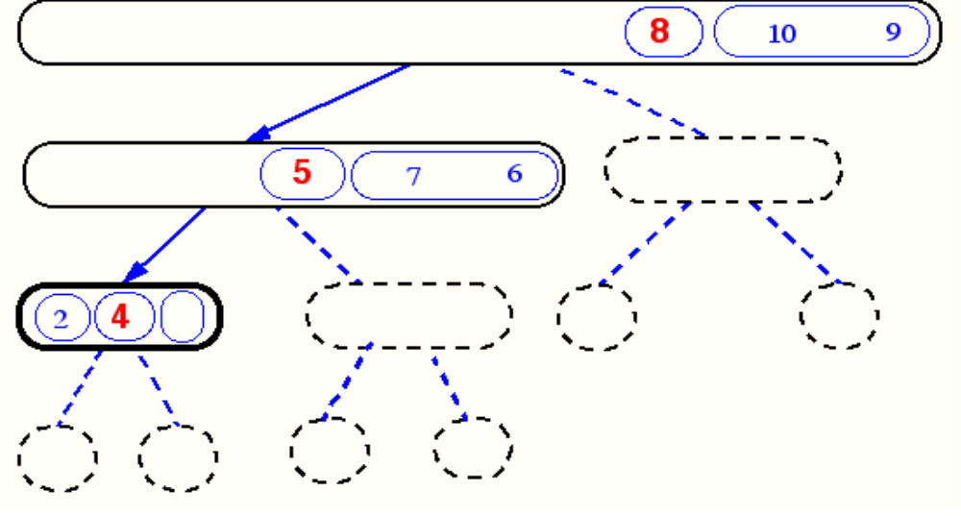
Quick-Sort Tree

Slide 38
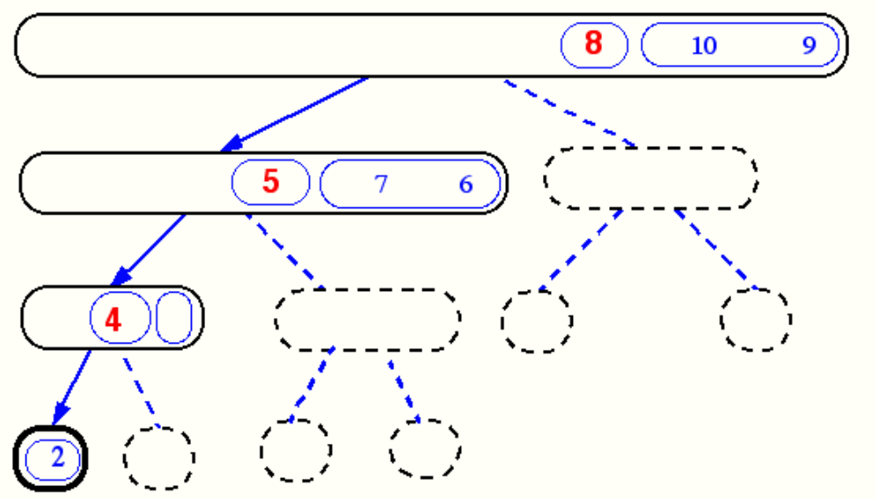
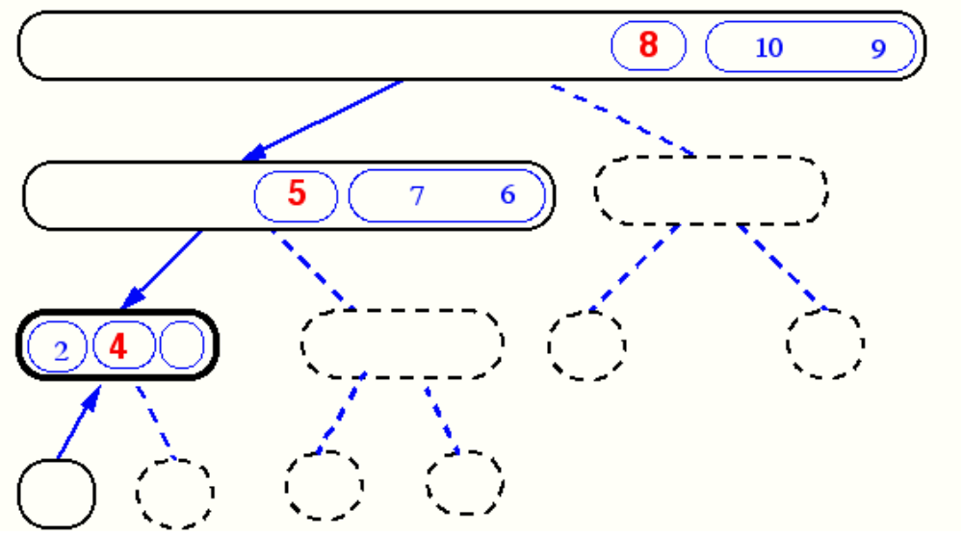
Quick-Sort Tree

Slide 39
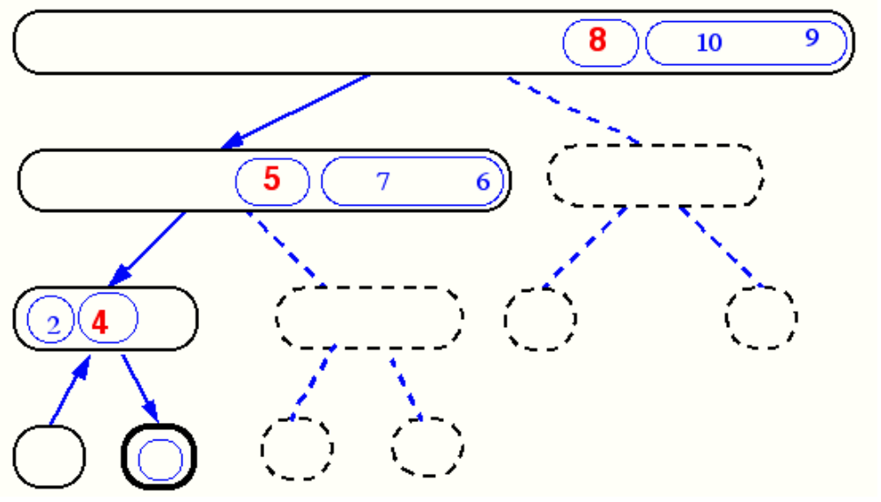
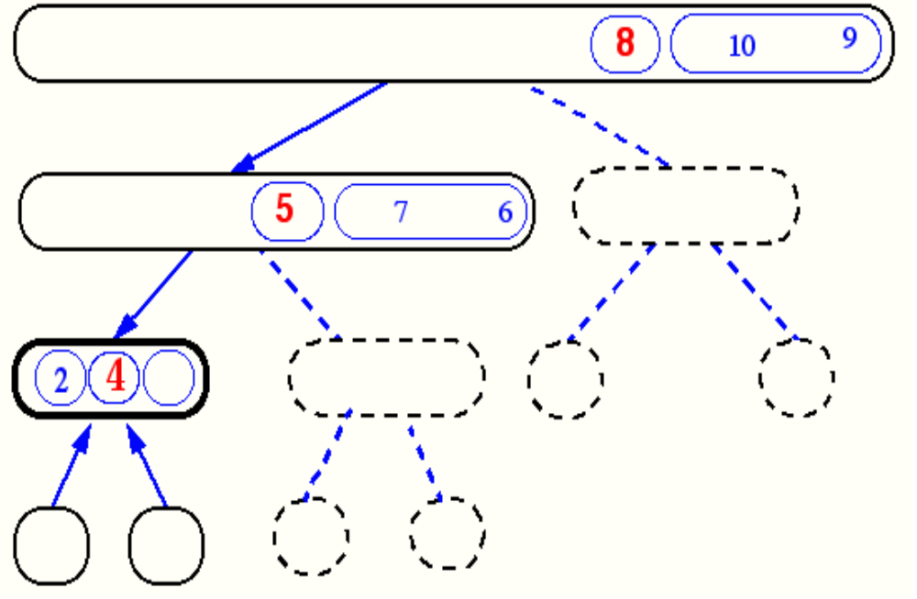
Quick-Sort Tree

Slide 40
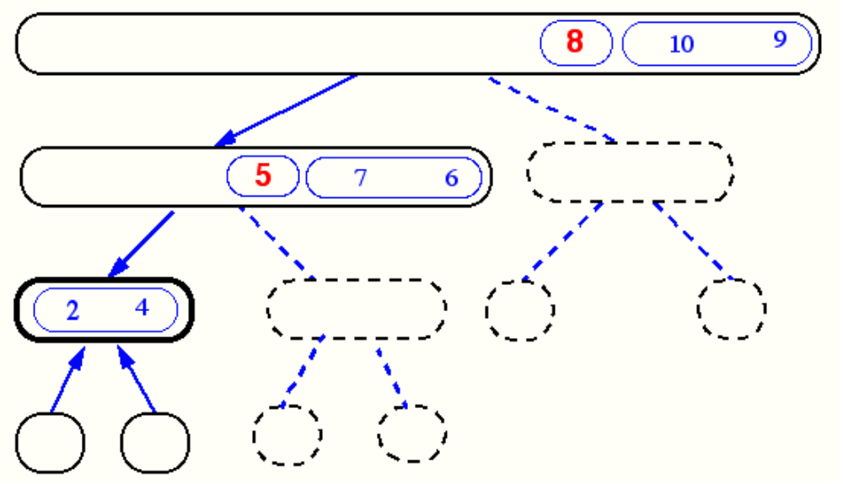
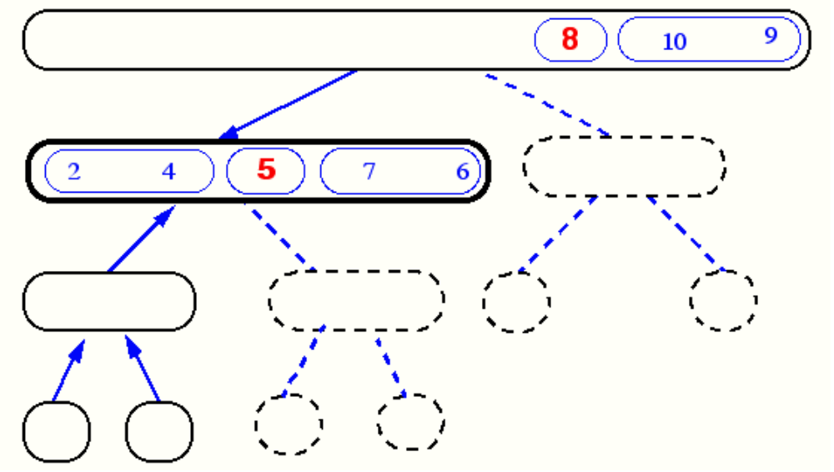
Quick-Sort Tree

Slide 41
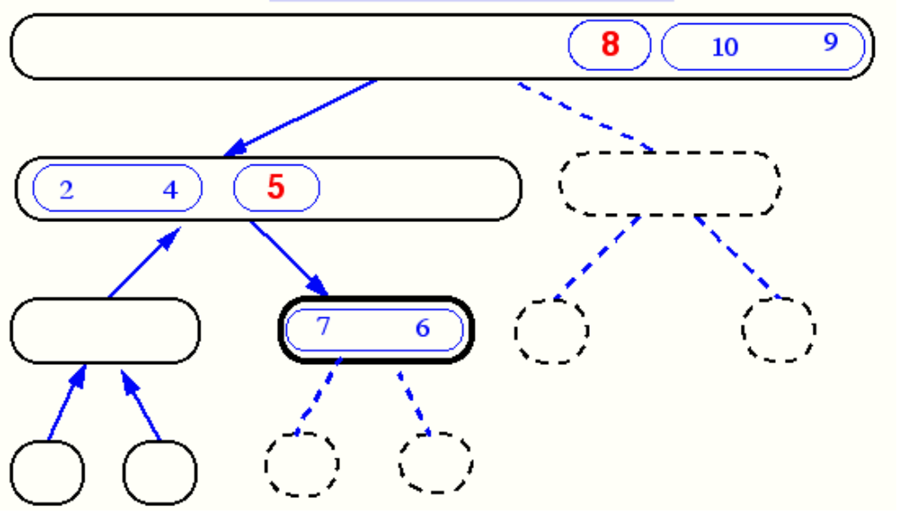
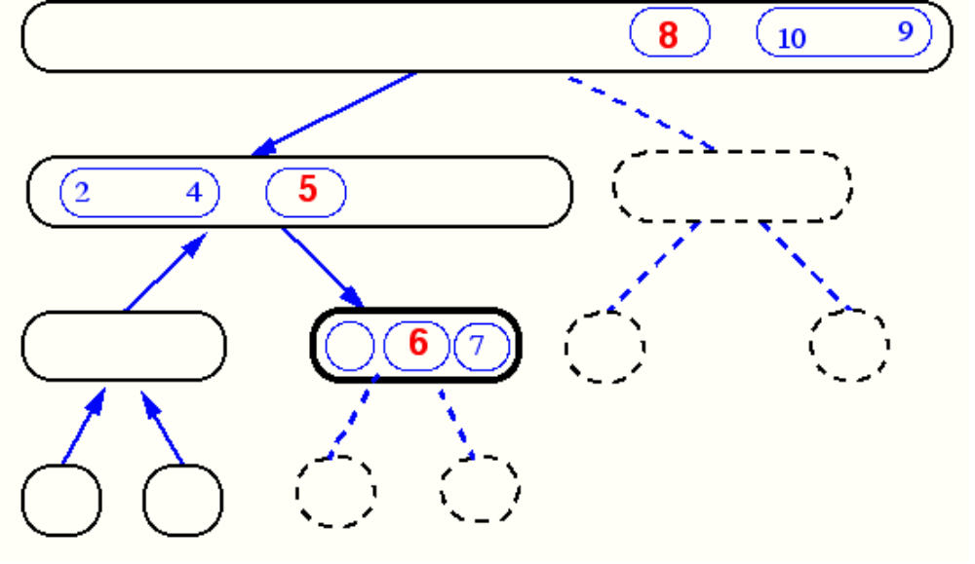
Quick-Sort Tree

Slide 42
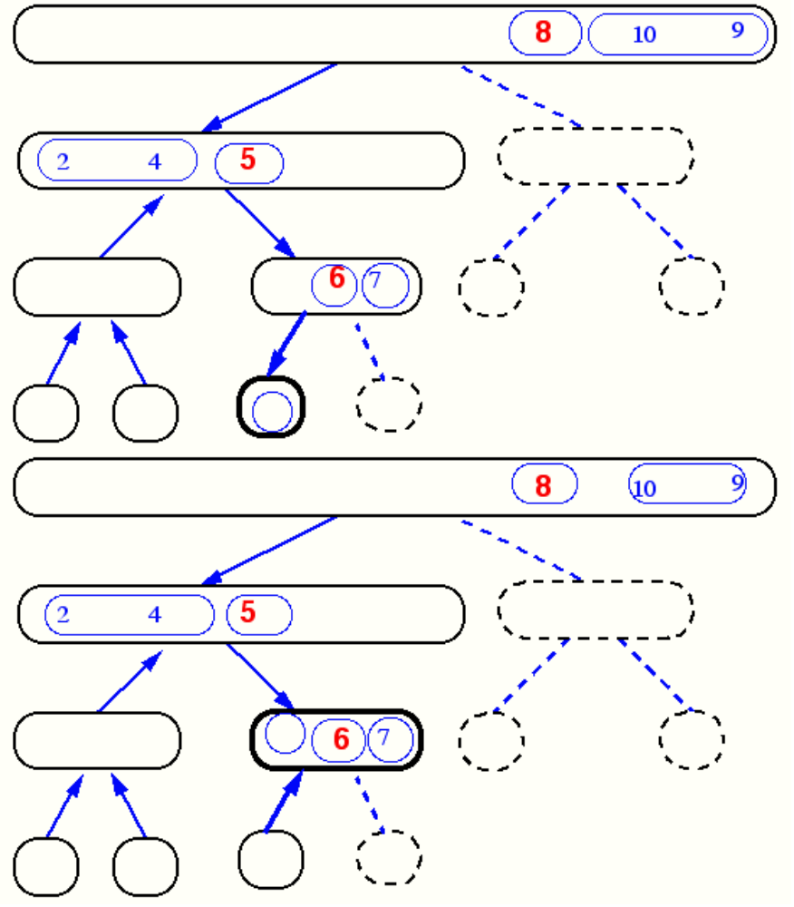
Quick-Sort Tree

Slide 43
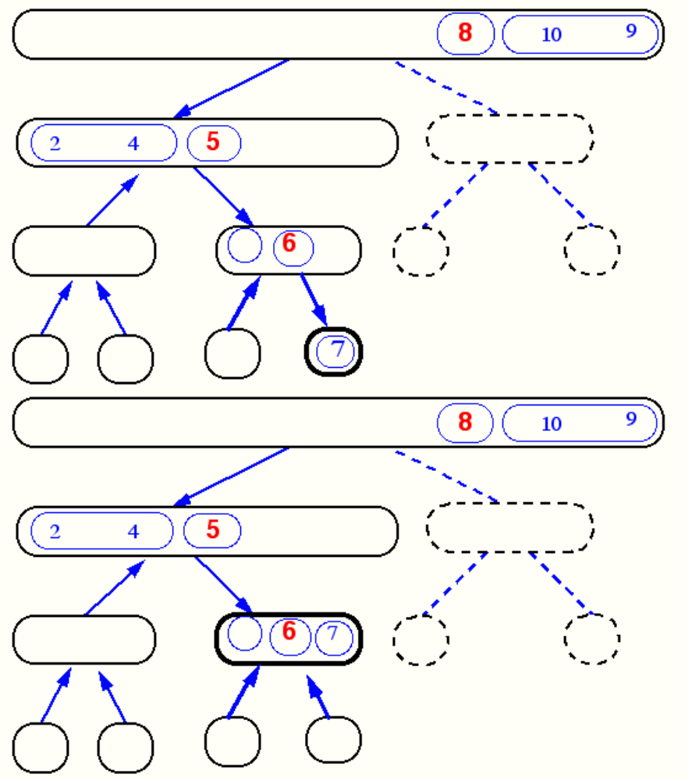
Quick-Sort Tree

Slide 44
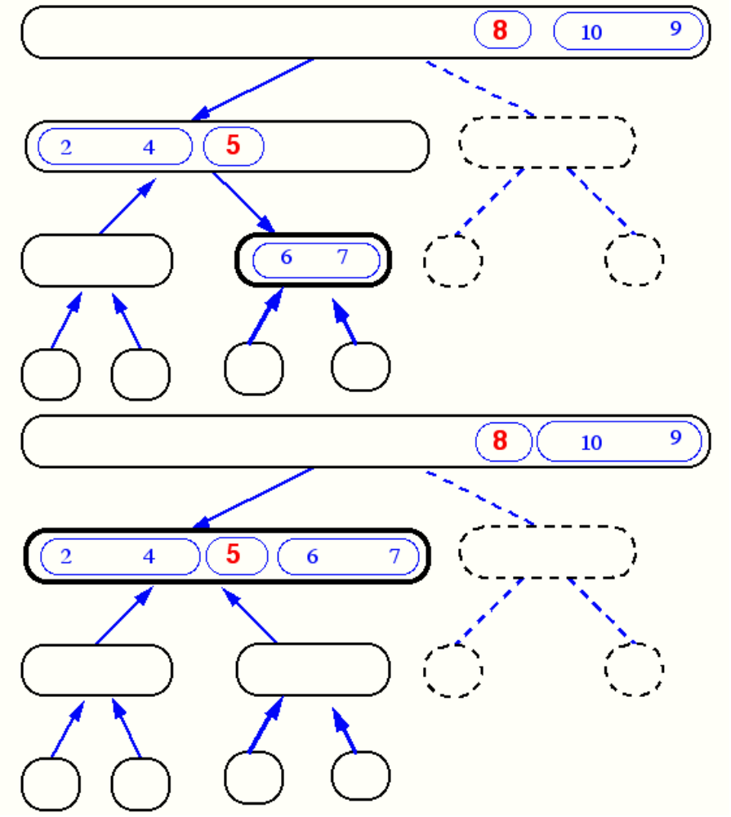
Quick-Sort Tree

Slide 45
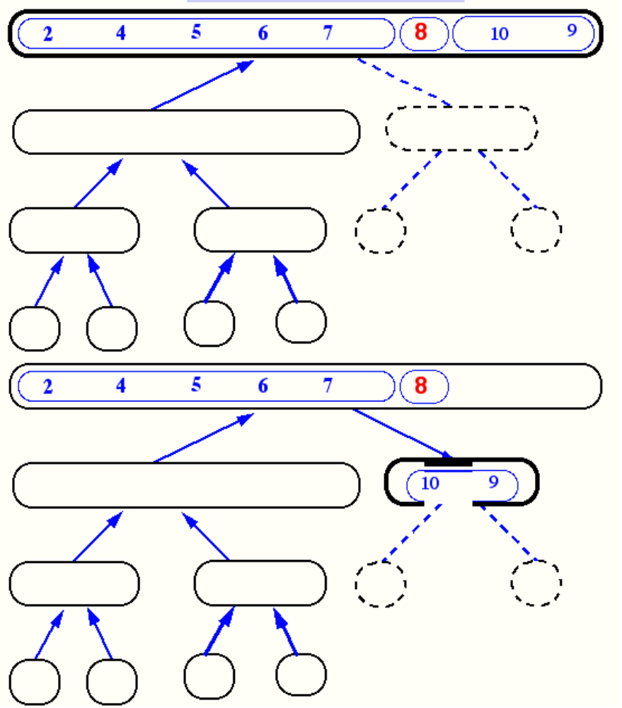
Quick-Sort Tree

Slide 46
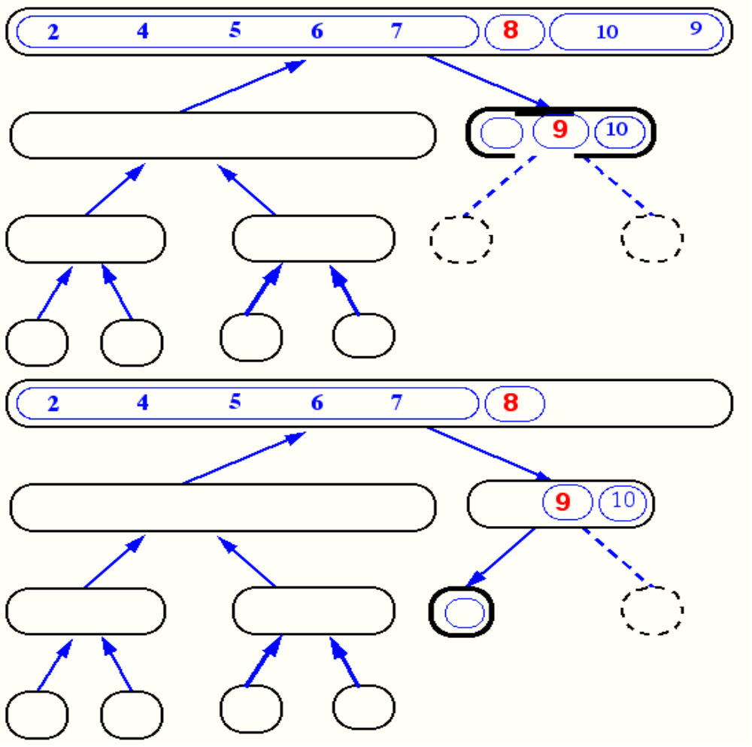
Quick-Sort Tree
Skipping ...

Slide 47
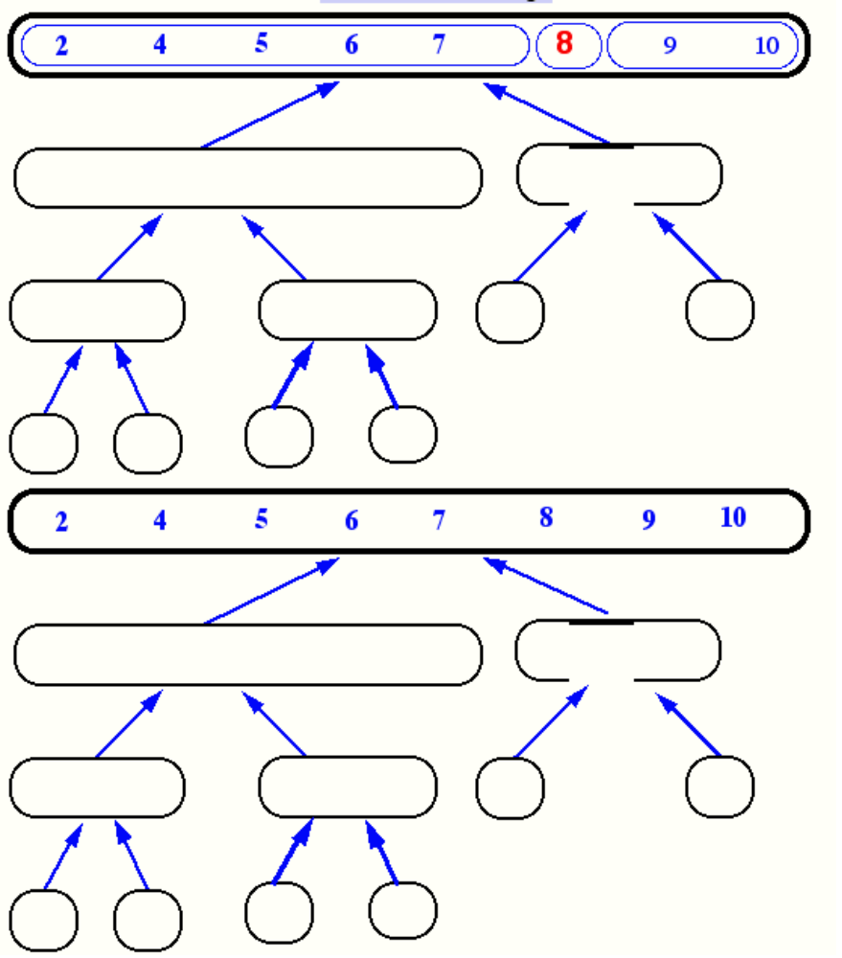
... Finally

Slide 48
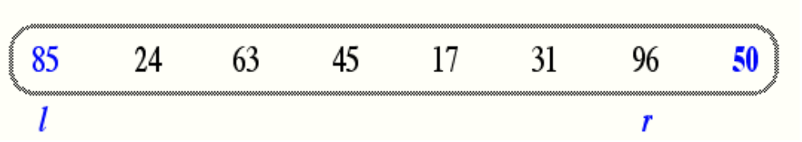
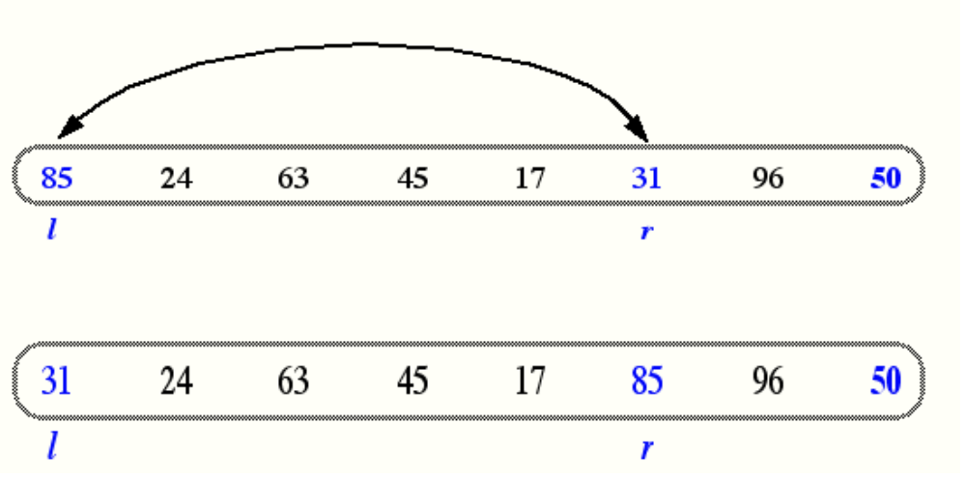
In-Place Quick-Sort
Divide step: l scans the sequence from the left, and r from the right.
A swap is performed when l is at an element larger than the pivot and r is at one smaller than the pivot.

Slide 49
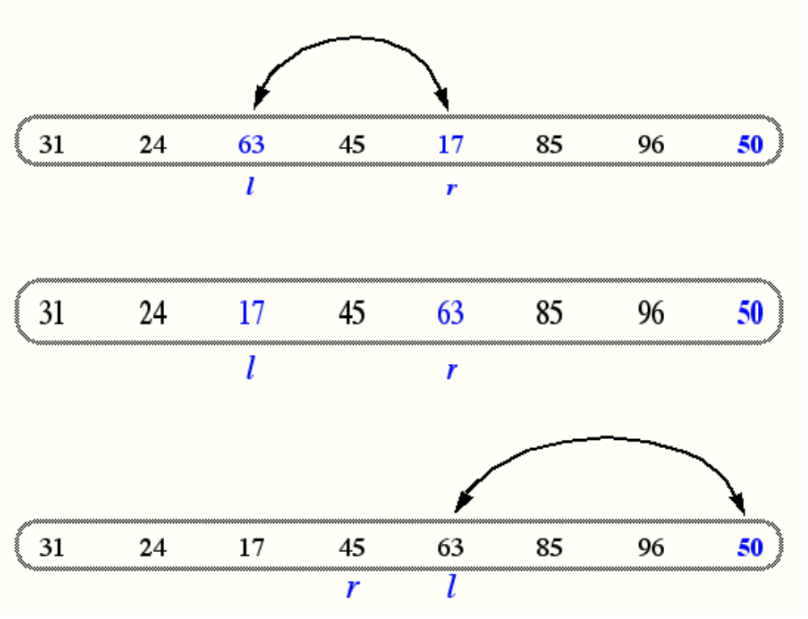
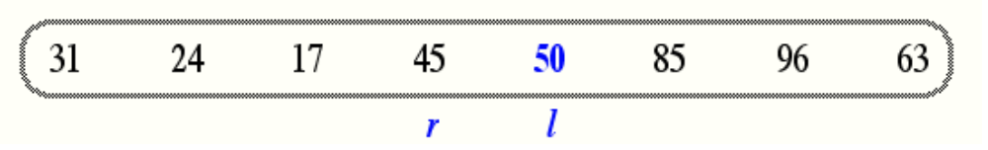
In Place Quick Sort (contd.)
A final swap with the pivot completes the divide step

Slide 50
Quicksort Algorithm
Given an array of n elements (e.g., integers):
If array only contains one element, return
Else
  pick one element to use as pivot.
  Partition elements into two sub-arrays:
    Elements less than or equal to pivot
    Elements greater than pivot
  Quicksort two sub-arrays
  Return results

Slide 51
Example
We are given array of n integers to sort:
40
20
10
80
60
50
7
30
100

Slide 52
Pick Pivot Element
There are a number of ways to pick the pivot element. In this example, we will use the first element in the array:
40
20
10
80
60
50
7
30
100

Slide 53
Partitioning Array
Given a pivot, partition the elements of the array such that the resulting array consists of:
  One sub-array that contains elements >= pivot
  Another sub-array that contains elements < pivot
The sub-arrays are stored in the original data array.
Partitioning loops through, swapping elements below/above pivot.

Slide 54
pivot_index = 0
40
20
10
80
60
50
7
30
100
[0] [1] [2] [3] [4] [5] [6] [7] [8]
too_big_index
too_small_index

Slide 55
While data[too_big_index] <= data[pivot]
++too_big_index
pivot_index = 0
40
20
10
80
60
50
7
30
100
[0] [1] [2] [3] [4] [5] [6] [7] [8]
too_big_index
too_small_index

Slide 56
While data[too_big_index] <= data[pivot]
++too_big_index
pivot_index = 0
40
20
10
80
60
50
7
30
100
[0] [1] [2] [3] [4] [5] [6] [7] [8]
too_big_index
too_small_index

Slide 57
While data[too_big_index] <= data[pivot]
++too_big_index
pivot_index = 0
40
20
10
80
60
50
7
30
100
[0] [1] [2] [3] [4] [5] [6] [7] [8]
too_big_index
too_small_index

Slide 58
While data[too_big_index] <= data[pivot]
  ++too_big_index
While data[too_small_index] > data[pivot]
  --too_small_index
pivot_index = 0
40
20
10
80
60
50
7
30
100
[0] [1] [2] [3] [4] [5] [6] [7] [8]
too_big_index
too_small_index

Slide 59
While data[too_big_index] <= data[pivot]
  ++too_big_index
While data[too_small_index] > data[pivot]
  --too_small_index
pivot_index = 0
40
20
10
80
60
50
7
30
100
[0] [1] [2] [3] [4] [5] [6] [7] [8]
too_big_index
too_small_index

Slide 60
While data[too_big_index] <= data[pivot]
  ++too_big_index
While data[too_small_index] > data[pivot]
  --too_small_index
If too_big_index < too_small_index
  swap data[too_big_index] and data[too_small_index]
pivot_index = 0
40
20
10
80
60
50
7
30
100
[0] [1] [2] [3] [4] [5] [6] [7] [8]
too_big_index
too_small_index

Slide 61
While data[too_big_index] <= data[pivot]
  ++too_big_index
While data[too_small_index] > data[pivot]
  --too_small_index
If too_big_index < too_small_index
  swap data[too_big_index] and data[too_small_index]
pivot_index = 0
40
20
10
30
60
50
7
80
100
[0] [1] [2] [3] [4] [5] [6] [7] [8]
too_big_index
too_small_index

Slide 62
While data[too_big_index] <= data[pivot]
  ++too_big_index
While data[too_small_index] > data[pivot]
  --too_small_index
If too_big_index < too_small_index
  swap data[too_big_index] and data[too_small_index]
While too_small_index > too_big_index, go to 1.
pivot_index = 0
40
20
10
30
60
50
7
80
100
[0] [1] [2] [3] [4] [5] [6] [7] [8]
too_big_index
too_small_index

Slide 63
While data[too_big_index] <= data[pivot]
  ++too_big_index
While data[too_small_index] > data[pivot]
  --too_small_index
If too_big_index < too_small_index
  swap data[too_big_index] and data[too_small_index]
While too_small_index > too_big_index, go to 1.
pivot_index = 0
40
20
10
30
60
50
7
80
100
[0] [1] [2] [3] [4] [5] [6] [7] [8]
too_big_index
too_small_index

Slide 64
While data[too_big_index] <= data[pivot]
  ++too_big_index
While data[too_small_index] > data[pivot]
  --too_small_index
If too_big_index < too_small_index
  swap data[too_big_index] and data[too_small_index]
While too_small_index > too_big_index, go to 1.
pivot_index = 0
40
20
10
30
60
50
7
80
100
[0] [1] [2] [3] [4] [5] [6] [7] [8]
too_big_index
too_small_index

Slide 65
While data[too_big_index] <= data[pivot]
  ++too_big_index
While data[too_small_index] > data[pivot]
  --too_small_index
If too_big_index < too_small_index
  swap data[too_big_index] and data[too_small_index]
While too_small_index > too_big_index, go to 1.
pivot_index = 0
40
20
10
30
60
50
7
80
100
[0] [1] [2] [3] [4] [5] [6] [7] [8]
too_big_index
too_small_index

Slide 66
While data[too_big_index] <= data[pivot]
  ++too_big_index
While data[too_small_index] > data[pivot]
  --too_small_index
If too_big_index < too_small_index
  swap data[too_big_index] and data[too_small_index]
While too_small_index > too_big_index, go to 1.
pivot_index = 0
40
20
10
30
60
50
7
80
100
[0] [1] [2] [3] [4] [5] [6] [7] [8]
too_big_index
too_small_index

Slide 67
While data[too_big_index] <= data[pivot]
  ++too_big_index
While data[too_small_index] > data[pivot]
  --too_small_index
If too_big_index < too_small_index
  swap data[too_big_index] and data[too_small_index]
While too_small_index > too_big_index, go to 1.
pivot_index = 0
40
20
10
30
60
50
7
80
100
[0] [1] [2] [3] [4] [5] [6] [7] [8]
too_big_index
too_small_index

Slide 68
While data[too_big_index] <= data[pivot]
  ++too_big_index
While data[too_small_index] > data[pivot]
  --too_small_index
If too_big_index < too_small_index
  swap data[too_big_index] and data[too_small_index]
While too_small_index > too_big_index, go to 1.
pivot_index = 0
40
20
10
30
7
50
60
80
100
[0] [1] [2] [3] [4] [5] [6] [7] [8]
too_big_index
too_small_index

Slide 69
While data[too_big_index] <= data[pivot]
  ++too_big_index
While data[too_small_index] > data[pivot]
  --too_small_index
If too_big_index < too_small_index
  swap data[too_big_index] and data[too_small_index]
While too_small_index > too_big_index, go to 1.
pivot_index = 0
40
20
10
30
7
50
60
80
100
[0] [1] [2] [3] [4] [5] [6] [7] [8]
too_big_index
too_small_index

Slide 70
While data[too_big_index] <= data[pivot]
  ++too_big_index
While data[too_small_index] > data[pivot]
  --too_small_index
If too_big_index < too_small_index
  swap data[too_big_index] and data[too_small_index]
While too_small_index > too_big_index, go to 1.
pivot_index = 0
40
20
10
30
7
50
60
80
100
[0] [1] [2] [3] [4] [5] [6] [7] [8]
too_big_index
too_small_index

Slide 71
While data[too_big_index] <= data[pivot]
  ++too_big_index
While data[too_small_index] > data[pivot]
  --too_small_index
If too_big_index < too_small_index
  swap data[too_big_index] and data[too_small_index]
While too_small_index > too_big_index, go to 1.
pivot_index = 0
40
20
10
30
7
50
60
80
100
[0] [1] [2] [3] [4] [5] [6] [7] [8]
too_big_index
too_small_index

Slide 72
While data[too_big_index] <= data[pivot]
  ++too_big_index
While data[too_small_index] > data[pivot]
  --too_small_index
If too_big_index < too_small_index
  swap data[too_big_index] and data[too_small_index]
While too_small_index > too_big_index, go to 1.
pivot_index = 0
40
20
10
30
7
50
60
80
100
[0] [1] [2] [3] [4] [5] [6] [7] [8]
too_big_index
too_small_index

Slide 73
While data[too_big_index] <= data[pivot]
  ++too_big_index
While data[too_small_index] > data[pivot]
  --too_small_index
If too_big_index < too_small_index
  swap data[too_big_index] and data[too_small_index]
While too_small_index > too_big_index, go to 1.
pivot_index = 0
40
20
10
30
7
50
60
80
100
[0] [1] [2] [3] [4] [5] [6] [7] [8]
too_big_index
too_small_index

Slide 74
While data[too_big_index] <= data[pivot]
  ++too_big_index
While data[too_small_index] > data[pivot]
  --too_small_index
If too_big_index < too_small_index
  swap data[too_big_index] and data[too_small_index]
While too_small_index > too_big_index, go to 1.
pivot_index = 0
40
20
10
30
7
50
60
80
100
[0] [1] [2] [3] [4] [5] [6] [7] [8]
too_big_index
too_small_index

Slide 75
While data[too_big_index] <= data[pivot]
  ++too_big_index
While data[too_small_index] > data[pivot]
  --too_small_index
If too_big_index < too_small_index
  swap data[too_big_index] and data[too_small_index]
While too_small_index > too_big_index, go to 1.
pivot_index = 0
40
20
10
30
7
50
60
80
100
[0] [1] [2] [3] [4] [5] [6] [7] [8]
too_big_index
too_small_index

Slide 76
While data[too_big_index] <= data[pivot]
  ++too_big_index
While data[too_small_index] > data[pivot]
  --too_small_index
If too_big_index < too_small_index
  swap data[too_big_index] and data[too_small_index]
While too_small_index > too_big_index, go to 1.
pivot_index = 0
40
20
10
30
7
50
60
80
100
[0] [1] [2] [3] [4] [5] [6] [7] [8]
too_big_index
too_small_index

Slide 77
While data[too_big_index] <= data[pivot]
  ++too_big_index
While data[too_small_index] > data[pivot]
  --too_small_index
If too_big_index < too_small_index
  swap data[too_big_index] and data[too_small_index]
While too_small_index > too_big_index, go to 1.
Swap data[too_small_index] and data[pivot_index]
pivot_index = 0
40
20
10
30
7
50
60
80
100
[0] [1] [2] [3] [4] [5] [6] [7] [8]
too_big_index
too_small_index

Slide 78
While data[too_big_index] <= data[pivot]
  ++too_big_index
While data[too_small_index] > data[pivot]
  --too_small_index
If too_big_index < too_small_index
  swap data[too_big_index] and data[too_small_index]
While too_small_index > too_big_index, go to 1.
Swap data[too_small_index] and data[pivot_index]
7
20
10
30
40
50
60
80
100
pivot_index = 4
[0] [1] [2] [3] [4] [5] [6] [7] [8]
too_big_index
too_small_index

Slide 79
Partition Result
7
20
10
30
40
50
60
80
100
[0] [1] [2] [3] [4] [5] [6] [7] [8]
<= data[pivot]
> data[pivot]

Slide 80
Recursion: Quicksort Sub-arrays
7
20
10
30
40
50
60
80
100
[0] [1] [2] [3] [4] [5] [6] [7] [8]
<= data[pivot]
> data[pivot]

Slide 81
void quicksort(int a[],int,int);
int split(int a[],int,int);
vnt a[20];
int main()
{
int i,n;;
for(i=0;i<n;i++)
{
printf("\nEnter no:");
scanf("%d",&a[i]);
}
partition(a,0,n-1);
for(i=0;i<n;i++)
{
printf("\n%d",a[i]);
}
}
void quicksort(int a[],int low,int high)
{
int i;
if(low<high)
{
i=split(a,low,high)
quicksort(a,low,i-1);
quicksort(a,i+1,high);
}
}

Slide 82
int split(int a[],int low,int high)
{
int i,p,q,t;
p=low+1;
q=high;
i=a[low];
while(p<=q)
{
while(a[p]<i)
P++;
while(q[q]>i)
q--;
if(q>p)
{
t=a[p];
a[p]=a[q];
a[q]=t;
}
}
t=a[low];
a[low]=a[q];
a[q]=t;
return q;
}

