Slide 1

Presentation
Identify the Face From An Image
Member:Yi,Rong SA17225281 JiaPing,Wang SA17225328
Xiao,Liu SA17225225
Shang,Ma

Slide 2
1. Introduction
Content
Presentation
2.Project
Process
4. Future
Work
3. Demo

Slide 3

1
Introduction
>>>

Slide 4
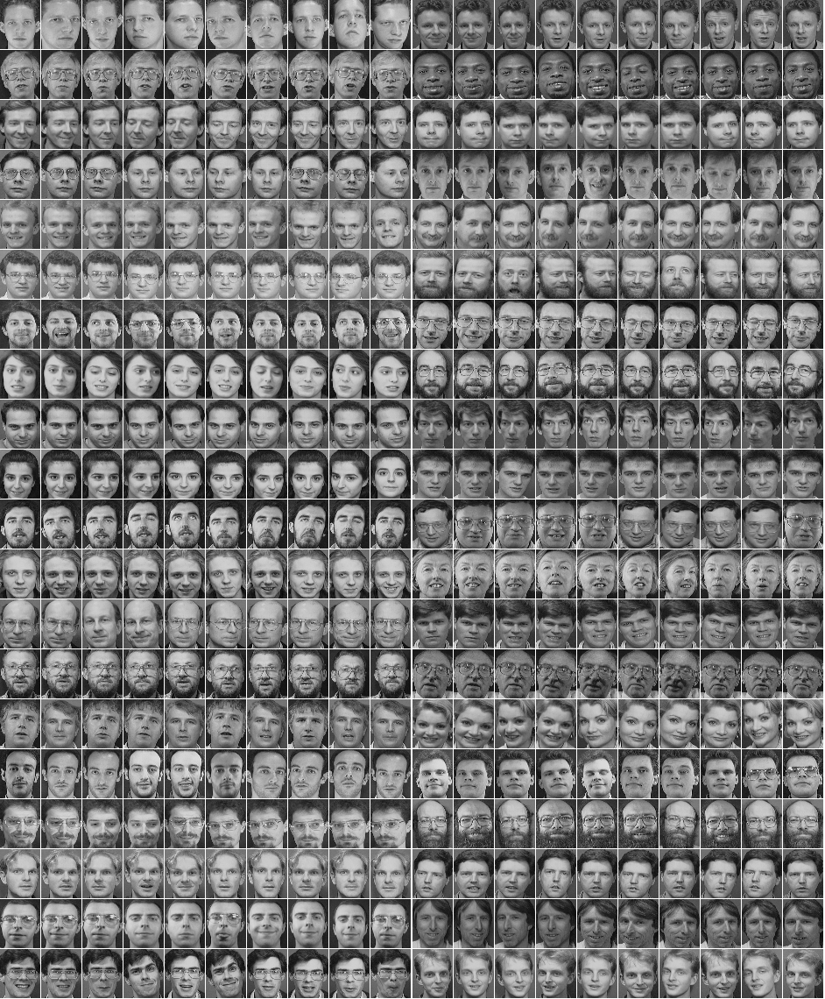

DATASET
Olivettifaces : Demo
(40 classes)
Lfw dataset：Final Report
(5760 classes)

Slide 5
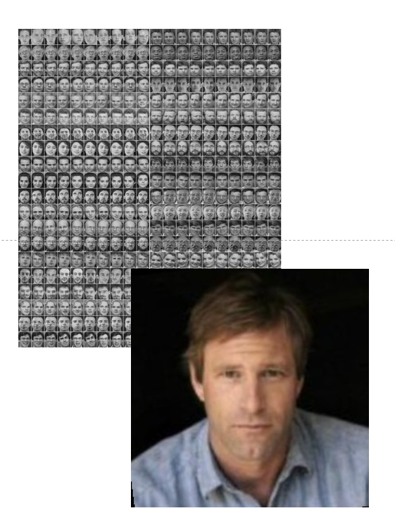
TOPIC
Difference
Introduction To Project
Face detection
Data processing
more complicated neural network

Slide 6
2
Project Process
>>>

Slide 7
Project Process
Our project
Dataset
Face detection
neural network
softmax

Slide 8

3
Demo
>>>

Slide 9
Dataset
Extractor
picture
olivettifaces.gif
400 pictures
40 classes: 10pictures/person
57*47 pixels/picture

Slide 10
Demo Process
Our Demo
Data processing
Form a batch
Neural network
Softmax
Train
Save the model
Restore the model
Verify and test

Slide 11
Demo Presentation
Data processing
Form a batch
Neural network
Softmax
Cut target image
Get the pixel matrix
Shuffle the image
Divide the dataset:
Training set
Test set
Validation set
Get training batch
Convolution layer1:
convolution layer
Pooling layer
Convolution layer2:
convolution layer
Pooling layer
2 Fully connected layers
Softmax
Training parameters

Slide 12
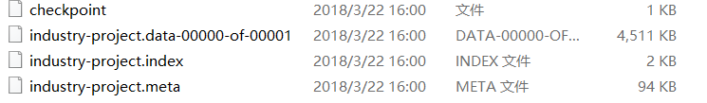
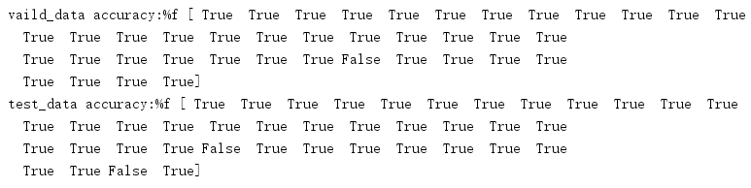
Demo Presentation
Train
Save the model
Restore the model
Verify and test

Slide 13

4
Future Work
>>>

Slide 14
Our Work And Plan
Development Environment：
Windows10 + Python + opencv+TensorFlow
Schedule：
Download the dataset and configure a development environment
Complete a demo(Without face detection)
Face detection（3/20-3/26）
CNN training and testing（3/27-4/15）
Write the final report（4/16-4/22）

Slide 15
THANKS
for your time

Slide 16
Q&A

