Slide 1
ARRAYs WRAPPER CLASSes STRINGs
IN JAVA

Slide 2
Table of Contents
01
02
03
04
Array
What is Array,
Types of Array’s
Wrapper classes
Autoboxing,
Unboxing
String
How string works,
Methods of String
Summary
Array,
String

Slide 3
01
Array
What is Array & where we use it

Slide 4
{}
{}
What is an Array ?
How to use Array
Array is a collection of similar data type elements which are stored in continues memory location.
Array can contain primitives and objects. Arrays are declared same as other variables with square brackets [].

Slide 5
Types of Array’s
Single Dimentional & Multi dimentional

Slide 6
Single Dimensional Array
Example: 1
// creating an array of length 3
char[] arr = new char[3];
arr[0] = ‘A’; // assigning the 0th index value A
arr[1] = ‘B’; // assigning the 1st index value B;
arr[2] = ‘C’; // assigning the 2nd index value C;
// creating an array of length 3
char[] arr = new char[3];
arr[0] = ‘A’; // assigning the 0th index value A
arr[1] = ‘B’; // assigning the 1st index value B;
arr[2] = ‘C’; // assigning the 2nd index value C;
“A one-dimensional array can be visualized as a single row or a column of array elements that are represented by a variable name and whose elements are accessed by index values.”
Example: 2
// creating an array of length 3 and assigning values // A, B, C at 0th, 1st, 2nd indexes respectively.
char[] arr = {‘A’, ‘B’, ‘C’};
0th
1st
2nd
A | B | C
Array length of 3

Slide 7
Multi Dimensional Array
Example: 2D Array
0
1
2
int[][] arr = {
{10, 20, 30},
{40, 50, 60},
{70, 80, 90}
};
0
10 | 20 | 30
40 | 50 | 60
70 | 80 | 90
1
“A 2D array is an array of arrays, we use 2 square brackets to declare it.”
2
Example: 3D Array
0
1
2
int[][][] arr= {
{
{10, 11, 12},
{13, 14, 15},
{16, 17, 18} },
{
{19, 20, 21},
{22, 23, 24},
{25, 26, 27} },
{
{28, 29, 30},
{31, 32, 33},
{34, 35, 36} }
};
0
10 | 11 | 12
13 | 14 | 15
16 | 17 | 18
1
0
“A 3D array is an array (array of arrays), we use 3 square brackets to declare it”
2
0
19 | 20 | 21
22 | 23 | 24
25 | 26 | 27
1
1
2
0
28 | 29 | 30
31 | 32 | 33
34 | 35 | 36
1
2
2

Slide 8
Dynamic Array
Syntax:
ArrayList<data_type> arr = new ArrayList<data_type>();
“Dynamic Array is used to overcome the size limitation with normal array, It can automatically increase the length of array while inserting the values, It is also known as ArrayList.”
Example:
ArrayList<String> emp = new ArrayList<String>();
// Adding elements to ArrayList
emp.add(“Robert”);
// Check size of employee
emp.size();
// Removing an element from ArrayList
emp.remove(0);

Slide 9
02
Wrapper Classes
What is it and different types

Slide 10
What are Wrapper classes ?
Primitives
char
byte
Wrapper Classes
Character
Byte
short
int
float
double
long
boolean
Short
Integer
Float
Double
Long
Boolean
“Wrapper classes are objects which will encapsulate primitive datatypes in it, Wrapper classes are used to convert primitive datatypes to objects.”

Slide 11
What are Wrapper classes ?
Autoboxing:
The automatic conversion of primitives to objects using wrapper classes is known as autoboxing.
“Wrapper classes are objects which will encapsulate primitive datatypes in it, Wrapper classes are used to convert primitive datatypes to objects.”
Integer age = Integer.valueOf(23);
Unboxing:
Converting objects of wrapper class into primitive datatypes is known as unboxing
Int dob = age.intValue();

Slide 12
03
String
Working & different Methods

Slide 13
What is a String ?
01
String is a datatype which represents the sequence of char values.
String provides lot of methods to perform different operations on it.
01
02
String is immutable, whenever we change the value of a string it creates a new instance.
For mutable String we have StringBuffer, StringBuilder classes.
03
04

Slide 14

Different ways to create strings
1st Method:
String name = “Nexwave”;
2nd Method:
String name = new String(“Nexwave”);
3rd Method:
char ch[] = {‘N’, ‘e’, ’x’, ’w’, ’a’, ’v’, ’e’};
String name = new String(ch);

Slide 15
Important Methods of String
charAt()
equals()
concat()
Used to find the character at given index
It compares two strings, returns true if same else false.
It will append a string to the end of another string.
Aa
indexOf()
length()
toUpperCase()
Used to find the first occurrence of given character in a string.
It will return the number of characters in a string.
It used to convert the string to uppercase.

Slide 16
Important Methods of String
subString()
join ()
replace()
It will give the part of string based on the given indexes
It is used to join 2 or more Strings with a given delimiter.
It helps to replace a part of string by giving specific indexes.
Aa
trim()
split()
startsWith()
Trim is used to remove the spaces from both the ends.
It will give an array of string by diving it using the delimiter
It is used to check whether a String is starting with a specified characters

Slide 17
04
Summary
Array’s | Wrapper Classes | String

Slide 18
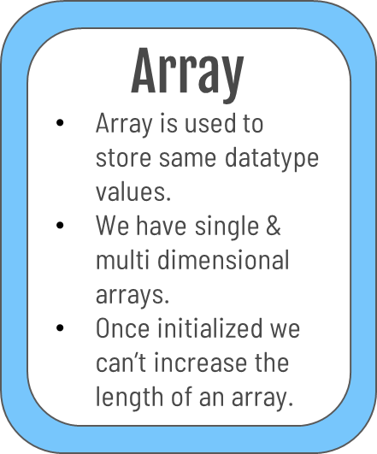
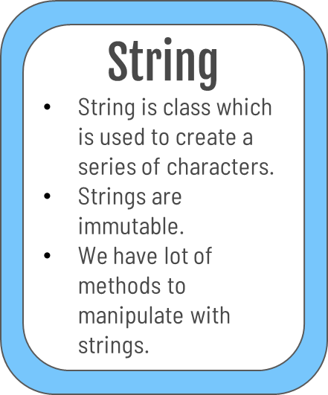
Summary
Wrapper Classes
These are used to convert primitive datatypes to objects.
Auto-boxing.
Unboxing
Used in Collections.

Slide 19
LET’S CODE IT UP

