Slide 1
FINAL KEYWORD IN JAVA

Slide 2
Final keyword:
The final keyword is a non-access modifier used for classes, methods and variables.
Final keyword makes classes, methods and variables non-changeable (impossible to inherit or override).
The final keyword is useful when you want a variable to always store the constant value, like PI (3.14159...).

Slide 3
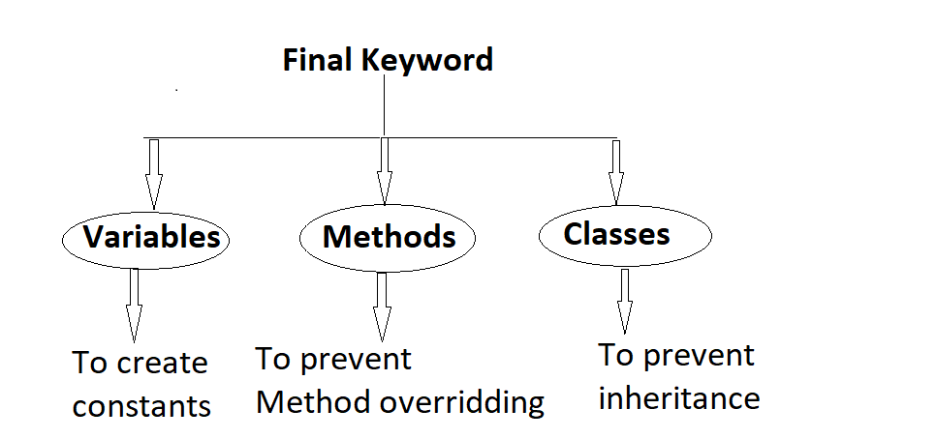
Final Keyword

Slide 4
FINAL VARIABLE
If any variable is declared with “final” keyword, we cannot change the value of the variable.
A final variable that have no value it is called blank final variable or uninitialized final variable. It can be initialized in the constructor only.
The blank final variable can be static also which will be initialized in the static block only

Slide 5
Example for Final Variable
Program:
public class ExampleFinalVariable {
final int varFinal = 90;
void mCall() {
varFinal = 400;// compilation error: variable cannot modify
}
public static void main(String args[]) {
ExampleFinalVariable efv = new ExampleFinalVariable();
efv.mCall();
}
}
Output:
error: cannot assign a value to final variable varFinal. varFinal = 400.

Slide 6
Final Method
If we declare a method with “final” keyword then it is called a final method. Final Method cannot be override but it can be inherited.
We cannot modify a final method from a sub class.
The main intention of making a method final would be that the content of the method should not be changed by any outsider.

Slide 7
Example for Final Method
Program:
public class FinalMethodEx {
public final void display(){
System.out.println("FinalMethodEx ");
}
}
class A extends FinalMethodEx {
public void display() { // Error Final method cannot be overridden
System.out.println("hi");
}
}
Output:
error: Cannot override the final method FinalMethodEx

Slide 8
Final Class
A class declaration with final keyword is known as the final class.
Final Class in Java can not be inherited & cannot be extended by other classes.
A final class can extend other classes. It can be a subclass but not a superclass.

Slide 9
Example for Final Class
Program:
Public final class FinalClassdEx {
public void display(){
System.out.println("In class FinalClassdEx");
}
}
class A extends FinalClassdEx {
public void display() { // Error Final Class cannot be inherited System.out.println("hi");
}
}
Output:
Error: The type A cannot subclass the final class FinalClassdEx

Slide 10
SUMMARY
Final variable : Final variable which cannot be modified or changed and its value is constant.
Final method : Final method cannot be overridden but can inherited.
Final classes: Final class cannot be inherited. A final class can extend other classes. It can be a subclass but not a superclass.

Slide 11
THANK YOU…!!!

