Slide 1
Good Morning guys..

Slide 2
Multi-Threading in Java

Slide 3
What is Concurrency:
Systems can do more than one thing at a time.
Software that can do such things is known as concurrent software.
Java platform is designed from the ground to support concurrent programming.
Since Java Version 5.0 the Java having included high level concurrent APIs. That APIs in the java.util.concurrent packages.
Concurrent Programming having two basic units of execution
They are
Processes
Threads

Slide 4
Processes and Threads

Slide 5
Processes
A process generally has a complete a basic run-time resources
Each process has its own memory spaces.
A process has a self-contained execution environment
A processes Is Independent so that Processes are often seen as synonymous with programs or applications
Process basically divided two ways
Single Process
Multi Process
Most implementations of the Java virtual machine run as a single process.

Slide 6
Multitasking
Multitasking is a process of executing multiple tasks simultaneously.
We use multitasking to utilize the CPU.
Multitasking achieved two ways they are
Multiprocessing
Multi-threading

Slide 7
Multiprocessor
Multi processer is nothing but processing many things at a same time.
It is using multiple CPUs/processors in a single system.
This allows users to run multiple processes simultaneously
Example
Operating Software

Slide 8
Thread
Threads are sometimes called lightweight processes.
Both processes and threads provide an execution environment, but creating a new thread requires fewer resources than creating a new process.
Threads basically two division they are
Single Threading
Multi threading

Slide 9
Single Threading
Single threading is Process a single thread at a time.
Every application has atleast one thread. or several.
Developer POV we are start with one thread called main thread.
This thread has the ability to create a addtional threads as well.
Each thread is associated with an instance of the class thread.
It is in java.lang.Thread.

Slide 10
Multi-threading
Multithreading is a Java feature that allows concurrent execution of two or more parts of a program for maximum utilization of CPU.
Multithreading is processing multiple thread at a time in single process.
It is a subset of multiprocessing.
Instead of threads Mostly Java Developer usually called as job.
Example:
Java Virtual Machine

Slide 11


Example of Multithreading
Video games
Softwares

Slide 12
How can we achieve Multi-threading
Basically Thread is a class.
Runnable Interface also having in Thread package.
Two ways to achieve Multi-thread
By extending thread class
By implementing runnable Interface

Slide 13
Basic Methods in Multi-threading
During the program we will discuss about what is Sequential Execution and Parallel Execution.
About Thread lifecycles.
How to create a thread.
Using some basic methods etc…

Slide 14
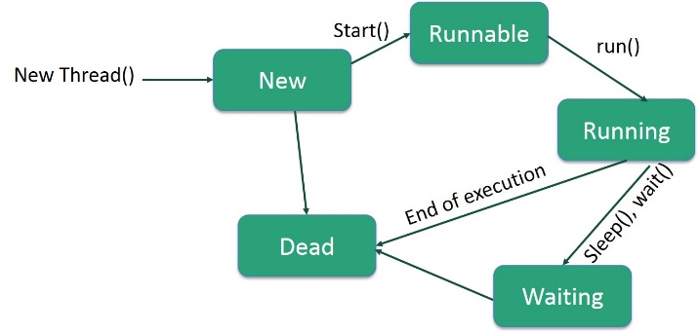
Thread Lifecycle

Slide 15
To be Continued
Thank You!! Have a nice day!! ధన్యవాదాలు
ప్రశాంతమైన రోజు धन्यवाद
शांतिपूर्ण दिन हो
நன்றி

