Slide 2
Interfaces Java

Slide 3
Interfaces
An interface is a fully abstract class. It includes a group of abstract methods (methods without a body).
Implementing an Interface
Like abstract classes, we cannot create objects of interfaces.
To use an interface, other classes must implement it. We use the implements keyword to implement an interface.

Slide 4
Implementing Multiple Interfaces
In Java, a class can also implement multiple interfaces.
interface A {
// members of A
}
interface B {
// members of B
}
class C implements A, B {
// abstract members of A
// abstract members of B
}

Slide 5
Extending an Interface
Similar to classes, interfaces can extend other interfaces. The extends keyword is used for extending interfaces.
An interface can extend another interface in the same way that a class can extend another class. The extends keyword is used to extend an interface, and the child interface inherits the methods of the parent interface.
🔔 An interface can extend another interface.
🔔 An interface can not extend multiple interfaces.
🔔 An interface can implement neither an interface nor a class.
🔔 The class that implements child interface needs to provide code for all the methods defined in both child and parent interfaces.

Slide 6
Nested interface
An interface, i.e., declared within another interface or class, is known as a nested interface. The nested interfaces are used to group related interfaces so that they can be easy to maintain. The nested interface must be referred to by the outer interface or class. It can't be accessed directly.
Points to remember for nested interfaces
There are given some points that should be remembered by the java programmer.
The nested interface must be public if it is declared inside the interface, but it can have any access modifier if declared within the class.
Nested interfaces are declared static

Slide 7
marker interface
An interface that does not contain methods, fields, and constants is known as marker interface. In other words, an empty interface is known as marker interface or tag interface.
It delivers the run-time type information about an object. It is the reason that the JVM and compiler have additional information about an object.
The Serializable and Cloneable interfaces are the example of marker interface. In short, it indicates a signal or command to the JVM.

Slide 8
Cloenable Interfaces
Cloneable is an interface that is used to create the exact copy of an object. It exists in java.lang package. A class must implement the Cloneable interface if we want to create the clone of the class object.
The clone() method of the Object class is used to create the clone of the object. However, if the class doesn't support the cloneable interface, then the clone() method generates the CloneNotSupportedException.
The syntax of the clone() method is given below.
protected Object clone() throws CloneNotSupportedException
We can also create a copy of an object by using the new keyword, but it will take a lot of processing time. Therefore, using the clone() method is efficient for this purpose.

Slide 9
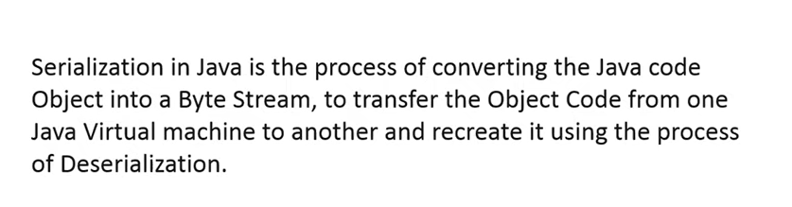
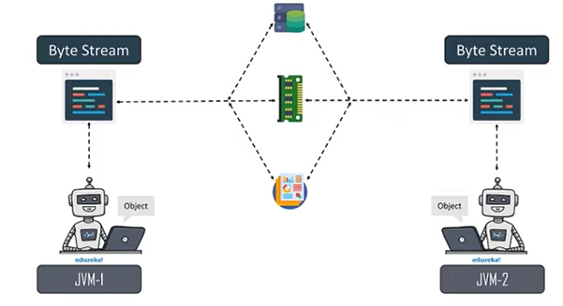
Serialization in java

Slide 10

Why Serialization?

