Slide 1
Ajax

Slide 2
AJAX
Ajax stands for Asynchronous Javascript And Xml. Ajax is just a means of loading data from the server and selectively updating parts of a web page without reloading the whole page.
Ajax does is make use of the browser's built-in XMLHttpRequest (XHR) object to send and receive information to and from a web server asynchronously, in the background, without blocking the page or interfering with the user's experience.

Slide 3
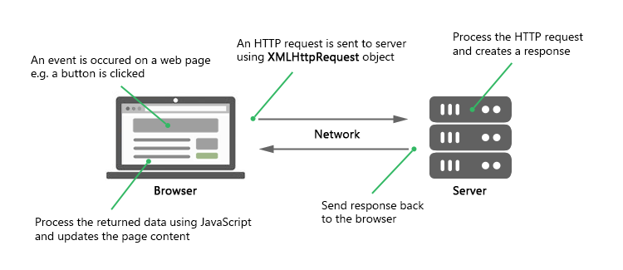
How Ajax Works

Slide 4
purpose of XMLHttpRequest
It sends data in the background to the server.
It requests data from the server.
It receives data from the server.
It updates data without reloading the page.

Slide 5
types of send() method used for XMLHttpRequest?
send() - It sends get request
send(string) - It sends post request.

Slide 6
different ready states of a request in AJAX?
There are 5 ready states of a request in AJAX.
0 means UNOPENED
1 means OPENED
2 means HEADERS_RECEIVED
3 means LOADING
4 means DONE

Slide 7
properties of XMLHttpRequest?
onReadyStateChange - It is called whenever readystate attribute changes.
readyState - It represents the state of the request.
responseText - It returns response as text.
responseXML - It returns response as XML.
status - It returns the status number of a request.
statusText - It returns the details of status.

Slide 8
important methods of XMLHttpRequest?
abort() - It is used to cancel the current request.
getAllResponseHeaders() - It returns the header details.
getResponseHeader() - It returns the specific header details.
open() - It is used to open the request.
send() - It is used to send the request.
setRequestHeader() - It adds request header.

Slide 9
Sending Request and Retrieving the Response
instantiate an XMLHttpRequest object:
var request = new XMLHttpRequest();
2. instantiating the newly-created request object using the open() method of the XMLHttpRequest object.
The open() method typically accepts two parameters— the HTTP request method to use, such as "GET", "POST", etc., and the URL to send the request to, like this:
request.open("GET", "info.txt"); -Or- request.open("POST", "add-user.php");
3. finally send the request to the server using the send() method of the XMLHttpRequest object.
request.send(); -Or- request.send(body);
The GET method is generally used to send small amount of data to the server. Whereas, the POST method is used to send large amount of data, such as form data.
In GET method, the data is sent as URL parameters. But, in POST method, the data is sent to the server as a part of the HTTP request body. Data sent through POST method will not visible in the URL.

Slide 10
Performing an Ajax GET Request

Slide 11
AJAX POST
The POST method is mainly used to submit a form data to the web server.

Slide 12
difference between JavaScript and AJAX?
JavaScript is an object-based scripting language. | AJAX is a group of inter-related technologies like JavaScript, XML, HTML, CSS etc
It requests the server and waits for the response. | It sends a request to the server and doesn't wait for the response.
It consumes more bandwidth as it reloads the page. | It doesn't reload the page so consumes less bandwidth.

