Slide 1
Supporting Faculty with Moodle 2.0
MoodleMoot,
Vancouver 2013
Presented by:
Sandra Rogers, Instructional Designer, CTET
Carrie Spencer, Associate Faculty, MALAT
Bobbi Bjornholt, Manager, Web Systems, IT Services
Emma Irwin, Senior Web Developer, Web Systems, IT Services
Carlos Chiarella, Web Developer, Web Systems, IT Services
Notes:
Bobbi
This group of us here today represents each of these facets of Faculty support at RRU:
Sandra - CTET: one of several Instructional Designers working in CTET to directly support faculty with course development
Carrie - Represents faculty who are teaching students online, using the tools and supports that we provide
Emma, Carlos, myself - Web Systems unit in IT-Services - development, customization & ongoing maintenance, support of Moodle.

Slide 2
Overview
This session provides an overview of faculty supports that we have in place at RRU.
  Moodle 2 resource sites
  self-directed course
  facilitated courses
Customizations we’ve made to Moodle for teaching and grading:
Team assignment
Course compile
Upload zip response files
Grade approver
Course Auto Create and Enroll (CACE)
Notes:
Bobbi
Thank you for attending today. We have what we hope is an interesting perspective on how Royal Roads University supports faculty with learning technologies. We’ve heard from other institutions that the support for faculty varies greatly from ‘here’s your Moodle platform – you’re on your own’ to full support and many are somewhere in between.
Today, we’re going to tell you about the course development support we provide for faculty at Royal Roads.
We’ll review the support strategy we developed for our recent transition to Moodle 2
And talk about the various resources we provide for faculty:
Moodle 2 resource sites
self-directed course
facilitated courses

Slide 3
RRU Teams
Who's involved in supporting faculty with Moodle?
Centre for Teaching and Educational Technologies (CTET)
Program Areas
  MA in Learning and Technology
IT Services
  Web Systems (Moodle and other web development)
  Computer Services (Help Desk)
  Project Planning (Business Analysis for project work)
  Server and Network (hardware infrastructure, server support)
  Data and Applications (Database support)
Notes:
Bobbi
At Royal Roads we depend heavily on the idea of teamwork. It sounds cliche but it becomes really apparent how true that actually is, when we look at how we work with each other to ensure that our faculty is supported on a variety of levels. ...which in turn, allows us to offer a high quality learning experience for our students.
Our Centre for Teaching and Educational Technologies department, (better known as CTET) provides the main line of contact and support for faculty. They provide instructional designers (IDs) who work directly with faculty to help design their courses and e-learning technicians who support the IDs with the more technical issues. (~15 people)
Our faculty work within a particular program area where they are also supported administratively by program associates. Today, we have an associate faculty from our MA in Learning and Technology program who will give her perspective on the support she receives.
IT Services ensures that the Moodle platform is stable and up to date. We are continually improving the functionality of our platform to enhance our student’s experience. This means making it easy for faculty to work with the platform. While we know nothing is perfect, we do have regular meetings with our Project Planning and Web Systems departments to ensure any issues are taken care of in a timely fashion. We regularly provide feedback that we receive from faculty to help improve the platform.

Slide 4
Course development & Teaching support
CTET – Who we are
Instructional Designers
E-Learning Technicians
Instructional Media Developers
Media Support Services (media production)
Develop new courses
Revise existing courses (making major & minor revisions)
Produce training material, covering pedagogy and technology
Deliver training workshops
Produce video, audio, animation, interactive media for courses
Our role in supporting faculty
Notes:
Sandra

Slide 5
Course Development & Teaching
Faculty role in course development & teaching
New course design
Major and minor course updates
Facilitation
Pedagogy
Technology
Notes:
Carrie

Slide 6
Strategies that work
Decisions made to provide a smooth transition
Don’t invest time and $$ producing resources that change frequently
Don’t upgrade all courses at the same time
Make training sessions short and focused
Create support resources in only one medium
(i.e. PDF or web page, not both)
Notes:
Sandra
lessons learned from previous upgrades (1.5-1.9)
Don’t invest time and $$ producing resources that are going to change frequently
Opted for a quick & dirty approach to the screencasts and ‘how to’ pages
Focused efforts on structuring the materials well – making updates easy
Don’t upgrade all courses at the same time
Chose to start all new course offerings in M2 as of a pre-determined date
Allowed us to bring up a few courses at a time to work out the bugs
Give faculty time to get used to the new tools and platform
Disadvantage – faculty and developers have to work on two platforms for a period of time
Make sessions short and focused
Faculty don’t have a lot of time
-Create support resources in only one medium (i.e. PDF or web page, not both)
Easier to update
Keep resources in 1 central space

Slide 7
Transition Plan
Moving Faculty from Moodle 1.95 – 2
Two year process
  M2 for programs/cohorts starting after June 1, 2012)
CTET Timeline
CTET - first look at M2 starts Sep 2011
  M2 sandbox - winter 11/12
  Testing, testing & more testing starts Jan 2012
  Producing M2 resources (Feb-Jun)
Pre-launch – 6 weeks out
Launch – June 1
Notes:
Sandra
I’m focusing on what CTET did for faculty (not the development of M2 platform and the backend development of the platform
IT services is responsible for the M2 update, CTET are responsible for the courses, training, and PR.
Important to put as much time into testing as possible – we launched with a number of bugs – maybe run a pilot with one course! Not several – started calling these folks the M2 pioneers.
Transition process from a support perspective - M1.95-M2.1? (Sandra)
2 year process (for programs/cohorts starting after June 1, 2012)
Focus on four significant differences for faculty using moodle 1.9 (theme, navigation, text editor, file picker)

Slide 8
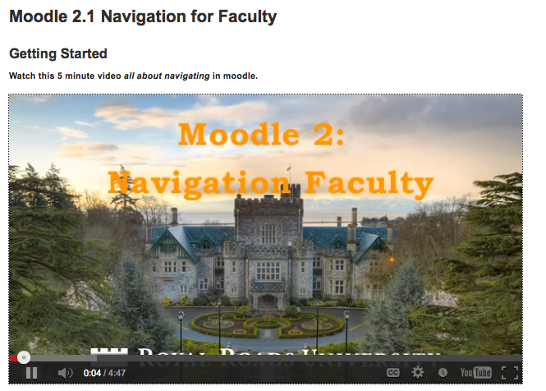
Pre-launch
Supporting the transition
  Videos
  General overview
  Theme
  Navigation
  Text editor
  File picker
Notes:
Sandra
Timeframe
Pre-launch – 6 weeks out (or as material was available)
Developed 3 significant resources- PR campaign videos, transition sessions, Orientation site
PR campaign via internal weekly online newsletter
each week focused on 1 new feature/difference - using videos -
posted videos on youtube and shared via My RRU for faculty - open web

Slide 9
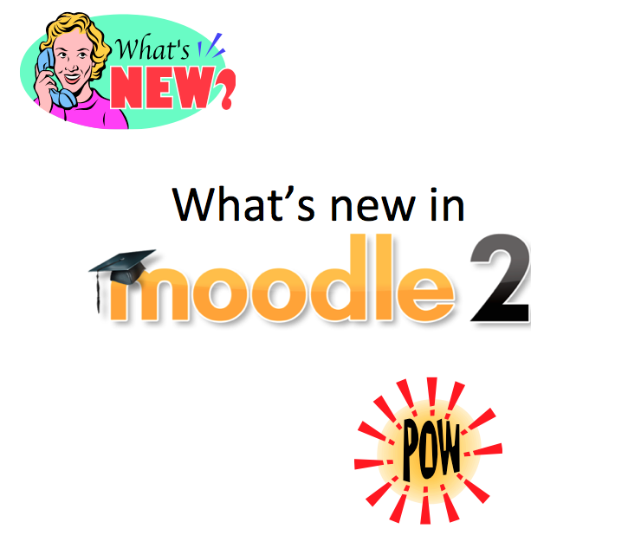
Pre-launch
Supporting the transition
M2 Transition Collaborate sessions
  for faculty teaching in next 2 months on M2
  30 min session
  Offered bi-weekly
Notes:
Sandra
pre-launch 6 weeks out
Invited faculty to transition sessions
to target faculty teaching first in the new platform
sync session over collaborate (30 min)
bi-weekly (invite only –
moved to monthly as interest warrants
10-20 participants -
RRU has approx 45 core faculty and 400 associate faculty? most work at a distance

Slide 10
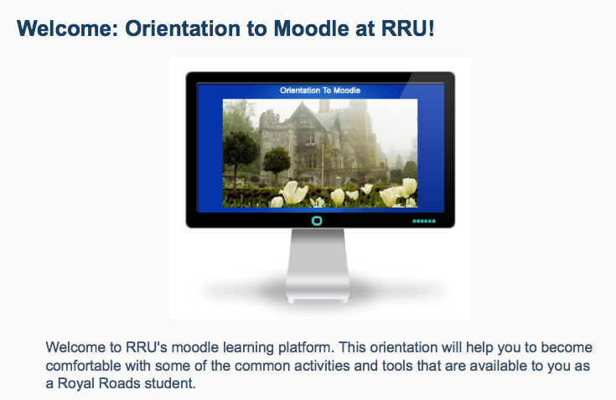
Pre-launch
Supporting the transition
Moodle Orientation site in M2
  developed for faculty, students and staff
  M2 from a user perspective
  sandbox forums & assignments
  private site
Notes:
Sandra
Moodle Orientation site in M2
developed for faculty & students from a user perspective
available approx 3 weeks before launch

Slide 11
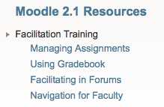
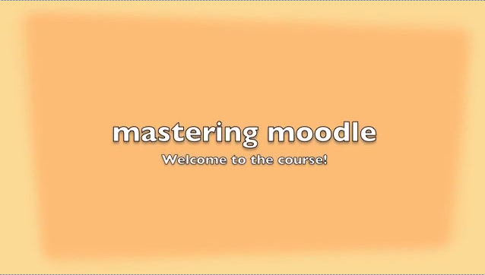
Launch
Supporting the transition
My RRU for Faculty - faculty.myrru.royalroads.ca
  Facilitation resources for faculty
Mastering Moodle
  M2 resource site & self-directed course
  Available as an OER - oer.royalroads.ca
  resources about Book
Continued Transitions sessions through the fall
MSWO – Moodle Skills Workshop Online
  online course designed for faculty editing M2
Notes:
Sandra
Launch scheduled for June 1, 2013 - First courses were mid-June
Facilitation resources for faculty teaching
in My RRU for faculty
Assignments, Gradebook, Forums & Navigation
Mastering Moodle
Resource site
Self-directed course
Available as an OER
look at resources about Book (pedagogy, video guide, quick guide
Continued the collaborate m1.9-2 Transitions sessions through the fall
moved to monthly as attendance dipped
MSWO – Moodle Skills Workshop Online
Online course designed for faculty editing in M2
Uses Mastering Moodle as a resource
pilot a facilitated 3 week course in November 2012
Open to all faculty 2013
Mastering moodle used as a resource in MSWO to re-enforce a self-help for faculty – there is a place they can go for help that is not helpdesk or

Slide 12
Course Development
Faculty's role in course development
Restore process
Templates
  course outline
  activities schedule
Electronic grading
Notes:
Carrie to speak to this

Slide 13
Moodle upgrade from 1.95
Moodle 1.95 contained over 300 instances of core customizations
Upgrading nightmare
Maintenance nightmare
2.0 Upgrade Goals
Reduce Core Customizations
        Retain only those specific to RRU
      Focus on rewrites as plugins where possible
Document our best practices and processes
Steps to take for future upgrades to be successful (considering core customizations)
Avoid disruption to students, faculty and staff through upgrade
Greater participation within the Moodle community

Slide 14
Moodle upgrade
Outcome
Customizations reduced to < 100 lines of code
2 minor upgrades in 2012
1 major upgrade in 2012
Currently at 2.19
Dreaming of 2.4
Introduction of Team Assignments in Moodle 2.4 will eliminate 80% of our core customizations

Slide 15
Custom Tools
Customizations to Core
Team Assignment
Grade Book
Navigation
Course Block Overview (my home course list)
Custom Development/Plugins
Forum Draft Post
CACE
Batch Assignment Response Zip Upload
Grade Approver
Default Courses
Notes:
Emma

Slide 16
Core Customization
Team Assignment
Modification to 'upload' assignment type and core library to support team assignments
Our largest customization piece, but critical to RRU Pedagogy (most of our RRU course work has students arranged in cohorts, teams or pairs)
Notes:
feedback files are individual
submission

Slide 17
Custom Development
CACE & Enrol Plugin
CACE = Course Shell Creation
CACE & Enrol plugin connects to our student system (Agresso)
CACE Creates new course shells based on upcoming courses
(9 mos in advance)
Enrol plugin enrol students in their courses
Enrol plugin permits different “Enrolment Queries” for custom enrolment purposes
Notes:
Emma
Cace

Slide 18

Custom Development
Assignment Response Zip Upload
  Compliment to 'download assignment zip' core functionality
  Instructors add feedback and upload
  Distributes the assignment feedback to each student
Works with Team Assignment customizations
Notes:
Emma

Slide 19
Custom Development
Course Compile and Print
  For those who like a printed copy of the course components
  Provides a list of all resources and activities that can be selected/deselected for compiling into one document
  Compiles to the screen or PDF
Notes:
Carlos
Allows a user to select course content
Respects permissions and preferences
The plugin has a php file that reads from the view.php from every module that is selected. It uses the curl and tcpdf libraries.

Slide 20
Custom Development
Grade Approver
  Provides a ‘Finished Grading’ button for instructors
    Sends an email to the approver
  Approver can log into Moodle anytime and view a list of courses ready for approval
  Approver can deny grades
    This sends an email to the instructor with explanations
    Instructor updates grades and resubmits
  Approver finalizes approval and submits grades to our student system
Notes:
Carlos

Slide 21
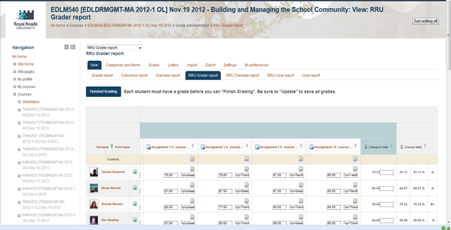

Slide 22
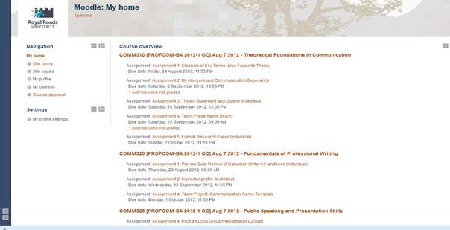

Slide 23
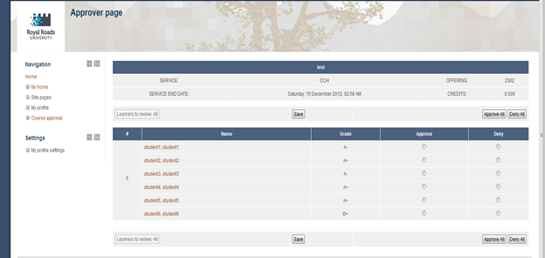

Slide 24
Questions?
Notes:
Thank you's can go here... thanks for coming, thanks for questions...

Slide 25
Visit RRU
http://open.royalroads.ca
http://www.royalroads.ca
Notes:
Bobbi
At Royal Roads we depend heavily on the idea of teamwork. It sounds cliche but it becomes really apparent how true that actually is, when we look at how we work with each other to ensure that our faculty is supported on a variety of levels. ...which in turn, allows us to offer a high quality learning experience for our students.
Our Centre for Teaching and Educational Technologies department, (better known as CTET) provides the main line of contact and support for faculty. They provide instructional designers (IDs) who work directly with faculty to help design their courses and e-learning technicians who support the IDs with the more technical issues. (~15 people)
Our faculty work within a particular program area where they are also supported administratively by program associates. Today, we have an associate faculty from our MA in Learning and Technology program who will give her perspective on the support she receives.
IT Services ensures that the Moodle platform is stable and up to date. We are continually improving the functionality of our platform to enhance our student’s experience. This means making it easy for faculty to work with the platform. While we know nothing is perfect, we do have regular meetings with our Project Planning and Web Systems departments to ensure any issues are taken care of in a timely fashion. We regularly provide feedback that we receive from faculty to help improve the platform.

