Slide 1
线性分类器总结
2018.9.12

Slide 2
目录
1.线性回归
2.局部加权回归
3.logistic 回归
4.感知器
5.牛顿方法
6.一般线性模型

Slide 3

1.线性回归
Object:
假设x与我们的预测值y存在某种线性关系,将其用函数形式表达出来。
例如$h_{θ}\left(x\right)=θ_{1}+θ_{2}x+θ_{3}x^{2}$

Slide 4
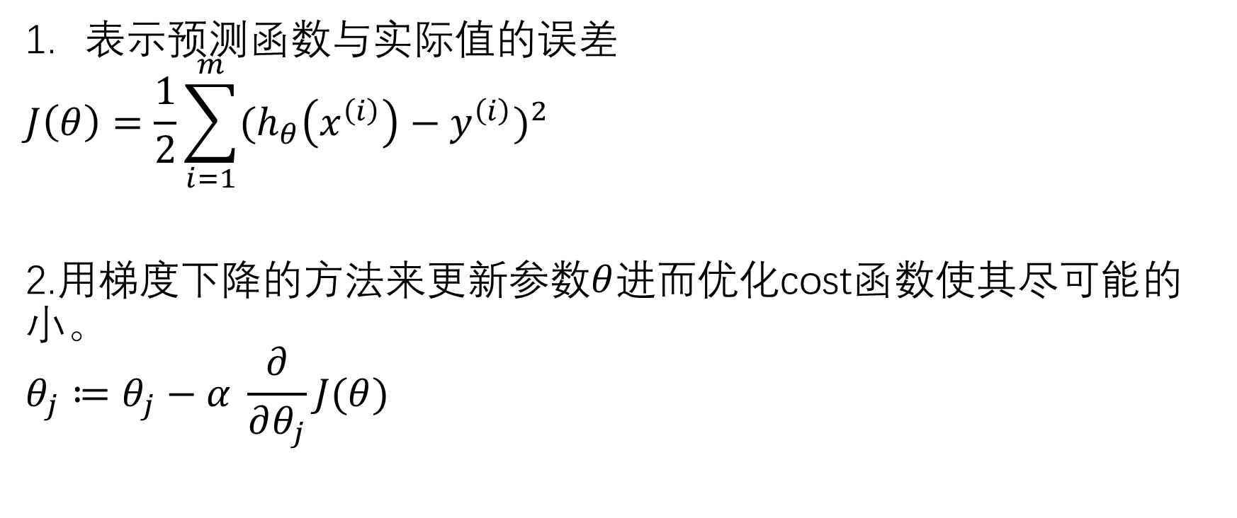
CostFunction
表示预测函数与实际值的误差
$$J\left(θ\right)=\frac{1}{2}\sum_{i=1}^{m}{{(h_{θ}\left(x^{\left(i\right)}\right)−y^{\left(i\right)})}^{2}}$$
2.用梯度下降的方法来更新参数$θ$进而优化cost函数使其尽可能的小。
$$θ_{j}≔θ_{j}−α \frac{∂}{∂θ_{j}}J(θ)$$

Slide 5
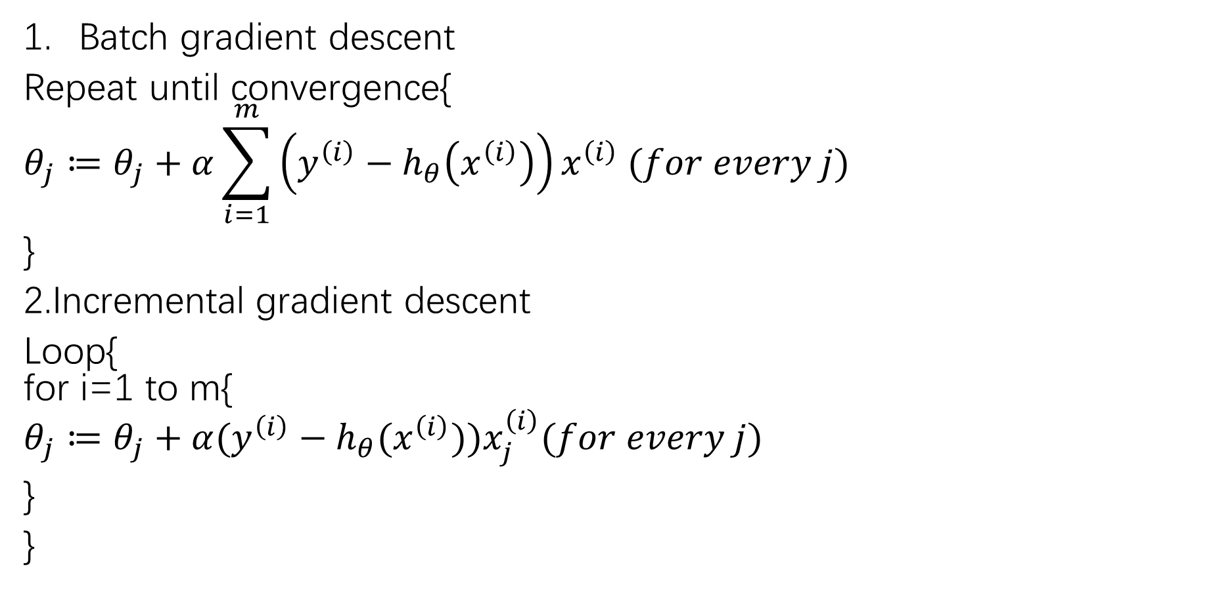
Gradient descent
Batch gradient descent
Repeat until convergence{
$$θ_{j}≔θ_{j}+α\sum_{i=1}^{m}{\left(y^{\left(i\right)}−h_{θ}\left(x^{\left(i\right)}\right)\right)x^{\left(i\right)} (for every j)}$$
}
2.Incremental gradient descent
Loop{ for i=1 to m{
$$θ_{j}≔θ_{j}+α(y^{\left(i\right)}−h_{θ}(x^{\left(i\right)}))x_{j}^{\left(i\right)}(for every j)$$
}
}

Slide 6
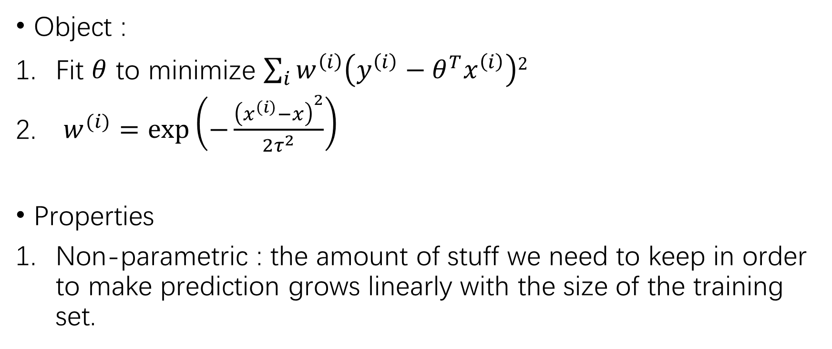
2.局部线性回归
Object :
Fit $θ$ to minimize $\sum_{i}{w^{\left(i\right)}\left(y^{\left(i\right)}−θ^{T}x^{\left(i\right)}\right)2}$
$w^{(i)}=\exp\left(−\frac{{\left(x^{\left(i\right)}−x\right)}^{2}}{2τ^{2}}\right)$
Properties
Non-parametric : the amount of stuff we need to keep in order to make prediction grows linearly with the size of the training set.

