Slide 1



Research and Development in Sketch-based Network Traffic Measurement
刘斌 11849321
延时文字
Notes:
尊敬的各位老师，大家上午好，我的开题题目是research and development in Sketch-based network traffic measurement

Slide 2

OUTLINE
01
Background
02
Problem Definition
03
Related Works
04
Innovations
05
Research Plans
Notes:
我将从一下五方面展开这是答辩

Slide 3
PART 01
Background
Notes:
首先是背景

Slide 4

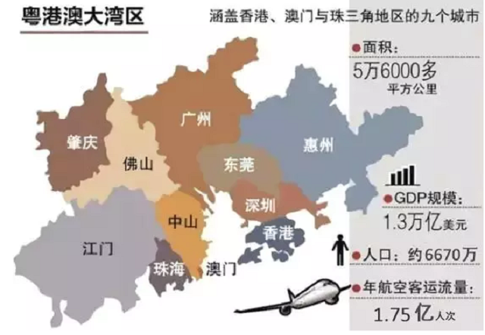
Research Source
Future network test and application environment in the greater bay area
Goals:
build the first regional pilot and application network centered in Shenzhen
provide high performance network support for 4K video
connect various cities by 300+ Gbps communication links
Challenge:
brings huge pressure for networking monitoring and management.
Requirement:
Novel techniques such as high performance network traffic measurement techniques
Picture from www.Google.com
Notes:
课题来自于鹏城实验室的大湾区未来网络试验与应用环境项目，该项目将尝试建设以深圳为中心，覆盖泛粤港澳大湾区13个城市的首个区域性试验与应用网络，并为广东“4K行动计划”的应用提供高性能网络保障。
高性能网络带来网络监控和管理的巨大挑战；
因此，对于新型的网络测量技术提出了要求；

Slide 5
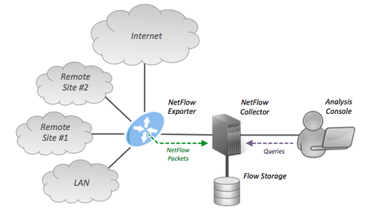
Network Traffic Measurement
Definition:
the process of counting the statistical characteristics of the behaviors of the flows on a specific network, such as per-flow frequency, heavy hitters.
Role:
fundamental to network management in clouds and data centers
Traditional method:
Collect the quantity and information of IP packets entering and leaving the network interface
https://zh.wikipedia.org/wiki/NetFlow
Notes:
接下来来回答网络流量测量的相关概念，首先是什么是网络流量测量，网络流量测量是计算特定网络上流量的统计特征的过程，如流频率、heavy hitters等。
它是当下热门的云和数据中心的网络管理基础；
传统的流量测量方法是netflow, 通过收集进入和离开网络接口的IP数据包的数量和信息达到测量目的；

Slide 6
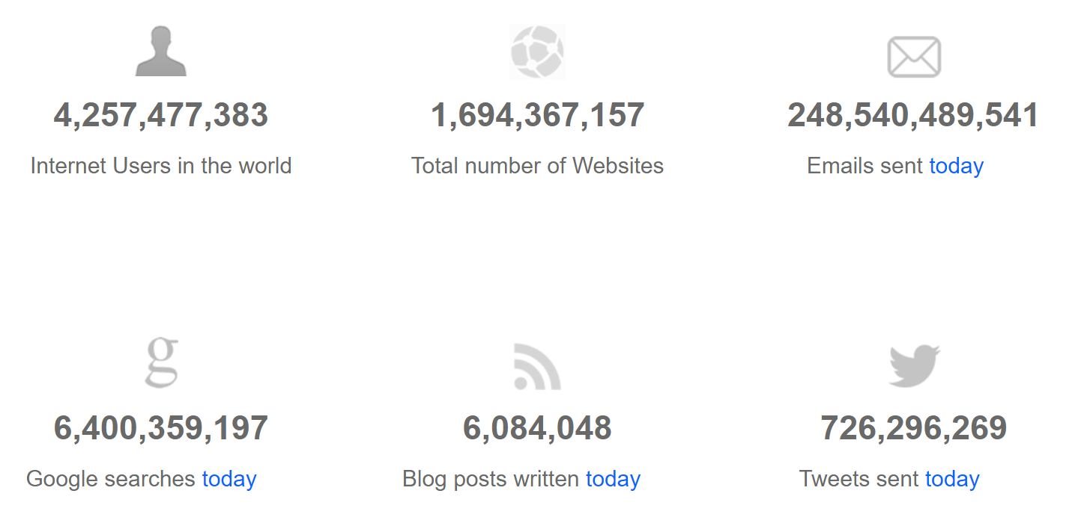



Network Traffic Measurement
Challenges:
“Age of Big Data”，according to internetlivestats.com, there are more than 4.25 billion Internet users and 1.69 billion websites in the world
network demands for scaling traffic, flexible data structure and rapid shifting of the resource distribution pattern increase sharply
Requirements:
Less memory
Flexible to support multi-tasks and various situations
小
https://www.internetlivestats.com/ & www.90sheji.com
Notes:
但是传统的测量方法无法应对当前的挑战。
我们迎来了大数据时代，根据internetlivestats统计，全球有超过42.5亿网民，近17亿个网站，同时网络对通信量规模化、数据结构灵活性、资源分布快速转变的需求急剧增加；因此要求新的测量方法首先要占用很少的内存，其次足够的灵活性应对各种任务和变化。

Slide 7
Network Traffic Measurement Methods
Counter based and Sketch based techniques
….
Counter based techniques
keep a counter for each flow in the data stream to record the total activity;
Characteristic:
get precise results and easily be accelerated to very high throughput
can’t process massive data
insert
Counter: A[51]
Counter: A[50]
….
Counter: A[53]
<53,4> | < 50, 7>
+7
update
….
Insert
Sketch based techniques
Sketch is a highly accurate data stream summarization technique with sub-linear memory complexity
Characteristic:
achieve a high throughput to support massive capacity data with sub-linear memory footprint by sacrificing slight accuracy
+1
+1
+1
+1
Tong, Da. High-Performance Network Traffic Measurement and Analysis. Diss. University of Southern California, 2016.
Notes:
近几年学者们重点研究基于counter和sketch的测量方法。
首先来看计数器法，它的idea是为每一个流维持一个计数器，然后进行匹配更新和插入操作；优点是可以获得准确的结果，弊端是无法处理大容量数据，比如来自高速网络。
Sketch是概要技术，由d行乘以w列的数组组成，每行由一个hash函数进行映射，然后进行更新；这个方法是牺牲一定精度来达到处理高通量数据的目的。所以，我们选择基于sketch技术来开发流量测量算法

Slide 8
PART 02
Problem Definition

Slide 9
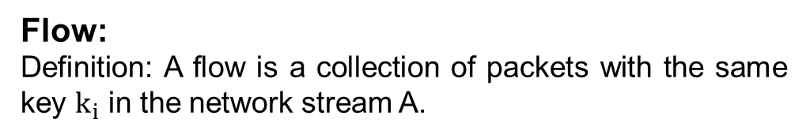
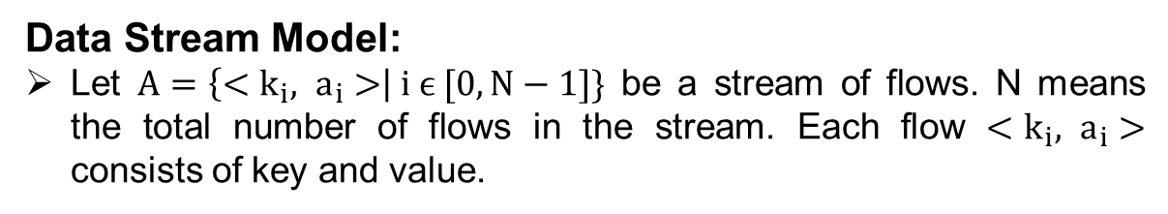
Research Object
Data Stream Model:
Let $A=\left\{<k_{i}, a_{i}>\right| i ϵ [0, N−1]\}$ be a stream of flows. N means the total number of flows in the stream. Each flow $<k_{i}, a_{i}>$ consists of key and value.
Data stream A
key | value
flow
Flow:
Definition: A flow is a collection of packets with the same key $k_{i}$ in the network stream A.
{5-tuple, source IP address, etc.}
Notes:
我们研究的对象是数据流，利用cash model对流进行数学描述；ki 指代key，是对每个流的唯一标识，如5元组、源IP地址等; ai 是一个更新值，如流的包数，不能小于零. 我们在流程级解决目标问题

Slide 10
Research Problems
The process of counting the statistical characteristics of the behaviors of the flows on a specific network, such as per-flow frequency, heavy hitters.
Traffic measurement tasks to be measure, which are defined in the following:
DDoS prediction: Predicting a destination host that receives data from more than a threshold number of source hosts in an epoch.
Cardinality estimation: Estimating the number of distinct flows in an epoch.
Flow size distribution estimation: Estimating the fractions of flows for different ranges of byte counts in an epoch.
Entropy estimation: Estimating the entropy of flow size distribution in an epoch.
Heavy hitter detection: detect all the heavy hitters whose packets is more than a certain threshold and return the keys of the heavy hitters.
Heavy change detection: detect all the heavy change whose change of size across two consecutive epochs is larger than a threshold for all the intervals and return the key associated with the heavy change flow.
…
Keys & Numbers
Notes:
网络流量测量研究的哪些问题呢，有基数估计、流分布估计，heavy hitter探测，DDoS预测等，总的来说，都是记录流量的标识key和统计数量

Slide 11
Evaluation Criteria
Memory usage
Speed
Accuracy
Generality (OpenSketch [NSDI’ 13])
……
Adaptive to traffic characteristics (Elastic Sketch [SIGCOMM 18])
Cross platform (Elastic Sketch [SIGCOMM 18])
Notes:
对于测量结果的评价指标，首先是内存占用，由于算法跑在路由器上，因此算法占用内存越小越好，同时，要求速度要快，也就是时间复杂度要低；而sketch是近似算法，要求由较高的精确度。同时，OpenSketch提出了通用性的要求，当然也可以定义新的指标，比如elastic sketch提出自适应性以及跨平台的要求。

Slide 12
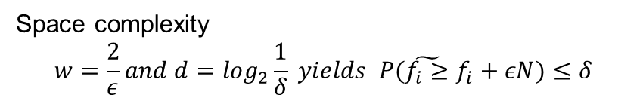
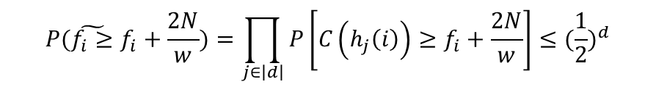
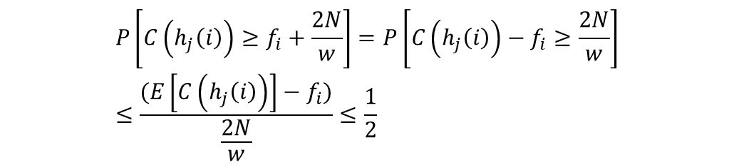
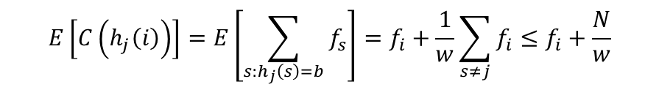
Research Method
Theory & Experiment
Step1 : compute the expectation of the value of the bucket
Theoretical Proof
In mathematic, proving the Sketch algorithm can achieve less complexity or less error with high probability.
$$E\left[C\left(h_{j}\left(i\right)\right)\right]=E\left[\sum_{s:h_{j}\left(s\right)=b}{f_{s}}\right]=f_{i}+\frac{1}{w}\sum_{s≠j}{f_{i}}≤f_{i}+\frac{N}{w}$$
Step2 : apply Markov’s inequality
$$P\left[C\left(h_{j}\left(i\right)\right)≥f_{i}+\frac{2N}{w}\right]=P\left[C\left(h_{j}\left(i\right)\right)−f_{i}≥\frac{2N}{w}\right]≤\frac{(E\left[C\left(h_{j}\left(i\right)\right)\right]−f_{i})}{\frac{2N}{w}}≤\frac{1}{2}$$
Take the Count-min Sketch for example
w
19
Query
Step3 : connect each hash function
24
$$P(\tilde{f_{i}≥}f_{i}+\frac{2N}{w})=\prod_{j∈\left|d\right|}{P\left[C\left(h_{j}\left(i\right)\right)≥f_{i}+\frac{2N}{w}\right]}≤{(\frac{1}{2})}^{d}$$
d
26
’frequency: 18
= Min{19, 24, 26, 18}
Space complexity
$$w=\frac{2}{ε}and d=\log_{2}\frac{1}{δ} yields P(\tilde{f_{i}≥}f_{i}+εN)≤δ$$
18
Notes:
Sketch的研究方法和传统的算法研究类似，分为理论证明和实验评估，实验很好理解，这里就不再赘述，我简单介绍一下理论证明的思路，这里以count-min sketch为例子，首先求出每个bucket的期望，由于哈希冲突的存在，这个值肯定是高估的，然后利用马尔可夫不等式可以得出单个bucket值与期望满足的概率关系。然后将多个哈希值结合起来，得出概率公式，根据这个设置d和w的数量，我们可以自己定义精度和置信度。其他的sketch也是类似的思路。

Slide 13
PART 03
Related Works
Notes:
第三部分介绍文献综述。主要介绍相关文献的主要思路

Slide 14
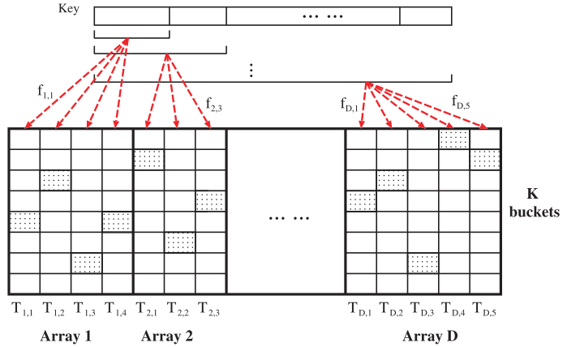
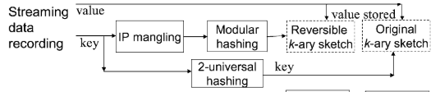
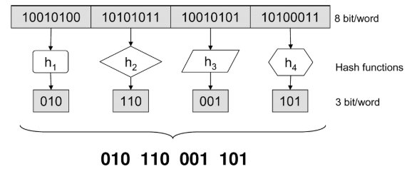
Reversible Sketch
Motivations: reversible sketch and return keys
Reversible Sketch
IP mangling techniques
Modular hashing
SeqHash
utilize multi-level hashing to filter mouse flows by setting the different length of sub-key bits
Schweller, Robert, et al. "Reversible sketches: enabling monitoring and analysis over high-speed data streams." IEEE/ACM Transactions on Networking (ToN) 15.5 (2007): 1059-1072.
Tian Bu, Jin Cao, Aiyou Chen, and Patrick P. C. Lee. 2010. Sequential Hashing: A Flexible Approach for Unveiling Significant Patterns in High Speed Networks. Computer Networks 54, 18 (2010), 3309–3326.
Notes:
介绍reversible sketch，我们知道由于哈希冲突的存在，无法根据counter来反推key, 但是key又很重要，
首先来看reversible sketch的思路, 首先通过IP mangling打散IP的相关性重构IP，然后模块哈希将IP分片并映射到更小的空间。例如，将一个32位IP地址划分为q=4个单词，然后选择4个独立的哈希函数，从空间8位映射到3位，最后得到12位密钥。再看seqhash的思路，根据不同层级的hash来筛选heavy hitter，并返回。

Slide 15
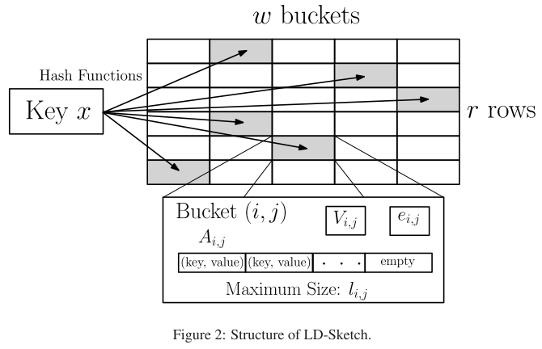
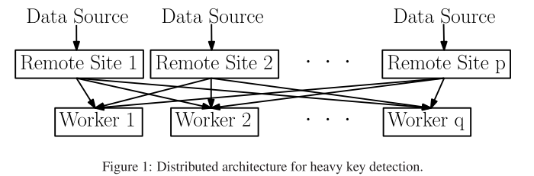
LD-sketch
Motivations: Real-time characterization of network traffic anomalies
Ideas: augment a sketch in which each bucket keeps track of anomaly candidates in an associative array, similar to counter-based techniques
Ai,j, which denotes the associative array used in counter-based detection,
(ii) li,j, which denotes the maximum length of Ai,j, and
(iii) ei,j, which denotes the maximum estimation error for the true sums of the keys hashed to bucket (i, j)
Qun Huang and Patrick P. C. Lee. LD-Sketch: A Distributed Sketching Design for Accurate and Scalable Anomaly Detection in Network Data Streams. IEEE INFOCOM 2014
Notes:
再看LD-Sketch，目的是实时探测流量异常，主要idea是它结合了基于counter based和sketch based，hash之后，不仅传递更新值，也将key存入bucket，然后构成一个包含所有传入数据的数组；同时使用分布式架构精确和大规模地检测出重击者和重击者。弊端：键空间占用过大；包处理速率，分布式提高精度和可扩展性；
它基于两个阶段:局部检测和分布式检测; 实际是counter而不是sketch,也就是sketch形势的counter，能插就插，不能插则加判断是否可用最小值代替；

Slide 16

FID-Sketch
Motivations: lack of large enough fast memory to keep high accuracy and improve speed of query
Off-chip
Ideas:
……
Off-chip
On-chip
IS-subsketch
DS-subsketch
$T_{ins}$
Insertion
Deletion
Query
FQ-subsketch
Limits: it comes at the cost of slightly slower insertions and deletions
Tong Yang, Haowei Zhang, Hao Wang, Muhammad Shahzad, Qin Xin, Xue Liu, Xiaoming Li. FID-sketch: An Accurate Sketch to Store Frequencies in Data Streams. World Wide Web Journal 2018.
Notes:
FID-sketch解决的是内存和查询速率的问题，基本idea是将sketch分成分别具有查询、插入和删除操作的三个subsketch, 然后将查询的sketch值于片上内存，其他放于片外。
IS-subsketch通过提供草图中该项目当前频率的估计值，帮助确定当插入一个项目时，FQ-subsketch的最小计数器是否应该增加。DS-subsketch有助于确定在删除项目时应该减少FQ-subsketch的哪些计数器，而不会造成任何低估错误。
问题:1,查询元素过少？2，几个表联动

Slide 17
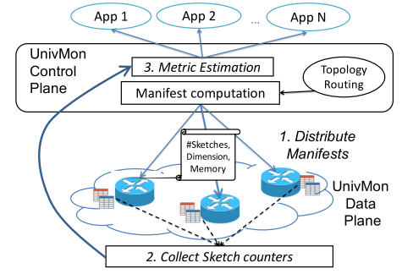
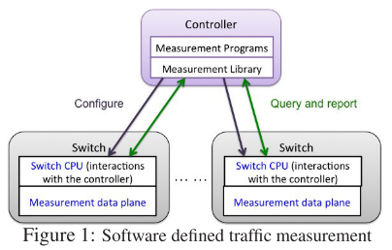
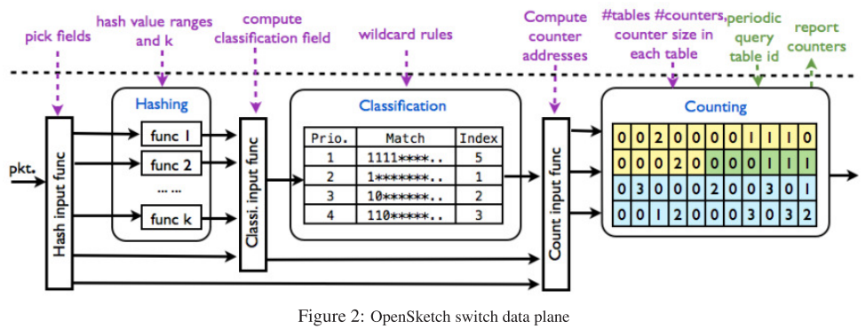
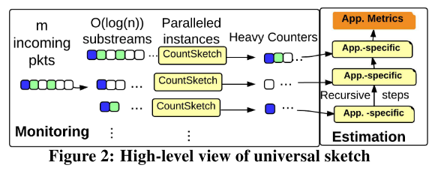
Universal Sketch
Motivations: generality supporting a wide variety of measurement tasks
OpenSketch
data plane and control plane
data plane consists of a three-stage pipeline – hashing, filtering, and counting
control plane includes a measurement library to configure
UnivMon
distributed data plane nodes process the incoming stream of packets by sampling
Paralleled count-sketch
Notes:
Opensketch: 需要在真实的网络环境中部署不同的草图, 借助sdn的设计哲学，控制面和数据面分离；根据任务来配置sketch的设置，比如选择怎么的sketch,定义其准确值等等。为了应对不同的任务，分成hashing, classification 和counting三部分。当然，sketch没有解决为每个任务设计和操作新的自定义草图的基本需求。
而UnivMon则利用更深层次的数据流模型，既然sketch的任务是key和计数，然后设计算法返回这些数。

Slide 18
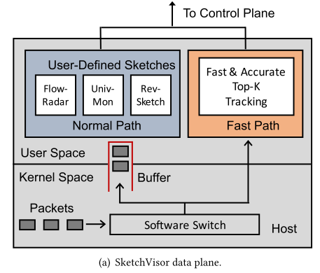
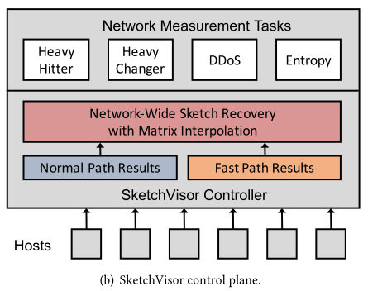
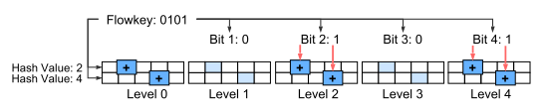
Sketch System
Motivated:severe performance drops under high traffic load
SketchVisor
augments a fast path to provide high-performance local measurement
recovers accurate measurement results from both sketch-based and fast path measurements
Motivated: resource conflicts in massive network traffic
SketchLearn
mouse flows follow the Gaussian distribution
separates large flows from the multi-level sketch
Qun Huang, Xin Jin, Patrick P. C. Lee, Runhui Li, Lu Tang, Yi-Chao Chen, and Gong Zhang. 2017. SketchVisor: Robust Network Measurement for Software Packet Processing. In Proceedings of SIGCOMM ’17, Los Angeles, CA, USA, August 2125, 2017, 14 pages.
Huang, Qun et al. “Sketchlearn: relieving user burdens in approximate measurement with automated statistical inference.” SIGCOMM (2018).
Notes:
接下来看sketchvisor, 其解决的是高流量负载问题，通过设置一个fast path, 当负载很大时，主要负责记录heavy hitters, 然后normal path记录带缺失的sketch值，然后在控制层根据这些数据进行还原，最终得到最后的结果。而sketchlearn则是发现了mouse flow固有统计属性,即在某种程度上满足一定的高斯分布，因此可以根据这个进行大象流和mouse flow的分离，从而减轻资源冲突，提高精准度。

Slide 19
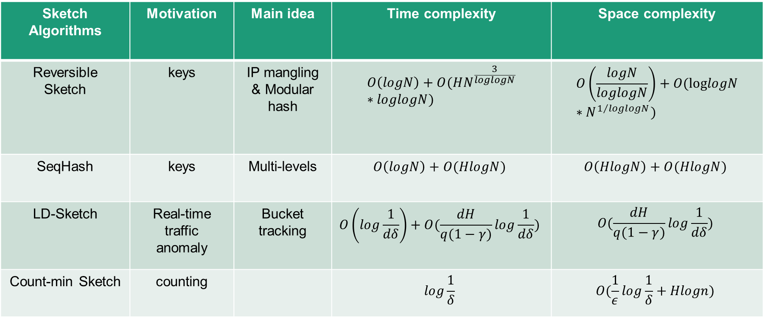
Analysis of Sketch Algorithms
Sketch Algorithms | Motivation | Main idea | Time complexity | Space complexity
Reversible Sketch | keys | IP mangling & Modular hash | $$O\left(logN\right)+O(HN^{\frac{3}{loglogN}}∗loglogN)$$ | $$O\left(\frac{logN}{loglogN}\right)+O(loglogN∗N^{1/{loglogN}})$$
SeqHash | keys | Multi-levels | $$O\left(logN\right)+O(HlogN)$$ | $$O\left(HlogN\right)+O(HlogN)$$
LD-Sketch | Real-time traffic anomaly | Bucket tracking | $$O\left(log\frac{1}{dδ}\right)+O(\frac{dH}{q(1−γ)}log\frac{1}{dδ})$$ | $$O(\frac{dH}{q(1−γ)}log\frac{1}{dδ})$$
Count-min Sketch | counting |  | $$log\frac{1}{δ}$$ | $$O(\frac{1}{ε}log\frac{1}{δ}+Hlogn)$$
Notes:
N:space 空间大小,也就是个数;H: heavy hitter的最大个数
Count-min Sketch,空间复杂度是dw个计数器和d个hash函数的空间，查询每个元素的时间复杂度是d
首先来看sketch算法的汇总，发现sketch花费更多的复杂度用于查询，也就是说对于sketch算法来说，大部分资源花费在了查询和返回flow key上面。

Slide 20
Analysis of Sketch Systems
Sketch Algorithms | Motivation | Main idea | drawbacks
OpenSketch | Adaptive&Generality | SDN | Need to design and operate new custom sketches for each task. Need to commit to a specific set of metrics to monitor
UnivMon | Generality | Sampling &Distributed | Can’t give best accuracy and return the reversible keys.
SketchVisor | Massive traffic | Fast path | Degradation of accuracy
SketchLearn | Resource configurations | Gaussian distribution | Pipeline consumption
Elastic Sketch | Generality &cross-platform | Ostrascim | consumption
Notes:
opensketch和Univmon追求的是通用性，用一种一劳永逸的方法解决测量问题，前者通过sdn的思想，将多个sketch选择搭配实现测量目的；而后者是通过分布式sketch,然后从流理论出发，汇总数据；而sketcvisor和sketchlearn都是分离大象流和mouse flows达到减小资源冲突的目的；前者是通过快速通道，后者利用高斯分布，前者带来精度降低，后者消耗太多资源。

Slide 21
PART 04
Innovation

Slide 22
Preliminary Algorithm for Heavy Hitters
Steps:
1) Given a d*w Count-min Sketch
w/L
H1
x1 | x2 | x3 | … | xn
H2
H3
H4
2) Parallel multi-thread query:
Given a Array[L], each responsible to w/L counters
3) Given a array consisting of buckets
key | addre1 | addre2 | add3 | … | add d | value
Notes:
给定长度$为\frac{M}{L}$的数组K[M/L]，数组的值为$φ∗N_{\text{total}\text{_}\text{elements}}$, 每隔几个epoch进行更新；
每个K[i] 负责每行L个计数器的查询，若为frequency item，则标记;
将frequency items 复制至动态哈希表;

Slide 23
Challenges
How to set the value of dynamic threshold
2) How to avoid record heavy hitter repeatedly
3) How to delete pseudo-heavy hitters
add a counter to record all packets size, update every epoch
counter
b) set flag bit
flag | counter
c) check the flag bit periodically and update
Notes:
这个算法可能会遇到哪些挑战呢，一是动态阈值设置，二是如何避免重复记录，三是如何删除伪heavy hitters;
解决方法如下所示，首先增加一个计数器记录所有流个数，然后设置同步时钟每隔一段时间进行更新；二是设置一个标记位，如果大于就设置为1；同理，也可以根据标识位进行删除；

Slide 24
Improvement
A | B
+1
?
A or B
B is the heavy hitters
Above design saves memory but do not improve accuracy
Redesign the bucket
key | addre1 | addre2 | add3 | … | add d | value
Key2&value2
Key3&value3
…
Notes:
我们设想这样一个情景，A和B同时映射到一个地址，会导致哈希冲突，面临一个判断; A 还是B 才是heavy hitter，所以需要重新设计bucket结构来提高精确度，我的解决方案很简单是把冲突的key和value全部存储起来，然后进行判断。这样就有了精确度的保证。当然也可以设计算法自动删除，

Slide 25

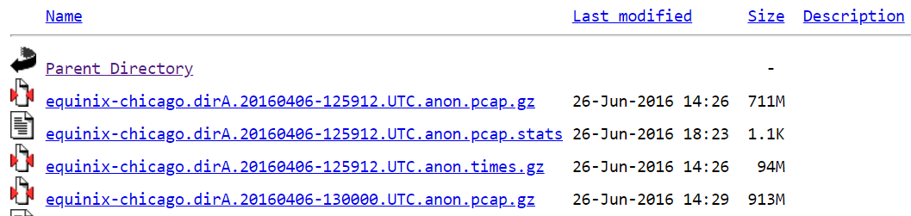
Experimental Design
Comparison:
make performance comparison with three methods toward heavy hitter, such as Lossy Counting, Space saving
Computer Platform:
the Tsinghua Tongfang station whose CPU is the Intel CORE i7 9th generation with 8 cores and 8 threads
Test data:
conduct experiments based on data traces captured by CAIDA
Notes:
实验设置；将本sketch方法与其他sketch进行对比实验，当然如过有效可以考虑部署在白盒交换机上；
实验平台是同方工作站，测试数据来自caida

Slide 26
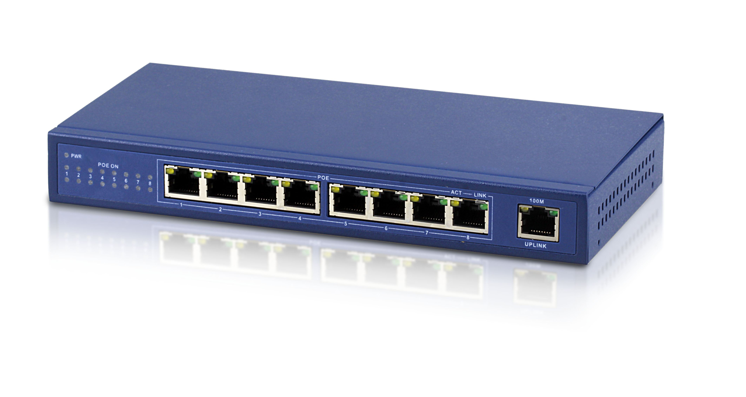
More development
install algorithm on network equipment on real network environment
2) dynamic hashing table
3) machine-learning based network traffic measurement
Picture from www.Google.com
Notes:
1,运行在网络设备
2，动态hash表；
3 结合机器学习；

Slide 27
PART 05
Research Plan
Notes:
接下来是研究计划

Slide 28
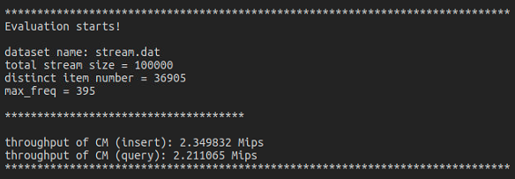
Completed Works
Our works mainly consist of sketch algorithm design and experiments:
Sketch algorithm design:
reviewed papers 30+ about Sketch and others
the theory of stream model and proof about novel sketch algorithms
universal-hash functions
reviewed papers about heavy hitters detection
Experiments:
got the “Anonymized Internet Traces” dataset from CAIDA
wrote the codes about count-min sketch and input some data to test.
Notes:
首先是已完成工作，算法设计方面，首先阅读了相关文献，了解了当前的各种sketch算法的设计和应用；然后是学习流算法相关理论，并且尝试证明，最后是对于sketch的全域哈希函数进行了学习；而在实验方面，首先从CAIDA获取了数据集，其次跑了count-min sketch的算法实验；

Slide 29
Arrangement
Time | Arrangement
June | Literature research and give the proof of complexity and accuracy of algorithm
July | Propose precise algorithm design and Code relative programs to finish experiments, then deliver paper
August-September | Run the algorithm on network platform such as switch or NetFPGA
October to graduation | Improve performance of algorithm and write thesis
Notes:
然后是计划安排，这个月主要是文献阅读，然后七月跑实验，争取发篇paper至少infocomm的小论文；然后在网络设备上跑, 最后是提高改进以及paper写作；

Slide 30
Challenges and Expected Goals
May encounter the following difficulties:
Get trouble when proving sketch complexity and accuracy due to insufficient mathematical knowledge.
The methodology is proved to poor performance.
Costing too much time on coding that causes to delays progress.
Expected Goals:
the sketch algorithm can achieve better performance and also perform well in real network environment.
propose paper to a conference meeting/journal.
Notes:
最大的挑战; 代码能力不足影响项目进度；
目标：跑出算法，中个会议

Slide 31
Q&A
Notes:
谢谢大家，欢迎各位老师批评指正。

