Slide 1
Modeling and Applications of Predicting Risk Factors for Spontaneous Intestinal Perforation (SIP) in Newborn Infants
Zigeng Wang, Rik Roy, Naveed Hussain, Sanguthevar Rajasekaran
Dept. of Computer Science and Engineering, University of Connecticut, Ellington High School & Dept of Pediatrics, University of Connecticut Health Center

Slide 2
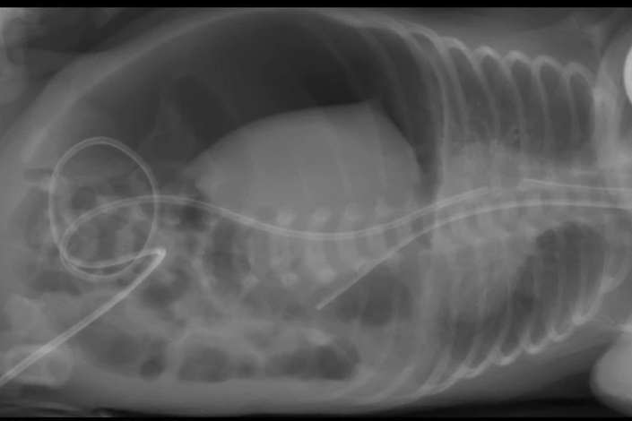
Spontaneous Intestinal Perforation (SIP)
Spontaneous intestinal perforation (SIP), also known as focal small bowel perforation, is an acquired form of neonatal bowel disease that is distinct from necrotizing enterocolitis (NEC) and has been documented within the low-birth-weight population for over 20 years¹.
Figure 1: A plain lateral decubitus x ray of the abdomen showing massive pneumoperitonium with no evidence of pneumatosis intestinalis and no portal venous gas²
(1) cited from Attridge, J. T., Clark, R., Walker, M. W., & Gordon, P. V. (2006). New insights into spontaneous intestinal perforation using a national data set: SIP is associated with early indomethacin exposure. Journal of perinatology, 26(2), 93-99.
(2) cited from Ibrahim, A. H., Hader, H. A., Alsherbiny, H., Hussein, M. R., & Khan, S. A. (2020). Spontaneous intestinal perforation followed by necrotizing enterocolitis in an extremely low birth weight neonate: case report and review of the literature. Annals of Pediatric Surgery, 16(1), 1-4.
Notes:
SIP is a well defined clinical entity which has catastrophic effects in premature infants. It has been studied for more than 2 decades and the risk factors associated with it have gradually come to be defined. Necrotizing enterocolitis (NEC) is a another similar condition which is often confused with SIP.

Slide 3
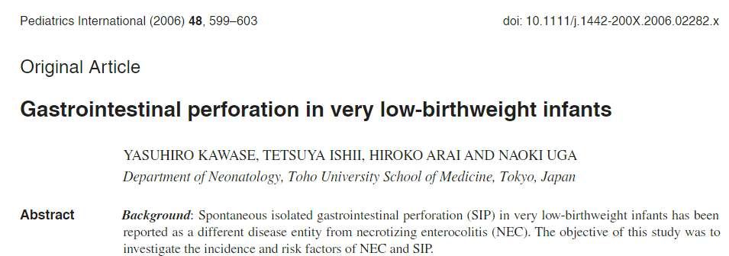

Conventional SIP Prediction
Clinical Knowledge & Experiences
Birth Weight
?
Apgar_5
Neonatologist
Race
Sex
Gestational Age
IVH
Preterm Labor
Multiple Gest
…
Clinical Evidence
Notes:
The list of suspected risk factors have been reported in different studies with varying levels of association.
Low Gestational age is a consistent risk factor and has factored in the neonatologist’s clinical assessment of the premature infant.

Slide 4
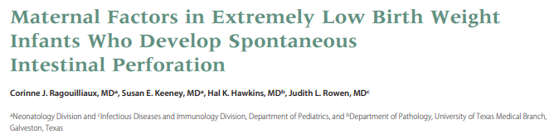
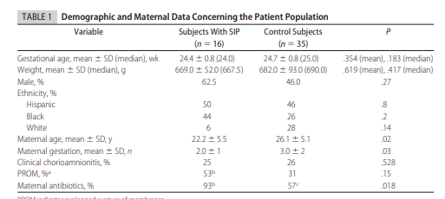
Conventional SIP Prediction
Clinical Knowledge & Experiences
Birth Weight
?
Apgar_5
Neonatologist
Race
Sex
Gestational Age
IVH
Preterm Labor
Multiple Gest
…
Clinical Evidence
Notes:
The study of ma’ternal and infant risk factors has continued to inform the neonatologist.

Slide 5
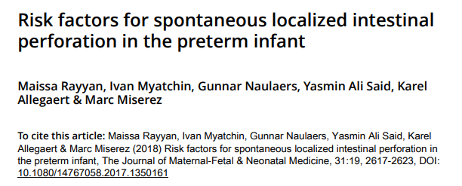
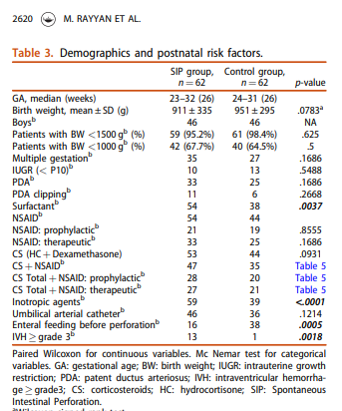
Conventional SIP Prediction
Clinical Knowledge & Experiences
Birth Weight
?
Apgar_5
Neonatologist
Race
Sex
Gestational Age
IVH
Preterm Labor
Multiple Gest
…
Clinical Evidence
Notes:
Different study methodologies have focused on different risk factors.

Slide 6
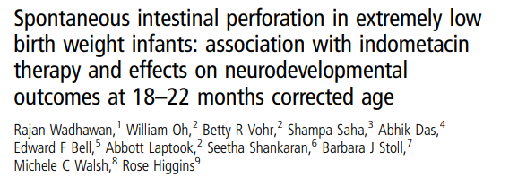
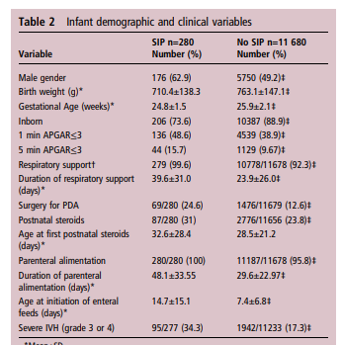
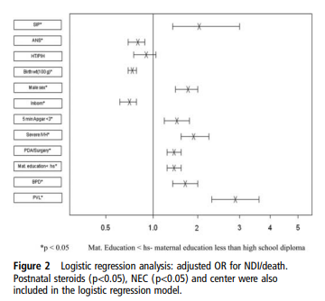
Conventional SIP Prediction
Clinical Knowledge & Experiences
Birth Weight
?
Apgar_5
Neonatologist
Race
Sex
Gestational Age
IVH
Preterm Labor
Multiple Gest
…
Clinical Evidence
Notes:
In the studies previously reported, one or few risk factors has been studied individually. But the interaction of one risk factor with another to predict the overall risk has not been studied comprehensively.

Slide 7
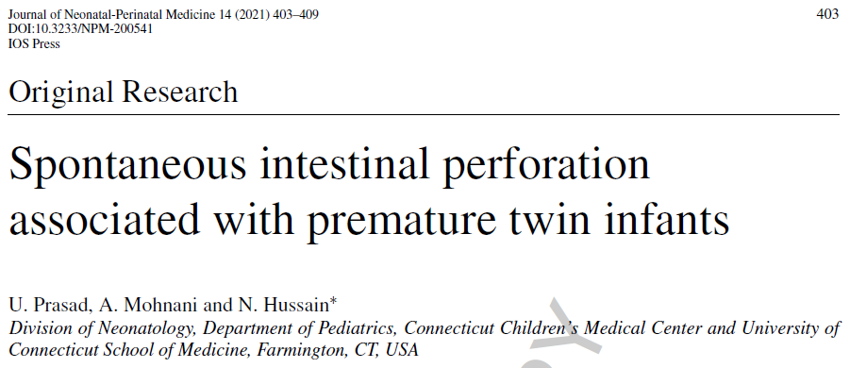
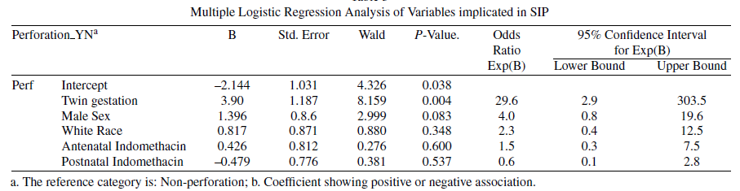
Conventional SIP Prediction
Clinical Knowledge & Experiences
Birth Weight
?
Apgar_5
Neonatologist
Race
Sex
Gestational Age
IVH
Preterm Labor
Multiple Gest
…
Clinical Evidence
Notes:
Our recent study of multiple gestations has brought to light a previously unreported risk factor for SIP i.e, twin gestation. However, the interaction of this risk factor with other known risk factor presented a challenge. We sought to address this issue by using a multiple logistic regression analysis.

Slide 8
Conventional SIP Prediction
Clinical Knowledge & Experiences
Birth Weight
Apgar_5
?
Neonatologist
Race
SIP Probabilistic Estimation
Sex
Gestational Age
IVH
Preterm Labor
Multiple Gest
…
Clinical Evidence
Notes:
We wonder if there is a better method of quantifying risk and developing a probabilistic estimation of conditions such as SIP which are relatively rare but very devastating.

Slide 9


Machine Learning Aided SIP Prediction
AIM: to develop a machine learning algorithm for a probabilistic prediction of SIP using data available from our NICU database at UCONN Health NICU of Connecticut Children’s
Clinical Knowledge & Experiences
Birth Weight
Apgar_5
?
Neonatologist
Race
SIP Probabilistic Estimation
Sex
Gestational Age
IVH
Machine Learning
SIP Probabilistic Prediction
Preterm Labor
Multiple Gest
…
Statistical Pattern of SIP History Records
Clinical Evidence
Notes:
The aim of our study was to develop a machine learning algorithm for a probabilistic prediction of SIP using data available from our NICU database at UCONN Health NICU of Connecticut Children’s.

Slide 10
Data Source
Database (NIS-5) available from UCONN Health NICU of Connecticut Children’s
Data available for all NICU admissions from 1991 to 2018
All admissions were included
No exclusions were made

Slide 11
Patient Detail
Total number of patients in the database were = 15, 299
Total number of maternal and infant risk factors studied were = 55
Total number of infants with SIP were = 95
Total number of infants with NEC were = 292

Slide 12
Machine Learning Two Phases
Phase 1: Model Training
Phase 2: Model Prediction
Learning statistical relations between clinical evidence and SIP
Predict SIP based on the learned statistics and clinical evidence
Training data: 15k newborn infants, from 1990 to 2018
Risk factors: GA_By_DatesWeek, BirthWeight, ansteroid, indomethacin, sepsis, Multiple_gest, Gravida, Para, Sex, Apgar_1, Apgar_5, DeliveryType, MothersAge, SGA, BirthSequence1, BirthSequence2, PC-Vag-Bleedg, PC-Preterm_Labor, PC-Hypertens, MFC-Chorioamn, MFC-Fetal Decel, Magn Sulf (Labor), Year of Birth, LBW, VLBW, White_YN, Multiple_YN, RDS, BPD, PDA, ivh, ivh severe etc.
Model input:
Risk factors of a specific infant
Model output:
probabilistic prediction of SIP positive
Input → Well-trained model → output
Machine Learning

Slide 13
Machine Learning Model Comparison
Models | Accuracy | ROC-AUC
Logistic Regression | 0.994 | 0.77
Decision Tree Classifier | 0.994 | 0.74
Random Forest Classifier | 0.994 | 0.79
Gradient Boosting Classifier | 0.994 | 0.77

Slide 14
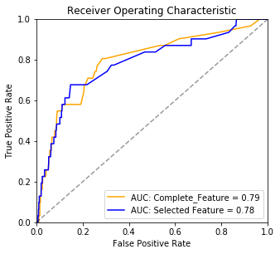
Machine Learning Feature Selection
Candidate Risk Factors (Features)
GA_By_DatesWeeks, BirthWeight, ansteroid, indomethacin, sepsis, Multiple_gest, FinalStatus, Gravida, Para, Sex, Apgar_1, Apgar_5, DeliveryType, MothersAge, SGA, BirthSequence1, BirthSequence2, PC-Vag-Bleedg, PC-Preterm_Labor, PC-Hypertens, MFC-Chorioamn, MFC-Fetal Decel, Magn Sulf (Labor), Year of Birth, LBW, VLBW, White_YN, Multiple_YN, Survived, RDS, BPD, PDA, ivh, ivh severe, Birth Date (Qtr2 vs other, Quarter of Birth, AM vs other, Apr vs. Other, Aug vs. Other, Dec vs. Other, Feb vs. Other, Jan vs. Other, Jul vs. Other, Jun vs. Other, Mar vs. Other, May vs. Other, Nov vs. Other, Oct vs. Other, Sep. vs. Other), Race (Race_A, Race_B, Race_O, Race_Others, Race_U, Race_W)

Slide 15
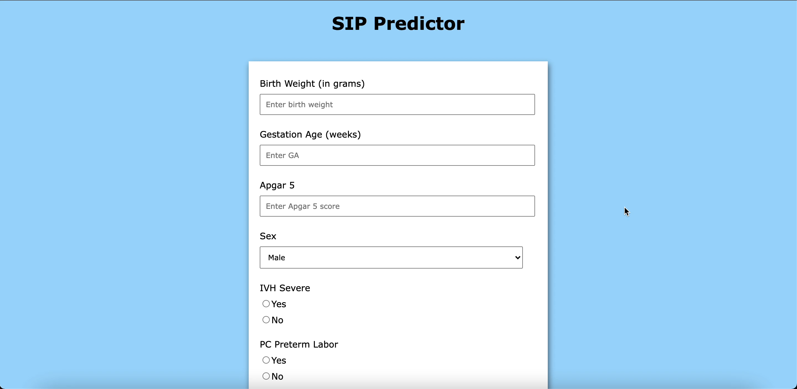
SIP Prediction Web-API

Slide 16
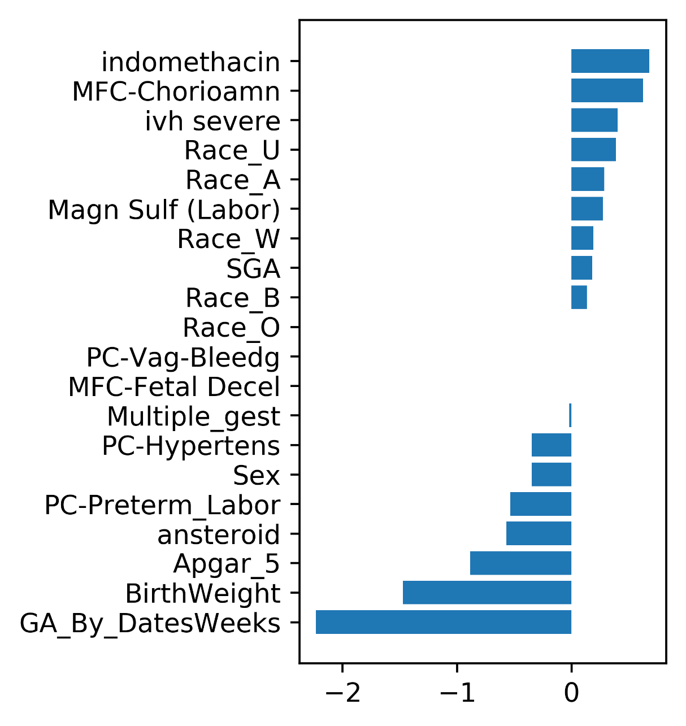
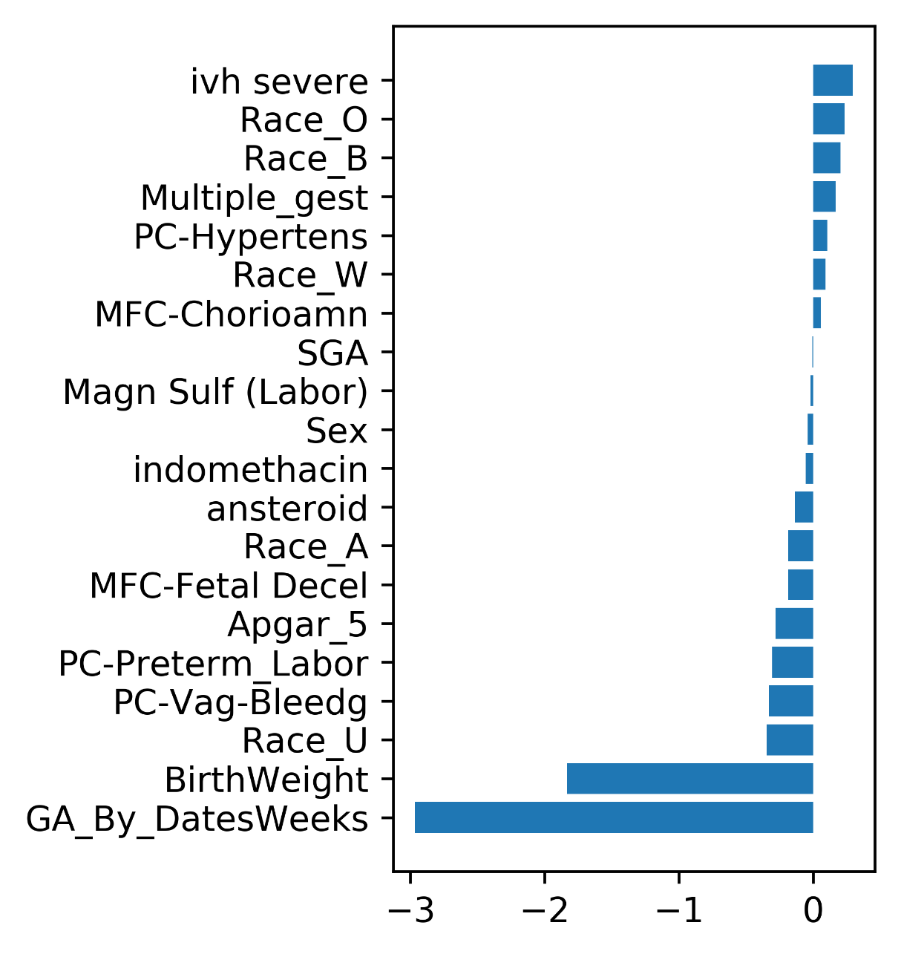
SIP vs NEC Feature Relations
SIP
NEC
Notes:
U: unknown

Slide 17
Thank you.
Zigeng Wang, Rik Roy, Naveed Hussain, Sanguthevar Rajasekaran

Slide 18
Total Risk Factors Studied
['SIP', 'GA_By_DatesWeeks', 'BirthWeight', 'ansteroid', 'indomethacin', 'sepsis', 'Multiple_gest', 'FinalStatus', 'Gravida', 'Para', 'Sex', 'Apgar_1', 'Apgar_5', 'DeliveryType', 'MothersAge', 'SGA', 'BirthSequence1', 'BirthSequence2', 'PC-Vag-Bleedg', 'PC-Preterm_Labor', 'PC-Hypertens', 'MFC-Chorioamn', 'MFC-Fetal Decel', 'Magn Sulf (Labor)', 'Year of Birth', 'LBW', 'VLBW', 'White_YN', 'Multiple_YN', 'Survived', ' NEC episode I', 'RDS', 'BPD', 'PDA', 'ivh', 'ivh severe', 'Qtr2 vs other', 'Quarter of Birth', 'AM vs other', 'Apr vs. Other', 'Aug vs. Other', 'Dec vs. Other', 'Feb vs. Other', 'Jan vs. Other', 'Jul vs. Other', 'Jun vs. Other', 'Mar vs. Other', 'May vs. Other', 'Nov vs. Other', 'Oct vs. Other', 'Sep. vs. Other', 'Race_A', 'Race_B', 'Race_O', 'Race_Others', 'Race_U', 'Race_W']

