Slide 1
Association Rule Mining (Market Basket) Assignment SUBMISSION
Anshul Roy - APFE1680584

Slide 2
Abstract
Online retail giant “Global Mart” wants to create a recommender system.
This can recommend the customers on relevant items that can be bought together based on their purchase history, items in cart or recent views.
The recommender system can also be used to provide discounts and attract customers.

Slide 3
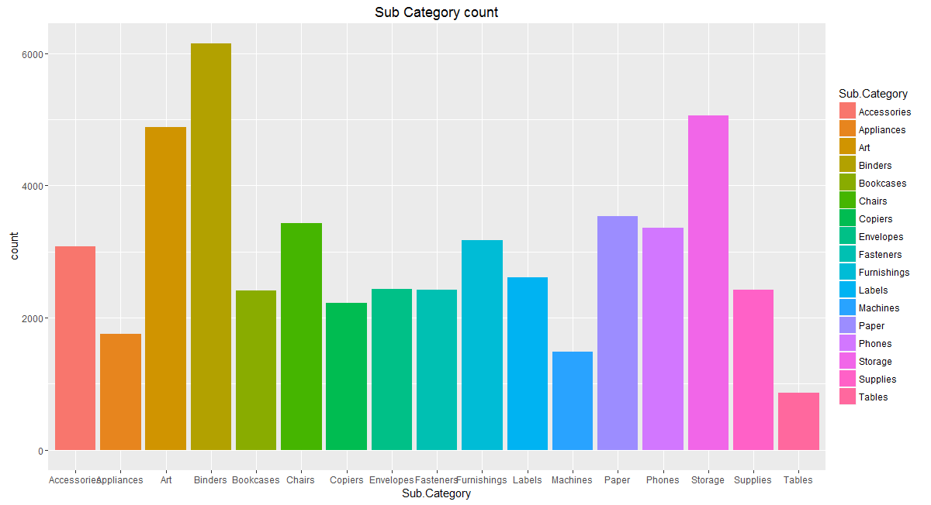
Business Understanding
Individual Count of sub category.
This can give information about the
Demand of different products & can
Help focusing on them.

Slide 4
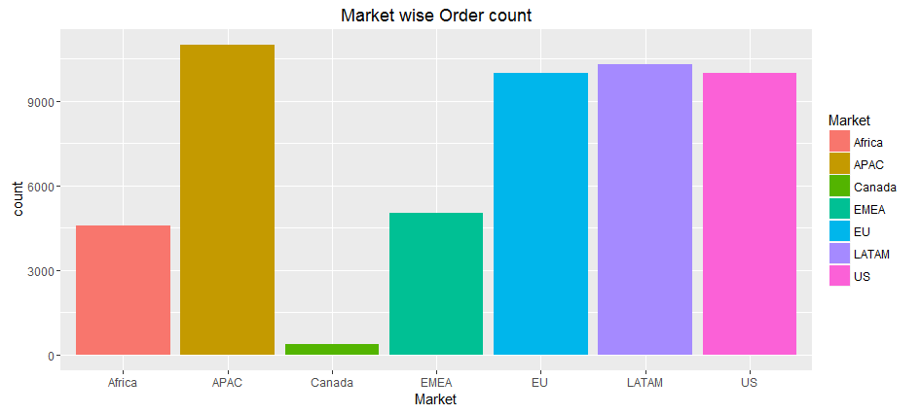
Business Understanding
Count of products bought in individual
Markets. This can give idea on the leading
Market to focus.

Slide 5
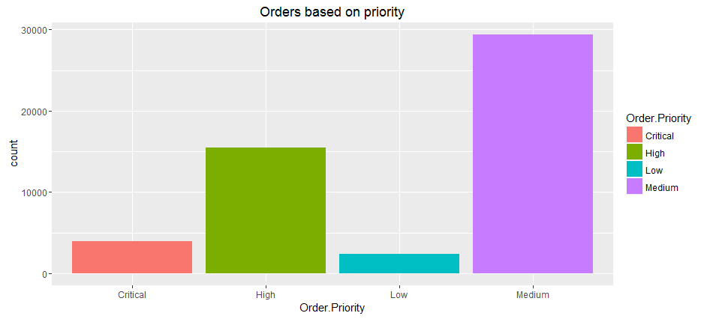
Business Understanding
Count of orders based on priority.
It gives idea on the priority of the products
Purchased by customers.

Slide 6
Market Basket Analysis - Concepts
Model selection depends on
Support – Identifies the ratio of occurrence of the rule in the available data. Greater the better.
Confidence – Identifies the probability of occurrence of rule. Greater Confidence is better.
Lift – Identifies correlation. At least should be greater than 1.
Optimal value selection for Support & confidence is required having lift greater than 1.
The rules selected should give good number of rules having business correlation.

Slide 7
Model Selection Process
Create multiple models with different support and confidence with lift greater than 1.
Analyse the rules created based on the number of rules
The number of rules should be intermediate in terms of count and relevance.
The rules created should have good support and confidence.

Slide 8
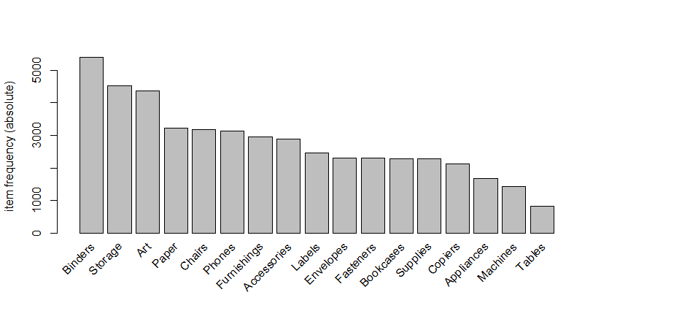
Model Item Frequency
Item Frequency of different
Sub categories

Slide 9
Final Model Selected
Attributes of final model selected
Support = 0.0005
Confidence = 0.5
Lift = 1
Number of Rules = 22

Slide 10
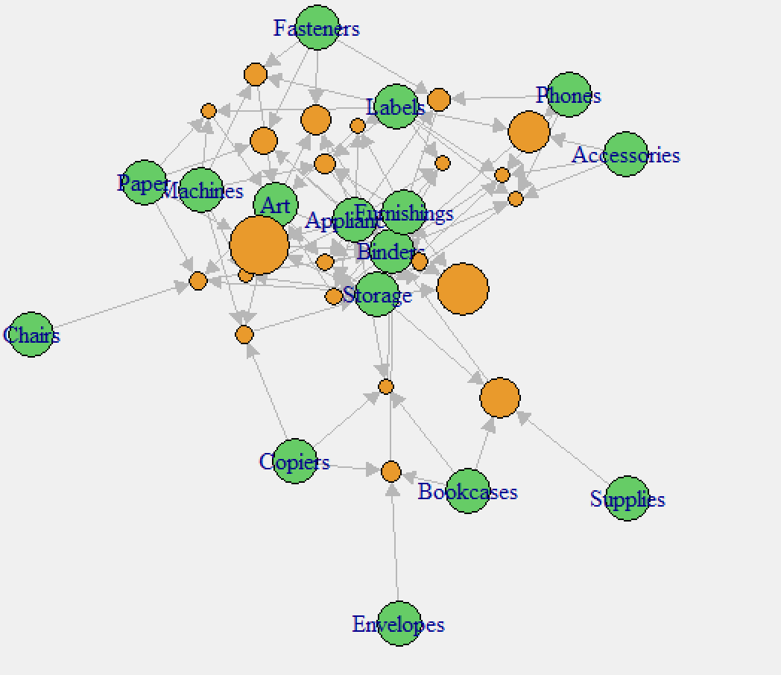
Plot for Final Model Rules

Slide 11
Final Model Results
Rules | Support | Confidence | Lift
Appliances,Machines,Storage} => {Art} | 0.00051927 | 0.619048 | 3.54967
{Art,Copiers,Machines} => {Storage} | 0.00055922 | 0.518519 | 2.863059
{Fasteners,Labels,Machines} => {Art} | 0.00063911 | 0.571429 | 3.276618
{Furnishings,Labels,Machines} => {Binders} | 0.00059916 | 0.535714 | 2.487316
{Labels,Machines,Paper} => {Art} | 0.00051927 | 0.541667 | 3.105961
{Appliances,Bookcases,Copiers} => {Binders} | 0.00051927 | 0.541667 | 2.514953
{Appliances,Fasteners,Phones} => {Binders} | 0.00063911 | 0.551724 | 2.561649
{Appliances,Fasteners,Paper} => {Binders} | 0.00071899 | 0.5625 | 2.611682
{Appliances,Art,Fasteners} => {Binders} | 0.00075894 | 0.5 | 2.321495
{Appliances,Furnishings,Labels} => {Art} | 0.00051927 | 0.5 | 2.867041
{Appliances,Furnishings,Labels} => {Binders} | 0.00051927 | 0.5 | 2.321495
{Appliances,Furnishings,Storage} => {Binders} | 0.00111843 | 0.595745 | 2.766036
{Appliances,Paper,Storage} => {Binders} | 0.00123827 | 0.607843 | 2.822209
{Bookcases,Copiers,Envelopes} => {Binders} | 0.00059916 | 0.535714 | 2.487316
{Bookcases,Storage,Supplies} => {Binders} | 0.00091871 | 0.5 | 2.321495
{Accessories,Labels,Phones} => {Binders} | 0.00095866 | 0.510638 | 2.370888
{Appliances,Art,Furnishings,Storage} => {Binders} | 0.00055922 | 0.7 | 3.250093
{Appliances,Art,Binders,Furnishings} => {Storage} | 0.00055922 | 0.608696 | 3.360983
{Appliances,Binders,Furnishings,Storage} => {Art} | 0.00055922 | 0.5 | 2.867041
{Accessories,Labels,Phones,Storage} => {Binders} | 0.00051927 | 0.65 | 3.017943
{Accessories,Binders,Labels,Phones} => {Storage} | 0.00051927 | 0.541667 | 2.990875
{Art,Chairs,Paper,Storage} => {Binders} | 0.00055922 | 0.56 | 2.600074

Slide 12
Conclusions
Among the 17 unique sub categories, the most likely bought fourth product is Binder. Meaning, if a customer buys 3 products from the 16 sub categories, the fourth product he will buy is Binder. This rule can be used to recommend the customers.
Art and Storage are the next most likely accompanied product that customers buy.

