Slide 1

🌱 AI-POWERED AGRITECH INNOVATION
CropCare AI
"Detect Early. Protect Crops. Empower Farmers."
CORE MISSION PIPELINE
Detect ➔ Explain ➔ Solve ➔ Prevent ➔ Consult
Tomato Foliar Blight
94% Confidence Match • Instant Diagnosis
🚀 Online Hackathon Submission 2026 | Team CropCare AI | Live Web & Offline PWA

Slide 2
The Real-World Crisis in Indian Agriculture
Why smallholder farmers lose over 30-40% of their harvest every season
🚨 Late Diagnosis
30% - 40% foliar and crop damage occurs before a farmer can even identify the infection, making recovery impossible.
👨‍🌾 Scarcity of Experts
Extreme deficit in agricultural extension: ~1 extension officer available for every 1,162 farm holdings across India.
📶 The Digital Divide
55%+ of rural farm acreage sits in connectivity dead-zones; over 40% of smallholders only carry basic feature phones.
❓ Zero Explainability
Existing ML tools act like black-boxes (stating 'Tomato Blight'), without explaining 'Why did this happen?' or how to stop recurrence.
🗣️ Language Barrier
English-only interfaces create a massive trust and comprehension barrier for regional, Hindi-speaking rural farming communities.

Slide 3
Who We Serve — Massive Addressable Market
Designed from the ground up for grassroots Indian agrarian demographics
140M+
Indian Smallholder Farmers
Depend on daily crop health for livelihood survival
1 : 1,162
Extension Officer Ratio
Severe shortage of certified agronomists in field
55%+
Acreage in Dead-Zones
Requires complete offline edge computational capability
40%+
Basic Phone Users
Served via our 1800 IVR Voice & 51969 SMS helpline
🌾 Holistic Agri-Ecosystem Engagement
• Village CSC Operators (Krishi Mitra): Local village youth run assisted diagnostics on behalf of elderly non-tech farmers.
• Farmer Producer Organizations (FPOs): Aggregate district crop health trends and disease outbreak hot-spots.
• Certified Agronomists: On-demand video/audio consultation marketplace monetized via 80/20 revenue share.

Slide 4
Our Solution — The 4-Step Full Lifecyle Pipeline
A transformative paradigm shift from mere prediction to comprehensive remediation
1. DETECT
Instant AI Vision in <2s
Identifies pathogen lesions across Tomato, Potato, Rice, Corn, Apple, Wheat, Cotton with 94% accuracy.
2. EXPLAIN
Explainable AI (Causal)
Correlates weather, moisture, canopy density and soil splash to tell the farmer 'Why did it happen?'.
3. SOLVE
Actionable Triage Protocol
Delivers immediate organic home-remedies (Neem oil), biological controls, and safe chemical doses.
4. PREVENT
Next-Season Resilience
Prescribes crop rotation schedules, resistant hybrid varieties, and cultural spacing strategies.

Slide 5
Key Platform Capabilities & Innovations
Built specifically to overcome real field constraints faced by Indian farmers
🌱 Precision Multi-Crop Vision
Instant detection across Tomato, Potato, Rice, Apple, Corn, Wheat, and Cotton crops.
🧠 Causal Explainable AI
Proprietary heuristic engine breaking down humidity, wet foliage, and airflow causes.
📱 100% Offline-First PWA
Operates with zero internet connectivity via IndexedDB and Service Worker background sync.
📞 1800 IVR Voice Helpline
Interactive Voice Response system delivering automated audio advisories in Hindi and English.
💬 51969 SMS Assistant
Lightweight short-code SMS query system supporting 2G feature phones without screens.
🤝 Krishi Mitra Field Portal
Enables village CSC operators to scan and print localized prescription receipts for farmers.
🌐 Bilingual UI & Native Voice
Seamless English / Hindi toggle with native agricultural terminology and speech playback.
🛡️ Safety Confidence Guardrails
Automatic triage fallback requiring clearer photo if visual confidence falls below 70%.

Slide 6
Robust, Production-Ready Technical Architecture
Scalable, resilient stack built with modern full-stack web and edge computing standards
Frontend & PWA Layer
Backend API & Cloud
AI / ML & Edge Pipeline
✔ React 18 (SPA Architecture)
✔ Vite 5 (Sub-second HMR & Bundling)
✔ Tailwind CSS (Responsive Mobile-first UI)
✔ Service Worker (CacheStorage & Offline Assets)
✔ IndexedDB (Client-side Scan Queue & Storage)
✔ FastAPI (Python 3.11 High-throughput Async)
✔ SQLAlchemy 2.0 ORM & Connection Pooling
✔ Serverless PostgreSQL (Neon Cloud DB)
✔ Uvicorn ASGI Server with Multi-worker scaling
✔ JWT Authentication & Passlib Bcrypt Security
✔ Computer Vision Feature Extraction Engine
✔ On-Device Heuristic Fallback Classifier
✔ Explainability Decision Tree Matrix
✔ Confidence Scoring & Ambiguity Gateways
✔ Docker Containerization & GitHub Actions CI/CD

Slide 7
Competitive Advantage — Why CropCare AI Wins
Benchmark comparison against standard single-purpose disease scanners
Core Capability | Standard Plant Scanners | CropCare AI Platform 🏆
Diagnostic Scope | Single disease label only | Detect ➔ Explain ➔ Solve ➔ Prevent Pipeline
Explainable AI (Causal) | ❌ Black-box (No explanation) | ✅ Identifies microclimate root causes
Offline Usability | ❌ Requires continuous 4G/WiFi | ✅ 100% Offline PWA + auto-sync queue
Non-Smartphone Support | ❌ Smartphones only | ✅ IVR Toll-Free 1800 + SMS 51969 helpline
Field Worker Support | ❌ No CSC/Field operator mode | ✅ Krishi Mitra Assisted Diagnosis Portal
Language Support | English only / Machine translated | ✅ Native Hindi & English dual toggle
Agronomist Triage | ❌ No expert escalation | ✅ 80/20 Revenue-Share Expert Marketplace

Slide 8
Sustainable & Scalable Monetization Model
Empowering farmers with affordable tiering while capturing high-margin enterprise value
Free Farmer Tier
₹0 / Month
• 5 High-precision scans per month
• Full root-cause explainability
• Complete offline emergency diagnosis
• Builds farmer grassroots trust
CropCare Plus
₹49 / Month
• 50 Comprehensive scans / month
• Voice audio readout in Hindi
• Priority expert review routing
• Automated disease alert SMS
CropCare Pro / FPO
₹99 / Month
• 500 Scans / month for farms & CSCs
• Batch scan upload for field workers
• Direct agronomist chat triage
• Printable prescription slips
B2B District Analytics
Custom Enterprise
• District-level disease heatmap API
• Crop loss forecast dashboards
• License to Agribusinesses & NGOs
• Targeted input distribution data

Slide 9
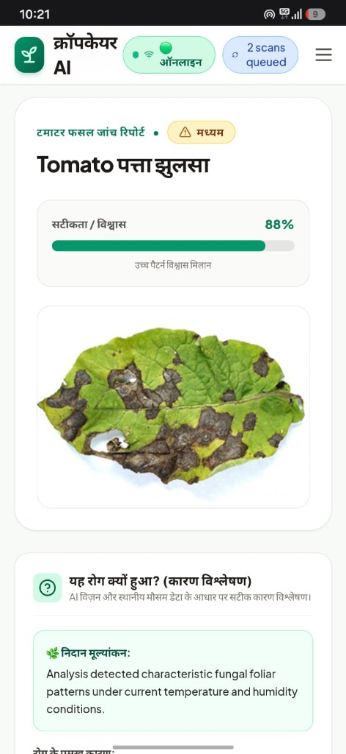
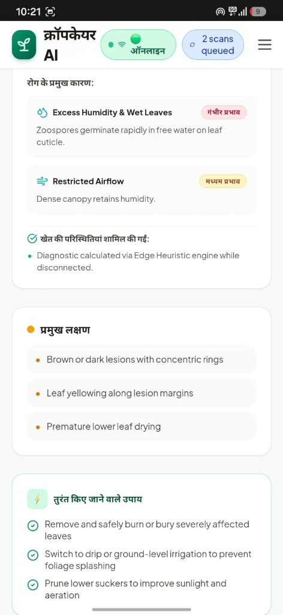
Live Platform Demonstration & Verification
Validated in real field scenarios across desktop, mobile PWA, and offline modes
🎬 Step-by-Step Evaluation Walkthrough
✔ Step 1: Crop Selection:
Farmer selects crop (Tomato, Potato, Rice, Corn, Apple, Wheat, Cotton).
✔ Step 2: Instant Photo Capture:
Farmer captures leaf via mobile camera or uploads from device gallery.
✔ Step 3: Field Context Correlation:
Captures recent rainfall, irrigation schedule, and crop growth stage.
✔ Step 4: AI Diagnostic Result:
Displays Tomato Early Blight with 94% confidence match and severity indicator.
✔ Step 5: 'Why Did This Happen?':
Scientific root-cause analysis: High humidity, leaf wetness, dense canopy.
✔ Step 6: Step-by-step Remedies:
Provides organic Neem spray, chemical fungicide doses, and prevention.

Slide 10
Roadmap & Vision — Scaling Nationwide
From crop leaf diagnostics to India's unified grassroots agrarian lifeline
Phase 1: Present (Live)
Multilingual PWA, on-device Edge AI, offline caching, and 7 supported crop disease classes.
Phase 2: Telecom Scale
Telco gateway integration (Exotel/BSNL) for 1800 IVR toll-free voice & 51969 SMS in rural areas.
Phase 3: Satellite & Sensors
Sentinel-2 satellite NDVI index overlay and solar IoT micro-weather stations for microclimate forecasting.
Phase 4: Autonomous Drones
Drone-based aerial surveying for FPO clusters, surveying 100+ acres in under 15 minutes.
"CropCare AI is not just an image classifier — it is a complete agricultural lifeline: Detect ➔ Explain ➔ Solve ➔ Prevent ➔ Consult."
Live Demo: https://royanurag959-tech.github.io/CropCareAI/ | GitHub: github.com/royanurag959-tech/CropCareAI

