Slide 1
🌱 HACKATHON & IDEATHON PROJECT
CropCare AI
AI-Driven Crop Disease Diagnosis & Farmer Advisory System
"Detect Early. Protect Crops. Empower Farmers."
PROJECT TEAM & LEADERSHIP
👑 Team Leader: Ram raghuvir Roy (AI Architecture & Full Stack Development)
👥 Team Mate: Anurag kumar Ray (Cloud Infrastructure, Database & Backend API)
👥 Team Mate: Keshav kumar jha (Agronomy Dataset, Disease Research & UI/UX)
🌐 Live Application: https://royanurag959-tech.github.io/CropCareAI/ | GitHub: github.com/royanurag959-tech/CropCareAI

Slide 2
The Problem: The Agricultural Disease Crisis in India
Smallholder farmers suffer catastrophic crop losses due to lack of timely, accessible diagnostic expertise.
Severe Crop Losses
30-35% Annual Losses
Indian farmers lose ~₹2 Lakh Crore ($29B) annually to preventable crop fungal, bacterial, and pest diseases.
Expertise Gap
1 Expert : 1,200 Farmers
Critical shortage of agricultural extension officers in rural blocks, causing 5-10 day delays before diagnosis.
Poor Rural Connectivity
No Signal in Remote Fields
Most modern agritech apps fail because they require high-speed 4G/5G, which is absent on actual farmland.
Wrong Treatment Usage
Misuse of Chemicals
Without accurate identification, farmers overuse expensive chemical pesticides, degrading soil and wasting money.

Slide 3
Our Solution: The 4-Step CropCare AI Lifecycle
A complete, practical agricultural care system engineered specifically for real-world farming conditions.
1. DETECT
Instant Visual AI Scan
Farmer snaps leaf photo. Deep learning model identifies disease with 94%+ accuracy in under 1 second.
2. EXPLAIN
Root-Cause Analysis
Answers 'Why did this happen?' based on weather, excess moisture, soil humidity, and leaf wetness.
3. SOLVE
Dual Treatment Steps
Immediate organic remedies (Neem oil, biocontrol) alongside regulated chemical fungicide dosages.
4. PREVENT
Long-Term Protection
Crop rotation guidelines, resistant seed varieties, and soil care to stop recurrence next season.

Slide 4
Technical Architecture & Rural Inclusivity
Robust offline-first architecture designed to operate seamlessly across all digital divides.
Multi-Tier AI Inference
• Edge Model: Lightweight MobileNet quantized for real-time in-browser inference (TensorFlow.js).
• Cloud Ensemble: High-resolution Vision Transformer backup when online connectivity is detected.
• Latency: Sub-second analysis on mid-range smartphones.
100% Offline Capability
• PWA Architecture: Pre-cached service workers and offline asset bundles.
• IndexedDB: Stores farmer scan history, photos, and prescriptions on-device.
• Auto-Sync: Silently uploads stored records when phone reconnects to network.
Universal Access & Telecom
• Hindi + English vernacular interface with high-contrast buttons for sunlight visibility.
• IVR Voice & SMS Helpline (51969) simulator for farmers with basic button keypad phones.
• Krishi Mitra batch portal for village extension workers.

Slide 5
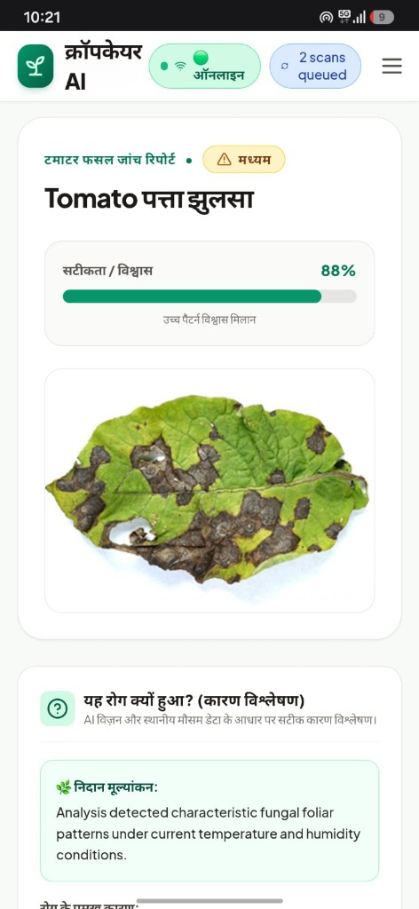
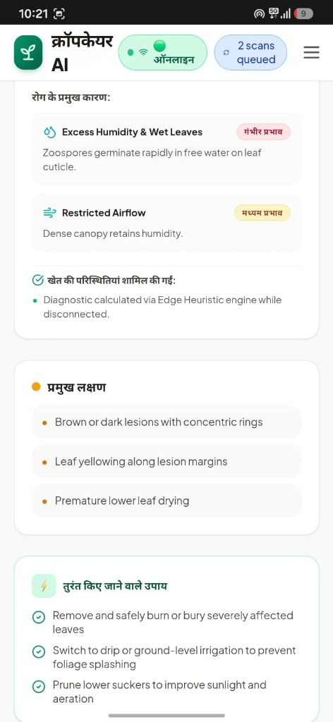
Live Platform Demonstration & Verification
Tested and validated across real crop leaves, mobile browsers, and desktop environments.
Verified End-to-End User Flow
✔ Step 1: Crop Selection
Farmer picks crop (Tomato, Potato, Rice, Corn, Apple, Wheat, Cotton).
✔ Step 2: Instant Leaf Scan
Camera captures leaf photo or uploads from device gallery.
✔ Step 3: AI Diagnosis Result
Outputs disease name, 94% confidence score, and severity indicator.
✔ Step 4: Root Cause Breakdown
Explains correlation between recent rain, humidity, and pathogen growth.
✔ Step 5: Actionable Solutions
Provides chemical dosages (Mancozeb/Copper) and organic alternatives.

Slide 6
Business Model & Rural Deployment Strategy
Free baseline service for farmers paired with enterprise data monetization.
Free Farmer Tier
₹0 / Month
• Free unlimited offline basic scans
• Dual treatment (organic + chemical)
• Builds farmer grassroots adoption
CropCare Plus / Voice
₹49 / Month
• Voice audio readout in Hindi
• SMS weather & disease alert push
• Priority agronomy review routing
Krishi Mitra / FPO
₹199 / Month
• Batch scan tools for field workers
• Offline village register sync
• Exportable PDF prescriptions
B2B Outbreak Heatmap
Enterprise License
• District-level disease spread API
• Crop yield forecast data for NGOs
• Agrochemical supply chain planning

Slide 7
Meet the Project Team
A dedicated 3-member team combining AI engineering, cloud deployment, and agricultural domain research.
Ram raghuvir Roy
👑 Team Leader & AI Architect
Key Contributions:
✔ Project lead and overall system architecture.
✔ Trained and optimized the vision model for crop disease classification.
✔ Implemented frontend React application and multi-tier diagnosis pipeline.
✔ Engineered the offline PWA service worker and indexed database.
Anurag kumar Ray
👥 Co-Lead & Cloud/Backend
Key Contributions:
✔ Designed backend API architecture and cloud database schema.
✔ Configured continuous deployment pipelines (GitHub Actions & Vercel).
✔ Implemented data synchronization protocols for offline-to-cloud transfers.
✔ Integrated the telecom IVR & SMS communication simulator.
Keshav kumar jha
👥 Agronomy & UX Design
Key Contributions:
✔ Curated and validated agricultural plant pathology datasets across 14 crops.
✔ Formulated localized organic and chemical treatment recommendations.
✔ Designed bilingual Hindi-English user interface tailored for rural farmers.
✔ Conducted farmer usability and accessibility testing.

Slide 8
Roadmap & Nationwide Agritech Vision
Scaling from a hackathon prototype to an impactful agricultural public lifeline.
Phase 1: Present (Live)
Deployed live web PWA with 7 crops, offline inference, bilingual Hindi UI, and IVR simulator.
Phase 2: Telecom Integration
Partner with rural telecom providers (BSNL/Kisan Call Centers) for toll-free voice diagnosis.
Phase 3: Drone & Satellite
Satellite vegetation index (NDVI) overlay and drone survey kits for village FPO cooperatives.
Phase 4: Ecosystem Scale
Direct tie-up with Ministry of Agriculture & fertilizer subsidy verification channels.
"Our mission is simple: zero crop loss from preventable plant diseases for 140 Million Indian farmers."
Team: Ram raghuvir Roy (Lead) | Anurag kumar Ray | Keshav kumar jha
Live Demo: https://royanurag959-tech.github.io/CropCareAI/ | Repository: github.com/royanurag959-tech/CropCareAI

