Slide 1
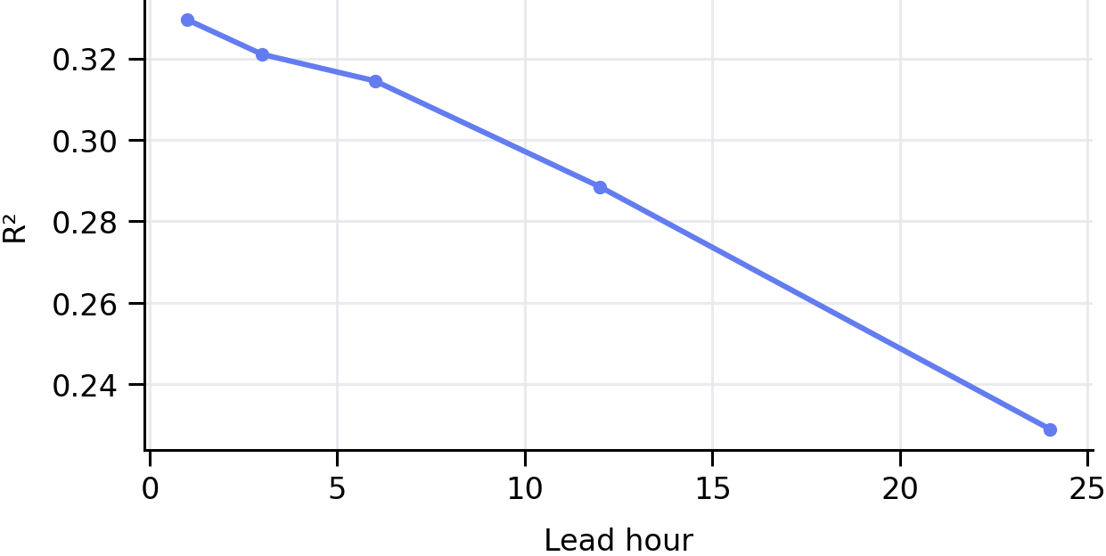
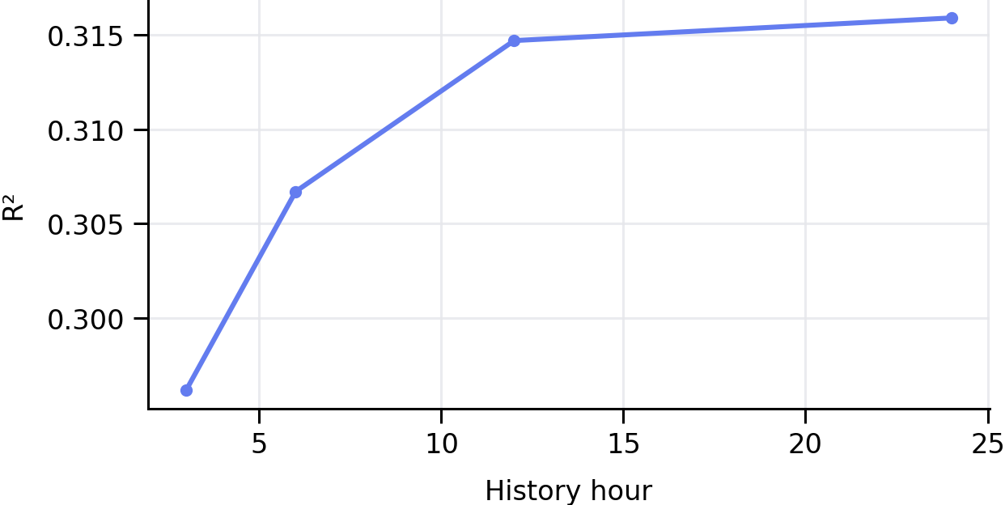
Problem Framing, ERA5 Inputs and Forecast Configuration
Can standard ML/DL families learn a heterogeneous rainfall regime well enough to provide a useful 6-hour warning?
RESEARCH STATEMENT
CONFIGURATION SENSITIVITY
Predict grid-level rainfall 6 hours ahead
XGBoost used as a fast diagnostic
using recent atmospheric state and rainfall history
Lead time
Positioning : Not a new architecture. A controlled test of model families under sharp topographic and rainfall variability as seen in the regions of Maharashtra.
ERA5 INPUT DATA
Coverage
2016–2025, hourly
Domain
15–22°N, 70–78°E
Skill declines substantially beyond 6 h
Grid
0.25°; 29 × 33 = 957 cells/hour
History window
Single level (10)
CAPE, sp, tcwv, msl, blh, tcc, u10, v10, t2m, d2m
Pressure level (5)
w at 500 & 700 hPa; u, v, q at 850 hPa
Target
Hourly total precipitation (tp)
Added predictors
Past rainfall + hour/doy sine–cosine encodings
Most gain is captured by the first 12 hours
Final tensor
X: (87672, 957, 20); y: (87672, 957)
SELECTED OPERATING POINT
→
Temporal split
Train 2016–22 | Val 2023 | Test 2024–25
12 h history
+6 h target
Notes:
[Sources] - https://cds.climate.copernicus.eu/datasets/reanalysis-era5-single-levels?tab=overview — ERA5 reanalysis description, hourly estimates and regular 0.25-degree product. - User-provided project details — years, spatial domain, variables, target, temporal split, tensor shapes and model-input design. - User-provided Maharashtra grid image: /mnt/data/4.png. - Sensitivity values transcribed from the user-provided lead-time and history-window plots previously supplied in this chat. - User-provided template image: /mnt/data/image.png. [/Sources]

Slide 2
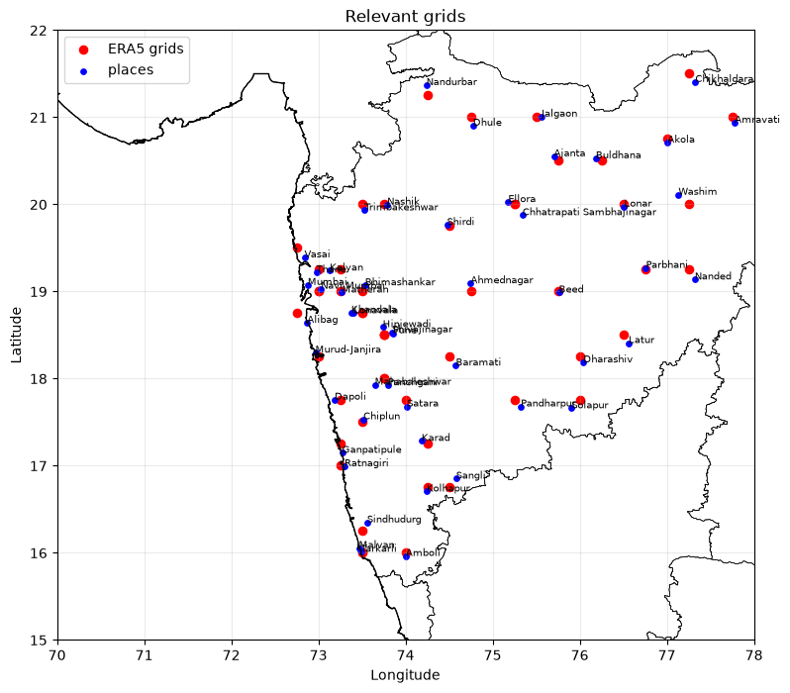
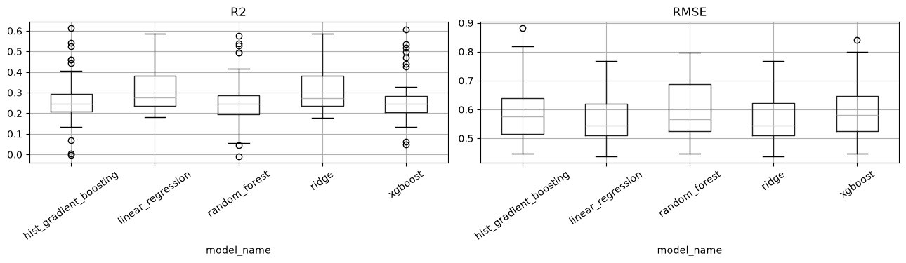
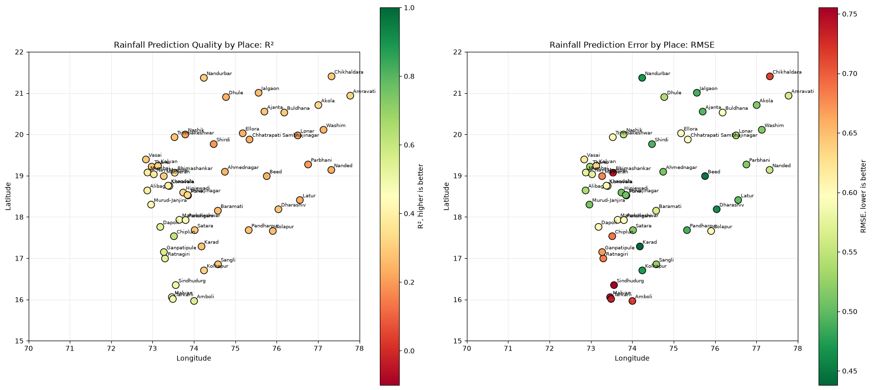
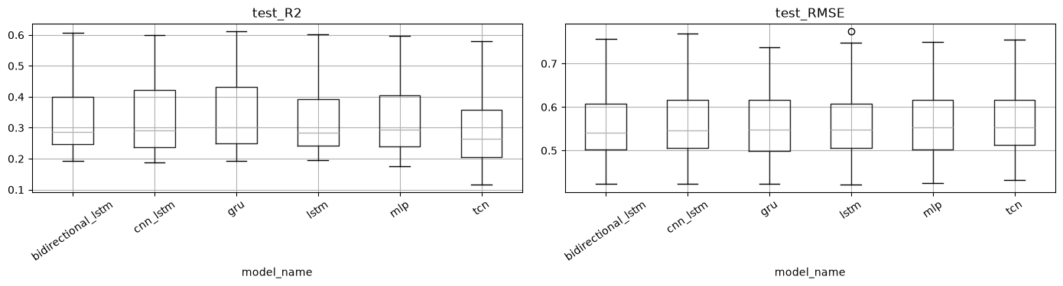
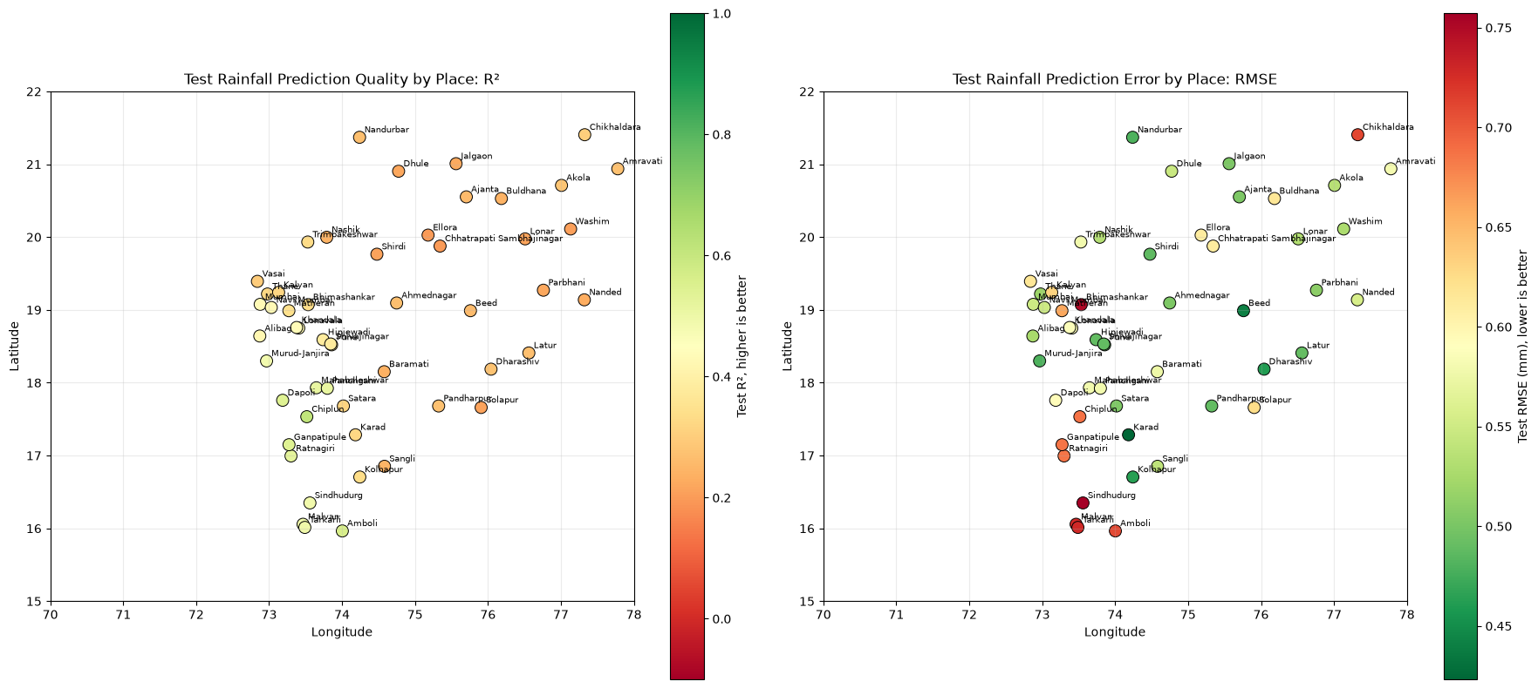
Six-Hour Forecast Performance Across Model Families
Distributional performance and geographic reliability across the 45 selected Maharashtra grids
STUDY DOMAIN
CLASSICAL ML
Primary: R² | Secondary: RMSE
Linear Regression • Ridge • Random Forest • HistGradientBoosting • XGBoost
Maharashtra grids :
Across-model distributions
Grid-level reliability
DEEP LEARNING
MLP 39,169
BiLSTM 30,017
LSTM 24,129
CNN–LSTM 22,465
TCN 19,425
GRU 18,625
Parameters
Across-model test distributions
Grid-level reliability
Domain: 15–22°N, 70–78°E
60 named locations → 45 unique nearest ERA5 grids
Gridwise training: independent parameters per location
2

Slide 3

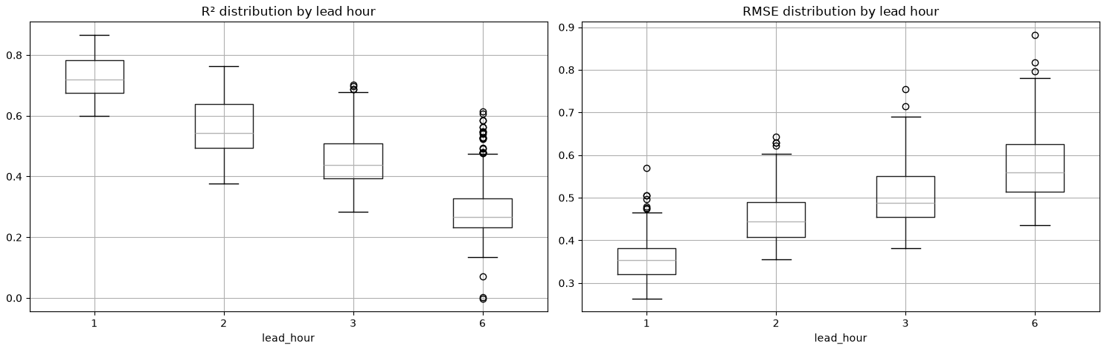
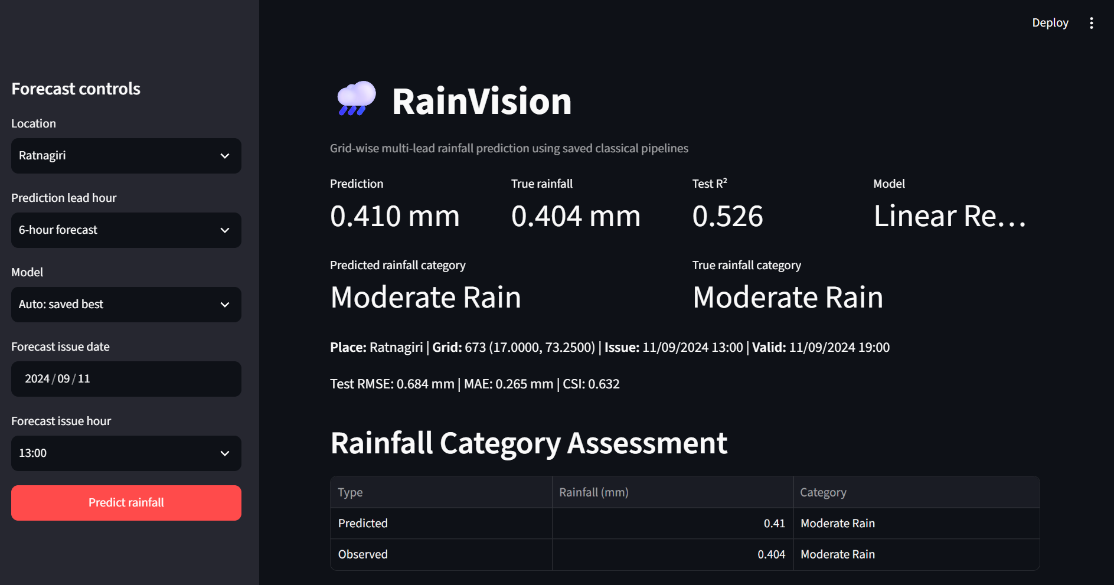
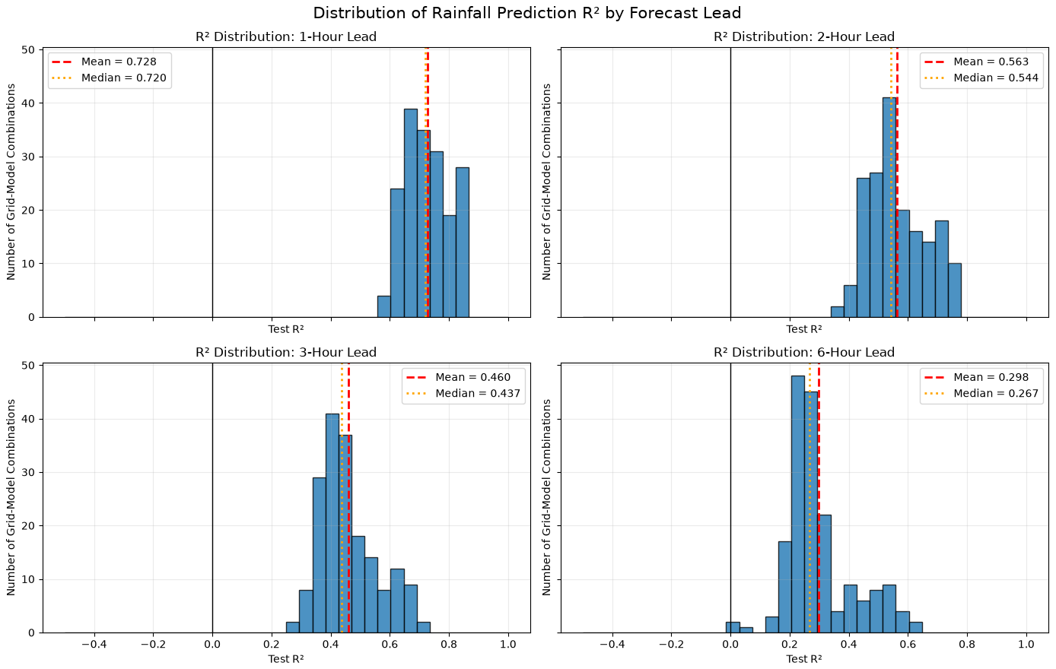
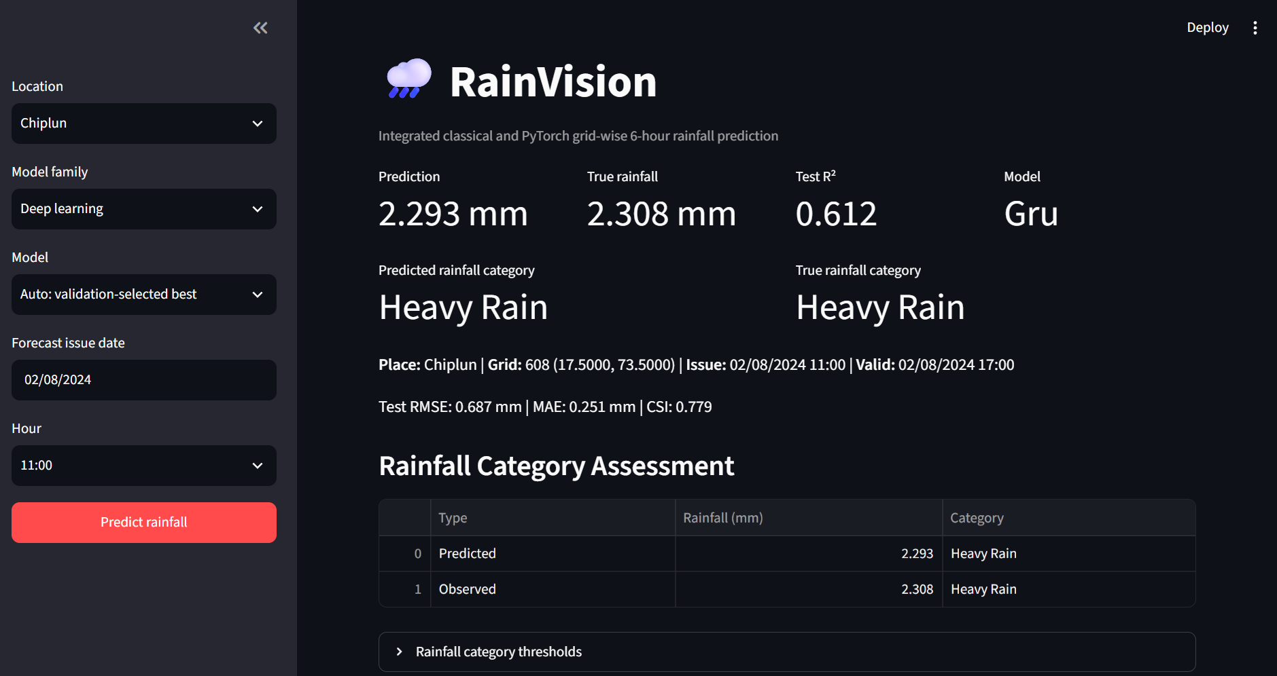
Multi-Lead Results, Improvement Roadmap and RainVision Demo
From measured lead-time degradation to a deployable interface and the next step toward spatially coherent rainfall forecasts
1 MULTI-LEAD RESULTS
2 IMPROVEMENT ROADMAP
3 RAINVISION DASHBOARD
Performance across 1, 2, 3 and 6 h
Multi-lead classical dashboard
CURRENT LIMITATION
Independent grid models capture temporal dependence only; neighbouring-grid interactions are not learned.
↓
PHYSICAL REQUIREMENT
Rainfall is spatio-temporal. Motion, moisture transport and evolving rain fields require joint spatial–temporal context.
R² falls while RMSE rises with increasing lead time.
↓
MODEL DIRECTION
R² variability across grid–model pairs
Use ConvLSTM or related spatial sequence models to learn propagation and local spatial structure.
Six-hour ML/DL dashboard
↓
PRESENT CONSTRAINTS
No GPU access for deeper models; 29 × 33 spatial grids may be too coarse for transport processes.
↓
FEATURE ENGINEERING
Mean R²: 0.728 → 0.563 → 0.460 → 0.298
Gridwise feature engineering gave limited gains; reassess engineered predictors inside spatial models.
How the dashboard is used
Interpretation: longer horizons amplify both forecast error and location-to-location uncertainty.
• Select location, issue time, lead and model.
• Predict hourly rainfall as a regression value.
• Convert the value to No, Light, Moderate, Heavy or Extremely Heavy Rain using thresholds.
Target: spatially coherent six-hour forecasts

Slide 4
Problem Framing, ERA5 Inputs and Forecast Configuration
Can standard ML/DL families learn a heterogeneous rainfall regime well enough to provide a useful 6-hour warning?
RESEARCH STATEMENT
CONFIGURATION SENSITIVITY
STUDY DOMAIN
Predict grid-level rainfall 6 hours ahead
XGBoost used as a fast diagnostic
Maharashtra grids :
using recent atmospheric state and rainfall history
Lead time
Positioning : Not a new architecture. A controlled test of model families under sharp topographic and rainfall variability as seen in the regions of Maharashtra.
ERA5 INPUT DATA
Coverage
2016–2025, hourly
Domain
15–22°N, 70–78°E
Skill declines substantially beyond 6 h
Grid
0.25°; 29 × 33 = 957 cells/hour
History window
Single level (10)
CAPE, sp, tcwv, msl, blh, tcc, u10, v10, t2m, d2m
Pressure level (5)
w at 500 & 700 hPa; u, v, q at 850 hPa
Target
Hourly total precipitation (tp)
Added predictors
Past rainfall + hour/doy sine–cosine encodings
Domain: 15–22°N, 70–78°E
Most gain is captured by the first 12 hours
60 named locations → 45 unique nearest ERA5 grids
Final tensor
X: (87672, 957, 20); y: (87672, 957)
SELECTED OPERATING POINT
→
Gridwise training: independent parameters per location
Temporal split
Train 2016–22 | Val 2023 | Test 2024–25
12 h history
+6 h target
Notes:
[Sources] - https://cds.climate.copernicus.eu/datasets/reanalysis-era5-single-levels?tab=overview — ERA5 reanalysis description, hourly estimates and regular 0.25-degree product. - User-provided project details — years, spatial domain, variables, target, temporal split, tensor shapes and model-input design. - User-provided Maharashtra grid image: /mnt/data/4.png. - Sensitivity values transcribed from the user-provided lead-time and history-window plots previously supplied in this chat. - User-provided template image: /mnt/data/image.png. [/Sources]

Slide 5
Six-Hour Forecast Performance Across Model Families
Distributional performance and geographic reliability across the 45 selected Maharashtra grids
CLASSICAL ML
Linear Regression • Ridge • Random Forest • HistGradientBoosting • XGBoost
Primary: R² | Secondary: RMSE
Across-model distributions
Grid-level reliability
DEEP LEARNING
Trainable parameters
MLP 39,169
BiLSTM 30,017
LSTM 24,129
CNN–LSTM 22,465
TCN 19,425
GRU 18,625
Across-model test distributions
Grid-level reliability
Same 45 grids
Result • Performance differences between architectures are modest relative to the persistent grid-to-grid variability.
5

Slide 6
Multi-Lead Results, Improvement Roadmap and RainVision Demo
From measured lead-time degradation to a deployable interface and the next step toward spatially coherent rainfall forecasts
1 MULTI-LEAD RESULTS
2 IMPROVEMENT ROADMAP
3 RAINVISION DASHBOARD
Performance across 1, 2, 3 and 6 h
Multi-lead classical dashboard
CURRENT LIMITATION
Independent grid models capture temporal dependence only; neighbouring-grid interactions are not learned.
↓
PHYSICAL REQUIREMENT
Rainfall is spatio-temporal. Motion, moisture transport and evolving rain fields require joint spatial–temporal context.
R² falls while RMSE rises with increasing lead time.
↓
MODEL DIRECTION
R² variability across grid–model pairs
Use ConvLSTM or related spatial sequence models to learn propagation and local spatial structure.
Six-hour ML/DL dashboard
↓
PRESENT CONSTRAINTS
No GPU access for deeper models; 29 × 33 spatial grids may be too coarse for transport processes.
↓
FEATURE ENGINEERING
Mean R²: 0.728 → 0.563 → 0.460 → 0.298
Gridwise feature engineering gave limited gains; reassess engineered predictors inside spatial models.
How the dashboard is used
Interpretation: longer horizons amplify both forecast error and location-to-location uncertainty.
• Select location, issue time, lead and model.
• Predict hourly rainfall as a regression value.
• Convert the value to No, Light, Moderate, Heavy or Extremely Heavy Rain using thresholds.
Target: spatially coherent six-hour forecasts

