Slide 1
Aptos_lottery
Project Encode club
Group-9

Slide 2
1. Introduction to the Project
Project Name: Decentralized Lottery System
Blockchain Platform: Aptos
Programming Language: Move
Objective: To develop a transparent and decentralized lottery system where users can purchase tickets, a winner is randomly selected, and prizes are securely distributed.
Key Features:
Decentralized lottery ticket purchase
Secure prize distribution using AptosCoin
Random winner selection using cryptographic methods
Future improvements for enhanced security and randomness
Target Audience: Developers, blockchain enthusiasts, financial institutions, gaming platforms.

Slide 3
2. Motivation and Purpose
Purpose: The project aims to demonstrate the potential of blockchain technology in creating fair and transparent decentralized applications (dApps) using Move, with a focus on randomness and secure prize distribution.
Why Lottery on Blockchain?
Traditional lotteries often lack transparency, leading to trust issues.
Blockchain ensures every transaction and selection process is verifiable, immutable, and transparent.
It removes the need for intermediaries, reducing costs and increasing trust.

Slide 4
Why Use Move and Aptos?
Move Programming Language:
Move is designed specifically for safe asset management on blockchain platforms.
Offers resource-oriented programming, ideal for smart contracts where tokens and ownership need strong security guarantees.
Efficient and scalable for building secure financial applications.
Aptos Blockchain:
Aptos provides low-latency, high-throughput transactions, making it ideal for fast, global lottery participation.
Built with an emphasis on safety, reliability, and scalability.

Slide 5
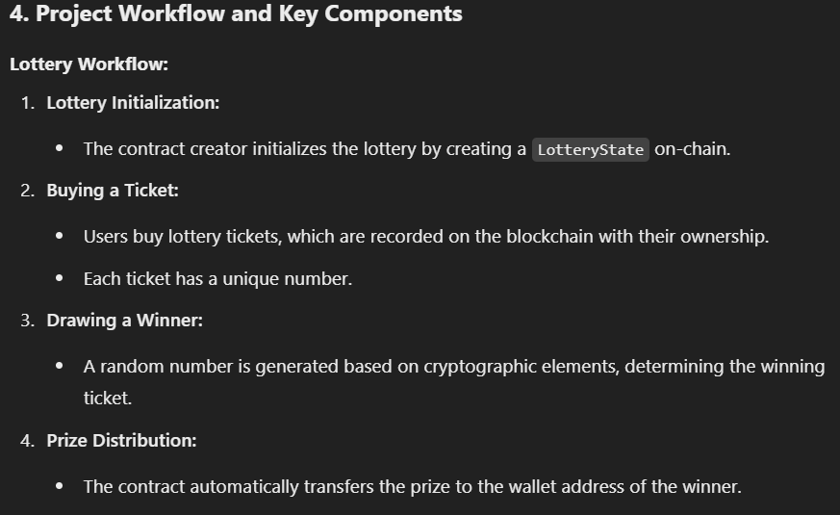

Slide 6
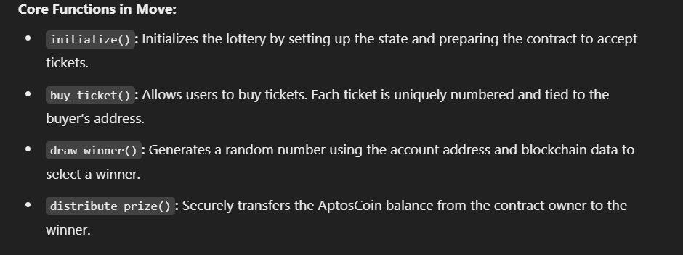

Slide 7
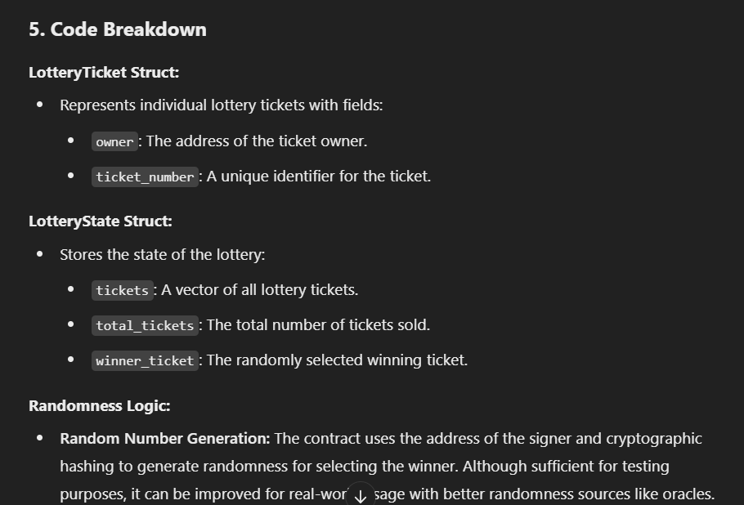

Slide 8
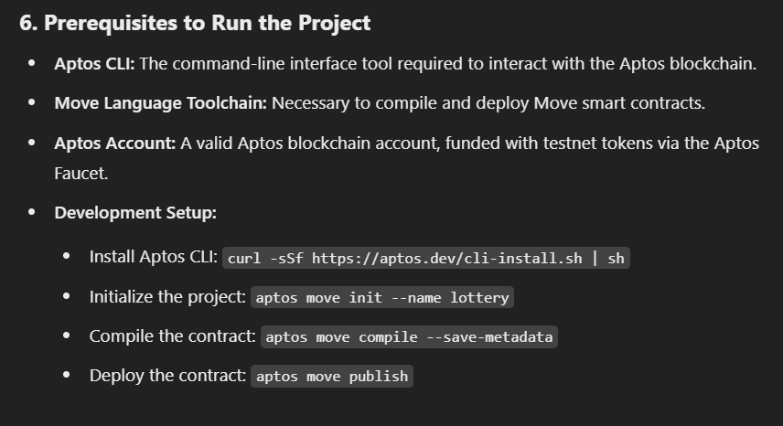

Slide 9
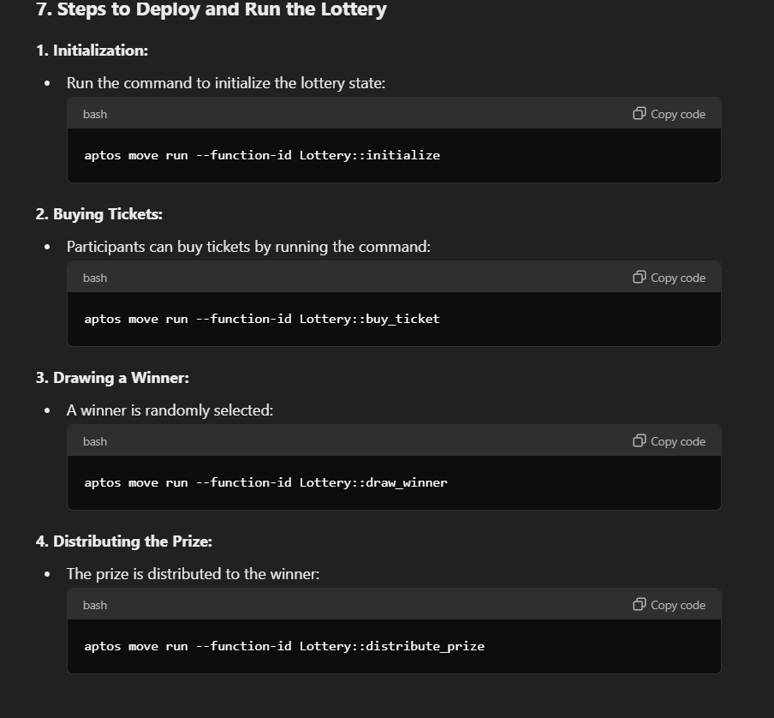

Slide 10
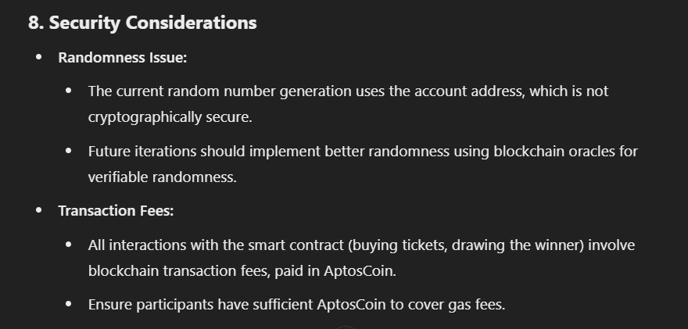

Slide 11
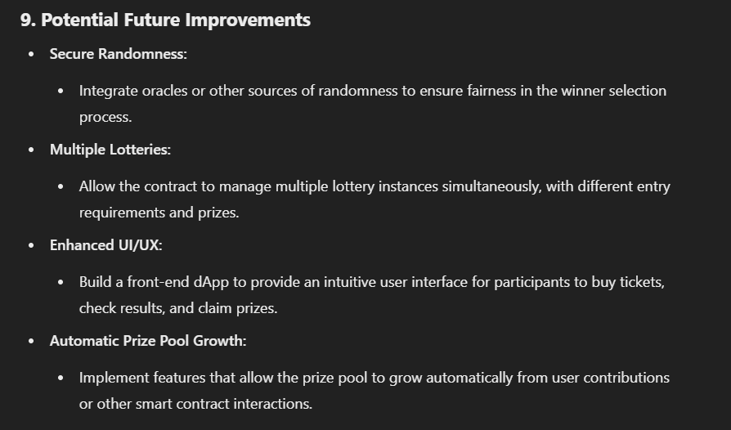

Slide 12
