Slide 1
AI Hack
Signature verification using machine learning
26/12/2018

Slide 2
Problem statement
Need to build a machine learning model that can successfully recognize signature images as belonging to specific known individuals
Data provided: few samples each of genuine signature samples of 40+ different individuals (to train the model) and forged signature samples (to test the model)

Slide 3
Solution Approach
We have created one jupyter notebook hosted in Google Colab development environment (has GPU for acceleration) hosted on Google Drive. Solution is coded in python
Image data extraction: Used opencv to convert image to a matrix of pixelwise RGB color data, image is resized, made smaller so that training can be done without runtime crashing
ML training and prediction: We use deep learning approach. We train a convolutional neural network (CNN) model with multiple layers (detailed in next slide) that maps the matrix of pixel values from input to one column vector representing the output (identity of the person to whom the signature belongs-one hot representation e.g., [0010] represents the 3rd person out of 4). The specific CNN model is inspired from handwriting recognition paper DeepWriter (https://arxiv.org/abs/1606.06472)

Slide 4
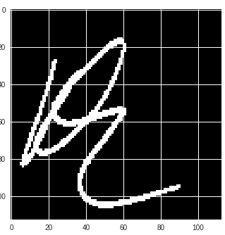
Solution Approach (Convolutional Neural Network : Deepwriter model)
Conv2D
32 filters
5x5 kernel
2x2 stride
Zero
Padding2D
(1, 1)
Conv2D
64 filters
3x3 kernel
1x1 stride
Zero
Padding2D
(1, 1)
Relu
activation
Maxpooling2D
2x2 pool
2x2 stride
Signature image
Fully
Connected
Layer
Conv2D
32 filters
5x5 kernel
2x2 stride
Relu
activation
Maxpooling2D
2x2 pool
2x2 stride
Relu
activation
Flatten
Dropout
.
.
.
.
.
.
Fully
Connected
Layer
Fully
Connected
Layer
Relu
activation
Dropout
Softmax
activation
[0 0 0...0 0...0 1 0 0]
.
.
.
.
.
.
.
.
.
.
.
.
DeepWriter paper : https://arxiv.org/abs/1606.06472

Slide 5
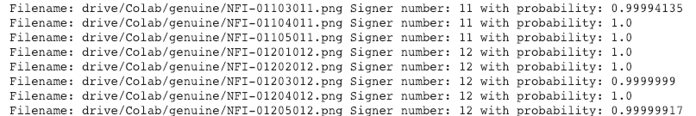
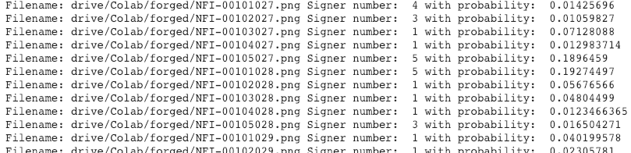
Output
Training accuracy is around 85%
The prediction on gold data (gen[] array for genuine signatures) is shown first with probability values.
The prediction on forged data (forg[] array) is shown later.
Forged dataset and genuine dataset have the same order of signatures. Gen[0] represents genuine signature sample 1 of person 0. Forg[0] represents forged signature sample 1 of person 0. Gen[4] represents genuine signature sample 5 of person 0. Forg[4] represents forged signature sample 5 of person 0. Gen[5] represents genuine signature sample 1 of person 1. Forg[5] represents forged signature sample 1 of person 1 and so on.

Slide 6
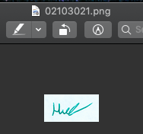
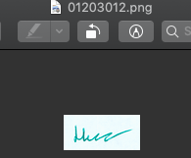
Observations
Quite a bit of overlap exists between the 4 datasets.
For e.g., 01203012.png in dataset 1 is genuine signature by person 12 in dataset 1. But 0120312.png exactly matches signature 02103021.png in dataset 3 (which is genuine signature by person 21 in dataset 3). By training our model on a hybrid dataset built from real signatures in dataset 3 and dataset 4, we are able to detect mislabeled signatures in dataset 1, 2 and 4. When the match accuracy is above 95% (probability 0.95), we can safely assume either a perfect signature match or detection of a duplicate (mislabelled) signature.
By running predictions on forged signature datasets (all 4) we get very low match accuracy in general to the genuine signatures.
Our prediction is able to detect forgery wherein it can detect images 00103026.png, 00102029.png are signatures of signer 1. Its able to do this because it is a handwriting recognition model.

