Slide 1
MODERN OPERATING SYSTEMS
Third Edition
ANDREW S. TANENBAUM
Chapter 7
Multimedia Operating Systems
Tanenbaum, Modern Operating Systems 3 e, (c) 2008 Prentice-Hall, Inc. All rights reserved. 0-13-6006639

Slide 2
Introduction To Multimedia (1)
Delivery of multimedia can be through:
  DVD, Blu-ray, HD DVD etc
  Web such as YouTube
OS need to support multimedia in creation and delivery
Also in games where in consists of many short clips that dynamically being selected for playing
Video on demand – where customer at home is able to select a movie using their television remote control and have it displayed on their TV set
  Require special infrastructure
Tanenbaum, Modern Operating Systems 3 e, (c) 2008 Prentice-Hall, Inc. All rights reserved. 0-13-6006639

Slide 3
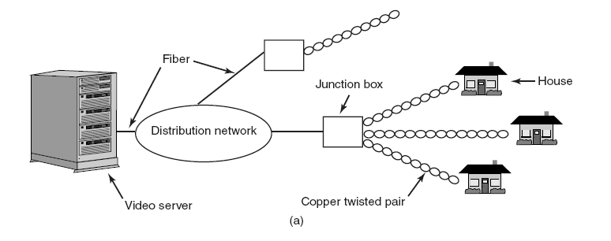
Introduction To Multimedia (2)
Figure 7-1. Video on demand using different
local distribution technologies. (a) ADSL.
Tanenbaum, Modern Operating Systems 3 e, (c) 2008 Prentice-Hall, Inc. All rights reserved. 0-13-6006639

Slide 4
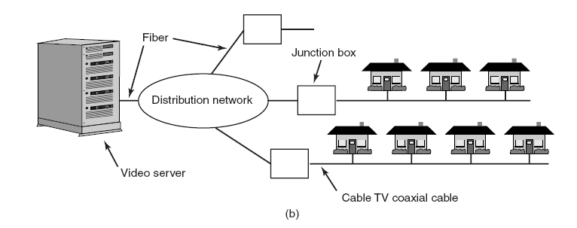
Introduction To Multimedia (3)
Figure 7-1. Video on demand using different
local distribution technologies. (b) Cable TV.
Tanenbaum, Modern Operating Systems 3 e, (c) 2008 Prentice-Hall, Inc. All rights reserved. 0-13-6006639

Slide 5
Introduction To Multimedia (4)
ADSL systems
  Provided by telephone companies
  Use existing twisted-paired telephone line
  Customer has dedicated lines, therefore bandwidth is not shared
  But usually bandwidth is low (a few Mbps)
Cable TV systems
  Provided by cable operators
  Use existing cable TV wiring for local distribution
  Customers have to shared the lines
  But higher bandwidth (at Gbps)
Tanenbaum, Modern Operating Systems 3 e, (c) 2008 Prentice-Hall, Inc. All rights reserved. 0-13-6006639

Slide 6
Introduction To Multimedia (5)
Set-top box is where ADSL or TV cable terminates
  Is a normal computer
  Use to decode the signal before displaying on TV or monitor
Tanenbaum, Modern Operating Systems 3 e, (c) 2008 Prentice-Hall, Inc. All rights reserved. 0-13-6006639

Slide 7
Introduction To Multimedia (6)
Key characteristics of multimedia:
Multimedia uses extremely high data rates.
  Due to the nature of visual and acoustic information
  The eye and the ear can process prodigious amounts of information per sec, and have to be fed at that rate to produce acceptable viewing experience
  Therefore a video server requires huge amount of storage and must be supported by h/w and OS
Multimedia requires real-time playback.
  Frames must be delivered at precise interval to prevent the movie from looking choppy
  Based on standard such as NTSC, PAL and SECAM
  Ear is more sensitive than eye, so variance of even a few ms in delivery times will be noticeable - jitter
Tanenbaum, Modern Operating Systems 3 e, (c) 2008 Prentice-Hall, Inc. All rights reserved. 0-13-6006639

Slide 8
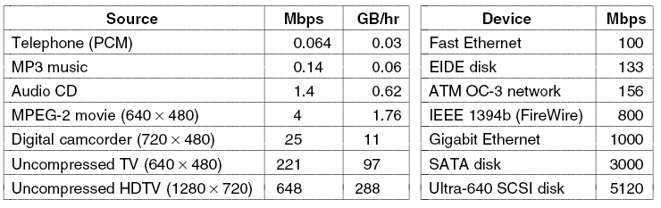
Introduction To Multimedia (7)
Figure 7-2. Some data rates for multimedia and high-performance I/O devices. Note that 1 Mbps is 10⁶ bits/sec
but 1 GB is 2³⁰ bytes.
Tanenbaum, Modern Operating Systems 3 e, (c) 2008 Prentice-Hall, Inc. All rights reserved. 0-13-6006639

Slide 9
Introduction To Multimedia (6)
The real-time properties required to play back multimedia acceptably are often described by quality of service (QoS) parameters.
  Include average bandwidth available, peak bandwidth available, min and max delay (jitter) and bit loss probability
Multimedia servers need resource reservation schemes and an admission control algorithm to decide when they can handle more work.
  E.g. only allow new customer to demand movie when the server has sufficient capability to prevent from degrading the quality on other customers
Tanenbaum, Modern Operating Systems 3 e, (c) 2008 Prentice-Hall, Inc. All rights reserved. 0-13-6006639

Slide 10
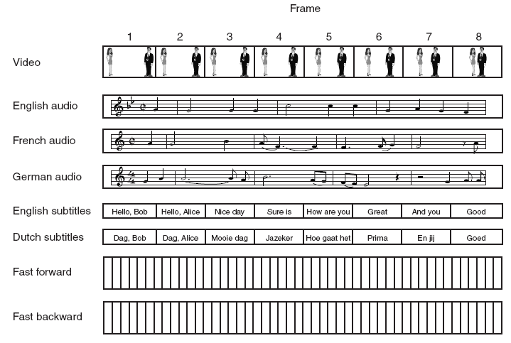
Multimedia Files (1)
Figure 7-3. A movie may consist of several files.
Tanenbaum, Modern Operating Systems 3 e, (c) 2008 Prentice-Hall, Inc. All rights reserved. 0-13-6006639

Slide 11
Multimedia Files (2)
Digital movie may actually consist of many files:
  One video file
  Multiple audio files
  Multiple text files
The file system needs to keep track of multiple “subfiles” per file.
  Manage each subfile as a traditional file and to have a new data structure that lists all the subfiles per multimedia file
  Or invent a kind of two-dimensional i-node, with each column listing the blocks of each subfiles
Organization must be such that the viewer can dynamically choose which audio and subtitle tracks to use at the time the movie is viewed
  Synchronization required
Tanenbaum, Modern Operating Systems 3 e, (c) 2008 Prentice-Hall, Inc. All rights reserved. 0-13-6006639

Slide 12
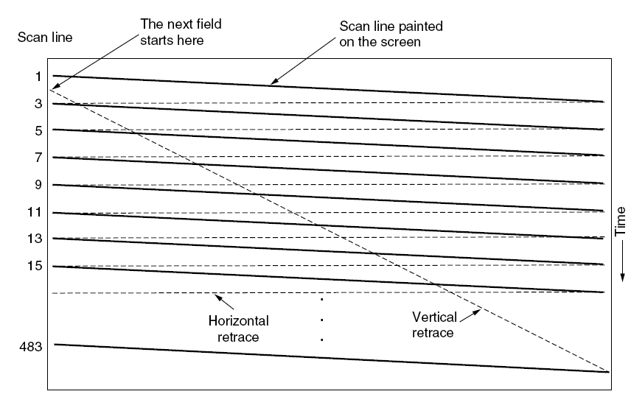
Video Encoding (1)
Figure 7-4. The scanning pattern used for NTSC
video and television.
Tanenbaum, Modern Operating Systems 3 e, (c) 2008 Prentice-Hall, Inc. All rights reserved. 0-13-6006639

Slide 13
Video Encoding (2)
Human eye has the property that when an image is flashed on the retina, it is retained for some number of ms before decaying
  50 or more images/s, the eye does not notice that it is looking at discrete images.
Tanenbaum, Modern Operating Systems 3 e, (c) 2008 Prentice-Hall, Inc. All rights reserved. 0-13-6006639

Slide 14
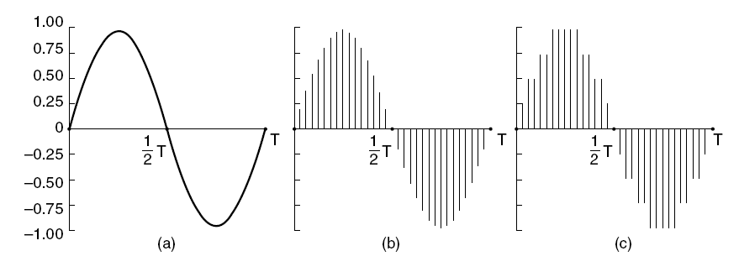
Audio Encoding
Figure 7-5. (a) A sine wave. (b) Sampling the sine wave.
(c) Quantizing the samples to 4 bits.
Tanenbaum, Modern Operating Systems 3 e, (c) 2008 Prentice-Hall, Inc. All rights reserved. 0-13-6006639

Slide 15
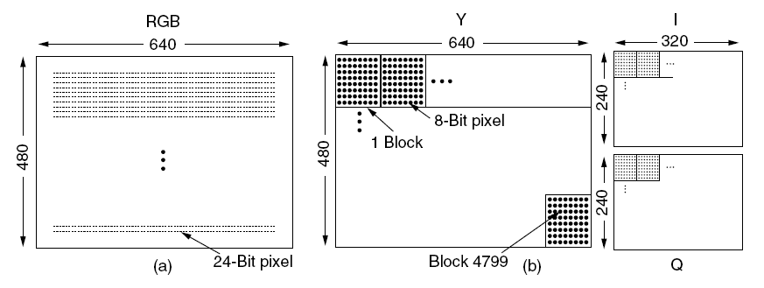
The JPEG Standard (1)
Figure 7-6. (a) RGB input data. (b) After block preparation.
Tanenbaum, Modern Operating Systems 3 e, (c) 2008 Prentice-Hall, Inc. All rights reserved. 0-13-6006639

Slide 16
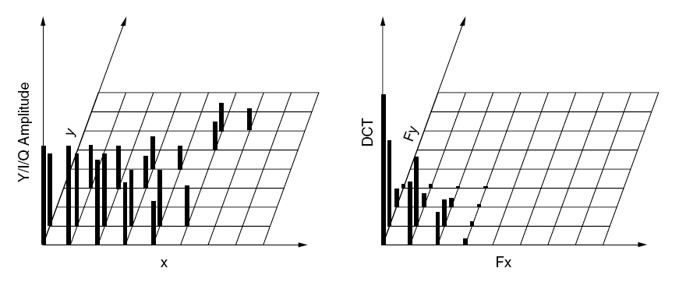
The JPEG Standard (2)
Figure 7-7. (a) One block of the Y matrix.
(b) The DCT coefficients.
Tanenbaum, Modern Operating Systems 3 e, (c) 2008 Prentice-Hall, Inc. All rights reserved. 0-13-6006639

Slide 17
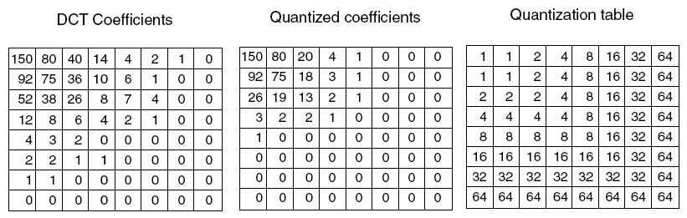
The JPEG Standard (3)
Figure 7-8. Computation of the quantized DCT coefficients.
Tanenbaum, Modern Operating Systems 3 e, (c) 2008 Prentice-Hall, Inc. All rights reserved. 0-13-6006639

Slide 18
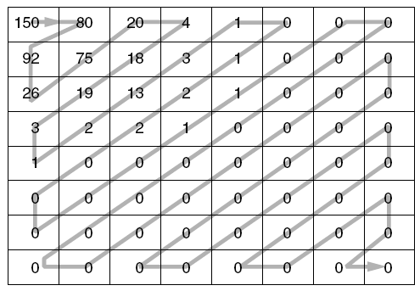
The JPEG Standard (4)
Figure 7-9. The order in which the quantized
values are transmitted.
Tanenbaum, Modern Operating Systems 3 e, (c) 2008 Prentice-Hall, Inc. All rights reserved. 0-13-6006639

Slide 19
The MPEG Standard (1)
Three types of MPEG-2 frames processed by the viewing program:
I (Intracoded) frames: Self-contained JPEG-encoded still pictures.
P (Predictive) frames: Block-by-block difference with the last frame.
B (Bidirectional) frames: Differences with the last and next frame.
Tanenbaum, Modern Operating Systems 3 e, (c) 2008 Prentice-Hall, Inc. All rights reserved. 0-13-6006639

Slide 20
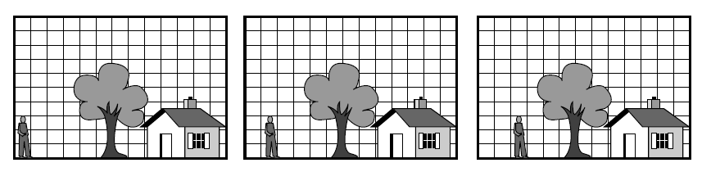
The MPEG Standard (2)
Figure 7-10. Three consecutive video frames.
Tanenbaum, Modern Operating Systems 3 e, (c) 2008 Prentice-Hall, Inc. All rights reserved. 0-13-6006639

Slide 21
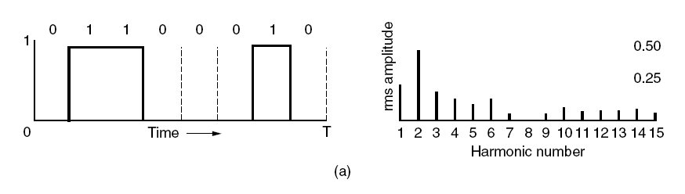
Audio Compression (1)
Figure 7-11. (a) A binary signal and its
root-mean-square Fourier amplitudes.
Tanenbaum, Modern Operating Systems 3 e, (c) 2008 Prentice-Hall, Inc. All rights reserved. 0-13-6006639

Slide 22
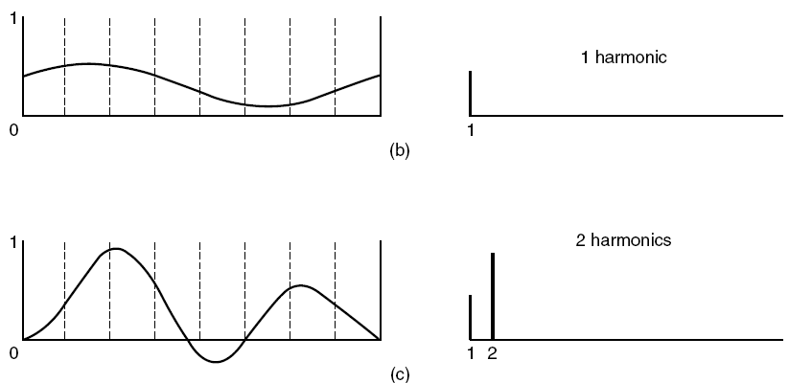
Audio Compression (2)
Figure 7-11. (b)–(e) Successive approximations
to the original signal.
Tanenbaum, Modern Operating Systems 3 e, (c) 2008 Prentice-Hall, Inc. All rights reserved. 0-13-6006639

Slide 23
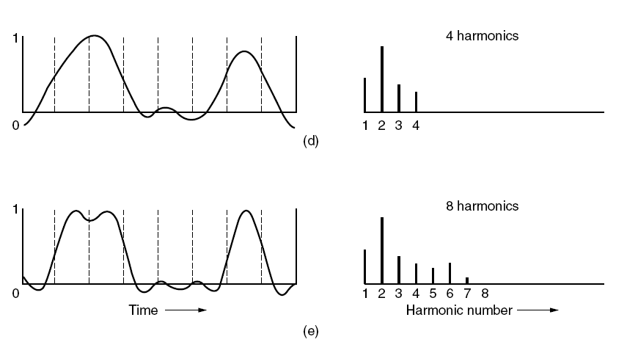
Audio Compression (3)
Figure 7-11. (b)–(e) Successive approximations
to the original signal.
Tanenbaum, Modern Operating Systems 3 e, (c) 2008 Prentice-Hall, Inc. All rights reserved. 0-13-6006639

Slide 24
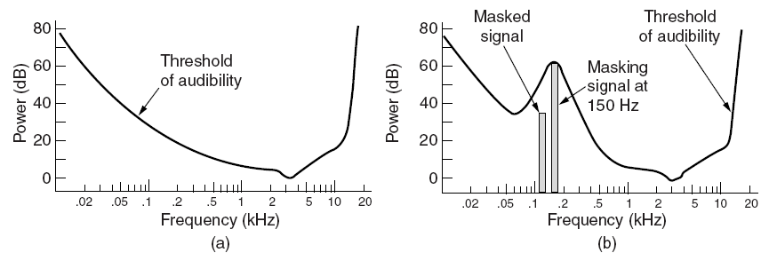
Audio Compression (4)
Figure 7-12. (a) The threshold of audibility as a
function of frequency. (b) The masking effect.
Tanenbaum, Modern Operating Systems 3 e, (c) 2008 Prentice-Hall, Inc. All rights reserved. 0-13-6006639

Slide 25
Audio Compression (5)
Possible sampling configurations:
Monophonic (a single input stream).
Dual monophonic (e.g., an English and a Japanese soundtrack).
Disjoint stereo (each channel compressed separately).
Joint stereo (interchannel redundancy fully exploited).
Tanenbaum, Modern Operating Systems 3 e, (c) 2008 Prentice-Hall, Inc. All rights reserved. 0-13-6006639

Slide 26
Multimedia Process Scheduling
OS support for multimedia in three main ways:
  Process scheduling
  File systems
  Disk scheduling
Scheduling Homogeneous Processes
  Simplest kind
    Fixed number of movies, using same frame rate, video resolution, data rates and other parameters
    All processes are equally important, have the same amount of work to do per frame, and block when they finished processing the current frame:-round robin
Tanenbaum, Modern Operating Systems 3 e, (c) 2008 Prentice-Hall, Inc. All rights reserved. 0-13-6006639

Slide 27
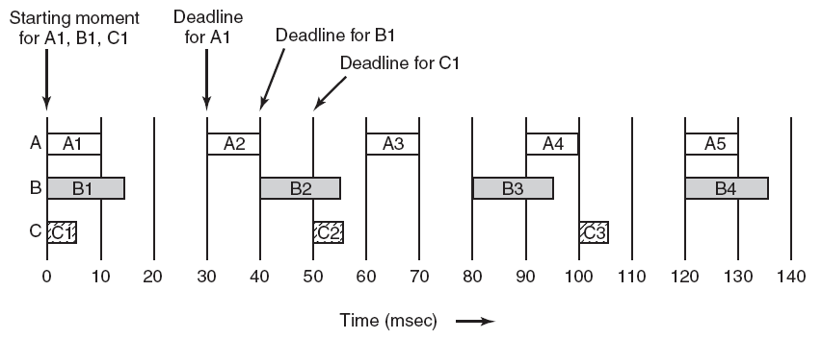
General Real-Time Scheduling
Figure 7-13. Three periodic processes, each displaying a movie. The frame rates and processing requirements per frame are different for each movie.
Tanenbaum, Modern Operating Systems 3 e, (c) 2008 Prentice-Hall, Inc. All rights reserved. 0-13-6006639

Slide 28
General Real-Time Scheduling
Simple scheduling technique will fail due to
  Number of viewers changes all the time
  Frame sizes are varied due to compression
  Different movies have different resolutions
Thus, different process may run at different frequencies, with different amount of works to do and with different deadline
  Multiple processes competing for the CPU
  Real-time scheduling
Tanenbaum, Modern Operating Systems 3 e, (c) 2008 Prentice-Hall, Inc. All rights reserved. 0-13-6006639

Slide 29
Rate Monotonic Scheduling (1)
Required conditions for RMS:
Each periodic process must complete within its period.
No process is dependent on any other process.
Each process needs same amount of CPU time on each burst.
Nonperiodic processes have no deadlines.
Process preemption occurs instantaneously and with no overhead.
Tanenbaum, Modern Operating Systems 3 e, (c) 2008 Prentice-Hall, Inc. All rights reserved. 0-13-6006639

Slide 30
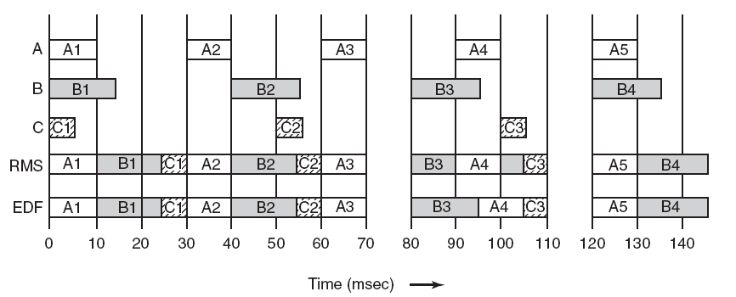
Rate Monotonic Scheduling (2)
Figure 7-14. An example of RMS and EDF real-time scheduling.
Tanenbaum, Modern Operating Systems 3 e, (c) 2008 Prentice-Hall, Inc. All rights reserved. 0-13-6006639

Slide 31
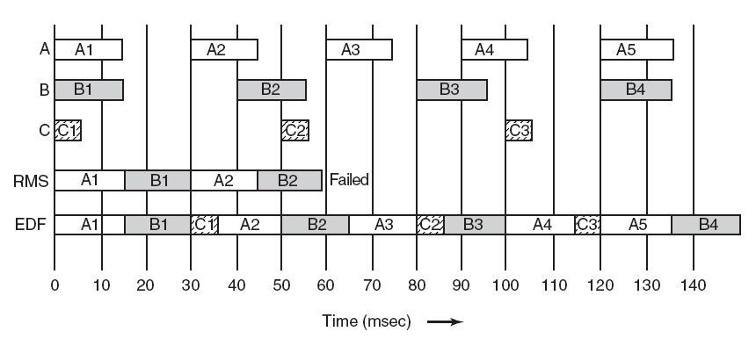
Earliest Deadline First Scheduling
Figure 7-15. Another example of real-time
scheduling with RMS and EDF.
Tanenbaum, Modern Operating Systems 3 e, (c) 2008 Prentice-Hall, Inc. All rights reserved. 0-13-6006639

Slide 32
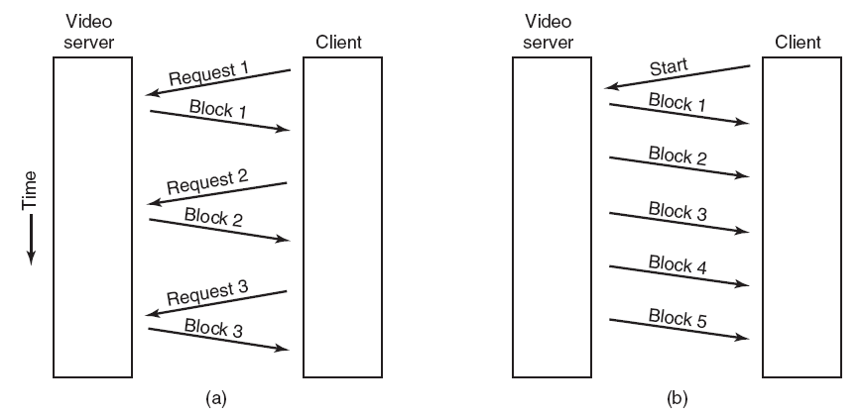
Multimedia File System Paradigms
Figure 7-16. (a) A pull server. (b) A push server.
Tanenbaum, Modern Operating Systems 3 e, (c) 2008 Prentice-Hall, Inc. All rights reserved. 0-13-6006639

Slide 33
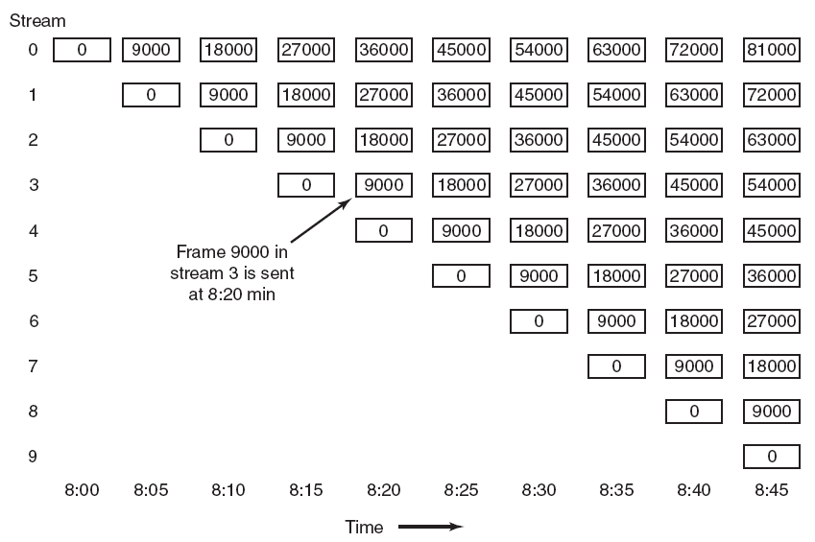
Near Video on Demand
Figure 7-17. Near video on demand has a new stream
starting at regular intervals, in this example
every 5 minutes (9000 frames).
Tanenbaum, Modern Operating Systems 3 e, (c) 2008 Prentice-Hall, Inc. All rights reserved. 0-13-6006639

Slide 34
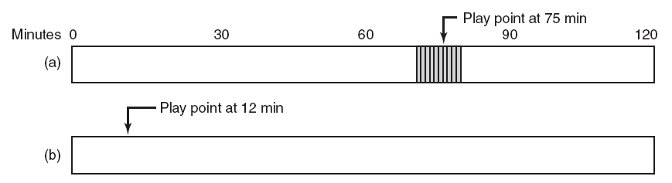
Near Video on Demand with VCR Functions (1)
Figure 7-18. (a) Initial situation. (b) After a rewind to 12 min
Tanenbaum, Modern Operating Systems 3 e, (c) 2008 Prentice-Hall, Inc. All rights reserved. 0-13-6006639

Slide 35
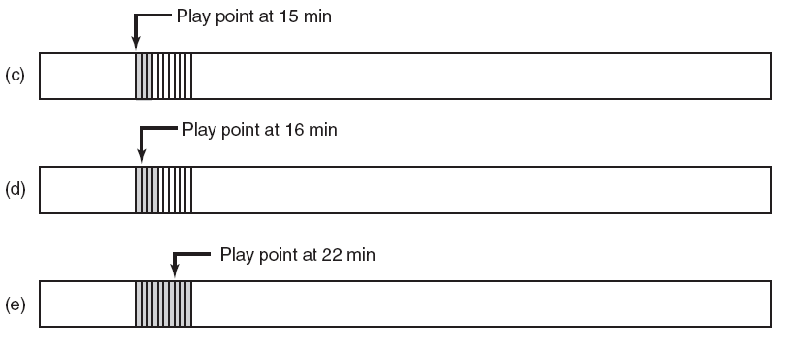
Near Video on Demand with VCR Functions (2)
Figure 7-18. (c) After waiting 3 min.
(d) After starting to refill the buffer. (e) Buffer full.
Tanenbaum, Modern Operating Systems 3 e, (c) 2008 Prentice-Hall, Inc. All rights reserved. 0-13-6006639

Slide 36
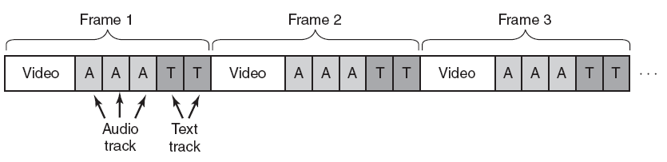
Placing a File on a Single Disk
Figure 7-19. Interleaving video, audio, and text in a single contiguous file per movie.
Tanenbaum, Modern Operating Systems 3 e, (c) 2008 Prentice-Hall, Inc. All rights reserved. 0-13-6006639

Slide 37
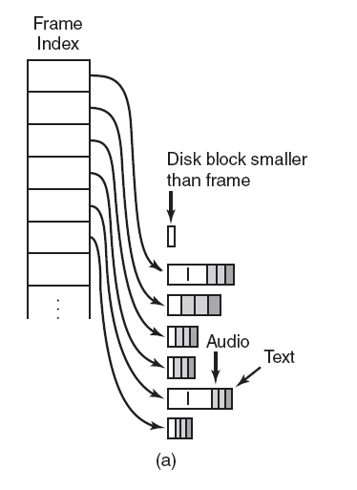
Two Alternative File Organization
Strategies (1)
Figure 7-20. Noncontiguous movie storage. (a) Small disk blocks.
Tanenbaum, Modern Operating Systems 3 e, (c) 2008 Prentice-Hall, Inc. All rights reserved. 0-13-6006639

Slide 38
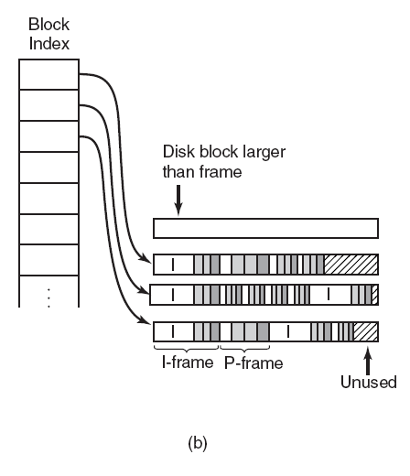
Two Alternative File Organization
Strategies (2)
Figure 7-20. Noncontiguous movie storage
(b) Large disk blocks.
Tanenbaum, Modern Operating Systems 3 e, (c) 2008 Prentice-Hall, Inc. All rights reserved. 0-13-6006639

Slide 39
Two Alternative File Organization
Strategies (3)
Trade-offs involved in these alternatives:
Frame index: Heavier RAM usage while movie is playing; little disk wastage.
Block index (no splitting frames over blocks): Low RAM usage; major disk wastage.
Block index (splitting frames over blocks is allowed): Low RAM usage; no disk wastage; extra seeks.
Tanenbaum, Modern Operating Systems 3 e, (c) 2008 Prentice-Hall, Inc. All rights reserved. 0-13-6006639

Slide 40
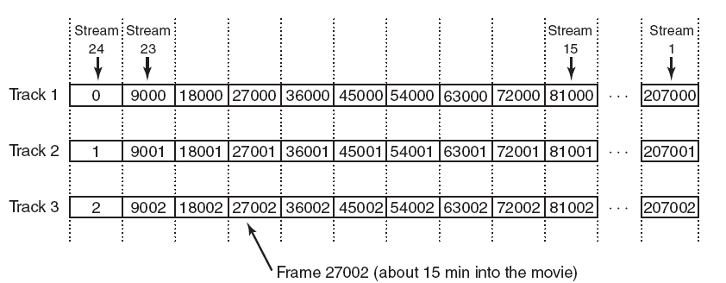
Placing Files for Near Video on Demand
Figure 7-21. Optimal frame placement for near video on demand.
Tanenbaum, Modern Operating Systems 3 e, (c) 2008 Prentice-Hall, Inc. All rights reserved. 0-13-6006639

Slide 41
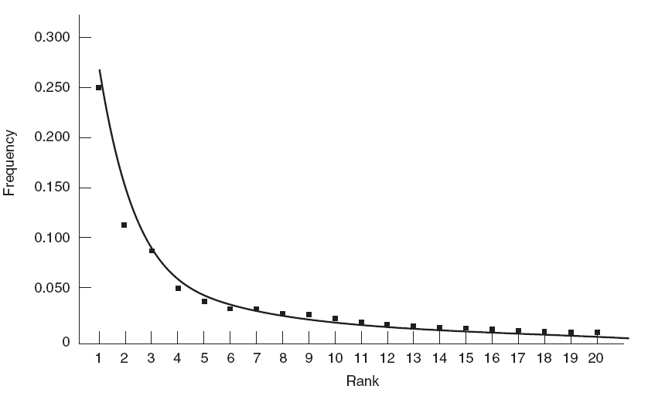
Placing Multiple Files on a Single Disk (1)
Figure 7-22. The curve gives Zipf’s law for N = 20. The
squares represent the populations of the 20
largest cities in the U.S., sorted on rank order
(New York is 1, Los Angeles is 2, Chicago is 3, etc.).
Tanenbaum, Modern Operating Systems 3 e, (c) 2008 Prentice-Hall, Inc. All rights reserved. 0-13-6006639

Slide 42
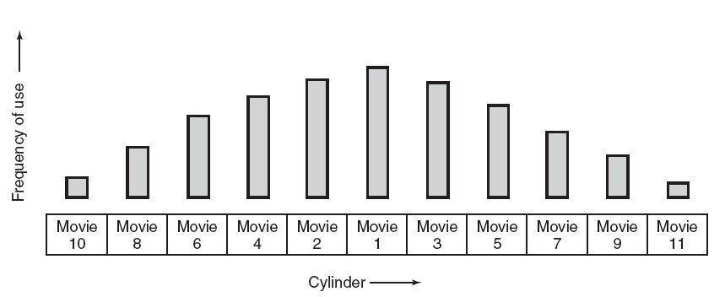
Placing Multiple Files on a Single Disk (2)
Figure 7-23. The organ-pipe distribution of files on a video server.
Tanenbaum, Modern Operating Systems 3 e, (c) 2008 Prentice-Hall, Inc. All rights reserved. 0-13-6006639

Slide 43
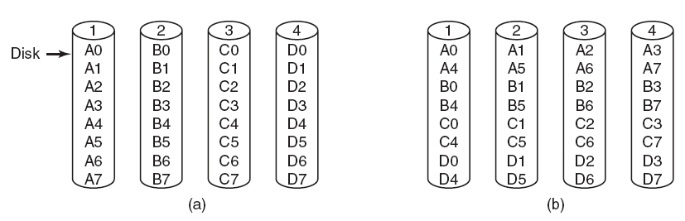
Placing Files on Multiple Disks (1)
Figure 7-24. Four ways of organizing multimedia files over multiple disks. (a) No striping. (b) Same striping all files.
Tanenbaum, Modern Operating Systems 3 e, (c) 2008 Prentice-Hall, Inc. All rights reserved. 0-13-6006639

Slide 44
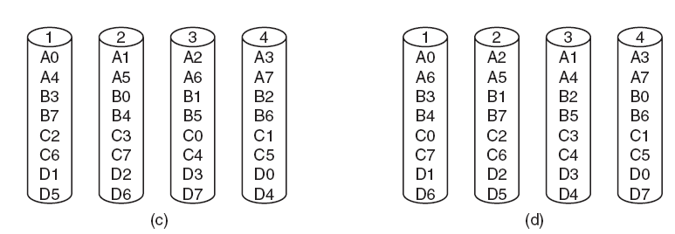
Placing Files on Multiple Disks (2)
Figure 7-24. Four ways of organizing multimedia files over multiple disks. (c) Staggered striping. (d) Random striping.
Tanenbaum, Modern Operating Systems 3 e, (c) 2008 Prentice-Hall, Inc. All rights reserved. 0-13-6006639

Slide 45
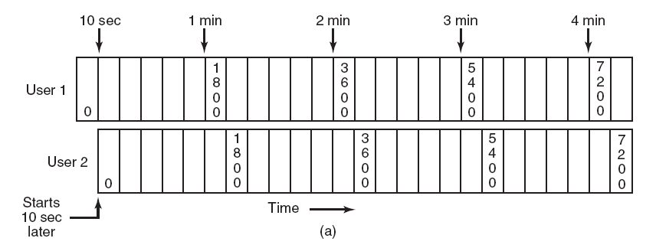
Block Caching (1)
Figure 7-25. (a) Two users watching the same
movie 10 sec out of sync.
Tanenbaum, Modern Operating Systems 3 e, (c) 2008 Prentice-Hall, Inc. All rights reserved. 0-13-6006639

Slide 46
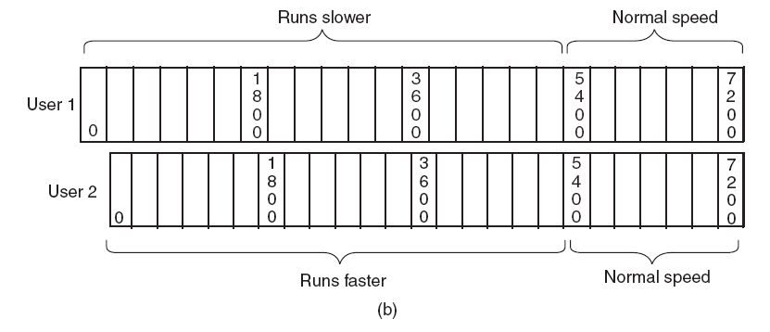
Block Caching (2)
Figure 7-25. (b) Merging the two streams into one.
Tanenbaum, Modern Operating Systems 3 e, (c) 2008 Prentice-Hall, Inc. All rights reserved. 0-13-6006639

Slide 47
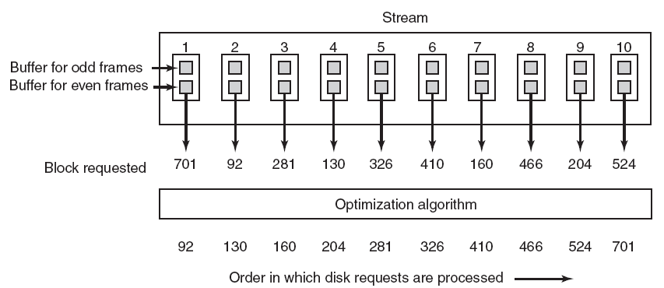
Static Disk Scheduling
Figure 7-26. In one round, each movie asks for one frame.
Tanenbaum, Modern Operating Systems 3 e, (c) 2008 Prentice-Hall, Inc. All rights reserved. 0-13-6006639

Slide 48
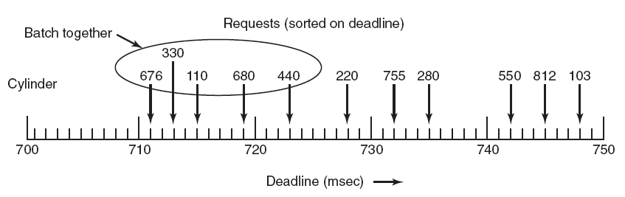
Dynamic Disk Scheduling
Figure 7-27. The scan-EDF algorithm uses deadlines and cylinder numbers for scheduling.
Tanenbaum, Modern Operating Systems 3 e, (c) 2008 Prentice-Hall, Inc. All rights reserved. 0-13-6006639

Slide 49
Questions
Tanenbaum, Modern Operating Systems 3 e, (c) 2008 Prentice-Hall, Inc. All rights reserved. 0-13-6006639

