Slide 1
MODERN OPERATING SYSTEMS
Third Edition
ANDREW S. TANENBAUM
Chapter 11
Case Study 2: Windows Vista
Tanenbaum, Modern Operating Systems 3 e, (c) 2008 Prentice-Hall, Inc. All rights reserved. 0-13-6006639

Slide 2
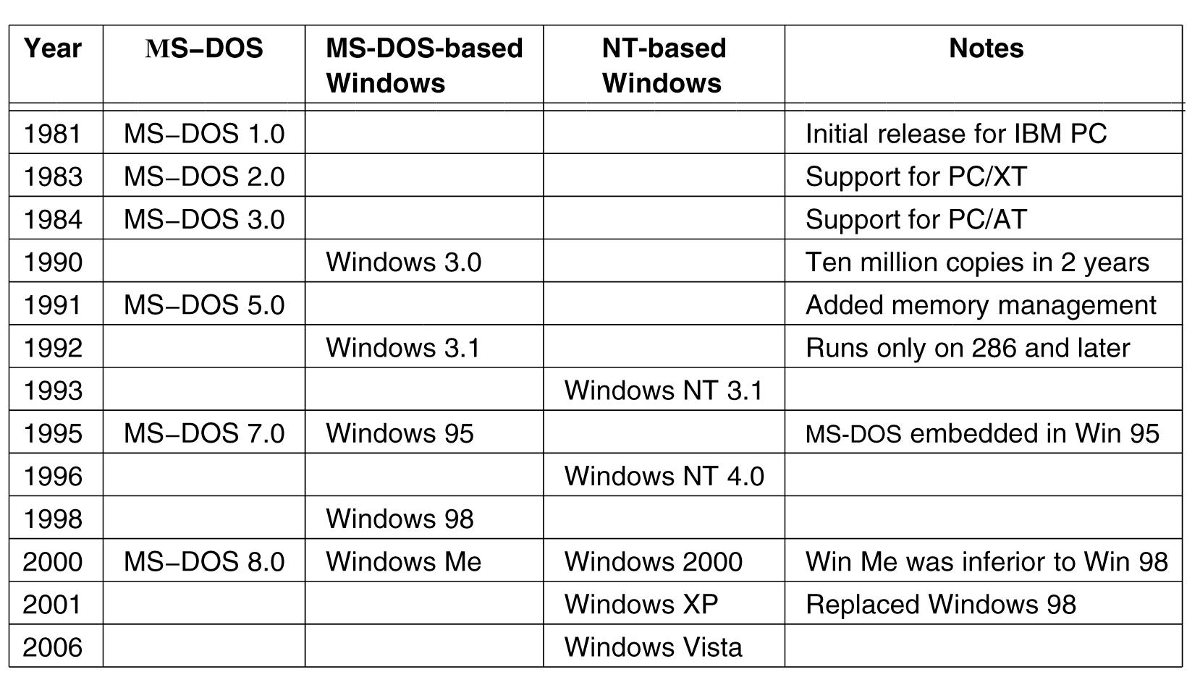
History of Vista
Figure 11-1. Major releases in the history of Microsoft operating systems for desktop PCs.
Tanenbaum, Modern Operating Systems 3 e, (c) 2008 Prentice-Hall, Inc. All rights reserved. 0-13-6006639

Slide 3
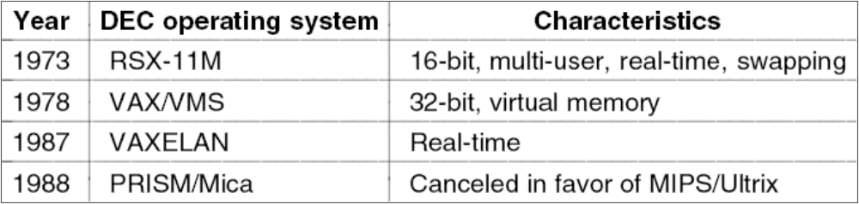
2000s: NT-based Windows (1)
Figure 11-2. DEC Operating Systems developed by Dave Cutler.
Tanenbaum, Modern Operating Systems 3 e, (c) 2008 Prentice-Hall, Inc. All rights reserved. 0-13-6006639

Slide 4
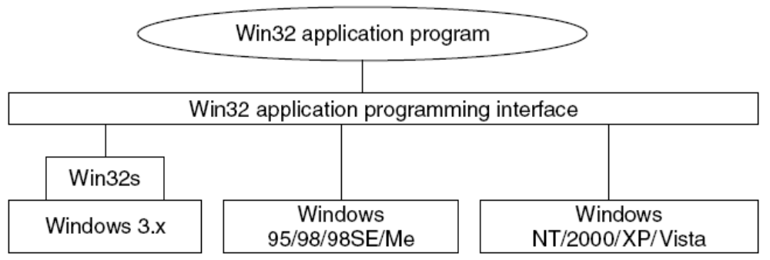
2000s: NT-based Windows (2)
Figure 11-3. The Win32 API allows programs to run
on almost all versions of Windows.
Tanenbaum, Modern Operating Systems 3 e, (c) 2008 Prentice-Hall, Inc. All rights reserved. 0-13-6006639

Slide 5
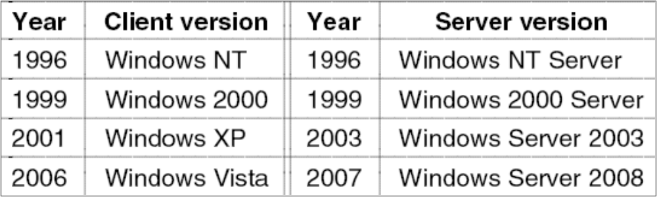
2000s: NT-based Windows (3)
Figure 11-4. Split client and server releases of Windows.
Tanenbaum, Modern Operating Systems 3 e, (c) 2008 Prentice-Hall, Inc. All rights reserved. 0-13-6006639

Slide 6
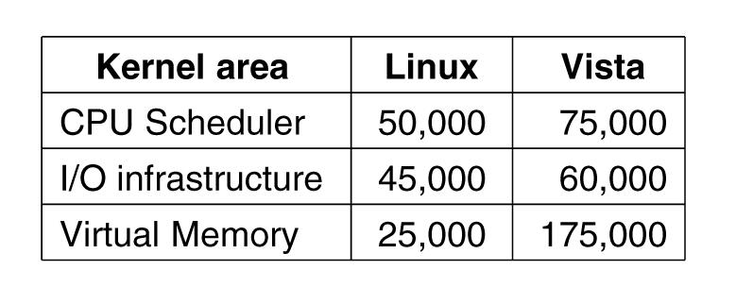
Windows Vista
Figure 11-5. Comparison of lines of code for selected
kernel-mode modules in Linux and Windows (from Mark Russinovich, co-author of Microsoft Windows Internals).
Tanenbaum, Modern Operating Systems 3 e, (c) 2008 Prentice-Hall, Inc. All rights reserved. 0-13-6006639

Slide 7
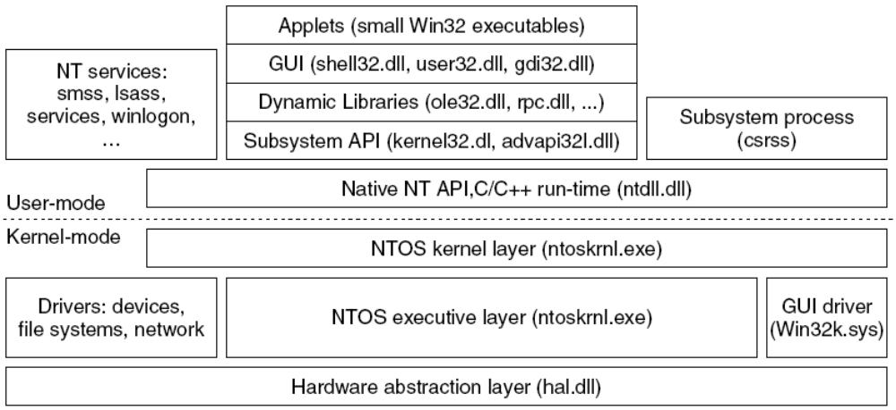
Programming Windows Vista
Figure 11-6. The programming layers in Windows.
Tanenbaum, Modern Operating Systems 3 e, (c) 2008 Prentice-Hall, Inc. All rights reserved. 0-13-6006639

Slide 8
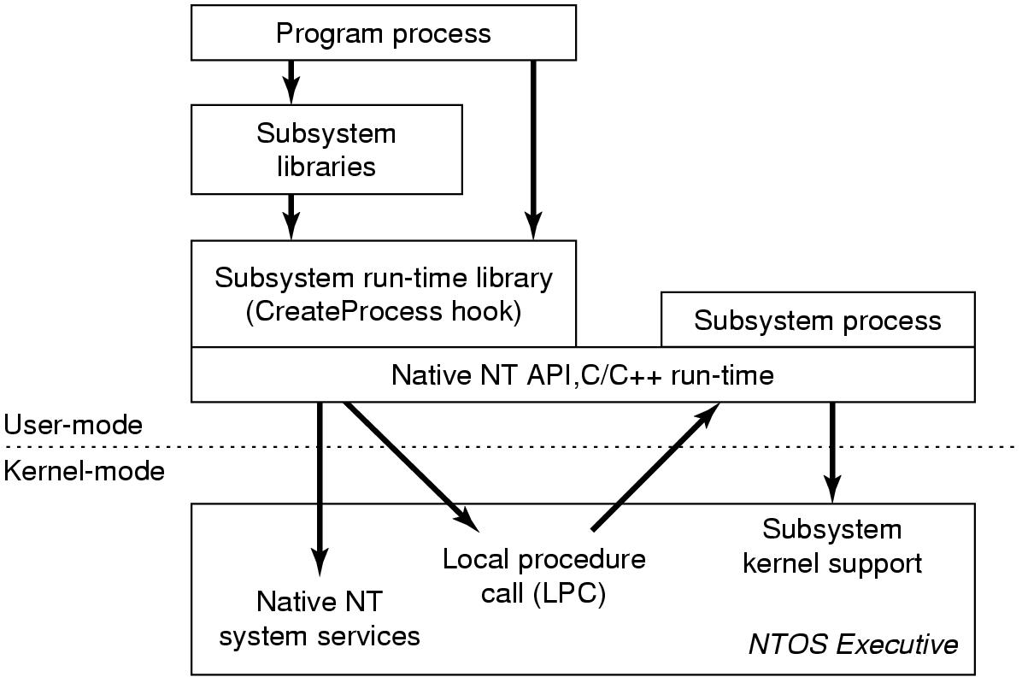
Programming Windows Vista (2)
Figure 11-7. The components used to build NT subsystems.
Tanenbaum, Modern Operating Systems 3 e, (c) 2008 Prentice-Hall, Inc. All rights reserved. 0-13-6006639

Slide 9
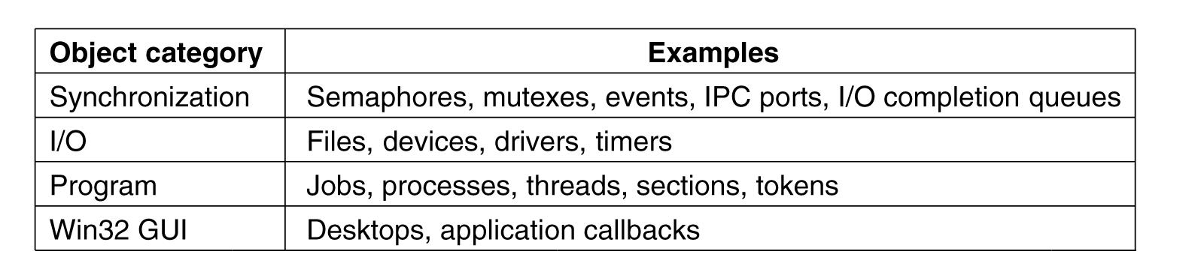
The Native NT Application
Programming Interface (1)
Figure 11-8. Common categories of kernel-mode object types.
Tanenbaum, Modern Operating Systems 3 e, (c) 2008 Prentice-Hall, Inc. All rights reserved. 0-13-6006639

Slide 10
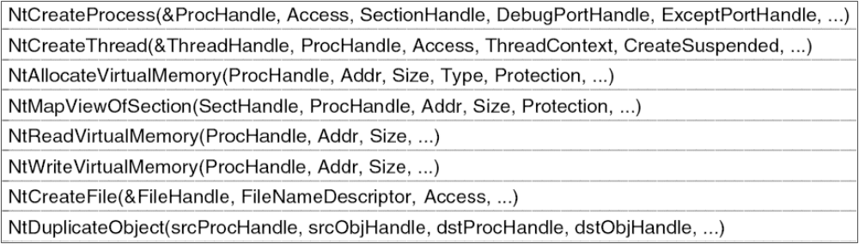
The Native NT Application
Programming Interface (2)
Figure 11-9. Examples of native NT API calls that use handles to manipulate objects across process boundaries.
Tanenbaum, Modern Operating Systems 3 e, (c) 2008 Prentice-Hall, Inc. All rights reserved. 0-13-6006639

Slide 11
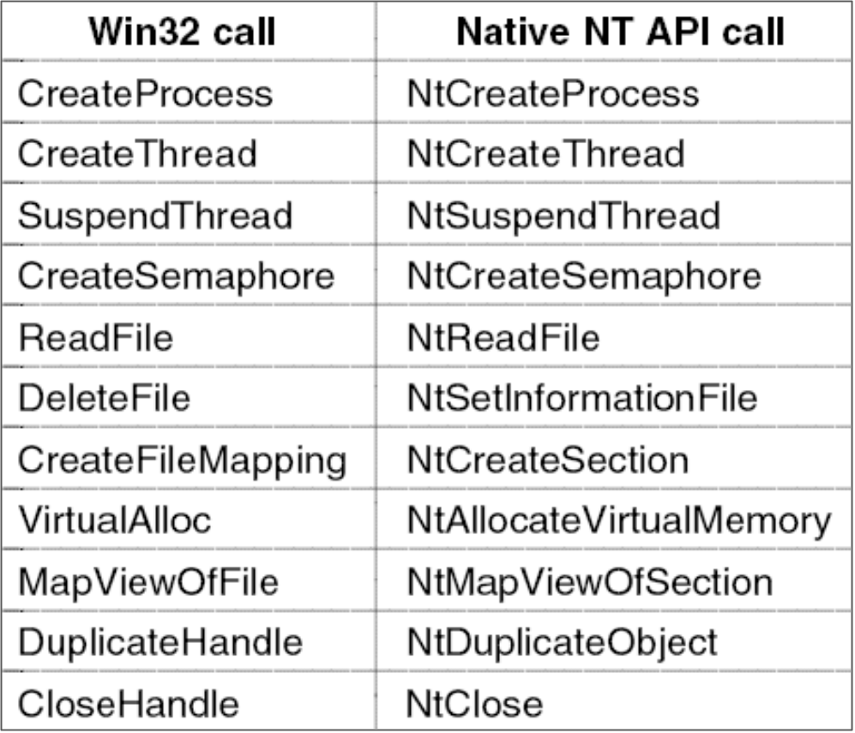
The Win32 Application
Programming Interface
Figure 11-10. Examples of Win32 API calls and the
native NT API calls that they wrap.
Tanenbaum, Modern Operating Systems 3 e, (c) 2008 Prentice-Hall, Inc. All rights reserved. 0-13-6006639

Slide 12
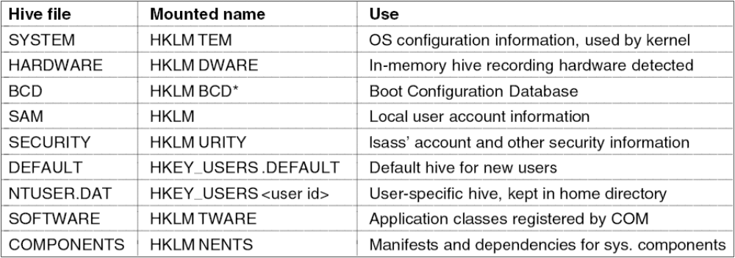
The Windows Registry (1)
Figure 11-11. The registry hives in Windows Vista. HKLM is a short-hand for HKEY_LOCAL_MACHINE.
Tanenbaum, Modern Operating Systems 3 e, (c) 2008 Prentice-Hall, Inc. All rights reserved. 0-13-6006639

Slide 13
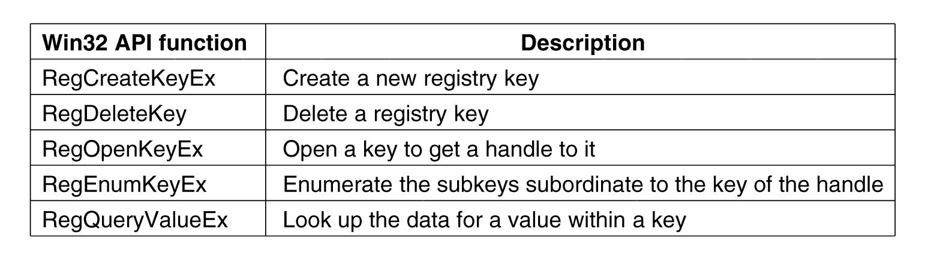
The Windows Registry (2)
Figure 11-12. Some of the Win32 API calls for using the registry
Tanenbaum, Modern Operating Systems 3 e, (c) 2008 Prentice-Hall, Inc. All rights reserved. 0-13-6006639

Slide 14
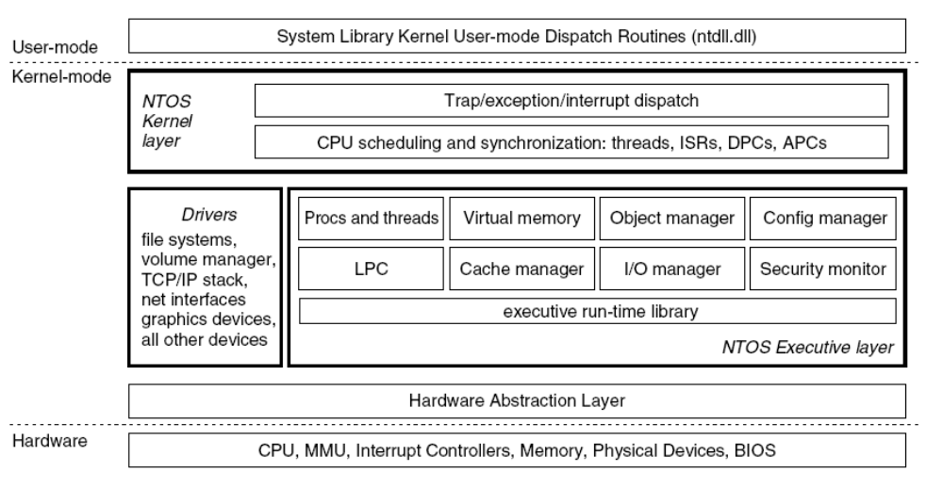
Operating System Structure
Figure 11-13. Windows kernel-mode organization.
Tanenbaum, Modern Operating Systems 3 e, (c) 2008 Prentice-Hall, Inc. All rights reserved. 0-13-6006639

Slide 15
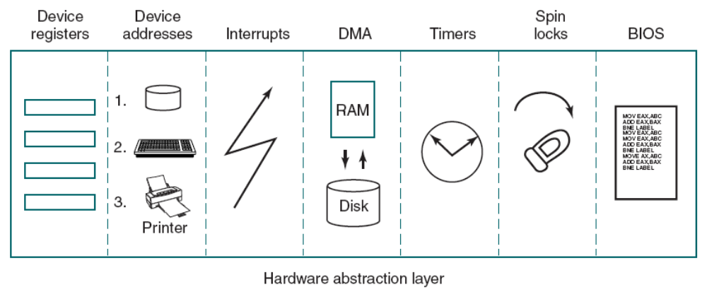
The Kernel Layer
Figure 11-14. Some of the hardware functions the HAL manages.
Tanenbaum, Modern Operating Systems 3 e, (c) 2008 Prentice-Hall, Inc. All rights reserved. 0-13-6006639

Slide 16
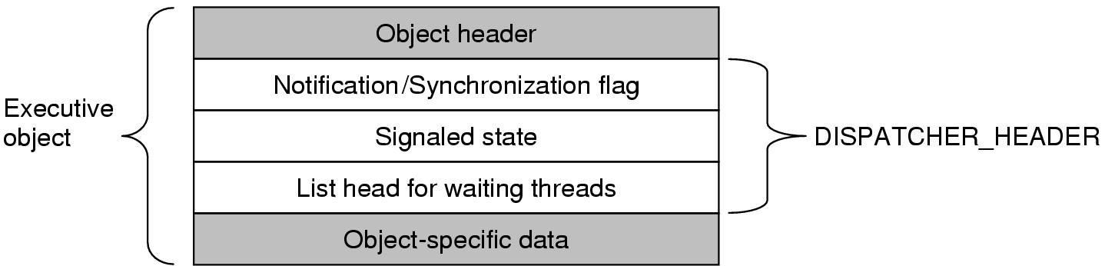
Dispatcher Objects
Figure 11-15. dispatcher_header data structure embedded in many executive objects (dispatcher objects).
Tanenbaum, Modern Operating Systems 3 e, (c) 2008 Prentice-Hall, Inc. All rights reserved. 0-13-6006639

Slide 17
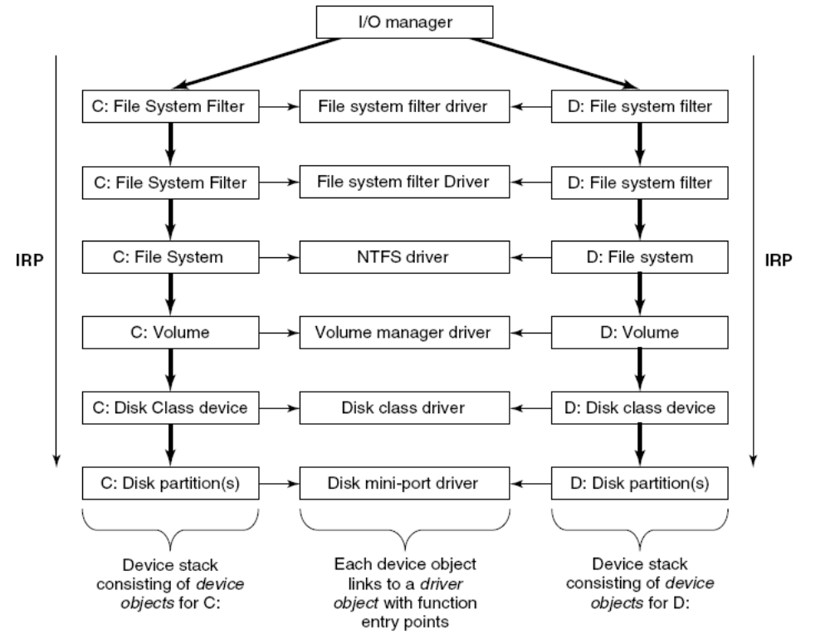
The Device Drivers
Figure 11-16. Simplified depiction of device stacks for two NTFS file volumes. I/O request packet passed from down the stack.
Tanenbaum, Modern Operating Systems 3 e, (c) 2008 Prentice-Hall, Inc. All rights reserved. 0-13-6006639

Slide 18
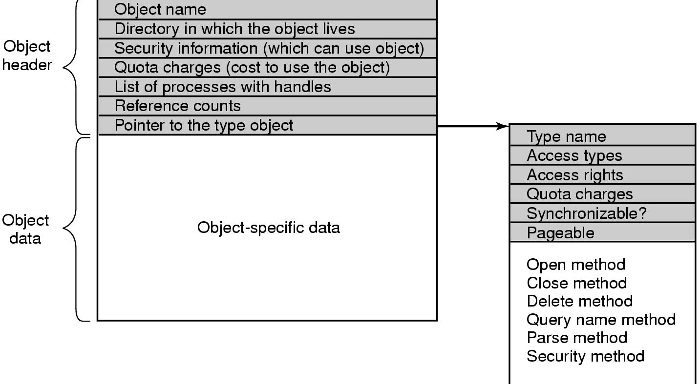
Implementation of the Object Manager
Figure 11-17. The structure of an executive object managed by the object manager.
Tanenbaum, Modern Operating Systems 3 e, (c) 2008 Prentice-Hall, Inc. All rights reserved. 0-13-6006639

Slide 19
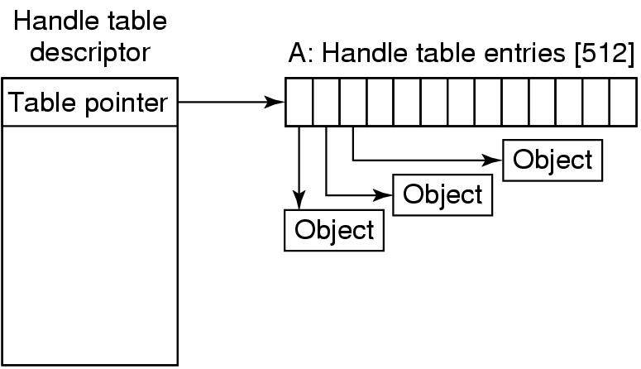
Handles (1)
Figure 11-18. Handle table data structures for a minimal table using a single page for up to 512 handles.
Tanenbaum, Modern Operating Systems 3 e, (c) 2008 Prentice-Hall, Inc. All rights reserved. 0-13-6006639

Slide 20
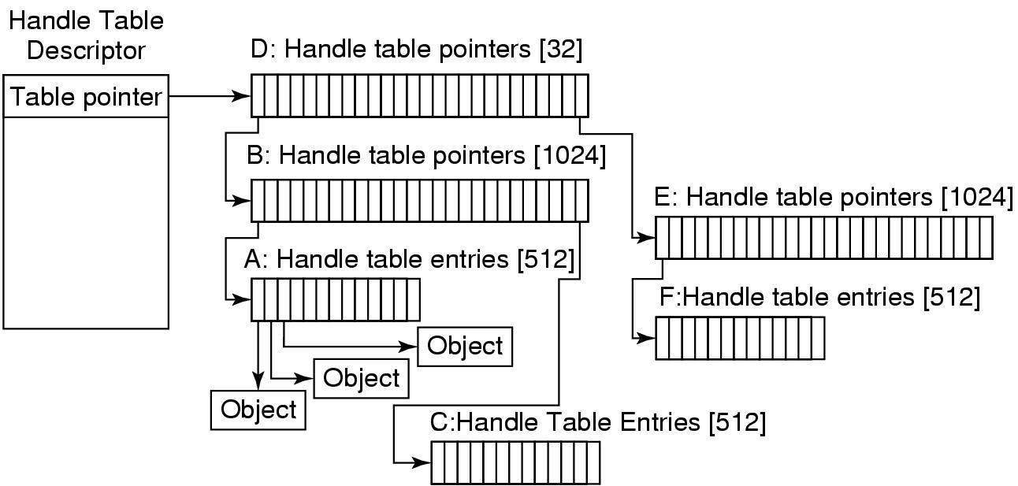
Handles (2)
Figure 11-19. Handle table data structures for a
maximal table of up to 16 million handles.
Tanenbaum, Modern Operating Systems 3 e, (c) 2008 Prentice-Hall, Inc. All rights reserved. 0-13-6006639

Slide 21
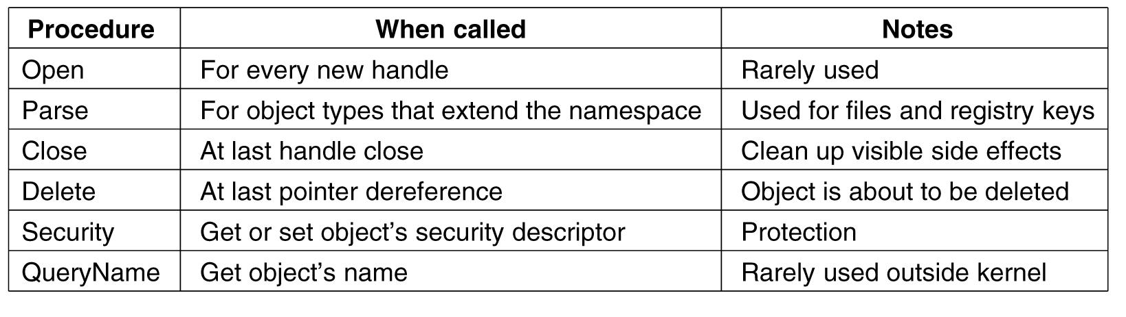
The Object Name Space (1)
Figure 11-20. The object procedures supplied
when specifying a new object type.
Tanenbaum, Modern Operating Systems 3 e, (c) 2008 Prentice-Hall, Inc. All rights reserved. 0-13-6006639

Slide 22
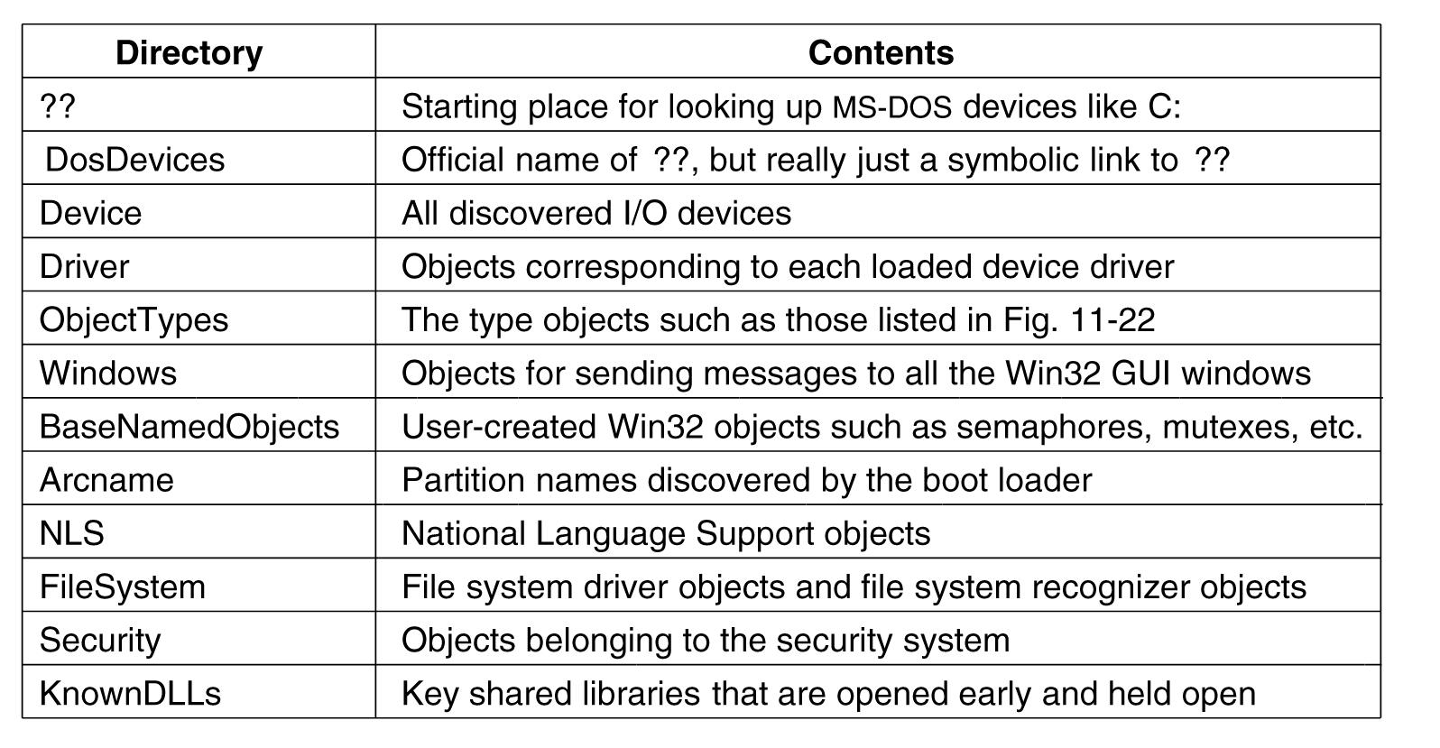
The Object Name Space (2)
Figure 11-21. Some typical directories in the object name space.
Tanenbaum, Modern Operating Systems 3 e, (c) 2008 Prentice-Hall, Inc. All rights reserved. 0-13-6006639

Slide 23
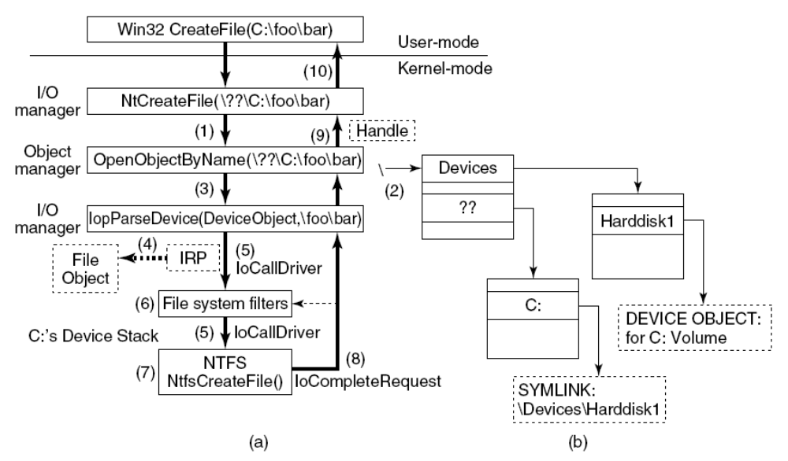
The Object Name Space (3)
Figure 11-22. I/O and object manager steps for
creating/opening a file and getting back a file handle.
Tanenbaum, Modern Operating Systems 3 e, (c) 2008 Prentice-Hall, Inc. All rights reserved. 0-13-6006639

Slide 24
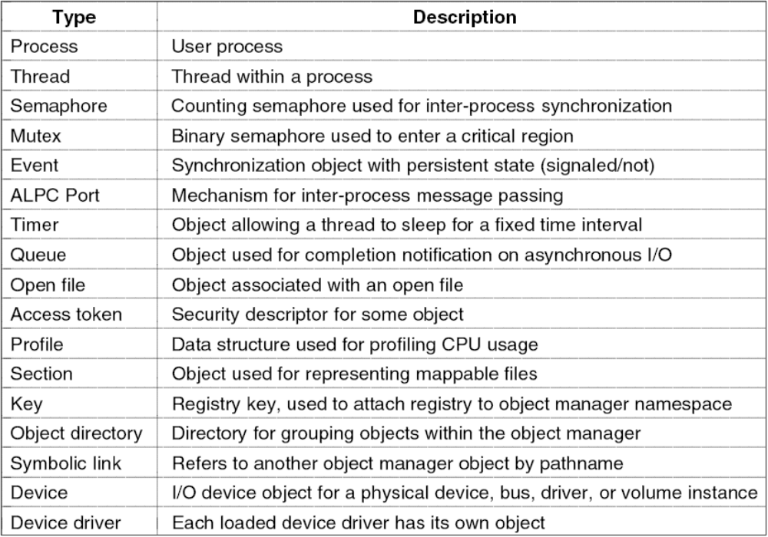
The Object Name Space (4)
Figure 11-23. Some common executive object types
managed by object manager.
Tanenbaum, Modern Operating Systems 3 e, (c) 2008 Prentice-Hall, Inc. All rights reserved. 0-13-6006639

Slide 25
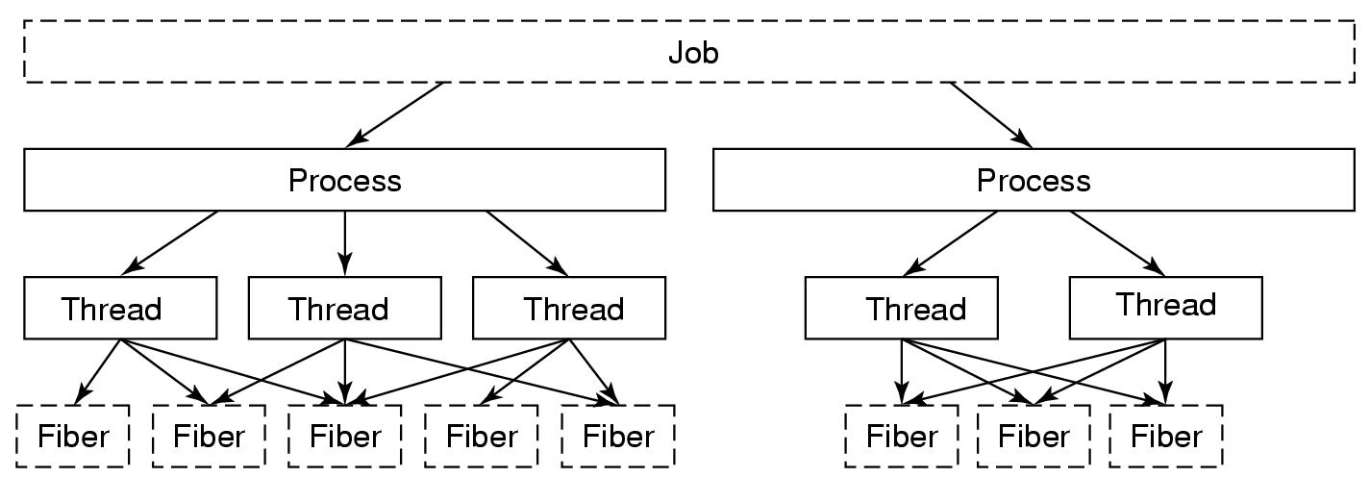
Processes and Threads in Windows Vista (1)
Figure 11-24. The relationship between jobs, processes, threads and fibers. Jobs and fibers are optional; not all processes are in jobs or contain fibers.
Tanenbaum, Modern Operating Systems 3 e, (c) 2008 Prentice-Hall, Inc. All rights reserved. 0-13-6006639

Slide 26
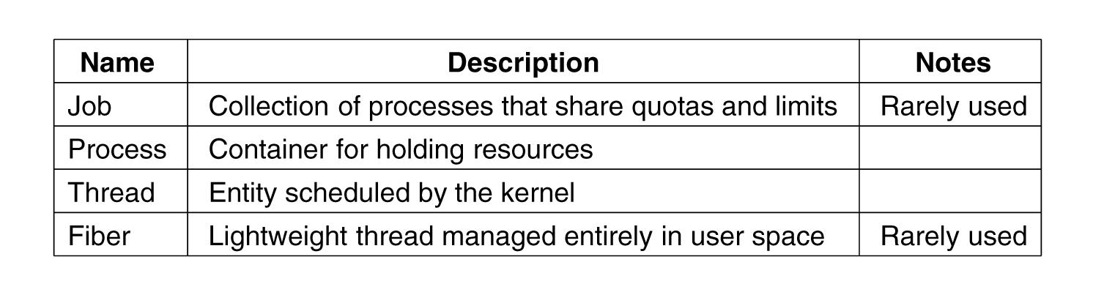
Processes and Threads in Windows Vista (2)
Figure 11-25. Basic concepts used for CPU
and resource management.
Tanenbaum, Modern Operating Systems 3 e, (c) 2008 Prentice-Hall, Inc. All rights reserved. 0-13-6006639

Slide 27
Job, Process, Thread, and Fiber Management API Calls (1)
Actual search path for finding program to execute buried in library code for Win32, but managed more explicitly in UNIX.
Current working directory is kernel-mode concept in UNIX but user-mode string in Windows.
UNIX parses command line and passes an array of parameters, Win32 leaves argument parsing up to individual program.
Whether file descriptors can be inherited in UNIX is property of handle. In Windows it is property of both handle and parameter to process creation.
Win32 is GUI-oriented, new processes directly passed information about their primary window
Tanenbaum, Modern Operating Systems 3 e, (c) 2008 Prentice-Hall, Inc. All rights reserved. 0-13-6006639

Slide 28
Job, Process, Thread, and Fiber Management API Calls (2)
Windows has no SETUID bit as property of executable, one process can create a process that runs as a different user, as long as it can obtain a token with that user’s credentials.
Process and thread handle returned from Windows can be used to modify the new process/thread in many substantive ways. UNIX just makes modifications to new process between fork and exec calls.
Tanenbaum, Modern Operating Systems 3 e, (c) 2008 Prentice-Hall, Inc. All rights reserved. 0-13-6006639

Slide 29
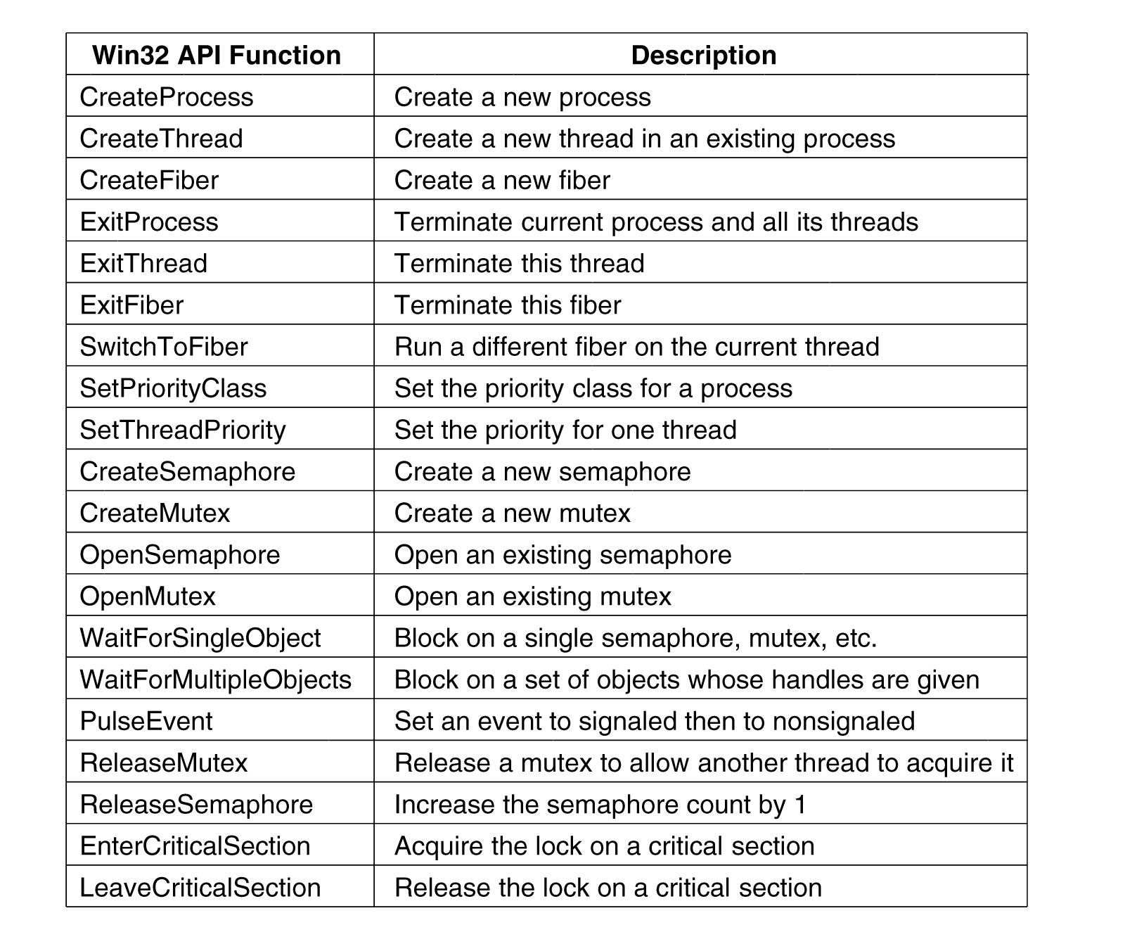
Synchronization
Figure 11-26. Some of the Win32 calls for
managing processes, threads, and fibers.
Tanenbaum, Modern Operating Systems 3 e, (c) 2008 Prentice-Hall, Inc. All rights reserved. 0-13-6006639

Slide 30
Scheduling (1)
The following conditions cause the currently running thread to execute the scheduler code:
The currently running thread blocks on a semaphore, mutex, event, I/O, etc.
The thread signals an object (e.g., does an up on a semaphore or causes an event to be signaled).
The quantum expires.
Tanenbaum, Modern Operating Systems 3 e, (c) 2008 Prentice-Hall, Inc. All rights reserved. 0-13-6006639

Slide 31
Scheduling (2)
The scheduler is also called under two other conditions:
An I/O operation completes.
A timed wait expires.
Tanenbaum, Modern Operating Systems 3 e, (c) 2008 Prentice-Hall, Inc. All rights reserved. 0-13-6006639

Slide 32
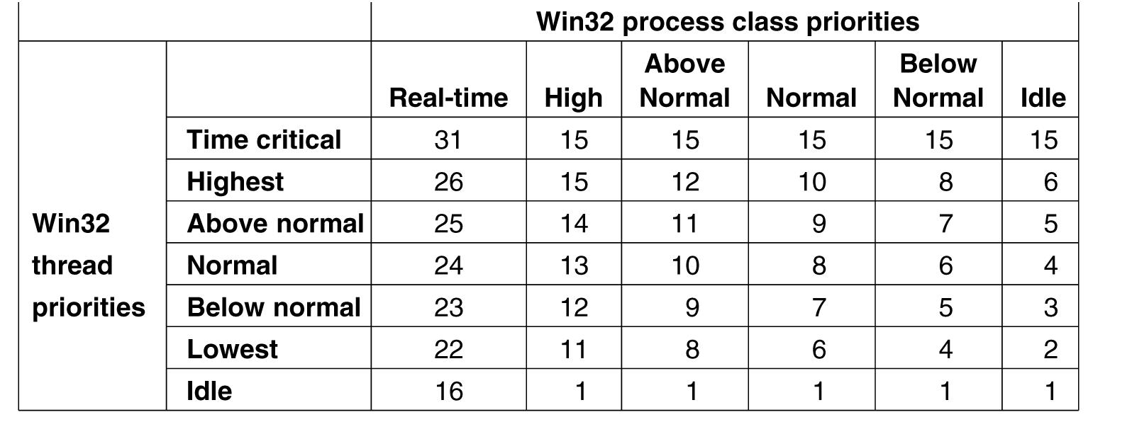
Scheduling (3)
Figure 11-27. Mapping of Win32 priorities to Windows priorities.
Tanenbaum, Modern Operating Systems 3 e, (c) 2008 Prentice-Hall, Inc. All rights reserved. 0-13-6006639

Slide 33
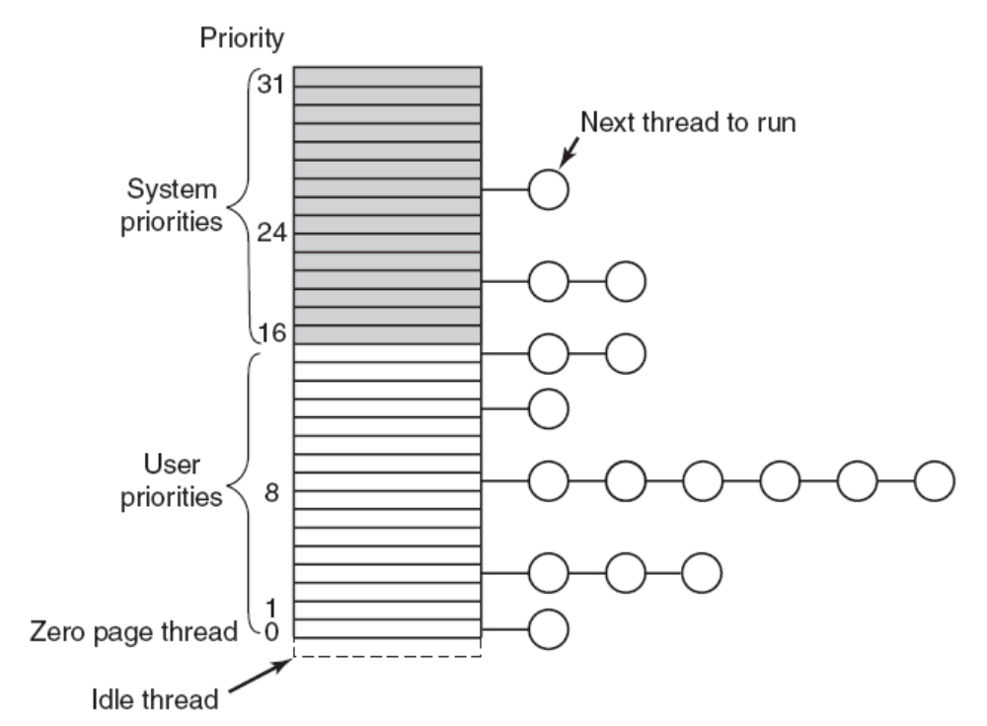
Scheduling (4)
Figure 11-28. Windows Vista supports 32 priorities for threads.
Tanenbaum, Modern Operating Systems 3 e, (c) 2008 Prentice-Hall, Inc. All rights reserved. 0-13-6006639

Slide 34
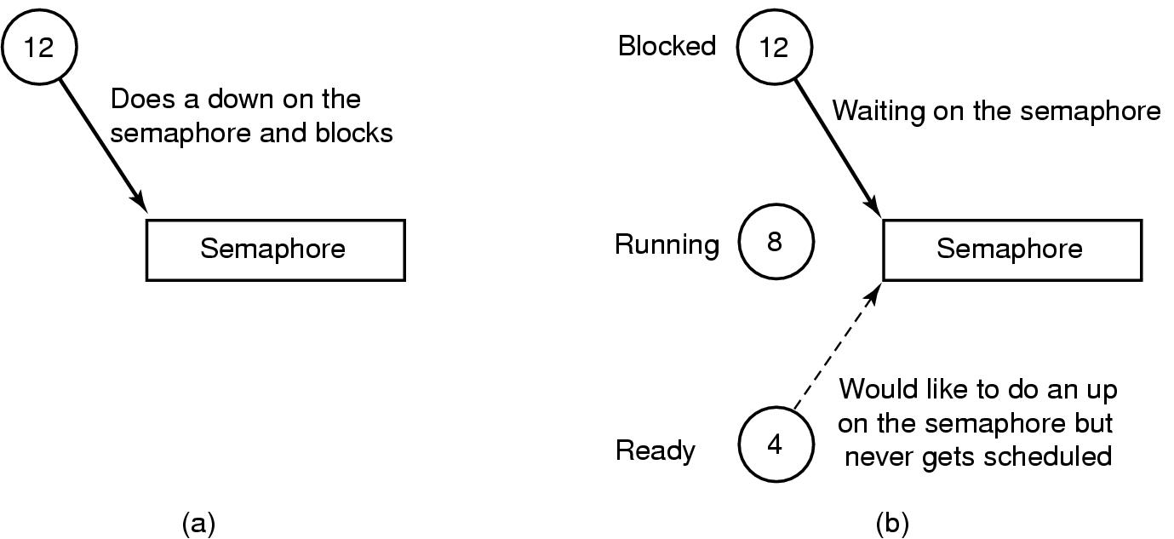
Scheduling (5)
Figure 11-29. An example of priority inversion.
Tanenbaum, Modern Operating Systems 3 e, (c) 2008 Prentice-Hall, Inc. All rights reserved. 0-13-6006639

Slide 35
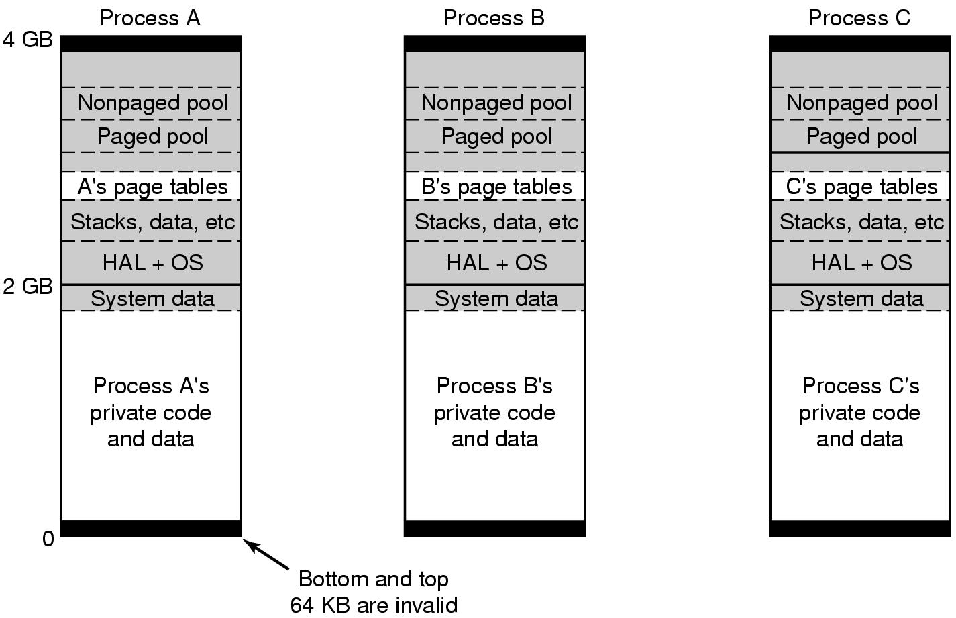
Memory Management(1)
Figure 11-30. Virtual address space layout for three user processes on the x86. The white areas are private per process. The shaded areas are shared among all processes.
Tanenbaum, Modern Operating Systems 3 e, (c) 2008 Prentice-Hall, Inc. All rights reserved. 0-13-6006639

Slide 36
Memory Management (2)
Figure 11-30. Virtual address space layout for three user processes on the x86. The white areas are private per process. The shaded areas are shared among all processes.
Tanenbaum, Modern Operating Systems 3 e, (c) 2008 Prentice-Hall, Inc. All rights reserved. 0-13-6006639

Slide 37
Memory Management (3)
Figure 11-30. Virtual address space layout for three user processes on the x86. The white areas are private per process. The shaded areas are shared among all processes.
Tanenbaum, Modern Operating Systems 3 e, (c) 2008 Prentice-Hall, Inc. All rights reserved. 0-13-6006639

Slide 38
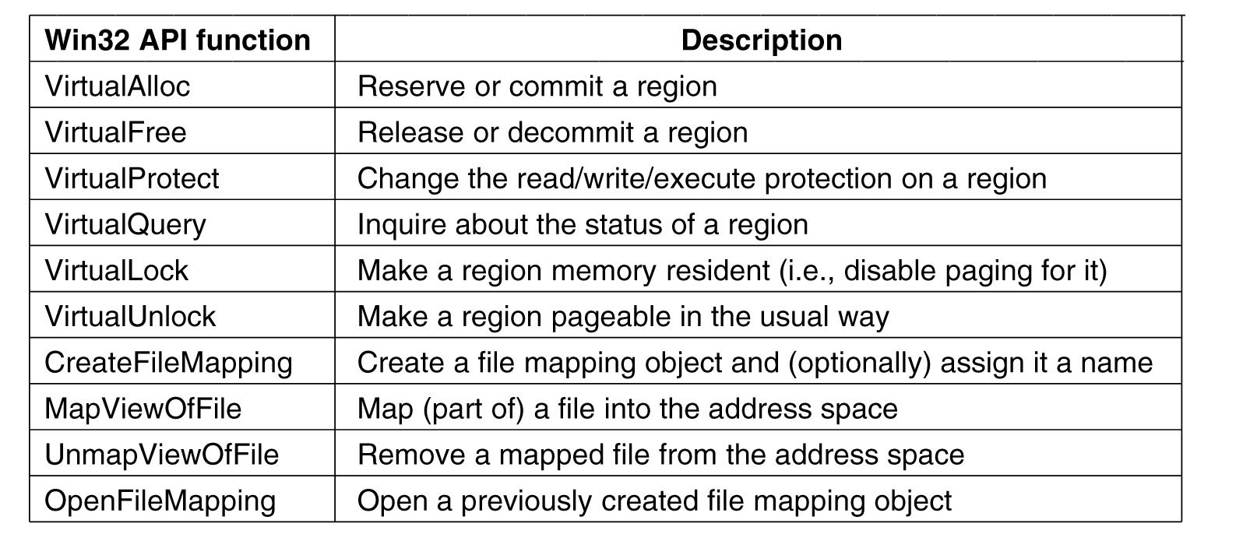
Addressing Large Physical Memories
Figure 11-31. The principal Win32 API functions
for managing virtual memory in Windows.
Tanenbaum, Modern Operating Systems 3 e, (c) 2008 Prentice-Hall, Inc. All rights reserved. 0-13-6006639

Slide 39
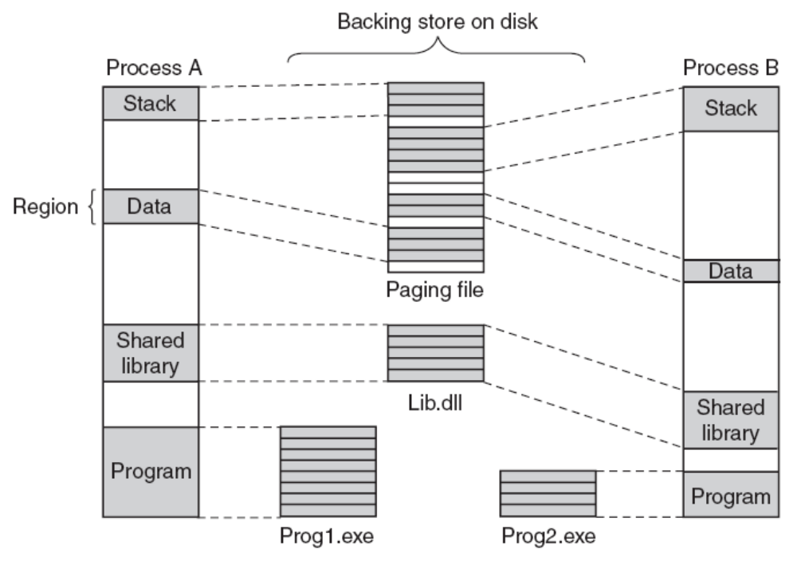
Implementation of Memory Management
Figure 11-32. Mapped regions with their shadow pages on disk. The lib.dll file mapped into two address spaces at same time.
Tanenbaum, Modern Operating Systems 3 e, (c) 2008 Prentice-Hall, Inc. All rights reserved. 0-13-6006639

Slide 40
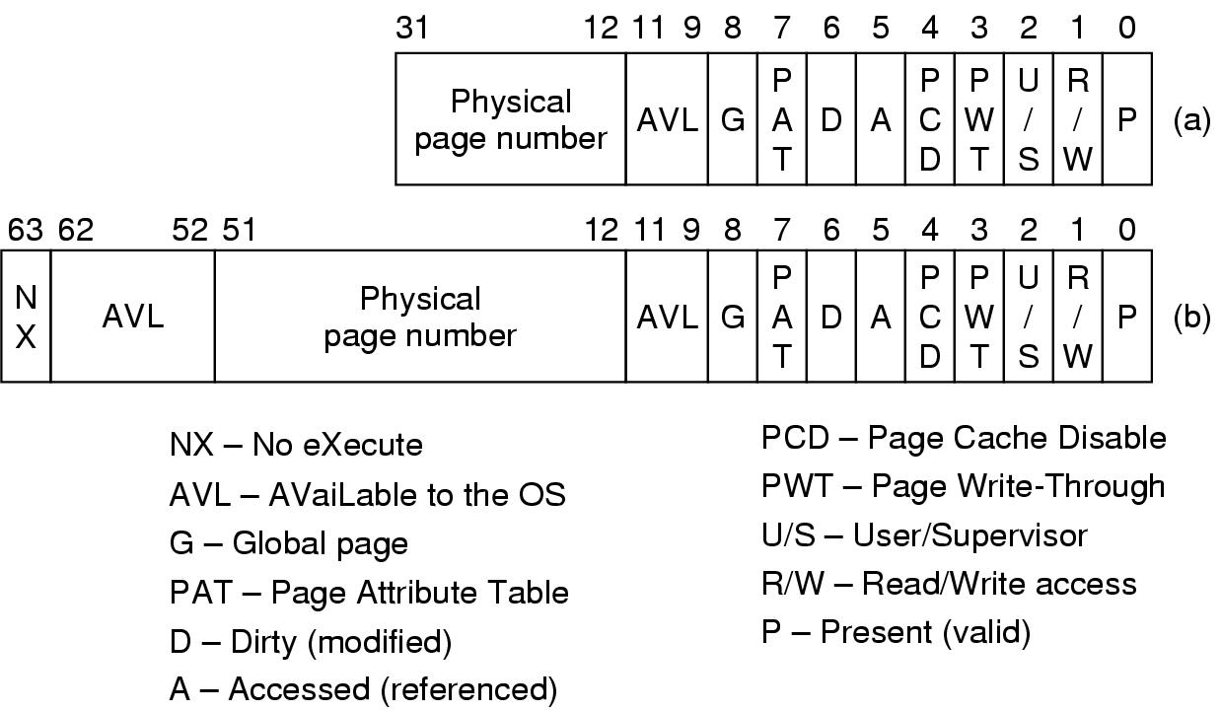
Page Fault Handling (1)
Figure 11-33. A page table entry (PTE) for a mapped page on the (a) Intel x86 and (b) AMD x64 architectures.
Tanenbaum, Modern Operating Systems 3 e, (c) 2008 Prentice-Hall, Inc. All rights reserved. 0-13-6006639

Slide 41
Page Fault Handling (2)
Each page fault can be considered as being in one of five categories:
The page referenced is not committed.
Attempted access to a page in violation of the permissions.
A shared copy-on-write page was about to be modified.
The stack needs to grow.
The page referenced is committed but not currently mapped in.
Tanenbaum, Modern Operating Systems 3 e, (c) 2008 Prentice-Hall, Inc. All rights reserved. 0-13-6006639

Slide 42
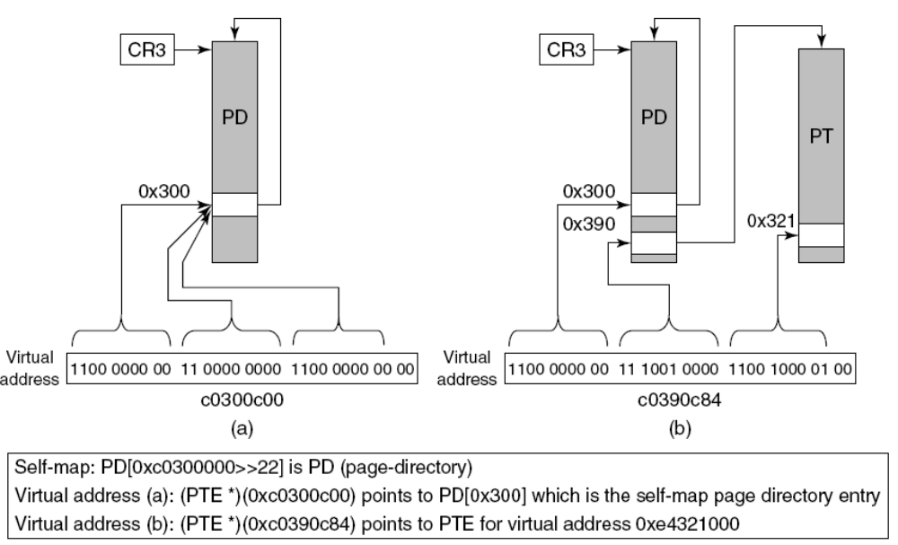
Page Fault Handling (3)
Figure 11-34. Windows self-map entry used to map the physical pages of page tables and page directory into kernel virtual addresses, for the x86.
Tanenbaum, Modern Operating Systems 3 e, (c) 2008 Prentice-Hall, Inc. All rights reserved. 0-13-6006639

Slide 43
The Page Replacement Algorithm
Three levels of activity by the working-set manager
  Periodic based on a timer
New activity is added at each level:
Lots of memory available
Memory getting tight
Memory is tight
Tanenbaum, Modern Operating Systems 3 e, (c) 2008 Prentice-Hall, Inc. All rights reserved. 0-13-6006639

Slide 44
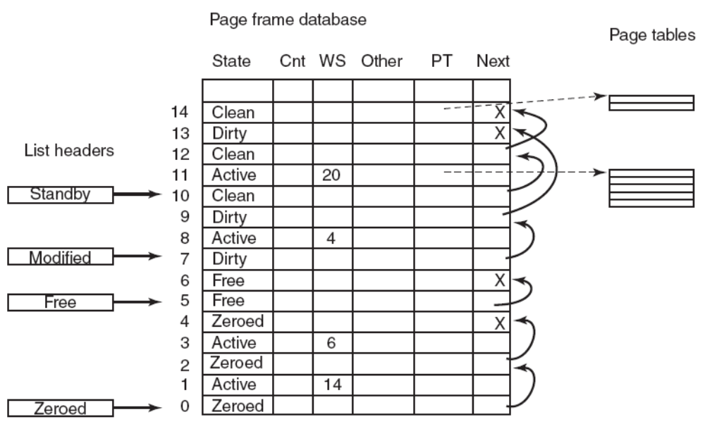
Physical Memory Management (1)
Figure 11-35. Some of the major fields in the
page frame database for a valid page.
Tanenbaum, Modern Operating Systems 3 e, (c) 2008 Prentice-Hall, Inc. All rights reserved. 0-13-6006639

Slide 45
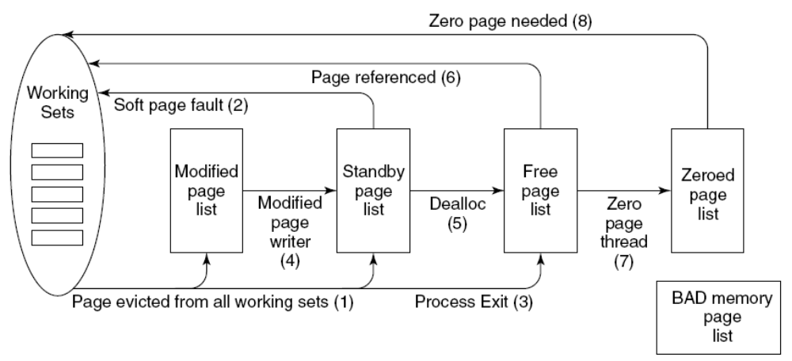
Physical Memory Management (2)
Figure 11-36. The various page lists and the
transitions between them.
Tanenbaum, Modern Operating Systems 3 e, (c) 2008 Prentice-Hall, Inc. All rights reserved. 0-13-6006639

Slide 46
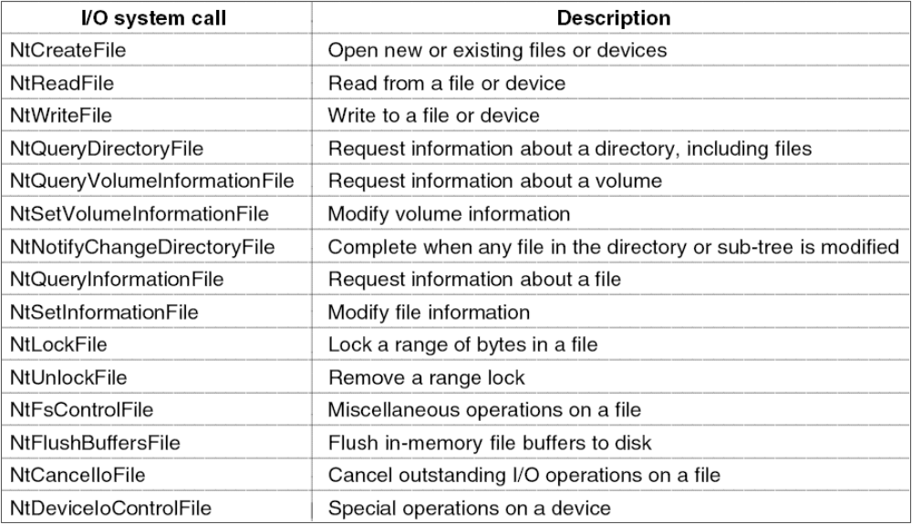
Input/Output API Calls
Figure 11-37. Native NT API calls for performing I/O.
Tanenbaum, Modern Operating Systems 3 e, (c) 2008 Prentice-Hall, Inc. All rights reserved. 0-13-6006639

Slide 47
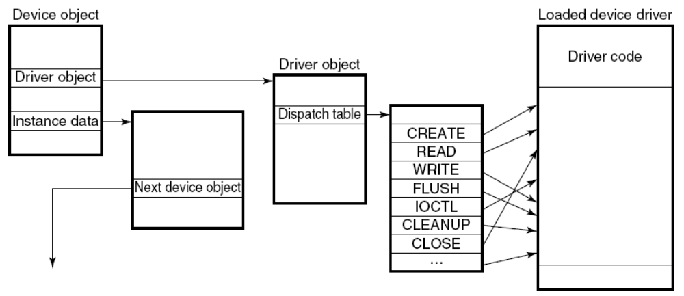
Device Drivers
Figure 11-38. A single level in a device stack.
Tanenbaum, Modern Operating Systems 3 e, (c) 2008 Prentice-Hall, Inc. All rights reserved. 0-13-6006639

Slide 48
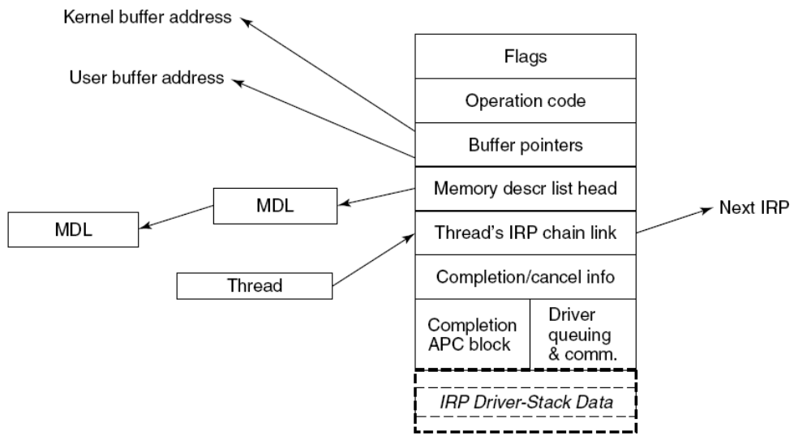
I/O Request Packets
Figure 11-39. The major fields of an I/O Request Packet.
Tanenbaum, Modern Operating Systems 3 e, (c) 2008 Prentice-Hall, Inc. All rights reserved. 0-13-6006639

Slide 49
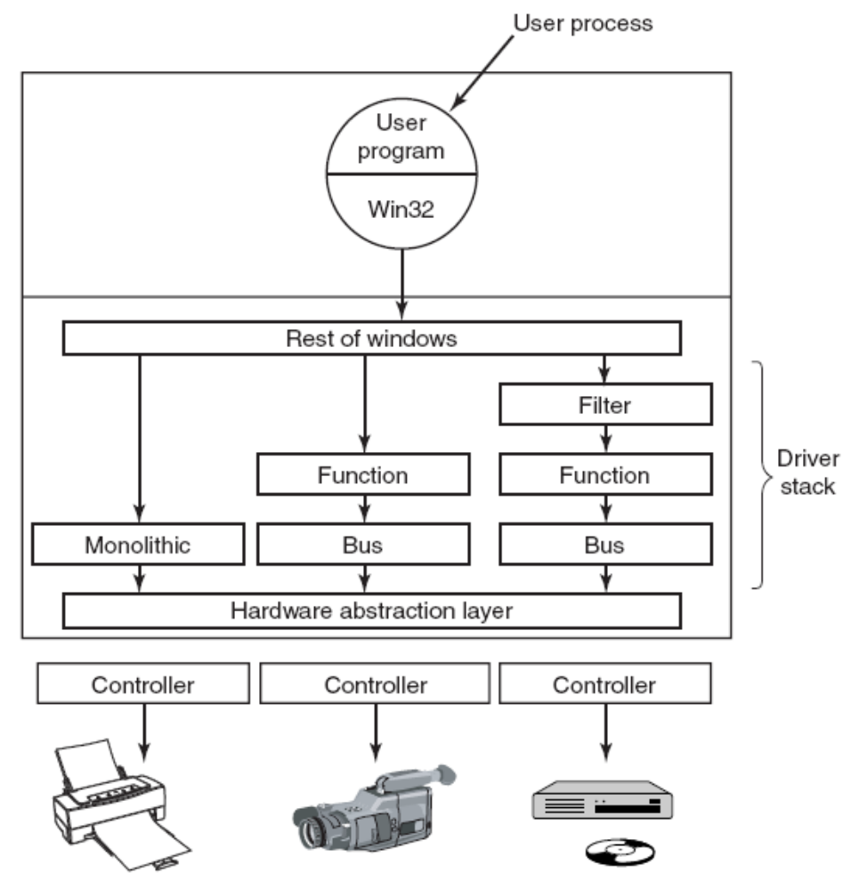
Device Stacks
Figure 11-40. Windows allows drivers to be stacked to work with a specific instance of a device. The stacking is represented by device objects.
Tanenbaum, Modern Operating Systems 3 e, (c) 2008 Prentice-Hall, Inc. All rights reserved. 0-13-6006639

Slide 50
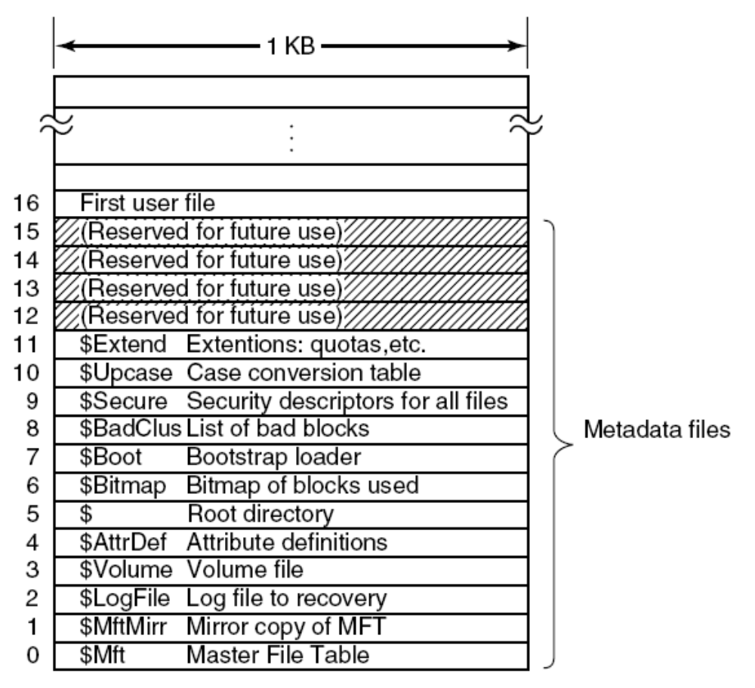
File System Structure (1)
Figure 11-41. The NTFS master file table.
Tanenbaum, Modern Operating Systems 3 e, (c) 2008 Prentice-Hall, Inc. All rights reserved. 0-13-6006639

Slide 51
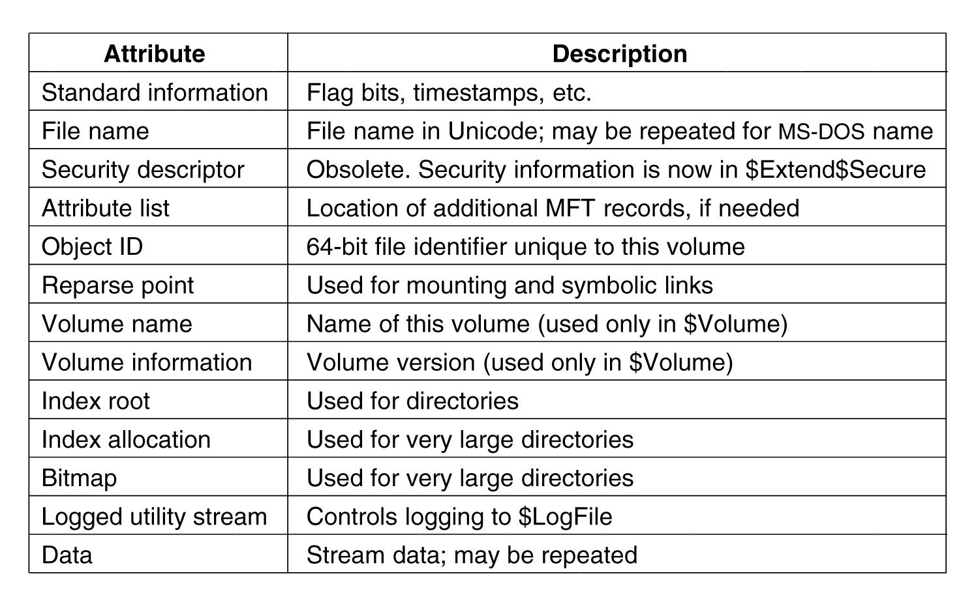
File System Structure (2)
Figure 11-42. The attributes used in MFT records.
Tanenbaum, Modern Operating Systems 3 e, (c) 2008 Prentice-Hall, Inc. All rights reserved. 0-13-6006639

Slide 52
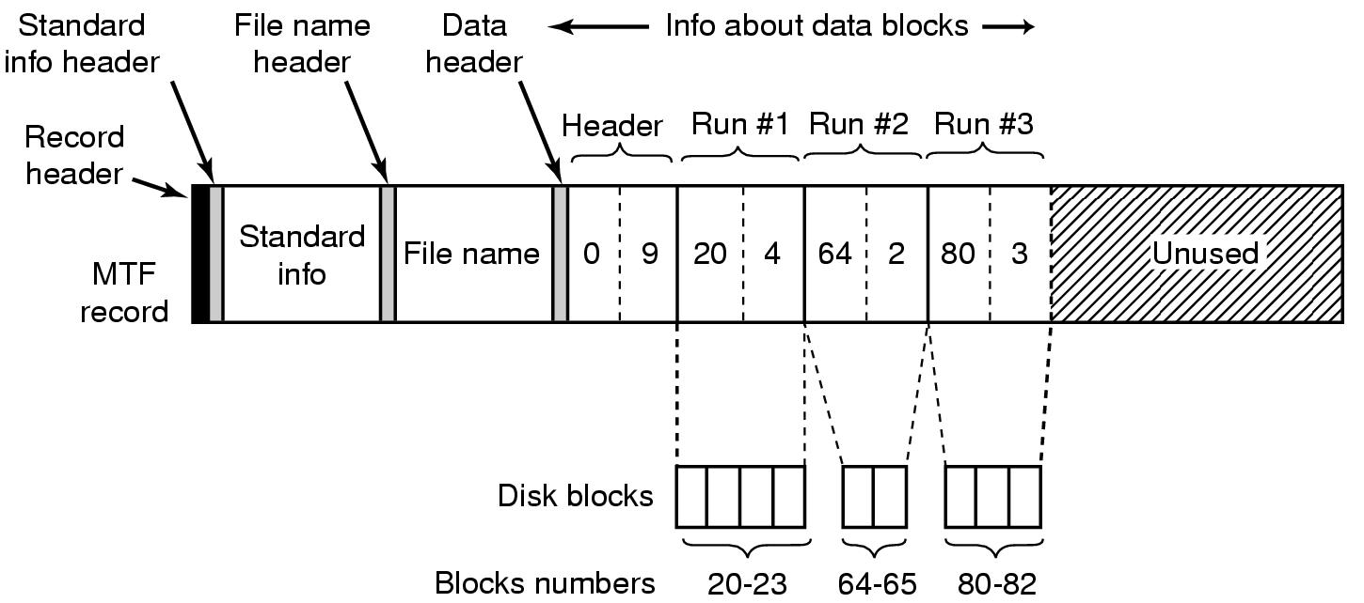
Storage Allocation (1)
Figure 11-43. An MFT record for a three-run, nine-block stream.
Tanenbaum, Modern Operating Systems 3 e, (c) 2008 Prentice-Hall, Inc. All rights reserved. 0-13-6006639

Slide 53
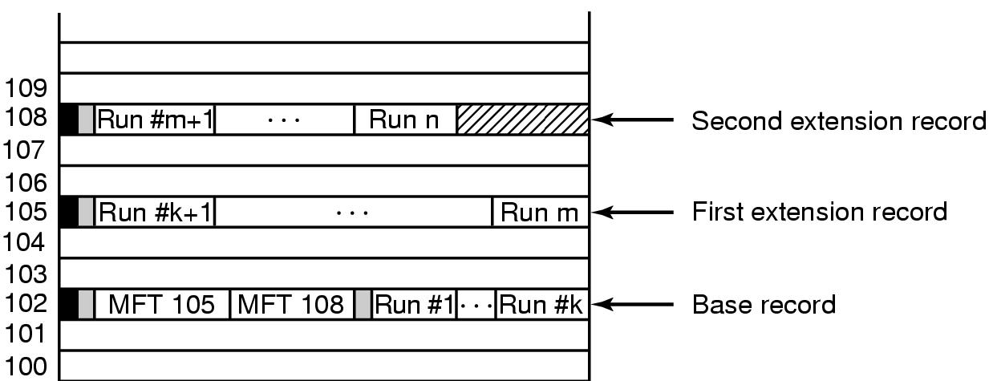
Storage Allocation (2)
Figure 11-44. A file that requires three MFT
records to store all its runs.
Tanenbaum, Modern Operating Systems 3 e, (c) 2008 Prentice-Hall, Inc. All rights reserved. 0-13-6006639

Slide 54
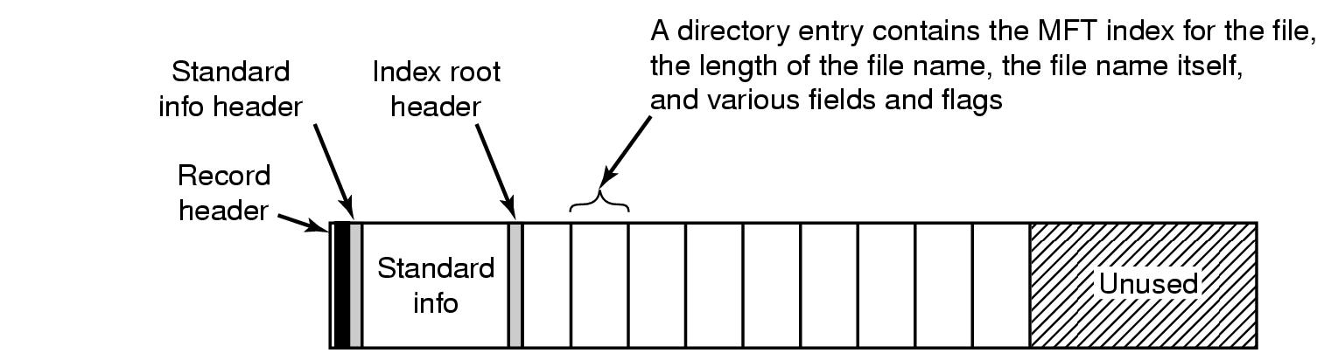
Storage Allocation (3)
Figure 11-45. The MFT record for a small directory.
Tanenbaum, Modern Operating Systems 3 e, (c) 2008 Prentice-Hall, Inc. All rights reserved. 0-13-6006639

Slide 55
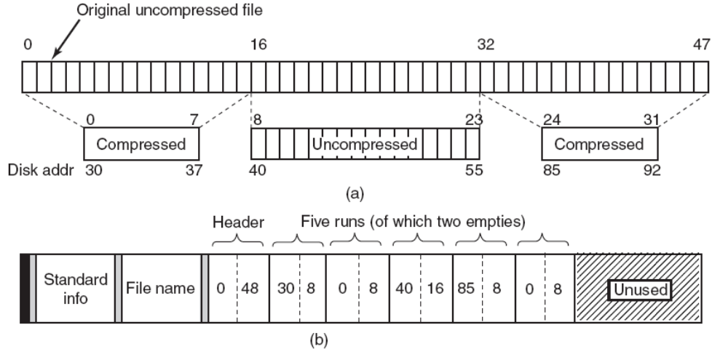
File Compression
Figure 11-46. (a) An example of a 48-block file being
compressed to 32 blocks. (b) The MFT
record for the file after compression.
Tanenbaum, Modern Operating Systems 3 e, (c) 2008 Prentice-Hall, Inc. All rights reserved. 0-13-6006639

Slide 56
Security in Windows Vista (1)
Security properties inherited from the original security design of NT:
Secure login with anti-spoofing measures.
Discretionary access controls.
Privileged access controls.
Address space protection per process.
New pages must be zeroed before being mapped in.
Security auditing.
Tanenbaum, Modern Operating Systems 3 e, (c) 2008 Prentice-Hall, Inc. All rights reserved. 0-13-6006639

Slide 57
Security in Windows Vista (2)
Figure 11-47. Structure of an access token.
Tanenbaum, Modern Operating Systems 3 e, (c) 2008 Prentice-Hall, Inc. All rights reserved. 0-13-6006639

Slide 58
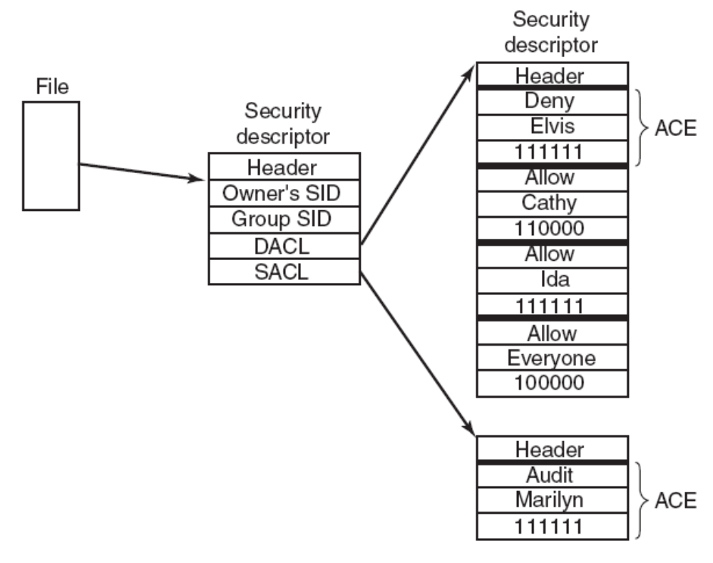
Security in Windows Vista (3)
Figure 11-48. An example security descriptor for a file.
Tanenbaum, Modern Operating Systems 3 e, (c) 2008 Prentice-Hall, Inc. All rights reserved. 0-13-6006639

Slide 59
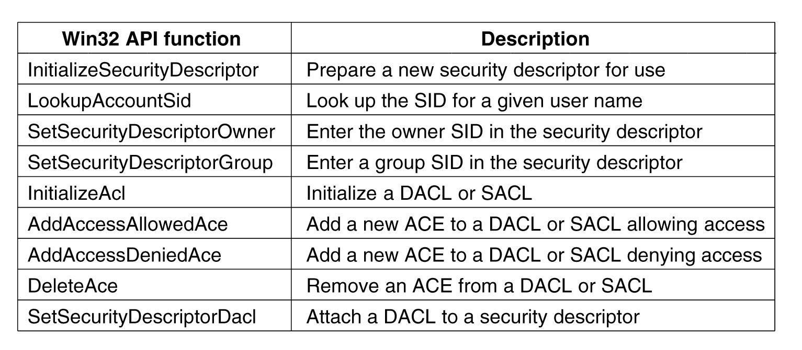
Security API Calls
Figure 11-49. The principal Win32 API functions for security.
Tanenbaum, Modern Operating Systems 3 e, (c) 2008 Prentice-Hall, Inc. All rights reserved. 0-13-6006639

