Slide 1
MODERN OPERATING SYSTEMS
Third Edition
ANDREW S. TANENBAUM
Chapter 13
Operating System Design
Tanenbaum, Modern Operating Systems 3 e, (c) 2008 Prentice-Hall, Inc. All rights reserved. 0-13-6006639

Slide 2
Operating System Goals
Define abstractions.
Provide primitive operations.
Ensure isolation.
Manage the hardware.
Tanenbaum, Modern Operating Systems 3 e, (c) 2008 Prentice-Hall, Inc. All rights reserved. 0-13-6006639

Slide 3
Difficulties Designing Operating Systems (1)
Operating systems have become extremely large programs
Must deal with concurrency
Have to deal with potentially hostile users
Many users want to share some of their information and resources with selected other users
Tanenbaum, Modern Operating Systems 3 e, (c) 2008 Prentice-Hall, Inc. All rights reserved. 0-13-6006639

Slide 4
Difficulties Designing Operating Systems (2)
Operating systems live for a very long time
Designers need to provide for considerable generality
Systems are generally designed to be portable
Operating systems need to be backward compatible with some previous operating system
Tanenbaum, Modern Operating Systems 3 e, (c) 2008 Prentice-Hall, Inc. All rights reserved. 0-13-6006639

Slide 5
Guiding Principles for Interface Design
Simplicity
Perfection is reached not when there is no longer anything to add, but when there is no longer anything to take away. (Antoine de St. Exupery)
Completeness
Everything should be as simple as possible, but no simpler. (Albert Einstein)
Efficiency
If a feature or system call cannot be implemented efficiently, it is probably not worth having (Tanenbaum)
Tanenbaum, Modern Operating Systems 3 e, (c) 2008 Prentice-Hall, Inc. All rights reserved. 0-13-6006639

Slide 6
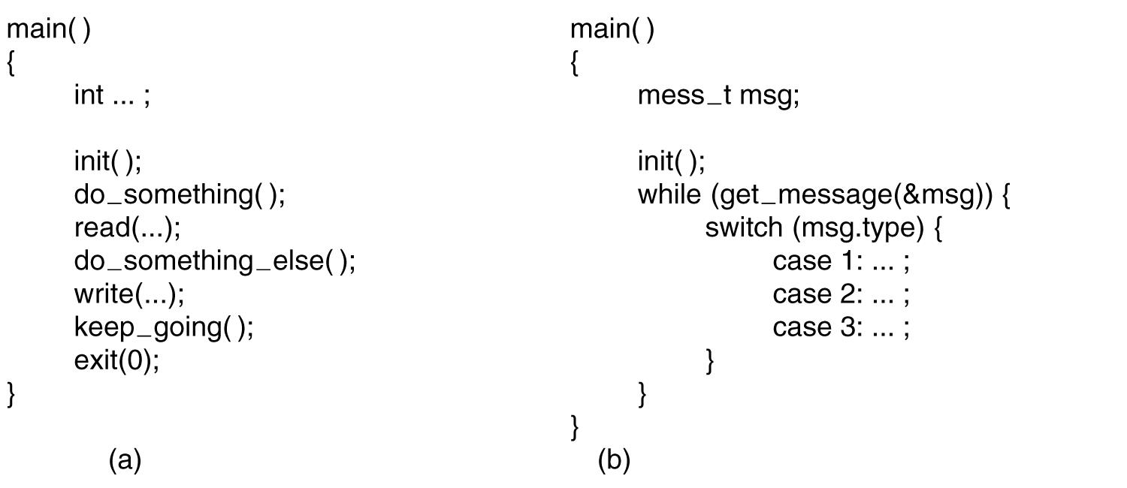
Execution Paradigms
Figure 13-1. (a) Algorithmic code. (b) Event-driven code.
Tanenbaum, Modern Operating Systems 3 e, (c) 2008 Prentice-Hall, Inc. All rights reserved. 0-13-6006639

Slide 7
System Structure
Layered Systems
Exokernels
Microkernel-Based Client-Server Systems
Extensible Systems
Kernel Threads
Tanenbaum, Modern Operating Systems 3 e, (c) 2008 Prentice-Hall, Inc. All rights reserved. 0-13-6006639

Slide 8
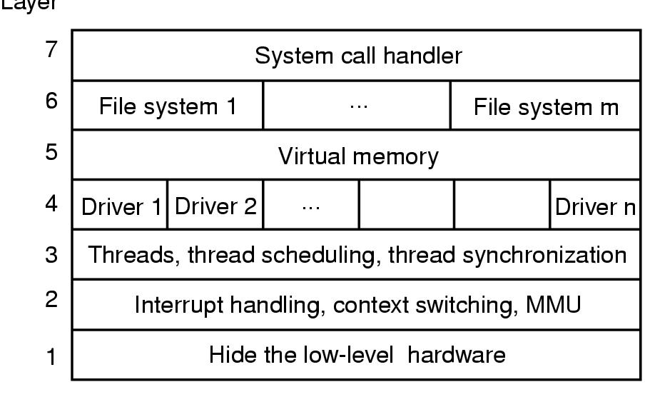
Layered Systems
Figure 13-2. One possible design for a
modern layered operating system.
Tanenbaum, Modern Operating Systems 3 e, (c) 2008 Prentice-Hall, Inc. All rights reserved. 0-13-6006639

Slide 9
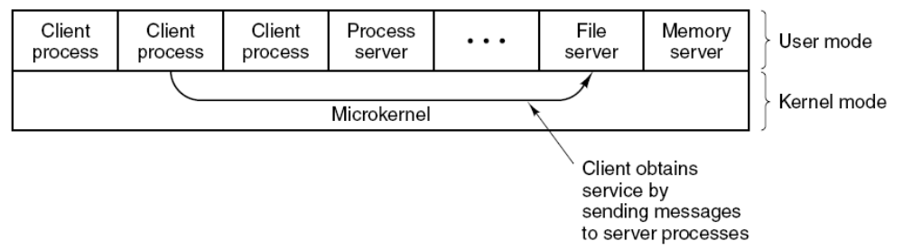
Microkernel-Based Client-Server Systems
Figure 13-3. Client-server computing based on a microkernel.
Tanenbaum, Modern Operating Systems 3 e, (c) 2008 Prentice-Hall, Inc. All rights reserved. 0-13-6006639

Slide 10
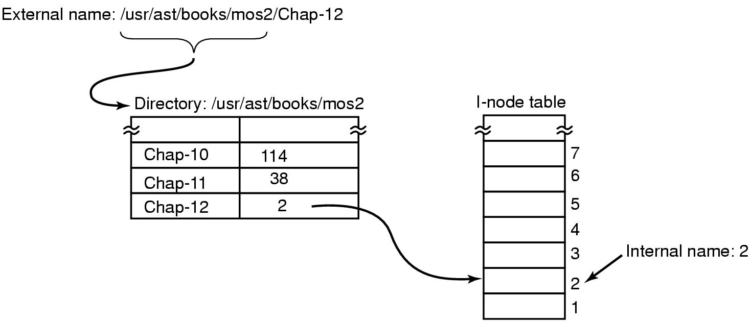
Naming
Figure 13-4. Directories are used to map
external names onto internal names.
Tanenbaum, Modern Operating Systems 3 e, (c) 2008 Prentice-Hall, Inc. All rights reserved. 0-13-6006639

Slide 11
Binding Time
Early binding
  Simple
  but less flexible
Late binding
  More complicated
  but more flexible
Tanenbaum, Modern Operating Systems 3 e, (c) 2008 Prentice-Hall, Inc. All rights reserved. 0-13-6006639

Slide 12
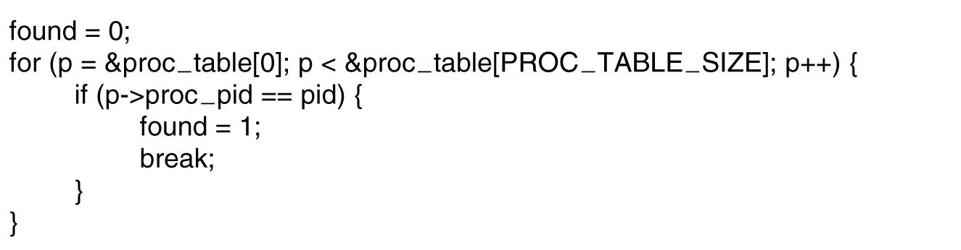
Static versus Dynamic Structures
Figure 13-5. Code for searching the process table for a given PID.
Tanenbaum, Modern Operating Systems 3 e, (c) 2008 Prentice-Hall, Inc. All rights reserved. 0-13-6006639

Slide 13
Useful Techniques
Hiding the Hardware
Indirection
Reusability
Reentrancy
Brute Force
Check for Errors First
Tanenbaum, Modern Operating Systems 3 e, (c) 2008 Prentice-Hall, Inc. All rights reserved. 0-13-6006639

Slide 14
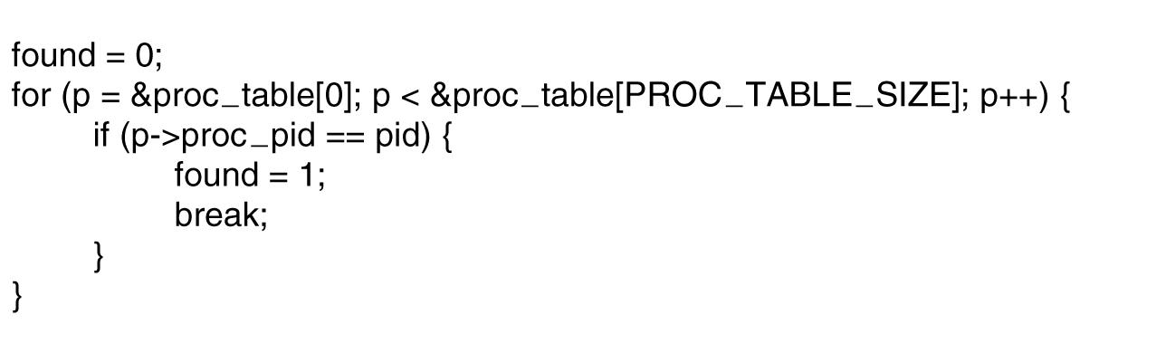
Hiding the Hardware (1)
Figure 13-6. (a) CPU-dependent conditional compilation. (
Tanenbaum, Modern Operating Systems 3 e, (c) 2008 Prentice-Hall, Inc. All rights reserved. 0-13-6006639

Slide 15
Hiding the Hardware (2)
#include “config.h”
init( )
#if (CPU = PENTIUM)
…
#endif
#if (CPU = SPARC)
…
#endif
#include “config.h”
#if (WORD_LENGTH == 32)
typedef int register
#endif
#if (WORD_LENGTH == 64)
typedef long register
#endif
Figure 13-6. (b) Word-length dependent
conditional compilation.
Tanenbaum, Modern Operating Systems 3 e, (c) 2008 Prentice-Hall, Inc. All rights reserved. 0-13-6006639

Slide 16
Performance
Why Are Operating Systems Slow?
What Should Be Optimized?
Space-Time Trade-offs
Caching
Hints
Exploiting Locality
Optimize the Common Case
Tanenbaum, Modern Operating Systems 3 e, (c) 2008 Prentice-Hall, Inc. All rights reserved. 0-13-6006639

Slide 17
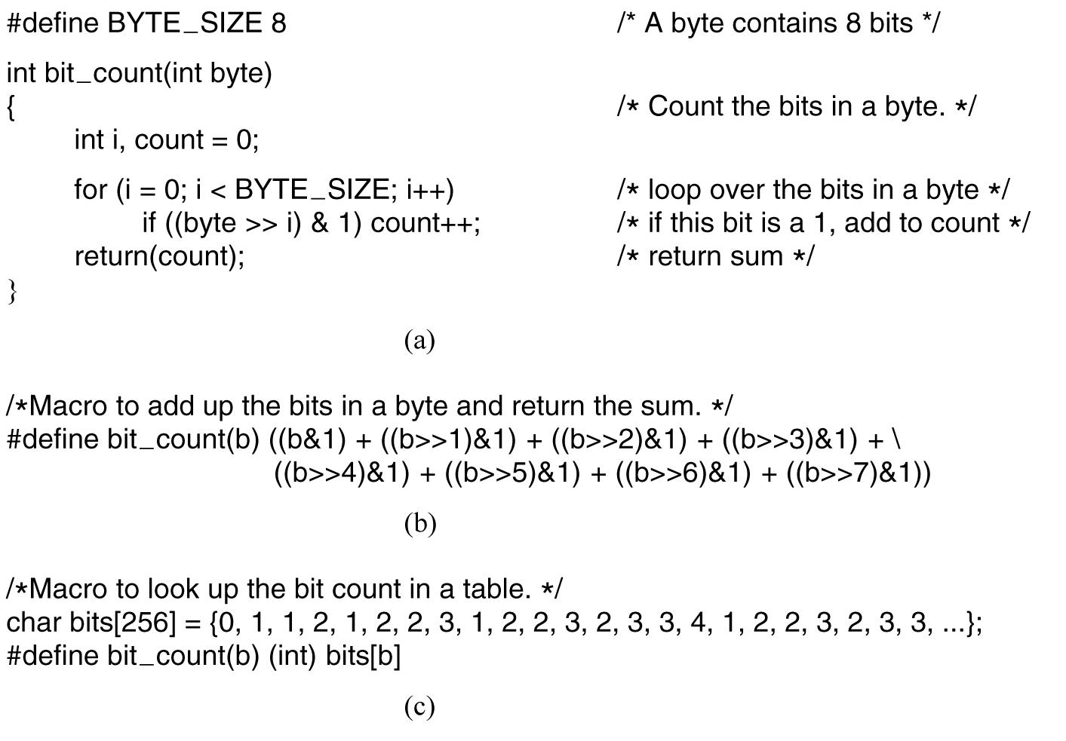
Space-Time Trade-offs (1)
Figure 13-7. (a) A procedure for counting bits in a byte.
(b) A macro to count the bits. (c) Table look up
Tanenbaum, Modern Operating Systems 3 e, (c) 2008 Prentice-Hall, Inc. All rights reserved. 0-13-6006639

Slide 18
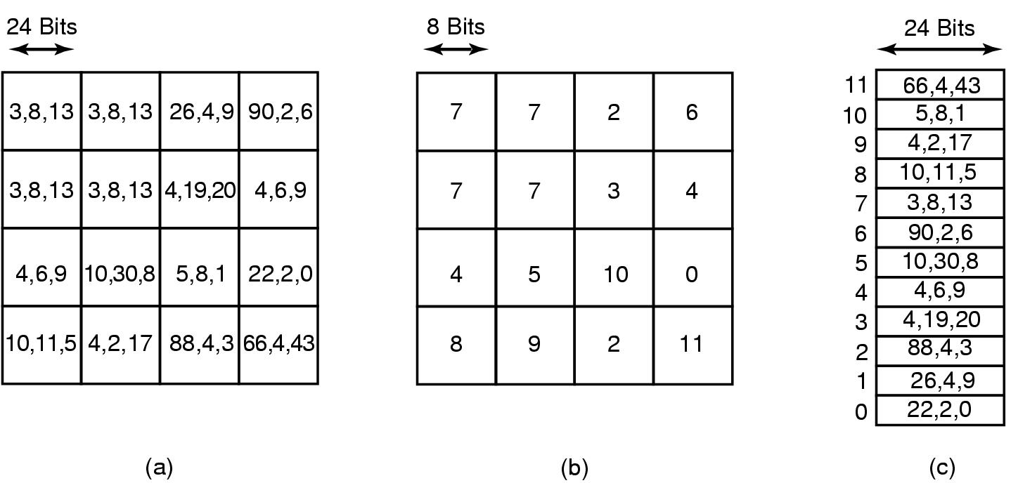
Space-Time Trade-offs (2)
Figure 13-8. (a) Part of an uncompressed
image with 24 bits per pixel. (b) With a palette
Tanenbaum, Modern Operating Systems 3 e, (c) 2008 Prentice-Hall, Inc. All rights reserved. 0-13-6006639

Slide 19
Caching (1)
To look up /usr/ast/mbox (Fig. 4-35) requires the following disk accesses:
Read the i-node for the root
directory (i-node 1).
Read the root directory (block 1).
Read the i-node for /usr (i-node 6).
Read the /usr directory (block 132).
Read the i-node for /usr/ast (i-node 26).
Read the /usr/ast directory (block 406).
Tanenbaum, Modern Operating Systems 3 e, (c) 2008 Prentice-Hall, Inc. All rights reserved. 0-13-6006639

Slide 20
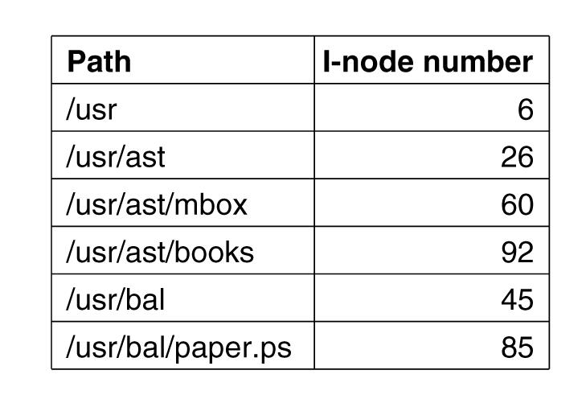
Caching (2)
Figure 13-9. Part of the i-node cache for Fig. 4-35.
Tanenbaum, Modern Operating Systems 3 e, (c) 2008 Prentice-Hall, Inc. All rights reserved. 0-13-6006639

Slide 21
Project Management
The Mythical Man Month
Large project design
  1/3 Planning
  1/6 Coding
  1/4 Module testing
  1/4 System testing
People and time not interchangeable
  Work cannot be fully parallelized
  Work must be partitioned into large numbers of modules
  Debugging is highly sequential
Tanenbaum, Modern Operating Systems 3 e, (c) 2008 Prentice-Hall, Inc. All rights reserved. 0-13-6006639

Slide 22
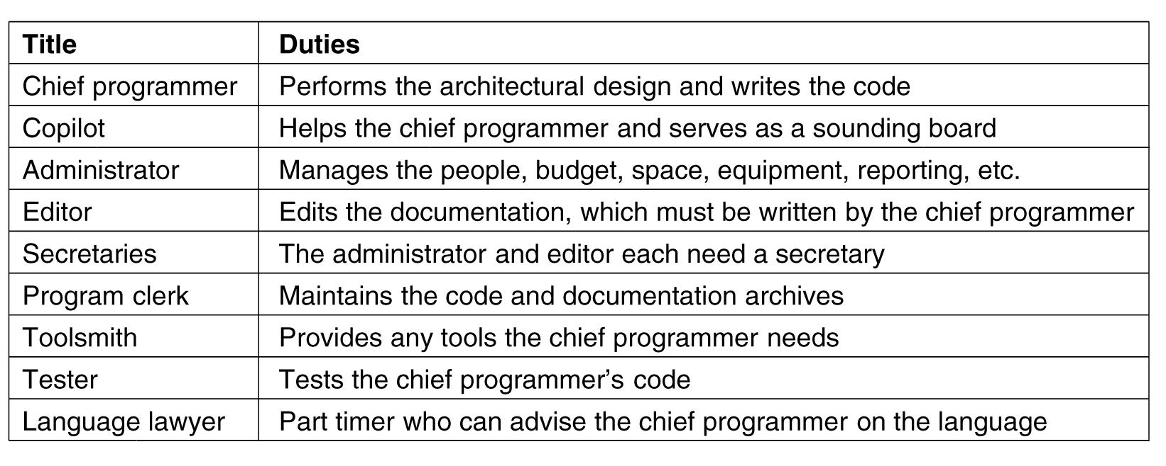
Team Structure
Figure 13-10. Mills’ proposal for populating a
10-person chief programmer team.
Tanenbaum, Modern Operating Systems 3 e, (c) 2008 Prentice-Hall, Inc. All rights reserved. 0-13-6006639

Slide 23
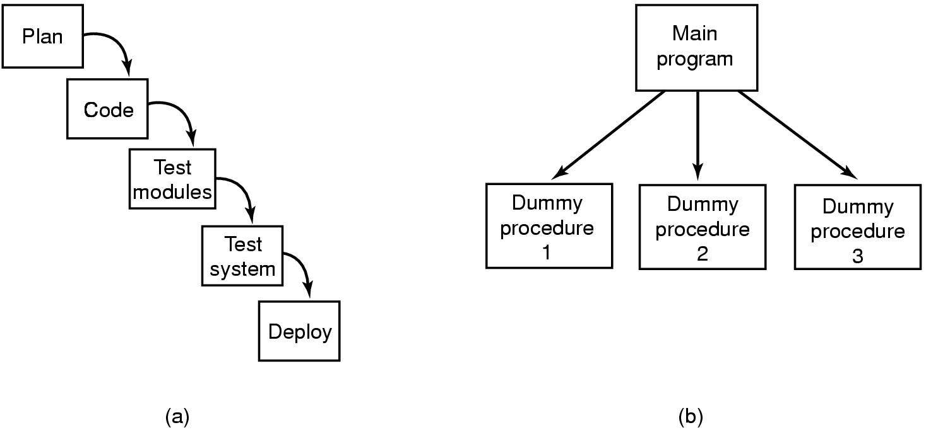
The Role of Experience
Figure 13-11. (a) Traditional software design progresses in stages. (b) Alternative design produces a working system (that does nothing) starting on day 1.
Tanenbaum, Modern Operating Systems 3 e, (c) 2008 Prentice-Hall, Inc. All rights reserved. 0-13-6006639

Slide 24
Trends in Operating Systems
Virtualization
Multicore Chips
Large Address Space Operating Systems
Networking
Parallel and Distributed Systems
Multimedia
Battery-Powered Computers
Embedded Systems
Sensor Nodes
Tanenbaum, Modern Operating Systems 3 e, (c) 2008 Prentice-Hall, Inc. All rights reserved. 0-13-6006639

Slide 25
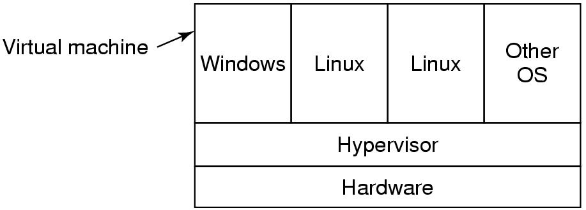
Virtualization
Figure 13-12. A hypervisor running four virtual machines.
Tanenbaum, Modern Operating Systems 3 e, (c) 2008 Prentice-Hall, Inc. All rights reserved. 0-13-6006639

