Slide 1
Decision-Focused Volatility Timing
Do better volatility forecasts make volatility-managed portfolios better?
Progress report | 6 October 2026
Ayush Roy, Farres, Robin | Introduction to Financial Engineering, Hanyang University
Notes:
Good afternoon. Today I will show where our project stands. Our main pipeline is finished and the protocol is frozen, so I will go through our main results, what we can and cannot claim, and what we plan before the final submission. Every number I show is net of trading costs and computed in real time.

Slide 2
Three findings so far
1
2
3
The risk side works, the return side leaks
The gain is a pre-2016 result
Little survives multiple testing
Timing always improves variance timing (VT about 1.25), but better forecasts lower mean timing: MT falls from 1.01 (realised variance) to 0.90 (VIX²).
Same rule on US, JKP (7 regions) and Ken French (3 regions) data: positive in 1998-2015, about zero or negative in 2016-2025.
296 timing comparisons, 41 nominally significant (15 expected by luck), 1 survives Romano-Wolf: vol-managed momentum.
So what for decision-focused learning: a decision loss can only beat an accuracy loss where the expected return moves. We have located where it moves (recovery months).
Notes:
These are our three findings so far. Our question was whether better volatility forecasts, or decision-focused training, give better portfolios. What we find is that the forecasting side does its job: risk goes down. But the Sharpe ratio also depends on returns, and volatility forecasts cut exposure exactly in the months when returns are high. The gains we do see were there before 2016 and mostly disappear after. And once we correct for the number of tests we ran, only volatility-managed momentum survives.

Slide 3
One frozen protocol, all in real time
1
2
3
4
Forecast
Exposure
Trade
Test
GARCH(1,1) on daily returns, refit every January on an expanding window. Monthly variance = sum of 21 daily forecasts.
w = c / v̂. Each January c is re-set on past months so the timed series matches buy-and-hold volatility. Cap 1.5.
Monthly rebalancing. 10 bp per unit of exposure change, measured after the portfolio drifts.
Sharpe gain with a 12-month block bootstrap (5,000 draws), Cederburg real-time combination, Holm / BH / Romano-Wolf.
Data. Ken French US: 6 factors + 10 industries, 1963-2025. JKP Global Factor Data: 8 regions. Ken French regional factors: 6 regions.
Samples. Main 1998-2025; splits 1998-2015, 2016-2025, 2021-2025. Everything before a date uses only data before that date.
Frozen. Costs, c rule, cap, periods and tests were fixed in SPEC.md before the final run; two robustness specs (old, uncapped).
Notes:
This is how we test everything. We forecast variance with a GARCH model that is refit every January using only past data. Exposure is c divided by the forecast. c only sets the scale: it does not change the Sharpe ratio by itself, but with a leverage cap and costs the level matters, so every January we set c so that the timed portfolio has the same volatility as buy and hold over the past. We cap exposure at 1.5 as in Moreira and Muir, and we charge 10 basis points per unit of exposure change. We fixed all of this in a spec file before the final run, so we could not tune it after seeing results.

Slide 4
Why better forecasts need not pay
Sharpe(timed) / Sharpe(buy and hold) = MT × VT
The theory
MT, mean timing = E[xR] / E[R]
Is exposure high in months that pay well? Above 1 is good.
VT, variance timing = sd(R) / sd(xR)
Does exposure cut risk? Above 1 is good.
x = exposure scaled to mean 1, R = monthly excess return.
Optimal exposure is w = μ / (γσ²).
If μ is constant, w ∝ 1/σ²: an accuracy loss (QMLE) and a decision loss aim at the same target.
So decision-focused training can only win through:
a misspecified forecast model
a time-varying expected return μ
frictions: the cap and trading costs
Notes:
This is the key idea of our project. We can write the Sharpe ratio of the timed strategy over buy and hold as MT times VT. VT asks whether exposure cuts risk; MT asks whether exposure is high in the months that pay well. Theory says the optimal exposure is mu over gamma sigma squared. Volatility timing assumes mu is constant. If it is, the most accurate variance forecast is also the best one for the portfolio, and decision-focused training has nothing to add. It can only help if the model is misspecified, if mu moves over time, or through frictions like the cap and costs.

Slide 5
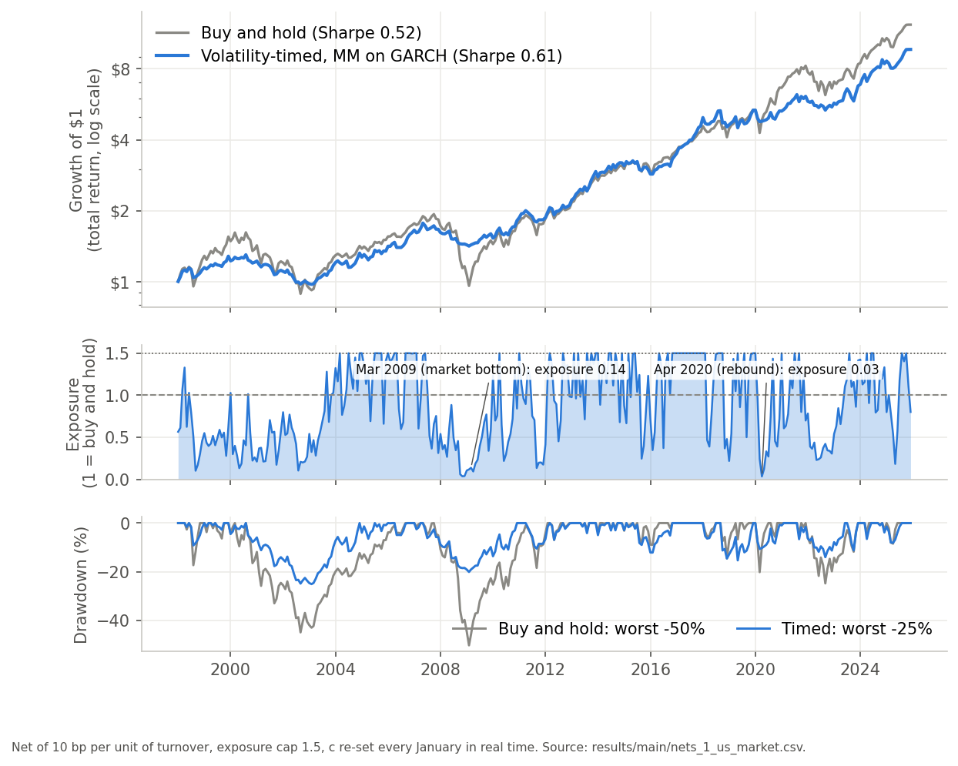
US market: smaller drawdowns, little Sharpe
0.52 → 0.61
Sharpe ratio, buy and hold → timed (MM on GARCH), 1998-2025
+0.09 [−0.13, +0.33]
Sharpe gain with 95% bootstrap interval: not significant
−50% → −25%
Maximum drawdown: halved
Exposure was 0.14 at the March 2009 bottom and 0.03 in April 2020, just before the two largest rebounds. The Cederburg real-time combination gains +0.00.
Notes:
First, the US market from 1998 to 2025. Timing cuts the worst drawdown in half, from minus 50 to minus 25 percent, and this holds almost everywhere we look. The Sharpe ratio goes from 0.52 to 0.61, but the 95 percent interval includes zero. Look at the middle panel: exposure was 0.14 at the March 2009 bottom and 0.03 in April 2020, right before the two biggest rebounds. That is where the return side leaks.

Slide 6
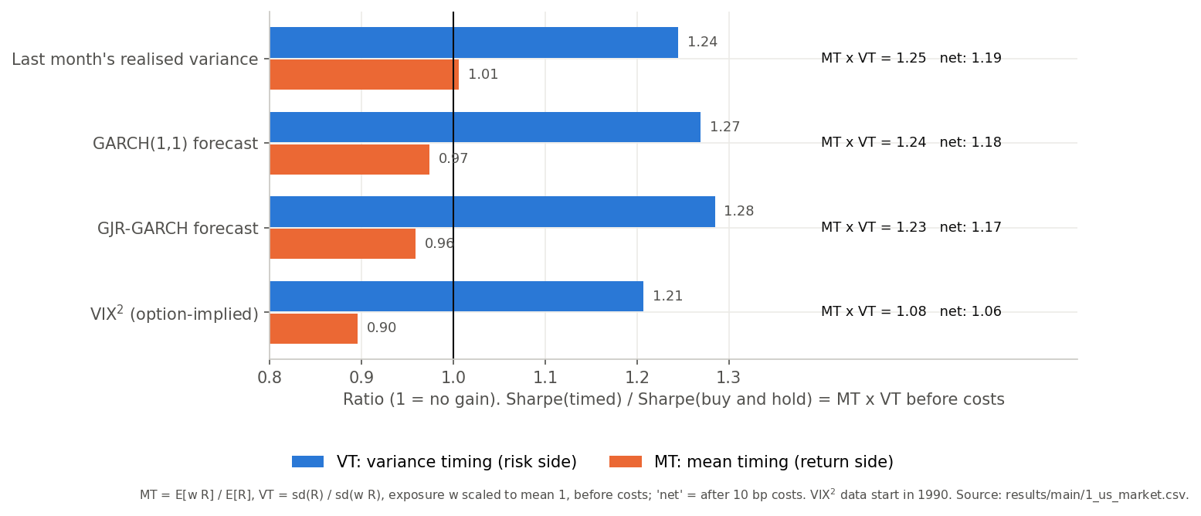
Better forecasts lose mean timing
Reading: moving from last month's realised variance to GARCH, GJR and VIX², the forecast gets better and VT rises, but MT falls from 1.01 to 0.90. The sharper the forecast, the harder it cuts high-volatility months, which are also high-return months.
Notes:
This slide shows why better forecasts do not help. We move from last month's realised variance to GARCH, GJR and finally VIX squared, which are better and better risk forecasts. VT, the blue bars, stays high. But MT, the orange bars, falls from 1.01 to 0.90. A sharper forecast cuts high-volatility months harder, and those months also have high expected returns. VIX squared is the extreme case: it contains a variance risk premium that is high exactly when expected returns are high.

Slide 7
Allocation does more than timing
+0.20 vs +0.03
Sharpe gain from diversifying into 6 factors vs from timing that mix
+0.19 [−0.05, +0.42]
Timing gain on the best mix; +0.03 after 2016
* Chosen with hindsight: #1 of 63 equal-weight mixes in 1998-2025, only #14 before 1998. Picking the best mix in real time does not work.
Notes:
We also found that allocation matters more than timing. Going from the market alone to an equal-weight mix of the six factors adds about 0.20 of Sharpe; timing that mix adds only 0.03. Our best mix, market plus profitability, investment and momentum, looks very good when timed, 1.04 against 0.85. But I want to be clear that we picked it with hindsight: it is number one of 63 mixes after 1998 but only number 14 before 1998, and its timing gain after 2016 is just 0.03.

Slide 8
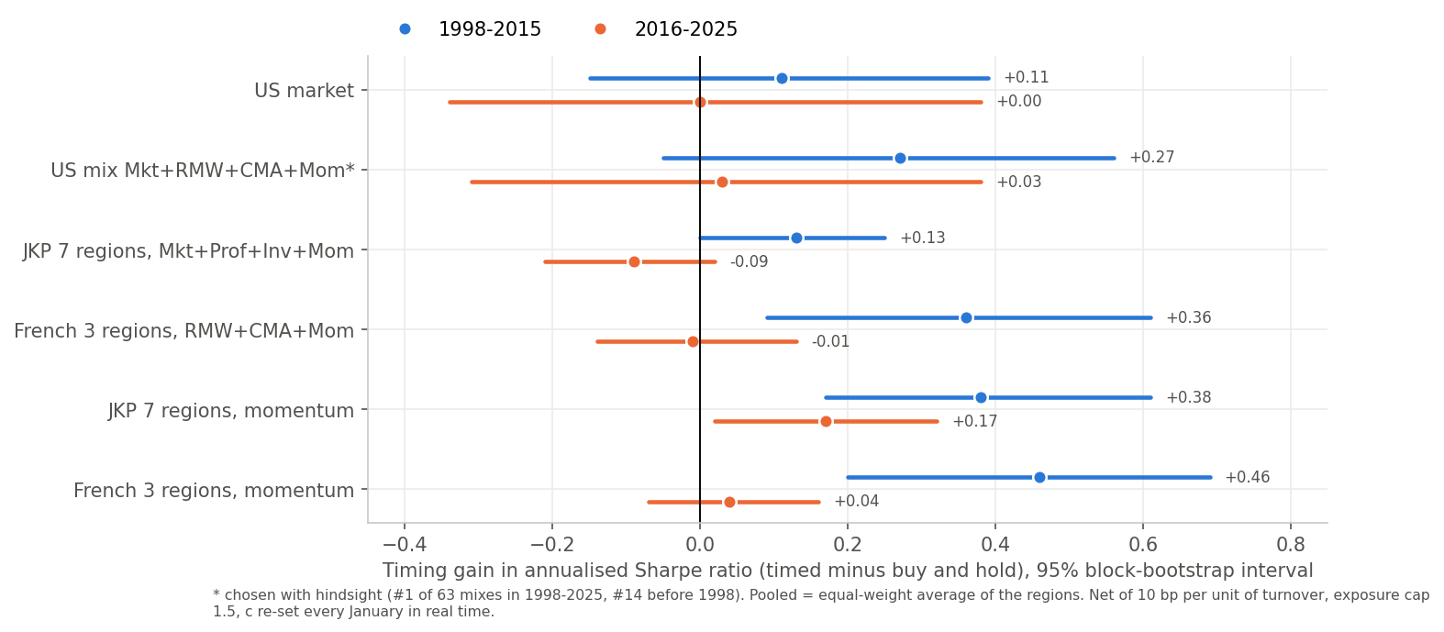
The gain fades after 2016
Two independent international data sets tell the same story as the US. Every mix gains in 1998-2015 and loses the gain in 2016-2025. Vol-managed momentum holds up best (JKP: +0.17 [+0.02, +0.32] after 2016).
Notes:
To check that this is not a US artefact, we ran the same rule on two independent international data sets: the JKP global factor data and Ken French's regional factors. The pattern is the same everywhere. The blue dots, 1998 to 2015, are positive; the orange dots, 2016 to 2025, are around zero or negative. Momentum holds up best, and in the JKP data its gain after 2016 is still significant. This fits a story of publication or crowding after 2017, but we have not tested that explanation.

Slide 9
Decision-focused training: no clear gain
0 of 36
tests survive correction (1 nominally significant; about 2 expected by luck)
1.2x to 3.5x
worse variance forecasts (QLIKE) after decision training
Our decision-focused experiment, evaluated under the frozen protocol: accuracy (QMLE) vs portfolio-utility training for GARCH, GJR and the Zhao et al. (2024) GARCH-LSTM, 5 seeds each. We will re-run the network training once to confirm.
Notes:
This is our direct test of decision-focused learning. We trained the same models two ways: on forecast accuracy, by quasi maximum likelihood, and on the utility of the portfolio after costs. The decision-trained network gains about 0.1 of Sharpe on HML, RMW and CMA and nothing elsewhere, and none of the 36 tests survives correction. The decision-trained forecasts are also 1.2 to 3.5 times worse as variance forecasts. That is what our theory predicts when the mean is roughly constant: the decision loss has nothing extra to learn, so it just bends the variance forecast.

Slide 10
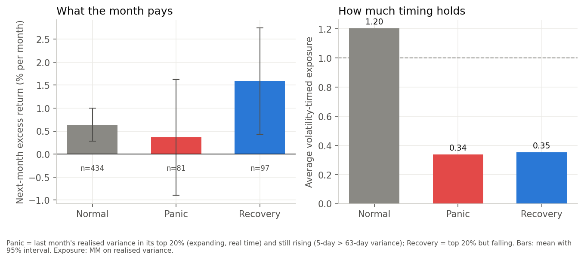
Timing sits out the recovery months
Recovery months (volatility high but falling) pay 1.6% a month, the most of any state, yet timing holds only 0.35 exposure. A pre-specified fix (exposure at least 1 in recovery) is consistently positive but small: market +0.07 [−0.07, +0.23], 9 of 16 series. On momentum +0.34 (raw p = 0.001), not significant after correction.
Notes:
Here is the mechanism behind the lost mean timing. We split months by volatility in real time. Panic means volatility is high and still rising; recovery means it is high but already falling. Recovery months pay about 1.6 percent a month, the most of any state, yet the timed strategy holds only 0.35 exposure in them. We wrote this rule down before testing it and first tested it on untouched 1975 to 2007 data. A simple fix, holding at least full exposure in recovery months, is positive but small, because these months are rare, they are the riskiest months, and the 1.6 percent is estimated with a lot of noise.

Slide 11
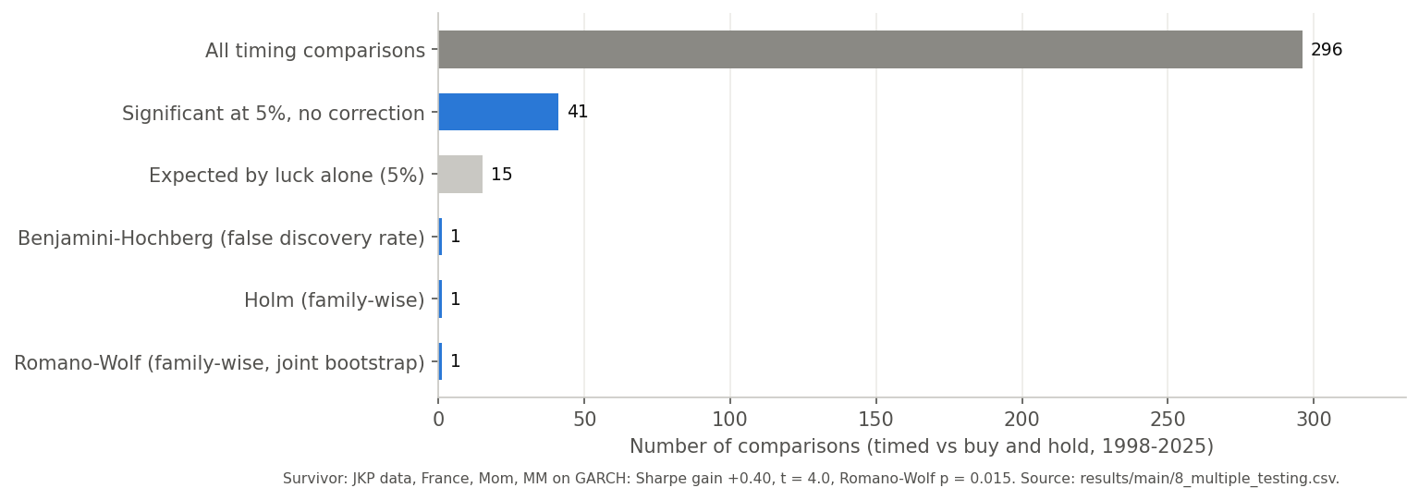
After 296 tests, one survives
One joint bootstrap across all comparisons keeps their correlation. The survivor is vol-managed momentum in France (+0.40, t = 4.0). Under the two robustness specs, 3 survive, all momentum or momentum mixes in Europe.
Notes:
Because we tried many things, we corrected for multiple testing. Out of 296 timing comparisons, 41 are significant at 5 percent, but about 15 would be expected by luck alone. After Benjamini-Hochberg, Holm or Romano-Wolf, only one survives: volatility-managed momentum in France. Under our two robustness specifications three survive, all of them momentum in Europe, which is consistent with Barroso and Santa-Clara on momentum.

Slide 12
What we can and cannot claim
✓
We can claim
✗
We cannot claim
Volatility timing reliably cuts drawdowns
Sharpe gains were positive before 2016, in three data sets
Better forecasts do not give better Sharpe: MT falls as VT rises
Vol-managed momentum is the closest to robust
That timing beats buy and hold after 2016
That Mkt + RMW + CMA + Mom is special (hindsight)
That decision-focused training helps
That the recovery-state fix is tradable
Notes:
So this is our honest scorecard. We can say that volatility timing reliably cuts drawdowns, that its Sharpe gains were positive before 2016 in three data sets, that better forecasts do not give a better Sharpe ratio because MT falls as VT rises, and that volatility-managed momentum is the closest to robust. We cannot say that timing beats buy and hold after 2016, that our best mix is special, or that decision-focused training helps.

Slide 13
Next steps to the final submission
1
Is our best mix robust?
2
Let the expected return vary
Bootstrap the ranks of all 63 mixes, and rank the same mix among all mixes in the JKP and French data.
Scale exposure up in recovery months by how much more they pay, estimated only on earlier data. One pre-specified test (next slide).
3
Decision-focused learning
4
Confirm and write up
Train the rule on the portfolio objective with the market state as an input, so it can learn when returns are high (next slide).
Re-run the network training once to confirm, then the final report.
Notes:
These are our next steps. First, I want to test whether our best factor mix is robust, by bootstrapping the ranking of all 63 mixes and checking where the same mix ranks abroad. Steps two and three are the natural continuation of the mechanism we found, and I explain them with the math on the next slide. Finally, we will re-run the network training once to confirm it, and then write the final report.

Slide 14
Steps 2 and 3: fixing the return side
2
Let the expected return vary
3
Train on the decision, not the forecast
Today the rule assumes the expected return μ is the same every month:
w_{t} = c / v̂_{t}
Theory says w_{t} = μ_{t} / (γσ_{t}²). If recovery months have a higher μ, scale them up:
w_{t} = c · m_{s} / v̂_{t}, m_{s} = μ̂_{s} / μ̂_{normal}
Example: recovery months earn about 2.5× a normal month (1.59% vs 0.64%), so exposure rises from 0.35 to about 0.9 (cap 1.5).
Clean test: m_{s} is estimated only on data before 1975, and we run it once.
The accuracy loss (QMLE) only sees squared returns, so it can only learn variance:
L_{acc} = Σ_{t} [ log h_{t} + R_{t}² / h_{t} ]
A decision loss sees the portfolio return itself, so it can learn when μ is high:
L_{dec} = −[ mean(w_{t}R_{t}) − (γ/2) var(w_{t}R_{t}) ]
with w_{t} = c · g_{θ}(state_{t}) / h_{t}
g_{θ} = 1 + θ_{P}·[panic] + θ_{R}·[recovery]: two parameters, trained on 1975-1997, tested on 1998-2025.
Why our network did not gain: its inputs carry only volatility, so the decision loss could only bend the variance forecast.
Notes:
Let me explain these two steps with the math. Step two needs no learning. Today our rule is w equals c over the variance forecast, which assumes the expected return is the same every month. The theory says the optimal exposure is mu over gamma sigma squared, so if recovery months have a higher mu, we should multiply exposure in those months by how much more they pay, m. As an example, recovery months earn about two and a half times a normal month, so exposure would go from 0.35 to about 0.9, still below the cap. To keep the test clean, we estimate m only on data before 1975 and run it once. Step three is where decision-focused learning can actually help. The accuracy loss only uses squared returns, so it can only ever learn the variance. A decision loss uses the portfolio return itself, so it can learn when the expected return is high, but only if the model is given an input that carries that information. So we add a small state term g with two parameters, one for panic months and one for recovery months, train it on the portfolio objective before 1998, and test it after. This also explains our earlier result: the network only had volatility inputs, so the decision loss could only distort the variance forecast.

Slide 15
Appendix: robustness of the protocol
Spec | Cost | c rule | Cap | US market gain | US mix gain* | Romano-Wolf survivors
main (SPEC.md) | 10 bp | vol-matched, re-set every January | 1.5 | +0.09 [−0.13, +0.33] | +0.19 [−0.05, +0.42] | 1
old | 5 bp | mean exposure 1, frozen on pre-1998 data | 2.0 | +0.06 [−0.22, +0.34] | +0.24 [−0.00, +0.48] | 3
uncapped | 10 bp | vol-matched, re-set every January | none | +0.06 [−0.23, +0.35] | +0.18 [−0.07, +0.42] | 3
The picture does not depend on the spec. One result does: leg-wise timing in the French data (market leg unmanaged, other legs timed) beats timing the whole mix with cap 1.5 but not with cap 2. It was designed after seeing the JKP results, so we report it as post-hoc.
* Mkt + RMW + CMA + Mom, 1998-2025, chosen with hindsight. Code: final-version/run_all.py --spec main | old | uncapped.
Notes:
This is a backup slide in case you ask about our parameter choices. All the main numbers come from the main specification. Our two alternative specifications, with our earlier settings and with no leverage cap, give the same picture.

