Slide 1
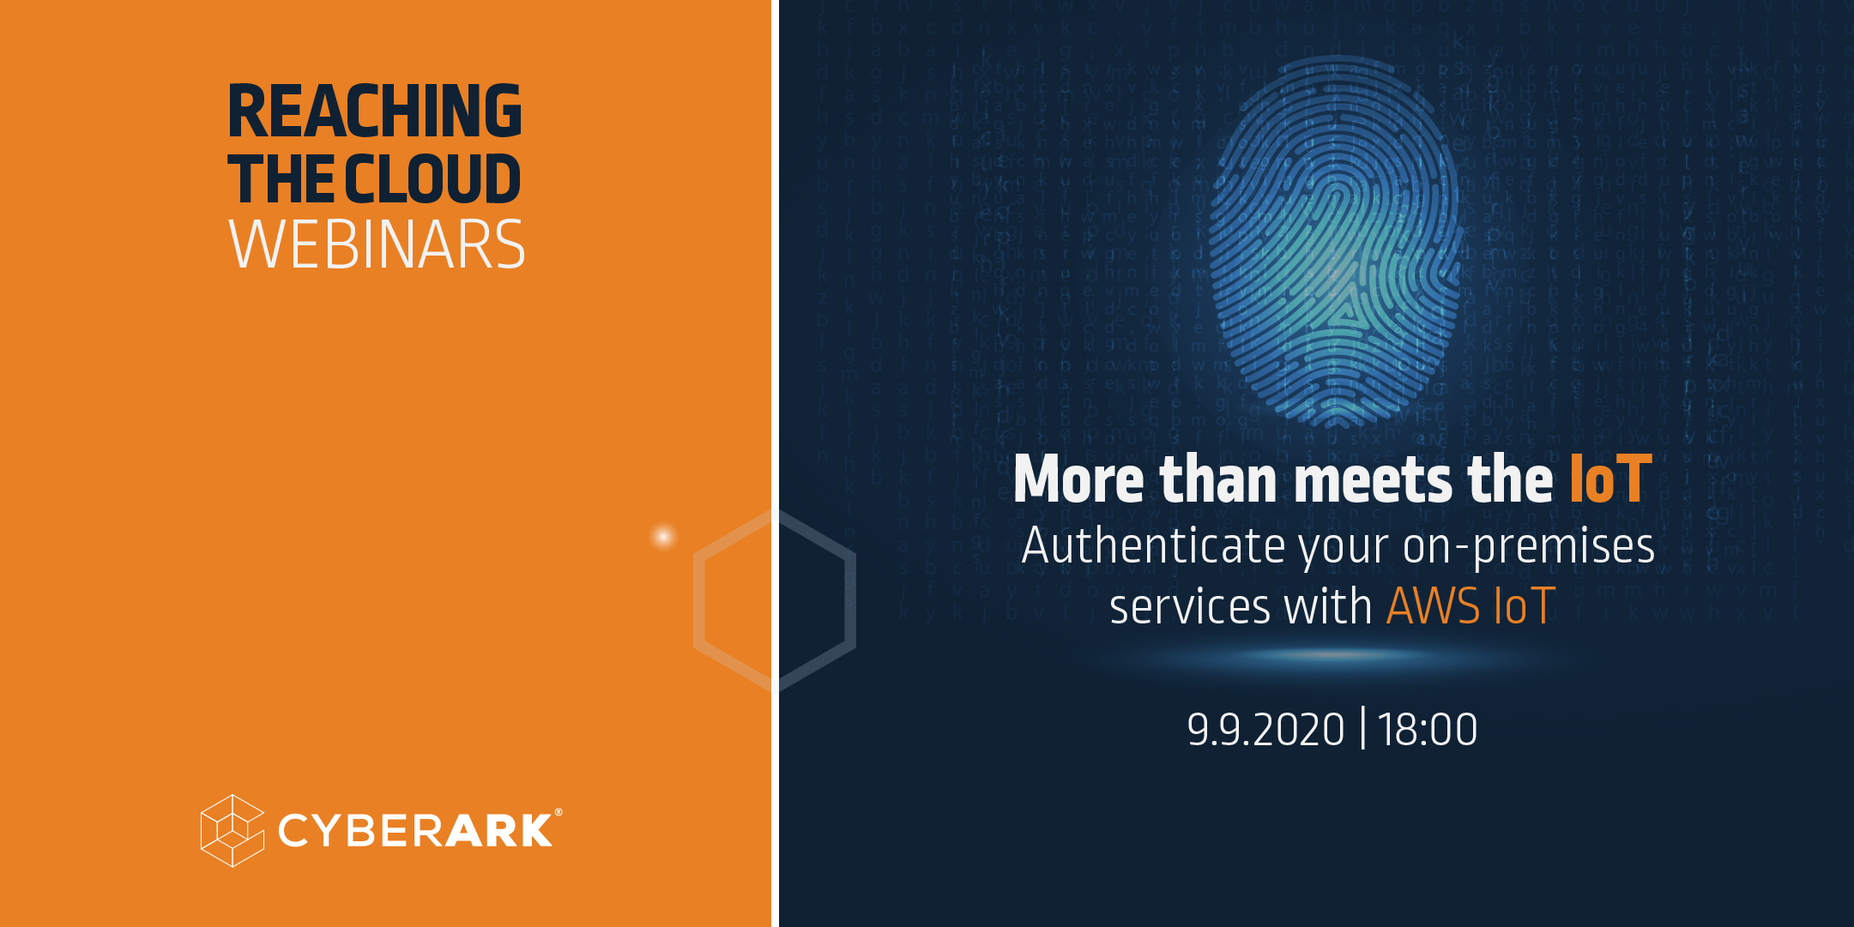

Slide 2
Reaching the Cloud - 2nd Webinar
More than meets the IoT: Authenticate your on-premises services with AWS IoT
Roy Ben Yosef
Notes:
LINK TO PART 1 in meetup and github

Slide 3
About me
Roy Ben Yosef
8.5 years in CyberArk
Software Architect
Working on our cloud offering platform
Contact:
roy.benyosef@cyberark.com
Twitter: @RoyBenYosefTM
Medium: https://medium.com/@royutil
Hobbies: Gaming, Board games, Movies
Notes:
CyberArk – the leader in the prviliged access management
Great place to work

Slide 4
GitHub
Everything is in this GitHub repo
Feel free to open issues for anything
The link is also in the meetup page
https://github.com/royby-cyberark/AWSIoTWebinar

Slide 5
Disclaimer
Everything in this presentation and demo should be considered at “demo level”. Do your own research, especially security wise.
AWS costs money. Don’t forget to clean after yourself.

Slide 6
What will you get from this webinar?
Learn about AWS IoT and its capabilities, like – Provisioning, Client authentication, Communication, policies and the services it offers.
Run with me through a working demo of authenticating a device to AWS IoT and have a two-way communication with the backend.
Sending data to the backend
Sending commands to the device

Slide 7
AWS IoT - Intro
As smart device grow in numbers, so raises the need to provide solutions for device authentication, management, data aggregation, and analysis, using ML to process data and other needs
Example use cases:
Smart homes
Smart agriculture
Smart cities
But this isn’t limited to IoT at all!

Slide 8

AWS IoT Intro
AWS IoT is a suite of services, designed to allow the provisioning and managing of IoT devices in a secure manner.
It includes things like, provisioning, authentication, two-way communication, variety of SDKs, Groups, Monitoring, Analysis, Security controls and much more.

Slide 9
Services and Features Overview

Slide 10
AWS IoT Core
Onboarding "Thing(s)" provisioning. This includes creation and registration of a device, or "thing", download of the SDK according to your needs, and setting some meta data, like thing type and attributes.
Management
- Thing Type
- Static Groups
- Dynamic Groups
Notes:
Managent
Thing type – add attributes to devices, can be used in policy variables
Static groups – can have heirarchies, can be assigned to policies, used in jobs
Dynamic groups – dynamically move devices between groups according to attributes, e.g. all devices with battery level of 80% or more. Can be used for example when you want to update devices firmware

Slide 11
Client Authentication
X.509 client certificates ←
Custom authentication
Access to AWS IoT Services
Authorizing direct calls
to AWS services
AWS Free course: “Deep Dive into AWS IoT Authentication and Authorization”
Notes:
digital certificates that use the X.509 public key infrastructure standard to associate a public key with an identity contained in a certificate. X.509 certificates are issued by a trusted entity called a certification authority (CA).
Known from web sites server certs By default AWS IoT uses its own CA which you need to download and use
You can also use custom auth. Like u/p, jwt token, etc usually for when migrating into IoT: AWS IoT Core lets you define custom authorizers so that you can manage your own client authentication and authorization. This is useful when you need to use authentication mechanisms other than the ones that AWS IoT Core natively supports.
*** Cognito : You can also use Cognito authenticated identities and give them access to AWS IoT services.
Direct access: use cert to mint a token and use that to sign a request to aws services
[A client certificate can be registered in multiple AWS accounts in the same AWS Region to facilitate moving devices between your AWS accounts in the same region.]

Slide 12

Communication
AWS IoT uses the standard MQTT protocol over HTTPS (Or WebSocket) for communication. It also supports devices and clients that use the HTTPS protocol to publish messages.
Message brokers
Devices communicate with the backend (or other devices) by publishing and subscribing to message queues with MQTT protocol over HTTPS or over WebSocket
Notes:
MQTT: MQTT is a Client Server publish/subscribe messaging transport protocol. It is light weight, open, simple, and designed so as to be easy to implement – ideal for IoT
HTTPS - Unlike MQTT, HTTPS does not support a clientId value. So, while a clientId is available when using MQTT, it's not available when using HTTPS.

Slide 13
AWS IoT Data-Plane Policies
During the provisioning process, you create a certificate and attach an IoT policy to it.
IoT policies determine which operations a device can perform in the AWS IoT data plane.
Although they are similar in format, they are NOT IAM policies, and are unlimited, they also include versioning unlike IAM policies and are only attached to IoT certificates.
Notes:
The AWS IoT Core APIs and commands are largely divided into control plane operations and data plane operations
Data plane vs Control plane: The control plane operations enable you to do tasks such as configuring security, registering devices, and setting up logging. The data plane operations enable you to ingest data from connected devices into AWS IoT Core
Thing type can be used in policy variables
Static groups can be assigned with IoT policies

Slide 14

AWS IoT Rules
Devices can send messages to AWS IoT backend topics and you can use these messages to carry out various actions
Write data received from a device to an Amazon DynamoDB database
Save a file to S3
Send a push notification to users using Amazon SNS
Push a message to SQS, Kinesis, Elasticsearch
Invoke a Lambda
Run a step-function
And more…
Notes:
Rules give your devices the ability to interact with AWS services. Rules are analyzed and actions are performed based on the MQTT topic stream.
In addition to the following you can:
Augment or filter data received from a device.
Change a CloudWatch alarm.
Send to Amazon Machine Learning to make predictions based on an Amazon ML model.
Send a message to a Salesforce IoT Input Stream.
Send message data to an AWS IoT Analytics channel
Send a message to a downstream HTTPS endpoint

Slide 15
AWS IoT Rules - Continued
An example: A device publishes JSON messages to some topic: my-service/audits.
The rule is defined so: "SELECT * FROM my-service/audits" which means that the data in that message can be used to perform some action.
An action is defined to send this incoming message to Kinesis (for example) for further processing.
You can also set multiple actions and fan out the messages that are processed.
Notes:
Number of actions/rule is hard limited to 10

Slide 16
AWS IoT Rules Basic Ingest
If you don’t require fancy pub-sub capabilities, you can reduce costs by using basic ingest to send messages directly to rules.
Use built in topic:
$aws/rules/…

Slide 17

AWS IoT Jobs
A job is a remote operation that is sent to and executed on one or more devices connected to AWS IoT
For example, you can define a job that instructs a set of devices to download and install application or firmware updates, reboot, rotate certificates, or perform remote troubleshooting operations
Continuous Jobs: Jobs that are always “Alive” and will be applied to any device that join a group for example
Notes:
* Continuos jobs – e.g when a device join a group, leaves group, also dynamic groups
* You can specify how quickly targets are notified of a pending job execution. This allows you to create a staged rollout to better manage updates, reboots, and other operations.

Slide 18

AWS IoT SDKs
Arduino
Java
Python
AWS Iot Provides many SDKs for all major languages and platforms.
Android
Can easily be implemented in Go with its standard libraries
Embedded C
iOS
C++
C++ 11+ CMake 3.1+, Clang 3.9+ or GCC 4.4+ or MSVC 2015+
JS

Slide 19

Other AWS IoT Services
Secure tunneling - When devices are deployed behind restricted firewalls at remote sites, you need a way to gain access to those device for troubleshooting, configuration updates, and other operational tasks.
Device management
IoT analytics - a fully-managed service that makes it easy to run and operationalize sophisticated analytics on massive volumes of IoT data.
Device defender - a fully managed service that helps you secure your fleet of IoT devices. AWS IoT Device Defender continuously audits your IoT configurations to make sure that they aren’t deviating from security best practices.
Events - enables you to monitor your equipment or device fleets for failures or changes in operation, and to trigger actions when such events occur.
Notes:
Secure tunneling –behind restricted firewalls at remote sites, you need a way to establish bidirectional communication to remote devices over a secure connection that is managed by AWS IoT. Secure tunneling does not require updates to your existing inbound firewall rule.
Similar to other "connector" solutions, or with ssh reverse tunnel, you can have a local proxy is a process that acts as the recipient or sender of incoming TCP connections. It transmits data sent by the device application through the Secure Tunneling service over a WebSocket secure connection.
IoT analytics – AWS IoT Analytics is a fully managed service that scales automatically to support up to petabytes of IoT data. With AWS IoT Analytics, you can analyze data from millions of devices and build fast, responsive IoT applications without managing hardware or infrastructure.
You supply the analysis, AWS IoT Analytics will import your custom authored code containers and run it when you want it to
Easily run queries on IoT data
AWS IoT Analytics stores the processed device data in a time-series data store that is optimized to deliver fast response times on IoT queries
AWS IoT Analytics includes data preparation techniques that make it easy to prepare and process your data for analysis.
AWS IoT Analytics makes it easy to apply machine learning to your IoT data with hosted Jupyter notebooks. You can directly connect your IoT data to the notebook and build, train, and execute models right from the AWS IoT Analytics console without having to manage any of the underlying infrastructure.
Device defender
audits IoT configurations associated with your devices against a set of defined IoT security best practices, For example, you can create an audit to check for identity certificates that are inactive, revoked, expiring, or pending transfer in less than 7 days. Audits make it possible for you to receive alerts as your IoT configuration is updated.
AWS IoT Device Defender detects anomalies in device behavior that may indicate a compromised. For example, AWS IoT Device Defender lets you define how many ports are open on the device, who the device can talk to, where it is connecting from, and how much data it sends or receives. Then it monitors the device traffic and alerts you if something looks wrong
AWS IoT Device Defender publishes security alerts to the AWS IoT Console, Amazon CloudWatch, and Amazon SNS
Events – AWS IoT Events recognizes events across multiple sensors to identify operational issues, such as equipment slowdowns, and triggers alerts such as notifying support teams of an issue. To detect events before AWS IoT Events, you had to build costly, custom applications to collect data, apply decision logic to detect an event, and then trigger another application to react to the event.
Accept input from multiple sources
Define a detector model logic
Trigger Actions Based on Events
Automatically Scale

Slide 20


Even more AWS IoT Services
Greengrass - Designed to address offline scenarios, it is basically an offline IoT Core and Lambda.
And the Most important thing is – go and explore! Find out for yourself the richness that AWS IoT has to offer
Notes:
Compact IoT Core layer to run on the edge (device registry, message broker)
Lambda runtime – devs can write lambdas normally
Devices can keep working when d/c and then sync when reconnected

Slide 21
And now to the fun part where we build stuff!

Slide 22
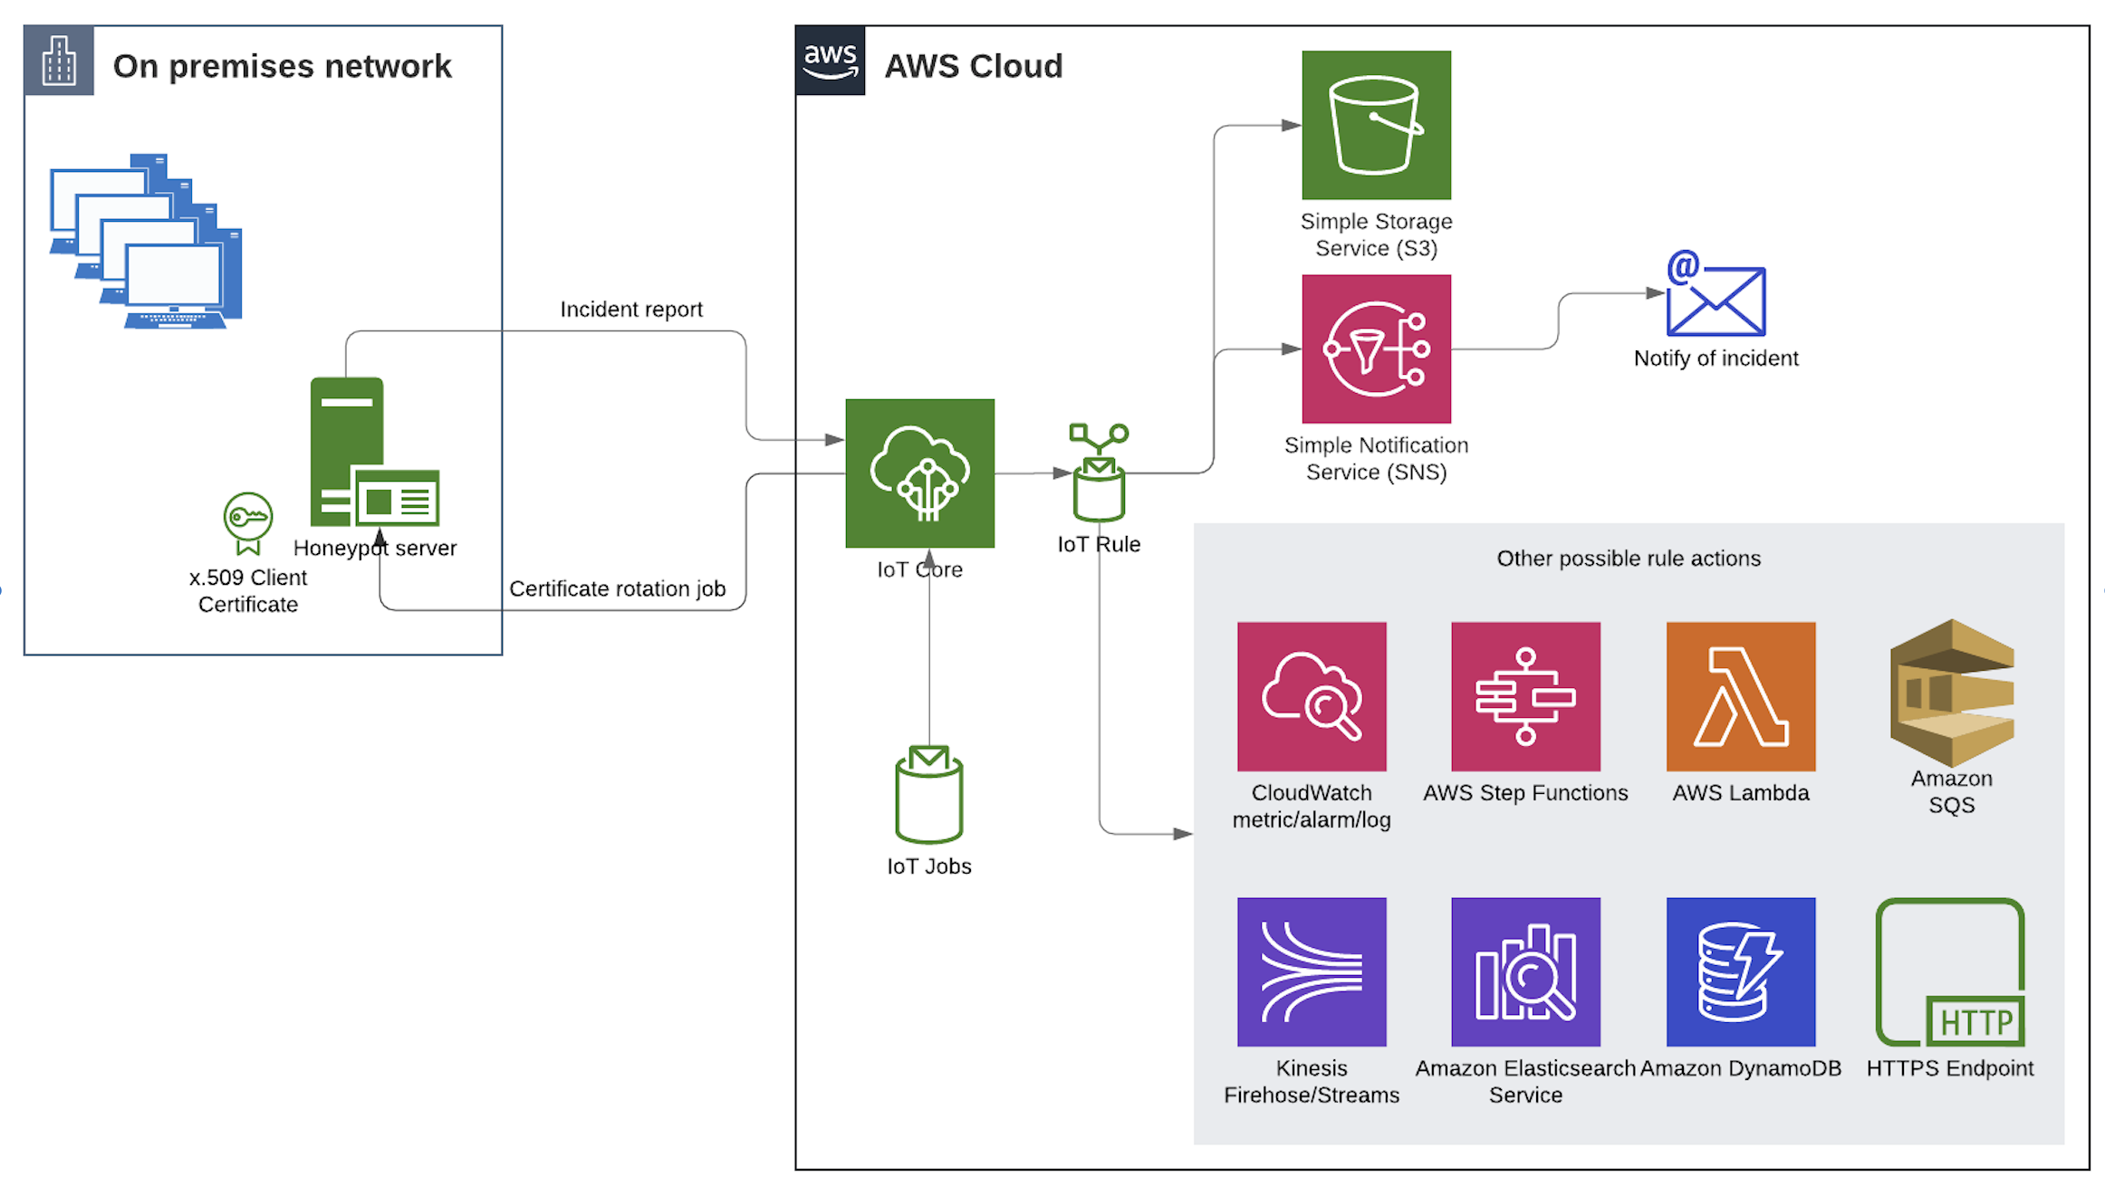
What are we going to build?
Notes:
Jobs – cert rotation job, why?

Slide 23
What Are We Going To Build?
We will use AWS IoT to allow our services which are external to AWS, access to our cloud platform and allow them to communicate with our backend securely.
We will see that AWS IoT doesn't have to do with IoT necessarily and can be leveraged for other purposes as well.

Slide 24
The Scenario
In our on-prem network, we run a honeypot service which acts as a bait for attackers.
It exposes dummy services like RDP and SSH servers, Databases etc.
The honeypot informs us on any attempt to connect to the dummy services.
We are going to have the canary service deliver such incidents into our audit service which is deployed on AWS.
And fan out these events into AWS services.

Slide 25
Summary – what did we do?
AWS IoT Core
Communication using MQTT
Client Authentication using x.509 certs
Policies, Rules, Jobs, SDKs
Other services – Analytics, Device defender, events, Greengrass, etc.
We’ve built an end-to-end demo of authenticating and communicating between the different parts.

