Slide 1
eyeKeysurf
Dmitry Dryomov
Roy Amit

Slide 2
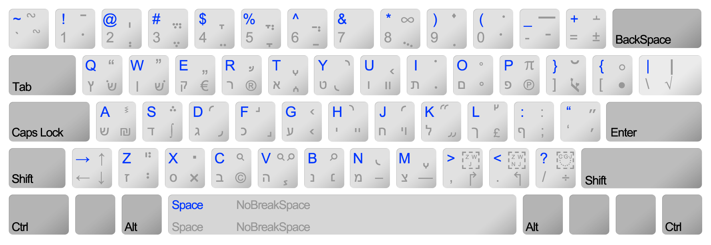
The current state of things
QWERTY keyboards:
Designed to maximize common bigram distance
9 degrees

Slide 3
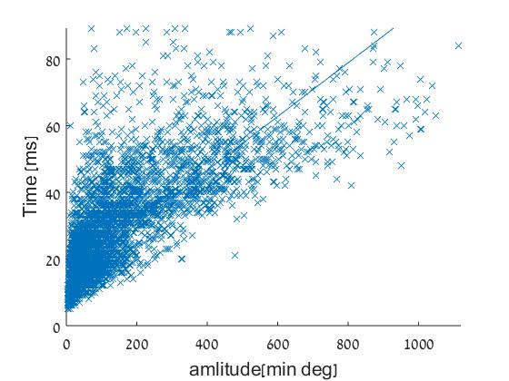
But with your eyes?
Moving from one side of the keyboard to another takes up to 120 ms!
R=0.79 ; p<10^-14

Slide 4
The solution
Speed up eye-typing by
Minimizing the required eye trajectory
By designing the perfect keyboard

Slide 5
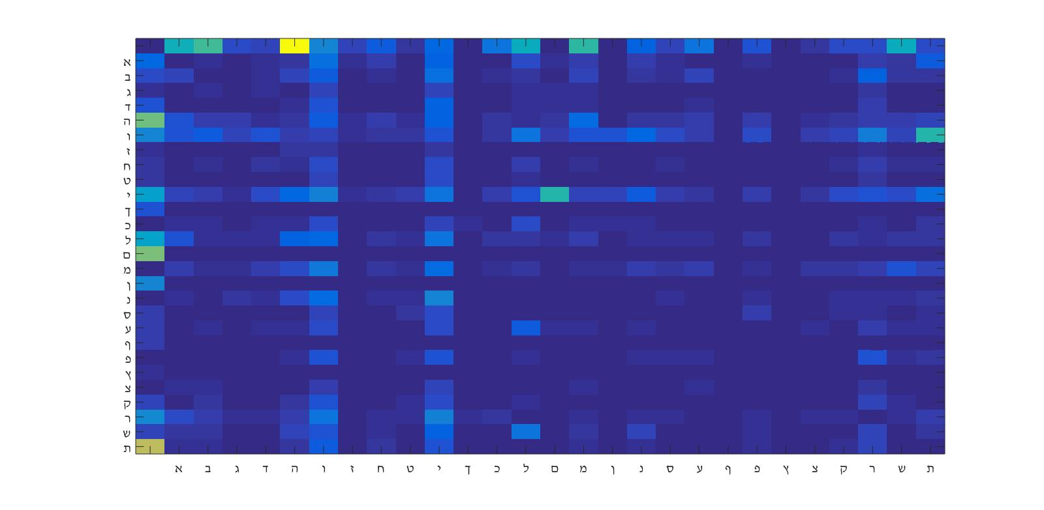
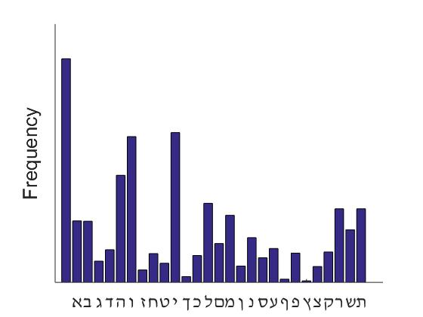
The inner-workings
Letter frequency and Bigrams were extracted from Entire Hebrew Wikipedia

Slide 6
The computational logic
Minimize weighted bigram frequency by distance sum.
Accurately predict next word and letter
This function minimizes required eye movement time, and ensures best typing speed.

Slide 7
demo
Autocomplete letter and word (ML-based)
Machine-learn the idiosyncratic typing pattern

