Slide 1
Human Fertilization
The adventure of a sperm cell in finding its egg cell
By: Henry Laynesa and Jullie Reyes

Slide 2
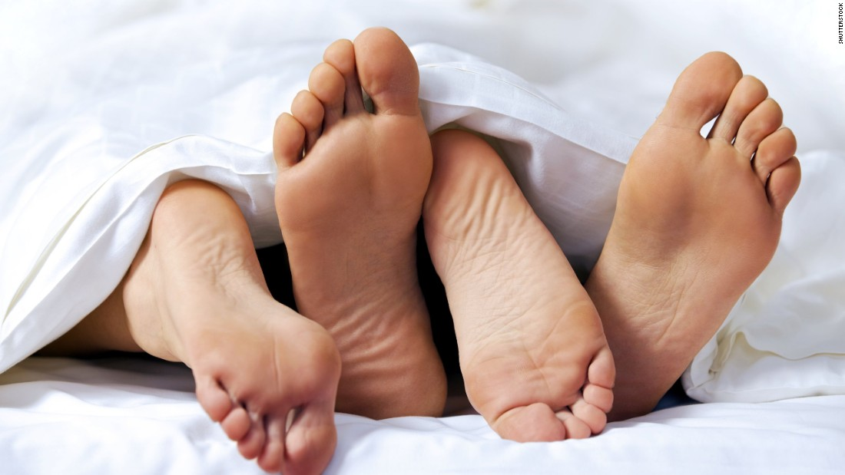
INTRODUCTION
Notes:
Have you ever wondered….

Slide 3
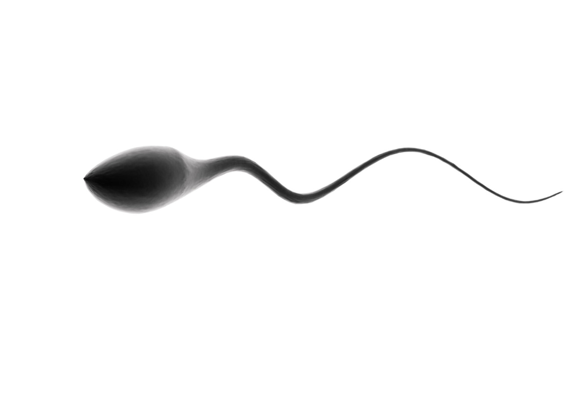
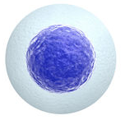
HOW IT WORKS
Notes:
Heat diffusion

Slide 4
DEMO!
MODEL
Agents
EGG CELL
SPERM CELL
Environment
HEAT
(not on each other)

Slide 5
THANKS FOR LISTENING!
Have fun with your own adventures!!

