Slide 1
Ames Housing Data
By Royce Phillips Jr

Slide 2
Problem Statement
Take the Ames Housing data to find sales price trends
To help home owners make best decisions on what affects value to home
What brings value up
What brings value down
By the end of presentation you know what to do to help increase sales

Slide 3
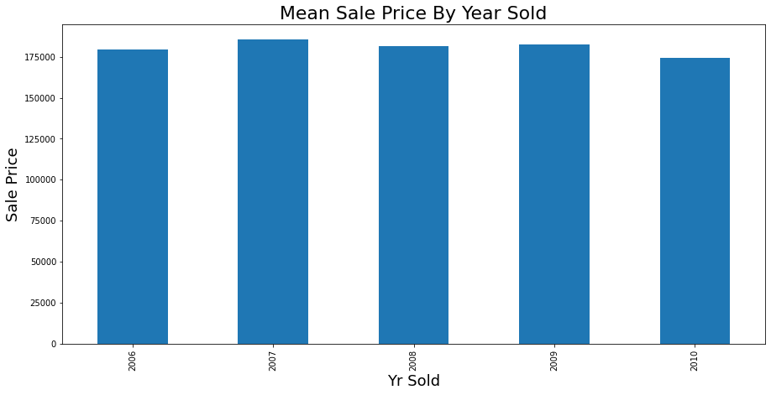

Slide 4
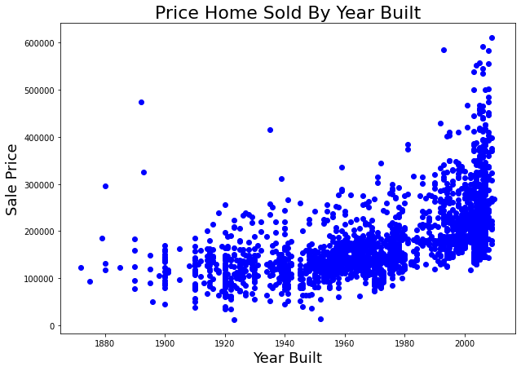

Slide 5
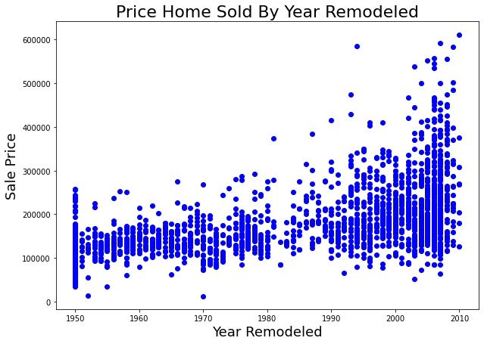

Slide 7
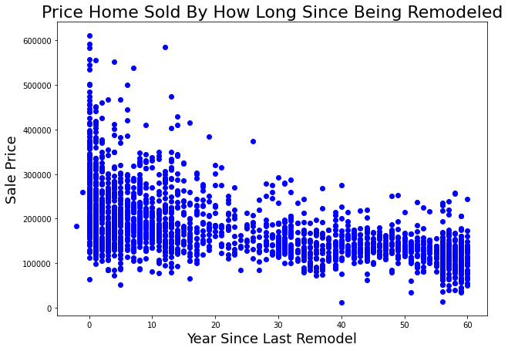

Slide 8
What kind of things help increase the value of the home?

Slide 9
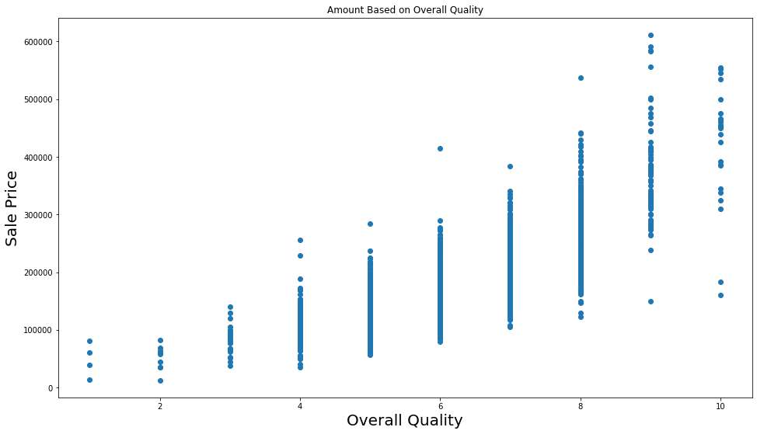

Slide 10
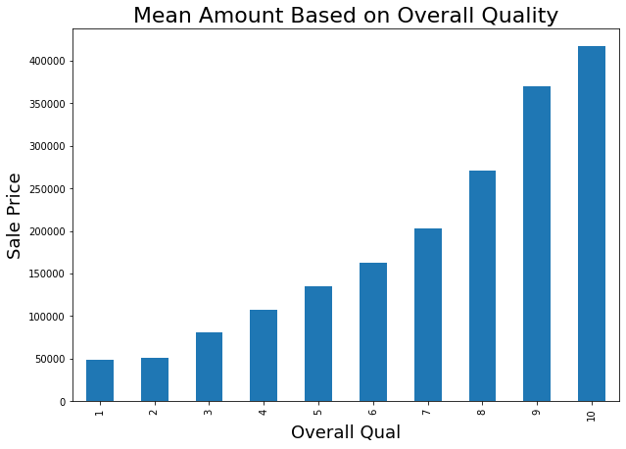

Slide 11
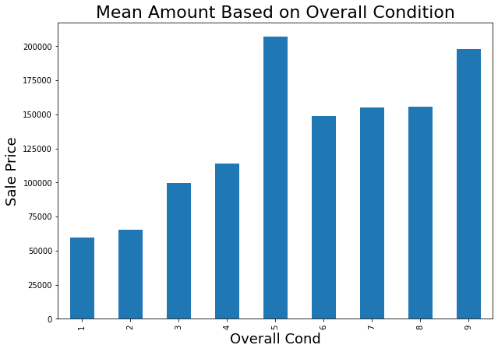

Slide 12
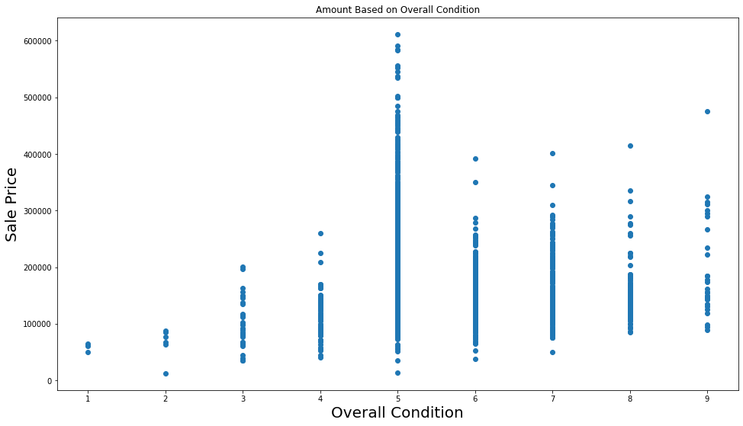

Slide 13
What qualities can you improve?
Exterior Qualities
What are best materials?
Basement Qualities
Size, furnished vs unfurnished, basement bathroom
Fireplace
Garage
Type, Size

Slide 14
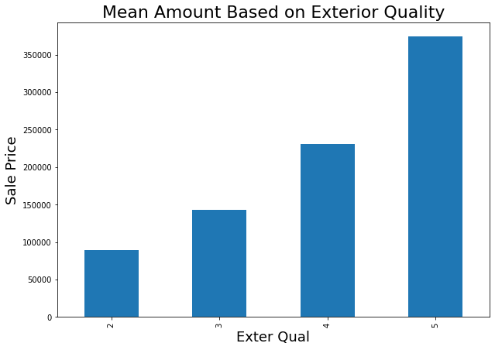

Slide 15
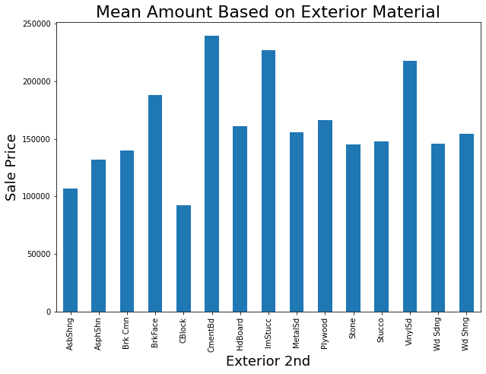
VinylSd =Vinyl Siding
CemntBd = Cement Board
ImStucc = Imitation Stucco
https://www.thebalancesmb.com/eifs-synthetic-stucco-1797883
https://www.homeadvisor.com/r/synthetic-versus-traditional-stucco-siding/

Slide 16
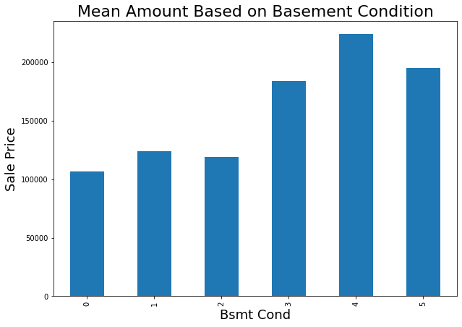
5 = Excellent
4 = Good
3 = Typical - slight dampness allowed
2 = Fair - dampness or some cracking or settling
1 = Poor - Severe cracking, settling, or wetness
0 = No Basement

Slide 17
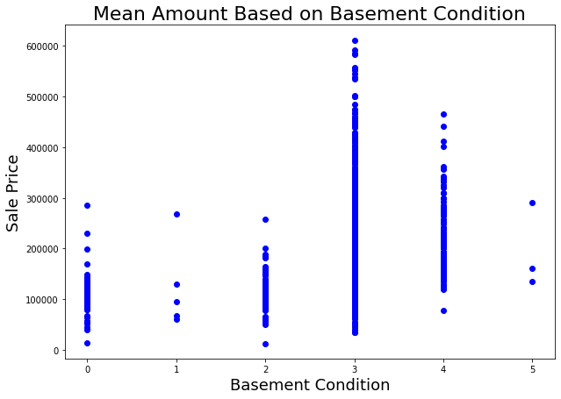
5 = Excellent
4 = Good
3 = Typical - slight dampness allowed
2 = Fair - dampness or some cracking or settling
1 = Poor - Severe cracking, settling, or wetness
0 = No Basement

Slide 18
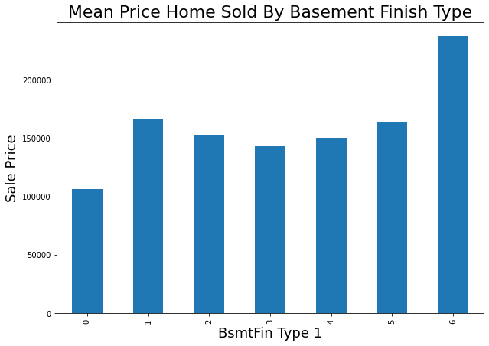
6 =Good Living Quarters
5 = Average Living Quarters
4 = Below Average Living Quarters
3 = Average Rec Room
2 = Low Quality
1 = Unfinshed
0 = No Basement

Slide 19
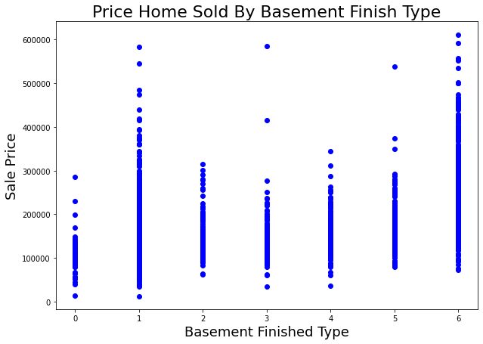
6 =Good Living Quarters
5 = Average Living Quarters
4 = Below Average Living Quarters
3 = Average Rec Room
2 = Low Quality
1 = Unfinshed
0 = No Basement

Slide 20
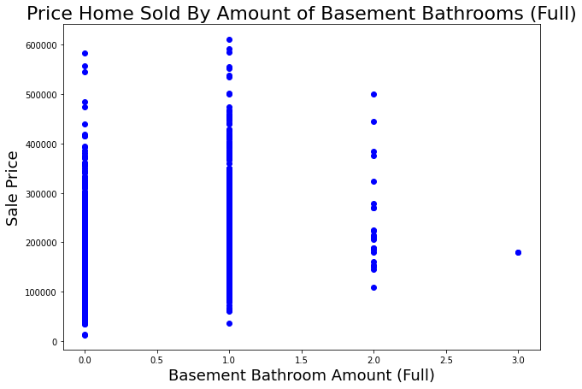

Slide 21
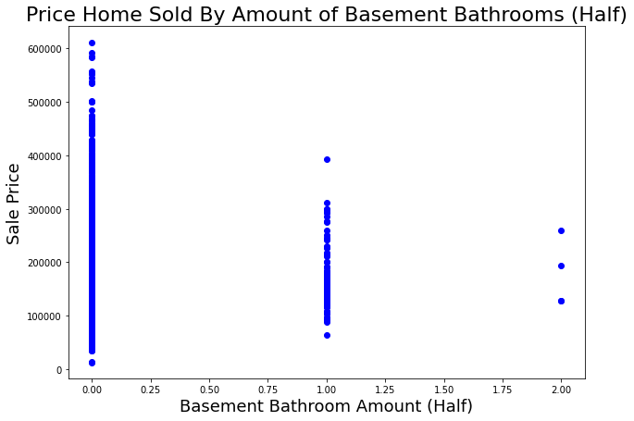

Slide 22
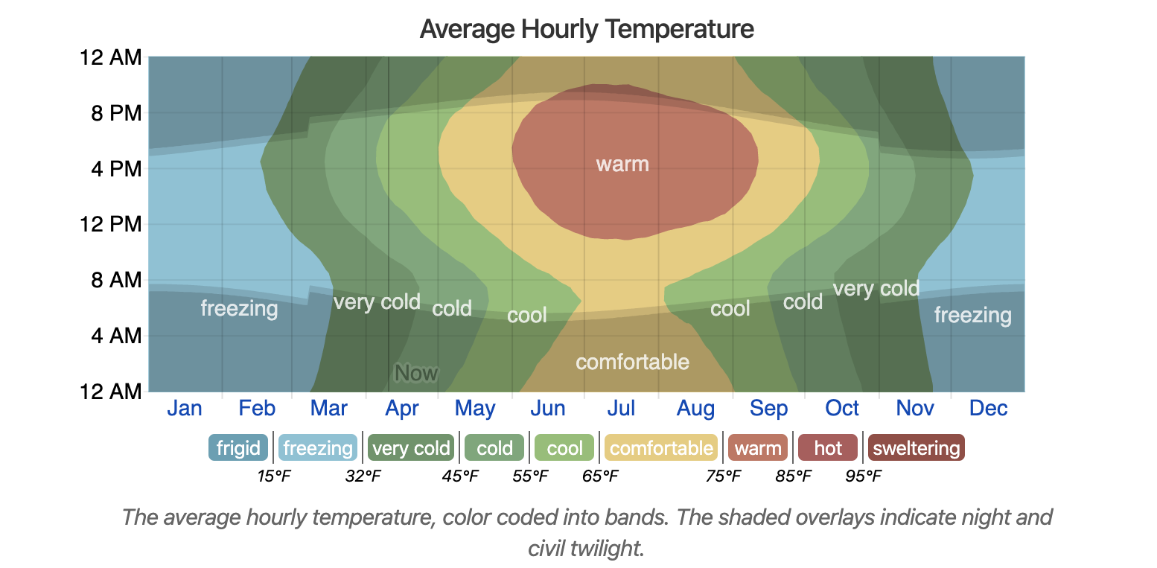
https://weatherspark.com/y/10339/Average-Weather-in-Ames-Iowa-United-States-Year-Round

Slide 23
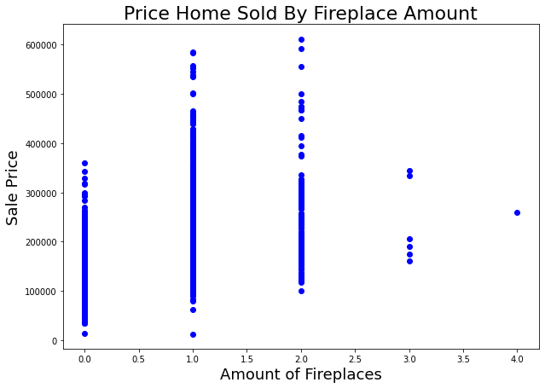

Slide 24
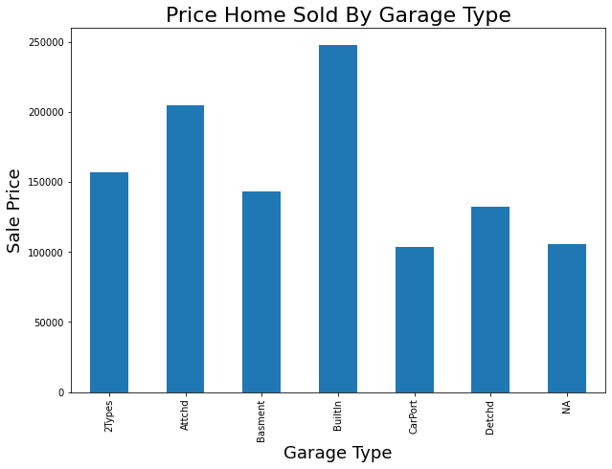

Slide 25
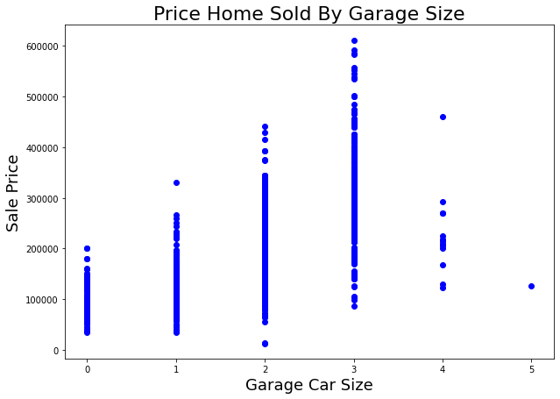

Slide 26
Conclusion/Recommendations
Build fireplaces, but no more than 2
Have these three items as exterior
Vinyl Siding
Cement Board
Imitation Stucco
This many bathrooms
No half baths in basement
Garage
No larger than a 3 car port
Make the home is up to date as possible

