Slide 1
MSC CYBERSECURITY · UNIVERSITY OF MANCHESTER · COMP66060
Implementing Post-Quantum Secure Exotic Signature Schemes in Blockchains
LAS — a lattice adaptor signature built on CRYSTALS-Dilithium primitives: implemented twice, benchmarked against two baselines, and demonstrated end-to-end in a post-quantum atomic swap.
Royce Steven · Supervisor: Dr Zhipeng Wang · evidence run 20260804_101750
Notes:
[planned 0:12] Title
Post-quantum secure exotic signature schemes in blockchains. I implemented LAS, a lattice-based adaptor signature, on top of the CRYSTALS-Dilithium reference implementation, and measured what it actually costs — as a standalone signature, and inside a working cross-chain atomic swap.

Slide 2
Why
Method
Results
Takeaway
THE APPLICATION FIRST
Two strangers, two chains, no trusted middleman
Alice
Bob
has bitcoin, wants ether
Alice’s bitcoin pays Bob
has ether, wants bitcoin
1 BTC
Bitcoin
one shared secret
10 ETH
Ethereum
chain 1
gates both payments
chain 2
spendable only by her own key
spendable only by his own key
Bob’s ether pays Alice
Only the holder of the secret can complete the first payment — and publishing it reveals the secret.
That reveal releases the other leg — no trusted intermediary, and either both transfers happen or neither does.
The adaptor signatures in use on blockchains today are elliptic-curve — which Shor’s algorithm breaks. NIST has standardised basic post-quantum signatures; the exotic ones remain unevenly implemented — multi-signatures are actively being built, and that is the gap this project addresses for the adaptor case.
So: can we build one — what does it cost — and will a real chain take it?
2 / 10
Notes:
[planned 0:42] Why this matters
Start with what this is for. Two people want to trade assets across two blockchains, with no centralised exchange or trusted intermediary. An ATOMIC SWAP makes that safe: either both transfers happen or neither does. The same primitive also underpins payment channels, one way blockchain payments can scale. What makes it work is an ADAPTOR SIGNATURE: only the party holding a secret can complete the first payment, and publishing it necessarily reveals that secret — which is what releases the other leg. The adaptor signatures in use on chains today are elliptic-curve, and Shor's algorithm breaks the assumption they rest on. NIST has standardised post-quantum replacements, but only BASIC signatures — ones that authenticate a message and nothing more. Coverage of the exotic schemes is uneven: multi-signatures are actively being built, and that unevenness is the gap this project addresses for the adaptor case. So the questions this talk answers are: can we build one, what does it cost, and will a real chain take it?

Slide 3
Why
Method
Results
Takeaway
THE MECHANISM · FOUR FUNCTIONS ADDED TO A PLAIN SIGNATURE
Publishing a signature leaks a secret — that is what makes a swap atomic
1 · PRESIGN
2 · ADAPT
3 · ON CHAIN
σ̂ = (c, ẑ)
+ witness y
z = ẑ + y
publish
σ → chain
accepted by PreVerify against Y
only the witness holder can do this
it looks like an ordinary payment:
not spendable — Verify rejects it
now an ordinary signature
no shared hash lock on either chain
σ is public — and the counterparty already holds its own σ̂
4 · EXTRACT
THE OTHER LEG
y = z − ẑ
settles with the same secret
subtract the pre-signature it already holds;
y adapts the matching pre-signature,
the recovered y is checked against Y
which is then published on the other chain
Both legs settle, or neither does — no trusted third party, and no shared hash lock tying the chains together.
3 / 10
Notes:
[planned 0:40] What an adaptor signature does
Here is the whole mechanism in four steps. One: PreSign produces a pre-signature that verifies against a statement Y, but is NOT a valid signature — you cannot spend with it. Two: anyone who knows the secret witness for Y can Adapt it into an ordinary signature. Three: that signature gets published on chain, and it looks exactly like a normal payment — no script, nothing unusual. Four — and this is the trick — the counterparty subtracts the pre-signature it already holds from the published signature, and out falls the witness. Publishing to claim one leg is what unlocks the other. Either both legs settle, or neither does.

Slide 4
Why
Method
Results
Takeaway
THE METHOD · HOW A BASIC SIGNATURE BECOMES AN ADAPTOR SIGNATURE
One substitution in the challenge hash — everything else is reuse
NEW — THE ADAPTOR LAYER
THE ONE SUBSTITUTION
PreSign · PreVerify · Adapt · Extract
Sign
c = H(pk, w, M)
+ byte-level wire encoding, the tests, and the atomic-swap application
PreSign
c = H(pk, w + Y, M)
SIMPLIFIED BASE SIGNATURE
↑ the statement, folded into the challenge
KeyGen · Sign · Verify
H is instantiated in two steps:
c̃ = SHAKE256(pk, w [+ Y], M)
REUSED UNCHANGED — CRYSTALS-Dilithium reference
c = SampleInBall(c̃)
NTT · polynomial arithmetic · SHAKE · sampling
the digest c̃ is what travels on the wire
zero upstream functions modified — shown by a two-branch diff, not asserted
Built a second time, independently
C and Rust agree byte for byte on a pinned known-answer digest: b4a10ffb…03be
The digest binds packed outputs over four fixed vectors, not internals; PreVerify and Extract are asserted per vector, not hashed.
functional · 1000 iterations × 3 parameter sets
tamper · every one of 6736 signature bytes
4 / 10
Notes:
[planned 0:40] The method
So how do you turn a basic signature into an adaptor signature? This is the whole method in one picture. At the bottom, the CRYSTALS-Dilithium reference primitives — the number-theoretic transform, polynomial arithmetic, SHAKE, sampling — reused with ZERO upstream functions modified, and a two-branch diff makes that auditable rather than something I assert. On top of that sits the simplified base signature. On top of THAT sit the four functions LAS adds. And on the right is the one change that makes the difference: the base signature hashes the commitment w to get its challenge, while PreSign hashes w PLUS the statement Y. That single substitution is what binds the signature to a secret, and everything else — the tripwire that stops a pre-signature being spent, the adaptation, the witness falling out on publication — follows from it. Then I built the whole thing a second time, independently, in Rust, and the two agree byte for byte on a pinned known-answer digest.

Slide 5
Why
Method
Results
Takeaway
DEMONSTRATION 1 OF 2 · THE PROTOCOL, STEPPED ON SCREEN · OBJECT SIZES FROM RUN 20260730_162109
Step it, break it, and watch the secret fall out
Alice holds the witness
Bob learns the witness
sk₁
chain 2
sk₂
SETTLED — Alice claimed
witness y
Y
tx₂ + σ₂ · 11233 B published — pays Alice
π · 30711–30760 B
Y · 4416 B
σ̂₂ from Bob · 6736 B
σ̂₁ from Alice · 6736 B
σ₂ adapted
σ̂₂ it made itself
chain 1
SETTLED — Bob claimed
y′ extracted
Knows y, so it completes Bob’s pre-signature and publishes. It takes Bob’s coin.
tx₁ + σ₁ · 11233 B published — pays Bob
Tries to spend the pre-signature it is holding — ordinary Verify refuses it.
REJECTED
Verify(σ̂₁, m₁, pk₁) → ⊥
σ₂ ← Adapt((Y, y), pk₂, σ̂₂, m₂)
Needs nothing further from Alice: it reads σ₂ off chain 2 and adapts σ̂₁ with what comes out.
1 · ABORT GATE
2 · THE TRIPWIRE
3 · PUBLISH
4 · LEAK, THEN CLAIM
Bob pre-signed only after π and PreVerify(σ̂₁) passed. Neither pre-signature is spendable by anyone.
A pre-signature is not a signature — that is what stops Bob claiming early.
On chain it is an ordinary payment: no script, no hash lock, nothing to see.
Ext returns y′; Bob adapts σ̂₁ with that value and publishes. Both settle, or neither does.
5 / 10
Notes:
[planned 0:45] DEMO A — walking the swap
Rather than describe the protocol, let me walk it. The exchange has already happened here: Alice sent the statement, the proof and its pre-signature, Bob checked both and sent its own back. Watch four things. One, the abort gate — Bob committed nothing until both the proof and Alice's pre-signature verified, and at this instant neither pre-signature is spendable by anyone; nobody has risked a coin. Two, the tripwire: Bob holds Alice's pre-signature and tries to spend it — ordinary verification refuses it, because a pre-signature is not a signature. That is the property the whole construction rests on. Three, Alice knows the witness, so it completes Bob's pre-signature and publishes; on chain that is an ordinary payment, with no script and no hash lock. And four, the leak — and note that Bob needs nothing further from Alice here. It reads the published signature off chain two, combines it with the statement and the pre-signature it made itself, and the witness falls out; it then uses that extracted value to complete Alice's pre-signature and publishes, taking the other coin. Publishing to claim one leg is what unlocks the other: either both settle or neither does.

Slide 6
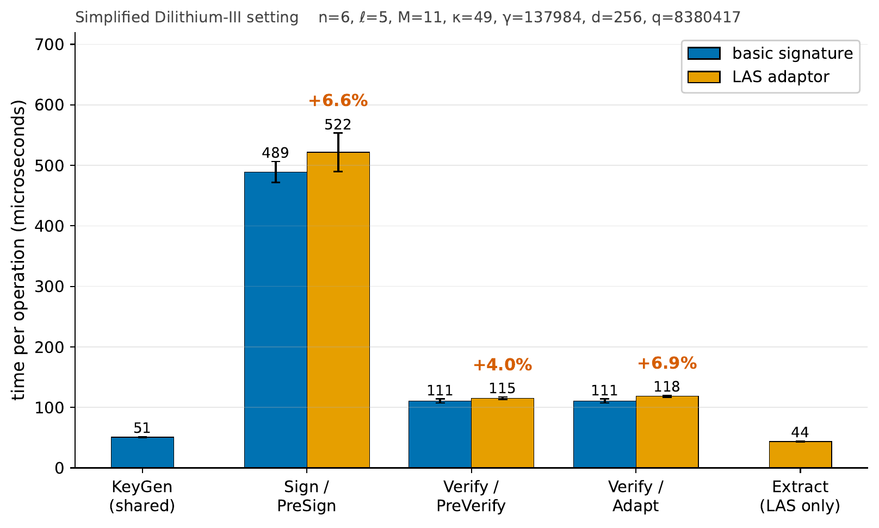
Why
Method
Results
Takeaway
COST IN TIME · SIMPLIFIED DILITHIUM-III · PAIRED, INTERLEAVED MEASUREMENTS
The adaptor layer is nearly free. The proof is not.
+6.6%
PreSign over Sign
+4.0%
PreVerify over Verify
+6.9%
Adapt over Verify
cheapest
Extract — no basic analogue
Rejection attempts are counted, never inferred from timing: 2.615 per Sign against 2.724 per PreSign, and the run aborts unless every timed call matches theory.
In a whole swap the proof takes 98.6% of end-to-end time — the signature is not the bottleneck.
6 / 10
Notes:
[planned 0:48] Cost in time
First question answered: what does the adaptor layer cost? The comparison is LAS against its own base signature at identical algorithm, parameters and primitives, so the only thing varying is the adaptor layer, and every adaptor operation is paired with the basic one it mirrors. The answer is single digits — PreSign 6.6 percent over Sign, PreVerify 4.0, Adapt 6.9, and Extract, which has no basic analogue, is cheapest. One methodological point: the rejection rate is COUNTED, never inferred from a timing ratio — inferring it gave a materially wrong number early on, so every run now aborts unless the count matches theory within five standard errors. But then I measured a whole swap on a UTXO ledger, and the signature turns out not to be the bottleneck at all. The zero-knowledge proof consumes 98.6 percent of it. In the controlled comparison — same signature, same relation, only the prover changes — the post-quantum prover is actually 53.1 percent FASTER end to end while being 61.9 percent larger.

Slide 7
Why
Method
Results
Takeaway
RESULT 2 · COMMUNICATION · THE PRICE OF POST-QUANTUM
The cost is not adaptor computation — it is bytes on the wire
classical ECDSA adaptor
LAS
one shared byte scale · Simplified Dilithium-II
classical signature
64 B
LAS signature
4640 B ≈ 72× classical
classical public key
33 B
LAS public key
2944 B ≈ 89× classical
Inside a LAS signature (6736 B at the target set)
And an adaptor swap adds one public object
The statement Y — 4416 B, exactly the size of a public key — plus a signature-sized pre-signature.
Those are the only objects an adaptor scheme sends that a basic signature does not.
response z — 99.3% · challenge digest c̃ — 0.7% The challenge travels only as its digest, so optimising LAS means optimising z.
Fairness: the classical baseline is a functionality-matched ECDSA adaptor signature (not plain ECDSA), compared at Simplified Dilithium-II — an engineering match to ≈128-bit, not a formal security-equivalence claim.
7 / 10
Notes:
[planned 0:38] Cost in bytes
Second result, and it is the sharp one. The price of post-quantum here is not computation, it is communication. Against a classical ECDSA adaptor signature at comparable dimensions, the LAS signature is about 72 times larger and the public key about 89 times larger — while every operation still runs in well under a millisecond. And the signature is almost entirely one object: the response vector z is 99.3 percent of it, because the challenge travels only as a short digest. On top of that, an adaptor swap transmits one extra public object a basic signature does not — the statement Y, which is public-key sized. So any optimisation of LAS is an optimisation of z and Y.

Slide 8
Why
Method
Results
Takeaway
DEMONSTRATION 2 OF 2 · A REAL BITCOIN CORE V31.1 NODE, ON REGTEST
It fits the size limits. It fails the verification rules — so I changed one.
1 · Carriage, stock node
A lattice-carrying spend: 2,939 vB, refused by default relay policy (bad-witness-nonstandard) — yet consensus-valid, and mined.
Standardness and validity are different questions; only the second decides feasibility.
the same spend, byte for byte — 2,917 vB, 24 witness items, no elliptic-curve signature at all — put to two clients of the same release
patched Core v31.1
stock Core v31.1
2 · Verification, patched node
One of the reserved OP_SUCCESS opcodes, 0xbb, defined as lattice verification — so a spend can be authorised by a LAS signature alone.
A whole two-leg swap settles on it: the adapted signature comes back out of the mined transaction, and Extract recovers the secret. Verdicts are consensus, not policy.
0xbb verifies the LAS signature
0xbb is still OP_SUCCESS
ACCEPTED · MINED
ACCEPTED
the valid spend
the valid spend — same block
REJECTED ×9
ACCEPTED ×9
every negative control
every negative control
Both clients accept the honest spend. Only the patched one can tell a bad LAS signature from a good one — so the difference between the columns is the new rule, and nothing else.
Honest limits: a patched node is not Bitcoin, so “cannot settle on Bitcoin as it stands” still holds; and the security of the new rule is not analysed.
8 / 10
Notes:
[planned 0:45] DEMO B — a real Bitcoin client
Second demonstration, and this is the part the report can only describe. One LAS settlement transaction weighs 11,537 weight units — about 2.9 percent of the 400,000 weight-unit standardness ceiling — so it fits that size limit with room to spare. Fitting a size ceiling is not the same as being relayed, and neither is the same as being verified, so I put it to a real client in two stages. First, carriage: on a stock Bitcoin Core v31.1 node the spend is refused by default relay policy — its witness chunks are nonstandard — yet it is consensus-valid and gets mined. Second, verification: I defined one of the reserved OP_SUCCESS opcodes as a lattice verification opcode, and a spend carrying NO elliptic-curve signature at all was accepted and mined. On that patched client I then settled a whole two-leg swap across two separate chains — pre-sign both legs, adapt and mine the first, read the adapted signature back out of the mined transaction, recover the secret from it with Extract, and use that to adapt and settle the second leg on the other chain. Now the control, which is what makes that meaningful. A stock node of the same release still treats that opcode as OP_SUCCESS, so it accepts every one of these variants regardless of the signature — it cannot be reacting to the signature at all: 9 negative controls — a changed amount, a changed recipient, a foreign signature — are refused by the patched node and accepted by the stock one. The difference between those two columns is the new rule and nothing else. And the honest caveat: a patched node is not Bitcoin, and I have not analysed the security of the rule I added.

Slide 9
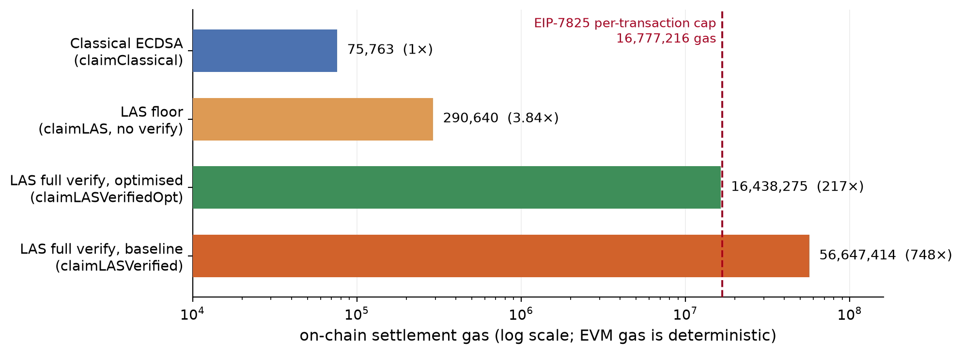
Why
Method
Results
Takeaway
CORRECTED BY MEASUREMENT, NOT BY ARGUMENT
Two beliefs measurement overturned — and three suggestions I closed instead
“It can never fit on chain”
I called the cause structural and inferred optimisation could not close it. Wrong — a real client mined full verification at 97.8% of the cap.
“The base scheme must be simplified”
Built a third time on the full FIPS 204 ML-DSA path: PreSign and PreVerify are new algorithms, but Verify is not — the stock verifier accepts 200/200 adapted signatures.
“That can be future work”
Three optimisations I could have listed as suggestions, run and closed instead:
SIMPLIFIED
ON ML-DSA
attempts per PreSign
2.7136
5.2172
signature
6736 B
3309 B
statement compression — fails at Extract, every depth tested
statement Y
4416 B
4416 B
batching — amortises the wrong cost
optimistic verifier — fraud proof cannot be mined
Y is unchanged, so it is the dominant remaining size target.
On-chain gas uses one fixed signature instance per measured parameter set, so instance-to-instance variation is unquantified; Dilithium-V is derived to exceed one transaction, never measured there; and the ML-DSA build is a functional demonstration — its unforgeability is not analysed.
9 / 10
Notes:
[planned 0:45] What I got wrong
Third question: will a real chain take it? Here I want to be straight about the things I got wrong, because each was corrected by measurement rather than argument. I believed local optimisation could not bring on-chain verification under the per-transaction gas limit — that was asserted, not measured, and re-expressing the same predicate closed it: a real client mined a whole claim — full verification plus the escrow release — at 97.8 percent of the cap at Dilithium-3, and one set down, verification on its own is charged at 65 percent. I believed the base signature had to be simplified for the adaptor to work — building it a third time on the full FIPS 204 ML-DSA path showed PreSign and PreVerify are genuinely new algorithms, but Verify is not: the stock verifier accepts the adapted signature. And three optimisations I could have left as future-work suggestions were implemented and closed instead — compressing the statement is invisible to the adaptor and fatal at Extract, batching amortises the wrong cost, and an optimistic verifier leaves a fraud proof that cannot be mined. An untested suggestion costs nothing to write and tells a reader nothing.

Slide 10
Why
Method
Results
Takeaway
BACK TO THE OPENING QUESTIONS
Post-quantum atomic swaps are buildable today — the bill arrives in bytes
YES
BYTES
SPLIT
Can we build one?
What does it cost?
Will a chain take it?
Yes — and twice.
Almost nothing in computation: at most +8.3% for the adaptor layer.
Ethereum: yes — a real client mined full verification inside one transaction.
Reuse of standardised primitives with zero upstream functions modified, reproduced independently in a second language to a pinned byte-identical digest.
The bill arrives in bytes — and in a whole swap it is the proof, not the signature, that dominates the time.
Bitcoin: not as it stands — carriage works on a stock node, but verification needs a new consensus rule; I patched one, and settled a whole two-leg swap on it.
Still open, specifically: a relation whose statement is small by construction; a proof system succinct at this scale; and the security of the ML-DSA variant and of the consensus rule.
10 / 10
Notes:
[planned 0:40] Answering the questions
Back to the three questions I opened with. Can we build one? Yes — a working, tested, end-to-end lattice adaptor signature, built by reuse of standardised primitives with zero upstream functions modified, and reproduced independently in a second language down to a pinned byte-for-byte digest. What does it cost? Almost nothing in adaptor computation — at most 8.3 percent at the core boundary. The bill arrives in bytes, and at the application level it is the proof, not the signature, that dominates. Will a real chain take it? On Ethereum, yes: a real client mined full verification inside one transaction. On Bitcoin, not as it stands — carriage works on a stock node, but verification needs a new consensus rule; I patched one, and settled a whole two-leg swap on it. What stays open is specific: a hard relation whose statement is small by construction, a proof system succinct at THIS scale rather than asymptotically, and the security analysis of both the ML-DSA variant and the consensus rule. Thank you.

