Slide 1

AIOT DRIVEN GREEN HOUSE MONITORING AND PREDICTIVE ANALYSIS
Supervisor: Dr. T.MUKUNTHAN
Reg No:
2021/E/015
2021/E/123

Slide 2
Contents
01
Introduction
05
Business Model Canvas
02
Architecture
06
Upcoming plan
03
Work Summary(7 th semester)
07
Work Summary
04
Work Summary(8 th semester)
02

Slide 3
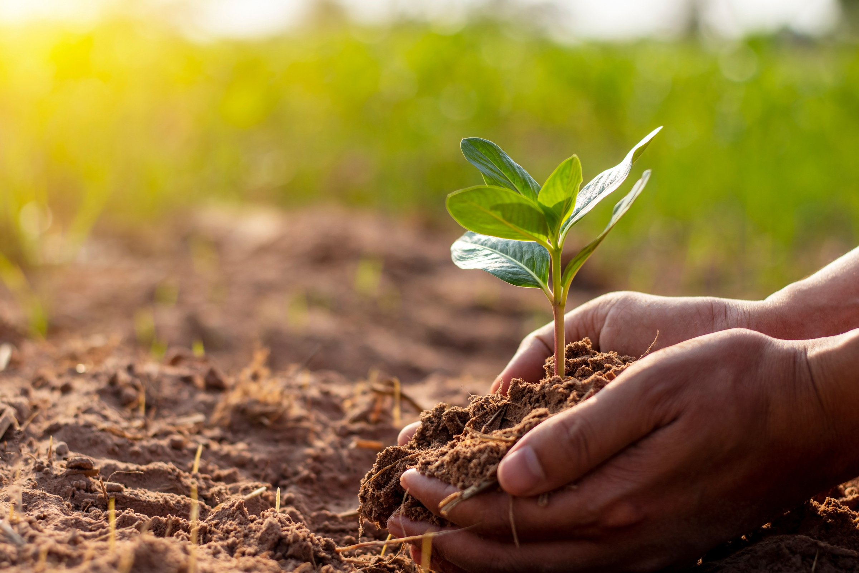
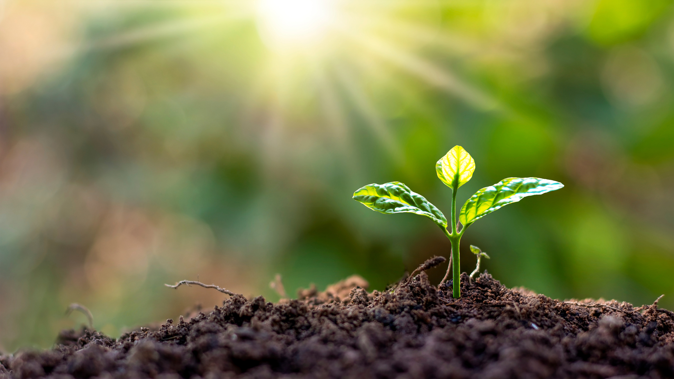
INTRODUCTION
Plant diseases cause billions in global agricultural losses, threatening food security and turmeric yields.
Our AI-powered pipeline on Jetson Orin Nano automates real-time disease detection for turmeric.
Integrating image and sensor data enables precise, environment-aware monitoring on edge devices.
Continual learning with automatic image generalization ensures adaptability to new disease patterns
03

Slide 4
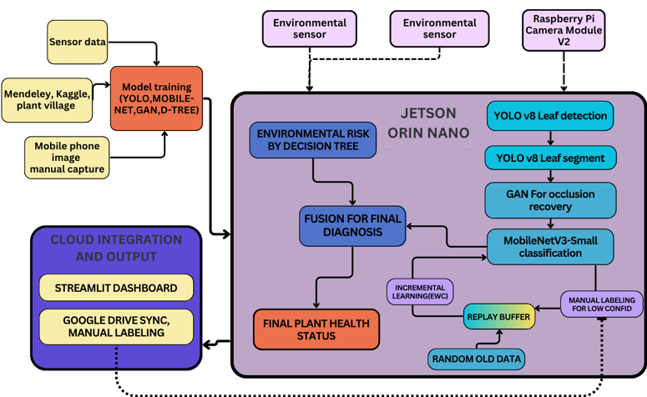
ARCHITECHURE
04

Slide 5
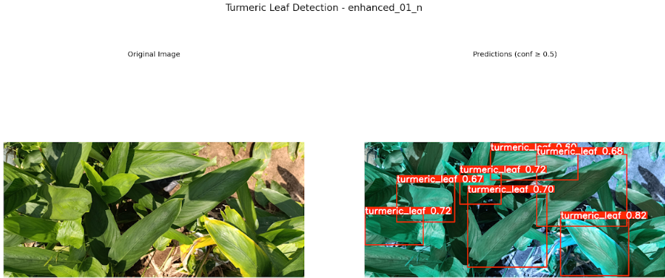
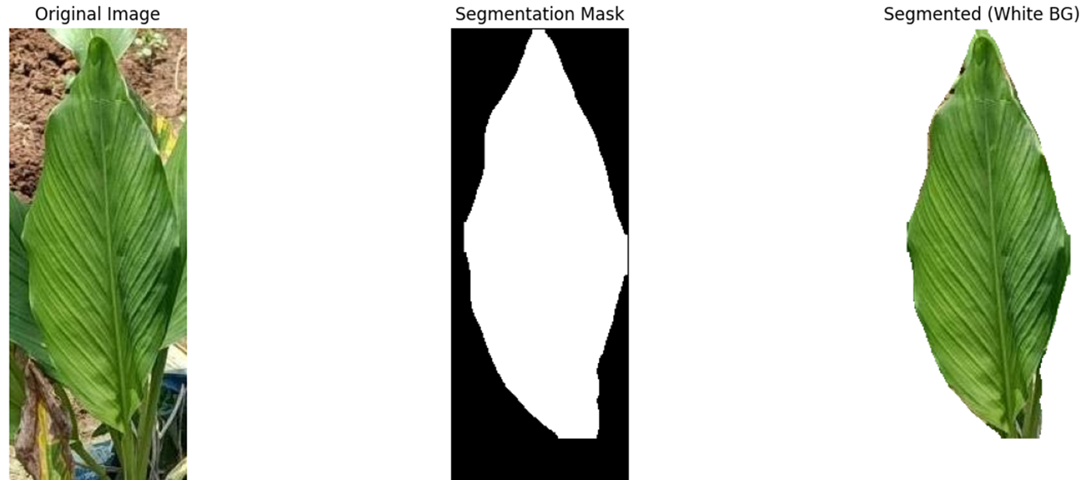

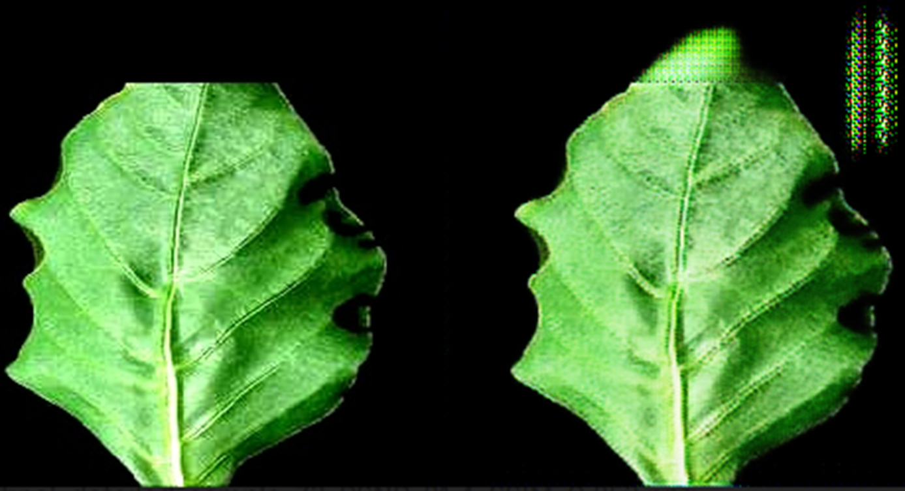
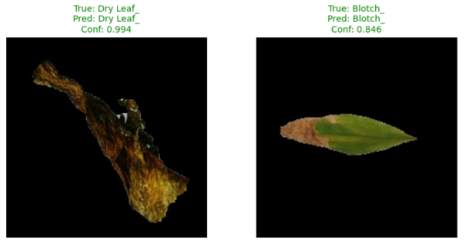

YOLOv8 leaf seperation models
leaf segmentation models
YOLOv8 Implementation
Created baseline with 70 annotated images (120 augmented)
Achieved 0.712 precision and 0.741 recall
Current confidence scores: 0.25-0.5 range
Next: Expand to 500+ images for improved accuracy
Light weight GAN Model
Mobile net V3-Small
05
PSNR: 22.28 dB, SSIM: 0.8168

Slide 6
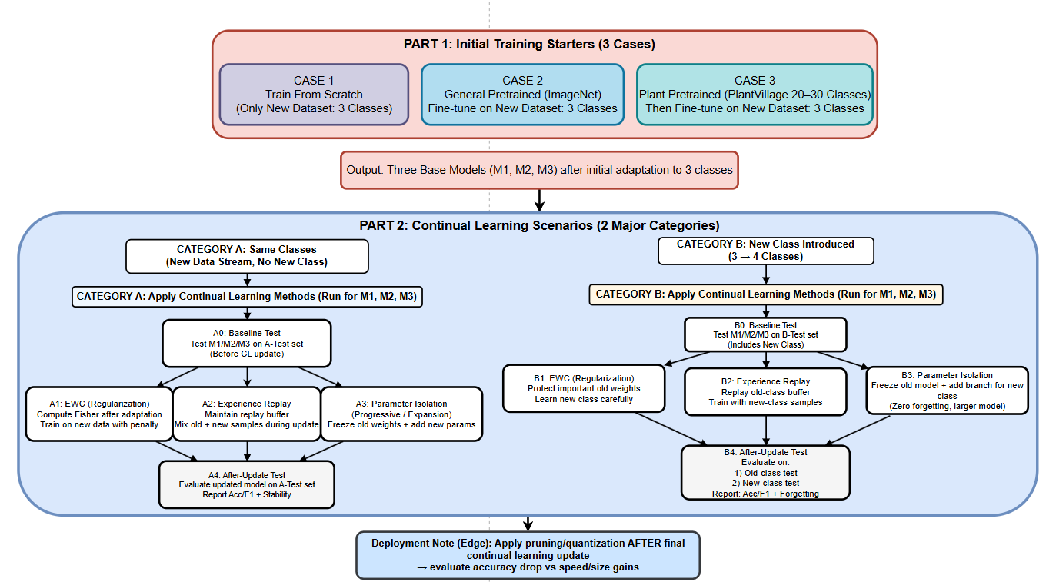
Work Summary semester 8
06

Slide 7
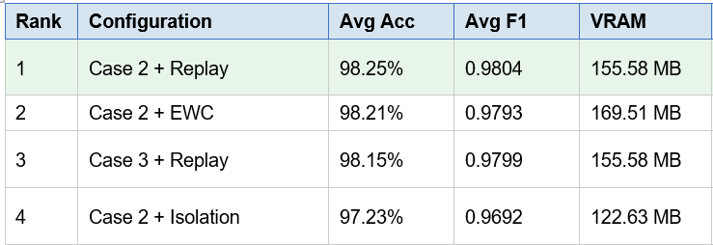
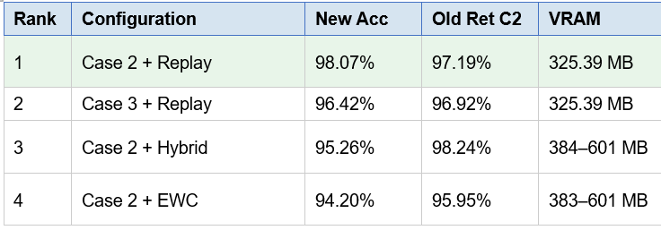

Work Summary
Category A Rankings — Same-Class CL
Category B Rankings — New-Class CL
07

Slide 8
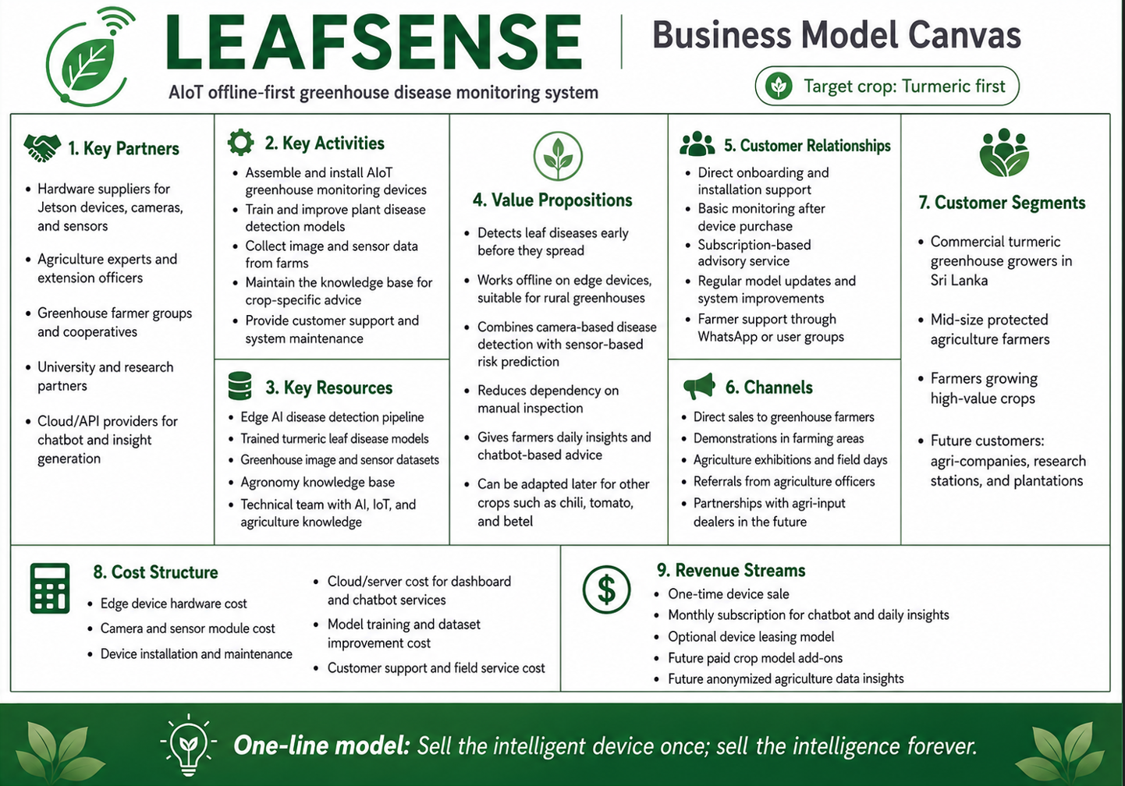

Slide 9
09

Slide 10
Thank You
10

