Slide 1
DEMONSTRATION
Supervisor: Dr. T.MUKUNTHAN
Reg No:
2021/E/015
2021/E/123

Slide 2
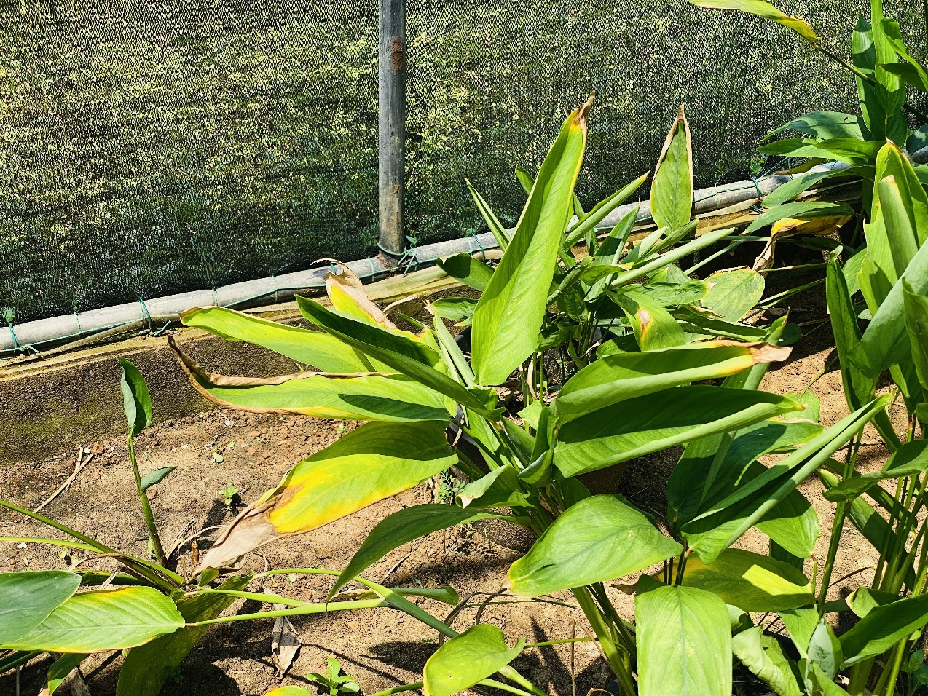
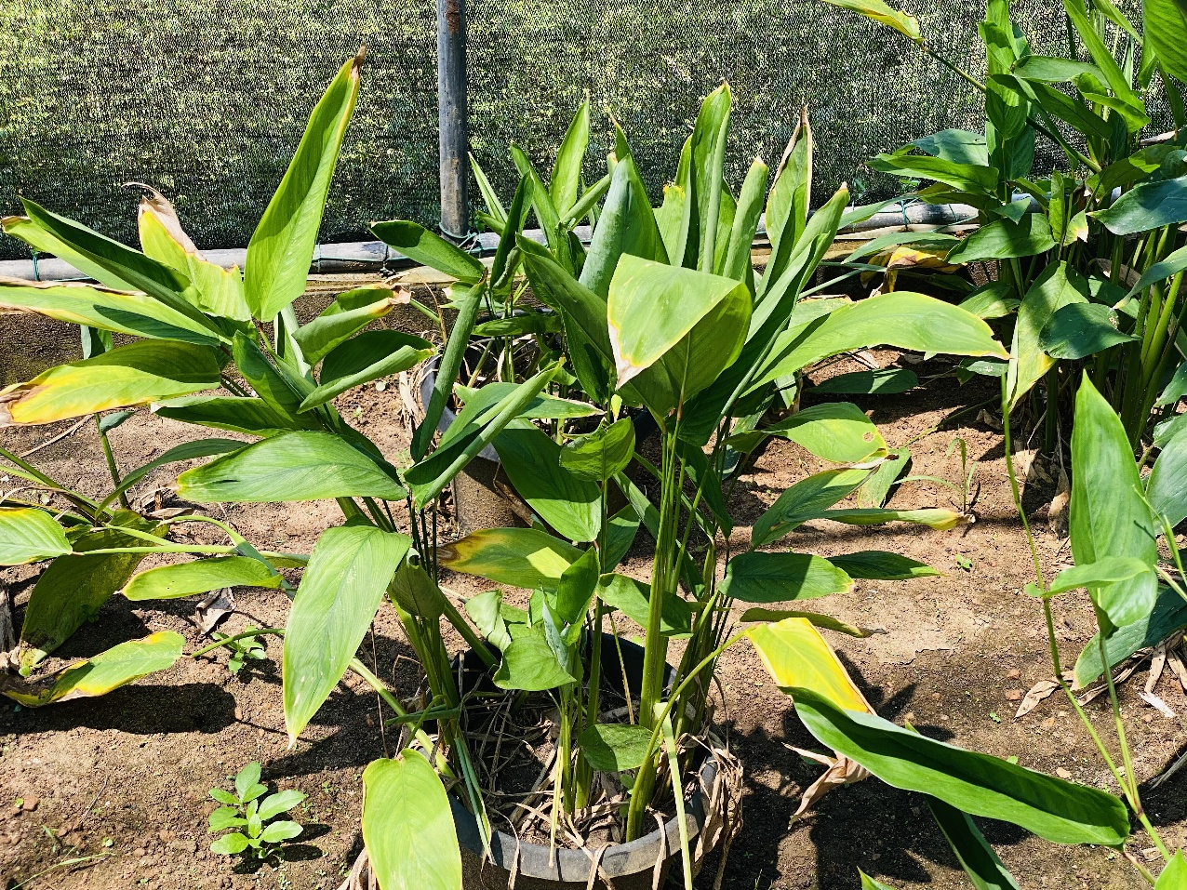
A Lightweight Modular Pipeline
Manual Data Collection
Turmeric dataset:
1,000 high resolution images of turmeric plants
Used 45° camera angle to capture wider plant coverage and leaf overlap details.
Ensures better model generalization for practical use.
The dataset includes 550 training images (5,582 annotated boxes),
YOLOv8 Implementation
Created baseline with 70 annotated images (120 augmented)
Achieved 0.712 precision and 0.741 recall
Current confidence scores: 0.25-0.5 range
Next: Expand to 500+ images for improved accuracy

Slide 3
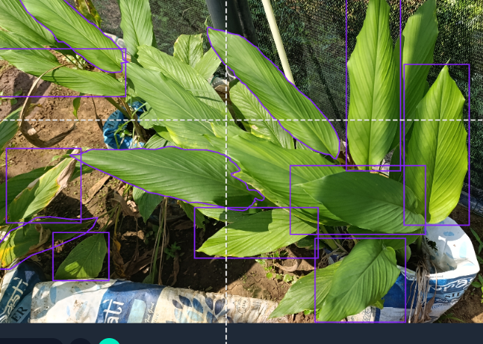
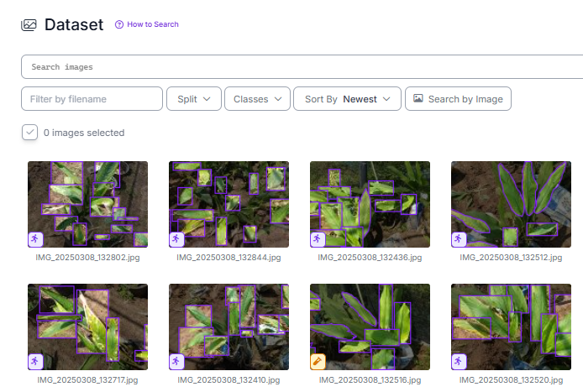
YOLOv8 leaf seperation models YOLO V8n.pt
Annotation(Roboflow)
bounding box

Slide 4
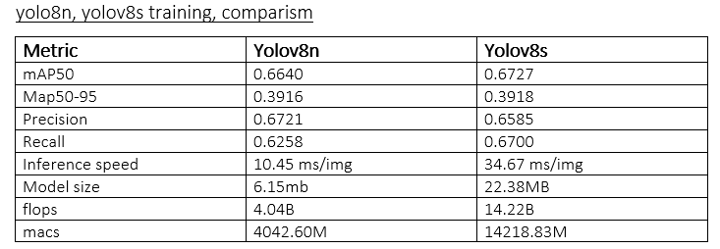
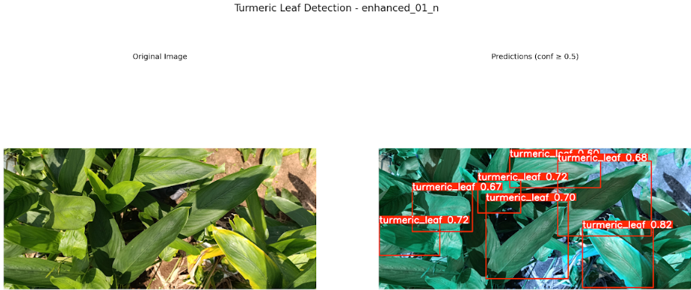
Output(100 epoches,640*640,batch_size=32)
YOLOv8 Implementation
Created baseline with 70 annotated images (120 augmented)
Achieved 0.712 precision and 0.741 recall
Current confidence scores: 0.25-0.5 range
Next: Expand to 500+ images for improved accuracy

Slide 5
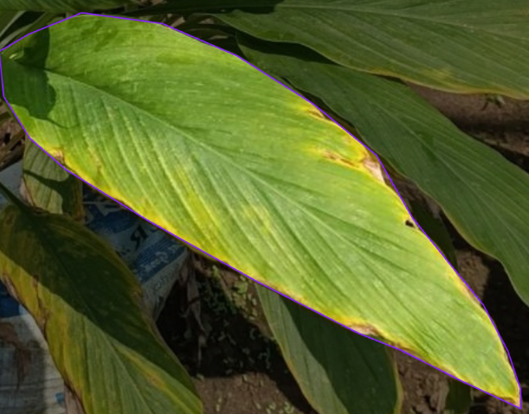
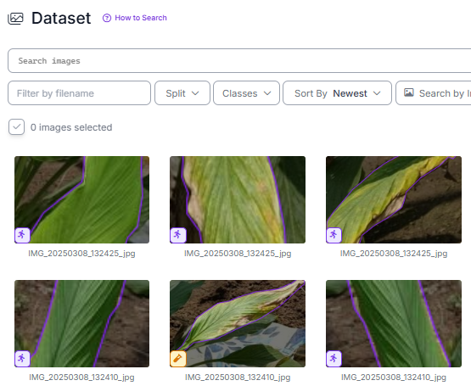
leaf segmentation models
Annotation(Roboflow)y
input size
50 epoches
YOLOv8 Implementation
Created baseline with 70 annotated images (120 augmented)
Achieved 0.712 precision and 0.741 recall
Current confidence scores: 0.25-0.5 range
Next: Expand to 500+ images for improved accuracy

Slide 6
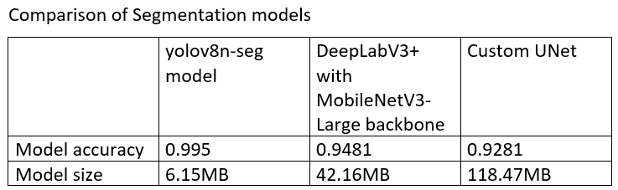
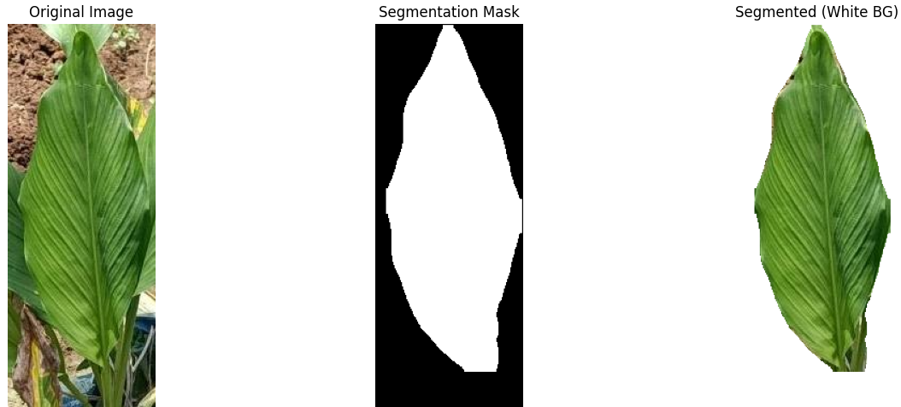
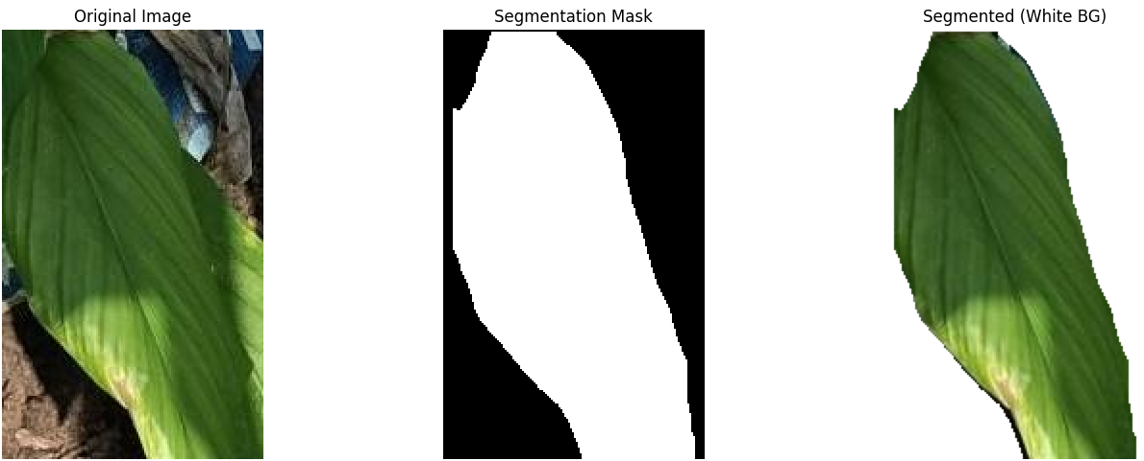
leaf segmentation models
YOLOv8 Implementation
Created baseline with 70 annotated images (120 augmented)
Achieved 0.712 precision and 0.741 recall
Current confidence scores: 0.25-0.5 range
Next: Expand to 500+ images for improved accuracy

Slide 7
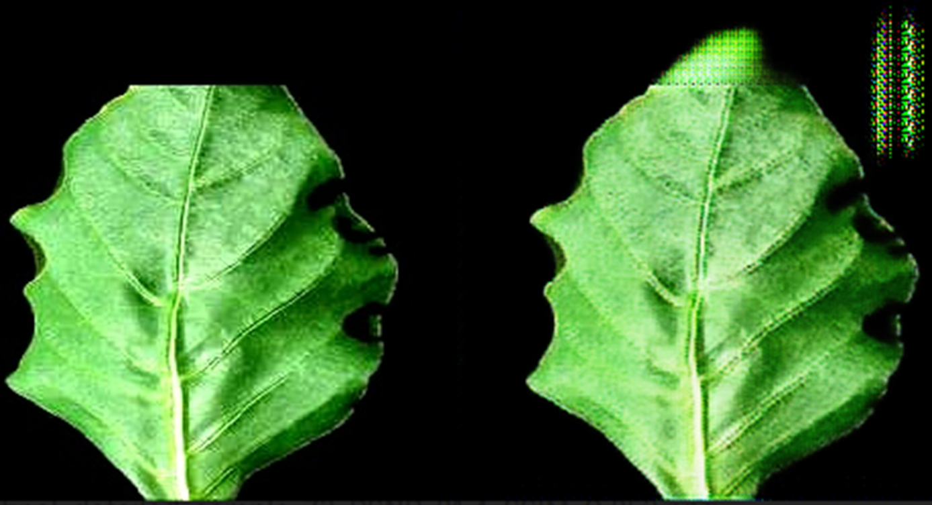
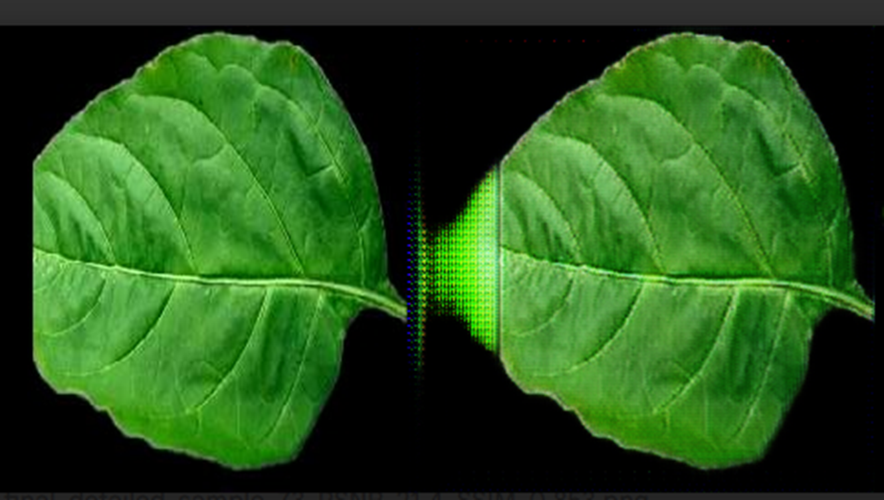
Light weight GAN Model
PSNR: 22.28 dB, SSIM: 0.8168
Generator: Lightweight TinyUNet with depth wise separable convolution
Discriminator: 70×70 PatchGAN

Slide 8
CLASSIFIER Base model details
MobileNetV3-Small (Enhance by CBAM Attention Module)
Backbone: MobileNetV3-Small (from timm library)
Input Size: 224×224 pixels
Why MobileNetV3-Small
1. Minimal Model Size & Parameters
2. Hardware-Optimized Inference Speed
3. Low Power & Offline Operation

Slide 9
training phase
Phase 1: Train from scratch on 15 PlantVillage classes.
Phase 2: Transfer & fine-tune the model on 5 new Turmeric classes.
Phase 3: Learn incrementally from new Turmeric data using EWC.

Slide 10
Data set details
Phase 1
Plant village dataset ,54000 images,38 classes
Phase 2
Classes: Healthy_Leaf_,
Leaf_Spot_,
Blotch_
Dry Leaf_
Aphids_Disease
Each contain 200 images per class
Source: Image Dataset for Turmeric Plant Leaf Disease Detection
(Published: 2 January 2025|Version 1|DOI:10.17632/jtttfbx342.1)
:Turmeric Plant Disease Dataset: Advancing AI for Agricultural Sustainability
(Published: 30 December 2024|Version 1|DOI:10.17632/g46dvrcvwn.1)
Phase 3
check by 50 images for each class from phase 2 data set

Slide 11
Phase 1 - Foundation Model (Scratch Training)
Goal: Create a domain-specific feature extractor for plants, unbiased by ImageNet.
Base Model: MobileNetV3-Small (chosen for edge optimization)
Enhancements:
Integrated CBAM attention module to focus on disease-specific regions.
Enhanced Classifier Head with BatchNorm and dropout for better feature processing.
Custom Weight Initialization optimized for scratch training.

Slide 12
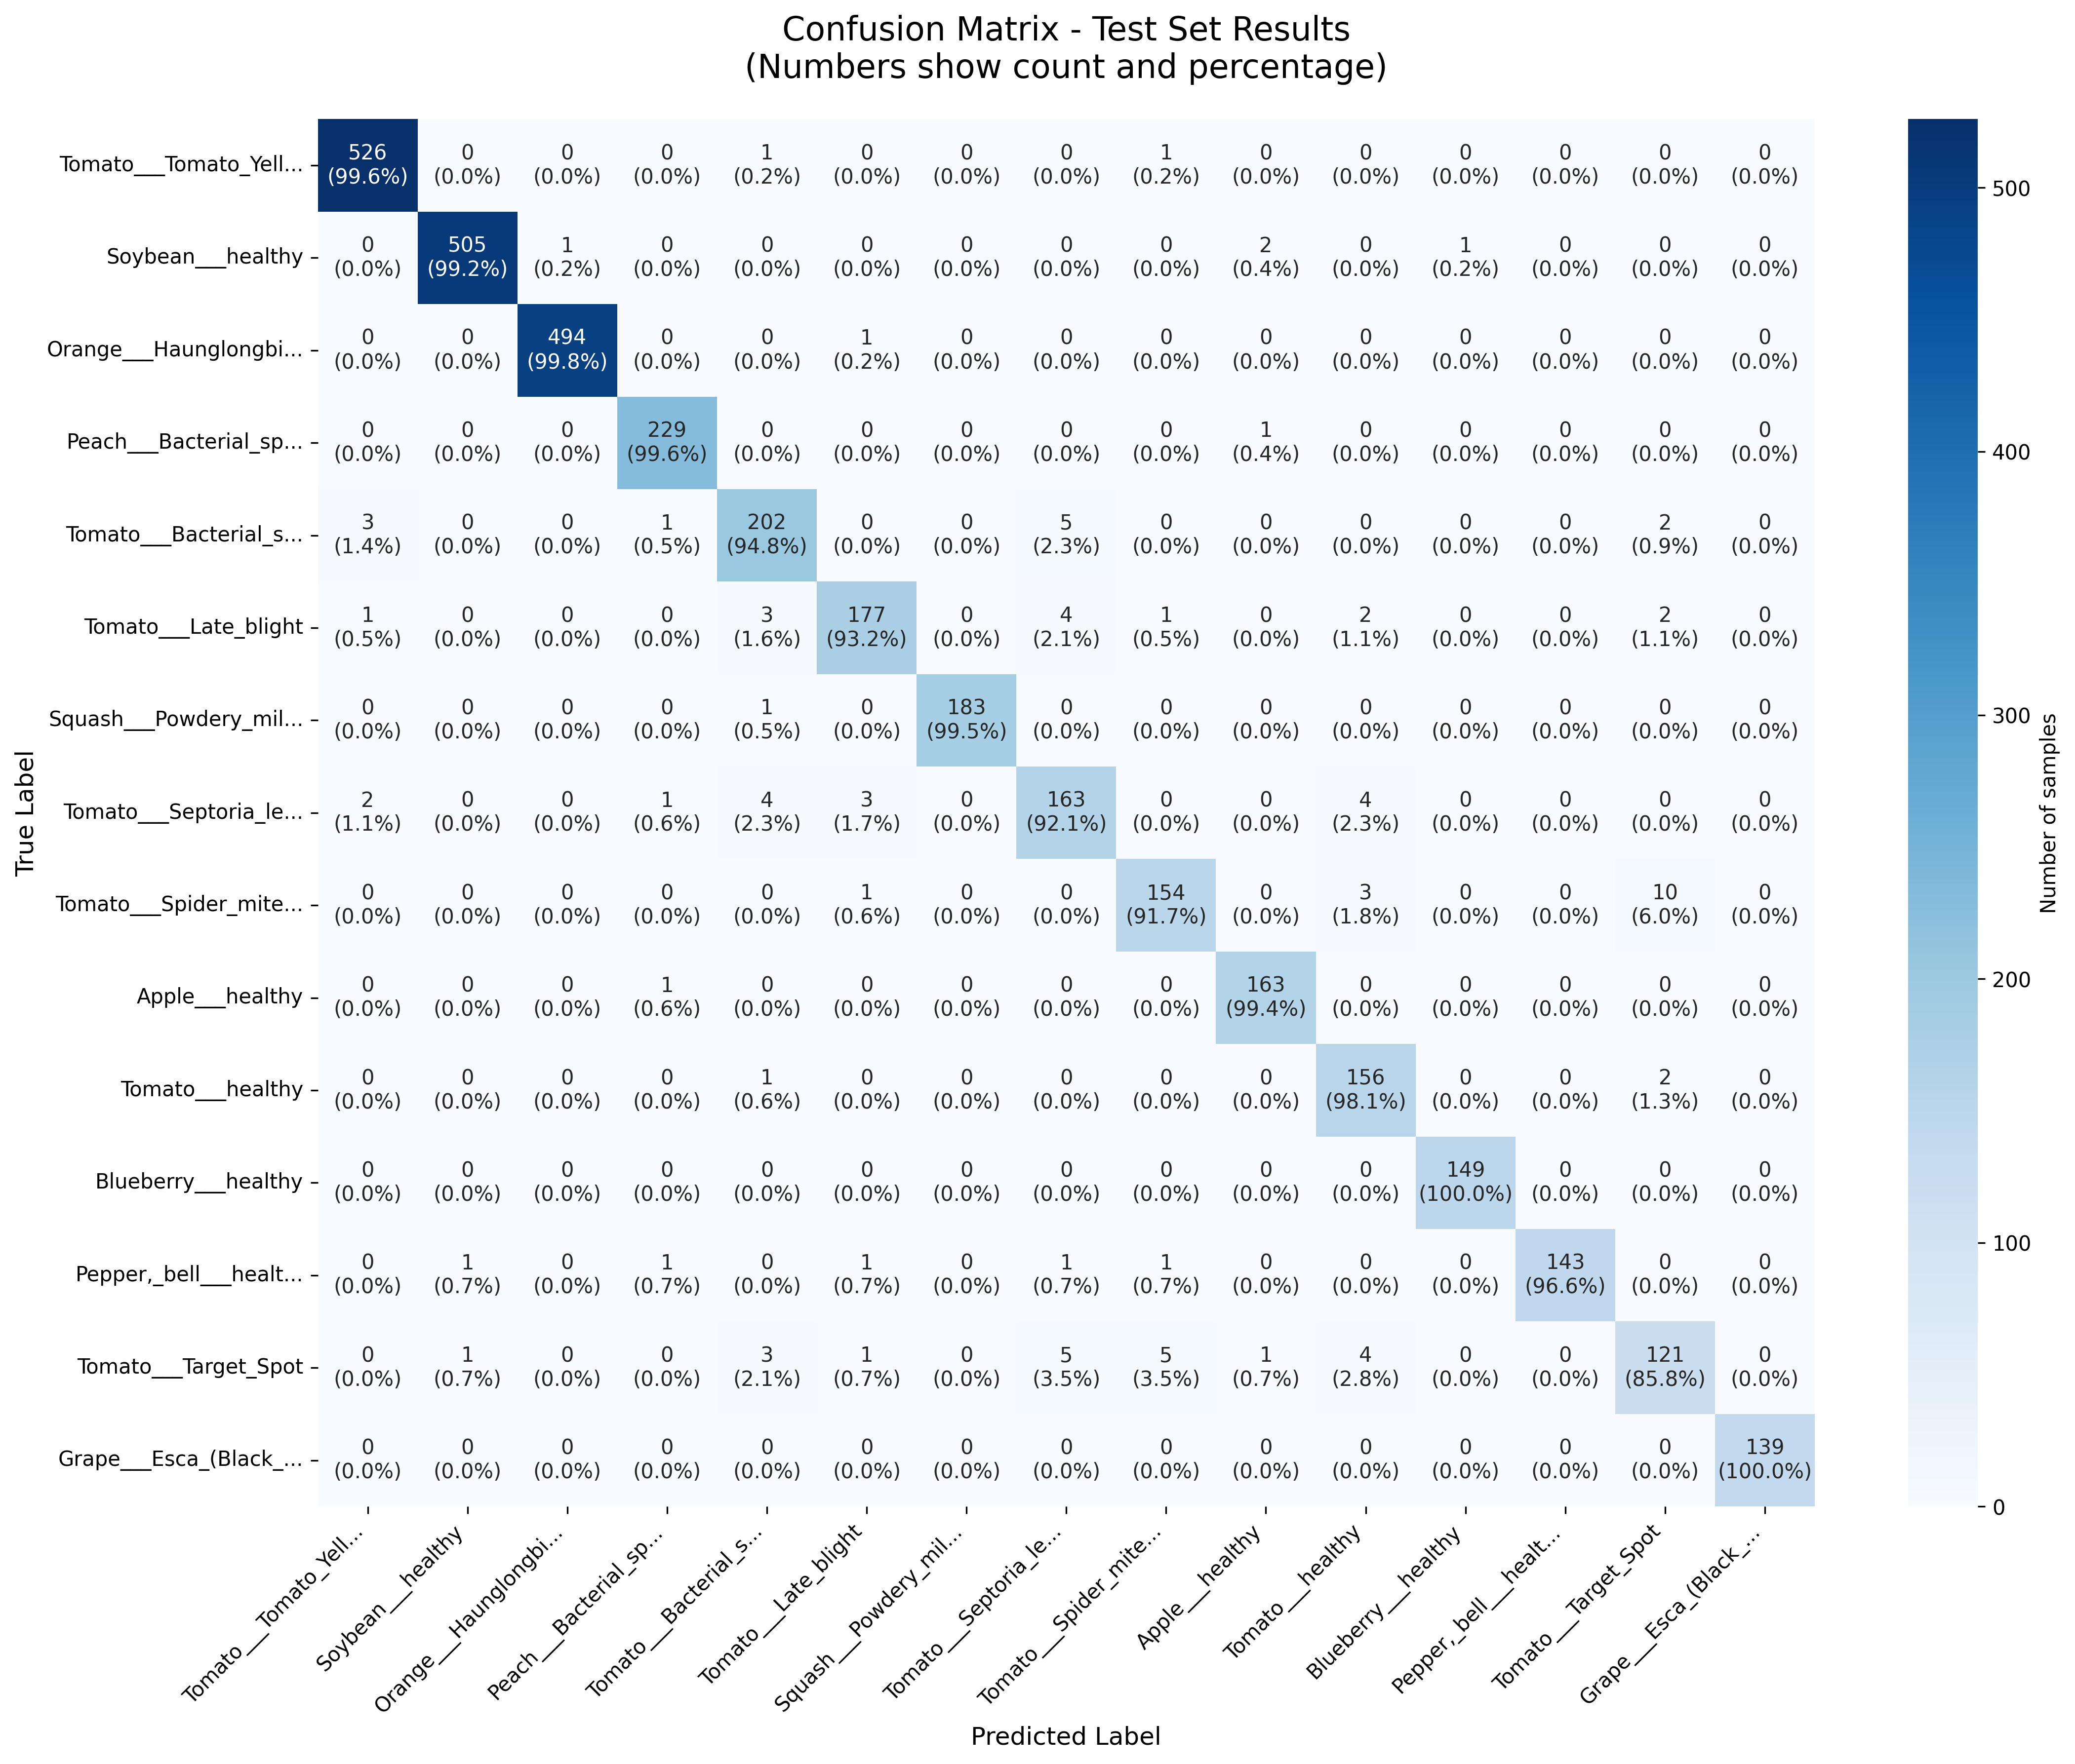
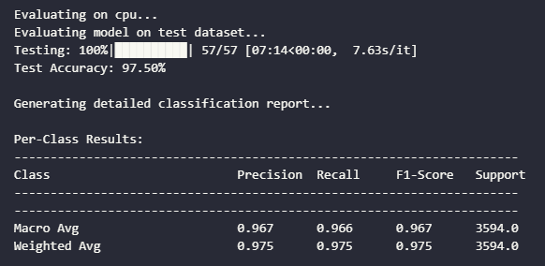
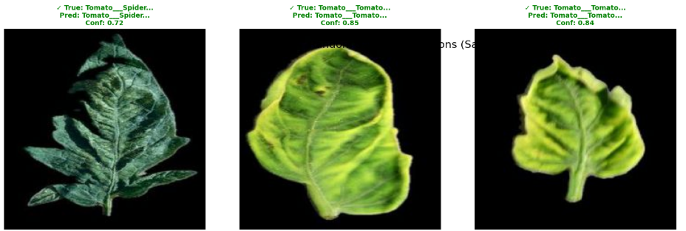
Phase 1 - OUTPUT

Slide 13
Phase 2 - Knowledge-Preserving Transfer Learning
Goal: Adapt the PlantVillage model to Turmeric diseases without forgetting previous knowledge.
Strategy: 3-Stage Gradual Fine-Tuning
Stage 1: Train only the new classifier head. (Freeze backbone)
Stage 2: Unfreeze and train late-stage backbone layers + classifier.
Stage 3: Unfreeze mid-to-late layers for final global tuning.

Slide 14
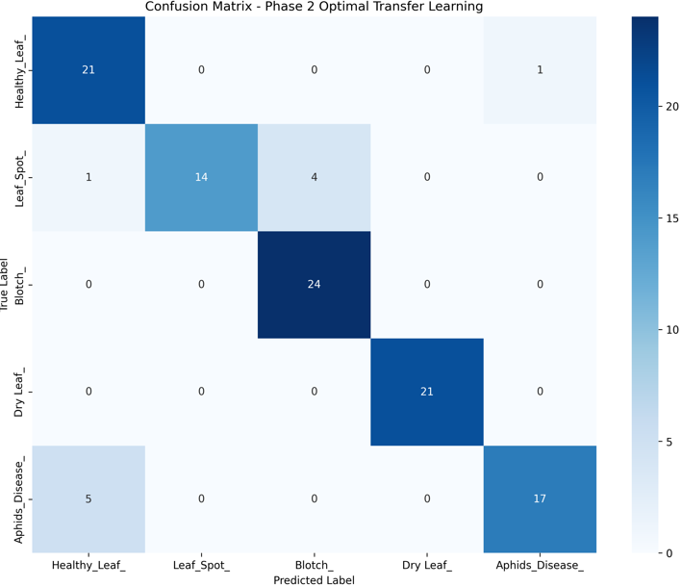
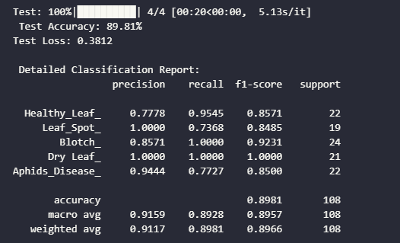
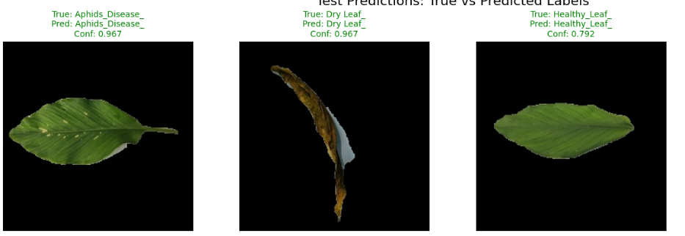
Phase 2 - OUTPUT

Slide 15
Phase 3 - Incremental Learning with EWC
Goal: Learn from new data (50 images/class) without catastrophic forgetting.
Core Technique: Elastic Weight Consolidation (EWC)
Works BY calculates a Fisher Information Matrix to identify the most important weights for previous tasks AND APPLY PENALTY.
Balances learning new information (Turmeric) with retaining old knowledge (PlantVillage).

Slide 16
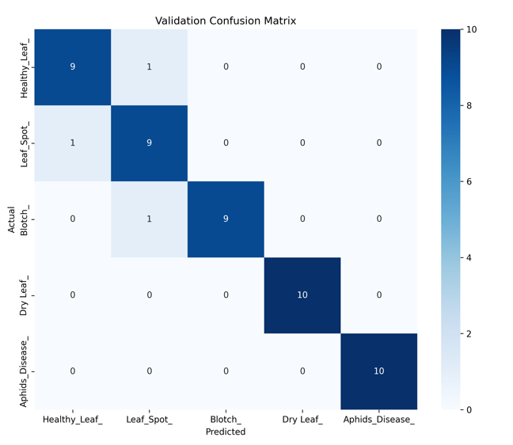

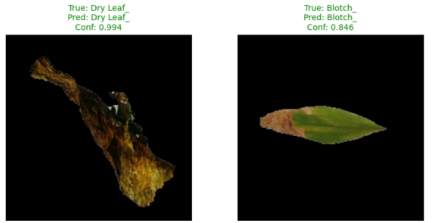
Phase 3 - OUTPUT

