Slide 1



AIOT DRIVEN GREEN HOUSE MONITORING AND PREDICTIVE ANALYSIS
Supervisor: Dr. T.MUKUNTHAN
Reg No:
2021/E/015
2021/E/123

Slide 2


Contents
01
Introduction
05
Methodology
02
Problem Statement
06
Architecture
03
Objective
07
Work Summary
04
Research gap
02

Slide 3
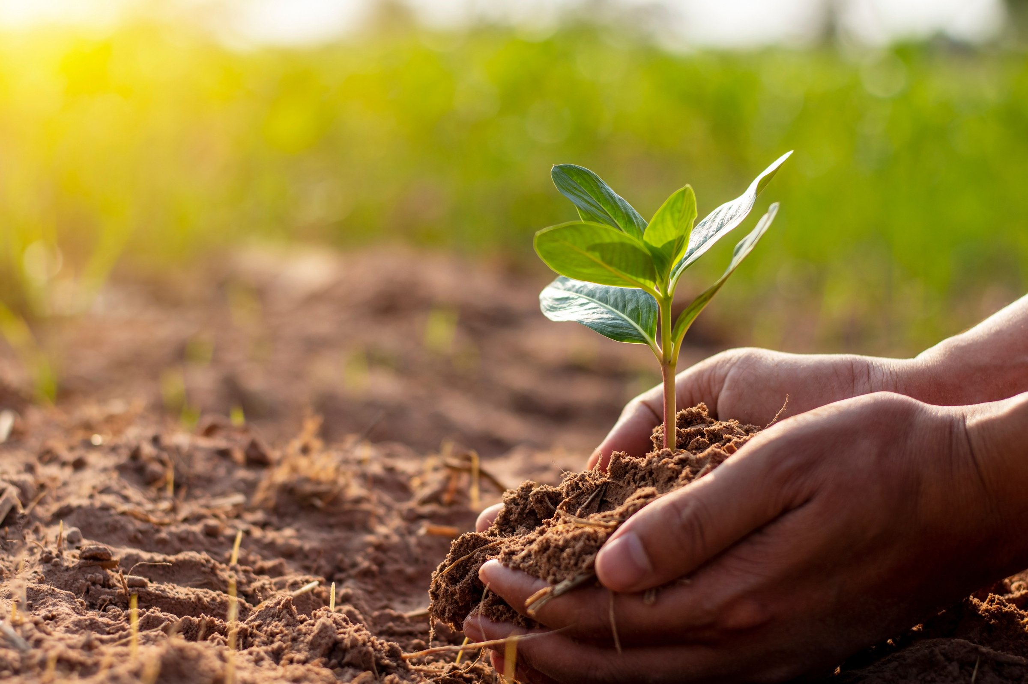

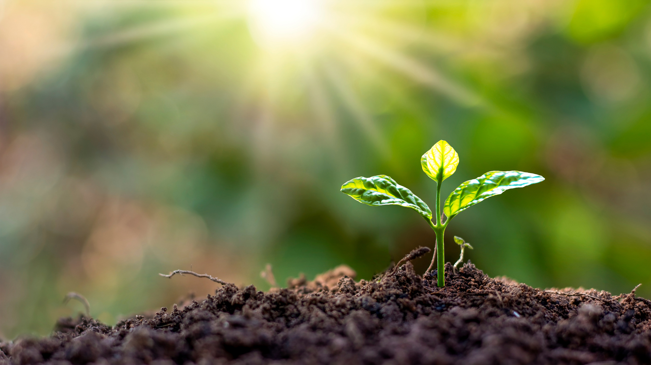
INTRODUCTION
Plant diseases cause billions in global agricultural losses, threatening food security and turmeric yields.
Our AI-powered pipeline on Jetson Orin Nano automates real-time disease detection for turmeric.
Integrating image and sensor data enables precise, environment-aware monitoring on edge devices.
Continual learning with automatic image generalization ensures adaptability to new disease patterns
03

Slide 4



.
PROBLEM STATEMENT
Manual disease detection is labor-intensive and error-prone, limiting scalability.
Most systems rely solely on image data, neglecting environmental context.
Generic dataset-trained models falter in real-world conditions, reducing accuracy.
Continual learning risks catastrophic forgetting, hindering adaptation to new diseases.
04

Slide 5

OBJECTIVE
Develop and implement a real-time system for detecting turmeric leaf diseases on Jetson Orin Nano.
Implement a lightweight Generative Adversarial Network (GAN) to recover occluded portions of leaves in images.
Develop a continual learning system for adapting the model to new data over time using Elastic Weight Consolidation (EWC).
Develop a real-time monitoring dashboard using Streamlit to visualize model predictions and performance metrics.
05

Slide 6
RESEARCH GAP
CURRENT LIMITATION | OUR INNOVATION
Static models degrade over time | Continual learning with data buffer
Poor occlusion handling | Lightweight GAN-based leaf reconstruction
Isolated vision/sensor data | Multi-modal fusion (MobileNetV3-Small + Decision Tree)
Catastrophic forgetting | EWC-based incremental learning
06

Slide 7
METHODOLOGY
YOLOv8 Segmentation
- Segments each leaf from complex backgrounds - Converts the noisy background into black.
Data collection
- High-res cameras + mobile phones
-Mendeley, Kaggle, plant village internet available dataset
Light weight GAN
-Reconstructs leaf edges
-synthetic occlusion created from real images
Image Annotation
-Roboflow for bounding box labeling
-Polygon tool for segmentation labeling
MobileNetV3-Small
-Train from scratch on 15 Plant Village classes
-Fine-tune with turmeric dataset (Mendeley + Kaggle)
YOLOv8 Detection
- YOLOv8 detects and crop’s individual leaves and separate as block,
07

Slide 8
METHODOLOGY
Edge Deployment
- Jetson Nano runs everything
- optimize for edge device
Continual Learning
- Uses a replay buffer method
- prevent caterstropic forgetting(EWC)
Environmental Risk via Decision Tree
- Predicts temp/humidity risks
Streamlit Real-Time Dashboard
- Live alerts + history, flags for manual labeling
Fusion for Final Diagnosis
- Combines disease prediction and environmental risk predictions
08

Slide 9

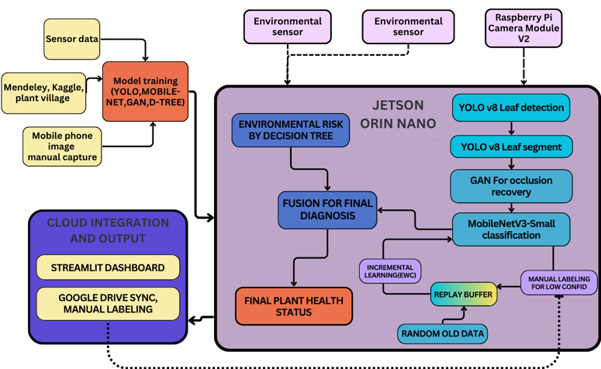
ARCHITECHURE
09

Slide 10
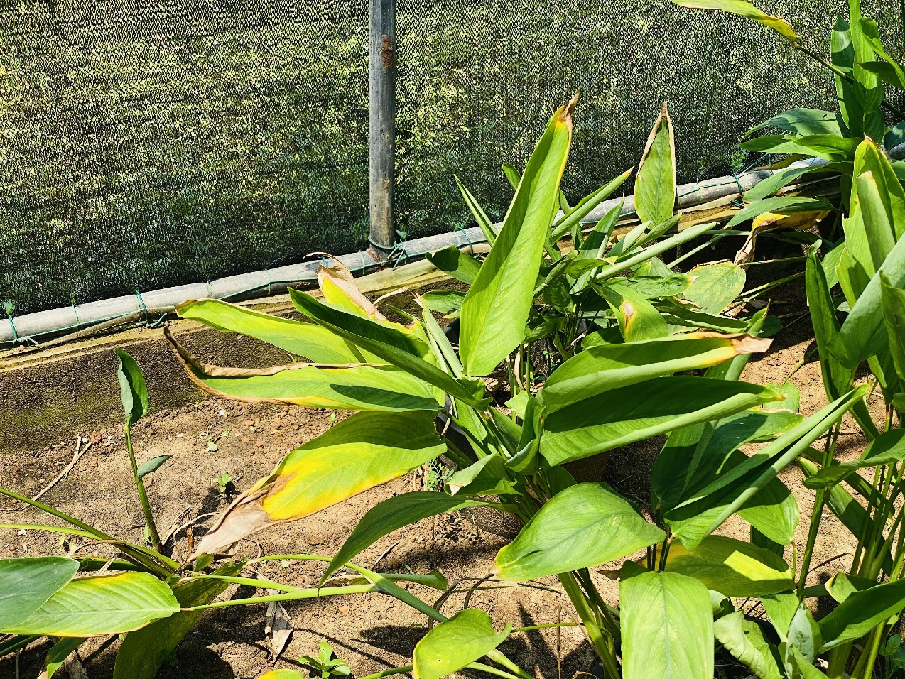
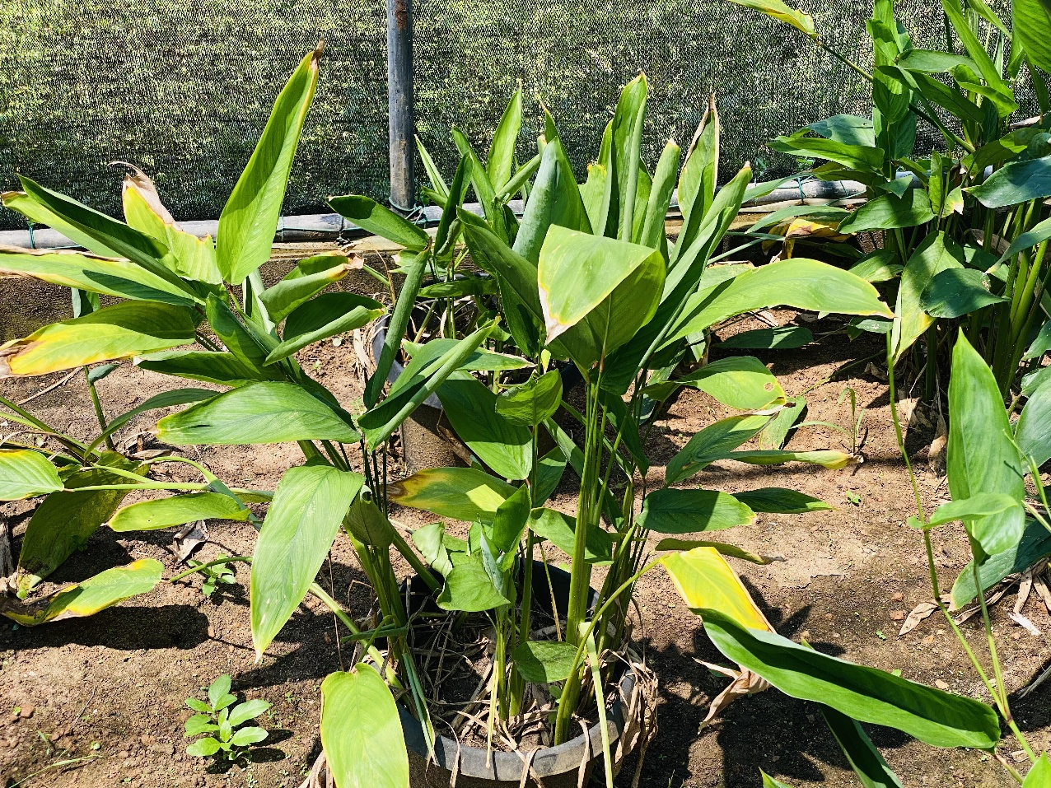
Work Summary
Database Collection
Public Dataset
Mendeley, Kaggle, plant village .
Domain-Specific Dataset:
Turmeric images collected in controlled greenhouse various conditions.
YOLOv8 Implementation
Created baseline with 70 annotated images (120 augmented)
Achieved 0.712 precision and 0.741 recall
Current confidence scores: 0.25-0.5 range
Next: Expand to 500+ images for improved accuracy
10

Slide 11
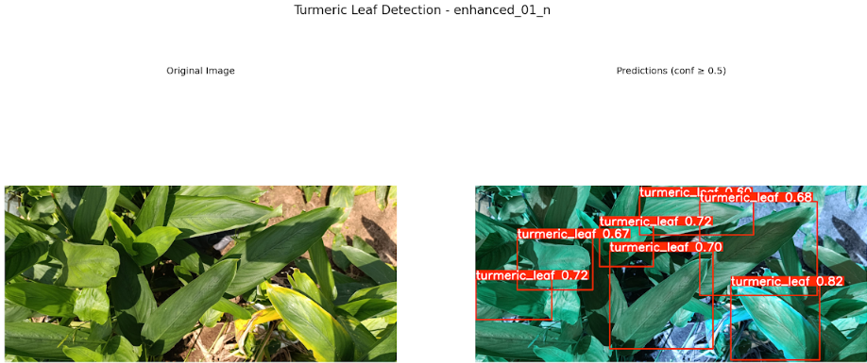
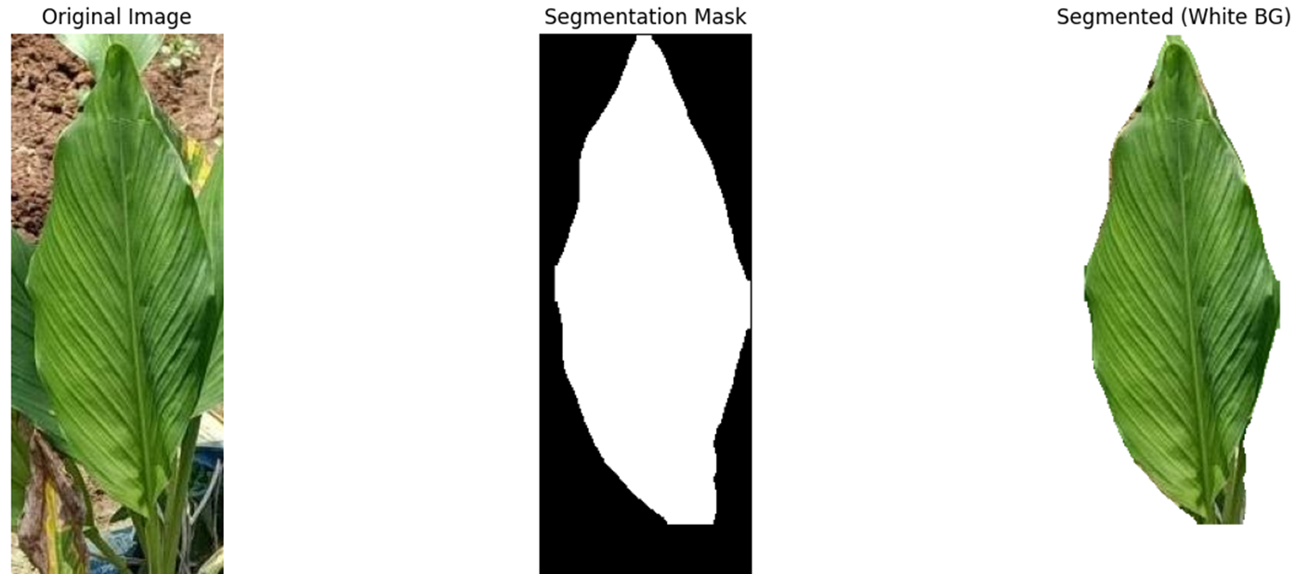
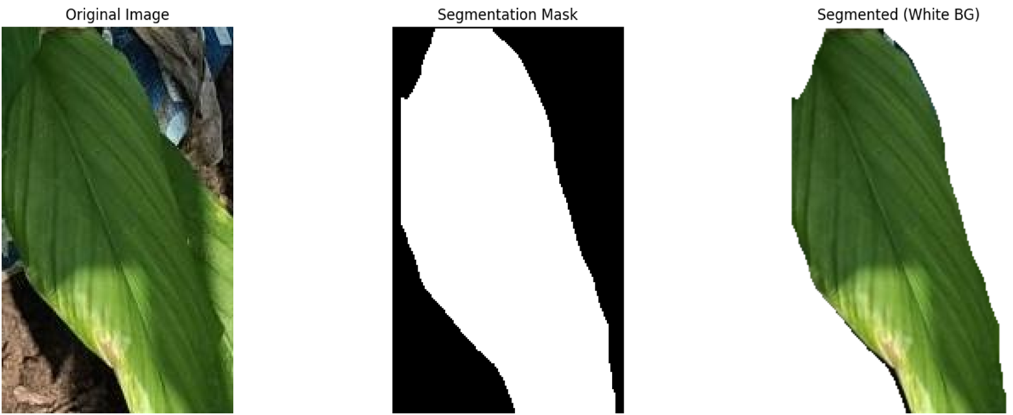
Work Summary
YOLOv8 leaf seperation models
YOLOv8 Implementation
Created baseline with 70 annotated images (120 augmented)
Achieved 0.712 precision and 0.741 recall
Current confidence scores: 0.25-0.5 range
Next: Expand to 500+ images for improved accuracy
leaf segmentation models
11

Slide 12
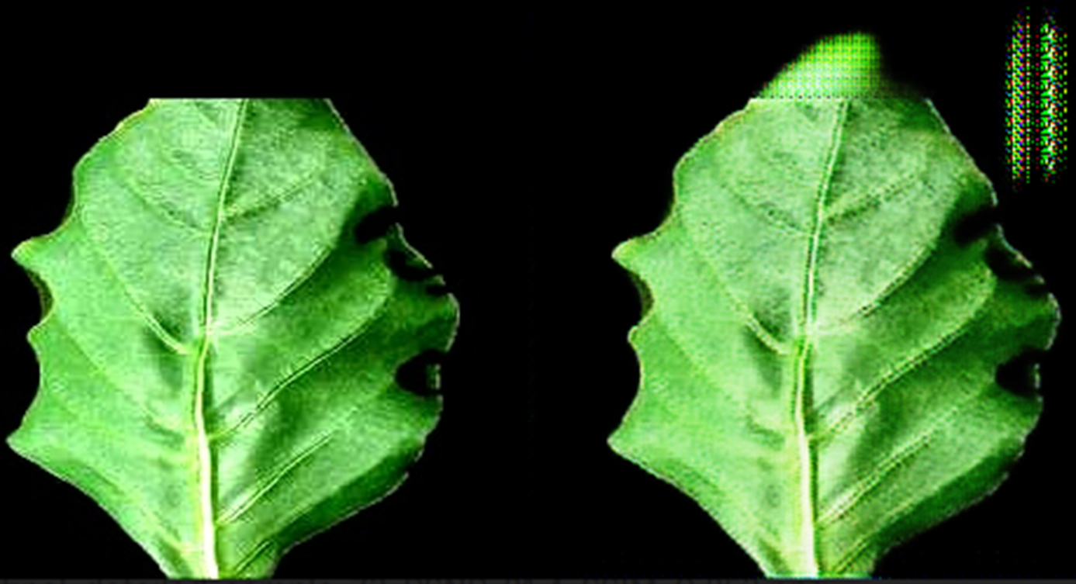
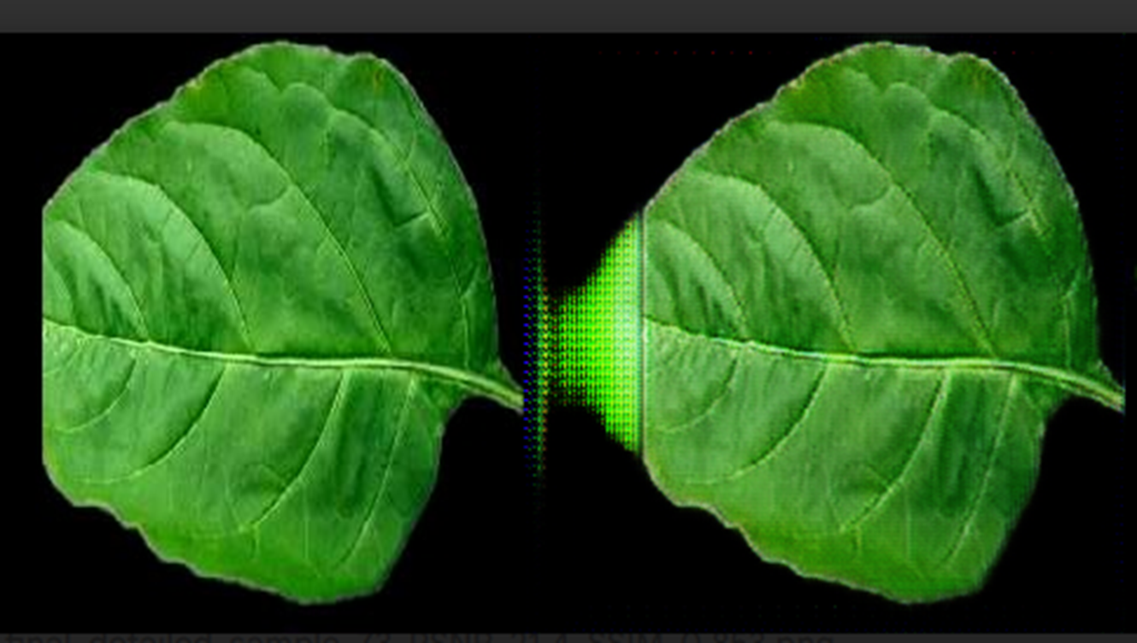
Work Summary
Light weight GAN Model
Generator: Lightweight TinyUNet with depth wise separable convolution
Discriminator: 70×70 PatchGAN
12

Slide 13
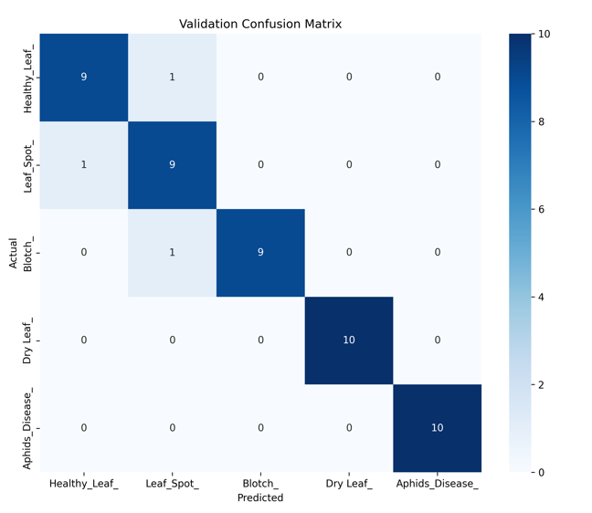

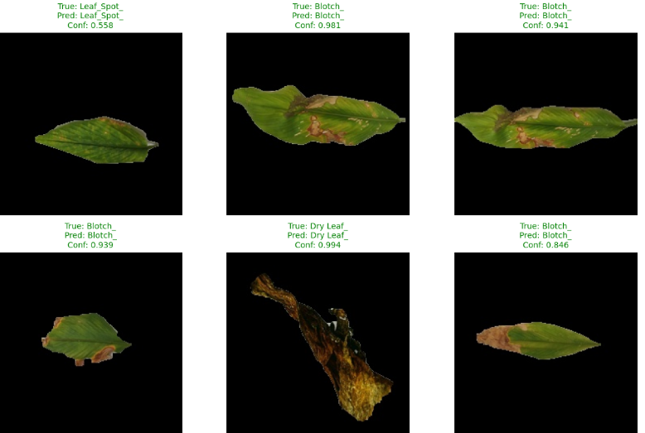

Work Summary
Mobile net V3-Small
Classify turmeric 5 classes(Healthy,blotch,leaf_spot,dry_leaf,alphid disease)
13

Slide 14
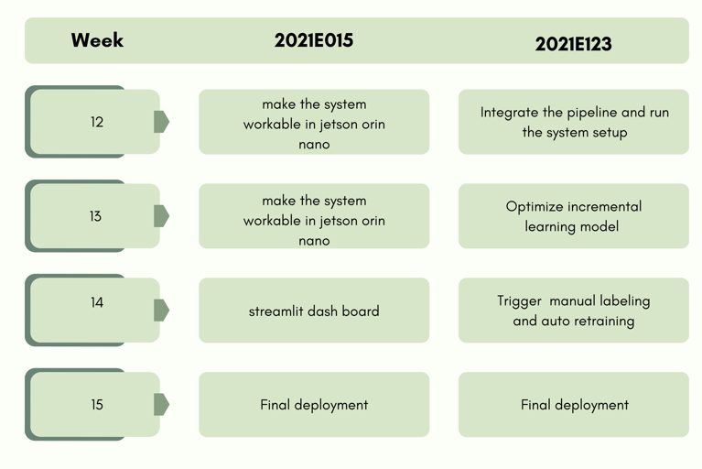
Upcoming plan
14

Slide 15

Thank You
16

