Slide 1
PRAG SENSOR FUSION SYSTEM

Slide 2
TEAM MEMBERS
Priyanka Lal
Meghna Roy Chowdhury
Arpita Kakkirala

Slide 3
The Problem Statement
To develop a sensor fusion system that will be mounted on a robot.
To sense the environment, using multiple sensors connected to an Arduino.
To maintain a log of their mission and this data is to be stored in a Raspberry pi.
Primary objectives of the mission : 1. Gather sensor data 2. Sensor fusion system with Arduino 3. Store/Log data in Raspberry pi

Slide 4
Various conditions to be analysed:
• Atmospheric pressure
• Magnetic Field
• Terrain conditions
• Vibrations
• Temperature
• Humidity
• Obstacles
• Fire
• Water
• Terrain Inclinations

Slide 5
Sensors used:
• (Barometric sensor)Atmospheric pressure
• (Hall effect sensor)Magnetic Field
• (Using LDR and laser)Terrain conditions
• (Piezo-electric sensor) Vibrations
• (Thermister-lm35)Temperature
• (Humidity sensor) Humidity
• (IR sensor) Obstacles
• (Smoke detector) Fire
• (Moisture sensor) Water
• (IMU(accelerometer with gyro sensor)) Terrain Inclinations

Slide 6
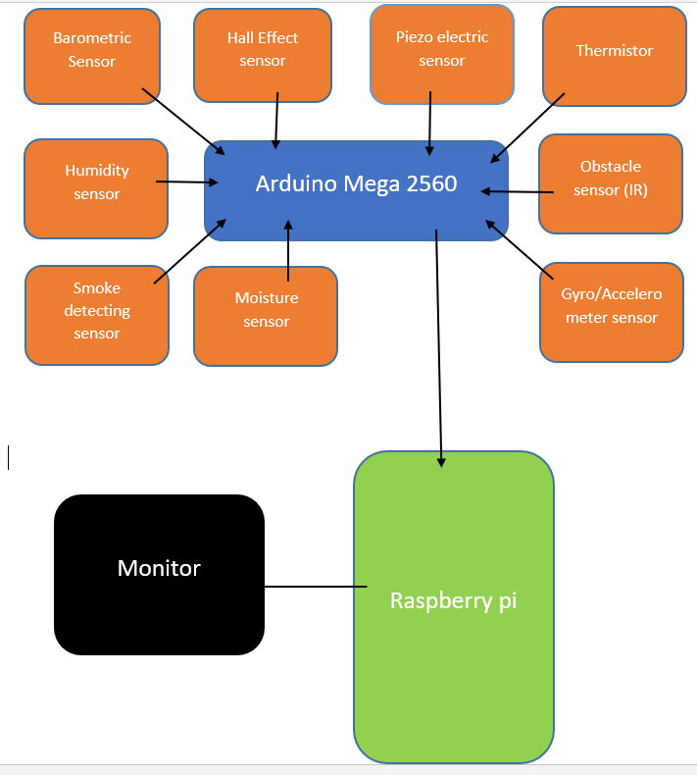

Slide 7
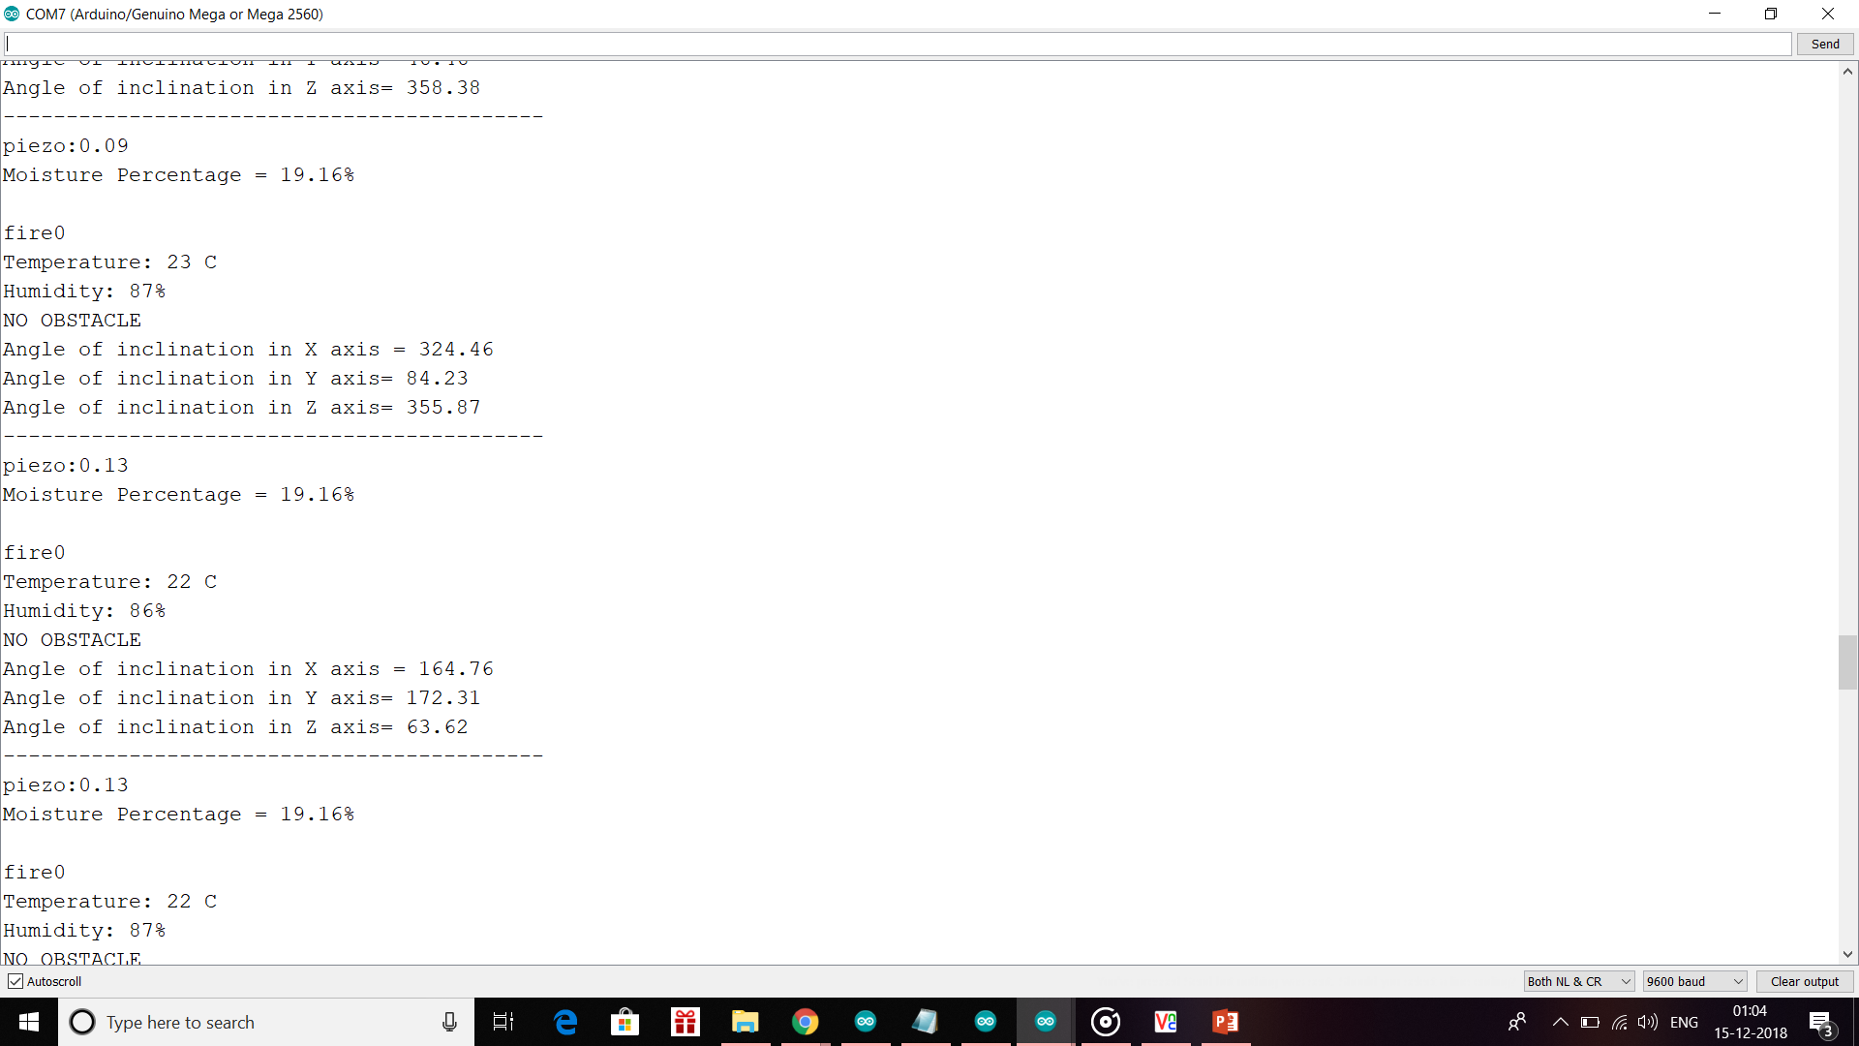
Serial Port output:

Slide 8
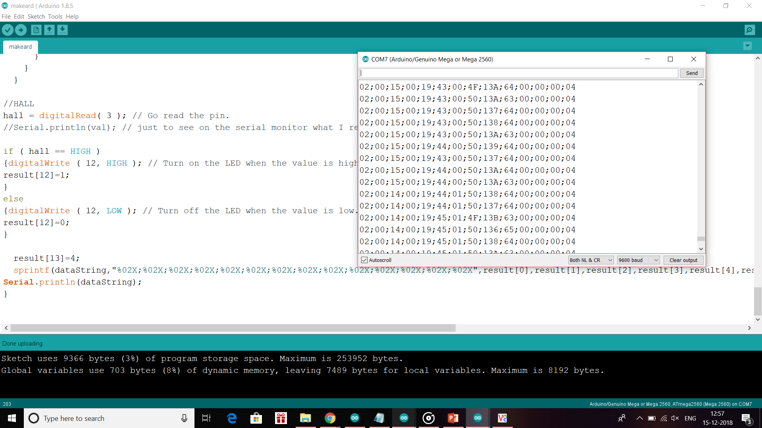
Arduino Code:

Slide 9
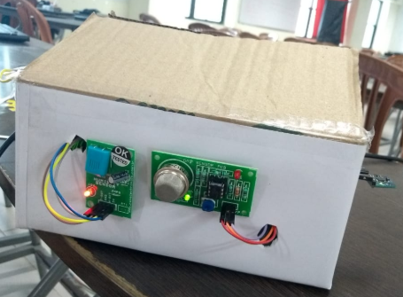
Finished sensor fusion model

Slide 10
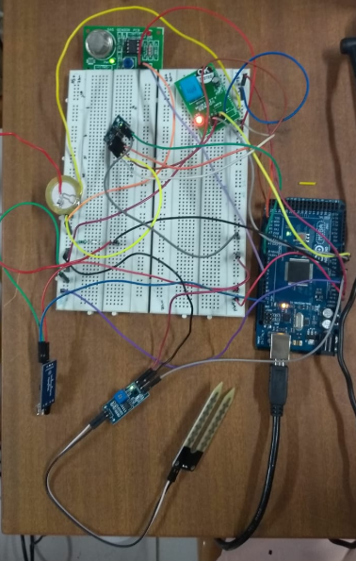
Circuit Diagram:

Slide 11
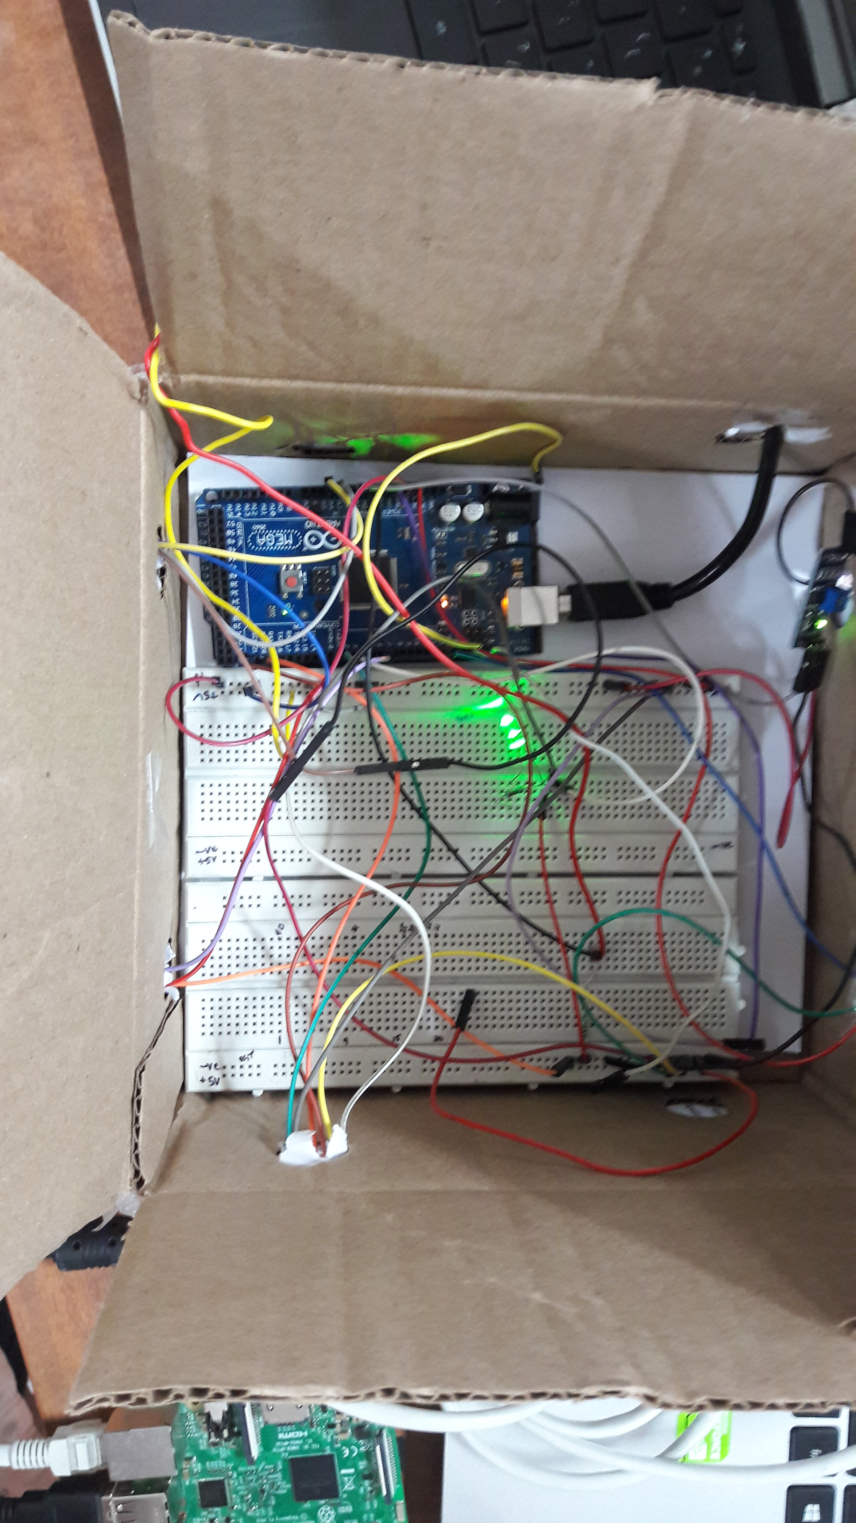

Slide 12
Timeline:
Before review 1:
Understand the problem statement, identify the required sensors, interfacing them with Arduino
Between review 1 and review 2:
Transferring the sensor input values from the Arduino to the raspberry pi and storing them in the required format
After review 2:
Analyse the data and store in a presentable manner

